Slide 1
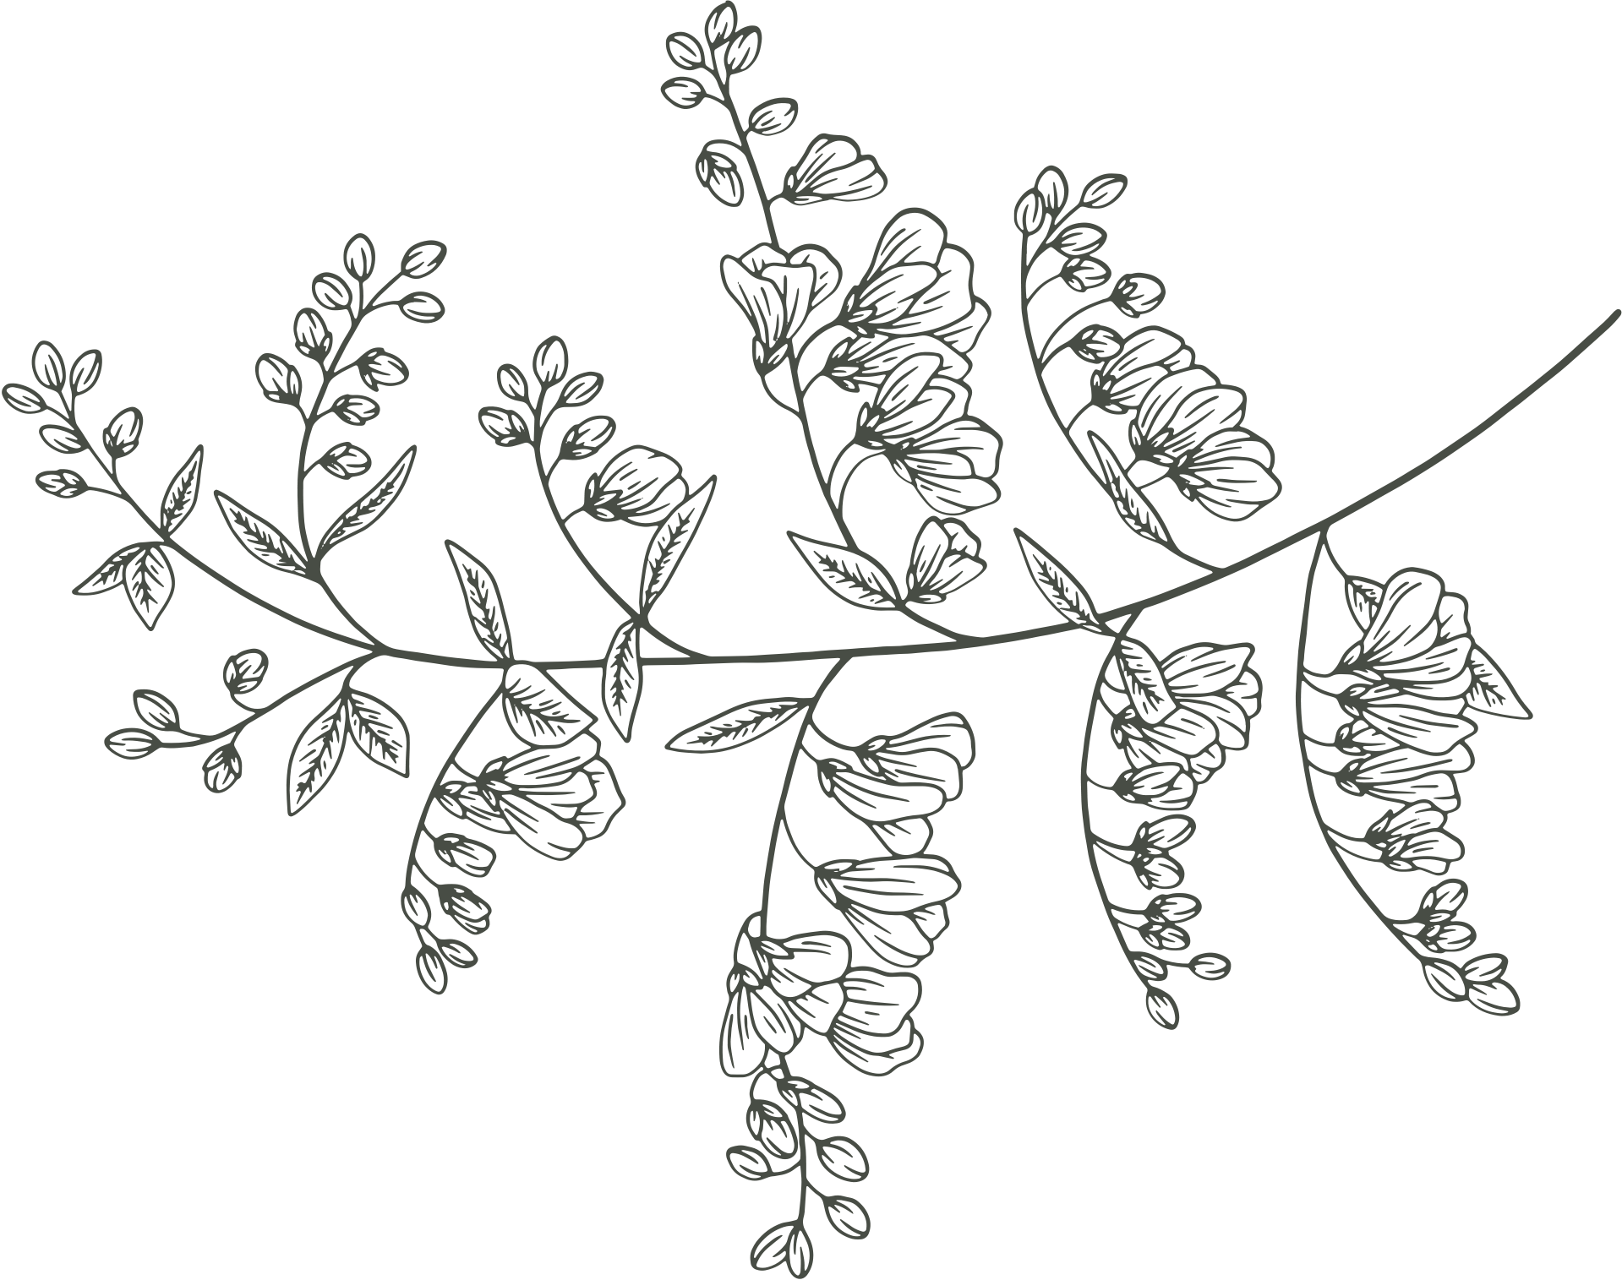
01
Demystifying Romanticism
Teaching Wuthering Heights
LAURA STEFANKO
ENGL 112B
DR. WARNER
DECEMBER 6, 2021

Slide 2
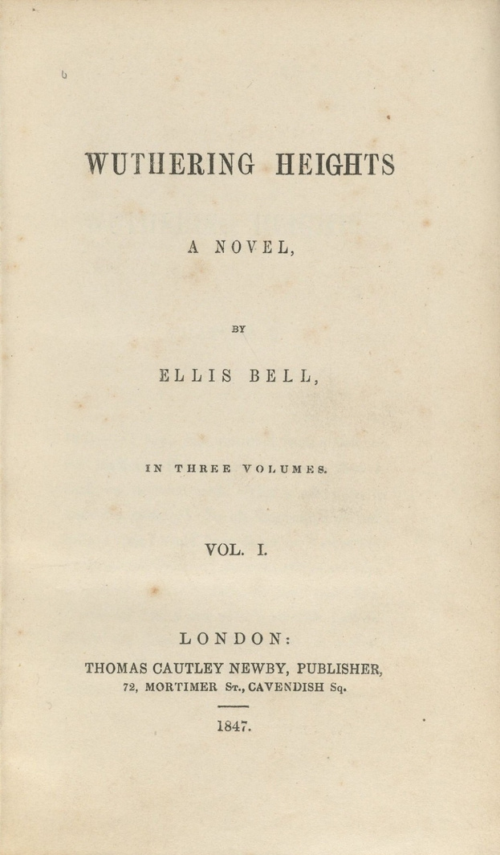
Rationale
Wuthering Heights by Emily Brontë was published in 1847. It is a canonical text that belongs to the genre of Romanticism/Gothic. Brontë’s novel exemplifies the themes of nature, the individual, the sublime, male and female roles, and isolation/melancholy present in Romantic literature. It explores themes of gender, race, and social class that continue to prevail nearly 175 years after its publication. In my Unit of Study, I hope to design a curriculum that makes Romantic literature approachable and understandable for young adult students of varying interest levels–whether they enjoy, despise, or are indifferent towards English literature.
02
https://en.wikipedia.org/wiki/Wuthering_Heights

Slide 3
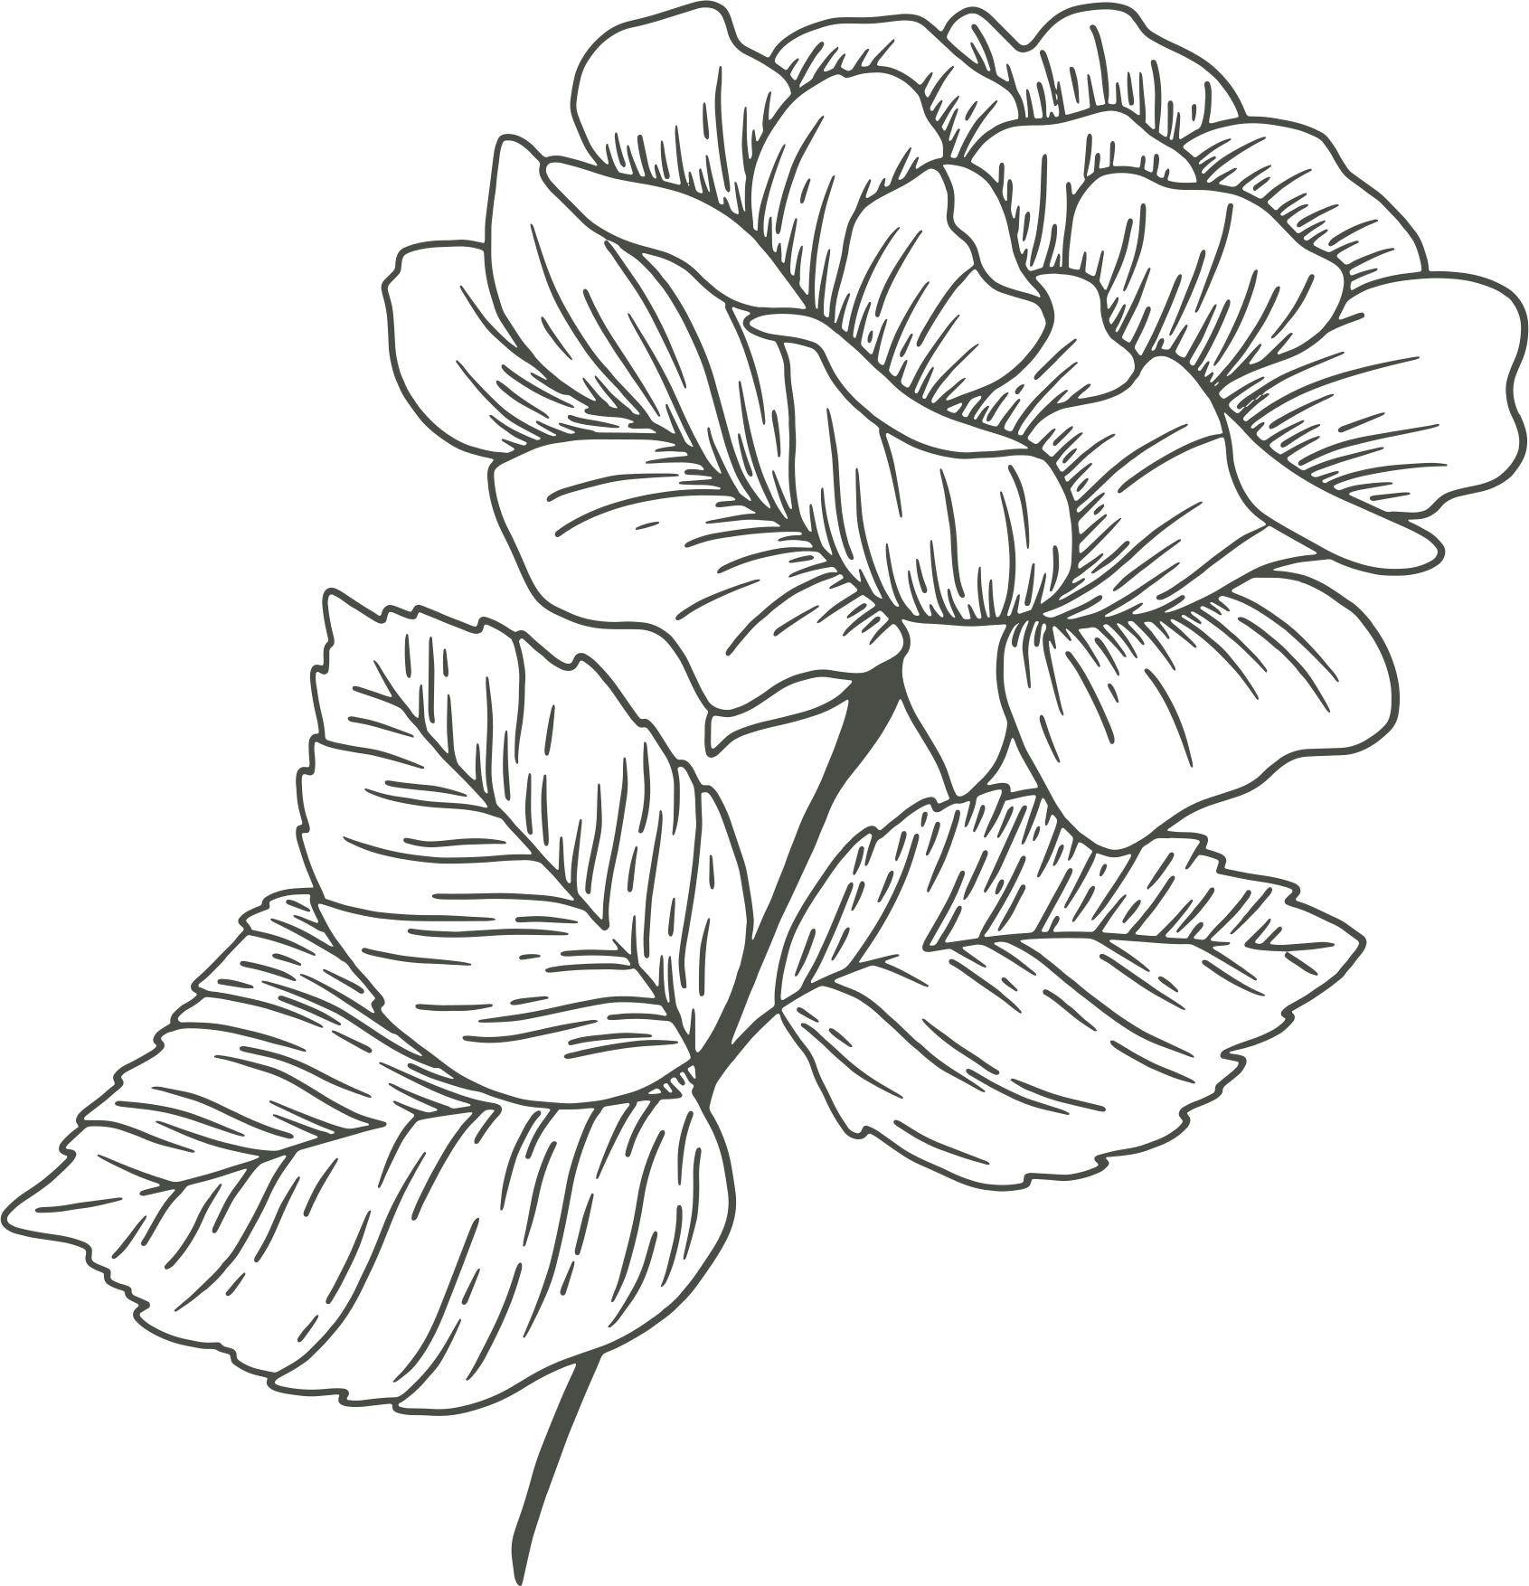
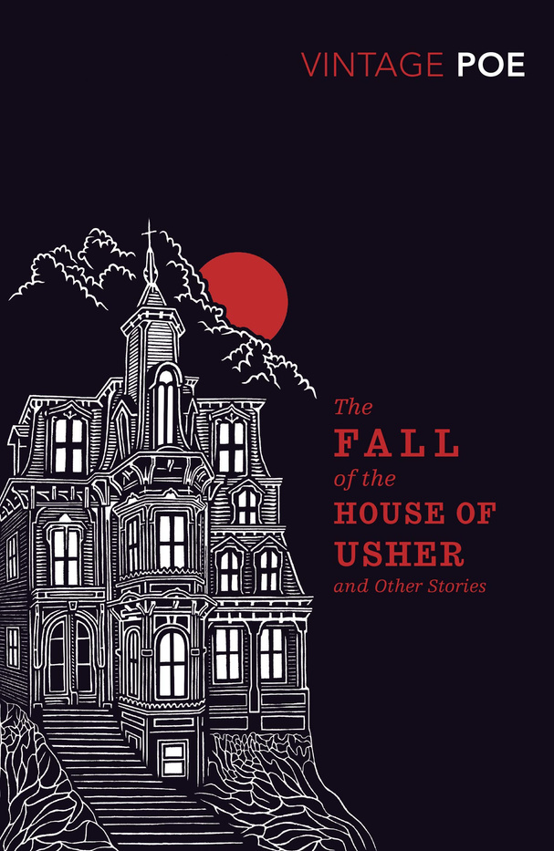
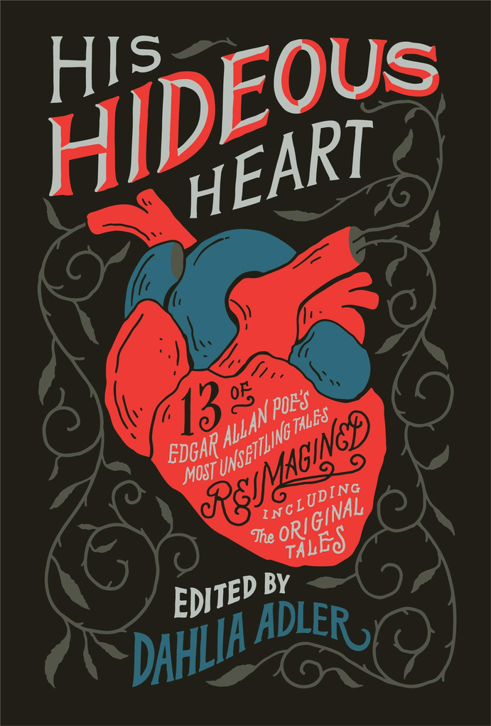
03
Into the Text
PREWORK FOR UNIT
https://www.amazon.com/House-Usher-Stories-Vintage-Classics-ebook/dp/B0047DVIHA
https://www.amazon.com/dp/B07LF5SYHN/ref=dp-kindle-redirect?_encoding=UTF8&btkr=1

Slide 4
Into the text
In class reading of Edgar Allan Poe’s “The Fall of the House of Usher”
This short story is dark, suspenseful, and contains typical Gothic and Romantic elements students will be able to identify in Wuthering Heights.
Students will be introduced to Romanticism and how the genre is further divided into sub-genres like American Romanticism, British Romanticism, and Gothic.
Before beginning Poe’s story, a short presentation on the background, founders, characteristics, and examples of Romantic literature will be given.
In the second half of the class period, we will begin an in-class reading of “The Fall of the House of Usher”.
https://www.amazon.com/House-Usher-Stories-Vintage-Classics-ebook/dp/B0047DVIHA
04

Slide 5
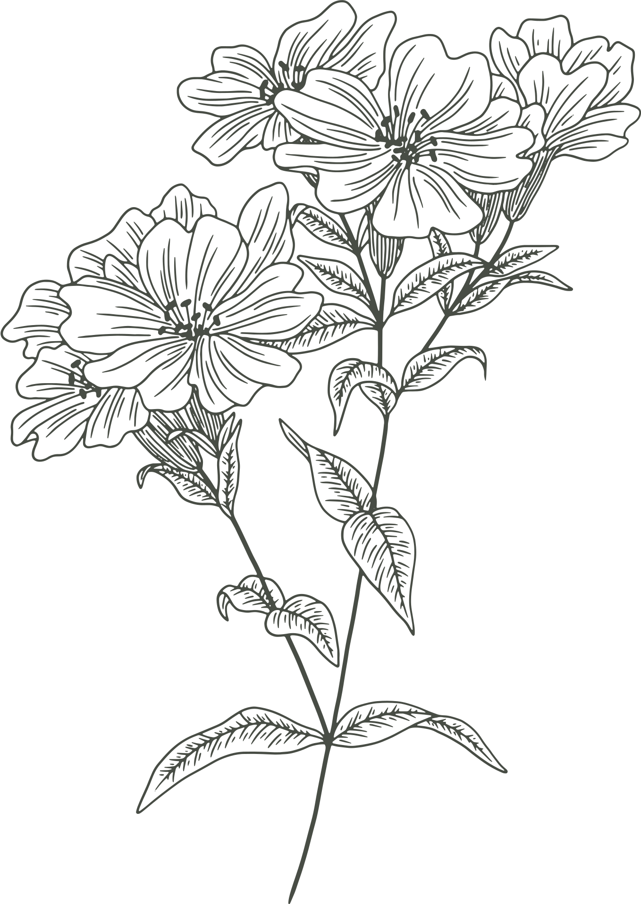
Into the text cont.
”The Fall of the House of Usher”
Students will discuss their opinions on the story as well as how this text fits into the genre of Romanticism. Special attention will be given to the setting of the story and its supernatural elements as these themes correspond directly to Wuthering Heights.
How does Poe convey a dark and ominous tone through the setting and mood of the story? Cite specific examples.
What role do supernatural forces play in the story? How do these elements affect the characters and environment?
Out of class, students will read “The Fall of the Bank of Usher”, a retelling by YA author Fran Wilde contained in the book His Hideous Heart edited by Dahlia Adler.
https://www.amazon.com/dp/B07LF5SYHN/ref=dp-kindle-redirect?_encoding=UTF8&btkr=1
05

Slide 6
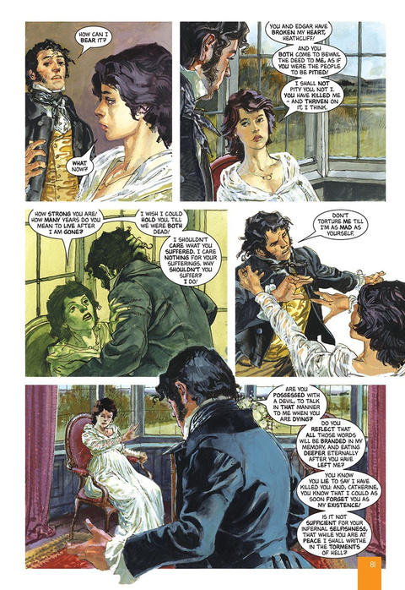
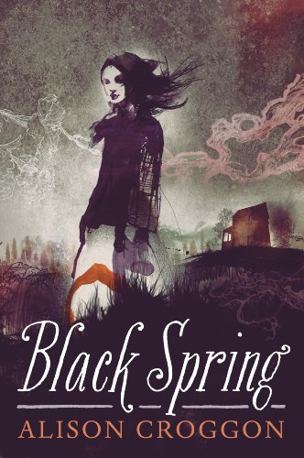
06
Through the Text
READING WUTHERING HEIGHTS
https://en.wikipedia.org/wiki/Wuthering_Heights
http://www.classicalcomics.com/product/wuthering-heights-graphic-novel/
https://www.amazon.com/Black-Spring-Alison-Croggon-ebook/dp/B00E3Y4R4O

Slide 7
Kate Bush "Wuthering Heights"
"Heathcliff, it's me, I'm Cathy
I've come home, I'm so cold
Let me in your window
Heathcliff, it's me, I'm Cathy
I've come home, I'm so cold
Let me in your window"
Bush’s song will be used to introduce the setting of the novel on the Yorkshire Moors, the tumultuous relationship between Heathcliff and Catherine, and the supernatural elements at play throughout the book.
07

Slide 8
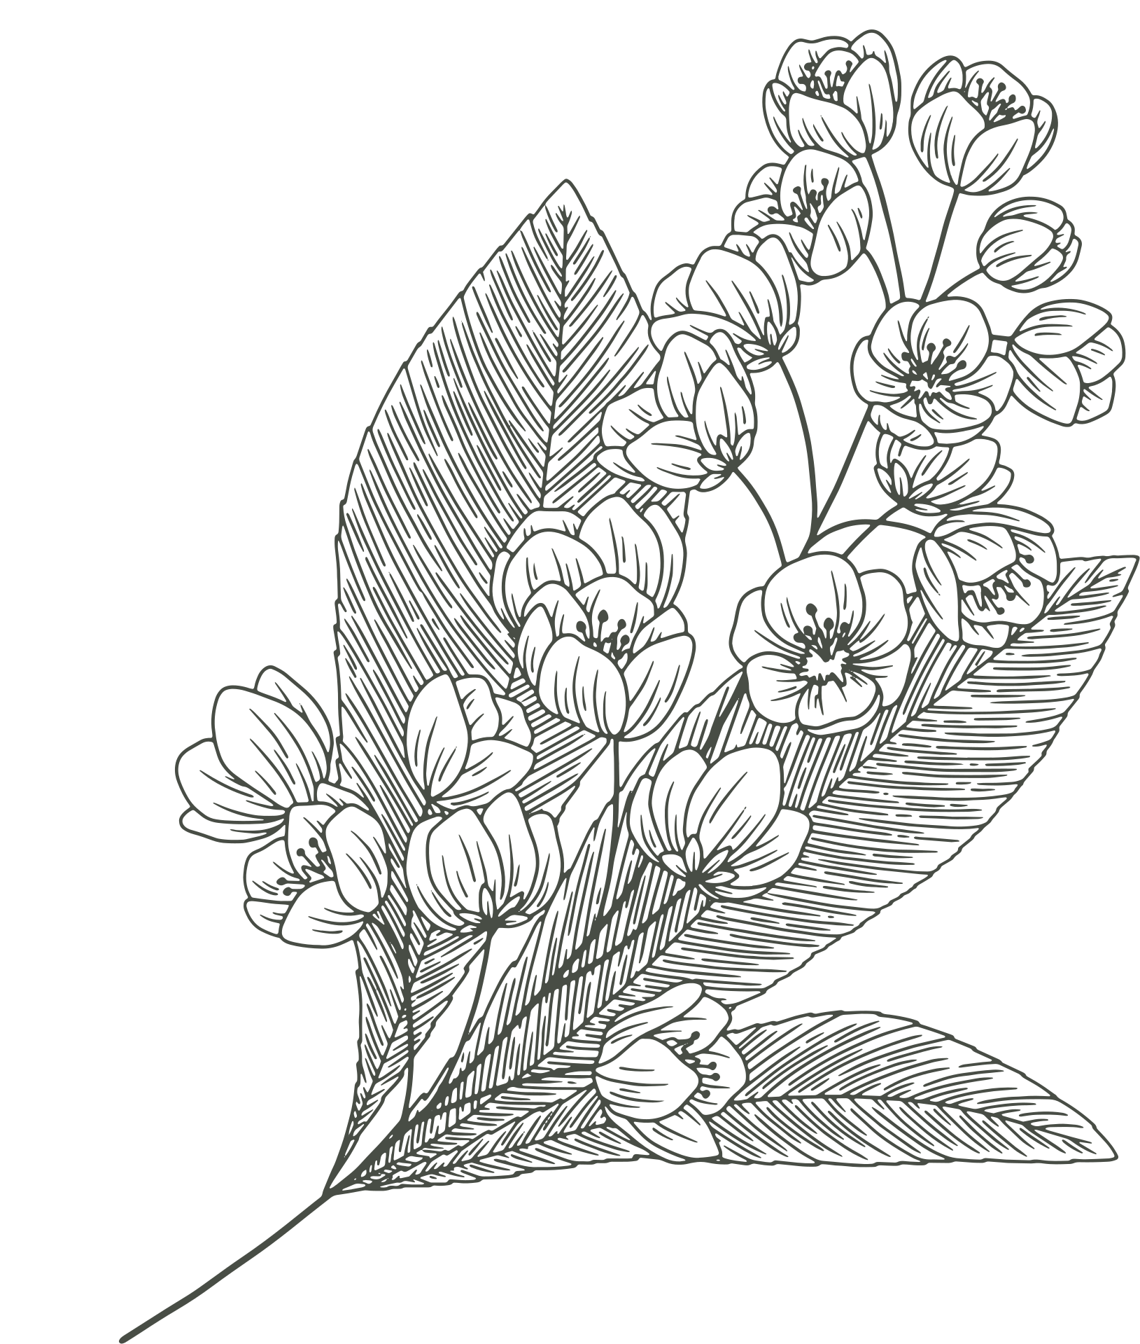
Through the text
Because of the novel’s complex themes, narration, and slow pace, all reading of Wuthering Heights will be completed in class.
During the reading, student’s will be able to view the graphic novel adaptation Wuthering Heights the Graphic Novel: Original Text by Michael Wilson projected on screen and follow along.
Reading of Black Spring by Alison Croggon should be completed as homework since students will not be expected to do out-of-class work on Wuthering Heights.
A YA retelling of Brontë’s Wuthering Heights. Croggon’s novel contains Romantic/Gothic elements similar to Wuthering Heights
08

Slide 9
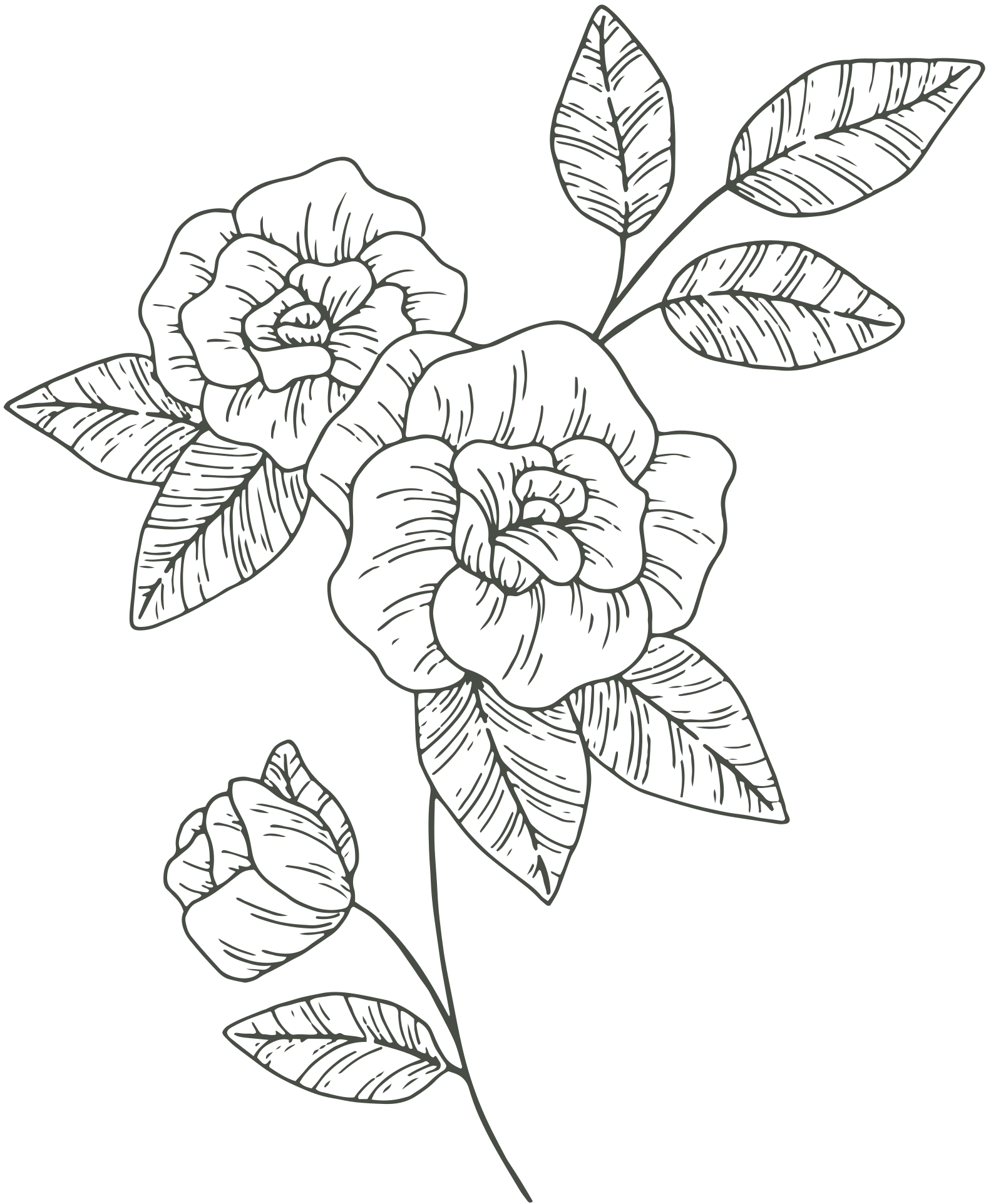
Through the text
Reading Activities
Journal and Final Exam: Students will be expected to keep a journal throughout the reading of Wuthering Heights. Each day, students will be given 10 minutes to write a short summary of what occurred in the section we covered in class. In addition, they will write any thoughts they have on the reading and write one question they hope to know the answer to by the end of the novel. When reading is concluded, students will try to answer their own questions and turn in a document with the questions and answers. I will select questions from these journals to include on a final exam. Journals will be graded for completion and students will be encouraged to keep detailed notes so they can use the journals during the test.
09

Slide 10
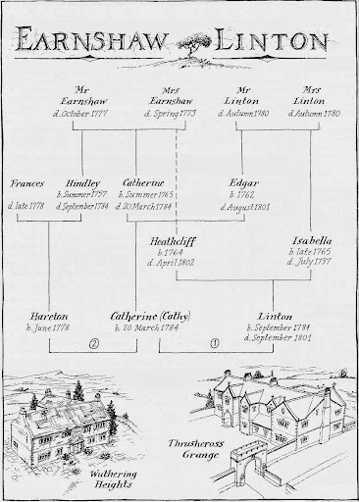
Through the text
Reading Activities
Family Tree: In order to facilitate a greater understanding of the family structures and connections in the novel, students will create a family tree and fill it out as they gain more insight into the relationships between characters. Family trees will be constructed in the journal and submitted with the Q&A’s.
10
http://teacherpress.ocps.net/wellsml/wuthering-heights-family-tree/

Slide 11
11
Beyond the Text
FINAL ACTIVITIES AND RECOMMENDED YA RESOURCES
In addition to the final exam, students will have the option to choose between multiple assignments to conclude the unit. I think it’s important that students have authority over what they choose to write or create. This will allow students to pick a topic they feel most comfortable with or inspired by and, hopefully, this will allow them to produce their best work.

Slide 12
Beyond the text
Final Essay:
Write a final essay incorporating Emily Brontë’s Wuthering Heights and Alison Croggon’s Black Spring. Choose from the prompts below or create your own (with authorization from myself)
Compare and contrast the two texts. Consider the unifying genre of Romantic/Gothic literature and comment on how both texts contain the previously discussed hallmarks of Romanticism.
Book Review! Write an argumentative essay about which text you prefer. Discuss how literary elements such as plot, narration, setting, character development, etc. influence your decision.
You may write about Wuthering Heights or Black Spring separately if you wish. Topics you may discuss include:
The role of social class and how it affects characters and the novel as a whole.
The role of the environment in the novel. How does the environment influence the plot and characters of the novel?
If you choose to write an essay on just Wuthering Heights or Black Spring, it is required you write a 500-word book review of the other text.
12

Slide 13
Beyond the text
Audioscape:
This final assignment requires two parts. First, students must create a (minimum) 10 song playlist for each novel (20 songs in total, a maximum of 3 songs may be the same for both texts). For each song you must write a rationale explaining why you chose this song and quotations from the novels that inspired your choice.
Graphic Novel: Two options
Create a minimum 5-page graphic novel for both texts. These graphic novels should be a general summary of key events in both stories. On each picture include a short description of the visual. Write a rationale for both graphic novels explaining why you chose these key events.
Create a minimum 10-page graphic novel that incorporates both stories. Using characters and/or events from both novels, write and visualize your own unique story. On each picture include a short description of the visual. Write a rationale explaining the authorial decisions you made when reimagining the stories.
12

Slide 14
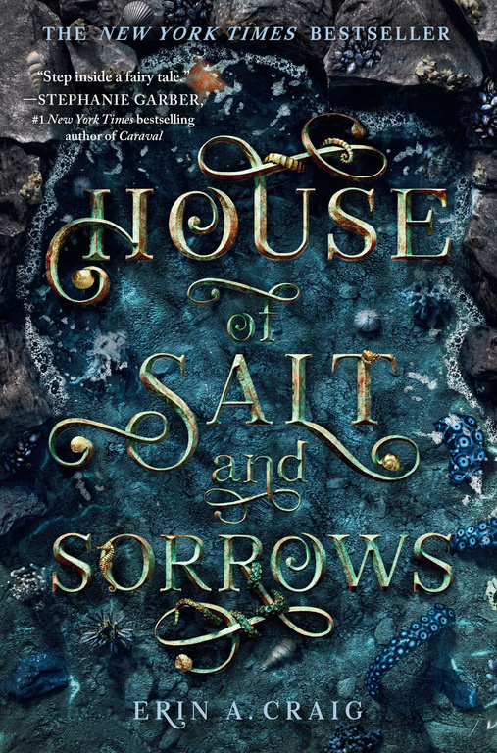
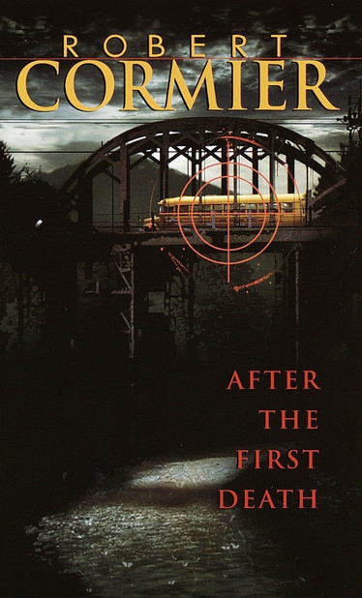
YA Resources
14
https://www.amazon.com/dp/B07KDVTR4Y/ref=dp-kindle-redirect?_encoding=UTF8&btkr=1
https://www.amazon.com/dp/B00BRUQ4S4/ref=dp-kindle-redirect?_encoding=UTF8&btkr=1
https://www.goodreads.com/book/show/6234369-we-were-here
House of Salt and Sorrows by Erin A. Craig
After the First Death by Robert Cormier
We Were Here by Matt de la Peña
YA adaptation and retelling of “The Twelve Dancing Princesses” by the Brothers Grimm
Romantic/Gothic elements: supernatural, mysterious, horrific, and romantic.
Themes of death and issues of race and class.
Suspenseful and psychological; like Wuthering Heights, it doesn’t end on a happy note.
Suspenseful; Told from a first-person perspective.
Themes of death and race.
Like House of Salt and Sorrows, de la Peña’s main character embarks on an adventure and the mystery unravels for the reader to witness.

Slide 15
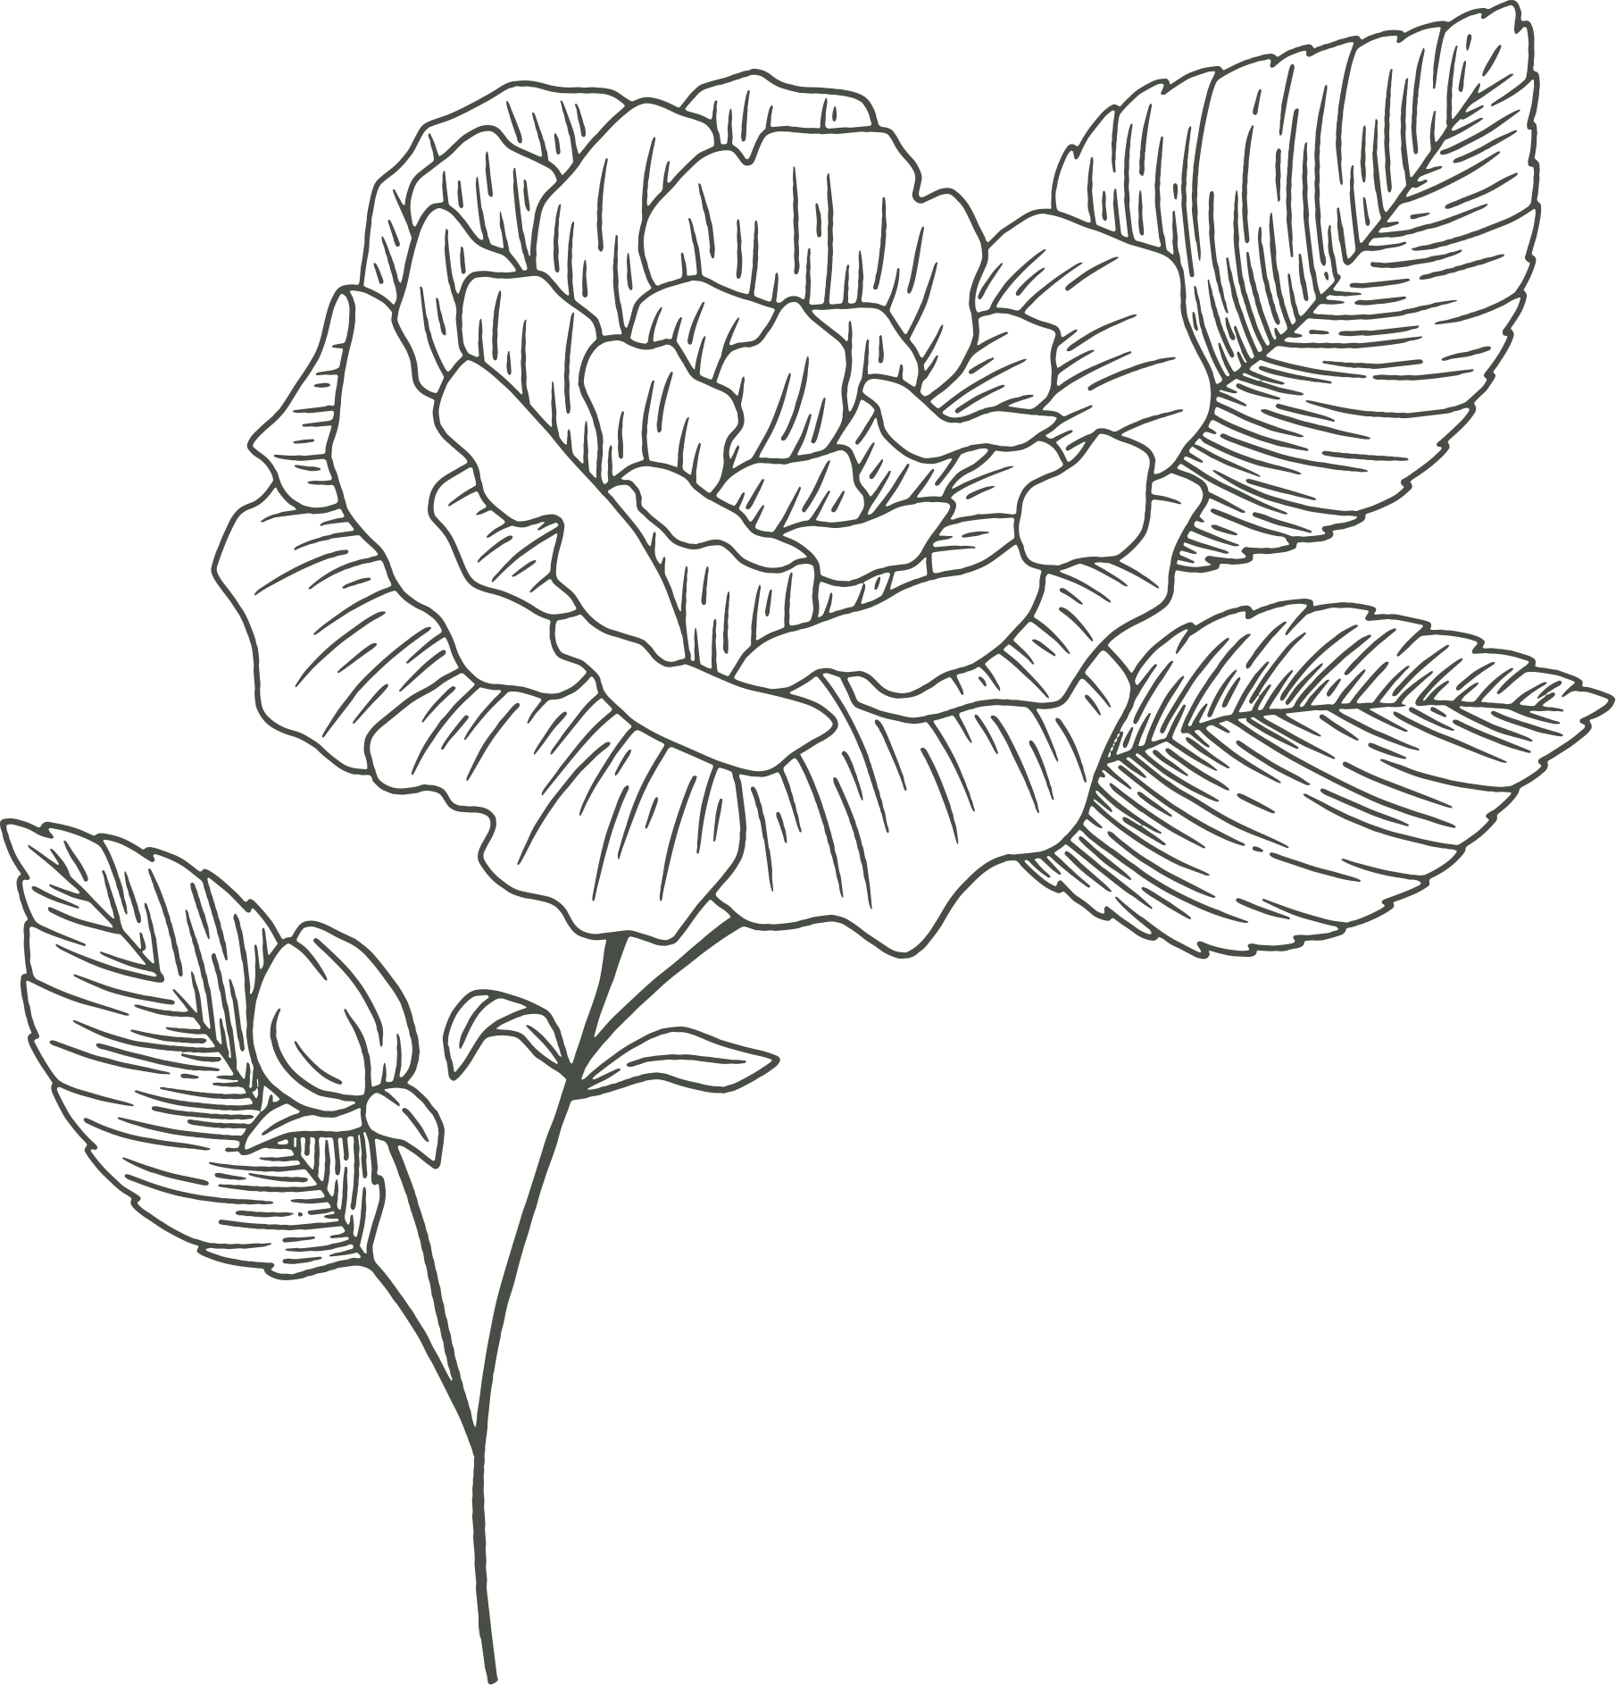
Works Cited
15
Brontë, Emily. Wuthering Heights. Pearson Education, 2008.
Bush, Kate. “Kate Bush - Wuthering Heights - YouTube.” Youtube, 2011, https://www.youtube.com/watch?v=Fk-4lXLM34g.
Bush, Kate. “Wuthering Heights.” Kate Bush - Wuthering Heights Lyrics , STANDS4, 2021, https://www.lyrics.com/lyric/22700/Kate+Bush/Wuthering+Heights.
Cormier, Robert. After the First Death. Penguin Books, 2016.
Craig, Erin A. House of Salt and Sorrows. Random House Children's Books, 2019.
Croggon, Alison. Black Spring. Candlewick Press, 2013.
De la Peña, Matt. We Were Here. Ember, an Imprint of Randon House Children's Books, 2019.
Poe, Edgar Allan. “The Fall of the House of Usher .” His Hideous Heart: Thirteen of Edgar Allan Poe's Most Unsettling Tales Reimagined, edited by Dahlia Adler, Flatiron Books, New York, 2021, pp. 397–423.
Wilde, Fran. “The Fall of The Bank of Usher.” His Hideous Heart: Thirteen of Edgar Allan Poe's Most Unsettling Tales Reimagined, edited by Dahlia Adler, Flatiron Books, New York, 2021, pp. 193–230.
Wilson Seán Michael, and Brontë Emily. Wuthering Heights: The Graphic Novel (Original Text). National Geographic Learning, 2013.

