Slide 1
Freedom, Forgetfulness, and Fantasy:
Learning to Question the World
By Brandon Luu

Slide 2
Opening Question:
What would you give up to remember something important?

Slide 3
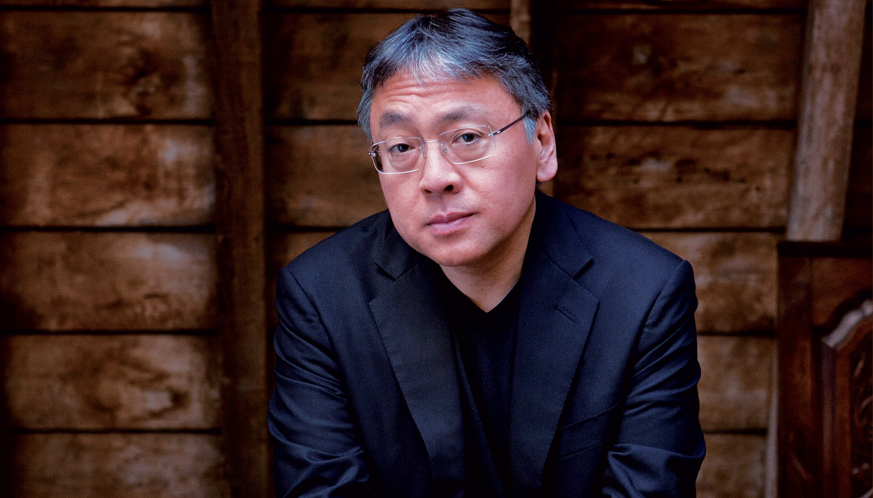
Literary Centerpiece:
Released in
March 3rd, 2016
The Buried Giant by Kazuo Ishiguro
Japanese-British novelist, screenwriter, and short story writer, age 62 as of 2016

Slide 4
Activities and Assignments
Journal for recording thoughts and vocab about the reading
Vocab sentences
In-class reading aloud
Creative Writing Prompts
Research Worksheet/Scavenger Hunt
In-class Character Dissection Posters

Slide 5
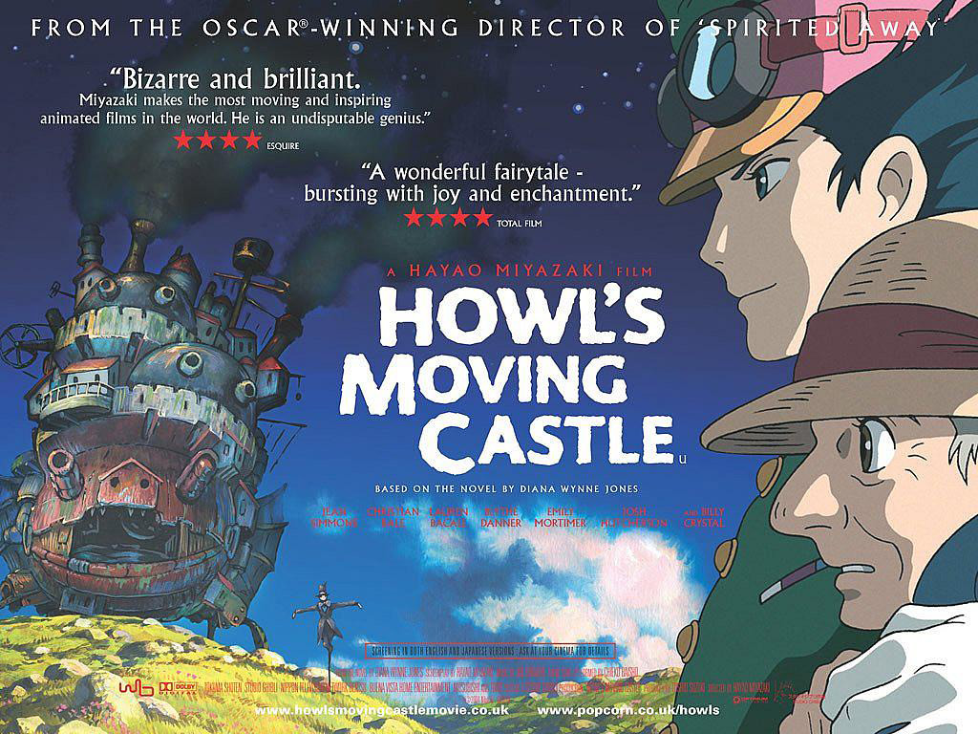
Movie Day!

Slide 6
Final Project:
Formal Essay

Slide 7
Closing Question:
What would you give up to remember something important?

Slide 8
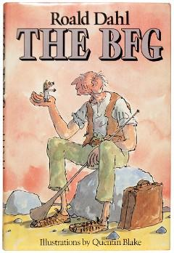
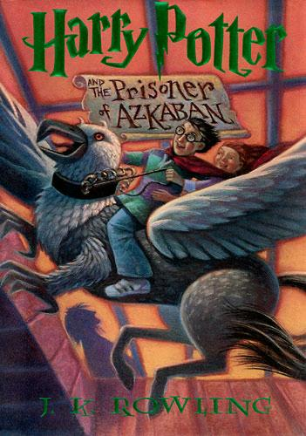
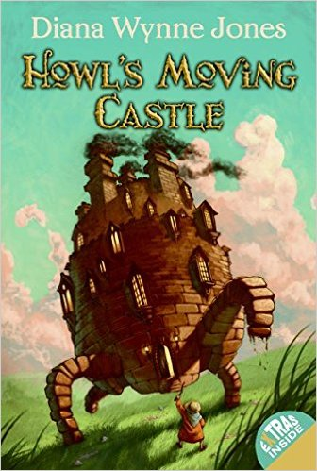
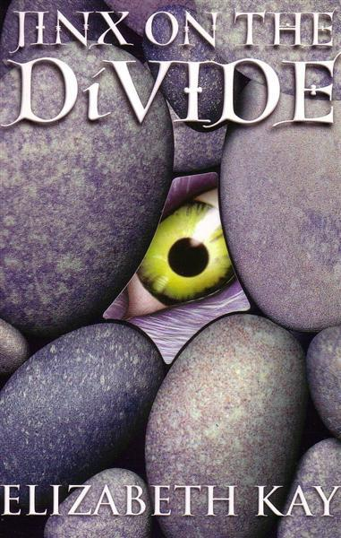
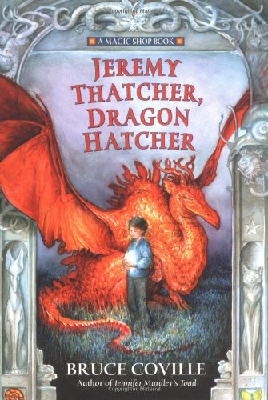
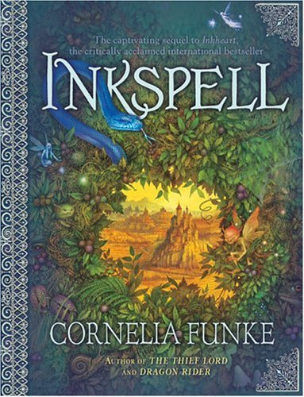
Supplementary Books

