Slide 1
Introduction of Touch Technologies
EE174 – SJSU
Tan Nguyen

Slide 2
Touch Technologies
Introduction
Brief History and Development
Components of a Touch Screen
Touchscreen Technology
Resistive
Capacitive
Surface Acoustic Wave (SAW)
Infrared LED or Optical
Applications
Market and Trends

Slide 3
Introduction
A touch screen is the most user friendly input device used to interface with a PC by simply touching the screen to select options presented on it, where associated hardware and software locate that touch.
A touch screen is being used in a wide variety of applications to improve human-computer interaction.
Because of its convenience, touchscreen technology solutions has been applied more and more to industries, applications, products and services, such as modern smartphones, video games, kiosks, navigation systems, POS, tablets, etc. . .

Slide 4
Brief History and Development
1965 First finger-driven touch screen invented by E.A. Johnson (Royal Radar Est.) for air traffic control.
1971 Dr. Sam Hurst, founder of Elographics developed the first touch opaque sensor “Elograph” at the University of Kentucky. In 1974 He developed the first real touch screen.
1977, Elographics developed the five-wire resistive technology then with the backing of Siemens Corporation, developed a curved glass sensor called the touch screen.
1983 HP-150 home computer using infrared technology.
1993 Apple’s touch-capable Newton and IBM’s Simon first touchscreen phone.
1998 Palm Inc. released Pilot Personal Digital Assistance (PDA).
2002 Microsoft introduces Windows XP Tablet
2007 Apple’s iPhone (Multi-touch)
2008 Microsoft introduces the Surface Tablet

Slide 5
Why use Touch Screens?
Improve human-computer interaction for first-time users to interface with computers instantly.
Eliminate operator errors because users make selections from clearly defined menus on screen.
Eliminate keyboards and mice, which many novice users find difficult to use.
Rugged enough to stand up to harsh conditions where keyboards and mice can be damaged.
Provide fast access to all types of digital content.
Ensure that no space is wasted since the input device is completely integrated into the monitor.

Slide 6
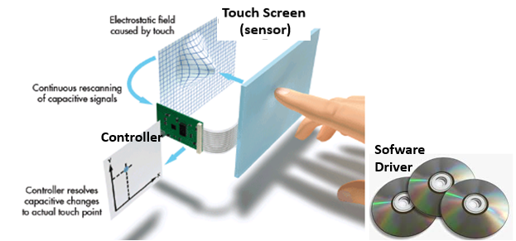
Components of Touch Screens
A basic touchscreen system has three main components:
A touch screen sensor.
A controller.
Software driver.
The touchscreen is an input device, so it needs to be combined with a display and a PC or other device to make a complete touch input system.

Slide 7
Components of Touch Screens
Touch sensor:
The touch screen is the face of a touchsystem and the user's first contact point with the system.
The sensor generally has an electrical current or signal going through it and touching the screen causes a change in the signal. This change is used to determine the location of the touch of the screen.
Controller:
The controller - essentially the brain of the touch system – typically a PC board contains a microprocessor, analog-to-digital converters, and microchips that connects between the touch sensor and the PC.
It takes information from sensor and translates it for understanding of PC. The controller determines what type of connection is needed.
Software driver:
It allows computer and touch screen to work together. It tells OS how to interact the touch event information that is sent from the controller.
Most touch screen drivers today are a mouse-emulation type driver. This makes touching the screen the same as clicking your mouse at the same location on the screen.
The driver software, residing on the host PC, is required to manage the raw coordinate data coming from the controller, apply calibration algorithms, position the mouse cursor, and generate mouse clicks.

Slide 8
Touchscreen Technology
There are four different technologies used to make touchscreens today:
Resistive Sensing
Capacitive Sensing
Surface Capacitance
Projected Capacitance (Self and Mutual Capacitance)
Surface Acoustic Wave (SAW)
Infrared LED or Optical

Slide 9
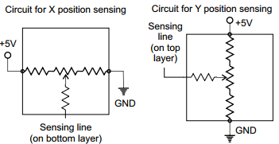
Resistive Technology
Construction: Typical Analog Resistive Touch Screen
Sensing Method: Use the pressure to create contact between resistive layers completing circuit which causes a change in the flow of electricity.
Two layers of conductive material
Voltage in circuit changes based on position
Controller determines location based on voltages
Any material can trigger sensors
When we press at some point on the screen, we “tap” into a the middle of a long resistor

Slide 10
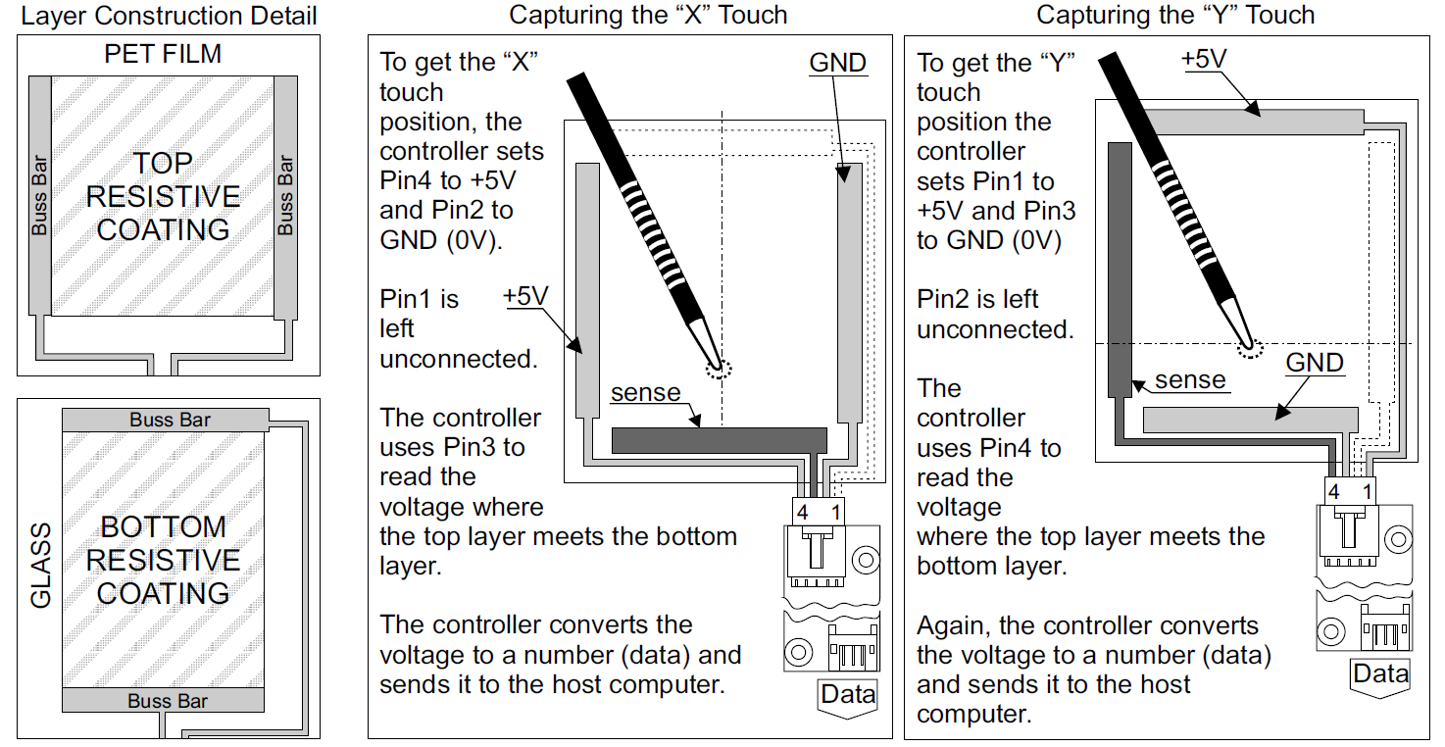
4-Wire Analog Resistive Touch Screen: How does it work?

Slide 11
4-Wire Analog Resistive Touch Screen Formulas
Example: Given a resistive touch screem specs: Resistance is 1kΩ/cm of electrode line, screen is (H x W) 30cm x 40cm and supply voltage V_{Drive} = 5V.
a) What are the resistor values of R_{X1} & R_{Y1} and voltages at V_{X+} & V_{Y+} for a touch at:
i) Center of the screen.
ii) Center of bottom-right quadrant
b) If V_{X+} = 2.3V and V_{Y+} = 1V, what are location of x and y?
Solution:
a) Resistance is 1kΩ/cm ➔ Height: (0 – 30cm ≈ 0 – 30kΩ), ➔ Width (0 – 40cm ≈ 0 – 40kΩ
i) At center of the screen: x = 20 cm, y = 15cm ➔ R_{X1} = 20kΩ, R_{Y1} = 15kΩ
➔ V_{X+} = (15kΩ / 30kΩ) x 5V = 2.5V
➔ V_{Y+} = (20kΩ / 40kΩ) x 5V = 2.5V
ii) At center of bottom-right quadrant
x = 30 cm, y = 7.5cm
➔ R_{X1} = 30kΩ, R_{Y1} = 7.5kΩ
➔ V_{X+} = (7.5kΩ / 30kΩ) x 5V = 1.25V
➔ V_{Y+} = (30kΩ / 40kΩ) x 5V = 3.75V
b) y = (2.3V / 5V) x 30cm = 13.8cm
x = (1V / 5V) x 40cm = 8cm
x
x
Location y = $\frac{\text{V}\text{x}\text{+}}{\text{V}\text{Drive} }$ x Height_{screen} Location x = $\frac{\text{V}\text{y}\text{+}}{\text{V}\text{Drive} }$ x Width_{screen}

Slide 12
Analog Resistive Technology
Types:
4-wire (low cost, short life) is common in mobile devices
5-wire (higher cost, long life) is common in stationary devices
8-wire operates like 4-wire touch screens but have an additional four sensing points which allows for better accuracy and linearity in larger touch screen sizes. Because of its input flexibility, low power draw, accuracy and low cost, our 8-wire resistive touch screen is a good choice for many interactive applications.
Constructions
Film (PET) + glass (previous illustration) is the most common
Film + film (used in some cellphones) can be made flexible
Glass + glass is the most durable; automotive is the primary use
Film + film + glass, others…
Size range
1” to ~24” (>20” is rare)
Controllers
Many sources
Single chip, embedded in chipset/CPU, or “universal” controller board
Suppliers
Young Fast, Nissha, Nanjing Wally, Truly, EELY, Mutto, J-Touch…
60+ suppliers
Applications
Mobile devices (shrinking)
Point of sale (POS) terminals
Automotive
Industrial
Wherever cost is #1

Slide 13
Analog Resistive Technology
Advantages
Works with finger, stylus or any non-sharp object
Lowest-cost touch technology
Widely available (it’s a commodity)
Easily sealable to IP65 or NEMA-4
Resistant to screen contaminants
Low power consumption
Market trends
Analog resistive is shrinking in units and revenue
P-cap dominates in most consumer applications
Analog resistive is still significant in commercial applications
Especially POS and industrial-control terminals
Disadvantages
Not durable (PET top surface is easily damaged)
Poor optical quality - The flexible top layer has only 75%-80% clarity
If the ITO layers are not uniform, the resistance will not vary linearly across the sensor. Measuring voltage to 10 or 12-bit precision is required, which is difficult in many environments.
No multi-touch
Require periodic calibration to realign the touch points with the underlying LCD image.

Slide 14
Capacitive Technology
Unlike resistive touch screens, capacitive technology does not use the pressure of your finger to create a change in the flow of electricity. Instead, they work with anything that holds an electrical charge – including human skin.
Surface Capacitance
Projected Capacitance
Self Capacitance
Mutual Capacitance

Slide 15
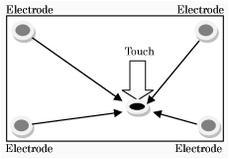
1. Surface Capacitance
Construction:
Top protective cover
Transparent electrode film
Bottom glass substrate
Sensing Method:
The same phase voltage is imposed to the electrodes on the four corners that creates a uniform electric field will be forming over the panel.
When a finger touches on the panel, electrical current will flow from the four corners through the finger. Ratio of the electrical current flowing from the four corners will be measured to detect the touched point. The measured current value will be inversely proportional to the distance between the touched point and the four corners.
Far from the touched point – Lower current
Close to the touched point – Higher current

Slide 16
Surface Capacitive
Advantages:
Surface capacitive technology is suitable for large size monitors.
Surface capacitive sensor can respond to light touch, and no pressure force is needed for detection
Visibility is high because structure is only one glass layer.
Surface capacitive is structurally tough as it is made of one sheet of glass.
Surface capacitive does not get affected by moist, dust, or grease.
Parallax is minimized in surface capacitive.
Surface capacitive has high resolution and high response speed.
Highly sensitive (very light touch)
Disadvantages:
Surface capacitive can detect touches by fingers only
Surface capacitive technology does not support multi-touch.
Surface capacitive touch screen is likely to be affected by noise. Recently, tolerance for noise has been improved with various methods such as noise shielding.

Slide 17
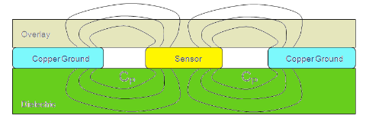
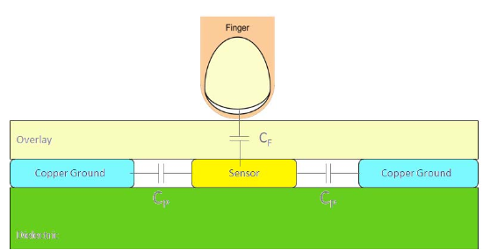
2. Projected Capacitance: Self Capacitance
Self Capacitance: In this implementation, each capacitive sensor is a conductive pad laid on a PCB, surrounded by a ground pattern. This sensor forms a parasitic capacitance Cp with the surrounding
ground pattern, and the electric field lines can be seen in the area above the sensor.
Sensing Method:
When a conductor like a finger enters the area above this sensor, it alters the electric field lines and effectively adds a finger capacitance Cf to the sensor Cp
➔ increase in capacitance from Cp to Cp + Cf
since Cp//Cf.
A controller detects changes in capacitance for each row & column to determines an (x, y) coordinate based on the capacitance changes. Self capacitance measure an entire row or column for capacitive change.
Typical capacitor values: Cp ≈ 15pF and Cf ≈ 0.5pF
When touch Cp increases to Cp + Cf

Slide 18
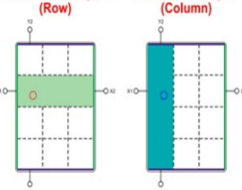
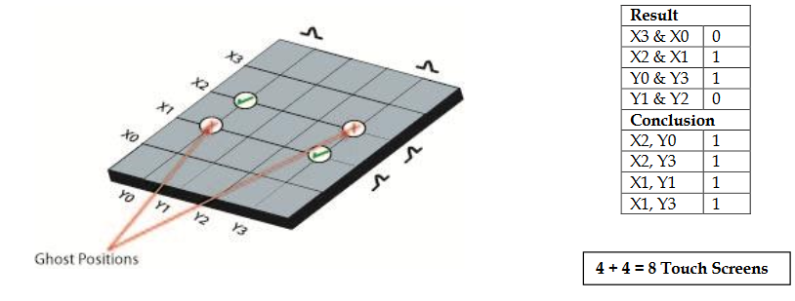
2. Projected Capacitance: Self Capacitance
Self Capacitance:
In this implementation, the electronics measure the current on each electrode to ground and therefore is called “self-capacitance”.
Rows and columns of conductors are overlayed in a grid pattern: One capacitor for each row and for each column.
Problem with self capacitance when multi-touch cause ghost positions.

Slide 19
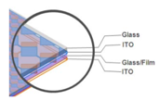
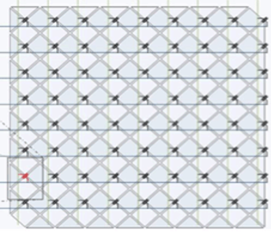
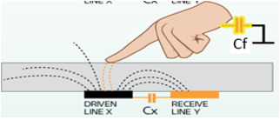
2. Projected Capacitance: Mutual Capacitance
Contruction: Mutual capacitance is the latest addition of capacitive sensing techniques. Such capacitive panels have two conductive layers stacked together with a very thin separation.
Sensing method: In this implementation, mutual capacitance are created between elements of columns and rows in the vicinity where each intersect the other. This allows the system electronics to measure each node (intersection) individually to detect multiple touches on the screen during one screen scan.
When a finger touches near an intersection, the mutual capacitance Cx between the row and column is coupled to the finger capacitance Cf (Cx in series with Cf) which reduces the capacitance at the intersection as measured by the system electronics. This reduced capacitance crosses the "touch threshold" set by the electronics indicating a touch has occurred. This reduction in capacitance is used to identify the presence of a finger.
Since every intersection has its own mutual capacitance and can be independently tracked, this method provides a distinct advantage for detecting multiple fingers.

Slide 20
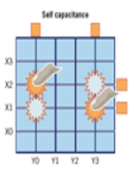
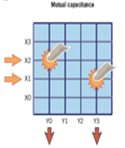
Self versus Mutual Capacitance
Result:
X3 & X0 = 0
X2 & X1 = 1
Y0 & Y3 = 1
Y1 & Y2 = 0
Conclusion:
X2, Y0 = 1
X2, Y3 = 1 G
X1, Y0 = 1 G
X1, Y3 = 1
------------------
4 + 4 = 8 Sensors:
4 rows + 4 columns
Result:
X2 * Y0 = 1
X1 * Y3 = 1
Conclusion:
X2, Y0 = 1
X1, Y3 = 1
------------------
4 * 4 = 16 Sensors:
4 x 4 intersections
Ghost points = False touches positionally related to real touches: (X1, Y0) and (X2, Y3)
Capable of recognizing multiple touches (Multi-touch)

Slide 21
Self versus Mutual Capacitance Comparison
 | Mutual Capacitance | Self Capacitance
Light Transmission | 84% to 90% | 84% to 90%
Stylus Type | Finger, Thin Glove, Passive Stylus | Finger, Thin Glove, Passive Stylus
Response Time | 6 ms | 10 ms
Touches | 20+ | 1
Accuracy | >99% | >98.5%
Number of Layers | 2 | 1 or 2
Measurement | Capacitance Between Electrodes | Capacitance of Electrodes to Ground
Scanning Method | Each Electrode Intersection | Each Electrode Individually
Sensor Design | Row and Column | Unique Electrode intersection
Sealability | NEMA 4/12 and IP 65 Standard | NEMA 4/12 and IP 65 Standard

Slide 22
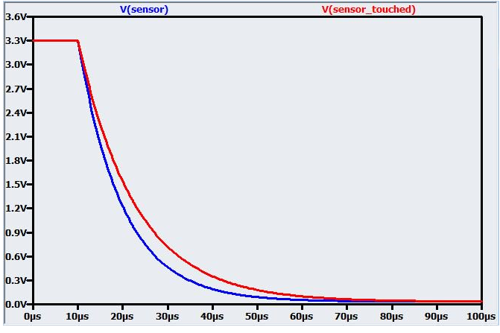
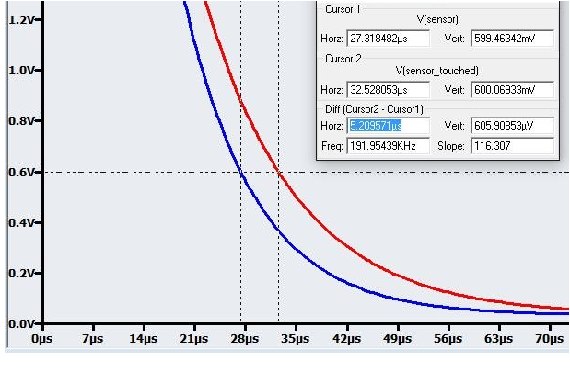
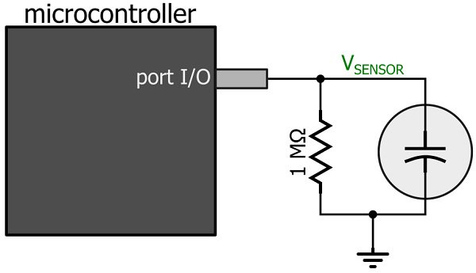
Example of detecting capacitive touchscreen
The discharge time is not much different by human standards, but a modern microcontroller could certainly detect this change. Given a RC circuit composed of a 1 MΩ resistor and a capacitive touch sensor 10 pF. When touch the
Ctotal = 10pF + 3 pF = 13 pF. The high level voltage VH = 3.3V and low level voltage to detect at VL = 0.6V,.
The plot for RC circuit to discharge with touch and no touch is shown below.
The capture event will occur when the discharging voltage crosses the pin’s logic-low threshold, e.g., 0.6 V. As shown in the following plot, the difference in discharge time with a threshold of 0.6 V is ΔT = 5.2 µs.With a timer clock-source period of 1/(25 MHz) = 40 ns, this ΔT corresponds to 130 ticks. Even if the change in capacitance were reduced by a factor of 10, we would still have 13 ticks of difference between an untouched sensor and a touched sensor.

Slide 23
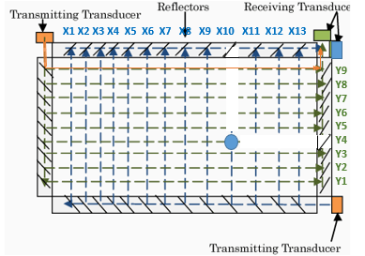
Surface Acoustic Wave (SAW)
Construction:
SAW touch screen consists of one glass sheet with transmitting transducers, receiving transducers, and reflectors.
SAWs are sent out from the transmitting transducers, and traveling along the edge of panel. The reflectors located on the edge of the panel change directions of the SAWs at the angle of 90 degrees, thus the SAWs travel over the panel. Once the SAWs reached the other side of the panel, their directions get changed again by the reflectors located on the other side, and travel toward the receiving transducers. Once the SAWs are received by the receiving transducers, they will be converted into electric signals.
Sensing Method:
There are routes on which the SAWs travel from the transmitting transducers to the receiving transducers. Each route has its own distance. If one of the routes is touched by a finger, the pulse will be absorbed, and the SAW on the route will not be received by the receiving transducers. Thus, the sensor will recognize which route was touched, and locate the touched point
Receiving Transducers will not receive SAW from routes X10 and Y4.

Slide 24
Surface Acoustic Wave (SAW)
Advantages:
Visibility is excellent because it consists of one glass layer.
SAW touch screen is notable for its durability. Even though the panel surface gets scratched, its sensing function will not be affected.
It is relatively easy to build a large size touch screen in SAW technology.
SAW touch screen does not get affected by external electric noise.
Accuracy of detecting touched points does not get affected by environment nor passage of time. Thus, it is free of maintenance.
Resolution is relatively high.
Disadvantage:
The frame areas need to be wide because transducers are located.
Detecting function of SAW technology can be affected by water droplet, oil and so on. Malfunction can be caused by those factors.
SAW touch screen does not detect a touch by hard materials which do not absorb pulse.

Slide 25
Surface Acoustic Wave (SAW)
Size range
6” to 52”
Advantages
Visibility is excellent because it consists of one glass layer.
Finger, gloved hand & soft-stylus activation
Notable for its durability; can be vandal-proofed with tempered or CS glass
SAW touch screen does not get affected by external electric noise.
Accuracy of detecting touched points does not get affected by environment nor passage of time. Thus, it is free of maintenance.
Disadvantages
Very sensitive to any surface contamination, including water
Relatively high activation force (50-80g typical)
Requires “soft” (sound-absorbing) touch object
Can be challenging to seal

Slide 26
Surface Acoustic Wave (SAW)
Suppliers
Elo Touch Solutions and General Touch have >90% share
<10 suppliers
Market trends
Two-touch and zero-bezel SAW should help reduce loss of share to p-cap in commercial applications
SAW will continue to grow moderately through 2017
Applications
SAW is usually employed for large size applications such as kiosk, arcade game, automated cash dispenser, medical equipment, office automation, factory automation, financial field, and so on.

Slide 27
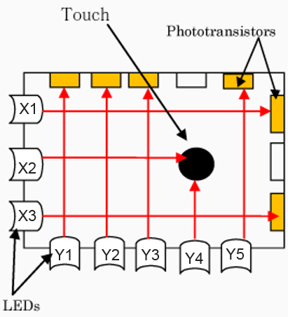
Traditional Infrared
Construction:
An infared touchscreen uses an array of X-Y infared LEDs and photodetector pairs around the screen edges arranged on opposite sides of the screen.
The LED beams cross each other in vertical and horizontal patterns.
Sensing Method:
When a user touches the screen, the sensors detect an interruption in the X-Y infrared pulses enabling the controller to calculate the touch location.
Since you're interrupting a beam, infrared screens work just as well whether you use your finger or a stylus.
This is similar to SAW technology but infrared uses infrared light beams and not ultrasonic waves.
LED Beams X2 and Y4 are interrupted

Slide 28
Traditional Infrared
Variations
Bare PCB vs. enclosed frame; frame width & profile height;
no glass substrate; enhanced sunlight immunity; force-sensing
Size range
8” to 150”
Controllers
Mostly proprietary, except IRTouch (China)
Advantages
Scalable to very large sizes
Multi-touch capable (only 2 touches, and with some “ghost” points)
Can be activated with any IR-opaque object
High durability, optical performance and sealability
Doesn’t require a substrate

Slide 29
Traditional Infrared
Disadvantages
Profile height (IR transceivers project above touch surface)
Bezel must be designed to include IR-transparent window
Sunlight immunity can be a problem in extreme environments
Surface obstruction or hover can cause a false touch
Low resolution
High cost
Applications
Large displays (digital signage)
POS (limited)
Kiosks
Suppliers
IRTouch Systems, Minato, Nexio, OneTouch, SMK, Neonode…
10+ suppliers

Slide 30
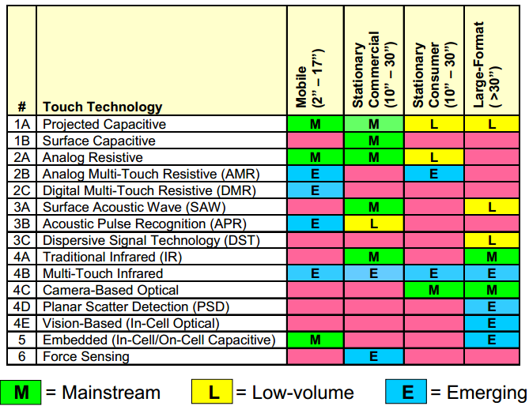
Touch Technologies by Size & Application

Slide 31
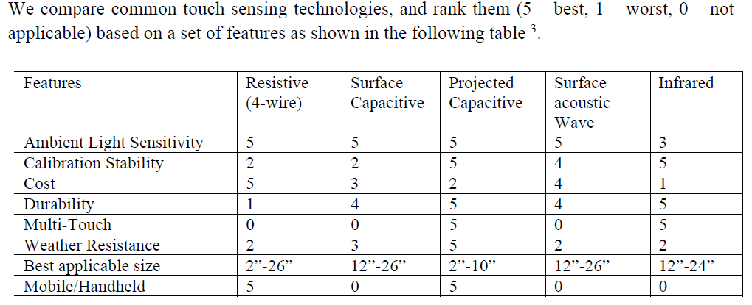
Touch Technologies Comparisons

Slide 32
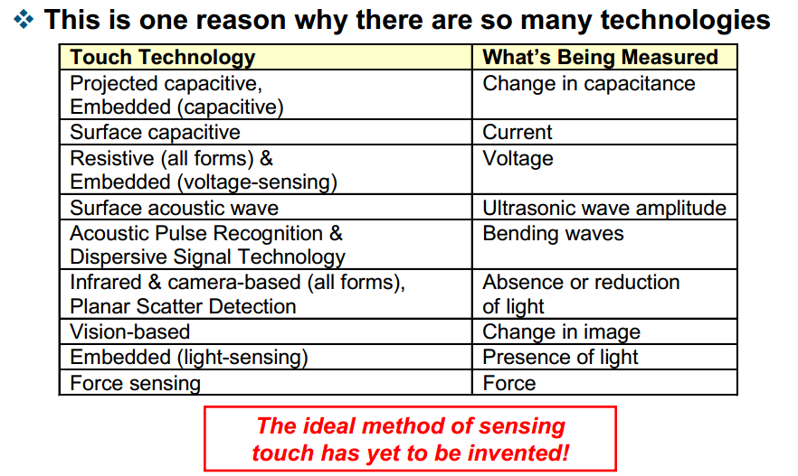
Touch Is An Indirect Measurement

Slide 33
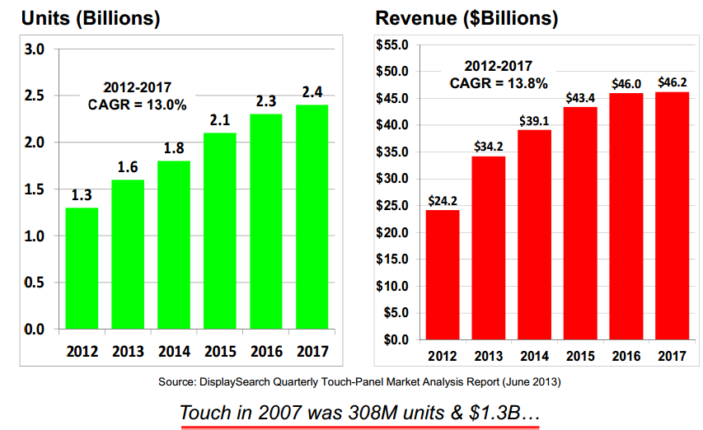
Overall Touchscreen Market 2012-2017
Compound Annual Growth Rate

Slide 34
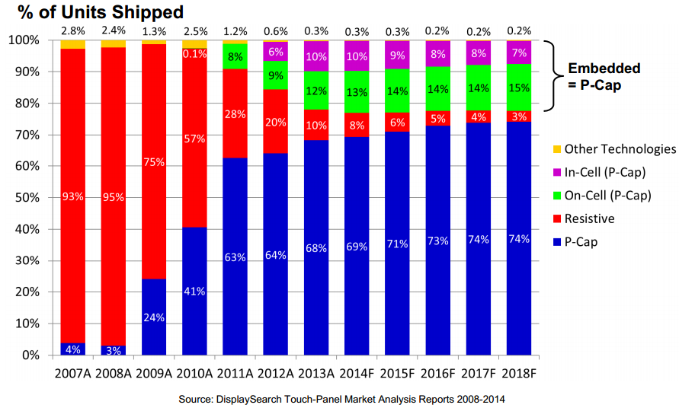
Touchscreen Market 2007-2018 by Technology (Units)

Slide 35
References:
http://www.walkermobile.com/Touch_Technologies_Tutorial_Latest_Version.pdf
http://ww1.microchip.com/downloads/en/DeviceDoc/93064A.pdf
http://ijcaonline.net/volume6/number8/pxc3871433.pdf
http://www.dmccoltd.com/english/museum/touchscreens/technologies/
https://www.touchsystems.com/surfacecapacitive
http://www.cypress.com/file/114081/download
slideplayer.com/slide/1722274/
https://www.sparkfun.com/datasheets/LCD/HOW%20DOES%20IT%20WORK.pdf
https://www.google.com/search?q=ibm+simon+ebay&rlz=1C1AVNC_enUS582US583&oq=ibm+sim&aqs=chrome.2.0j69i57j0l4.12508j0j8&sourceid=chrome&es_sm=122&ie=UTF-8#q=royal+radar+establishment+touch+screen+picture
http://www.elotouch.com/resources/newtotouch/hardware.asp
http://www.dawar.com/touch-screen-tools
Http://www.cypress.com/?docID=17212
http://www.computerworld.com/article/2491831/computer-hardware/how-it-works--the-technology-of-touch-screens.html
http://www.explainthatstuff.com/touchscreens.html
http://www.eecs.umich.edu/eecs/courses/eecs373/Lec/F13Student/CapacitiveTouchScreens.pdf
http://www.atmel.com/Images/article_enabling_capacitive_touchscreens.pdf
https://www.sparkfun.com/datasheets/LCD/HOW%20DOES%20IT%20WORK.pdf
https://www.slideshare.net/MrQaz996/touch-screen-technology-presentation
http://www.dawar.com/Product-5-Wire-touch-screens
https://www.dmccoltd.com/english/museum/touchscreens/technologies/Surface.asp
http://www.accuview.com/cmspage.php?page_id=22
http://studymafia.org/touch-screen-technology-seminar-ppt-and-pdf-report/
https://www.dmccoltd.com/english/contact_us/faq08.asp
http://www.cypress.com/file/114081/download
https://arstechnica.com/gadgets/2013/04/from-touch-displays-to-the-surface-a-brief-history-of-touchscreen-technology/
https://www.allaboutcircuits.com/technical-articles/circuits-and-techniques-for-implementing-capacitive-touch-sensing/

