Slide 1
INDIAN AND PAKISTANI FOODS

Slide 2
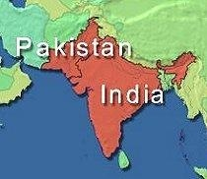

Slide 3
HISTORICAL BACKGROUND
Food practices of India, Pakistan, & Bangladesh similar
– Differences in religious beliefs & practices
More than 6 different religions practiced in India
Many variances in foods throughout the very large geographic area of India
More than 850 languages & dialects spoken, including Hindi (official language) & English

Slide 4
INDIANS IN THE U.S.
Among the fastest growing ethnic groups in the U.S.
– Largest population groups in the
Northeast (35%); South (24%) and West (23%) of this population group
– Population group relatively affluent
Many professionals, small business owners, managers
Very prevalent in U.S. hospitality industry

Slide 5
Traditional Beliefs
Holy Vedic Scriptures (basis of Hinduism—believed to be ageless)
  Categorize commonly used foods
  Emphasize connection between foods, moods, fitness and longevity of life
  Three major categories of foods, depending on kind of mind-altering, mood-provoking, and physiological influences they are believed to exert

Slide 6
Traditional Beliefs
Food Categories:
  Sattvic Foods (milk, dairy products, rice, wheat, ghee, most legumes, some vegetables)
    Believed to make person serene, enlightened, healthy, and long-lived
    Calling someone “sattvic” is a high tribute
  Rajasic Foods (some meats, eggs, very bitter, sour, salty, rich, and spicy foods)
    Believed to make person aggressive, acquisitive, passionate, and have a desire for power

Slide 7
Traditional Beliefs
Tamasic Foods (garlic and pickled, preserved, stale or rotten foods, alcohol & drugs used in excess for pleasure)
  Believed to contribute to lust, malice, confusion, slothfulness, and dullness in a person
Yoga (meaning to “rein in” or “tune” the body) held in high esteem
  Consists of structured exercises and body positions; mental exercises and meditation to relieve from daily stresses; controlled leisure activities

Slide 8
Traditional Beliefs
Ayurveda (Code of life and longevity):
  Classical system of Indian medicine practiced yet today
  Body and foods can interact to preserve a homeostatic harmony or cause imbalance
  Ayurvedic remedies prescribed for various ailments ( i.e. colds, coughs, constipation, stomach pains)

Slide 9
Traditional Beliefs
According to Ayurveda beliefs
  Kapha Foods (white sugar, millet, buttermilk) are thought to be:
    Heavy, dense, mucus-producing
    Avoided by persons with respiratory ailments
  Vata Foods (gas-producing like legumes)
    Thought to be unpredictable
    Avoided during states of distension

Slide 10
Traditional Beliefs
Ushna (“Hot”) Foods (black mung beans, cowpeas, ripe eggplant, papaya)
  Believed to promote digestion
Seeta (“Cool”) Foods (cereals such as rice, wheat, mung beans, kidney beans, most fruits and vegetables, milk from most animals except goats, butter, and ghee)
  Impart strength and nourishment

Slide 11
Traditional Beliefs
Moderation is advocated, even when eating the proper foods
  Obesity is NOT favored
  Solid food should fill ½ the stomach
  Liquids should fill ¼
  Remaining ¼ left empty for smooth digestion

Slide 12
Vegetarianism
Vegetarianism, derived from religious beliefs, is commonly practiced
  Based on tenet of “ahimsa”, or a reverence for all life
  Jains, Hindus, and Buddhists all subscribe to “ahimsa” belief
  BUT Jainism only major religion in the world that is unconditionally vegetarian
  Lactovegetarian diet widely practiced
  Lacto-ovo vegetarian and vegan diets followed by some, but a lesser number of persons
  Non-vegetarians eat vegetarian meals on auspicious or religious occasions
    True for most areas; meat &/or fish allowed on these occasions in some areas

Slide 13
Vegetarianism
Beef Consumption Forbidden
  Cow considered a “cosmic symbol”—a “universal mother”
  Is a sustained supply of dairy products in a largely vegetarian diet
  Flesh foods ( other than beef) often an accompaniment to a starch, i.e. rice or bread

Slide 14
Other Religions
Sikh faith does not prohibit eating meat, but:
  Sikh diet in villages primarily vegetarian
  Includes occasional meat
  Includes wide assortment of lentils & other legumes
  “Langar” (or community meal)- Sikhs uphold equality of all people
    Eat a vegetarian meal so that they offend no one
Parsi’s (Zorastrian) faith- follows mainly non-vegetarian diet
  Dishes include eggs, fish, shrimp, chicken, or goat
  Believe in charity
  Symbols of fertility (like eggs) placed on tray with raw rice, coconut, fresh flowers, and oil lamps

Slide 15
Other Religions
Christians & Jews follow
  Regional food practices
  Use spices and condiments while retaining own beliefs and traditions
Muslims in India and Pakistan
  Follow the Islamic food laws
    Some local and regional variations
    Practices parallel those of the Muslims in the Middle East

Slide 16
Food Traditions
Fasting common in both India and Pakistan
  Also common among U.S immigrants
Spices and condiments synonymous with Indian and Pakistani cuisine
  Kinds used vary with the dish, geographical region, and purpose
Uses of spices and condiments
  Preserve food from spoilage in hot climates
    Salt Chilies
  Increase flavor—highly aromatic cuisine
    Garlic Cumin Asafetida
    Asafetida—a resin with a sharp smell, used in small quantities

Slide 17

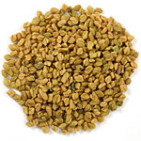

Food Traditions
Spices used for medicinal value-
  Diluted buttermilk with a pinch of salt and asafetida—taken for indigestion
  Fresh ginger—reduces distension
  Fenugreek (methi)- believed to help control diabetes
  Dried neem tree flowers, taken with rice and scalding ghee—help with diarrhea
  Turmeric- used as an antiseptic
  Fenugreek seeds- used to promote lactation

Slide 18

Food Preparation
General method of seasoning food:
  Oil heated in a skillet
  Appropriate condiments and spices are added and cooked to intensify flavors
  Mixture then added to cooked entrée or side dish
  Commonly used spices and flavorings: Caraway seeds, cayenne, cloves, chilies, bay leaves, cardamom, cinnamon, coriander, mace, mustard seeds, nutmeg, onion seeds, black pepper, saffron, sesame seeds, pomegranate seeds, tamarind
Masala: Mixture of spices and herbs– can be either fresh and wet or dried and powdered
Boiling, stewing, and frying most common forms of cooking

Slide 19
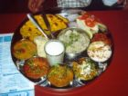
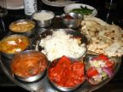
Current Food Practices
Eating is a vital part of the social matrix of India and Pakistan
  Refusing a host’s offering or a host’s not offering foods is a social affront
  Cuisine includes wide variety of snacks and desserts for social occasions
  Many traditional snacks high in fat, sugar, or salt
  Mixed dish entrees are a prominent feature of the cuisine
    Vegetables cooked with grains, legumes, or other vegetables
    Milk and milk products with vegetables or fruits
    Legumes or grains with meat, poultry and seafood
  Meals served on plates of brass, stainless steel, or silver
      Small bowls hold different condiments, or freshly cut banana leaves

Slide 20
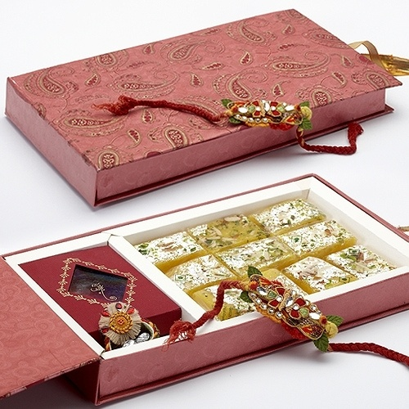
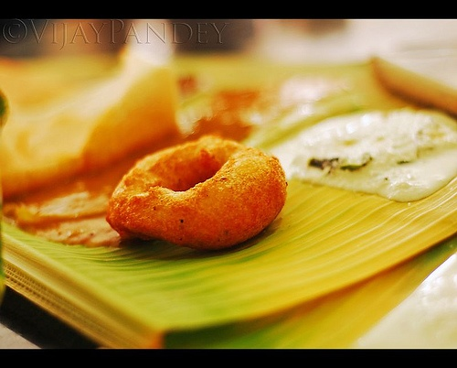
Current Food Practices
Freshly cut and washed banana leaves serve as plates for festive or religious functions
Boiled rice usually accompanies all courses in a meal
Gifts of sweets an important tradition

Slide 21
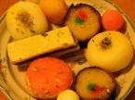

Current Food Practices
Reduced- milk desserts predominate
  Made by gently evaporating whole milk until its sugars are cooked without burning in dishes of varying sweetness, color, and consistency
  Sugar, condiments, or fat may be added
  Alcoholic beverages traditionally unacceptable all over India, but immense rise in popularity now
    Forbidden in Islam
    Prohibition lifted in the last thirty years

Slide 22
Current Food Practices
Most meals include the following:
  Homemade bread (made just before or as the meal is served)
  Rice
  Legumes (dhal) –also known as curry
  Meats, poultry, fish and eggs for non-vegetarians
  Fried wafer (papad), chutney, pickle, salad
  Salt placed in one corner for optional use
  Desserts (largely from reduced milk; other bases include grains, lentils, and nuts)
  Spiced tea or coffee
  Mouth fresheners like betel leaves and fennel seeds

Slide 23
Current Food Practices
A ritualistic practice
  Wash hands and rinse mouth prior to and after meals
Bread (Roti) is eaten daily
  Chapatis (Roti)– whole wheat flat breads cooked on a griddle without oil
  Puris– fried breads
  Paratha– another fried bread used to wrap spiced vegetable fillings
  Curry: a term referring to a basic powder of different spices
    Can be stir-fried vegetables- especially in south of India
    Gravy with meat or vegetables

Slide 24
Current Food Practices
Wheat– the staple of the North
Rice– the staple of the South
  Both may be eaten within the same meal through out India
Dhals– A generic term for hulled, split pulses or legumes, like mung beans. The main varieties are toor (red gram), mung (green gram), mungo (black gram), and channa (split pea). Soaked and blended dhals used in many dishes
Tea flavored in the North; Coffee in the South
  Spiced sweetened tea is the beverage of choice at any time of the day

Slide 25
Pakistani Food Practices
Archaeological evidence indicates culinary, baking and brewing arts highly developed here 5000 years ago
  People often ate oven-baked bread and wholesome foods
Culinary arts underwent change under Moghul rulers a few centuries later
Moghul style of cooking includes dishes prepared with:
  Lamb, mutton, goat and chicken
  May or may not contain grains and/or vegetables
  Wheat, rice and corn are staples of the diet
    Wheat used commonly to make the fresh homemade breads (rotis, parathas, nans etc)

Slide 26
Pakistani Food Practices
Cracked wheat eaten as hot cereal cooked in milk or water
Rice becoming popular as pulao ( with vegetables or meat)
  Young children, elderly, and the ill are given soft, overcooked white rice as it is considered to be easily digestible
Corn rotis seasoned with mustard greens and fresh butter eaten in rural areas
Millet and sorghum used frequently
Variety of legumes eaten as dhal
Chickpea flour used as an ingredient in a variety of foods, including batter for frying vegetables, meats, poultry etc

Slide 27
Pakistani Food Practices
Meat well liked, but cost may be high– chicken, lamb, and goat popular
Grilled meats (kebabs), casseroles (kormas), minced, deep-fried kofta dishes are some of the meat delicacies in the cuisines
  Kofta– Round, deep fried fritters made of cheese, vegetables and gram flour, soaked in gravy
Fish is expensive, but is consumed in coastal cities
Dahi (yogurt), lassi (a diluted yogurt drink), milk, and paneer (homemade cheese) are some of the commonly consumed dairy products

Slide 28
Pakistani Food Practices
Nuts– pistachios, almonds and pine nuts commonly used
  Usually eaten in winter months
  Used in desserts
  Used in preparation of rice, meat, or vegetable dishes
Fats, such as cream, ghee, vanaspati (hydrogenated vegetable fat), oils from corn, sunflower seeds and mustard seeds used
Drink tea with milk and sugar
Alcohol prohibited and forbidden by Muslim law
Large variety of herbs, spices, onions, garlic, and fresh/ dried ginger used

Slide 29
Pakistani Food Practices
Gifts of sweets an important marker of transitions (weddings, festivals)
Traditionally, both foods and beverages served to visitors

