Slide 1
Minoan Crete and
Ancient Greece
Religion and Philosophy
Mysticism and Esotericism

Slide 2
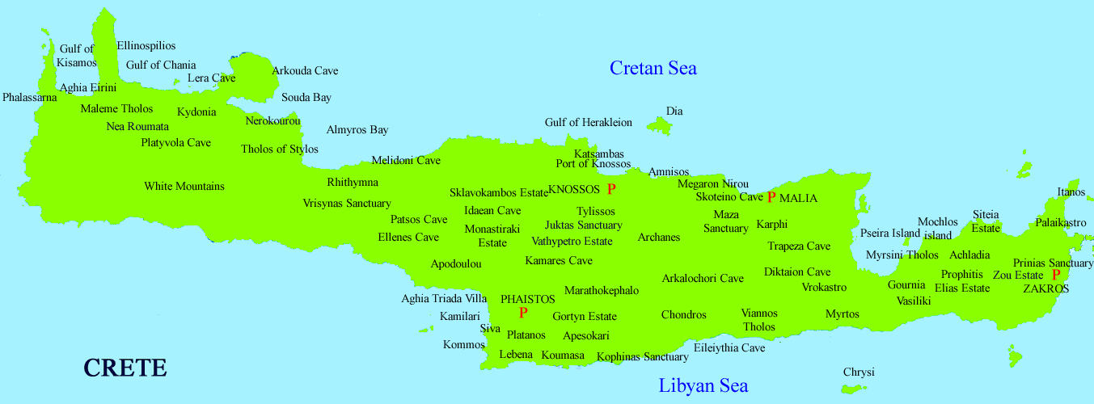
Map of Minoan Crete

Slide 3
Background: Minoan Crete
Advanced to full urban culture, often credited with being the first urban culture in Europe
Palace-cities of Knossos, Phaistos, Zakros flourished from 1700-1375 BCE; Knossos destroyed 1375 BCE
Collapse of Minoan culture due to combination of external invasion and frequent volcanic irruptions and earthquakes

Slide 4
Achievements: Minoan Crete
• Palaces point to affluence: large public spaces, ample and comfortable dwellings;
• Women and men both had social and political power;
• Fertility of the land and plenitude of trade discouraged militarism, encouraged local (decentralized) urban government;
• Frescoes, in their color and buoyant playfulness, convey a basic sense of optimism.

Slide 5
Minoan Crete among Urban Cultures
Minoan Crete is unusual among urban cultures for its lack of concern with military matters, its optimistic art forms, its female-inflected religious artifacts, and its exuberant joie de vivre.
These characteristics have led to speculation that Minoan Crete is a transition from smaller-scale agricultural societies that were matrifocal in their religion and social structures

Slide 6
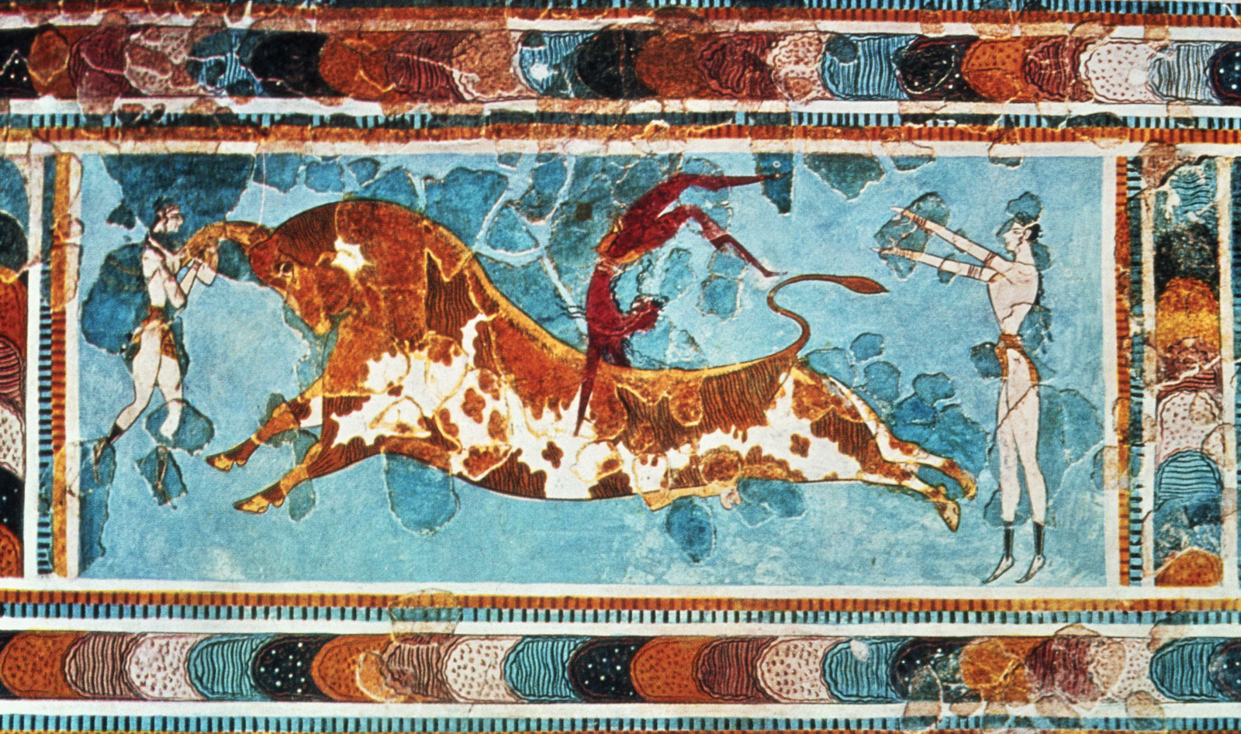
Bull-jumping (Fresco at Knossos)

Slide 7
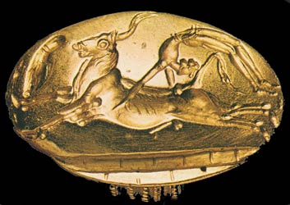
Bull-leaping
Bulls were venerated, connected to fertility, youth & strength
The act of young acrobats, to (literally) grab the bull by the horns and leap over it, appears to be an exuberant display of vitality.
Both men and women participated

Slide 9
DO NOT TRY THIS AT HOME!! THESE WERE TRAINED PROFESSIONALS!! YOU’VE BEEN WARNED!!

Slide 10
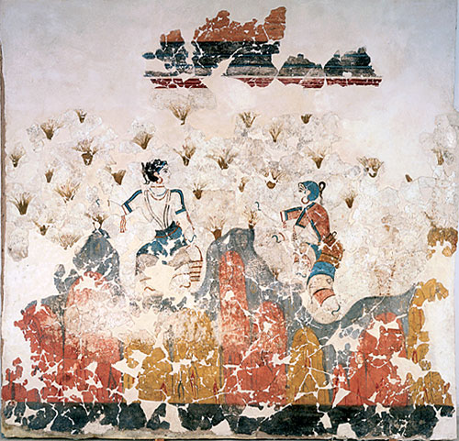
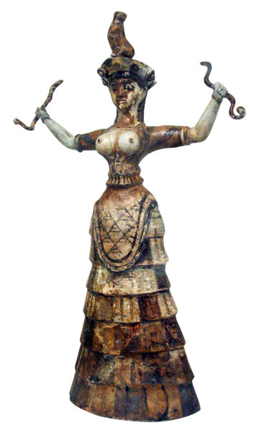
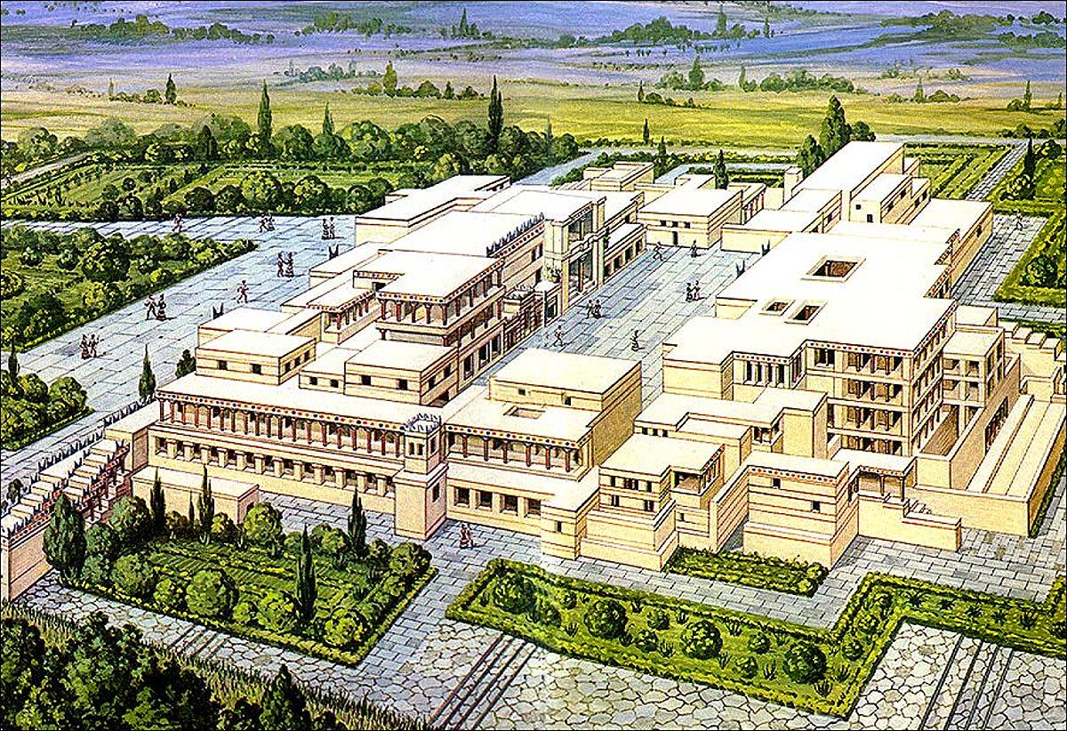
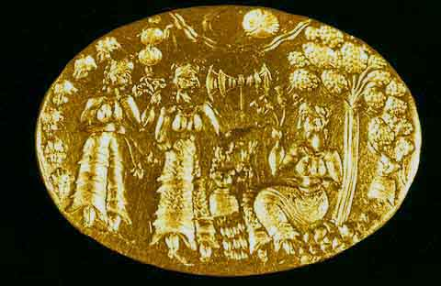
Minoan Art Forms: Fresco, Statuary, Signet Ring, Architecture
Written documents have not yet
been deciphered, so the religion
of Minoan Crete must be studied
through visual artifacts

Slide 11
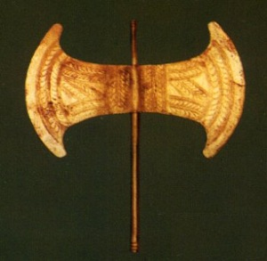
Characteristics of Minoan Art
Use of bright colors
Combination of stylization and naturalism
Recurrent symbolism: labrys, bull horns, goddess with animals

Slide 12
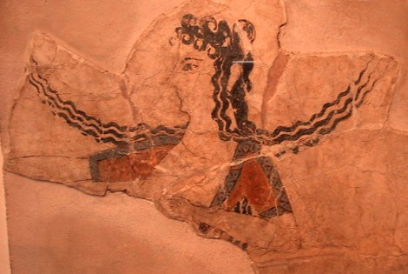
Minoan Art
People are shown as self-confident, interactive with each other, generally happy and contented

Slide 13
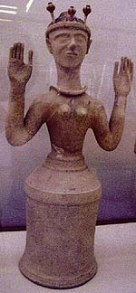
Minoan Goddesses
Most statuary figures are female
These women/goddesses often hold animals, or have attributes in their hands or on their heads
Poppy goddess to the left, Snake goddess to the right

Slide 14
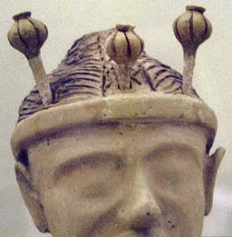
Minoan Religion and Altered States
Religions are often keen to induce visions and access to sacred realms through altered states of consciousness.
Poppy seeds and other hallucinogens were
sacred and used in rituals.

Slide 15
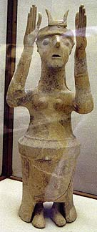
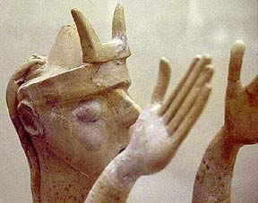
Minoan Religion and Symbolism
This goddess (or priestess) wears stylized bull horns on her head.
The meaning of the bull horns is uncertain

Slide 16
Minoan Religion and Symbolism
The labrys is a double-edged ax
However, the labrys found from Minoan Crete are made of a metal too soft for effective military use; they appear to be ritual objects rather than serious weapons
Speculative meanings include the duality of life and death; seeing the labrys as simultaneously a weapon and a highly stylized butterfly; the idea that the labrys is a female parallel to bull’s horns.

Slide 17
Ancient Greece
Greek City-States are independent powers that flourished in the Mediterranean area from 1200 BCE to conquest by the Romans in 146 BCE
The Golden Age of Athens runs from about 550-404 BCE
Alexander the Great extends Greek influence during his years of empire building, 336-323 BCE
Greek cultural influence remained crucial throughout the time of the Roman empire, especially in the realm of philosophy

Slide 18
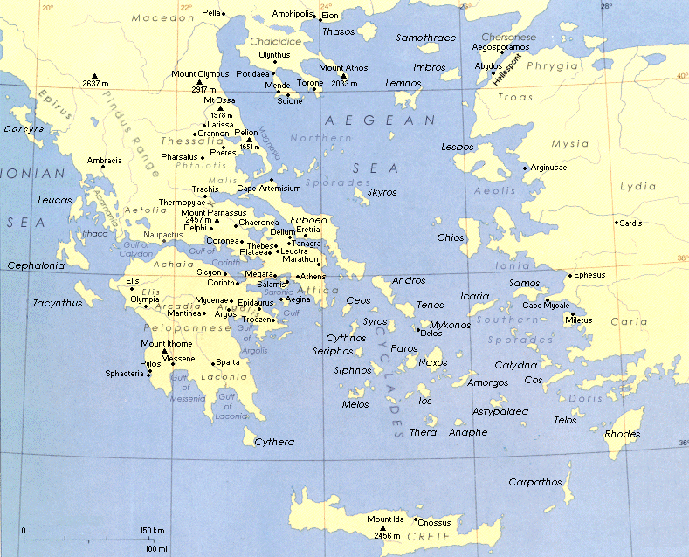
Ancient Greek World

Slide 19
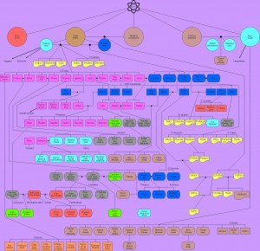
Now that’s a pantheon!

Slide 20
The Olympian Gods
The Big Twelve:
Zeus
Poseidon
Apollo
Hera
Artemis
Aphrodite
Athena
Ares
• Demeter
Hephaestus
Hermes
Hestia
And a few more:
Hades
Persephone
Dionysus
Prometheus

Slide 21
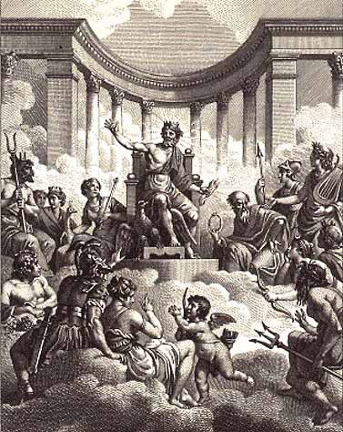
One Happy
Dysfunctional
Family
Gods pictured here, from Zeus, clockwise
Zeus, Cronos, Athena, Apollo, Hermes, Artemis, Poseidon, Eros, Aphrodite, Ares Dionysius, Hades, Rhea, Hestia, and Hera

Slide 22
The Olympian Gods
• Demeter – Harvest, Grains
Hephaestus - Crafts
Hermes - Messenger
Hestia – Home/Hearth
And a few more:
Hades – Underworld/Death
Persephone – wife of Hades, also brings Spring
Dionysus – Wine, Pleasure
Prometheus – bringer of fire
The Big Twelve:
Zeus – King of the Gods
Poseidon - Sea
Apollo – Balance, Music
Hera – Queen of Gods
Artemis – Virgin, Hunter
Aphrodite - Beauty
Athena - Wisdom
Ares - War

Slide 23
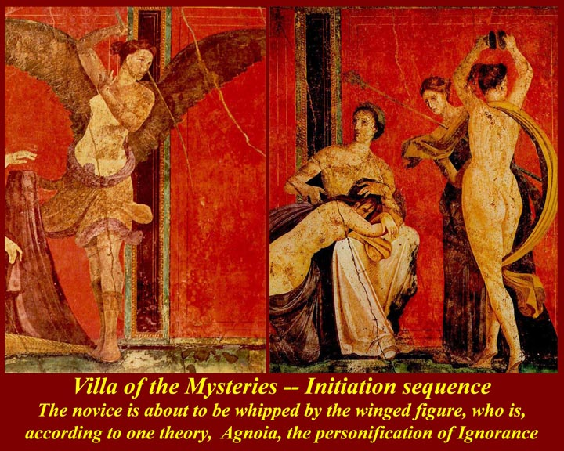
Dionysian Mystery Religion
Estoric initiatory religious practice
Coming-of-age rites
Fertility of vine for wine
Altered states of consciousness induced
Meal of bread and wine celebrated
Dionysian Mystery Religion existed in both Greece and Rome

Slide 24
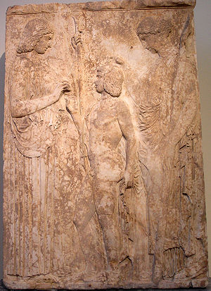
Eleusinian Mystery Religion
Esoteric initiatory religious practice based on myths of Demeter and Persephone
Continuation of Goddess worship from Minoan Crete
Fertility of grains
Altered states of consciousness induced
Concepts of resurrection and immortality

Slide 25
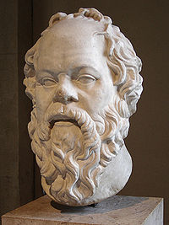
Socrates (449-399 BCE)
Significant thinker, teacher, and gadfly in Western philosophy
Uses dialectic method of question-and-answer
Plato’s teacher
Executed for “corrupting the youth” = helping them think for themselves
“The unexamined life is not worth living” (Apology)

Slide 26
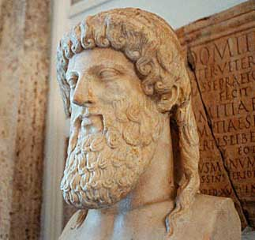
Plato (427-347 BCE)
Author of philosophic dialogues, most featuring his teacher, Socrates
All we know on earth is a pale imitation of the Perfect Ideas above
We should always look to the macrocosm to understand the microcosm

Slide 27
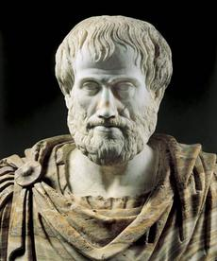
Aristotle
(428-348 BCE)
Author of philosophical treatises dealing with topics from science to ethics to meta-physics
Postulated the need for a divine enabling force, the unmoved Mover
Student of Plato, but diverged from his thought
Maintained philosophy should start from the physical world, not from the divine
Tutor to Alexander the Great

Slide 28
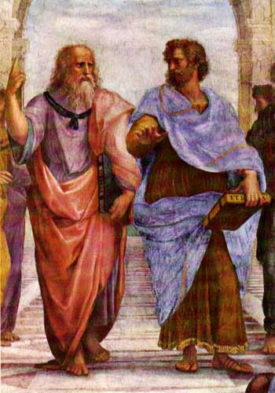
Platonism and Aristotelianism
These two schools of thought were rivals from the beginning until even today
Much of Western philosophic thought, and religious thought, uses either a Platonic or Aristotelian framework
From Raphael’s School of Athens

Slide 29
Platonism and Aristotelianism
Plato turns to the realm of the Ideas, looking up
Aristotle looks to actual existing things, looks earthward
From Raphael’s School of Athens

Slide 30
Platonism and Aristotelianism
While both are concerned with theology, Platonism has been more significant in the history of mysticism and spiritual experience, while Aristotelianism has been more significant to ethics and the interplay between science and religion
From Raphael’s School of Athens

Slide 31
Platonism and Aristotelianism
Both thinkers wrote about political philosophy, gender relations, education, science, cosmogony, and cosmology
Their works were known to Jewish, Christian, and Muslim thinkers, and, along with Neo-Platonism, were quite influential
From Raphael’s School of Athens

Slide 32
MYSTICISM
Direct Contact or Union with the Divine
Spiritual Virtuosity
Experiential Goal of Religion

Slide 33
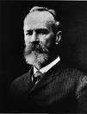
William James’ Four Qualities of Mystical Experiences
Ineffability
Noetic Quality
Transience
Passivity
William James, American psychologist and theorist of religion, 1842-1910

Slide 34
Ineffability
An experience can be described as ineffable when words are unable to express its essence and/or complexity. It has two shades of meaning.
Something which is ineffable may exceed the capability of language to describe it (“oh, wow!” moments)
Something which is ineffable may also be a spiritual secret which is demeaned by sharing it wantonly with others (why we disapprove of those who “kiss-and-tell”).
Ineffability, or claims thereof, may be an elaborate subterfuge, or a highly coded, esoteric use of words. Paradox and apparent contradiction are literary techniques employed to achieve ineffability even in the midst of volubility.

Slide 35

Consider the two meanings of ineffability in this excerpt from the African Methodist-Episcopal preacher Jarena Lee (ca. 1810, writing this account in 1847):
“a new rush of the same ecstasy came upon me, and caused me to feel as if I were in an ocean of light and bliss.
During this time I stood perfectly still, the tears rolling in a flood from my eyes. So great was the joy, that it is past description. There is no language that can describe it, except that which was heard by St. Paul, when he was caught up to third heaven, and heard words which it was not lawful to utter.”
(Mysticism a.k.a. “oceanic feelings” in the psychology of religion)
Reference to 2 Corinthians 12

Slide 36
Noetic Quality
Noetic, related to gnosis (Greek), Inanna (Mesopotamian), jñana (Sanskrit), and our word “knowledge”
Technically the word means something apprehended by, or pertaining to, intellect
Mystical experiences generate a specific kind of knowledge - cosmological insight. They generally claim to reveal a/the truth about how the universe is organized.

Slide 37
Transience
Mystics do not (at least to our knowledge) attain and then permanently retain this intensity of experience

Slide 38
Transience
Mystics do not (at least to our knowledge) attain and then permanently retain this intensity of experience
(you know how they warn you against “erections lasting more than four hours” on Viagra commercials? It’s like that).

Slide 39
Transience
The temporary quality of the mystical experience makes it quite suitable to literary treatment, either in the distilled form of poetry, or as a key episode in the life of a fictional character in prose.

Slide 40
Transience and Action
The transience of mystical states can also be interpreted, and often is by mystics in ethically-motivated religious traditions, as necessitating a return to the world, to share your insights and to live the truth you’ve glimpsed/grasped. Richard of St. Victor, a Christian saint, extends bridal mysticism’s metaphors to childrearing: the mystic “abandons ecstatic union to return to service to others,” willing even to surrender the presence of the Beloved.

Slide 41
Passivity
Passivity is used by James to describe the ways in which the mystical experience occurs, in its greatest intensity, without the active will of the mystic (no matter how actively they have prepared for this moment).
Loss of clear ego-boundaries on the part of the mystic would be another way of expressing this dimension.
Ralph Waldo Emerson describes it thus: “All mean egotism vanishes.”

Slide 42

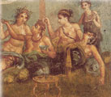
The Rivalry Between
Decorum and Chaos
Religions build themselves around powerful experiences, and experiences of power.
Religions make a cosmological decision to embrace sexuality as an ally, or regulate it as a potential enemy or rival.

Slide 43

Decorum
Some synonyms for decorum: stately – majestic – dignified – solemn – respectful – staid – sober – formal.
Many (but not all) religions that stress decorum have a strong emphasis on ritual.
Religions concerned with decorum are often trying to mirror the transcendence, majesty, and dignity of the divine.
Religions concerned with decorum are often suspicious of the sensual and the sexual.

Slide 44
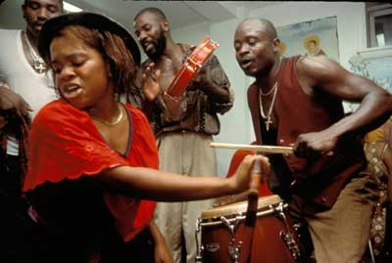

Chaos
Some synonyms for chaos: emotional – feeling – expression – immediacy – urgency — momentous — sensual — energetic — letting loose
Many (but not all) religions that stress chaos use ritual as a gateway to other experiences
Religions concerned with chaos are often trying to enter into the energy of the divine.
Religions concerned with chaos are often allied with the sensual and the sexual.

Slide 45
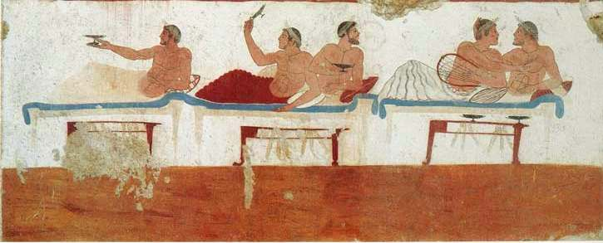
The Symposium
In Ancient Greece, a symposium was a social dinner-and-drinking gathering among friends, where both intellectual and frivolous ideas and activities could be entertained

Slide 46
The Symposium
Plato’s dialogue, The Symposium, tells the story of such an evening, meant to celebrate the recent prize-winning work of a young playwright, Agathon
The dialogue turns to definitions of Love, and a discussion of how Socrates’ teacher, Diotima, conceived of the goal of philosophy: a vision of what is truly real and truly beautiful

Slide 47
The Symposium
Complex literary structure of multiple frames
  Outer frame consists of Apollodorus, a friend of Socrates, telling Glaucon, a businessman, what was said at the Symposium
  Apollodorus heard the stories from Aristodemus

Slide 48
The Symposium
Complex literary structure of multiple frames
  The speeches in the dialogue
    1) Phaedrus – student of Plato’s, love enobles us
    2) Pausanius – Agathon’s lover, stresses loves social role
    3) Eryximachus – pedantic doctor, argues for moderation
    4) Aristophanes – comic playwright; halved humans strive for unity
    5) Agathon – the celebrated host, sets up naively perfect ideal of love
    6) Socrates – embarrasses Agathon, but admits to same youthful errors
    7) Diotima (in absentia – not present in the room) – Love’s Ladder = Mysticism of Ascent
    8) Alcibades – young, impetuous man here; reports on his attempt to seduce Socrates – he later becomes an infamous general and traitor in Athenian history

Slide 49
The Symposium
Complex literary structure of multiple frames
  Diotima’s speech is, therefore
    1) reported second-hand by Socrates
    2) at the climax of a long night of speeches
    3) followed by the impetuous Alcibiades
    4) all of the speeches being reported by Aristodemus to Apollodorus Apollodorus heard the stories from Aristodemus
    5) Appolodorus now retells the stories to Glaucon
Diotima’s speech, like the vision of the Good and the Beautiful, will take many stages to reach, even if understood conceptually
  Spiritual discipline
  Philosophic rigor and telos (goal)

Slide 50
The Symposium
What are the reasons for its significance in religious, philosophic, and literary history?
Why is Diotima a woman?
Is Diotima an historical character?

Slide 51
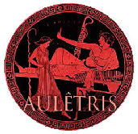
“We dispense with the services of the flute girl…and let her go and play to herself or to the women inside there…while we spend our evening in discussion…” (176e)
Aulêtris, or flute girl, was a slave who performed music and sexual favors for those at a gathering like the symposium.
Distinct from the heteirea, who were sophisticated courtesan companions.

Slide 52
Diotima
Socrates introduces her by saying, “I would rehearse a tale of love which I heard from Diotima of Mantineia, a woman wise in this and in many other kinds of knowledge….She was my instructress in the art of love, and I shall repeat to you what she said to me.”
Mantineia means “place of prophecy”
Socrates credits her with delaying a plague from striking Athens

Slide 53
Diotima’s teachings: opposites are not absolutes
Diotima first suggests to Socrates that there is something between opposites:
“Hush, she cried; must that be foul which is not fair? And is that which is not wise, ignorant? Do you not see that there is a mean between wisdom and ignorance?”
“And what may that be?” Socrates asked
“Right opinion, she replied; which, as you know, being incapable of giving a reason, is not knowledge,” but is not ignorance, either.

Slide 54
Diotima’s teachings: general opinion is not correct
Socrates says, “Love is surely admitted by all to be a great god.”
Diotima replies, “By those who know or by those who do not know?”
Socrates says, “By all.”
“And how, Socrates, she said with a smile, can Love be acknowledged to be a great god by those who say he is not a god at all?”
“And who are they?”
“You and I are two of them, she replied.”
Diotima now points out that Love is not a God, or perfect (as Agathon had said), but strives after the Good, for lack of the good

Slide 55
Diotima’s teachings:
Love is the Child of Plenty and Poverty
Fanciful descent of love from Poverty’s seduction of the drunken Plenty
Love is always wanting, always striving
“The truth of the matter is this: No god is a philosopher, or seeker after wisdom, for he is wise already; nor does any man who is wise seek after wisdom. Neither do the ignorant seek after Wisdom.”
Socrates asks “But who then, Diotima, are the lovers of wisdom, if they are neither the wise nor the foolish?”
“A child may answer that question, she replied!”

Slide 56
Diotima’s teachings:
Love is like Us
The lovers of wisdom are neither the wise nor the foolish: “they are those who are in a mean between the two….For wisdom is a beautiful thing, and Love is of the beautiful; and therefore Love is a also a philosopher, or lover of wisdom, and being a lover of wisdom is in a mean between the wise and the ignorant.”
Love wants to create – pro-create, and creativity in artistic, athletic, poetic, and all other ways
Love wants to possess the beautiful eternally – having children is a kind of immortality, gaining fame is immortality, but grasping the beauty of ideas is, too.

Slide 57

Mysticism of Ascent: Diotima’s Teachings
Vision of the One/Sacred/Divine
Beauty of Knowledge
Beauty of Laws & Institutions
Beauty of the Soul
Beauty of One Body ----> Beauty of All Bodies

Slide 58
Diotima’s teachings:
Vision of the Good
Reaching the ultimate on this ascent, Diotima says the lover of wisdom “arrives at the notion of absolute beauty, and at last knows what the essence of beauty is. This, my dear Socrates, said the stranger of Mantineia, is that life above all others which man should live, in the contemplation of beauty absolute;…in that communion, beholding beauty with the eye of the mind, he will be enabled to bring forth, not images of beauty, but realities (for he has hold not of an image, but of a reality), and bringing forth and nourishing true virtue to become the friend of the divine and be immortal, if mortal man may. Would that be an ignoble life?”

