Slide 1

Christian History 500-1517
The Middle Ages
Schism, Hierarchy, Crusades
Mysticism, Philosophy

Slide 2
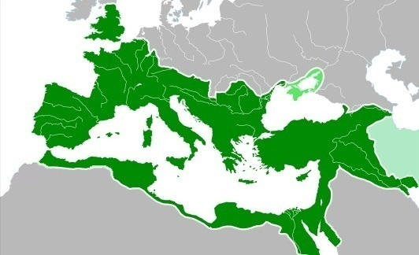
Roman Empire 117 CE at its greatest extent

Slide 3
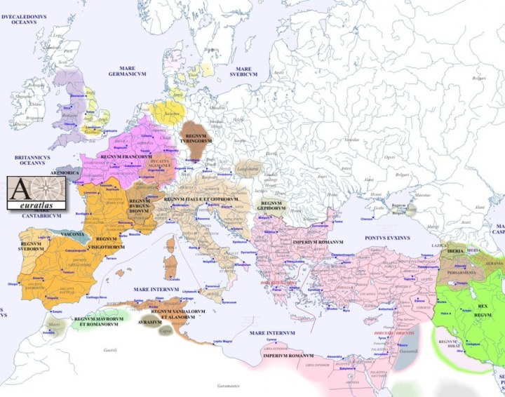
Europe around 500 CE

Slide 4
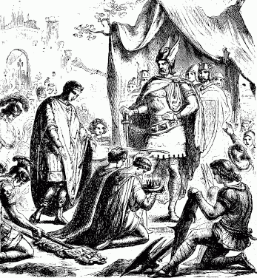
Fall of Rome
476 CE traditional date for fall of Western Roman Empire (last Emperor surrenders)
The Catholic Christian Church, built around the pope in Rome, provides continuity
Catholic church provides structure, order
Catholic church maintains literacy and learning

Slide 5
Pope Gregory I (r. 590-604) a.k.a. St. Gregory the Great
Pope who organized the Church post-empire
the first pope of the Middle Ages
Encouraged proselytizing in distant places, such as England
Had lived as a monk, would have preferred to return to monastery but elected Pope instead!
Understood that there would have to be visual theology: “Illiterate men can contemplate in the lines of a picture what they cannot learn by means of the written word.”

Slide 6
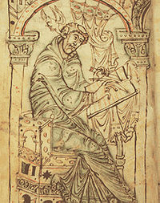
Gregory the Great & Gregorian Chant
Tradition credits Gregory with writing the main body of chants used in the Catholic Church, inspired by the Holy Spirit (the dove at his ear)
What scholars know is that Gregory reformed the rituals, known as the liturgy, of the Church

Slide 7
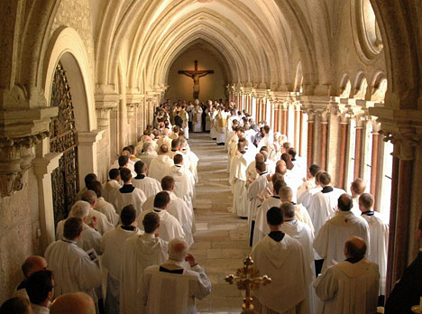
Chanting is a Form of Heightened Speech
Chanting of a text demands a higher level of attention to that text, on the part of both listeners and singers.
Chanting of a text slows delivery of text content; this allows time for reflection and internalization of text.

Slide 8
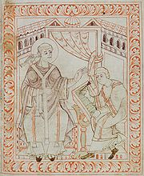
Gregorian Chant
Gregorian chant is the predominant chant form in Western Christianity.
Traditionally attributed to St. Pope Gregory the Great, this attribution is now widely doubted by scholars
The Gregorian Chant repertoire develops from 8th to 13th centuries
First major world repertoire to be preserved through a consistent, reproducible form of notation.

Slide 9
Gregorian Chant
The Holy Spirit, as a Dove, inspires St. Gregory; note also the scribe taking it all down!

Slide 10
Dies Irae
Dies irae! dies illa
olvet saeclum in favilla
este David cum Sibylla
Day of wrath! O day of mourning! See fulfilled the prophets' warning, heaven and earth in ashes burning!
This poem and its chant have become a stock representation of the Middle Ages
Reference to Zephaniah 1:15 (minor prophet)

Slide 11
The Papacy
The office of the Pope is called the Papacy.
The adjectival form of Pope is Papal, as in Papal authority, or Papal States, or Papal robes, etc.
The Popes had immense power and authority throughout Western Europe for the next 900 years, until the Reformation
They could take action against secular leaders (Kings, judges, military leaders) when the leaders were not being true to the church – or the church’s interests

Slide 12
Monasticism
Christianity had developed a monastic tradition
Asceticism + communal living for discipline
St. Benedict of Nursia (480-547) wrote “The Rule of St. Benedict” (ca. 540), setting rules for the community, to enhance spiritual growth while not allowing either the excesses of individualism or the laziness of shirking within a community
Monasticism became a structural part of medieval Christianity

Slide 13
Byzantine Empire and
Eastern Christianity
Justinian, Emperor in the East (b. 482, r. 527-565)
Establishes Constantinople as center of secular world, and a Christian religious center to rival Rome
Builds the Hagia Sophia in 530s
Builds Monastery at Mt. Sinai in 560s
Pattern of close relationship between secular leader and religion established
Constantinople affected by rise of Islam in 7th century, much more than Rome

Slide 14
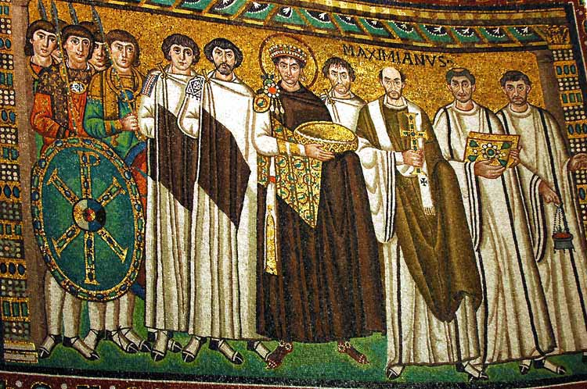
Justinian and the Unity of Church and State

Slide 15
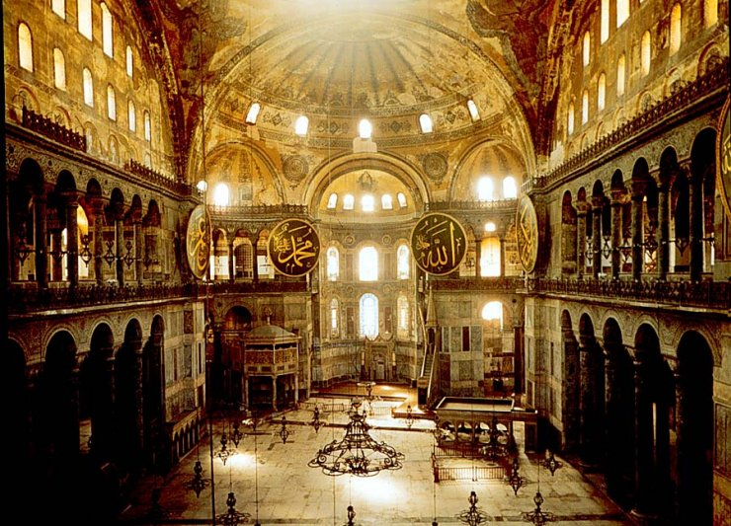
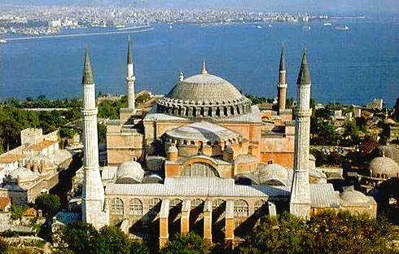
Hagia Sophia
Interior, Hagia Sophia
External, Hagia Sophia

Slide 16

Charlemagne (742-814) & Centralized Control
Political parallel to Pope Gregory the Great
Stalls Muslim advance, protecting Europe for Christianity
Regularizes laws, relation of church and state, and even takes part in ensuring regulation of church rituals and music

Slide 17
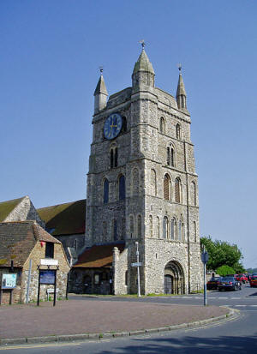
Building Projects
Monasteries, Churches, Tombs of Saints, and other building projects provided kings and military leaders with ways to patronize the church.
New Romney Church in England, a Norman building, resembles a castle

Slide 18
1054: Schism between West and East
Final split between Eastern Orthodox and Roman Catholic Christianities happens in 1054
Pope Leo IX and Patriarch Michael I excommunicated each other!
Long-raging theological dispute about the Trinity, known as the filioque, also key to split
Eastern Church said Holy Spirit came through the Father; Western Church said Holy Spirit came through the Father and the Son

Slide 19
Sainthood and Canonization
Saints are people who exemplified some aspect of Christian ideals when alive, and, according to the Catholic church, can work miracles after their death
Saints are central to popular piety in Catholicism
The most important saint is Mary, the Mother of Jesus

Slide 20
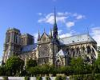
Devotion to Virgin Mary
Marianism, Mariology are technical names for the philosophy of, and devotion to, Mary
Devotion to Mary was a hallmark of late medieval Christianity
Notre Dame in Paris

Slide 21
The 12th Century Renaissance
In the 12th century (1100s), vast changes happened in medieval Europe
Advances in architecture, warfare, philosophy, mysticism
Establishment of the first universities in Europe (University of Bologna 1088; Oxford University 1096; University of Paris 1150)
Scholasticism in philosophy: more abstract, more open to scientific advances than earlier Platonism and Augustinianism

Slide 22
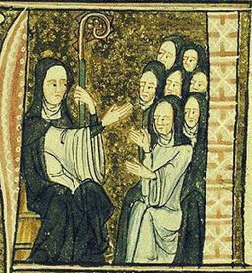
Hildegard of Bingen (1098-1179)
German Abbess
Mystic
Music Composer
Visual Artist
Founder of four Abbeys for Women
Medical Researcher
Author
Medieval Christianity, while strictly patriarchal, provided many roles to women

Slide 23
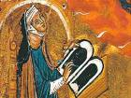
Hildegard von Bingen (1098-1179)
German nun and abbess
One of the intellectual giants of her time, she was a mystic visionary, healer, visual artist, and composer.
She wrote her monophonic music for the nuns in her convent.

Slide 24

Hildegard von Bingen:
Potent Representative of Those who are Hidden from History!
Hildegard’s fame in our own time makes her the crown jewel of feminist compensatory history.
Compensatory history is the search for members of previously marginalized groups, whose history has been ignored, erased, or devalued.
The textbooks I read in college, authored in the mid 1970s, did not even mention her once! She is now perhaps the best-known medieval composer besides Machaut.

Slide 25
Hildegard: Symphony of Virgins
O sweetest lover, you sweetest embracer:
help us to guard our virginity!
We are born of dust,
and alas, alas, in Adam’s sin.
It is very hard to refuse
what tastes like the apple.
Set us upright, savior Christ.
We ardently long to follow you.

Slide 26
St. Francis of Assisi (1182-1226)
Starts a new order of priests, dedicated to Christian poverty and preaching in the manner of Christ’s apostles
Well-known for his love of nature and of all God’s creatures
Supported the Crusades
Rebelled against his father to become a priest
Supported a parallel movement of nuns by St. Clare of Assisi

Slide 27
High Middle Ages Mysticism
Mysticism flourished, especially with the proliferation of monasteries, abbeys, and convents
The intersection of philosophy and theology, especially in the universities, also encouraged mystical speculation
Popular devotional practices likewise fostered involvement with intense prayer practices

Slide 28
Beguines
Women, usually of upper-class and/or educated status, who chose to live religiously-directed lives, but not as nuns. The lived in houses together, where they also taught and earned their livings. Because they were often not under official church oversight, they were sometimes treated with suspicion.
Demographic imbalances of women to men existed because of extended internecine warfare as well as the Crusades.
Origin and meaning of name not fully understood.

Slide 29
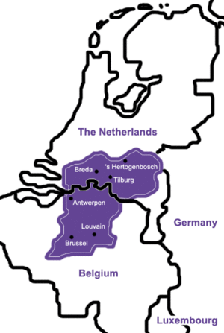
Hadewijch (mid 13th century)
Hadewijch wrote in her vernacular language of Flemish
She was likely a member of the Beguines, a group of Christian women who pursued spiritual progress as a group without being nuns.

Slide 30
Outline of Hadewijch’s Life
She was a leader and teacher in her Beguine community
Her leadership was resented by others, both inside and outside the community.
She was accused of quietism, the heresy that one need take no action (and likely should not), but be passive before God’s will.
She was likely exiled from her community and her beloved students.
Well-read, she knew the works of Richard of St. Victor, Origen, and Bernard of Clairvaux.

Slide 31
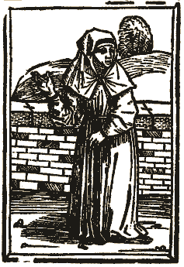
Persecution of Beguines
A Beguine contemporary of Hadewijch, Aleydis, and some of her followers, were executed for heresy after an Inquisitorial trial in 1236. Their heresy involved a belief in the power of God’s Love to be internal and immanent.
Marguerite of Porete was executed in Paris in 1310, for circulating, and not renouncing, her original mystical writings.

Slide 32
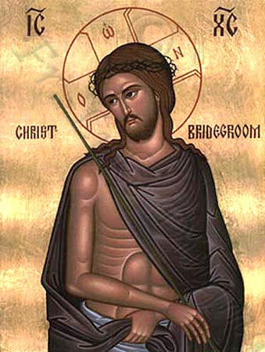
“Bridal Mysticism”
Given the physicality of the Incarnation in Christianity, the trope of mysticism as a romantic union of the mystic with God likely would have arisen even without the Song of Songs.
Orthodox Christian Icon of Christ the Bridegroom

Slide 33
Meister Eckhart (1260-1329)
One of the greatest philosophic mystics in world history: a Christian Neo-Platonist
Preached that God was intimately close to us; it was our mistakes in perception that made us think God was distant
“One who truly has God will have Him in all places, in the streets and in the world, no less than in the church.”
Mystical Ethics of Eckhart: “A person works in a stable. That person has a spiritual breakthrough. What should that person do? Return to work in the stable.”

Slide 34
Crusades
Pope Urban II, in 1095, responding to the plea of the Byzantine Emperor, launches the first Crusade against Muslim control of the Holy Land.
There are numerous versions of Urban II’s speech. Excerpts from the most detailed version follows

Slide 35
Urban II’s Speech at Clermont 1095
Oh, race of Franks, race from across the mountains, race chosen and beloved by God as shines forth in very many of your works set apart from all nations by the situation of your country, as well as by your catholic faith and the honor of the holy church! To you our discourse is addressed and for you our exhortation is intended. We wish you to know what a grievous cause has led us to Your country, what peril threatening you and all the faithful has brought us. From the confines of Jerusalem and the city of Constantinople a horrible tale has gone forth and very frequently has been brought to our ears, namely, that a race from the kingdom of the Persians, an accursed race, a race utterly alienated from God…has invaded the lands of those Christians and has depopulated them by the sword, pillage and fire…

Slide 36
Urban II’s Speech at Clermont 1095
(The Muslim Empire has) led away a part of the captives into its own country, and a part it has destroyed by cruel tortures; it has either entirely destroyed the churches of God or appropriated them for the rites of its own religion. They destroy the altars, after having defiled them with their uncleanness. They circumcise the Christians, and the blood of the circumcision they either spread upon the altars or pour into the vases of the baptismal font. When they wish to torture people by a base death, they perforate their navels, and dragging forth the extremity of the intestines, bind it to a stake; then with flogging they lead the victim around until the viscera having gushed forth the victim falls prostrate upon the ground. Others they bind to a post and pierce with arrows….What shall I say of the abominable rape of the women? To speak of it is worse than to be silent….

Slide 37
Urban II’s Speech at Clermont 1095
On whom therefore is the labor of avenging these wrongs…incumbent, if not upon you? You, upon whom above other nations God has conferred remarkable glory in arms, great courage, bodily activity, and strength to humble the hairy scalp of those who resist you. Let the deeds of your ancestors move you and incite your minds to manly achievements; the glory and greatness of king Charles the Great, and of his son Louis, and of your other kings, who have destroyed the kingdoms of the pagans, and have extended in these lands the territory of the holy church. Let the holy sepulchre of the Lord our Saviour, which is possessed by unclean nations, especially incite you, and the holy places which are now treated with ignominy and irreverently polluted with their filthiness. Oh, most valiant soldiers and descendants of invincible ancestors, be not degenerate, but recall the valor of your progenitors

Slide 38
Urban II’s Speech at Clermont 1095
But if you are hindered by love of children, parents and wives, remember what the Lord says in the Gospel, "He that loveth father or mother more than me, is not worthy of me." "Every one that hath forsaken houses, or brethren, or sisters, or father, or mother, or wife, or children, or lands for my name's sake shall receive an hundredfold and shall inherit everlasting life." Let none of your possessions detain you, no solicitude for your family affairs, since this land which you inhabit, shut in on all sides by the seas and surrounded by the mountain peaks, is too narrow for your large population; nor does it abound in wealth; and it furnishes scarcely food enough for its cultivators. Hence it is that you murder one another, that you wage war, and that frequently you perish by mutual wounds. Let therefore hatred depart from among you, let your quarrels end, let wars cease, and let all dissensions and controversies slumber.

Slide 39
Urban II’s Speech at Clermont 1095
Enter upon the road to the Holy Sepulchre; wrest that land from the wicked race, and subject it to yourselves. That land which as the Scripture says "floweth with milk and honey," was given by God into the possession of the children of Israel. Jerusalem is the navel of the world; the land is fruitful above others, like another paradise of delights. This the Redeemer of the human race has made illustrious by His advent, has beautified by residence, has consecrated by suffering, has redeemed by death, has glorified by burial. This royal city, therefore, situated at the centre of the world, is now held captive by His enemies, and is in subjection to those who do not know God, to the worship of the heathens.

Slide 40
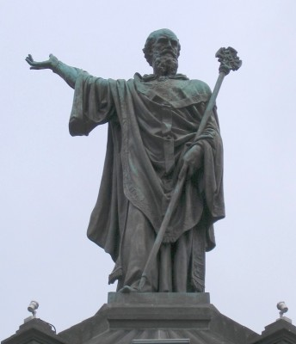
Urban II’s Speech at Clermont 1095
She (Jerusalem) seeks therefore and desires to be liberated, and does not cease to implore you to come to her aid. From you especially she asks succor, because, as we have already said, God has conferred upon you above all nations great glory in arms. Accordingly undertake this journey for the remission of your sins, with the assurance of the imperishable glory of the kingdom of heaven..

Slide 41
Urban II’s Speech at Clermont 1095
When Pope Urban had said these and very many similar things in his urbane discourse, he so influenced to one purpose the desires of all who were present, that they cried out, "It is the will of God! It is the will of God!" When the venerable Roman pontiff heard that, with eyes uplifted to heaven he gave thanks to God and, with his hand commanding silence, said: Most beloved brethren, today is manifest in you what the Lord says in the Gospel, "Where two or three are gathered together in my name there am I in the midst of them." Unless the Lord God had been present in your spirits, all of you would not have uttered the same cry. For, although the cry issued from numerous mouths, yet the origin of the cry was one. Therefore I say to you that God, who implanted this in your breasts, has drawn it forth from you. Let this then be your war-cry in combats, because this word is given to you by God.

Slide 42
Urban II’s Speech at Clermont 1095
When an armed attack is made upon the enemy, let this one cry be raised by all the soldiers of God: It is the will of God! It is the will of God! And we do not command or advise that the old or feeble, or those unfit for bearing arms, undertake this journey; nor ought women to set out at all, without their husbands or brothers or legal guardians. For such are more of a hindrance than aid, more of a burden than advantage. Let the rich aid the needy; and according to their wealth, let them take with them experienced soldiers. The priests and clerks of any order are not to go without the consent of their bishop; for this journey would profit them nothing if they went without permission of these. Also, it is not fitting that laymen should enter upon the pilgrimage without the blessing of their priests.

Slide 43
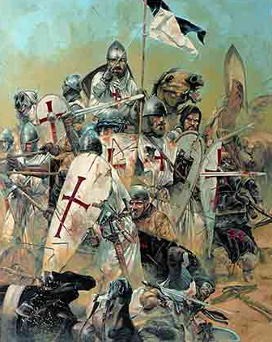
Urban II’s Speech at Clermont 1095
Whoever, therefore, shall determine upon this holy pilgrimage and shall make his vow to God to that effect and shall offer himself to Him as a, living sacrifice, holy, acceptable unto God, shall wear the sign of the cross of the Lord on his forehead or on his breast. When,' truly',' having fulfilled his vow be wishes to return, let him place the cross on his back between his shoulders. Such, indeed, by the twofold action will fulfill the precept of the Lord, as He commands in the Gospel, "He that taketh not his cross and followeth after me, is not worthy of me."

Slide 44
The Crusades
Military attacks on the Middle East from Europe, happened intermittently from 1095 to 1300
First Crusade was most ‘successful’
  Captured Jerusalem
  Established Kingdom of Jerusalem
Muslim warrior Saladin (Salah al-Din) retook Jerusalem in 1187
Casualties and outrages enormous during Crusades: Jews, Muslims, other Christians, civilians slaughtered

Slide 45
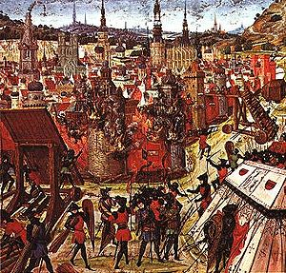
The Crusades
Create lasting mistrust between
  Christianity and Islam
  Europe and the Middle East
  Roman Catholic Christianity and Eastern Orthodox Christianity
Create an enduring link between religious exclusivism and military imposition of “the truth”

Slide 46
Orthodoxy and Heresy
Medieval Western European Catholic Christianity makes a point of suppressing heresies
  Cathars/Albigensians
  Waldensians
  Hussites
  Mystics, including the Beguines
  Inquisition set up to hunt down heretics

Slide 47
St. Dominic (1170-1221)
Founded a new order of priests, the Dominicans, to be theologically and philosophically prepared to fight heretics
Participated in burning the books of heretics, and, sometimes, the execution of the heretics themselves

Slide 48
The Black Death
Plague and Social Dislocation
in 14th Century Europe

Slide 49
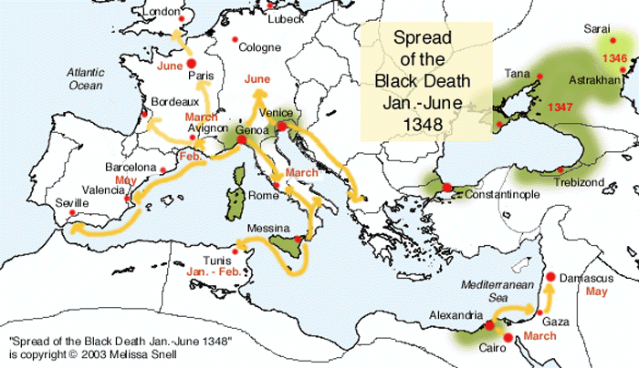
Spread of the Black Death, 1346-1348

Slide 50
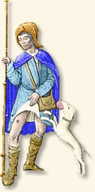
Signs of Disease
The various forms of the disease could take from one to eight days to kill the victim
The man in this picture is showing he has a “bubo” - the puss-filled sore from which we derive the term “bubonic plague.”
The “bubonic” strain was the least virulent, killing ‘only’ 65-75% of its victims.

Slide 51
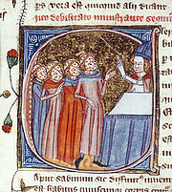
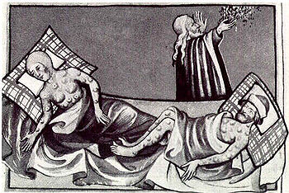
Victims
Priests disfigured Illustration of dying victims
by plague, late from Toggenburg Bible (1411)
14th century

Slide 52
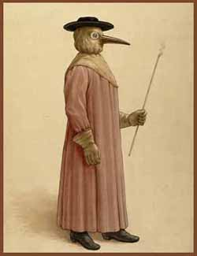
Doctors’ Precautions
The doctors would cover themselves to avoid contracting the disease
The beak contained herbs meant to filter the humors that were felt to be transmitters
The stick was for removing clothing from patient (or corpse)

Slide 53
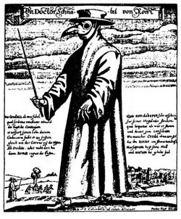
Doctors’ Precautions
Contemporary illustration

Slide 54
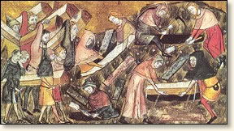
Mass Graves
So many people were dying, that social order broke down.
People were afraid to visit the sick, or even talk to their neighbors.
Unburied corpses could lead to the spread of the disease, and lack of burial could also increase the wrath of God.
Burial was most often in quickly dug mass graves.

Slide 55
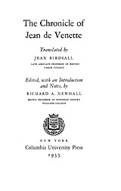
Jean de Venette and Boccaccio
Jean de Venette notes the persecution of the Jews
Both Boccaccio and Venette lament the loss of morals caused by the Plague
Venette also notes that Pope Clement VI used papal powers to calm the dying…and to gain wealth for the church through inheritances from the dying

Slide 56
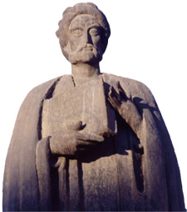
Ibn Khaldun
(1332-1406)
Muslim Historian, Geographer, and Theorist
Wrote a global history, al-Muqaddimah, which also contained a philosophy of history, that covered areas we would today name as sociology, group psychology, and political science.
Born in Tunis; traveled extensively from Spain to Middle East
Take a course with Prof. Amiras (hurry! She might retire soon!) to learn more about ibn Khaldun.

Slide 57
Ibn Khaldun on the Plague
Civilization both in the East and the West was visited by a destructive plague which devastated nations and caused populations to vanish. It swallowed up many of the good things of civilization and wiped them out. It overtook the dynasties at the time of their senility, when they had reached the limit of their duration. It lessened their power and curtailed their influence. It weakened their authority. Their situation approached the point of annihilation and dissolution. Civilization decreased with the decrease of mankind. Cities and buildings were laid waste, roads and way-signs were obliterated, settlements and mansions became empty, dynasties and tribes grew weak. The entire inhabited world changed. The East, it seems, was similarly visited, though in accordance with and in proportion to [the East’s more affluent] civilization. It was as if the voice of existence in the world had called out for oblivion and restriction, and the world responded to its call.

Slide 58
Sobering Statistics
Between 1338 and 1351, scholars estimate 24-75 million people died of plague worldwide
Over half the inhabitants of Paris, Hamburg, and Florence perished between 1348-1351
Blame was cast on minority communities, most notably Jews; many Jewish communities were destroyed by vengeful Christian survivors of the Black Death

Slide 59
Social Impact of the Plague
Gottlieb offers that “The environmental crisis of the Late Middle Ages caused existing social and political systems to stagnate or to regress. Deep-seated moral, philosophical and religious convictions were tested and found wanting.”
Doctors knew they were ignorant of how to stop the disease: therefore it seeded a revolution in approaches to science.

Slide 60
Avignon:
The Babylonish Captivity
&
The Great Schism
Two separate, but related, travesties of 14th century
papal governance

Slide 61
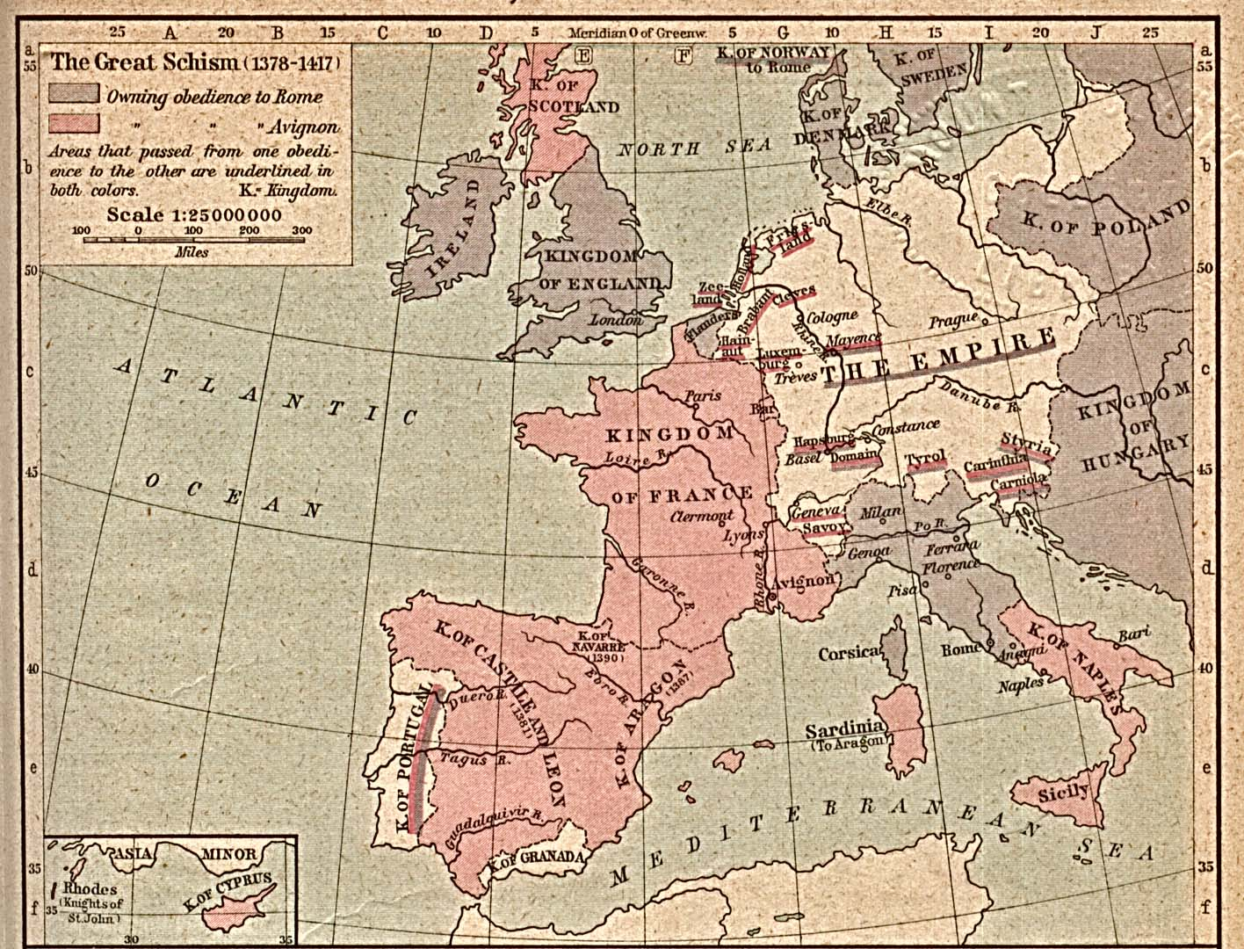

Slide 62
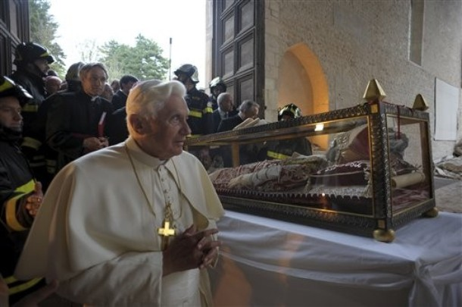
Saint Pope Celestine V
Solitary, meditative monk
Elected Pope in 1294
Disliked the job, and voluntarily resigned
His successor, Boniface VIII, held Celestine as a prisoner
Died in prison in 1296
His relic/remains saved during 2009 earthquake; picture here shows Benedict XVI praying aside him…but not following his example!

Slide 63
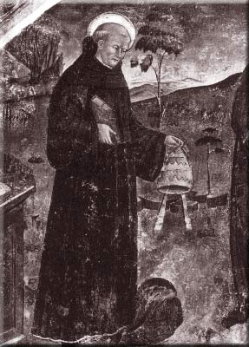
Celestine’s Resignation
“…desiring a more humble state and a more perfect life, fearing to compromise my conscience and seeing my weakness and incapacity, considering the malice of men and yearning for the rest and spiritual consolation I enjoyed before I was raised to this position, I, Celestine V, Pope, do hereby freely and voluntarily renounce the Sovereign Pontificate and abandon the dignity and position to which I was raised.”
Dante loathed Celestine for this, "I saw and recognized the shade of him Who by his cowardice made the great refusal" (Inferno, III, 59-60).
Boniface VIII, Celestine’s successor, would cause problems for Dante, for King Philip the Fair of France, for papal power in general, and provoke the move to Avignon

Slide 64
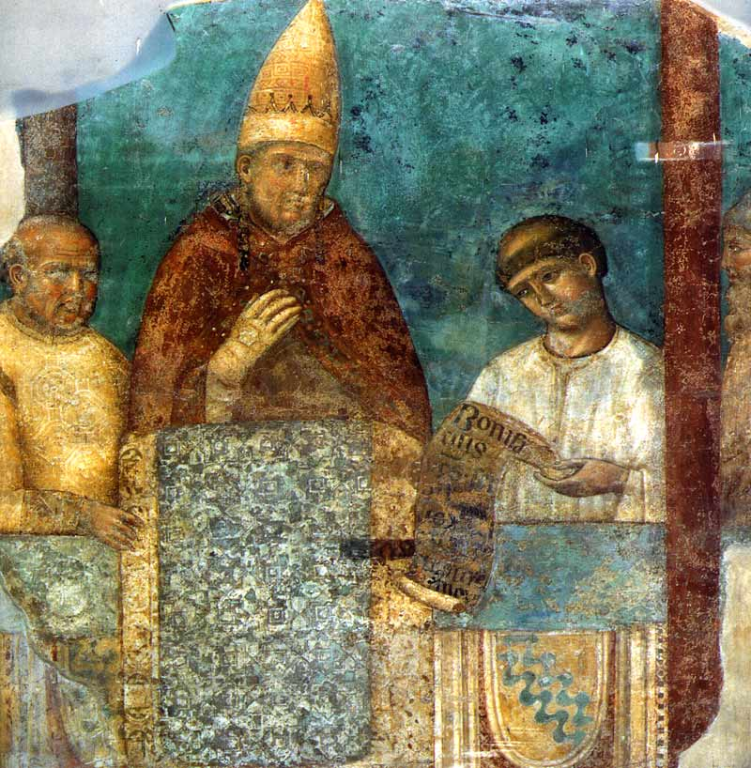
Boniface VIII, r. 1294-1303
Asserts papal supremacy to its furthest logical reach, but without the actual power to “make it so” (to quote Picard)
Patron of the Arts
Received this sketch of himself from Giotto, and said Giotto was the best painter of the era.

Slide 65
Boniface VIII’s Unam Sanctam
“It is absolutely necessary for salvation that every human creature be subject to the Roman pontiff”
The Two Swords doctrine - the church wields one sword; the state wields the other sword for the Church

Slide 66
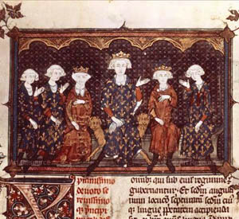
Philip the Fair
Doesn’t Play Fair
King Philip IV of France didn’t want Boniface’s doctrines to become permanent
He had his troops arrest Boniface VIII on charges of heresy!
Boniface was so shocked he died within days, many suspect of a heart attack!
Even after Boniface’s death, Philip pursued having a posthumous trial.
But state power had already, in effect, won.

Slide 67
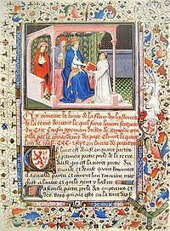
Rigging the Election
Philip the Fair makes sure that a French successor is chosen.
The first pope after Boniface dies rather suddenly; poison is suspected
Then Clement V, a proper Frenchmen, pliant to the French king, is chosen in 1305

Slide 68
Moving to Avignon
Good reasons:
More centrally located
Safer from attack
Safer from street unrest
Popes in better position to negotiate for peace between France and England
Bad reasons:
Makes Popes look like French (king’s) poodle
No Biblical history with Avignon
No famous saints’ tombs
Building a new infrastructure will need funding

Slide 69
Every Pope Wants a Crusade
Crusades were how Urban II and his successors united Christendom
Crusades would sustain peace between European nations, ensuring stability for the Church
A successful Crusade could make a Pope’s reputation

Slide 70
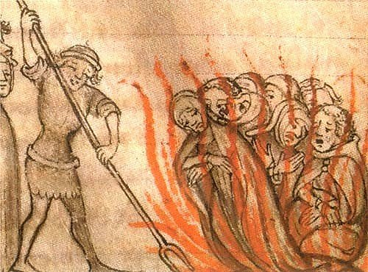
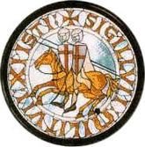
But Philip the Fair Doesn’t…
…so there will be no Crusade
Instead he blames the Knights Templar, a major European crusader group (and charity) since 1129, for Crusade failures
Philip the Fair owed them money; instead of paying back, he had them suppressed in 1307
Pope Clement V supported the king and had many Templars executed

Slide 71
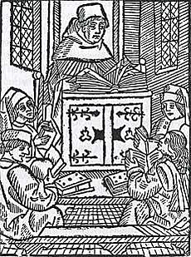
…and while we’re burning people
…nothing smells as good as intellectuals and mystics at the stake!
Marguerite Porete was executed in 1310
Meister Eckhart was condemned posthumously
Mysticism, by giving people direct experience of God, can undermine reliance on authority

Slide 72
Marguerite Porete (ex. 1310)
a French mystic and writer who was executed as a relapsed heretic in 1310
Represents an antinomian philosophy
What is antinomianism?
Battle between law and experience; the feeling that direct experience can obviate the laws that non-mystics follow
Antinomian attitudes are always a critique of the clergy in any religion

Slide 73
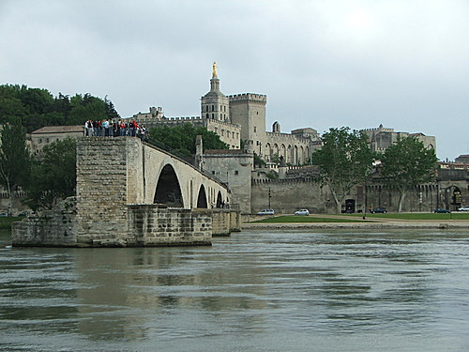
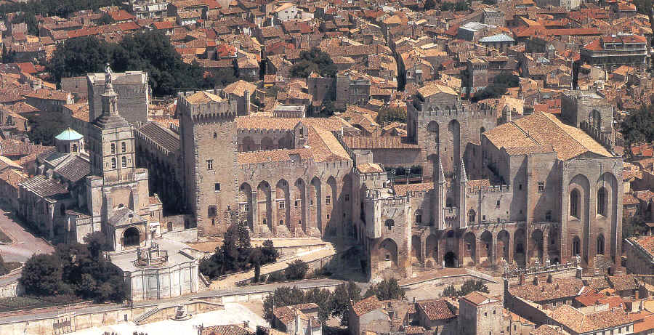
The Popes Settle in at Avignon
The Avignon Popes were practical men, not very spiritual; they also were known for nepotism
They spent lavish sums of money on the Papal Palace, and other administrative needs

Slide 74
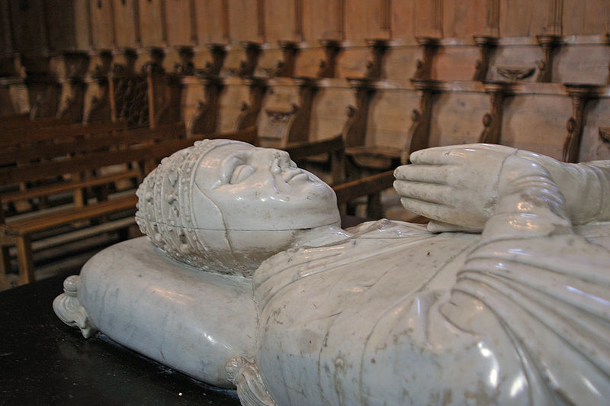
Clement VI:
The Worst of Times, the Worst of Popes
Reigned 1342-1352
He had previously served as a bishop, and as the Chancellor of France (government role)
Wanted Avignon to be a world-capital, taxed and spent to achieve this.
Above, Clement VI now, in quieter times

Slide 75
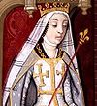
Joanna I of Naples
Born 1328, r. 1343-1381, deposed, murdered 1382
Perfect foil to Clement VI
Joanna’s first husband, Andrew of Hungary, died, let’s just say, mysteriously (psst…she killed him)
She runs to Avignon for safety from a Hungarian invasion, and “somehow” gets off the charge of murder when she gives her rights over Avignon to Clement VI.

Slide 76
Clement VI:
The Worst of Times…OK, I’ll give him his props
Pope during the worst of the Plague
Personally aided in local relief efforts
Called Jubilee in 1350, earlier than scheduled, as a way for people to implore God’s mercy
Pilgrims visited Avignon, but Rome was their goal.
This revealed the magnitude of the Popes’ symbolic error in moving to Avignon.

Slide 77
Who Will Save Europe?
from these hypocritical Popes!
from these conceited lawless rulers!
from the ravages of plague-induced chaos!

Slide 78
The Poets and the Mystics!
The Virgin and her Painters!
And the Everyday Soldiers!
That’s who!

Slide 79
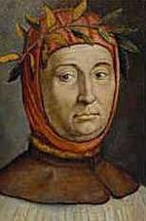
Petrarch 1304-1374
Father of Humanism
Italian poet and essayist
Credited with the phrase “Dark Ages” to describe early medieval period
Grew up in Avignon
Despised Avignon papacy
“Instead of holy solitude we find a criminal host and crowds…instead of soberness, licentious banquets.”

Slide 80
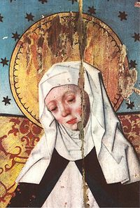
Saint Bridget of Sweden 1303-1373
Mother and wife; when husband dies she starts an order of nuns
Has mystic visions, including one of Christ’s 5,475 wounds, calling for fifteen prayers a day to commemorate this
Moves to Rome in 1350 (Jubilee Year) to await the return of the Pope; remains until her death
Canonized by Boniface IX; affirmed by Council of Constance

Slide 81
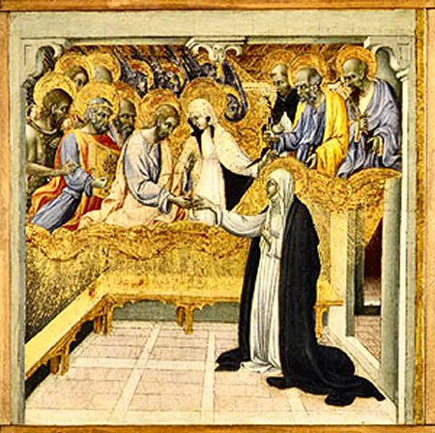
Saint Catherine of Siena
(1347-80)
One of the most remarkable women in history, she was ascetic from a young age
Very learned, and an excellent prose stylist in Italian
Had intense mystical experiences, including spiritual espousal, stigmata, and, in 1370, a special set of visions that inspired her to contact Pope Gregory XI and encourage him to return the Papacy to Rome.
Mystical Marriage of St.
Catherine - Giovanni di Paolo

Slide 82
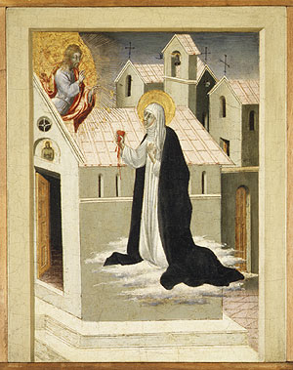
Saint Catherine of Siena
Pope Gregory XI sees the hand of God when Catherine arrives in Avignon to harangue him!
She says that he undermines all authority by staying away from his flock:
“Come, come, and resist no more the will of God that calls you; the hungry sheep await your coming to hold and possess the place of your predecessor and Champion, Apostle Peter.”
Catherine and Jesus swap
hearts. Giovanni di Paolo

Slide 83
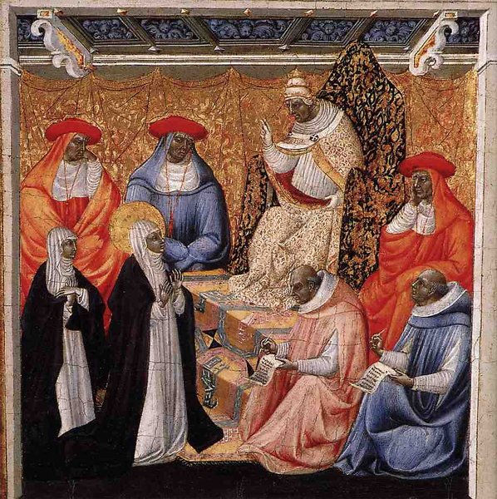
Catherine of
Siena at
Avignon,
speaking with
Pope Gregory
XI.
Giovanni di
Paolo, 1460s

Slide 84
IT WORKS!
Gregory XI returns to the Vatican in 1377.
Unfortunately, he dies from stress and exhaustion in 1378.
NOW WHAT?

Slide 85
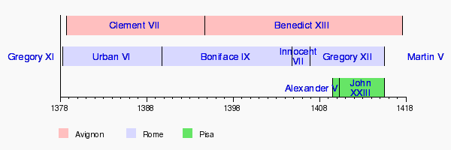
The Great Schism
Three competing claimants to the Papal throne was confusing for Catholics
Each of the three had a natural constituency
The Cardinals tried to resolve the two-way split at Pisa in 1409, but only made matters worse: a three-way split

Slide 87
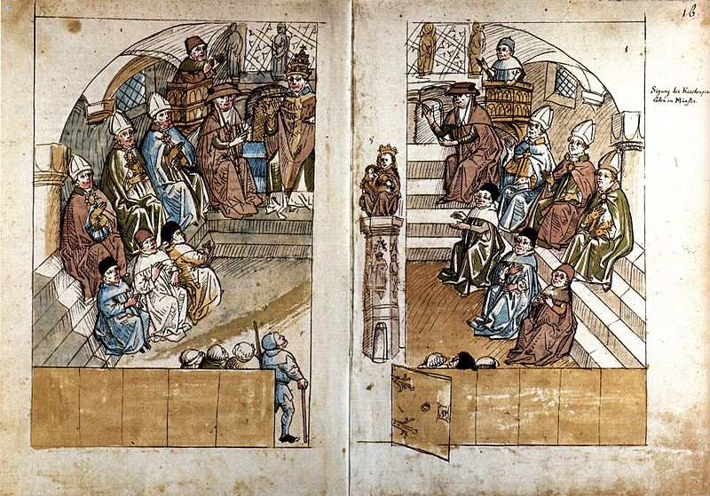
Council of Constance (1414-1418)

Slide 88
Council of Constance (1414-1418)
Council called to solve The Great Schism
The Council also sought to suppress heresy
The Council deposed all three of the alleged popes
Benedict XIII (Avignon)
John XXIII (Pisa)
Gregory XII (Rome)
The Council elected Martin V as the new, unified Pope, to be based in Rome
This contemporary drawing shows John XXIII addressing the Council

Slide 89
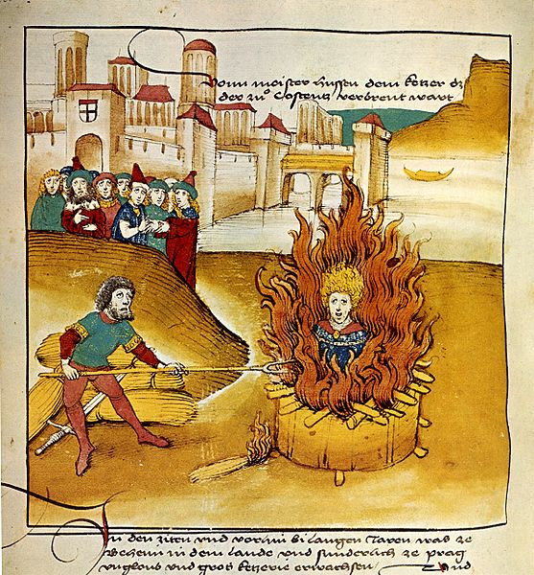
Council of Constance (1414-1418)
Having solved the Schism, the Council now turned to suppressing heresy
Two leading heretics were punished: John Wycliffe of England (posthumously) and Jan Hus of Bohemia (who was condemned and burned at the stake)
Both Wycliffe and Hus translated the Bible into vernacular languages, and thus were forerunners of the Reformation.

Slide 90
Oops! I forgot something major
The Hundred Years War between France and England…which actually lasts more than 100 years…1337-1450, approximately

Slide 91

Why 100 (113) Years War?
It is about who is the legitimate king of France.
OK…when Philip the Fair dies, his descendents reign for a while. They kill one poor kid, King John the Posthumous, who was born a king, but then mysteriously dies after five days…hmmmm…little Baby King John --->
But when all three of Philip the Fair’s sons have died, who should take over?
His daughter, perhaps? Or her children?

Slide 92
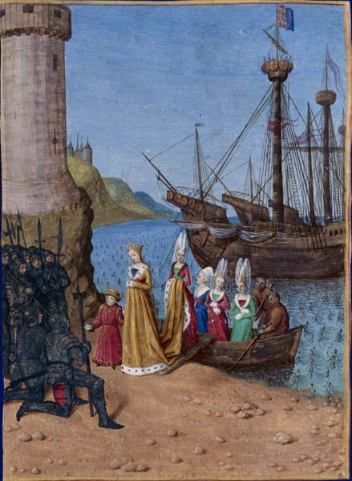
Salic Law
Problem was, Philip the Fair’s daughter, Isabella of France, had married King Edward II of England, which meant that their son, the future Edward III, had a legitimate claim on the throne of France
This prospect did not leave French people feeling sanguine. Lawyers searched through ancient Frankish law codes, and found a rule that property could not be inherited through a female: the Salic Law.

Slide 93

Edward III of England, b. 1312, r. 1327-1377
Edward III wanted to press his French claim, recognizing that the Salic Law was weak
Edward III was ruthless, a great military leader and organizer, much more practical than chivalric in his outlook

Slide 94

Hundred Years War and Military Strategy
Because of the lengthy time-span, the Plague occurring in the middle of the war, and changes in military technology, the Hundred Years War - and four major battles in it - are significant milestones in military history.

Slide 95

Crécy - 1345
England 1
France 0
The English awaited the French, and took elevated positions on small hillsides. The English long-bows could kill an armed knight. Despite being out-numbered, the English were able to pick off the French nobility. Most of the French knights who perished died from commoners’ bows: a real reverse to codes of chivalry.

Slide 96

Poitiers - 1356
England 2
France 0
Edward III’s son, Edward the Black Prince, an even more ruthless, militarily-smart general, conducted a scorched earth policy preceding this battle
In the battle, he used feints to disrupt the knights’ charge, again with commoners defeating the noblemen.
France’s King John II was captured at this end of this battle, and had to be ransomed later.

Slide 97

MASSIVE FAIL!
Capture of King Jean II (John the Good) of France at the Battle of Poitiers

Slide 98

Agincourt - 1415
England 3
France 0
Henry V of England, vastly outnumbered, out-organized the French forces, and once again the chivalric techniques of the French fell before the longbow capacities and new techniques (such as setting traps and obstacles to slow down cavalry).
Henry V warned his common soldiers that if they lost the French were likely to have no mercy
Overwhelming victory for the English.

Slide 99


Slide 100
What Can the French Do?
By 1420, the French situation looked dire.
Henry V was talented; the French King, Charles VI, was known to be mentally ill.
But then they both died in 1422. The situation reversed. The new English King, Henry VI, would have his own bouts of insanity. But the new French King, Charles VII, couldn’t even get himself properly crowned, due to the now-extensive English holdings in the north of France.

Slide 101
Who Will Save France?
from the English!
from their own weak rulers!
from their old-fashioned hide-bound generals!

Slide 102

Why, of course!
Joan of Arc
(1412-1431)

Slide 103

Joan of Arc as Epitome of Era
Synthesizes the entire 14th and 15th centuries
Mystic
Nationalistic
Uses new military strategies
Upset over Great Schism
Argues for central authority, yet also acts individualistically

Slide 104

Orléans - 1429
France 100 (!)
England 3
The English were laying siege to the town of Orléans. The siege had lasted over six months. The English knew that if they controlled Orléans, they could take all of France
Joan of Arc, working with two royal generals, broke the siege nine days after her arrival.
Twice she took bold offensive actions against the English, either without or against the knowledge of the other generals, and both times it worked brilliantly.
Her nickname “Maid of Orléans” comes from this success .

Slide 105

Is Joan of Arc a Witch?
A Heretic?
When she was injured during the Battle of Orléans, the English troops started singing “The witch is dead!”
After the English capture her, and Charles VII doesn’t ransom her, she is put on trial as a witch, with the English using the Two Swords rule.

Slide 106
Joan of Arc’s Crimes
Wearing men’s clothes
Claiming direct visions from God (i.e. circumventing authority)
Implicitly questioning the Council of Constance

Slide 107
Joan of Arc and the Great Schism
After her victory in Orléans, about to march for Paris, she was asked who was the true pope.
She replied that she didn’t have the leisure to think about it, but when she was at peace she would inquire of God about it.
This letter, hastily dictated as she mounted her steed, would come back to haunt her.
• She dictated it in 1329, but the Council of Constance had met and resolved this issue in 1315.

Slide 108
The Great Schism at Joan’s Trial
Asked by the prosecutors who was Pope, she said Martin V, “having received no revelation otherwise.” Her accusers were happy with her answer, because to them it proved she was a heretic, preferring her own opinion to that of the Council of Constance.
Joan’s mystic self-assurance was a sign of a growing individualism in religion, and a distrust of institutional authority, even though Joan sought to reinstate royal authority.

Slide 109

Joan of Arc, executed May 30, 1431

Slide 110

Christine de Pisan (1363-1434)
First known professional woman writer
Wrote works about women, such as The City of Ladies, recounting stories of famous women in history, religion, and mythology
And then she was lucky enough to be a contemporary of Joan of Arc!

Slide 111
Christine de Pisan on Joan of Arc
"we never heard tell of such an extraordinary marvel, for the prowess of all the great men of the past cannot be compared with this woman's…God gives [her] strength and power to be the champion who casts the rebels down….What an honor for the female sex, which it seems that God loves!"

Slide 112

High Middle Ages Art and Architecture
Machaut,
Notre Dame
Mass

Slide 113

Giotto di Bondone
(ca. 1266-1337)
• Credited with introducing and sharpening artistic ways of illustrating perspective and three-dimensional figures.
• Adds drama, individuality, and emotion into Biblical scenes.
• Affiliated with Florence

Slide 114

Giotto
Kiss of Judas ca. 1305

Slide 115

Giotto - Kiss of Judas - detail

Slide 116

Giotto
Lamen-tation of Christ

Slide 117

The Onion
The Body of Christ Laid to Rest In and Around the Lake

Slide 118

Duccio di Buoninsegna
(ca. 1255/60-1319)
• Greatest Sienese artist of his time
• Reconciles new lessons of perspective while retaining spiritual impact of iconic images
• Incorporates perspective, but not fully committed to it

Slide 119

Duccio - Temptation of Christ - 1310

Slide 120

Duccio
Flight to Egypt
1308

Slide 121

Flight Into Egypt
Duccio Giotto

Slide 122


Entry into Jerusalem
Duccio Giotto

Slide 123

Simone di Martini (1284-ca. 1344)
• Sienese artist, student of Duccio’s
• Works at Papal court at Avignon, where he dies
• Continues to unify realism and iconicism, while also showing courtly elegance and influence of illustration.

Slide 124

Sts. Mary Magdalena and Catherine of Alexandria
Simone di Martini
Note Attributes, Balance of Iconicity and Interaction

Slide 125

Simone di Martini
Jesus Returning to His Parents after being with the Rabbis at the Temple
1342

Slide 126

Madonna of Humility - Simone di Martini - Avignon

Slide 127

Taddeo di Bartolo (1362-1422)
• Later Sienese artist, shows eclecticism of art styles in early 15th century
• Solemn yet interactive figures
• Coronation of the Virgin, ca. 1405 (on display at University of Arizona)

Slide 128


Roman Images and Allegories: Taddeo di Bartolo
Apollo and Athena in their medieval guise
Allegory of Wisdom, also represented as Catherine of Alexandria

Slide 129

Lucifer
Taddeo di Bartolo (1396) following Dante

Slide 130


Taddeo di Bartolo,
Madonna &
Child (1400)
• Painting located in San Francisco, at Palace of the Legion of Honor
Iconic, yet in motion
Iconic, yet Madonna and Child are each in relation to viewer

