Slide 1
Egyptian Religions
Immortality, Royalty,
Trans-form-ing Deities

Slide 2
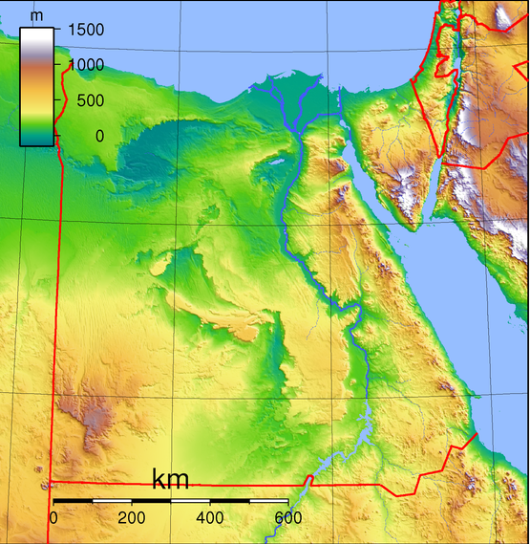
Egypt’s Geography
Egypt a paradigmatic river culture, shaped by the Nile River and its annual flooding
Flooding created continually rich soil for agriculture
Delta of the Nile serves for agriculture and trade

Slide 3
Egyptian Time Line
Egyptian history divided into many dynasties
3100-2700 BCE – Early Dynasties
2700-2200 BCE – Old Kingdom
2000-1750 BCE – Middle Kingdom
1550-1050 BCE – New Kingdom
1050-664 BCE – Third Intermediate Period
664-332 BCE – Late Period
332-30 BCE – Ptolemaic Period
30 BCE-311 CE – Roman Period

Slide 4
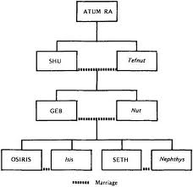
Egyptian Pantheon

Slide 5
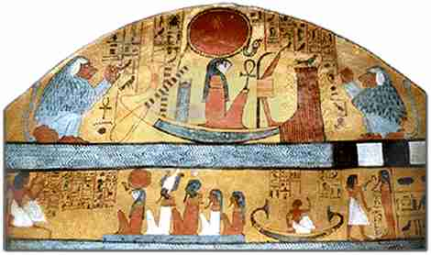
Atum-Ra: Sun God, Creator
Changes over time in Egyptian thought
Associated with sun, with Pharaoh (and with Horus)
Created all things by enunciating their secret names
Has a solar disk on his head

Slide 6
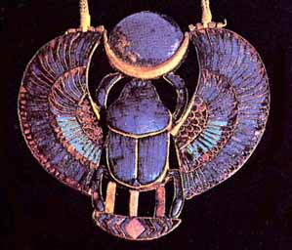
Atum-Ra: The First Beetle
Every morning, Ra would re-emerge into the world as a scarab, a kind of dung beetle
The beetle is another symbol of transformation of matter and energy

Slide 7
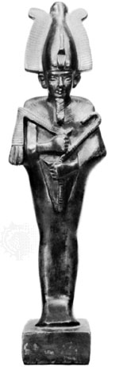
Isis, Osiris and Seth
Key mythological deities
Osiris and Isis are husband and wife
Seth is the enemy of Osiris
Seth murders Osiris and dismembers him, scattering fourteen parts around Egypt

Slide 8
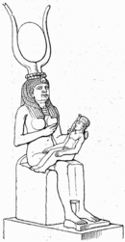
Isis, Osiris and Horus
Isis sets about to re-assemble Osiris, visiting all the parts of Egypt
Her sister Nephthys assists her
She gets thirteen of the fourteen pieces, but fish had feasted on Osiris’ phallus
Isis made a new phallus for Osiris, and then conceived their child, Horus

Slide 9
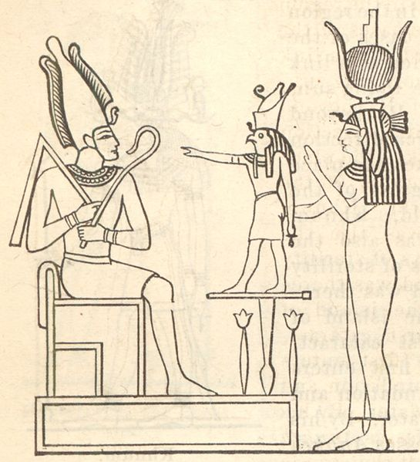
Osiris and Death
Osiris represents the Underworld, the land of death
He also represents the renewal of life that comes with the season, and the relation of life and death
The dead Pharaoh was believed to be Osiris
The Egyptian Holy Family, or Sacred Trinity

Slide 10
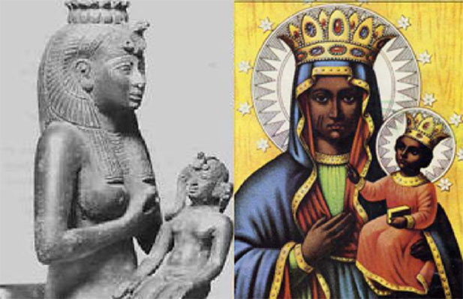
Isis and Fertility
Isis represents fertility
She also has the role of chief mourner for her husband
Settings of her nursing Horus may have influenced representation of Virgin Mary in Christianity
Most important as a magician and source of magic (creation of operative phallus)

Slide 11
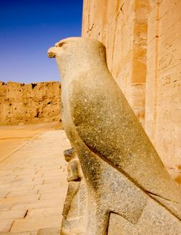
Horus in Falcon Form
Horus, son of Osiris and Isis, represents the living Pharaoh
Horus is most often shown in zoomorphic form
Zoomorphic = animal form

Slide 12
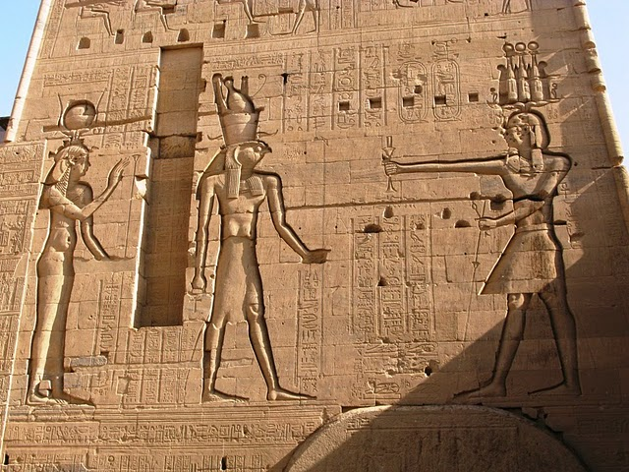
Pharaoh Ptolemy XII making an offering to Horus and Isis (ca. 45 BCE)

Slide 13
Pharaoh Ptolemy XII making an offering to Horus and Isis (ca. 45 BCE)
This temple, at Philae, one of the reputed burial sites of Osiris, a site of ongoing importance in Egyptian religion
This temple was the last pagan temple to be closed in the Roman Empire (ca. 530 CE)

Slide 14
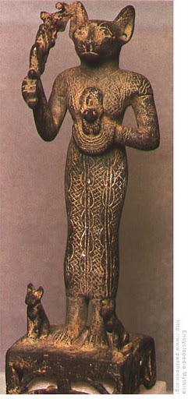
Bastet
Bastet the daughter of Ra
Depicted in female feline form
Protector because a destroyer of vermin
Sensual and proud
A famous example of a zoomorphic deity

Slide 15
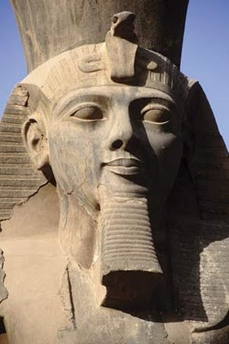
Pharaohs and Divinity
Pharaohs are believed to be in divine line
Unity of religious and political power
They have duty to visit all of Egypt
  Creates national unity
  Serves purposes of Pharaoh, too
Ramses II, Egypt’s most accomplished Pharaoh 1279-1213 BCE

Slide 16
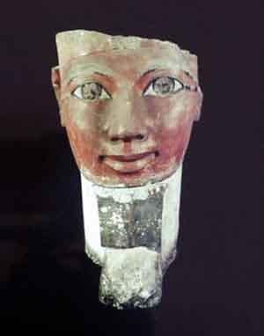
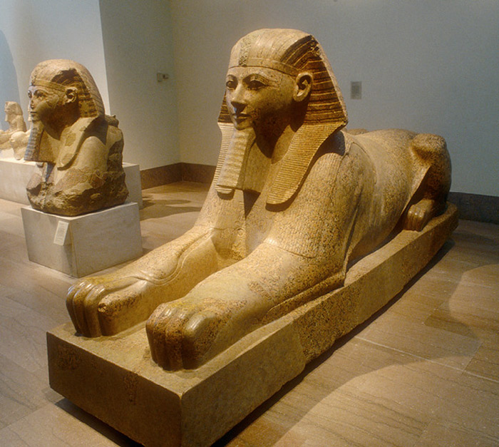
Hatshepsut (b. 1508, r. 1473-1458 BCE)
Female Pharaoh, who wore the symbolic beard of power; developed trade and religion

Slide 17
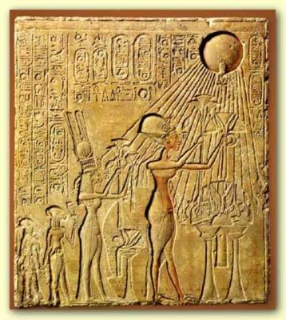
Akhenaten (r. ca. 1353 – 1335 BCE)
Established a kind of monotheism
Worship only sun disc, aten, of which he believed himself to be a living form
Husband to Nefertiti, who succeeded him
Father to Tutankhamun, during whose reign the monotheistic experiment ended

Slide 18
Akhenaten’s Hymn to the Sun: Verse 1
When in splendor you first took your throne high in the precinct of heaven, O living God, life truly began!
Now from eastern horizon risen and streaming, you have flooded the world with your beauty.
You are majestic, awesome, bedazzling, exalted, overlord over all earth, yet your rays, they touch lightly, compass the lands to the limits of all your creation.
There in the Sun, you reach to the farthest of those you would gather in for your Son (Akhenaten), whom you love;
Though you are far, your light is wide upon earth; and you shine in the faces of all who turn to follow your journeying.

Slide 19
Akhenaten’s Hymn to the Sun: Verse 2
When you sink to rest below western horizon earth lies in darkness like death
Sleepers are still in bedchambers, heads veiled, eye cannot spy a companion;
All their goods could be stolen away, heads heavy there, and they never knowing!
Lions come out from the deeps of their caves, snakes bite and sting:
Darkness muffles, and earth is silent: he who created things lies low in his tomb.

Slide 20
Akhenaten’s Hymn to the Sun: Verse 3
Earth-dawning mounts the horizon, glows in the sun-disk as day:
You drive away darkness, offer your arrows of shining, and the Two Lands (Upper and Lower Egypt) are lively with morningsong.
Sun’s children awaken and stand, for you, golden light, have upraised the sleepers;
Bathed are their bodies, who dress in clean linen, their arms held high to praise your Return
Across the face of the earth they go to their crafts and professions.

Slide 21
Akhenaten’s Hymn to the Sun: Verse 4
The herds are at peace in their pastures, trees and the vegetation grow green;
Birds start from their nests, wings wide spread to worship your Person;
Small beasts frisk and gambol, and all who mount into flight or settle to rest live, once you have shown upon them;
Ships float downstream or sail for the south, each path lies open because of your rising;
Fish in the River (Nile) leap in your sight, and your rays strike deep in the Great Green Sea (the Mediterranean).

Slide 22
Akhenaten’s Hymn to the Sun: Verse 5
It is you create the new creature in Woman, shape the life-giving drops into Man,
Foster the son in the womb of his mother, soothe him, ending his tears;
Nurse through the long generations of women to those given Life, you ensure that your handiwork prosper.
When the new one descends from the womb to draw breath the day of its birth,
You open his mouth, make him aware of life newly given, for you determine his destiny.

Slide 23
Akhenaten’s Hymn to the Sun: Verse 6
Hark to the chick in the egg, he who speaks in the shell! You give him air within to save and prosper him;
And you have allotted to him his set time before the shell shall be broken;
Then out from the egg he comes, from the egg to peep at his natal hour!
And up on his own two feet goes he when at last he struts forth therefrom.

Slide 24
Akhenaten’s Hymn to the Sun: Verse 7
How various is the world you have created, each thing mysterious, sacred to sight,
O sole God, beside whom is no other!
You fashioned earth to your heart’s desire, while you were still alone,
Filled it with man and the family of creatures, each kind on the ground, those who go upon feet, he on high soaring on wings,
The far lands of Khor (Syria) and Kush (Sudan), and the rich Black Land of Egypt.

Slide 25
Akhenaten’s Hymn to the Sun: Verse 8
And you place each one in his proper station, where you minister to his needs;
Each had his portion of food, and the years of life are reckoned him.
Tongues are divided by words (different languages), natures made diverse as well
Even men’s skins are different that you might distinguish the nations.

Slide 26
Akhenaten’s Hymn to the Sun: Verse 9
You make Hapy (the God of the Nile’s flooding), stream through the underworld, and bring him, with whatever fullness you will,
To preserve and nourish the People in the same skilled way you fashion them.
You are Lord of each one, who wearies himself in their service,
Yet Lord of all earth, who shines for them all, Sun-disk of day, Great Lightener!

Slide 27
Akhenaten’s Hymn to the Sun: Verse 9, cont.
All of the far foreign countries—you are the cause they live
For you have put a Nile in the sky that he might descend upon them in rain—
He makes waves on the very mountains like waves on the Great Green Sea (Mediterranean) to water their fields and their villages

Slide 28
Akhenaten’s Hymn to the Sun: Verse 10
How splendidly ordered are they, your purposes for this world, O Lord of eternity, Hapy in heaven!
Although you belong to the distant peoples, to the small shy beasts who travel the deserts and uplands,
Yet Hapy, he comes from Below for the dear Land of Egypt as well.
And your Sunlight nurses each field and meadow: when you shine, they live, they grow sturdy and prosper through you.

Slide 29
Akhenaten’s Hymn to the Sun: Verse 10, cont.
You set seasons to let the world flower and flourish—winter to rest and refresh it, the hot blast of summer to ripen;
And you have made heaven far off in order to shine down therefrom, in order to watch over all your creation.

Slide 30
Akhenaten’s Hymn to the Sun: Verse 11
You are the one God, shining forth from your possible incarnations as Aten, the Living Sun.
Revealed like a king in glory, risen in light, now distant, now bending nearby.
You create the numberless things of this world from yourself, who are One alone—cities, towns, fields, the roadway, the River;

Slide 31
Akhenaten’s Hymn to the Sun: Verse 11, cont.
And each eye looks back and beholds you to learn from the day’s light perfection.
O God, you are in the Sun-disk of Day, Over-Seer of all creation—your legacy passed on to all who shall ever be;
For you fashioned their sight, who perceive your universe, that they praise with one voice all your labors.

Slide 32
Akhenaten’s Hymn to the Sun: Verse 12
And you are in my heart; there is no other who truly knows you but for your son, Akhenaten.
May you make him wise with your inmost counself, wise with your power, that earth may aspire to your godhead, its creatures fine as the day you made them.
Once you rose into shining, they lived; when you sink to rest, they shall die.
For it is you who are Time itself, the span of the world; life is by means of you.

Slide 33
Akhenaten’s Hymn to the Sun: Verse 12, cont.
Eyes are filled with Beauty until you go to your rest;
All work is laid aside as you sink down the western horizon.
Then, Shine reborn!
Rise splendidly! my Lord, let life thrive for the King!
For I have kept pace with your every footstep since you first measured ground for the world.
Lift up the creatures of earth for your Son who came forth from your Body of Fire!

Slide 34
Akhenaten and Monotheism
An isolated experiment
Psalm 104 in the Hebrew Bible shows many parallels to this hymn
Akhenaten’s monotheism may have been
  genuine philosophic speculation
  a move to consolidate his centralized power
  an attempt to heighten his connection to the divine

Slide 35
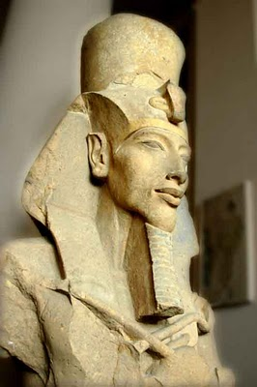
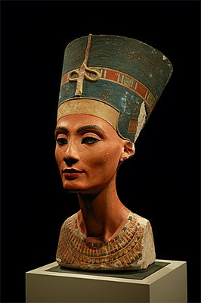
Akhenaten and Nefertiti

Slide 36
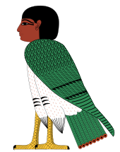
The Soul: Ka + Ba
The ka is the life force, that leaves a body when death occurs.
The ba combines notions of soul, personality, and character. The ba and the ka can reunite after the death of the body
The Ba as represented in hieroglyphs

Slide 37
Egyptian Book of the Dead
A guide to the underworld
Deals with a final judgment of the soul
Originally intended only for those of high rank, mummification and the journey to rebirth ‘democratized’ in later periods of Egyptian history

