Slide 1
The ANCIENT WORLD of the NEAR EAST AND MEDITERRANEAN
3500 BCE – 500 CE
Mesopotamia
Egypt
Greece
Rome

Slide 2
These Ancient Religions
Interesting in their own integrity
  Divine kingship
  Rural/urban developments
  Response to local conditions
  Frank acknowledgement of power of sexuality
  Development of philosophy
Interesting because of influence on Abrahamic religions
  Shared stories
  Shared ideas of social organization
  Beginnings of monotheism

Slide 3
These Ancient Religions
Literate
Temple-based
Polytheistic
Connection between Religious and Political Spheres

Slide 4
Dating System
Scholars use BCE = Before the Common Era and CE = Common Era
BCE and CE dates are the same as BC and AD
The system acknowledges that this dating system is a commonly accepted compromise, without acceding to Christian cosmological claims in the traditional names for BC (before Christ) and AD (Anno Domini, year of the Lord)
This dating system was launched in 525 (AD or CE!)

Slide 5
Urban v. Rural Split
Urban civilizations include hierarchy and job specialization
Urbanites think of themselves as sophisticated, urbane, civilized
Urbanites look down on “country bumpkins”
Rural peoples are close to seasons, nature, tradition religiously
They prefer order and predictability
Common religious designators such as “pagan” and “heathen” were originally words to describe rural people.

Slide 6
MESOPOTAMIA
Large-scale Agricultural Society
Religious and Social Organization
Influence on Monotheistic Religions

Slide 7
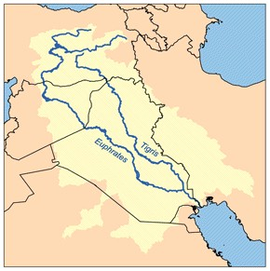
Tigris and Euphrates Rivers
Mesopotamia = Between the Rivers

Slide 8
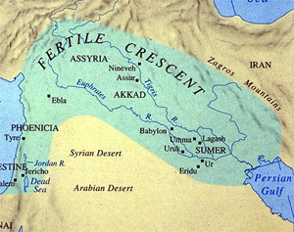
The Fertile Crescent Connected Mesopotamia to Palestine
Note the Four Named Empires:
Sumerian
Akkadian
Babylonian
Assyrian

Slide 9
Chronology of Mesopotamia
Sumerian era 3200-2300 BCE
Akkadian dynasty 2300-2150 BCE
Dynasty of Ur 2100-2000 BCE
Babylonian period (Hammurabi) 1900-1600 BCE
Middle Babylonian period 1600-900 BCE
Assyrian Empire 900-609 BCE
Chaldean dynasty 609-538 BCE

Slide 10
Chronology of Mesopotamia
Sumerian era
  writing on clay tablets by 3000 BCE
  Gilgamesh is king in Uruk
Akkadian period
  King Sargon
  Enheduanna, priestess and earliest known poet, writes of Inanna
Dynasty of Ur
  Records legends of Gilgamesh
Babylonian period
  Hammurabi’s Law Code 1700s BCE
Middle Babylonian period
  Development of Epic of Gilgamesh by 1300 BCE
Chaldean dynasty 609-538 BCE
  Babylonian captivity of Jews 586-539 BCE

Slide 11
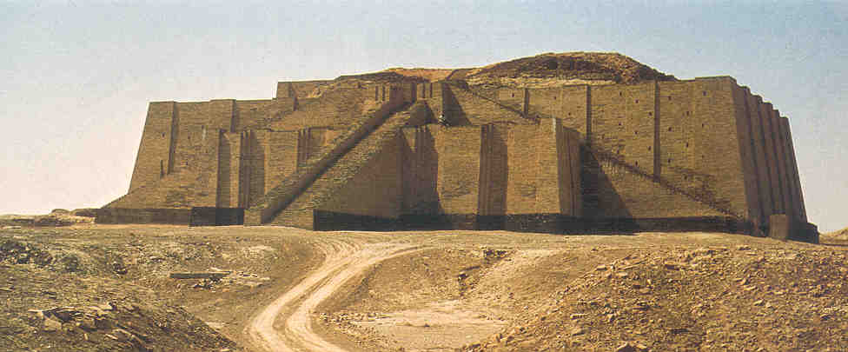
The Ziggurat at Ur (what remains)

Slide 12
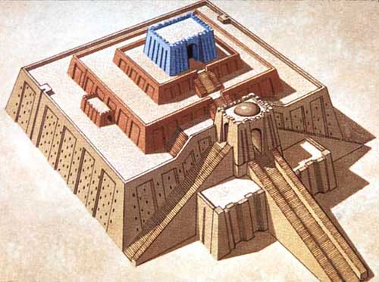
The Ziggurat at Ur (reconstruction)

Slide 13
The Ziggurat at Ur (reconstruction)
Ceremonial center
Central to city organization
Pyramidal form represents tripartite cosmology of underworld-earth-heavens

Slide 14
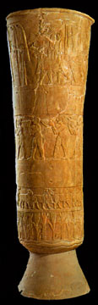
The Warka Vase ca. 3000 BCE
Sumerian
Inanna’s Story Presented as Narrative

Slide 15
Enheduanna (ca. 2250 BCE)
Earliest known poet
Daughter of King Sargon (r. 2270-2215)
Priestess of the Goddess Inanna
Hymns to Inanna imply a personal relationship to deity
Enheduanna uses the first person in her hymns

Slide 16
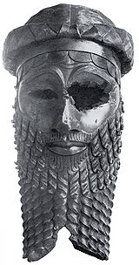
Sargon, Akkadian Emperor

Slide 17
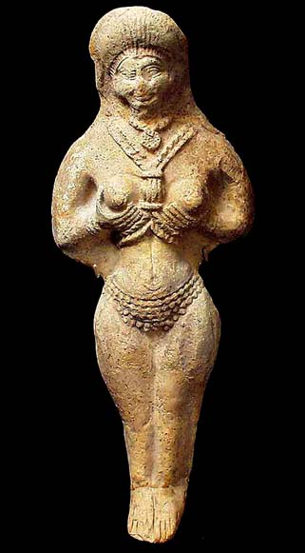
Inanna
A Versatile Goddess
Inanna represented as young, headstrong, beautiful, sexually forward woman
Her attributes include the morning and evening stars, date palms, and beer

Slide 18
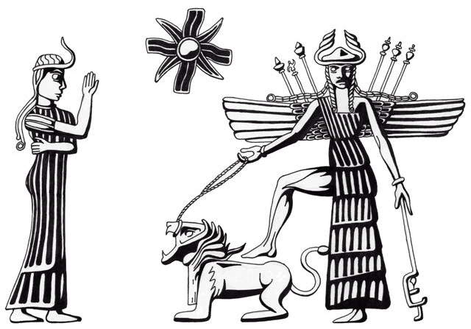
Inanna and Knowledge
Inanna’s name is cognate with the words for knowledge in Sanskrit (jñana), Greek (gnosis) and English (knowledge)
Sexuality and knowledge were linked in Mesopotamia
Triumphant Inanna-Ishtar, winged, with foot on her roaring lion and star symbol, being worshipped by a lesser goddess. Black-stone cylinder seal. Akkadian, ca. 2334-2154 BCE.

Slide 19
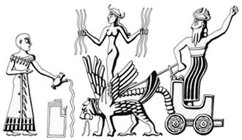
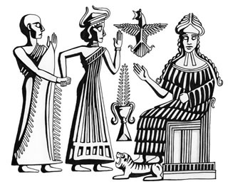
Inanna’s Versatility
Inanna shown here on her throne, pointing to a date palm, and attended by worshippers
Inanna as a bringer of rain (she is holding rain here, standing astride the storm god’s lion)

Slide 20
Four Sacred Texts
The Marriage of Inanna and Dumuzi
The Descent of Inanna
Enuma Elish (cosmogonic myth)
The Epic of Gilgamesh

Slide 21
Four Sacred Texts
The Marriage of Inanna and Dumuzi
  Agriculture and sexual knowledge linked
  Prototype for Eve and Adam
The Descent of Inanna
  Death and Rebirth
    Agricultural and seasonal metaphors
    Possible model for Christian mythology of resurrection
    Sibling rivalry between sisters

Slide 22
Four Sacred Texts
Enuma Elish (cosmogonic myth)
  Battle of Generations, of Genders, of Rational v. Emotional
    Order from Chaos
    Increasing differentiation
The Epic of Gilgamesh
  Power and Restraint
    Rivalry and Friendship
    The “worthy” opponent
    Urban v. rural ways of life
  Question of Immortality
    Flood narrative

Slide 23
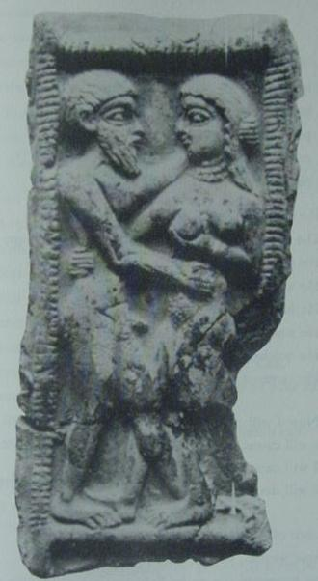
The Marriage of Inanna and Dumuzi
An early poetic text
Shows a balance of female and male powers
Explicitly illustrates the connection agricultural societies draw between the planting of crops and acts of human sexual reproduction.
Parental warning: uninhibited sexual language!
http://www.reweaving.org/inanna2.html

Slide 24
The Marriage of Inanna and Dumuzi
"What I tell you Let the singer weave into song. What I tell you, Let it flow from ear to mouth, Let it pass from old to young:
My vulva, the horn, The Boat of Heaven, Is full of eagerness like the young moon. My untilled land lies fallow.
As for me, Inanna, Who will plow my vulva! Who will plow my high field! Who will plow my wet ground!
As for me, the young woman, Who will plow my vulva! Who will station the ox there! Who will plow my vulva!"
Dumuzi replied:
"Great Lady, the king will plow your vulva. I, Dumuzi the King, will plow your vulva."
Inanna:
"Then plow my vulva, man of my heart! Plow my vulva!"

Slide 25
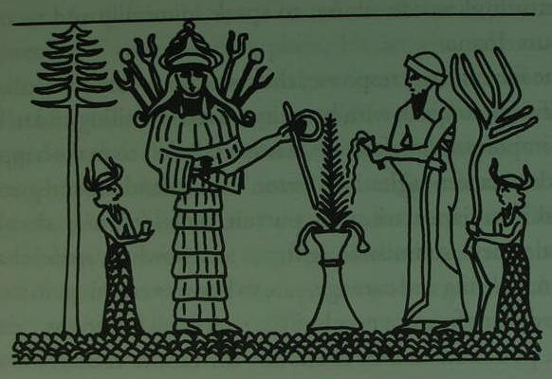
Agricultural Metaphors
"He brought me into his garden. My brother, Dumuzi, brought me into his garden. I strolled with him among the standing trees, I stood with him among the fallen trees, By an apple tree I knelt as is proper.
Before my brother coming in song, Who rose to me out of the poplar leaves, Who came to me in the midday heat, Before my lord Dumuzi, I poured out plants from my womb. I placed plants before him, I poured out plants before him. I placed grain before him, I poured out grain before him. I poured out grain from my womb."
Inanna and Dumuzi in the garden may well
be a prototype for Eve and Adam.
Note the apple tree in the poem.
Note also how Inanna’s body produces
plants like the land produces grain.

Slide 26
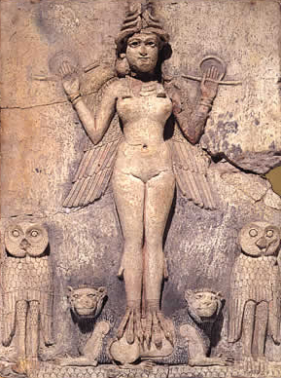
The Descent of Inanna
An early poetic text
Shows a battle between the realms: Inanna and her sister Erishkigal, goddess of the underworld
Themes of humility, death and rebirth
http://www.piney.com/InanasDescNetherKram.html
Erishkigal and Lilith may be two dimensions of the same goddess

Slide 27
COSMOGONY: Types of Creation
ex nihilo - "from nothing" - deity creates by fiat, by authoritative decree, by the sound of a voice or via the abstract idea of creation (e.g. "God said 'Let there be light' and there was light" - the first Genesis narrative in the Hebrew Bible)
emanation - creation as an unconscious or conscious byproduct of a deity's essential nature (e.g. how sun rays emanate from the sun)
artisan - a creator deity fashions creation from available materials (e.g. Marduk's "artful works" with the body of the slain Tiamut)
Generative - primal forces create by means of sexual reproduction or a process metaphorically likened to sexual reproduction
Enabling Force - an agent (deity, power, etc.) who breathes life into what is a dormant or stagnant mass - what Aristotle and the science of mechanics mean by "prime mover" (Aristotle also postulates an "unmoved mover" who is the first cause of all movement yet which is itself not subject to movement. This is a special case of an enabling force.)

Slide 28
COSMOGONY: Types of Creation
ex nihilo = Commands
Emanation = Powers known from your own essence (the effect a cheerful person can have; the effect that the mere appearance of a loving mother can have on a crying child)
artisan = a sculptor, or a good cook working with ingredients
Generative = sexual reproduction
Enabling Force = you with your car keys.

Slide 29
COSMOGONY: Basic Themes
Movement from chaos to order
    Chaos often represented as watery or fluid
Order manifests through increasing differentiation
    Creation of time
    Separation of land and water
    Naming of animals, places, people

Slide 30
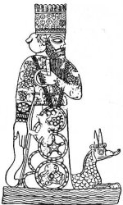
Marduk:
Chief God of Babylonian Pantheon

Slide 31
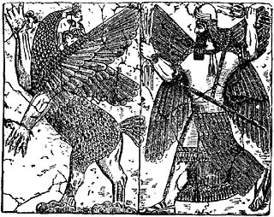
ENUMA ELISH
Creation myth
Enuma Elish = In the beginning
Tiamut and Marduk in battle
Chaos and order
Read in a ritual context
Heiros Gamos = divine wedding
http://www.sacred-texts.com/ane/enuma.htm
http://faculty.gvsu.edu/websterm/Enuma_Elish.html

Slide 32
The Epic of Gilgamesh
Gilgamesh a deified heroic king
Described as a child of the gods (2/3, 1/3 split)
With his rival-then-friend, Enkidu, goes on heroic adventures
After spurning Ishtar/Inanna, Enkidu dies
Gilgamesh searches for his friend and the secret for immortality
Meets Utnaphistam, sole survivor of the great flood
Gilgamesh cannot be immortal, so rededicates himself to being a good king and leader
http://www.ancienttexts.org/library/mesopotamian/gilgamesh/tab1.htm

Slide 33
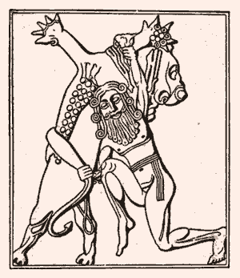
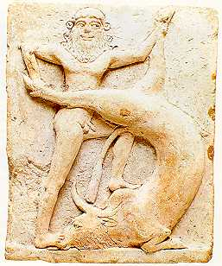
Gilgamesh and the Bull of Heaven

Slide 34
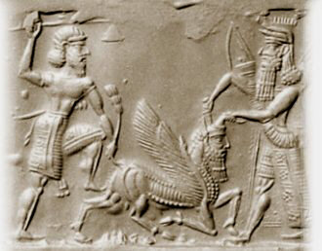
Enkidu, Gilgamesh and the Bull of Heaven
Enkidu and Gilgamesh represent the tension, and then the collaboration, between rural and urban ways of life
Enkidu and Gilgamesh become the first “buddy” team

Slide 35
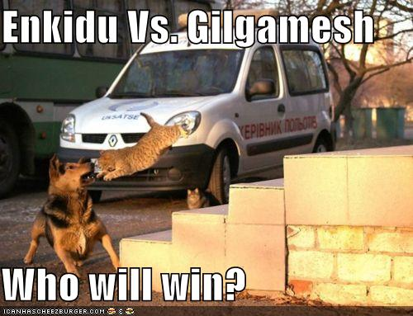
Enkidu vs. Gilgamesh, then…

Slide 36
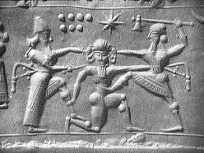
Enkidu and Gilgamesh are Friends
Enkidu and Marduk Slaying Humbaba

