Slide 1
The Protestant Reformation
1500-1600

Slide 2
Umbrella Chart of Christianity

Slide 3
Protestant Reformation I

Slide 4
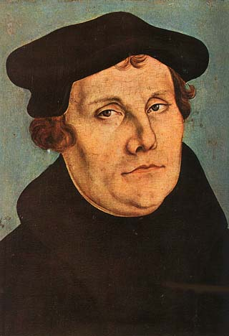
Martin Luther (1483-1546)
Author of 95 Theses, opposing the Catholic Church’s arrogation of God’s sovereignty – 1517
Theology: People are saved by 1) Faith alone, and that Faith is in the Scriptures alone, a.k.a. The Word of God (double meaning of scripture and Jesus)

Slide 5
Changes instituted by Luther
Use of vernacular: translated the Bible into German
Emphasis on preaching from/about the Bible, rather than on sacramental ritual
Rejection of Papal authority

Slide 6
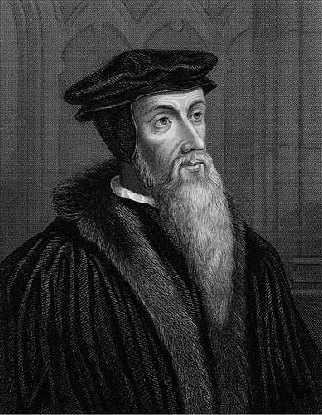
Jean Calvin (1509-1564)
Calvin is, with Luther, the most significant Magisterial Reformer
Active in France and Switzerland
In Geneva, helps establish and maintain a Protestant theocracy

Slide 7
Calvin’s Theological Contributions
Calvin stresses God’s absolute sovereignty
This includes
  pre-destination – God’s foreknowledge of what will happen to us
  the inability of humans to influence God
  the ultimate unworthiness of any human being to receive salvation from God

Slide 8

Jean Calvin and Thomas Hobbes
Bill Wasserman playfully named his rambunctious & mischievous comic characters after the two most depressing philosophers in European history!

Slide 9
Biblical Interpretation
Lutheranism and Calvinism represent two approaches to Biblical interpretation
Luther says that when the Bible is silent on an issue, we can use our best judgment on it
Calvin says that when the Bible is silent on an issue, we cannot participate in it
Example: Use of musical instruments in church

Slide 10
Biblical Interpretation
Catholic Church warned against multiple interpretations of scripture
Protestants do disagree about scripture, and how to interpret it
Protestants = better to be right and alone, then wrong in a group, like they think the Catholics are
Catholics = we can work this out and stay together as a family of believers

Slide 11
Music in the Tensions of Religion
High-church Protestants (Lutherans and Anglicans), because of their emphasis on text and use of the vernacular, and their spiritual trajectory toward individual introspection, encouraged creation of new religious music.
However, Calvinist churches (Dutch Reformed and Presbyterian) insisted that instrumental music did not belong in worship. They also sought to reduce music’s presence and impact in secular society.

Slide 12
Biblical Basis
Colossians 3:16 (from the Epistles of Paul)
“Let the word of Christ dwell in you richly in all wisdom; teaching and admonishing one another in psalms and hymns and spiritual songs, singing with grace in your hearts to the Lord.”
Luther, Zwingli and Calvin are each concerned about following the Word of God, but have different rules of interpretation of the Biblical texts

Slide 13
Biblical Basis
Colossians 3:16 (from the Epistles of Paul)
“Let the word of Christ dwell in you richly in all wisdom; teaching and admonishing one another in psalms and hymns and spiritual songs, singing with grace in your hearts to the Lord.”
Luther will interpret this as saying one should have music in worship and for devotion
Zwingli will interpret this as saying one should NOT have music, except silently (“in your heart”)
Calvin will interpret it as allowing vocal music but no instruments in church

Slide 14
Biblical Basis
Psalms 98: 4-6
“Make a joyful noise unto the Lord, all the earth: make a loud noise, and rejoice, and sing praise.
Sing unto the Lord with the harp; with the harp, and the voice of a psalm.
With trumpets and sound of cornet make a joyful noise before the Lord, the King”

Slide 15
Biblical Basis
Psalms 98: 4-6
“Make a joyful noise unto the Lord, all the earth: make a loud noise, and rejoice, and sing praise.
Sing unto the Lord with the harp; with the harp, and the voice of a psalm.
With trumpets and sound of cornet make a joyful noise before the Lord, the King”
Luther uses this passage to justify organs (can sound like trumpets and cornets, and they are loud)
Calvin and Zwingli argue that this is part of the Old Dispensation, since Jesus is not recorded participating in any such loud, noisy, instrumental music
Calvin also notes that the organ is not mentioned explicitly, and therefore forbidden

Slide 16
Zwingli contra Music
Zwingli (1484-1531) – Protestant in Zurich – argues against music in worship, saying it will distract from the Word
Believed worship should not be ostentatious, nor a crying aloud, nor showing off
Concerned to distance nascent Protestant worship from Catholic ritual in form and style
Music in worship not explicitly commanded by God in Old or New Testament
Christ instructed men to pray to God individually and in private
Saint Paul urged men, when together, to worship God and pray to Him in their hearts – silently

Slide 17
Luther in favor of Music
Luther believed that the entire congregation was part of the universal community of believers
Thus all people should participate in worship (opposition to Catholic division of labor in ritual)
Luther encouraged the congregation to sing chorales in their own languages, so that the Word of God might be engrained in their hearts and minds.

Slide 18
Luther in favor of Instrumental Music
Luther argued that music can have a positive psychological effect on the worshipper
God speaks with us through His Word, and we in response speak with Him through prayer and praise - Luther’s famous formulation in the sermon for the dedication of the castle church in Torgau (1544)
Music affirmed as part of the goodness of God’s creation. Therefore, playing music and creating music could help develop a believer’s faith and morality. This attitude leads to Schütz and Bach.

Slide 19
Where Luther and Zwingli converge
Luther’s positive theology of music, and Zwingli’s alienation of music from worship, both result in the growth of a culture of music among Protestants.
Zwingli and other Calvinists were not against music per se, and encouraged music in the home, opening the way to secular music culture.
Luther’s sacred assessment of music leads to the notion that music can be an aid to devotion and ethics, influencing status of classical music.

Slide 20
Martin Luther: A Mighty Fortress
Hymn based on popular song forms of his day
Use of vernacular everyday German
Congregational singing possible
Protestant theology makes self-reflection imperative for every one; hymns internalize both praise and self-examination

Slide 21
Martin Luther: Ein’ feste Burg
Ein’ feste Burg ist unser Gott, Ein gute Wehr und Waffen; Er hilft uns frei aus aller Not, Die uns jetzt hat betroffen. Der alt’ böse Feind, Mit Ernst er’s jetzt meint, Gross’ Macht und viel List Sein’ grausam’ Ruestung ist, Auf Erd’ ist nicht seingleichen.
Mit unsrer Macht is nichts getan, Wir sind gar bald verloren; Es steit’t für uns der rechte Mann, Den Gott hat selbst erkoren. Fragst du, wer der ist? Er heisst Jesu Christ, Der Herr Zebaoth, Und ist kein andrer Gott, Das Feld muss er behalten.
Und wenn die Welt voll Teufel wär’ Und wollt’ uns gar verschlingen, So fürchten wir uns nicht so sehr, Es soll uns doch gelingen. Der Fürst dieser Welt, Wie sau’r er sich stellt, Tut er uns doch nicht, Das macht, er ist gericht’t, Ein Wörtlein kann ihn fällen.
Das Wort sie sollen lassen stahn Und kein’n Dank dazu haben; Er ist bei uns wohl auf dem Plan Mit seinem Geist und Gaben. Nehmen sie den Leib, Gut, Ehr’, Kind und Weib: Lass fahren dahin, Sie haben’s kein’n Gewinn, Das Reich muss uns doch bleiben.

Slide 22

Martin Luther: A Mighty Fortress
A mighty fortress is our God, a bulwark never failing; Our helper He, amid the flood of mortal ills prevailing: For still our ancient foe doth seek to work us woe; His craft and power are great, and, armed with cruel hate, On earth is not his equal.
Did we in our own strength confide, our striving would be losing; Were not the right Man on our side, the Man of God’s own choosing: Dost ask who that may be? Christ Jesus, it is He; Lord Sabaoth, His name, from age to age the same, And He must win the battle.
And though this world, with devils filled, should threaten to undo us, We will not fear, for God hath willed His truth to triumph through us: The Prince of Darkness grim, we tremble not for him; His rage we can endure, for lo, his doom is sure, One little word shall fell him.
That word above all earthly powers, no thanks to them, abideth; The Spirit and the gifts are ours through Him who with us sideth: Let goods and kindred go, this mortal life also; The body they may kill: God’s truth abideth still, His kingdom is forever.

Slide 23
Magisterial Reformation
The Magisterial Reformation has three features
  Acknowledged relation between secular and sacred authority (i.e. magistrates)
  Guarding of dignity (and retention of some ritual) in church buildings and surroundings (sense of majesty)
  Retention of layers of hierarchy as a key component of cosmology

Slide 24
Protestant Reformation II

Slide 25
Radical Reformation
The Radical Reformation has four features
  Denies that secular authority should also hold religious power
  Maintains that there should be no intermediaries between God and individual believers
  Questions social conventions, such as marriage, taxes, warfare, and infant baptism
  Uses the Reformation as an opportunity to question all things

Slide 26
The Reformation and Change
The Reformation unleashed an energy for change in many areas of life, because the authority of the Catholic Church had never been successfully challenged before.
This fuels the Radical Reformation
"The theses of this Augustinian from Thuringia had the effect of lightening in a powder magazine. The manifold and contradictory strivings of the knights and the middle-class, the peasants and the plebians, the princes craving for sovreignty, the lower clergy, secretly playing at mysticism and the learned writer's opposition of a satirical and burlesque nature, found in Luther's theses a common expression around which they grouped themselves with astounding rapidity." (Engels The Peasant War in Germany, 93)

Slide 27
Intermediaries between God and us
Catholic Church - many levels of clergy and sacrament, plus secular authority
Magisterial Protestant - fewer, but still some, layers of clergy/ritual + secular authority
Radical Reformation - as few intermediaries as possible between God and ourselves
God
Clergy
Kings
Rituals
Us
God
Clergy
Kings
Rituals
Us
God
Us

Slide 28
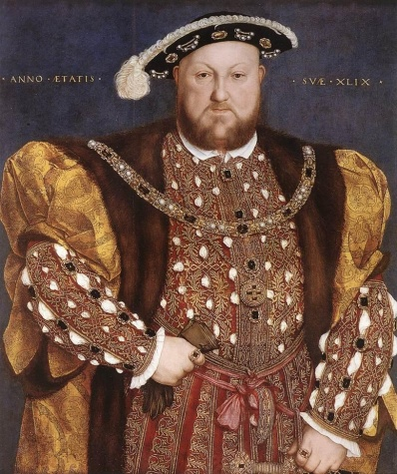
Meanwhile, back in England…
The Anglican Reformation has its own peculiar course to take…
Henry VIII was the big cheese there
A theologically conservative king who broke with the Pope
There’s more to the story, of course…

Slide 29
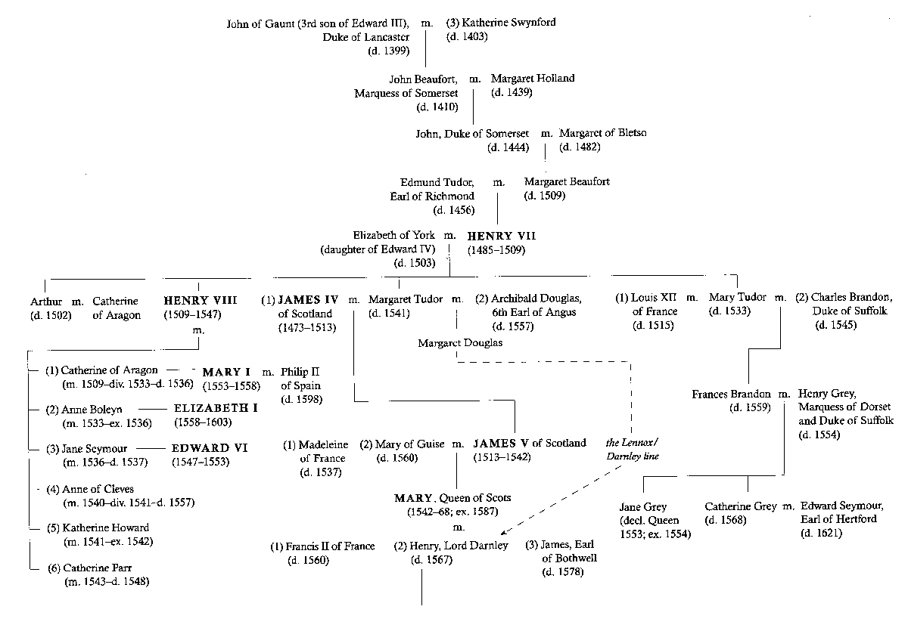
Family Tree of Henry VIII
JAMES VI/I
1566-1625, r.1603-1625

Slide 30
The Tudor Dynasty
(1485-1547)
{Richard III (r.1483-1485) - last of house of York, his death ends wars of succession known as the War of the Roses}
Henry VII (r. 1485-1509) - establishes the house of Tudor; allies England with Spain
Henry VIII (r. 1509-1547) - establishes Church of England (Anglican church) with break from Papal authority over divorce and authority questions

Slide 31
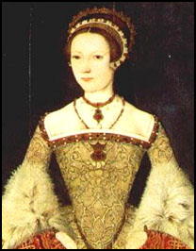
The Tudor Dynasty: Protestants post-Henry VIII (1547-1553)
Edward VI (r. 1547-1553) Church of England becomes more firmly Protestant in its theological orientation
Lady Jane Grey (r. 1553) In an attempt to keep England Protestant, Lady Jane Grey, grand-daughter of Henry VII, was placed on the throne instead of Mary. The coup failed; she is executed a few years later.

Slide 32
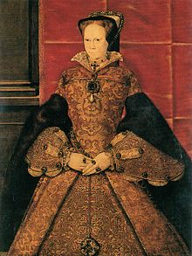
The Tudor Dynasty: Catholicism returns (1553-1558)
Mary I (r. 1553-1558)
Daughter of Henry VIII and Catherine of Aragon, she took her mother’s side in the Great Divorce
Attempts to re-establish Catholic Church as the official church of England; marries Philip II of Spain
persecutes and executes leaders of the Church of England
also known as "Bloody Mary" (she is not the same person as Mary, Queen of Scots)

Slide 33
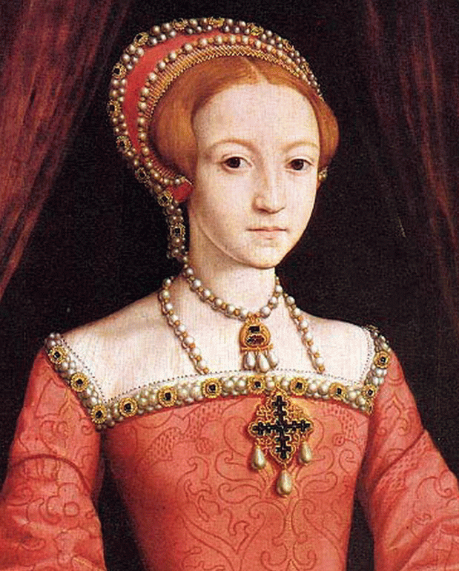
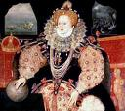
Elizabeth I
(1533-1603, r. 1558-1603)

Slide 34
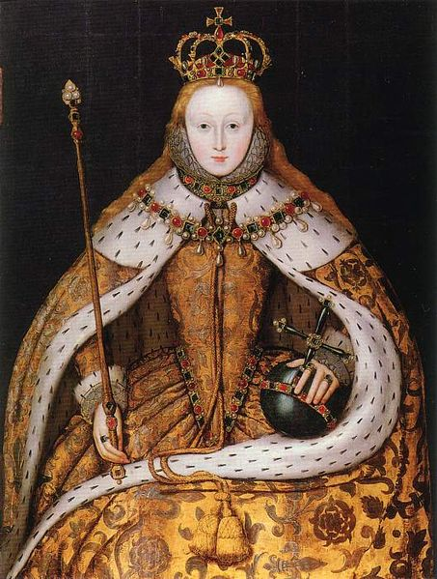
Elizabethan Settlement I
To control religious pluralism and dissent, Elizabeth declared in 1559 that
All citizens of England were members of the Church of England (a.k.a. Anglican Church)

Slide 35
Elizabethan Settlement II
In exchange for religious conformity to the Church of England, Elizabeth vowed not to examine the personal religious conscience of her subjects
Outward conformity, inner conscience
Religious persecution only when religion motivated a crime

Slide 36
Elizabethan Settlement III
Results of the Settlement:
Church of England an official state church
It retains elements of Catholic organization and ritual
Most conform
Creates blending (and tension) of religion and state
Contrarians resist conformity: Catholics, Puritans, Separatists (Pilgrims)

Slide 37
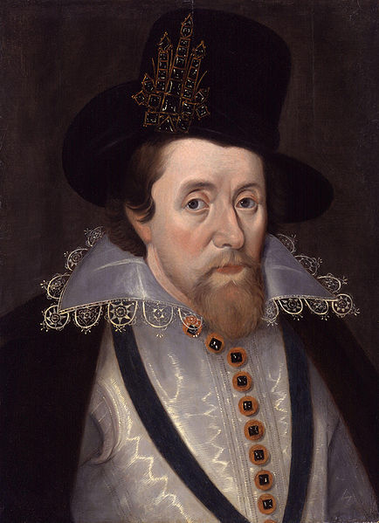
The Elizabethan Settlement’s Discontents
Catholic opposition muted by patriotism (e.g. Spanish Armada) and distancing from domestic terrorism (e.g. Guy Fawkes’ plot)
Separatists refused to conform – lead to “Pilgrims” to America
Conformist Reformers wanted to make Church of England more Calvinist – lead to the Puritans who both come to America, and lead a revolution in England
King James I,
r. 1603-1625

Slide 38
Anglican Reformation

Slide 39
Catholic Reformation
Also called the Counter-Reformation
Council of Trent – held intermittently in Triento, Northern Italy) - 1545-1549, 1551-1552, 1562-1563
Organized by Charles V, Holy Roman Emperor and King of Spain
attempt to clarify Catholic doctrine after reconciliation with Protestants fails
Some reforms in ritual and priestly power
Culturally more rigor against sins of the flesh
  sexual purity
  musical and artistic purity
  against theater, dancing, drinking, popular festivals, and fashion

Slide 40
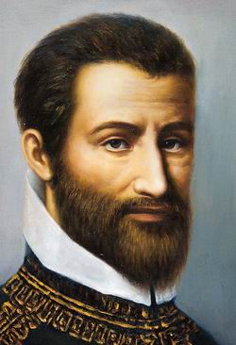
Palestrina (1525-1594)
From town of Palestrina; full name was Giovanni Pierluigi de Palestrina
Not a priest, but a married man with four children
Wrote rules of counterpoint that avoided dissonance

Slide 41
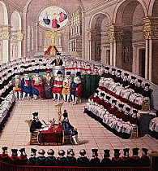
Council of Trent
Held in Trento, Italy: 1545-1549, 1551-1552, 1562-1563
Convened by Charles V of Spain
Needed to clarify church doctrine against Protestant challenges
Catholic Church Councils convene all the cardinals, leading bishops, and key theologians

Slide 42
Council of Trent of Music
All things should indeed be so ordered that the Masses, whether they be celebrated with or without singing, may reach tranquility into the ears and hearts of those who hear them, when everything is executed clearly and at the right speed. In the case of those Masses which are celebtrated with singing and with organ, let nothing profane be intermingled, but only hymns and divine praises. The whole plan of singing in musical modes should be constituted not to give empty pleasure to the ear, but in such a way that the words be clearly understood by all, and thus the hearts of the listeners be drawn to desire of heavenly harmonies, in the contemplation of the joys of the blessed….They shall also banish from church all music that contains, whether in the singing or in the organ playing, things that are lascivious or impure” – Council of Trent Canon on Music to be used in the Mass, September 1562

Slide 43
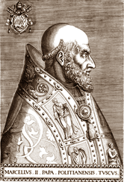
Pope Marcellus II
Elected in April 1555
Died 22 days later!
Palestrina had been friends with previous Pope; therefore he was in the Vatican Choir
Palestrina wrote the mass that bears the Pope’s name for the 1555 commemoration of Good Friday

Slide 44
Pope Marcellus Mass
Reputed to have saved polyphony for Catholic church music
Beauty of the ritual made additionally pleasing to human and divine audience

Slide 45
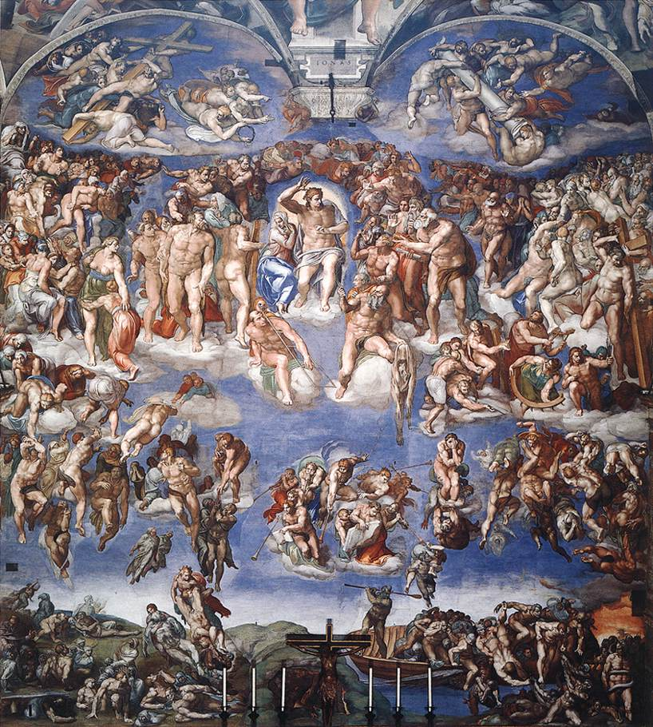
Sexual Purity in Art
Pope Paul IV (r. 1555-1559)
As part of Council of Trent reforms, demands that all nude figures in the paintings and sculptures of the Sistine Chapel, be clothed!
Daniele da Volterra painted the panties on to Michelangelo’s work!

Slide 46
Paul IV also disciplines Palestrina
Pope Paul IV (r. 1555-1559)
As part of Council of Trent reforms, demands that all members of the Sistine Chapel Choir, be umarried!
Palestrina strikes back by publishing a set of secular madrigals, and claims to be a member of the choir still!

Slide 47
Mainline Protestantism
Lutherans, Methodists,
United Church of Christ,
Presbyterians, and Episcopalians

Slide 48
Lutherans
The various Lutheran churches all stem from Martin Luther, and are therefore a part of the Magisterial Reformation.
Lutheran churches in Europe are centered around central Europe and Scandinavia, and include a number of national churches.
Lutherans in the colonies were most represented in New Sweden, a brief-lived Swedish colony, later absorbed into New Jersey and Delaware.

Slide 49
Presbyterians
The Presbyterian Church is a Magisterial Protestant church, based in Scotland, formed in the 1550s and 1560s. Its theological basis is Calvinistic.
The term “Presbyterian” refers to their form of organization and governance by elders, known as “Presbyters.”
Scottish immigration to the colonies, and later to the United States, included significant settlements throughout the eastern seaboard, Appalachia, and the upper Midwest. They also sponsored an aggressive “home missionary” campaign in the nineteenth century, that proselytized and established colleges and other institutions.

Slide 50
Episcopalians
The Episcopalian church is the American name for those who follow the practice of the Church of England. Following the American Revolution, “Anglicans” thought it would be better to re-name their religious practice so as not to appear disloyal, and to better reflect their church’s bishop-based form of organization.
The Episcopal Church is strongest on the East Coast, where it played a role in all of the original colonies.

Slide 51
Congregationalists
The name Congregationalist meant that this denomination organized itself around each individual congregation (those who attend church at a single location). The logic of Congregationalism is that each congregation can be self-governing, because the people within it know each other better than an external, distant authority (meaning they rejected rule by a pope, bishop, or king)
The Pilgrims were Congregationalists; the Puritans soon became so in America.

Slide 52
Methodists
The Methodist church has aspects of a Radical Reformation denomination, but it is also an offshoot of the Church of England. It was started in the 18th century by two brothers, John and Charles Wesley, who feared that modern life and urbanization was distracting people from their religious needs. They devised a “method” for individuals to stay focused on religion through daily prayer and reflection.
The Wesley brothers traveled to the colony of Georgia in the 1730s.

Slide 53
Baptists
Baptists were Radical Reformers, originally known as Ante-Baptists.
Believe in autonomy of each congregation, priesthood of all believers, adult baptism, and Biblical basis for belief
Very large denomination, but not very unified because of doctrines of autonomy

Slide 54
Evangelical Christianity in America
Great Awakenings,
Religions of the Oppressed,
Emotional Immediacy

Slide 55
Historical and Style Distinctions in Protestant Christianity
Magisterial Reformation
State Churches
Uphold God’s Authority by Reinforcing Earthly Authority
Stress decorum and orderliness in worship
Side with ruling class
Lutherans, Calvinists, Anglicans/Episcopalians
Radical Reformation
Independent Churches
Hold God’s Authority as only necessarily legitimate authority; decry mediation between individuals and God
Allow for bodily involvement in worship
More populist
Baptists, Methodists, Evangelicals

Slide 56
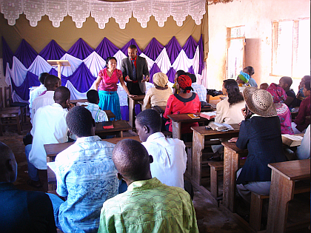
Characteristics of
Evangelical Christianity
Urgency of the Gospel message
Emotional immediacy in preaching and practice
Directly feeling the power of God (“have you let Jesus into your heart?”)
Being “born again” in a new life with Jesus
Following “The Great Commission” to proselytize actively (Matthew 28:16-20)
American missionaries preaching
in East Africa

Slide 57
America’s Great Awakenings
Awakenings are periods in American history when evangelical religion has held wide-spread appeal, and been a major influence on culture and even politics.
There are at least two, and possibly as many as four, Great Awakenings (the number varies depending on the historian in question)

Slide 58
America’s Great Awakenings
First Great Awakening, ca. 1730-1760
Second Great Awakening, ca. 1800-1850
Third Great Awakening, ca. 1880-1925
Fourth Great Awakening, ca. 1980-now
The First and Second Great Awakenings are generally agreed upon. The last two are not as commonly known by these numerical names.

Slide 59
FIRST GREAT AWAKENING ca. 1730-1760
• Calvinist in focus
• Helps to form Colonial American identity
    Awakening prompted by decreasing church attendance
    Earliest intense period of evangelical Christianity in America
    Utilized immediacy of gospel message to revive religious dedication
    Itinerant preachers traveled to frontier outposts (w. NY, w. PA, GA)
      Opposition to “settled” clergy, preached most notably by Gilbert Tennent (1703-1763) in his sermon “Danger of an Unconverted Ministry” (1743), which suggested that settled ministers had not experienced the Spirit of God
    Tension between itinerant preachers and settled ministers
    Establishment of Radical Reformation ideas in the deep South and Midwest, via the Methodist and Baptist denominations.

Slide 60
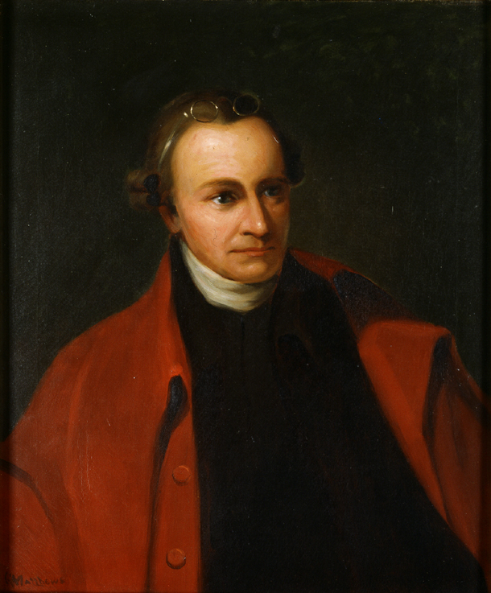
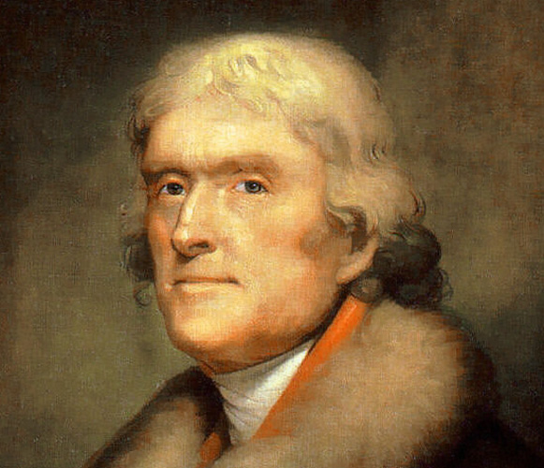
Evangelicalism & the Founding Fathers
The generation that led the American Revolution were mostly not evangelicals. In fact, most of the Founding Fathers, especially Thomas Jefferson (right), reacted against what they saw as the irrationality and emotional excesses of the Great Awakening.
One exception was Patrick Henry (left) of Virginia
While the leaders of the American Revolution were not evangelical, many of the participants were. The Great Awakening had helped people articulate their own sense of individual conscience. These empowered people were ready to think for themselves politically, too.
Baptists and Methodists were among the denominations whose preachers gave support to the American Revolution.

Slide 61
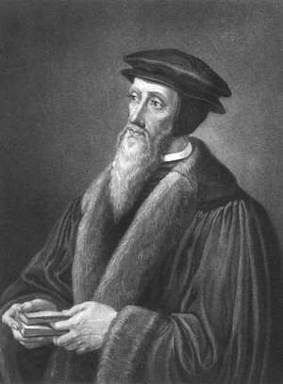
Calvin’s T.U.L.I.P.
Calvinism stresses God’s transcendence
T = Total Depravity
U = Unconditional Election (salvation)
L = Limited Atonement
I = Irresistable Grace
P = Perserverance of the Elect/Saints
It is up to God to choose to act on you, not up to you to demand God give you attention

Slide 62
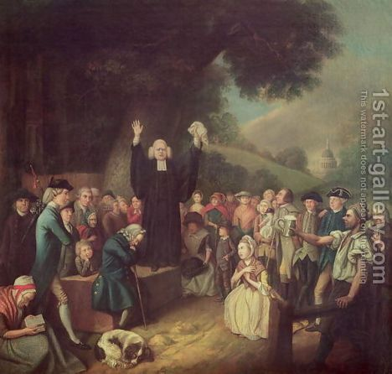
George Whitefield (1714-1770)
prominent preacher in both England and the American colonies, especially Georgia and the American south.
a skilled open-air preacher, able to preach to 10,000 and more without amplification.
helped establish the evangelical pattern known today as “non-denominationalism,” urging conversion to Christianity regardless of what denomination one eventually chose to follow.
In 1740, in Boston, he preached against settled ministers for being too complacent and arid
Whitefield preaching

Slide 63
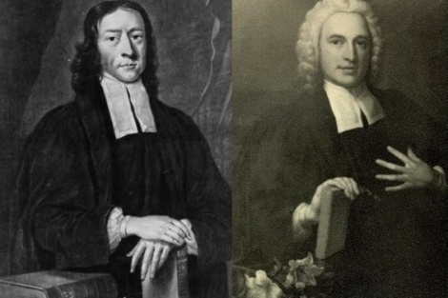
John (1703-1791) and Charles Wesley (1707-1788)
Founders of Methodist denomination in England
Believed that people needed religion to come to them - in their homes and workplaces - rather than forcing people to find religion only inside churches
Encouraged itinerancy
Both spent time in the colony of Georgia, but didn’t like the climate
Friends with Whitefield
John and Charles Wesley

Slide 64
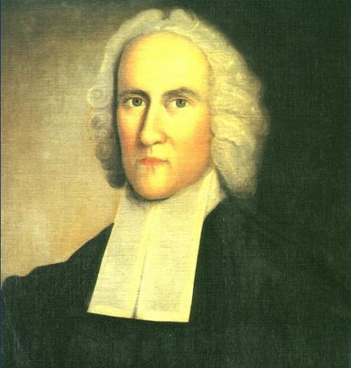
Jonathan Edwards (1703-1758)
Intellectual and theological leader of the First Great Awakening
A Puritan preacher in western Massachusetts, he wanted to make people feel their faith, and not merely give intellectual assent. This is termed “sensationalism”

Slide 65
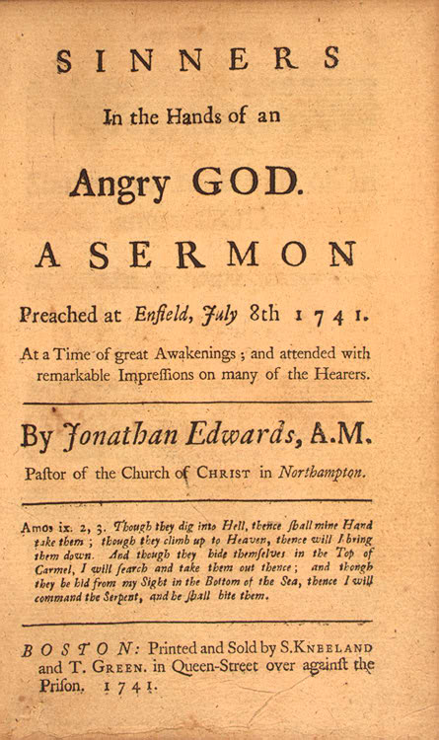
“Sinners in the Hands of an Angry God”
Perhaps the most famous sermon in American history
Delivered in a monotone by Edwards
Parishioners so afraid that they hung onto the railings for fear hell would open beneath them.
Delivered July 8, 1741, Enfield Connecticut

Slide 66
Sinners in the Hands of an Angry God: I
The bow of God's wrath is bent, and the arrow made ready on the string, and justice bends the arrow at your heart, and strains the bow, and it is nothing but the mere pleasure of God, and that of an angry God, without any promise or obligation at all, that keeps the arrow one moment from being made drunk with your blood. Thus all you that never passed under a great change of heart, by the mighty power of the Spirit of God upon your souls; all you that were never born again, and made new creatures, and raised from being dead in sin, to a state of new, and before altogether unexperienced light and life, are in the hands of an angry God.

Slide 67
Sinners in the Hands of an Angry God: II
However you may have reformed your life in many things, and may have had religious affections, and may keep up a form of religion in your families and closets, and in the house of God, it is nothing but his mere pleasure that keeps you from being this moment swallowed up in everlasting destruction. However unconvinced you may now be of the truth of what you hear, by and by you will be fully convinced of it. Those that are gone from being in the like circumstances with you, see that it was so with them; for destruction came suddenly upon most of them; when they expected nothing of it, and while they were saying, Peace and safety: now they see, that those things on which they depended for peace and safety, were nothing but thin air and empty shadows.

Slide 68
Sinners in the Hands of an Angry God: III
The God that holds you over the pit of hell, much as one holds a spider, or some loathsome insect over the fire, abhors you, and is dreadfully provoked: his wrath towards you burns like fire; he looks upon you as worthy of nothing else, but to be cast into the fire; he is of purer eyes than to bear to have you in his sight; you are ten thousand times more abominable in his eyes, than the most hateful venomous serpent is in ours. You have offended him infinitely more than ever a stubborn rebel did his prince; and yet it is nothing but his hand that holds you from falling into the fire every moment. It is to be ascribed to nothing else, that you did not go to hell the last night; that you was suffered to awake again in this world, after you closed your eyes to sleep. And there is no other reason to be given, why you have not dropped into hell since you arose in the morning, but that God's hand has held you up. There is no other reason to be given why you have not gone to hell, since you have sat here in the house of God, provoking his pure eyes by your sinful wicked manner of attending his solemn worship. Yea, there is nothing else that is to be given as a reason why you do not this very moment drop down into hell.

Slide 69
Sinners in the Hands of an Angry God: IV
O sinner! Consider the fearful danger you are in: it is a great furnace of wrath, a wide and bottomless pit, full of the fire of wrath, that you are held over in the hand of that God, whose wrath is provoked and incensed as much against you, as against many of the damned in hell. You hang by a slender thread, with the flames of divine wrath flashing about it, and ready every moment to singe it, and burn it asunder; and you have no interest in any Mediator, and nothing to lay hold of to save yourself, nothing to keep off the flames of wrath, nothing of your own, nothing that you ever have done, nothing that you can do, to induce God to spare you one moment.

Slide 70
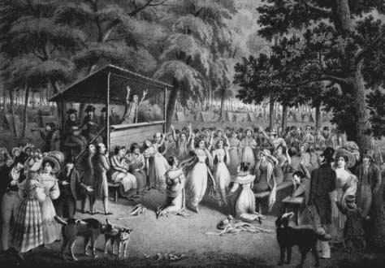
Second Great Awakening

Slide 71
Second Great Awakening
    Arminian in focus
    Prompted by increasing population and geography of United States, and open competition between denominations, due to disestablishment of state churches
    Signature event in establishing full range of evangelical Christianity in America
    Utilized immediacy of gospel message to revive religious dedication in people

Slide 72
Second Great Awakening
    Itinerant preachers traveled to frontier outposts (American “home” and international missions)
    Tension between spontaneous preachers and educated ministers
    Strengthening of individualism in American religious expression
    Politically, the Second Great Awakening propelled progressive movements, such as the Abolition of slavery, fair treatment and education for Native Americans, opening universities, and endorsing the rights of women, more than it helped conservative causes (though compelling interpretations can be made to contest this).

Slide 73
Calvin’s T.U.L.I.P.
Calvinism stresses God’s transcendence
T = Total Depravity
U = Unconditional Election (salvation)
L = Limited Atonement
I = Irresistable Grace
P = Perserverance of the Elect/Saints
It is up to God to choose to act on you, not up to you to demand God give you attention

Slide 74
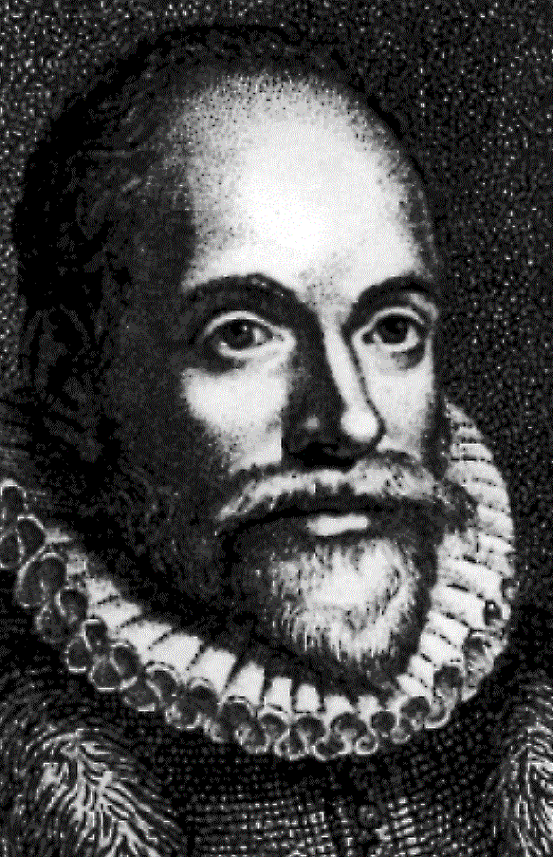
Arminianism revises the T.U.L.I.P., allowing for free will
Rival theology to Calvin, articulated by Jacob Arminius (1560-1609)
T revised to say humans can be aided by the Holy Spirit, and thus are not totally depraved
U revised to say that election is conditioned by faith
L revised to say that salvation is not limited, but only believers will enjoy its benefits
I revised to allow for free will: the grace of God can be resisted, and therefore it can also be accepted.
P revised to say that salvation can be lost and/or reclaimed.

Slide 75
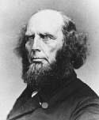
Charles Finney (1792-1875)
Most significant preacher of the Second Great Awakening
Despised Calvinist theology, calling it “an abomination”
Supported abolition of slavery and women’s rights
Founded Oberlin College, first college to admit Blacks and women

Slide 76
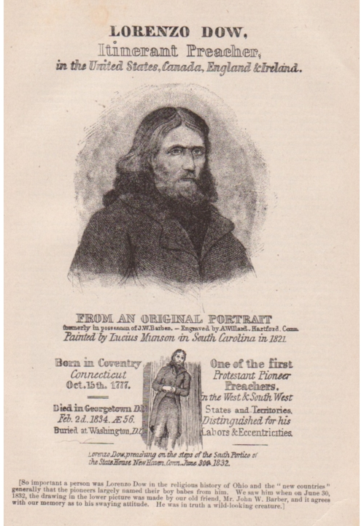
Lorenzo Dow (1777-1834)
A prototypical Second Great Awakening itinerant preacher
Dramatic methods of preaching caused people in his audience to go into convulsions and shaking fits
Internationally known American preacher indicates that the center of evangelical Christianity had shifted to the United States

Slide 77

Jarena Lee (1783-ca. 1850s)
First Woman Preacher of the AME
Traveled extensively as an itinerant preacher
Wrote her autobiography to answer her male critics

Slide 78


Richard Allen and Jarena Lee
Lee had been ‘converted’ and ‘justified’ through Allen’s preaching
She asked him for permission to preach
He at first refuses, but eventually relents
This authorization was challenged by later AME bishops, who sought to marginalize Lee’s contributions
This follows a pattern of women’s participation in religious groups: during a founding period, their participation is more possible than during periods of consolidation and respectability

Slide 79
At the first meeting which I held in my uncle's house, there was, with others who had come from curiosity to hear the woman preacher, an old man, who was a Deist, and who said he did not believe the coloured people had any souls - he was sure they had none. He took a seat very near where I was standing, and boldly tried to look me out of countenance. But as I labored on in the best manner I was able, looking to God all the while, though it seemed to me I had but little liberty, yet there went an arrow from the bent bow of the gospel, and fastened in his till then obdurate heart. After I had done speaking, he went out, and called the people around him, said that my preaching might seem a small thing, yet he believed I had the worth of souls at heart. This language was different from what it was a little time before, as he now seemed to admit that coloured people had souls, as it was to these I was chiefly speaking; and unless they had souls, whose good I had in view, his remark must have been without meaning. He now came into the house, and in the most friendly manner shook hands with me, saying, he hoped God had spared him to some good purpose. This man was a great slave hlder, and had been very cruel; thinking nothing of knocking down a slave with a fence stake, or whatever might come to hand. From this time it was said of him that he became greatly altered in his ways for the better. At that time he was about seventy years old, his head as white as snow; but whether he became a converted man or not, I never heard.

Slide 80
Third Great Awakening (1880-1925)
Responding to urbanization, industrialization, Civil War
Rescue ‘missions’ in cities, such as Young Men’s Christian Association (YMCA)
Active in temperance movement
Ambivalent on immigration, child labor
Utilize popular media of the time

Slide 81
Third Great Awakening (1880-1925)
Involved in the science v. religion debates of modernity
Spawns two opposite movements: very physically and emotionally compelling Pentecostalism, and the intellectual movement known as Fundamentalism
The courtroom victory, but PR defeat suffered in the Scopes Trial, ends this period.

Slide 82
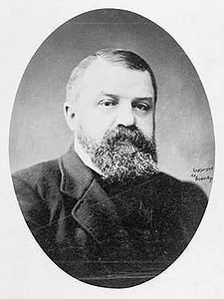
Dwight Moody (1837-1899)
Most significant preacher of the Third Great Awakening
Started his career as a preacher helping sailors to avoid sinning
Raised Unitarian, and attended Henry Ward Beecher’s church, but later rejected liberal Christianity as not providing sufficient discipline or fear of God
Founded Moody Bible Institute in Chicago
Opposed modernizing trends and the rise of scientific explanations
Helped popularize Dispensationalism

Slide 83
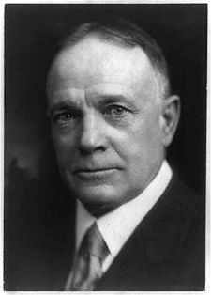
Billy Sunday (1862-1935)
Major league baseball player turned preacher in the Third Great Awakening
Opposed to Darwin’s theory of evolution
Theologically he combined fundamentalism and evangelical style
Very theatric preacher
Played key role in the passage of the Prohibition Amendment
Became very wealthy through his preaching; businessmen supported him because he preached morality to workers, rather than politics!

Slide 84
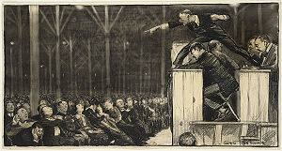
Billy Sunday Preaching
Picture by George Bellows

Slide 85

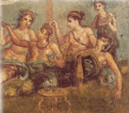
The Rivalry Between
Decorum and Chaos
Religions build themselves around powerful experiences, and experiences of power.
Religions make a cosmological decision to embrace the body/sensuality/sexuality as allies, or regulate them as potential enemies or rivals.

Slide 86

Decorum
Some synonyms for decorum: stately – majestic – dignified – solemn – respectful – staid – sober – formal.
Many (but not all) religions that stress decorum have a strong emphasis on ritual.
Religions concerned with decorum are often trying to mirror the transcendence, majesty, and dignity of the divine.
Religions concerned with decorum are often suspicious of the sensual and the sexual.
African religions involved the body
African-American religions tend
to be less decorous and staid than
European forms

Slide 87
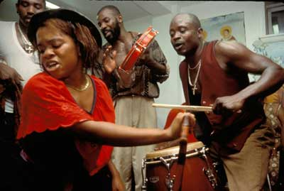

Chaos
Some synonyms for chaos: emotional – feeling – expression – immediacy – urgency — momentous — sensual — energetic — letting loose
Many (but not all) religions that stress chaos use ritual as a gateway to other experiences
Religions concerned with chaos are often trying to enter into the energy of the divine.
Religions concerned with chaos are often allied with the sensual and the sexual.

Slide 88
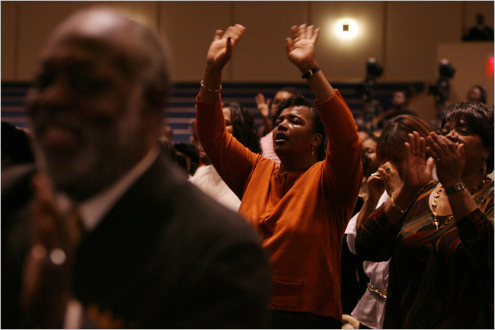
Pentecostalism
Pentecostal movement is a moment of rich interaction between races
The charismatic gifts of the spirit make Pentecostalism physically engaging

Slide 89
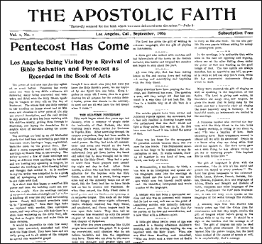
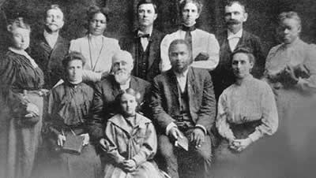
Azusa Street Revival and Pentecostalism’s Egalitarian Origins
William Seymour, 2nd from right, lower row; Jenny Moore, third from left, upper row

Slide 90
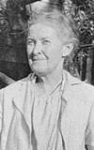
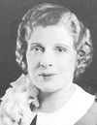
Pentecostalism’s Female Origins
Seymour first attends Charles Parham’s (segregated) classes in Houston through his friendship with Lucy Farrow, African-American governess to Parham’s children
Neely Terry, a friend of Farrow’s from Los Angeles, hears Seymour while visiting in Houston in 1905; she invites Seymour to her friend Julie Hutchinson’s renegade holiness congregation in LA, which is looking for a pastor
Julie Hutchinson had broken from a local Baptist church over matters of Holiness doctrine; while she had first rejected Seymour’s Baptism of the Spirit doctrine, she eventually experienced the Pentecostal rebirth at Azusa
Seymour’s wife Jenny Moore, inherits his ministry at his death in 1922
Among white women, the first person ever to experience the Baptism of the Spirit was Parham’s student, Agnes Ozman, January 1, 1901; the most famous Pentecostal preacher of the Gilded Age was a white woman, Aimee Semple McPherson, the first woman to own a radio station.

Slide 91
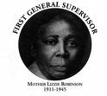
COGIC: Church of God in Christ
Largest African-American denomination in U.S., largest Pentecostal denomination in U.S., fourth largest denomination overall in U.S.
Bishop Charles Mason, the founder, participated in Azusa Street Revivals
Denomination forbids women ministers, but has a powerful Women’s Department. The first head of the Women’s Department, Lizzie Woods Roberson, was independent of Mason (who was divorced), and was given the title of overseer (equivalent to Biblical bishop); this implied parallel governance structures for men and women.

Slide 92
Fundamentalism
Fundamentalism arises in the midst of threats from modernism: Darwin, Marx, Biblical Scholarship, and Psychology
Fundamentalism thrives on a sense of being embattled and intellectually under seige.
Fundamentalism is primarily an intellectual movement, that stresses the limitations of human reason, to reassert God’s transcendence
Fundamentalism demands cleaving to sacred texts as closely (and often as literally) as possible.
The term “fundamentalist” was coined by an American preacher, Curtis Lee Laws, in 1920.

Slide 93
Why are fundamentalisms attractive?
“Conversion to a religion that offers clear answers and belief systems can provide relief from the overwhelming multiplicity of options and cacophony of voices pulling the individual in different directions. It can provide a coherent center from which to conduct one’s life in a world where that center has been lost.” Lewis Rambo, Understanding Religious Conversion p. 31

Slide 94
The ambivalent meaning of “religion”
Recall that the Latin root, ‘religio,’ meaning “to bind,” can have either the sense of constricting (‘binding the slaves’) or connection (‘this binds our family together’).
Note that author Louis Rambo finds this same dynamic in the adoption of fundamentalist perspectives:
“This providing of focus can be viewed either negatively, as a constriction of options, or positively, as a stable creative center or unchanging core that can enrich and expand one’s life.” Lewis Rambo, Understanding Religious Conversion p. 31

Slide 95
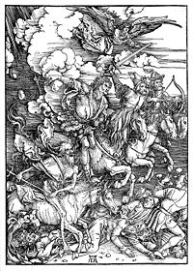
Eschatology
The branch of theology that concerns itself with what happens at the end of time
We encountered this term already, in some of the NRMs of the 19th century
Starting in the mid-19th century, some radical new ideas about eschatology were articulated by British and American evangelical and fundamentalist thinkers
Durer’s Four Horseman of the Apocalypse

Slide 96
Book of Revelation
Final book in New Testament
Contains predictions of destruction
Three chronological ways of interpreting it
  1) Preterism –the events to which Revelation refers are specifically connected to the events of 70 CE and what led to it (John Humphrey Noyes would be a Preterist)
  2) Historicism –the events to which Revelation refers have largely happened already
  3) Futurism – the events to which Revelation refers have not yet happened

Slide 97
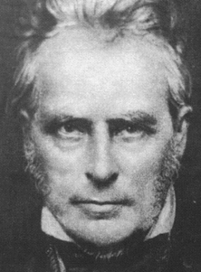
Dispensationalism
John Nelson Darby (1800-1882) and the Plymouth Brethren
Futurist concerning The Book of Revelation, he believed we were living prior to the millennium (pre-millennial)
Divided the time periods of God’s acting in history into different epochs, called “dispensations”
Darby based his teaching on 2 Timothy 2:15

Slide 98
Dispensationalism in the U.S.
Darby traveled widely through the English-speaking world, including the United States, Canada, Australia and New Zealand
He is the ultimate source of the Biblical interpretative school that leads to literal readings of the Bible, and to the idea of the ‘rapture’
Charles Henry Mackintosh (1820-1896) helped popularize ideas of Darby in the U.S.
Converts to dispensationalist interpretations of Christianity were highly influential

Slide 99
Dispensationalism in the U.S.
Cyrus Scofield (1843-1921) produced an important “Bible reference” that correlates all of these doctrines with specific Bible passages, it is still used prominently today
William J. Erdman (1833-1923) established connections toconservative Presbyterians, and built connections to seminaries and publishing houses
Bible Institute of Los Angeles (now called BIOLA University), Moody Bible Institute in Chicago, and other seminaries form a network of Dispensationalist schools

Slide 100
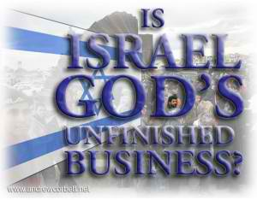
Israel in Dispensationalism
Dispensationalist Christians maintain that the Jews are still God’s chosen people, and will have all promises God made to them fulfilled
Dispensationalists saw the establishment of Israel as a nation in 1948 as an indicator of the veracity of their truth claims

Slide 101
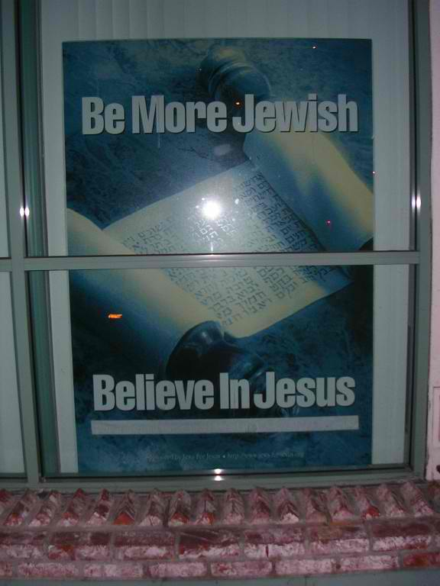
Israel in Dispensationalism
Dispensationalists are sometimes called “Zionist Christians” for their militant support of the nation-state of Israel
Jews for Jesus is a Dispensationalist Christian group that tries to convert Jews as Jews to Christianity

Slide 102
Dispensationalism in American Politics
Dispensationalist views on foreign policy call forth
  Strong support of Israel
  Rejection of attempts at world-wide unity and government
Dispensationalists believe in obeying the government, but not taking anything from it
  Opposition to health care, welfare, etc.

Slide 103
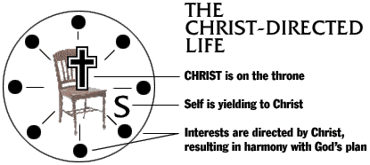
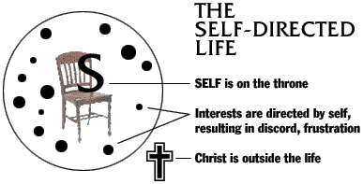
An Evangelical Christian Cosmology

Slide 104
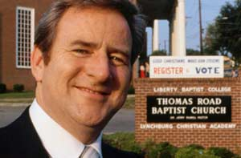
Jerry Falwell (1933-
2007)
Baptist Fundamentalist minister, based in Lynchburg, Virginia (pre-millennial dispensationalist)
Leader and organizer of religio-political group, the Moral Majority, which reacted against the social changes of the 1960s and 1970s
Founded conservative Liberty University in Lynchburg

Slide 105
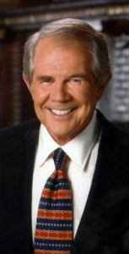
Pat Robertson (b. 1930)
Charismatic Evangelical preacher and leader of the Religious Right
Host of “The 700 Club”
Co-founds the Christian Coalition, the Christian Broadcasting Network, and American Center for Law and Justice (ACLJ)
Based in se Virginia
Ran for President in 1988
Supports Christian Dominionism

Slide 106
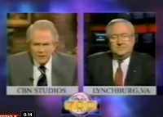
Dualism – Us v. Them – Cosmology at Work
September 13, 2001, 700 Club, Falwell blames 9/11 attacks on sinners who had led God to remove his protection from the USA

Slide 107
September 13, 2001
Falwell: What we saw on Tuesday, as terrible as it is, could be miniscule if in fact God continues to lift the curtain and allow the enemies of America to give us probably what we deserve.
Robertson: Well Jerry, that’s my feeling. I think we’ve just seen the antechamber to terror. We haven’t even begun to see what they can do to the major population.
Falwell: The ACLU’s got to take a lot of blame for this.
Robertson: Oh, yes.

Slide 108
September 13, 2001
Falwell: And I know I’ll hear from them for this but throwing God out successfully with the help of the court system, throwing God out of the public square, out of the schools… The abortionists have got to bear some burden for this because God will not be mocked. And when we destroy 40 million little innocent babies, we make God mad. I really believe that the pagans and the abortionists and the feminists and the gays and the lesbians who are actively trying to make that an alternative lifestyle, the ACLU, People For the American Way — all of them who have tried to secularize America — I point the finger in their face and say, “you helped this happen.”
Robertson: Well I totally concur.

Slide 109
September 14, 2001
Falwell reportedly apologized in a phone call to CNN the next day
“I would never blame any human being except the terrorists, and if I left that impression with gays or lesbians or anyone else, I apologize,” he told CNN, before citing scripture to back up what he originally said. “I do believe, as a theologian, based upon many Scriptures and particularly Proverbs 14:23, which says ‘living by God’s principles promotes a nation to greatness, violating those principles brings a nation to shame,” he said.

Slide 110
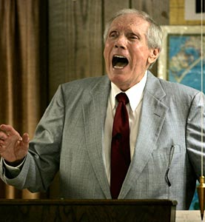
Fred Phelps (b. 1929)
Calvinist Baptist minister of Westboro Baptist Church in Topeka, Kansas
Protests at funerals of AIDS victims and U.S. military deaths to protest nation’s tolerance for homosexuality
Website = godhatesfags.com
Easily the most detested religious figure in America, but he seeks publicity for the truth claims of his theology

Slide 111
Fred Phelps hates Jerry Falwell
Phelps considers Falwell an Armininian, because he appeared in a TV debate with a lesbian political leader, thus legitimating her!

