Slide 1
Western Religions
Religious Studies
Middle East Studies
Humanities
70A

Slide 2
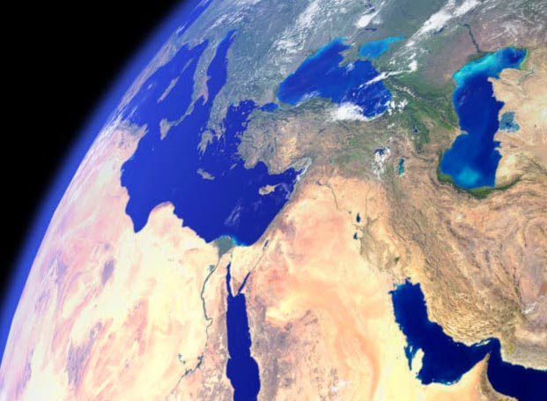
Home of the Western Religions

Slide 3
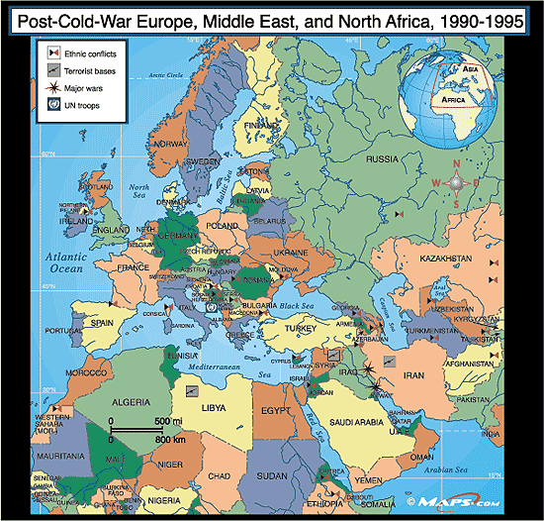

Slide 4
The Influential Ancients
Egypt
Mesopotamia
Zoroastrians (Iran)
Greek and Roman Paganism
Greek Philosophy
  Platonism
  Aristotleanism
  Middle Platonism (Stoicism, Philo)
  Neo-Platonism (Plotinus)

Slide 5
The Religions of the Book
Judaism
Christianity
Islam

Slide 6
The Religions of the Book
Judaism
Christianity
Islam
All three share the following characteristics:
  Monotheistic God
  God acts in history
  Revelation/Intervention from God to humankind
  God uses human beings as prophets
  Continuous story of God’s interaction, starting with Abraham

Slide 7
The Religions of the Book
Judaism
Christianity
Islam
These three religions:
  Share many of the same stories
  Can be understood as successive revelations, in the order listed

Slide 8
The Religions of the Book
Judaism, Christianity and Islam have their differences, too
  Each sees itself as the most recent and the most correct
  Christianity and Islam are universal religions, while Judaism has a universal cosmology but an ethnic basis for membership
  Christianity’s revelation is an incarnation, recorded in writing, while the revelation in Judaism and Islam is the eternal book.

Slide 9
Peoples of the Book
The Three Abrahamic, Monotheistic Religions -
Judaism Christianity Islam
- share many structural similarities, such as a) revelation received from b) a trascendent, monotheistic God who c) acts in history through d) individuals (prophets) and e) historical events (battles, rise and fall of nations, etc.)

Slide 10
Peoples of the Book
The Three Abrahamic, Monotheistic Religions -
Judaism Christianity Islam
- share so much revelation, mythology, ancestry, and structure that they can be called “Sibling religions.”

Slide 11

The Problem with the word “Sibling”
…is that the word that comes most quickly to mind is “Rivalry” - and, indeed, Judaism, Christianity and Islam share aspects of Sibling Rivalry, most prominently the question of who is best loved by the Big Parent

Slide 12
Peoples of the Book
The Three Abrahamic, Monotheistic Religions
and their forms of revelation:
Judaism Christianity Islam
Torah Jesus Qur’an
(as recorded in
New Testament)

Slide 13
Peoples of the Book
The three religions appropriate each others’ revelations sequentially, but with corrections
Judaism Christianity Islam
Torah Jesus/New Qur’an
Testament + “Old” Torah + NT
Testament, ‘corrected’ have truths but
(“the New law”) ‘human errors’ are
corrected by
Qur’an

Slide 14
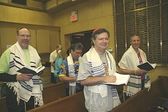
Jewish Worship
This is a morning minyan
From Fair Lawn Conservative Synagogue, New Jersey
What do you notice about this picture?

Slide 15
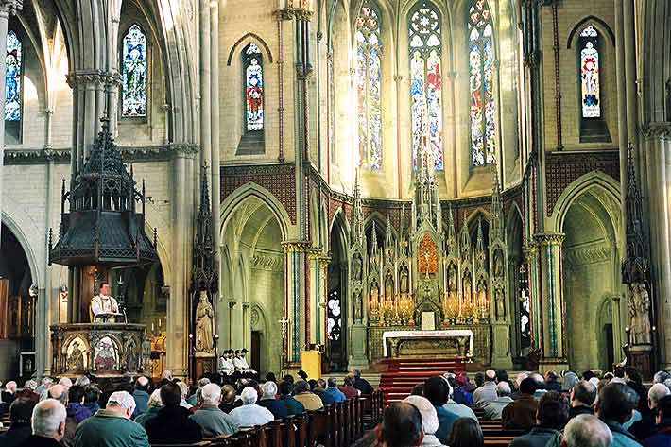
Christian Worship
This is a Sunday Catholic Christian mass
From The Holy Name of Jesus Catholic Church, Manchester, UK
What do you notice about this picture?

Slide 16
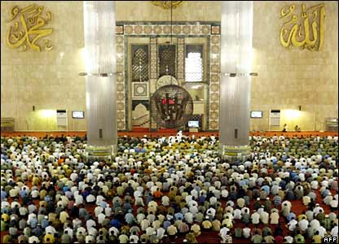
Muslim Worship
This is a Friday prayer service
At the Istiqlal mosque Jakarta, Indonesia
What do you notice about this picture?

Slide 17
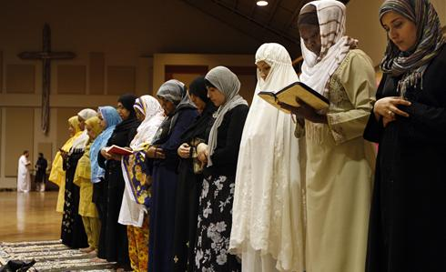
Can We All Just Get Along?
What does this picture tell you?
Now, let’s go to the accompanying article:
http://content.usatoday.com/communities/Religion/post/2011/01/mosque-church-evangelical-islam-christian/1

Slide 18
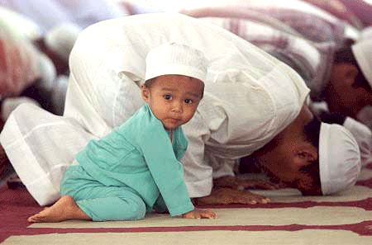
How Do We Learn a Religion?
Generational Continuity
Conversion
Revival (Confirmation, renewed Commitment)

Slide 19
Introduce Yourselves
YOUR NAME
SOMETHING OF INTEREST FROM THE INTRODUCTORY SHEET
SOMETHING OF INTEREST, and MEMORABLE, ABOUT YOU
SOME QUESTION(S) YOU HAVE ABOUT RELIGION, IN RELATION TO THIS CLASS

