Slide 1
Contextualizing a year of significant change
1972

Slide 2
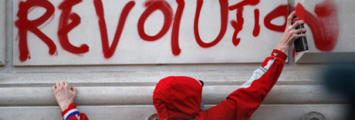
Social issues – fueled by young people
Anti-war Women’s rights Black power Gay liberation Chicano/a movement
Voting rights-age Environmental concerns

Slide 3

FBI spies infiltrate American organizations

Slide 4
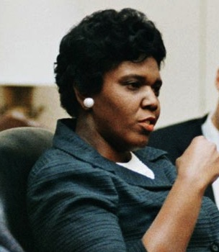
Electoral politics
All levels of government effected by various movements
Increase in numbers of women running for office
Policy changes resulted
Emphasis on domestic issues with eye to equal treatment

Slide 5
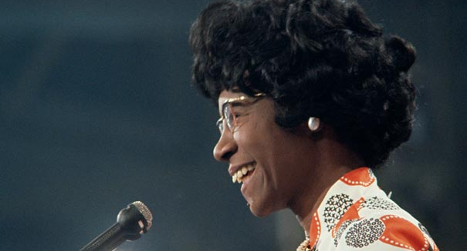
Shirley Chisholm

