Slide 1
Shout Out
Women of Color Respond to Violence
Understanding the book as a work of social literature regarding women of color

Slide 2
What are the defining characteristics of social literature?
Envisioning People understand who they are through the imaginary and the critical
Articulating Formulate thoughtful and lively analytical strategies
Strategizing Opportunities to conceive and develop processes for empowerment
Circulating Emphasis on social networks for the articulation of ideas and processes

Slide 3
Identities evolve from social constructs: ideas about the self
Understanding of position in society through the relationship of self to others
Identity is not a fixed status
Constantly emerges from a variety of situations and setting
In other words, human identities are the products of social constructs

Slide 4
collective envisioning about identity
Race / ethnicity
Culture
Sexual orientation
Disability
Social class status
Rural / urban / suburban
Spirituality / religion
Parenting status
Generation / age
Level of education
What else might shape a personal or collective identity?
Individuals may find identity
forged within the collective self

Slide 5
Shout Out – builds on a legacy regarding identity and activism
Roots in the social literature developed by women of color
Contributors to this body of information include:
Toni Cade Bambara, Alice Walker (African American)
Gloria Anzaldúa, Cherríe Moraga (Chicana)
Paula Gunn Allen (American Indian)
Teresia Teaiwa (Indigenous Pacific Islander – Fijian)
Bushra Rahman, (Middle Eastern / South East Asian)

Slide 6
Collective works by/and about women of color
This Bridge Called My Back (1982)
Making Waves: An Anthology By and About Asian Women (1989)
Spider Woman’s Granddaughters: Traditional and Contemporary Writing by Native American Women (1989)
Haciendo Caras / Making Face, Making Soul (1992)
All the Women are White, All the Blacks are Men, but Some of Us Are Brave (1993)

Slide 7
Artistry = Cultural work
Toni Cade Bambara originated the term “cultural worker” (1982 anthology This Bridge Called My Back)
Acknowledges that creative work is labor
Links the act of creation to the vocation (different from avocation)
Requires an active audience participation

Slide 8
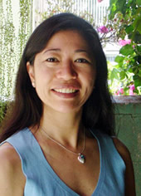
How did the book Shout Out come into being?
Barbara K. Ige
A co-founder of the Women of Color in Collaboration and Conflict Research Cluster at UC Santa Cruz

Slide 9
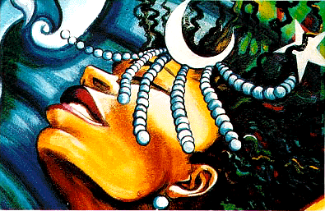
Discussions regarding the persistence of violence against women
María Ochoa
A co-founder of the research cluster and co-editor of a publication Enunciating Our Terms

Slide 10
Process of creating the book
Issue call for papers
Largely web based outreach
Received more than 100 submittals
Pared the submittals to about 70
Approached publishers
Took four years to find a suitable publisher

Slide 11
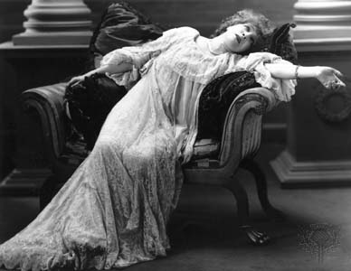
Commitment to the various elements
Poetry
Creative non-fiction
Academic analysis
Visual art

