Slide 1
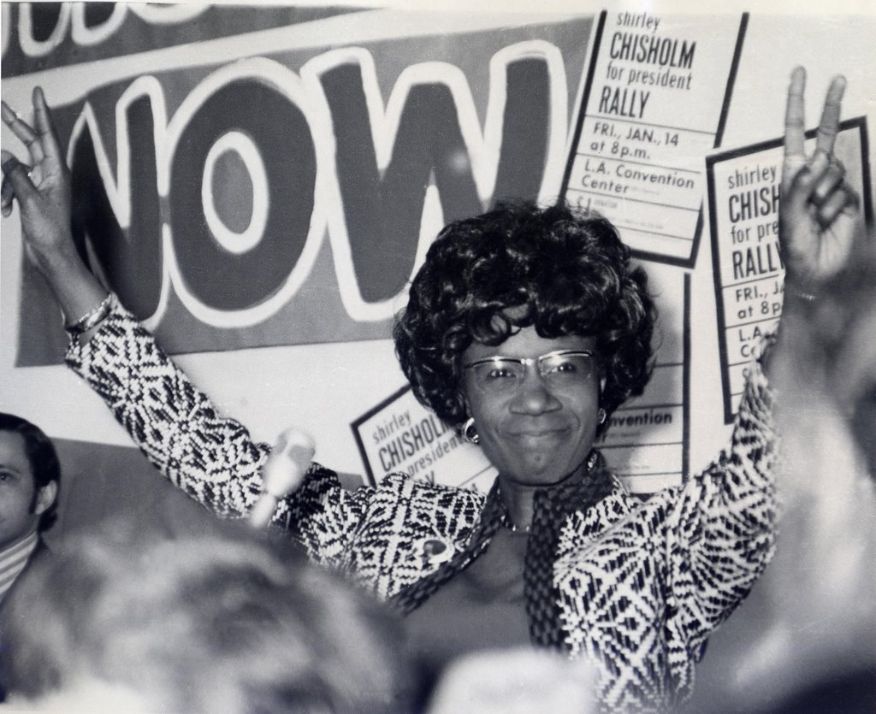
Women elected leaders
a QUITE brief history

Slide 2
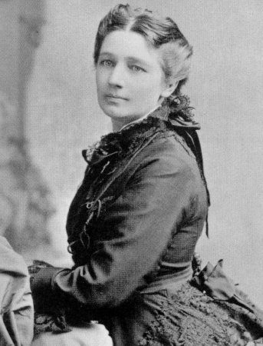
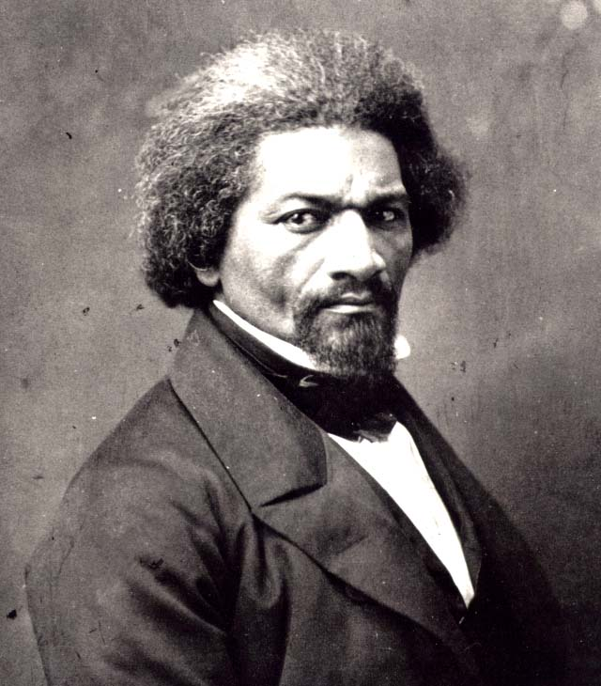
1872 ~ Equal Rights Party
Victoria Woodhull
Frederick Douglass

Slide 3
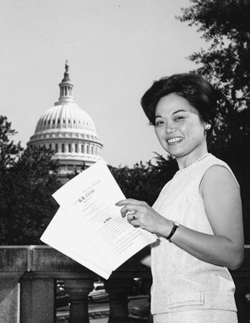
1965 ~ Cong. Patsy Mink
(D - Hawai’i)

Slide 4
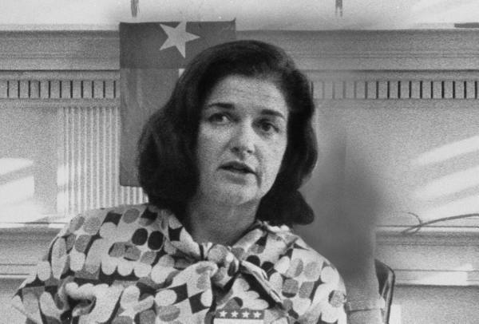
1972 ~ Democratic Party
Frances “Sissy” Farenthold

Slide 5
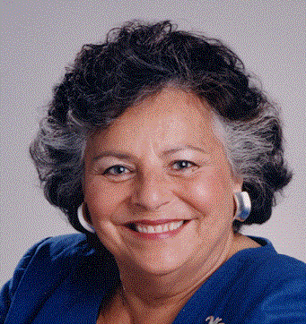
1980 ~ Citizens Party
La Donna Harris (Comanche)

Slide 6
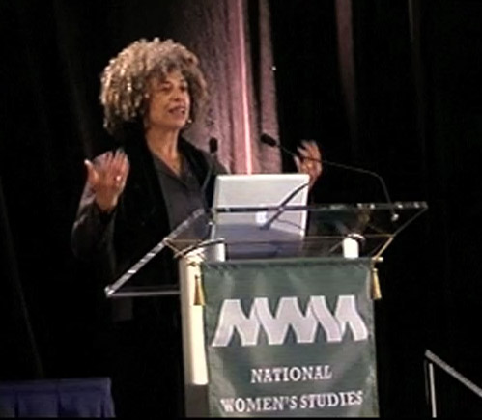
1980 ~ Communist Party USA Angela Y. Davis

Slide 7
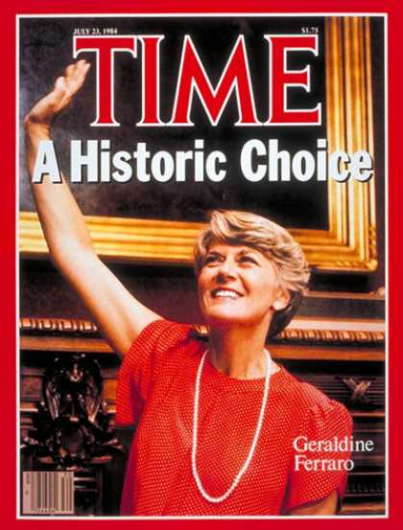
1984 ~ Democratic Party
Geraldine Ferraro

Slide 8
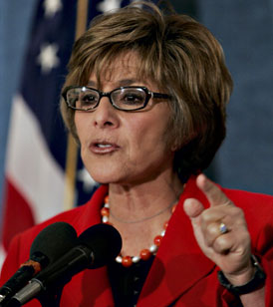
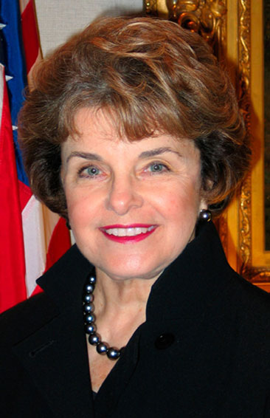
1992 ~ U.S. Senate (California)
Barbara Boxer / Dianne Feinstein

Slide 9
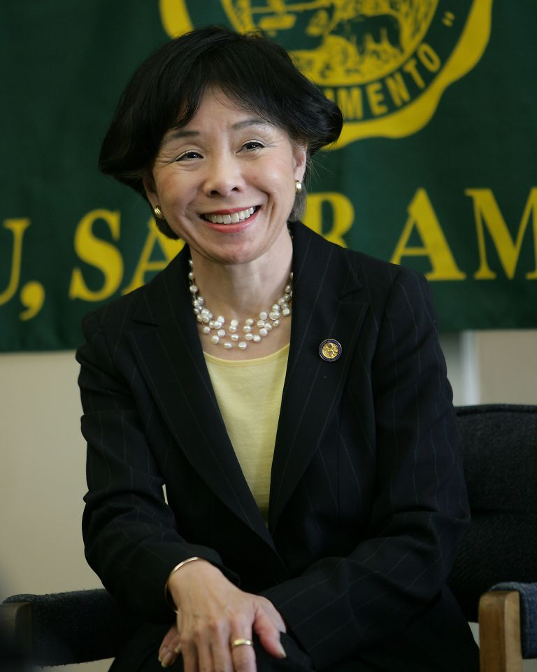
2005 ~ Cong. Doris Matsui (D-CA)

Slide 10
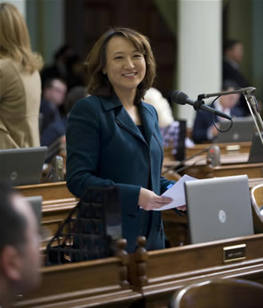
2006 ~ Assemblywoman Mary Hayashi (D-Hayward)

Slide 11
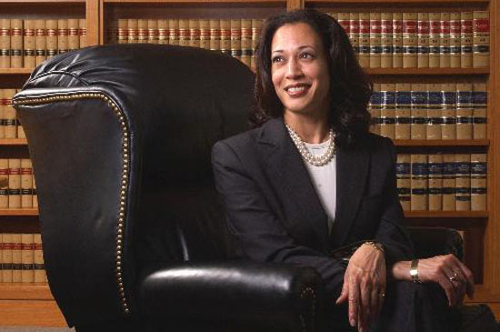
2010 ~ California AG
Kamala Harris

Slide 12
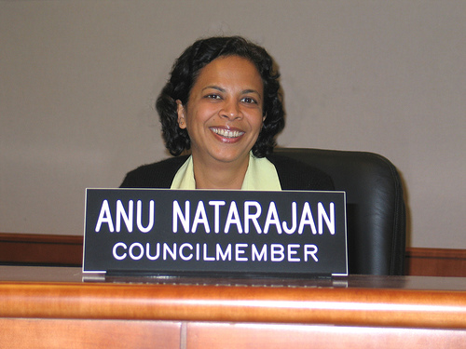
(2004/2006/2010) ~Anu Natarajan – Fremont City Council

Slide 13
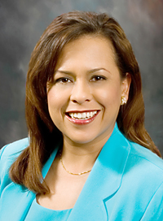
(2005/ 2009)Ana Apodaca – Newark City Council

