Slide 1
Climate Policy
November 15/16 2009
Met 112

Slide 2
Participation
You have discussed challenges we face with climate change and ways to mitigate climate change and greenhouse gas emissions
In a group of 2-3, write down:
  Top 3 things the state could do to limit global warming
  Top 3 things YOU can do as people/consumers/students to reduce GHG limit global warming
You may use scratch paper or split a sheet of paper with another group (reduce, reuse, recycle!)
Make sure all member names and date on paper!

Slide 3
Recall…
IPCC
  Assessments suggest human influence on climate
  Use climate models to predict future temp changes
Kyoto Protocol
  In effect in Feb 2005
  Sets emission targets for 37 industrialized nations
  Reduce GHG emissions 5% below 1990
  No target for developing countries
  US did not sign
  Expires in 2012! Must make plans beyond 2012…

Slide 4
UN Climate Change Conference
“Copenhagen Summit” or COP15
7-18 December 2009 in Copenhagen, Denmark
Follow-up to Kyoto protocol
  Intent to establish policy beyond 2012
A follow-up to many UN CCC’s
  Bali Roadmap created at COP13 in Bali, Indonesia in 2007
  Says binding agreements to be made at Copenhagen
High expectations for legally binding agreements at Copenhagen!

Slide 5


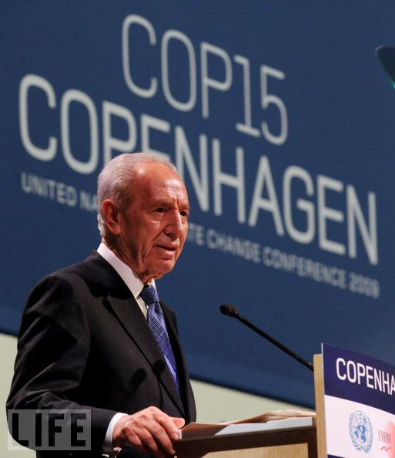
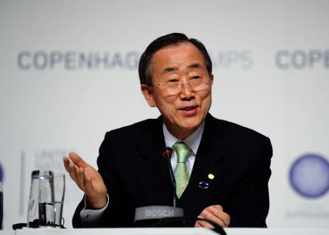
UN Secretary General Ban Ki-moon
Israeli
President
Shimon
Peres

Slide 6
Copenhagen Accord
Drafted by US, China, India, Brazil, South Africa
Primary stipulations:
  Keep global temp increase below 2°C
  Cut GHG emissions (each country to establish their reduction goals)
  Raise funds to help developing countries grow sustainably
  Reduce deforestation and promote sustainable land use
US proposed to cut GHG levels by 17% below 2005 levels by 2020

Slide 7
Problems of Copenhagen Accord
Not legally binding, no firm commitments made
Many countries (especially developing) oppose, as well as NGO’s
Countries stated their proposed actions, but no agreement reached
Many perceive COP15 and Copenhagen Accord as a failure.

Slide 8
Copenhagen Accord
Fierce negotiations took place during conference, near end of conference it seemed no agreements could be reached
Large protests, 40,000-100,000 people
People wanted “strong and binding agreement” between countries on climate change mitigation
By end of Jan 2010, 140 countries “agreed” to Copenhagen accord

Slide 9
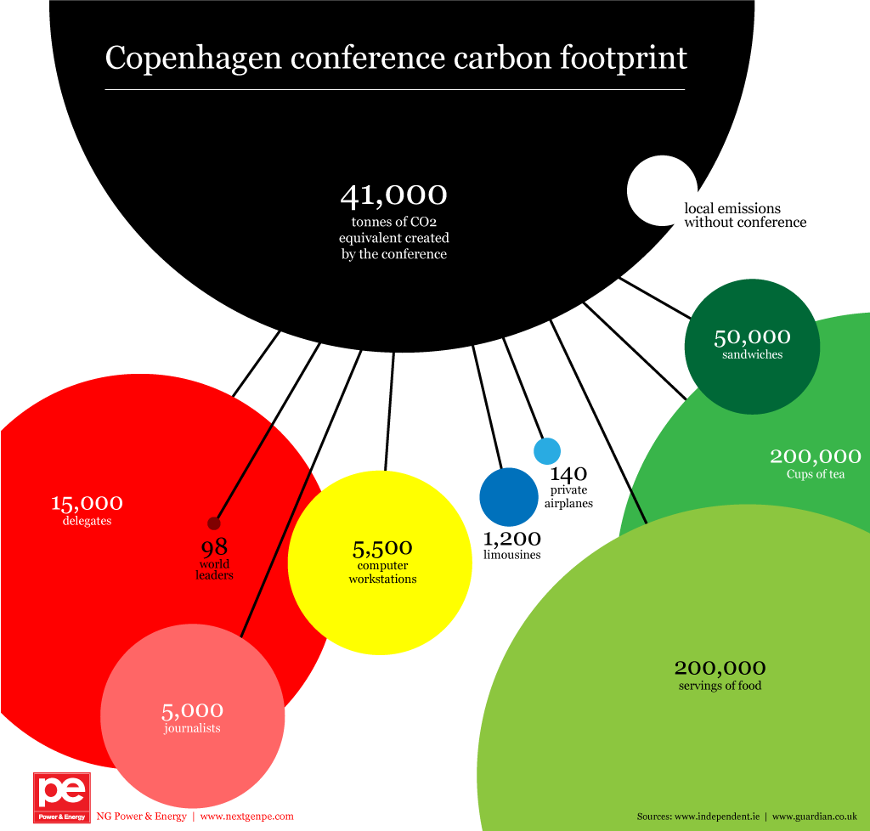

Slide 10
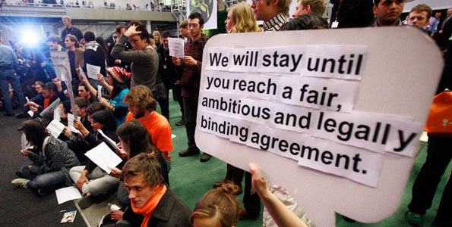

Slide 11
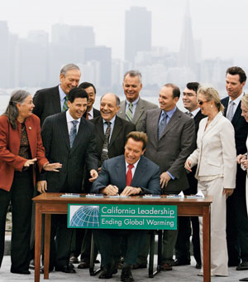
More Local: AB 32
California Global Warming Solutions Act
Signed by Gov. Schwarzenneger 2006
Sets 2020 emissions reduction as law
1990 emission levels target for 2020

Slide 12
Stipulations of AB 32
Firm limit on emissions for all consumers/producers
Per capita reduction from 14 tons CO2/year to 10 tons/year
Reduction in 30% of vehicle GHG emissions by 2016
Improved appliance efficiency standards
Add 1 million solar roofs, alternative energy sources
Adopt green building practices, green existing buildings for efficiency
More efficient ag equipment, distribution
Emissions audit for largest 800 emitters in CA
Reduce methane from landfills with high recycling, zero waste programs

Slide 13
Opposition to AB 32
Concern it will cost small businesses money, place restrictions on small business
Concern it will drive business and industry out of state
  Green jobs fastest growing job market in CA!
Concern it will add thousands to household bills/homeowner costs
  Efficient appliances, buildings reduce bills
AB 32 rules and market mechanisms to take effect Jan 1, 2012, and become legally enforceable!

Slide 14
Very Local: San Jose Green Vision
Within 15 years, the City of San José in tandem with its residents and businesses will:
1. Create 25,000 Clean Tech jobs as the World Center of Clean Tech Innovation
2. Reduce per capita energy use by 50 percent
3. Receive 100 percent of our electrical power from clean renewable sources
4. Build or retrofit 50 million square feet of green buildings
5. Divert 100 percent of the waste from our landfill and convert waste to energy
6. Recycle or beneficially reuse 100 percent of our wastewater (100 million gallons per day)
7. Adopt a General Plan with measurable standards for sustainable development
8. Ensure that 100 percent of public fleet vehicles run on alternative fuels
9. Plant 100,000 new trees and replace 100 percent of our streetlights with smart, zero-emission lighting
10. Create 100 miles of interconnected trails

Slide 15

San Jose Green Vision
Try to keep San Jose at forefront of innovation
Measurable goals! Helps with public motivation
Launched in 2007
Give incentives for clean tech companies
Incentives for solar panels
Improve transit system
Adopt and encourage efficiency products (ex: lighting)
Green building ordinances
Increase recycled H2O

Slide 16
Thin film solar technology

Slide 17
San Jose energy use goals

Slide 18
Other Policies:
Carbon Offsets
People can purchase carbon offsets to reduce their carbon footprint
Ex- flight to Europe adds 3-4 tons to your carbon footprint!
Purchase carbon credits at $5-$20 per ton to “offset” carbon emitted by your actions
Carbon trade companies invest in projects that reduce GHG’s
Install windmills, geothermal, solar energy projects

Slide 19




Carbon Trade Companies
Make sure you use a reputable company
Gold Standard companies adhere to strictest regulations
Some notable, respected companies:
  Airshed (New Zealand)
  Climate Care (UK)
  GEQ (Chile)
  ZeroCO2 (Canada)
  Native Energy (US)

Slide 20

Holiday Shopping?

Slide 21
Compliance vs. Voluntary Market
Some businesses, governments required to purchase carbon offsets under Kyoto Protocol if not meeting their goals
Compliance market
Large share of carbon trade
Countries/governments can trade with countries with carbon surplus or purchase credits
Most businesses, local governments, NGO’s and individuals part of voluntary market
Trading volumes much smaller
No established rules, regulations. Purchasing credits to help reduce GHG’s

Slide 22
rebates and incentives
Local and Federal government programs offer rebates and incentives to individuals and small businesses
Not manditory
Designed to increase efficiency and lower amount of energy used by individual/business
Main categories:
  Building materials
  Appliances
  Energy
  Water

Slide 23
Examples of Rebates/Incentives
Photovoltaics (solar) installed on home or business
  Tax credit of 30% of cost from US Dept of Energy
From excess solar energy created by your system
  $1.10-1.90 per watt given to public utility system from CA Public Utilities Commission
Energy efficient building materials (roofing, doors, insulation, windows, lighting
  Rebates both local and federal
Rebates for energy efficient appliances (Energy Star)
In Monterey County, $25 rebate per 100 gallons up to 25,000 gallons for installing water catchment system

Slide 24

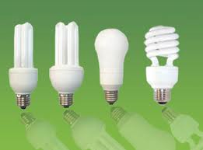
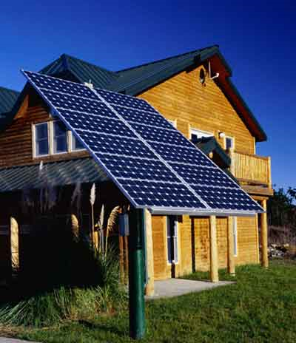
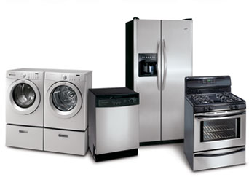

Slide 25
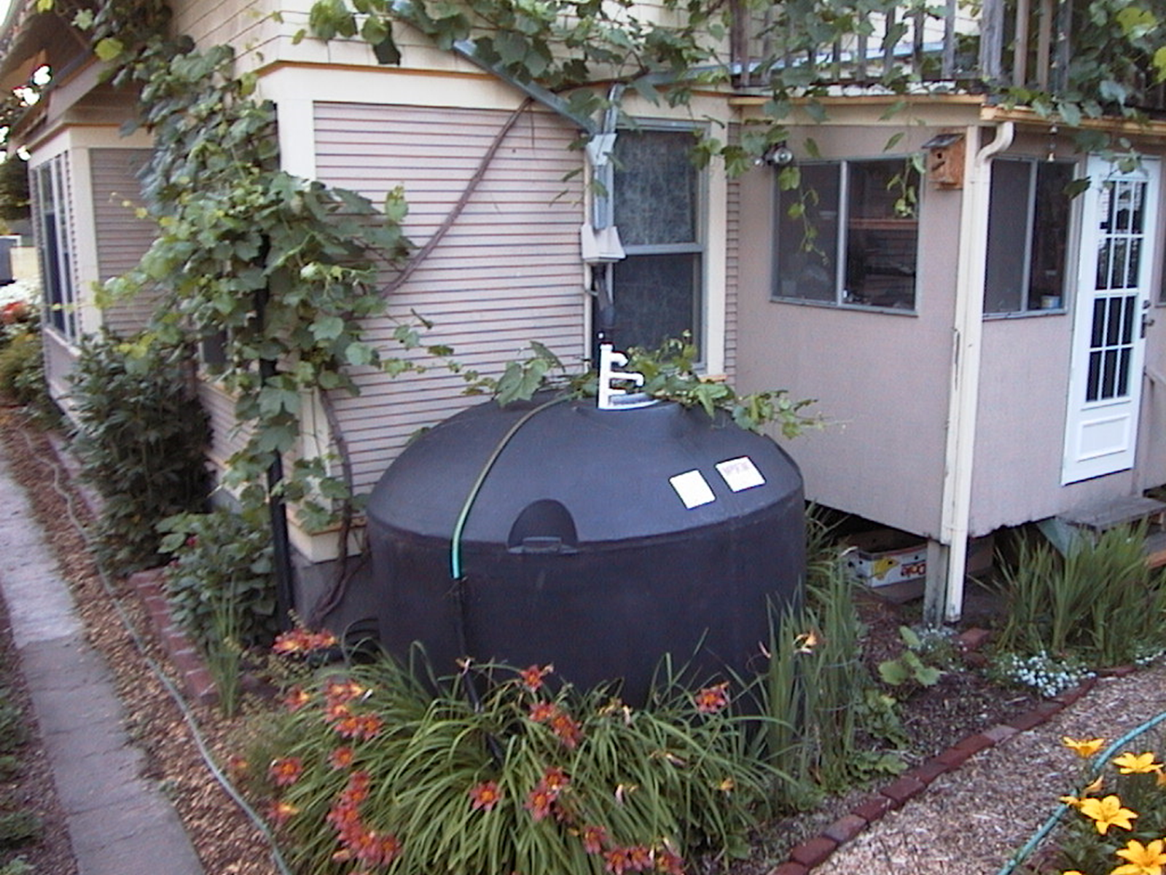

Slide 26
Resources
Air Resources Board www.ARB.ca.gov
COP15 www.denmark.dk/en.cop15.dk
Green Vision San Jose www.greenvision.sanjose.gov
US Department of Energy www.energysavers.gov
Tufts Climate Initiative http://www.tufts.edu/tie/carbonoffsets
Environmental Protection Agency www.epa.gov
Gold Standard www.cdmgoldstandard.org
Wikipedia www.en.wikipedia.org

