Slide 1
Corporate Image and Brand Management
Chapter 2

Slide 2
Chapter Overview
Managing a corporation’s image and brands
Developing and promoting brand names and logos
Importance of packaging and labels
Developing brand and corporate positioning strategies

Slide 3
Corporate Image
Components of image
Tangible Intangible
1. Product sold
2. Were sold
3. Where produced
4. All communications
5. Corp. name and logo
6. Packages and labels
7. Employees
1. Corporate, personnel, and environmental policies
2. Ideals and beliefs of corporate personnel
3. Culture of country and location of the company
4. Media reports

Slide 4
Consumer Perspective
Provide assurance, psychological reinforcement
Unfamiliar settings
Little or no previous experience
Reduce search time
Provide
Provide social acceptance

Slide 5
Company Perspective
Extension name to new products.
Ability to charge more
Consumer loyalty
More frequent purchases by customers
Positive word-of-mouth
Attracts higher quality employees

Slide 6
Top Corporate Global Brands
Rank Company Brand Value Country of Ownership
(billions)
1 Apple $98.3 United States
2 Google $93.3 United States
3 Coca-Cola $79.2 United States
4 IBM $78.8 United States
5 Microsoft $59.5 United States
6 General Electric $46.9 United States
7 McDonald’s $41.9 United States
8 Samsung $39.6 South Korea
9 Intel $37.3 United States
10 Toyota $35.4 Japan
Adopted from http://www.interbrand.com/en/best-global-brands/2013
Notes:
Brands have value. BusinessWeek provides a listing of the top 100 global brands. This slide presents the top 10 and their brand value. Companies with multiple brands were not considered. The list is only of companies where the brand name is the company name. Most of the brands are from the United States and include very familiar names such as Coca-Cola, IBM, Microsoft, and General Electric. Only 2 foreign brands made the top 10 list, Nokia from Finland and Toyota from Japan.

Slide 7
Corporate Image Development
Create, reinforce, or change image
Overcome negative press

Slide 8
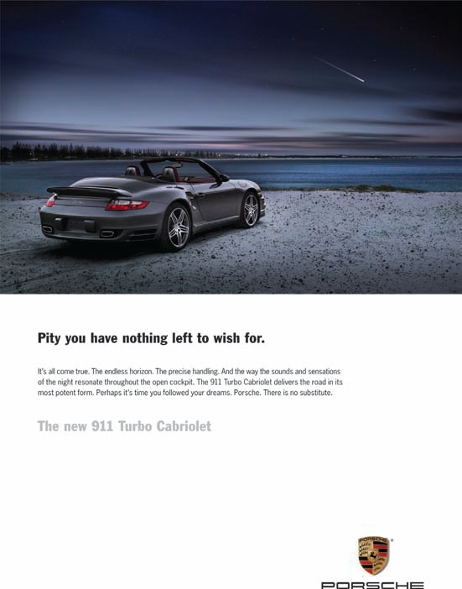
Identifying the Desired Image
Evaluate current image
Ask customers
Ask non-customers
Create strategic advantage

Slide 9
Logos - Benefits of Recognizability
Aids in recall
Specific brands
Advertisements
Reduces shopping effort
Reduces search time

Slide 10
What colors should you use in your logo?
Black
seriousness, distinctiveness, boldness, power, sophistication, and tradition
Blue
authority, dignity, security, faithfulness, heritage, corporate stability, and trust
Brown/gold
history, utility, earthiness, richness, tradition, conservative
Gray/silver
somberness, authority, practicality, corporate mentality, and trust
Source: Adapted from “Jared McCarthy, “Logos: What Makes Them Work (Part 1of 2),” (www.marketingprofs.com/5/mccarthy4.asp), February 22, 2005.
Notes:
Colors are very symbolic and convey various meanings. This slide provides information on various colors and what they tend to mean in American culture. The meaning is going to vary widely across other cultures and in other countries. While consumers may not consciously think about the color in a logo and what it means, there may be a subconscious attachment between the color and these meanings.

Slide 11
What colors should you use in your logo?
Orange
fun, cheerfulness, warmth, exuberance, health, and youth
Green
tranquility, health, freshness, stability, and appetite
Pink
femininity, innocence, softness, health, and youth
Purple
sophistication, spirituality, wealth, royalty, youth, and mystery
Source: Adapted from “Jared McCarthy, “Logos: What Makes Them Work (Part 1of 2),”
(www.marketingprofs.com/5/mccarthy4.asp), February 22, 2005.
Notes:
Colors are very symbolic and convey various meanings. This slide provides information on various colors and what they tend to mean in American culture. The meaning is going to vary widely across other cultures and in other countries. While consumers may not consciously think about the color in a logo and what it means, there may be a subconscious attachment between the color and these meanings.

Slide 12
What colors should you use in your logo?
Red
aggressiveness, passion, strength, vitality, fear, speed, and appetite
White/silver
purity, truthfulness, faith, contemporary, refined, and wealth
Yellow
youth, positive feelings, sunshine, cowardice, refinement, caution, and appetite
Source: Adapted from “Jared McCarthy, “Logos: What Makes Them Work (Part 1of 2),”
(www.marketingprofs.com/5/mccarthy4.asp), February 22, 2005.
Notes:
Colors are very symbolic and convey various meanings. This slide provides information on various colors and what they tend to mean in American culture. The meaning is going to vary widely across other cultures and in other countries. While consumers may not consciously think about the color in a logo and what it means, there may be a subconscious attachment between the color and these meanings.

Slide 13
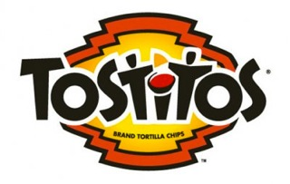

Slide 14
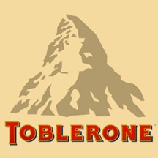

Slide 16
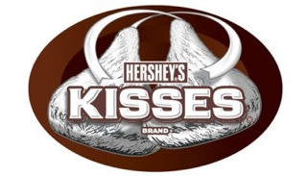

Slide 17
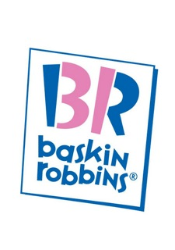

Slide 18
Types of Brands
Co-Branding
Family brands
Brand extensions
Flanker brands
Private brands
Ingredient
Cooperative
Complementary

Slide 19
Types of Brands
Family brands
Campbell’s, GE, Kraft, Toyota
Brand extensions
Nike clothing, Porsche watches
Flanker brands
Healthy Choice, Shoebox Greetings, Scion
Private brands
Craftsman, Safeway Select, Kirkland

Slide 20
Types of Brands
Types of Brands
Co-Branding
Ingredient
Intel/HP, Hershey’s/Betty Crocker
Cooperative
Amex/Costco, AA/CitiCard
Complementary
“7&7,” Oreo Milkshakes

Slide 21
Developing Strong Brands
Begins with understanding why consumers buy a brand.
Where does your brand stand now?
What are your objectives?
What are your brand’s strengths? Weaknesses?
Which opportunities should be pursued first?
Where are the pitfalls?
Notes:
Developing strong brands begins by understanding why consumers buy a brand. On this slide are typical questions that can be asked of a client to measure the current position of a brand and to help an agency understand the current position of a brand.

Slide 22
Measuring Brand Equity
Brand Metrics
Brand metrics measure return on branding investments.
Attitudinal measures
Awareness
Recall
Recognition
Brand power index (BPI)

Slide 23
Benefits of Brand Equity (Fig 2.8)
Higher prices, margins
Channel power
Additional retail shelf space
Reduces customer switching
Prevents erosion of market share
Notes:
Brand equity offers a number of advantages, just like a strong corporate name. Companies can charge a higher price for the brands, which results in higher gross margins. Consumers will pay the higher price because they believe the brand is better and unique, superior to competing brands. It allows a brand to have greater channel power and additional retail shelf space. After all, retailers want to make money and will sell whichever brands consumers will purchase. Because consumers see the brand as being superior, it reduces brand switching and prevents erosion of market share to competitors.

Slide 24
Brand Loyalty
If not “your” brand, would you switch to another?
(% of yes responses)
Greeting cards 68%
Groceries and canned food 67%
Women’s apparel 50%
Men’s apparel 55%
Beverages 49%
Toys 47%
Candy 47%
Consumer electronics 40%
Computer software 35%
Source: Adopted from Debbie Howell, “Today’s Consumers More Open To Try New Brands,” DSN Retailing Today, vol. 43, No. 20 (October 25, 2004), pp. 29-31.
Notes:
Research by DSN Retailing Today provides an indication of how important brand names are and the level of brand parity within certain product categories. For instance, if a consumer did not find his/her preferred brand of greeting cards, then 68% said they would just buy another brand. Thus, most consumers see very little differences among brands of greeting cards, indicating a high level of brand parity. The same is true for groceries and canned food. At the other end of the list is computer software. If the desired brand is not available, only 35% would purchase another brand. Much lower brand parity.

Slide 25
Private Brands
Connotation of low price, low quality
Historically price-sensitive consumers
Retailers investing in private brands
Believe equivalent to manufacturers’ brands - 72%
Notes:
The popularity of private brands has fluctuated over the years. In the past, private labels were seen as low priced, low quality goods. Historically, only price-sensitive consumers purchased private brands. Because of the higher gross margins on private brands, retailers began investing into their private brands. As a result, 72% of consumers today see private brands as being equivalent to manufacturers’ brands.

Slide 26
Changes in Private Brands
Quality improvements
Higher store loyalty
Lower loyalty to manufacturer brands
Increase in advertising/featuring of private brands

Slide 27
Product Positioning
Relative to competition.
Exists in the mind of the consumer.
Attributes
Competitors
Use or application
Price/quality
Product user
Product class
Cultural symbol
Markets
Consumer
B-to-B
International

Slide 28
Packaging
Traditional elements
Protect the product
Provide for ease of handling, placement
Prevent or reduce theft, tampering
New trends
Meet consumer needs for speed, convenience, and portability
Must be contemporary and striking
Must be designed for ease of use

Slide 29
Packaging
Packaging
Final opportunity to make impression
~2/3 of purchase decisions made in-store
Have 3 seconds to catch attention
Needs to stand out
Tells customers what is inside
Notes:
The importance of packaging should never be overlooked. It is the final opportunity to make an impression. Research has shown that 69% of purchase decisions are made in the store. This means packaging can be influential in the final purchase decision. Research has further shown that a package has 3 seconds to catch someone’s attention. Therefore, it needs to stand out. It needs to tell customers what is inside, or why they should look inside.

Slide 30
Labels
Must meet legal requirements
Another marketing opportunity
Notes:
Labels are an important component of packaging. They must meet legal requirements in terms of listing contents and providing information on ingredients. But, labels also provide a marketing opportunity. Words such as gourmet, all-natural, premium are used to convey what is offered and why it is important to consumers. Labeling can be the last opportunity to tell consumers about a product.

Slide 31
Ethical Issues
Brand infringement
Brand name becomes a generic term
Domain or cyber squatting

Slide 32
International Implications
Adaptation vs. standardization
Standardization reduces costs
Shrinking world → standardization
High-profile, high-involvement – global brand
Low-involvement products – local brand
Packaging and labeling
Image and positioning issues

