Slide 1
Evaluating an Integrated Communications Program
Chapter 15

Slide 2
Chapter Overview
“I know half the money I spend on advertising is wasted, but I can never find out which half.”
John Wanamaker

Slide 3
Chapter Overview
Matching methods with objectives
Message evaluations
Evaluation criteria
Behavioral evaluations
Evaluating public relations
Evaluating the IMC program

Slide 4
Evaluation Categories
Message evaluations
Physical design
Cognitive elements
Affective elements
Online evaluation metrics
Real-time measures
Respondent behavior evaluations
Conative elements
Measurable with numbers
Customer actions

Slide 5
Evaluation and IMC Objectives
Match objectives
Pre- and post-tests
Levels of analysis
Short and long term
Product-specific
Corporate level

Slide 6
Message Evaluation Techniques
Concept testing
Copytesting
Recall tests
Recognition tests
Attitude and opinion tests
Emotional reaction tests
Physiological tests
Persuasion analysis

Slide 7
Evaluating Advertising Management
Message Evaluation Techniques:
Current
Advertising Tracking Research
Copytesting
Future
Cognitive Neuroscience
Fig. 15.1
Notes:
Currently, message evaluations are conducted through advertising tracking research or copytesting. The future of advertising evaluation may be in cognitive neuroscience.

Slide 8
Advertising Tracking Research
Track ads after launch
Nielsen IAG
Millward Brown
Monitors
Brand performance
Advertising effectiveness
Specific time test
Continuous tracking
Notes:
A common method of evaluation involves tracking an advertisement by one of the advertising research firms, such as Nielsen IAG or Millward Brown. These tracking services monitor an ad’s performance and measure its effectiveness. Tests can be performed at specific times or continuously. Nielsen IAG, for instance, offers a syndicated database of real-time brand and ad performance based on more than 210,00 television program episodes and 250,000 commercials. Nielsen conducts thousands of surveys daily measuring viewer engagement with TV programs and effectiveness of ads.

Slide 9
Copytesting
Finished or final stages of development
Evaluates main message and format
Portfolio tests
Theater tests
Online tests
Immediate results and lower costs
Consumers pay more attention to ads
Measures ad potential
Notes:
Copytesting can occur during the final stages of development or after an ad is finished. The purpose of copytesting is to evaluate the main message and format of the ad. Portfolio tests are used with print ads and theater tests with TV ads. Because of costs, many advertising research firms are moving to some type of online copytests. It is also quicker. Consumers pay more attention to ads when copytesting is done online. Thus, it really measures the ads potential since it has the full attention of the consumer.

Slide 10
Recall Tests
Day-after-recall (DAR)
Unaided recall
Aided recall
Incorrect answers
Used primarily after ads launched

Slide 11
Items Tested for Recall
Product name or brand
Firm name
Company location
Theme music
Spokesperson
Tagline
Incentive being offered
Product attributes
Marketing/advertising selling point

Slide 12
Sample DAR Test 30-Second TV Advertisement for Pet Food
Overall Recall 12.9%
15-12

Slide 13
Sample DAR Test 30-Second TV Advertisement for Pet Food
15-13

Slide 14
Recall Decay Magazine Ad vs. Television Ad
Source: Magazines Canada’s Research Archive
15-14

Slide 15
Factors That Influence Recall Test Scores
Attitude towards advertising
Prominence of brand name
Brand used by respondent
Institutional ads
Respondent’s age

Slide 16
Emotional Reaction Tests
Affective advertisements.
Used for material designed to impact emotions.
Difficult to measure emotions with questions.
Warmth monitor
Emotional reaction tests are self-reported instruments.

Slide 17
Sample Graph from a Warmth Meter
30-Second TV Advertisement
Warmth meter
Ad section that elicited negative emotions
Notes:
This graph shows the emotional reaction to a 30-second TV ad. Although the emotional reaction was different for the target audience versus the total audience, it does provide good information. Especially important is the one point in the ad where negative emotions occurred.

Slide 18
Cognitive Neuroscience
Measures brainwave activity
Does not rely on self-reporting
Power of cognitive neuroscience
Reveals physiological reactions
Understand how information is being processed
Companies experimenting with neuroscience
EmSense, NeureoFocus, Sands Research
Frito-Lay
Notes:
Cognitive neuroscience measures brainwave activity and is the latest advance in advertising research. It is a better indicator of a person’s true reaction since it does not rely on self-reporting. A number of companies are experimenting with cognitive neuroscience. Frito-Lay used cognitive neuroscience to examine a particular ad that was rated inappropriate by a focus group. The neuroscience research showed women loved the ad. The power of neuroscience is that it reveals physiological reactions. It provides information on where the information is being processed in the brain and what consumers do with the information they receive. Instead of rely on self-reporting, cognitive neuroscience hopes to measure reactions accurately.

Slide 19
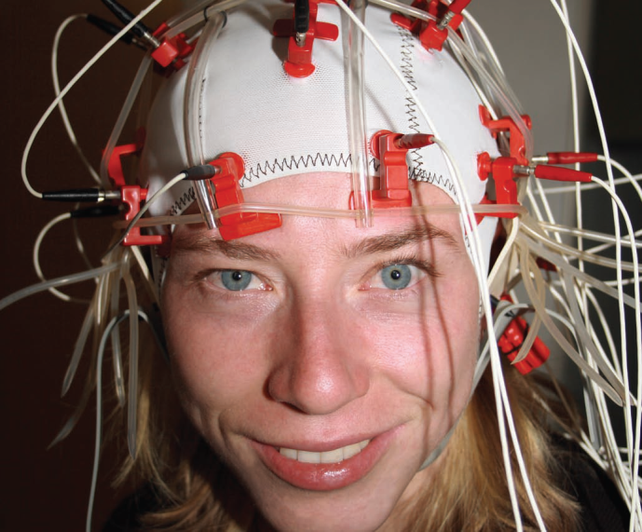
Sands Research, Inc.
Tangible evidence advertising works
Neuromarketing – Dr. Steve Sands
Cognitive neuroscience technology
EEG sensors - measure brainwave activity
Measure impact of advertising
Three memory structures
Knowledge memories
Emotion or episodic memories
Action or procedural memories
Notes:
Sands Research, Inc. is one of the companies that is on the leading edge in a new science, neuromarketing which uses brain waves and neuroscience to study marketing and advertising. This new approach has been partially driven by the need for tangible evidence that advertising works. Neuromarketing is based on the work of Dr. Steve Sands and uses EEG sensors. It measures brainwave activity, which allows for an understanding of what is happening in the brain when a person views an ad. Cognitive neuroscience is able to measure 3 memory structures – knowledge memories, emotional or episodic memories, and action or procedural memories, because each of these occur in different parts of the brain.

Slide 20
Online Evaluation Metrics
Click-throughs primary measurement, but validity is questioned
Length of engagement
Dwell rate & time
Redemption rates
Response rates
Sales
Web chatter
Notes:
The online environment provides a number of metrics that cannot be obtained with other media, especially so quickly. Web metrics can be obtained in almost real-time. The primary measure of online ads is click-throughs, which is the number of people who click on the ad and go to the Web site. Length of engagement is a newer metric that measures how long a person stays at a Web site, regardless of where they are on the site. Dwell rate measures the proportion of ad impressions that result in users engaging with an ad. Dwell time measures the amount of time users spend engaged with a particular ad. Redemption rates and response rates can be used to measure ad effectiveness, as well as sales. Companies can also monitor Web chatter to see how many times the brand name is being mentioned and what is being said about the brand.

Slide 21
Online Metrics
Audience demographics
MediaMetrix – basic demographics
NetRatings – GRP and other rating instruments
SRI Consulting – Psychographic information
NetGuide – Web site ratings and descriptives
BPA Interactive – Web traffic audit data

Slide 22
Behavioral Evaluations
Only evaluation – sales
Measures results
Not all communications objectives measurable
Promotions easier to measure than advertising
Notes:
Behavioral evaluations focus on behaviors of consumers and results of marketing efforts. For some, sales is the only legitimate measure of advertising and marketing. The difficulty with that view is that not all communication objectives are measurable and not all are designed to produce sales, at least in the short-term. Also, promotions are easier to measure than advertising. Unless consumers mentioned to Flair that they saw this ad, Flair would have no way of measuring its impact on sales.

Slide 23
Sales and Response Rates
UPC codes
Scanner data
Retailers
Manufacturers
Changes in sales

Slide 24
Advertising - Difficult to Evaluate
Influence of other factors
Delayed impact of advertising
Consumers changing their minds
Brand in consumer’s evoked set
Level of brand parity
Fig 15-5
Notes:
Advertising is very difficult to evaluate for a number of reasons: 1) Other factors can influence sales, not just advertising 2) The impact of advertising is delayed. It seldom will have an immediate impact. Further, advertisers really can’t predict how long that delay will last. 3) Consumers can change their mind. An ad can influence the brand choice, but once in the store the consumer may choose a different brand. 4) If the brand is in the consumer’s evoked set, they are more likely to purchase it. If not, then it is unlikely one ad will move the brand into the evoked set. 5) Because of brand parity, consumers have a set of brands they choose from, not just one.

Slide 25
Responses That Can Be Tracked
Changes in sales
Telephone inquiries
Response cards
Internet inquiries
Direct marketing responses
Redemption rate of sales promotion offers
Coupons, premiums, contests, sweepstakes
Fig 15-6
Notes:
There are a number of responses in marketing that can be tracked. Sales, of course is easy to measure. Telephone inquiries, response cards, Internet inquires, direct mailing responses, and redemption rates on sales promotion can all be tracked. The key is make sure codes are put on ads or promotions so the responses can be tracked and marketers know the source.

Slide 26
Test Markets
Used to assess
Advertisements
Consumer and trade promotions
Pricing tactics
New products
Attempt to mimic reality
Design to model full marketing plan
Length of test market
Competitive actions

Slide 27
Evaluating Public Relations
Number of clippings
Number of impressions
Advertising equivalence
Comparison to PR objectives

Slide 28
Evaluating the IMC Program
Greater demand for accountability
ROI of advertising and marketing
Difficult to measure ROI
Difficult to define ROI

Slide 29
Evaluating Overall Health of a Company
Level of innovation
Productivity
Physical and financial resources
Profitability
Manager performance and attitude
Employee performance and attitude
Social responsibility
Value Image

