Slide 1
Tech 190B
Senior Project Portfolio Preparation

Slide 2
Project Overview
Notes:
Project Overview

Slide 3
The Portfolio Content Organization and Submission
The portfolio content organization and submission is worth 10 points
= 4% of course grade

Slide 4
Portfolio Has the Following Contents
Cover Page that includes a title for the group, an image of the product, the course name, semester and year, and the names of everyone in the group.
Table of content for the entire report
Group’s 1 ½ - 2-page introductory report
A copy of team’s schedule
Log of group’s meetings
Final Assembly or 3-D drawing (complete, titled and clearly labeled)
Group individual reports (for each of the team members):
3-5-page report for first team member
Updated fully dimensioned, specified and titled part and/or component drawing(s) and documented design materials for which first team member had primary responsibility
3-5-page report for second team member
Updated fully dimensioned, specified and titled part and/or component drawing(s) and documented design materials for which second team member had primary responsibility
3-5-page report for third team member
Updated fully dimensioned, specified and titled part and/or component drawing(s) and documented design materials for which third team member had primary responsibility
3-5-page report for next team member
Updated fully dimensioned, specified and titled part and/or component drawing(s) and documented design materials for which next team member had primary responsibility

Slide 5
Cover Page
Should include:
A title for the group
Course name
Names of group members
An image of the product
Semester and year

Slide 6
Table of Contents
Includes everything in the entire report
Includes page numbers

Slide 7
Group’s Introductory Report (4%)
This is a 1 ½ - 2-page introduction which discusses:
The purpose(s) and functions of the product
Its parts and materials
Why it is needed, and
Who the target market is
Introduction can also include a mention of the team members who produced the product, their background and majors

Slide 8
Comprehensive Schedule
Should bear all the latest changes made to the original
schedule
Covers the period of the project build phase

Slide 9
Log of Group’s Meetings
Should include the following information:
All notes taken during each meeting
Dates of all meetings
Attendants to all meetings

Slide 10
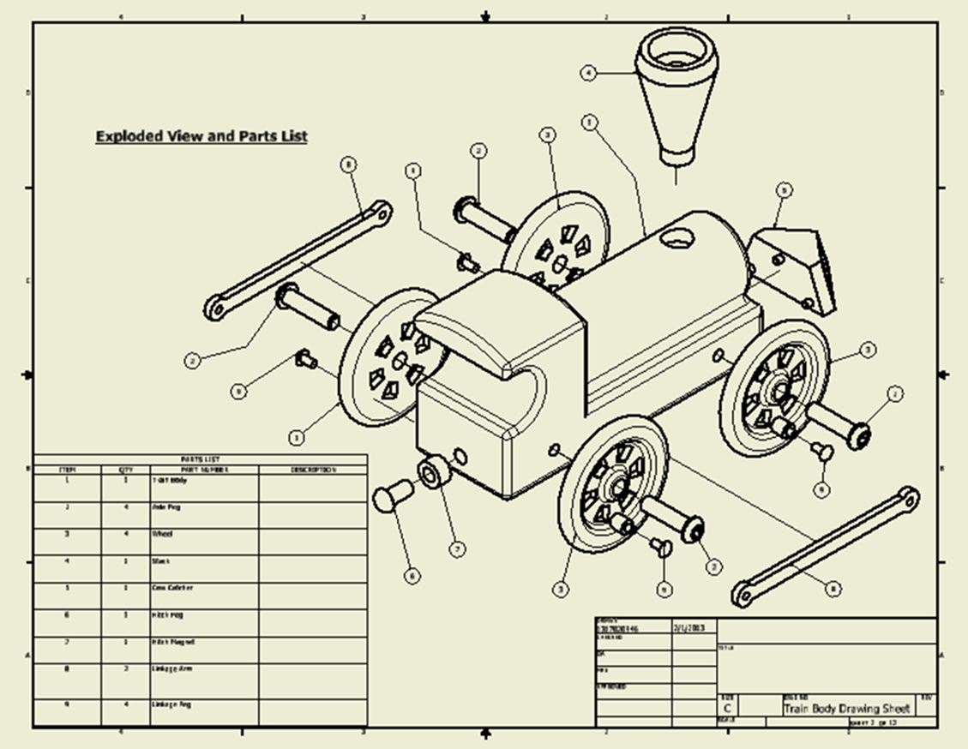
Final Assembly 3-D Drawing
Should be:
Complete
Titled
Clearly labeled

Slide 11
Individual Cover Sheet for Each Team Member
To act as a separator for individual report and materials belonging to each team member

Slide 12
Individual Report for Each Team Member (6%)
Includes the following:
3-5-page report for each team member
1 – 1 ½ page description of all your individual activities and personal contributions to the project
1 – 1 ½ page description of how your product and production activities incorporated ethical considerations for the environment, society, employees, customers, organization etc.
3) 1 – 2 page report on how you think the product itself, design, processes, materials, and project can be improved
Updated fully dimensioned, specified and titled part and/or component drawing(s) and documented design materials for which the team member had primary responsibility

Slide 13
Individual Written Report Grading (15 points)
Grading will bear on:
Content & Completeness 9 Points
Format 2 Points
Grammar/spelling 2 Points
Clarity 2 Points
Total 15 Points

Slide 14
Oral Presentation Grading (25 Points)
Grading will bear on:
Demonstrations (4 points)
Time (4 points)
Timely arrival
Time used in presentation (3-5 minutes per student)
Content & Completeness of presentation (4 points)
visual aids (4 points)
Audibility & Clarity (3 points)
Outline (3 points)
Appearance (3 points)

Slide 15
Grading the Finished Product
Grading will bear on understanding and development of:
Professional practices
Engineering ethics
Global and societal issues
.

Slide 16
Grading the Finished Product (50 Points)
Grading will bear on:
Completeness
Conformance to specifications
Finish/Burrs/Dents
Fit
Aesthetics
Reliability
Safety
Application
Functionality
Performance
Extra features
Durability and others.

Slide 17
Finished Product Grading Sheet

Slide 18
Product Judging Sheet

