Slide 1
Staffing and Selection Methods and their Validity/Utility
By Rupa Padhy, Jose Vasquez, Priyanka Neelakrishnan, Arvin Emadi

Slide 2
Agenda
Discrimination in Resume Screening - Rupa Padhy
Impression Management in Interviews - Jose Vasque
HRM effective practices - Priyanka Neelakrishnan
Networking on Voluntary Turnover - Arvin Emadi

Slide 3
Discrimination in Resume Screening
RUPA PADHY
Based on the article
“Double Jeopardy Upon Resume Screening: When Achmed is Less Employed than Aisha”
Personnel Psychology (2015) 68: 659-696
Notes:
Discussing the hiring discrimination while resume screening as a part of Selection methods

Slide 4
Overview of the Research
Arabs in Netherlands: largest ethnic minority group with 2x unemployment rate compared to host ethnicity
Previous Studies
Single Social category
Students
Less reliable
Present Study
Multiple Social category (ethnicity and gender)
Actual recruiters
Higher Validity and Reliability
Notes:
Resume screening is highly receptive to recruiter’s biasness when limited information is available on a page or two long resume.
This research focuses on Arabs in Netherlands , who are the largest ethnic minority group with unemployment rate twice compared to Dutch and other minor ethnic groups .
Previous Studies: emphasis on single social category, such as sex and race . Participants were commonly students which resulted in competing views. Hence they were less reliable .
Present Study :On the contrary the authors focuses on multiple social category, together they have taken ethnicity and gender.They worked with actual recruiters with experience ranging from 3 to 10 years in resume screening . This paper contributes a more complete findings in the context of resume screening with higher validity and reliability.

Slide 5
KEY TERMs | MEANING
Multiple Categorization | Individuals belong to multiple social groups (e.g., ethnic, sex, religion, age ) Eg: employment discrimination minority men (29.5%) vs minority women (22.5%) for Arabs
Job Contingencies | The nature of the job might affect views of multiple category (sex and ethnicity) Eg: Arab women are viewed better match for high client contact jobs “the amount of external client interaction”
Recruiters’ Prejudice | Recruiter’s attitudes toward members of groups (i.e. prejudice) Eg: high ethnic prejudice will pay more attention to ethnicity
Implicit Association Test | -Implicit ways of measuring prejudiced attitudes -Measures different psychological domains, such as ethnic discrimination
Notes:
The level of employment discrimination against minority men (29.5%) was larger than minority women (22.5%) for Arabs.
In the Netherlands, Arab women are viewed as a better match for positions requiring high client contact compared to Arab men
Recruiter with high in ethnic prejudice will pay more attention to ethnicity and high in sexism will pay more attention to gender
Very promising tool, more fluent and efficient compared to explicit ways of measuring prejudice attitudes as they are subject to biases. IAT measures different psychological domains, such as social behaviors.

Slide 6
Research Method-Study 1
Participants:
60 non-Arab/Dutch recruiters
41.5% male
3 to 10 years of recruiting experience
Method:
Recruiters were randomly assigned to evaluate four resume ́s by rating applicants’ job suitability.
2 (Ethnicity) × 2 (Sex) × 2 (Client contact) design for Clerical (low demand) jobs
Recruiter took two IAT test- ethnic and gender role (E-prime v2.0.)
Arab-IAT for ethnic prejudice - paired Arab/Dutch names with pleasant/unpleasant words
Gender-roles IAT for sexism - paired female/male words with career/domestic-related words
Lastly, Recruiters took an online Survey
Notes:
Research design. There were 2 studies conducted in this research paper.
For Study 1, the sample size was 60 , they were non arab/dutch recruiters having exp ranging from 3-10 years in resume screening. More than 40% of them were male.
While design this research, resumes and advertisements were developed for clerical position /job
The author followed a 3 step method to conduct the research.
Recruiters were randomly chosen and given four resumes to provide their suitability ratings against the adv designed.
The piles of resume that were designed had 2E(Dutch/Arab) 2S (Male/Female) and 2CC(low/high client contact)
The strength of association and how quickly they paired names with words then determined the score in the tool- Eprime.
All the data was then analyzed in LISERL v9.1

Slide 7
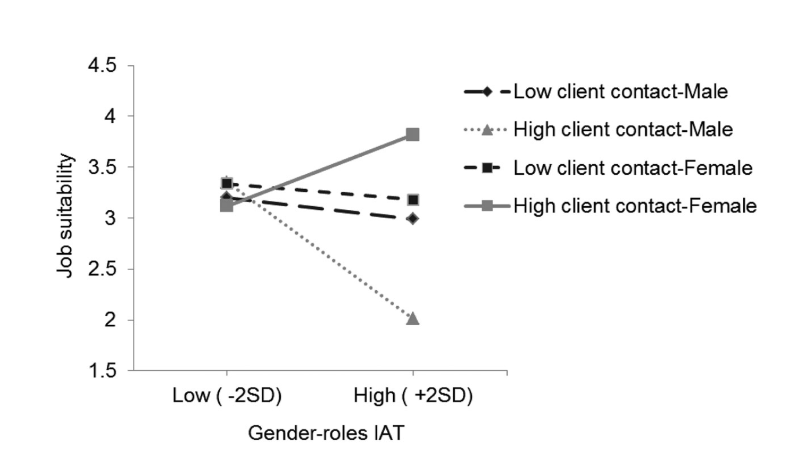
Moderating Effects of Recruiter’s Implicit Sexism on Job Suitability Ratings of Arab Male/Female Applicants Applying for Low-Demand Jobs With Low/High Client Contact
Inference: Hiring discrimination was found against Arab Men (minority) in low-demand jobs
Notes:
This graph summarizes the results from Study 1 . Job suitability Ratings on the Y axis and IAT test score for Gender Roles is in the X axis with mean/avg and spread across +- standard deviation.
Participants perceived the applicants’ ethnicity and sex as intended.
Low suitability ratings were given for Arab men (Hypothesis 1 was supported
Women were rated higher for high contact jobs (“stereotype- matching principle” was supported)
Moderating effect depended on the job condition and hence the inference

Slide 8
Research Method-Study 2
Participants:
124 Non-Arab / Dutch recruiters
57.8% male
3 to 10 years of recruiting experience
Method:
Consultancy job
High Demand jobs
Multiple category: [3 (Ethnicity) x 2 (Sex) x 3 (Client Contact)]
Notes:
This led to the motivation to conduct Study 2 to find whether similar trends and patterns were found even in high demanding jobs.
Ethnicity (Dutch/Arab/Mixed)| Sex (Male/Female)| Client Contact (Low/Moderate/High)

Slide 9
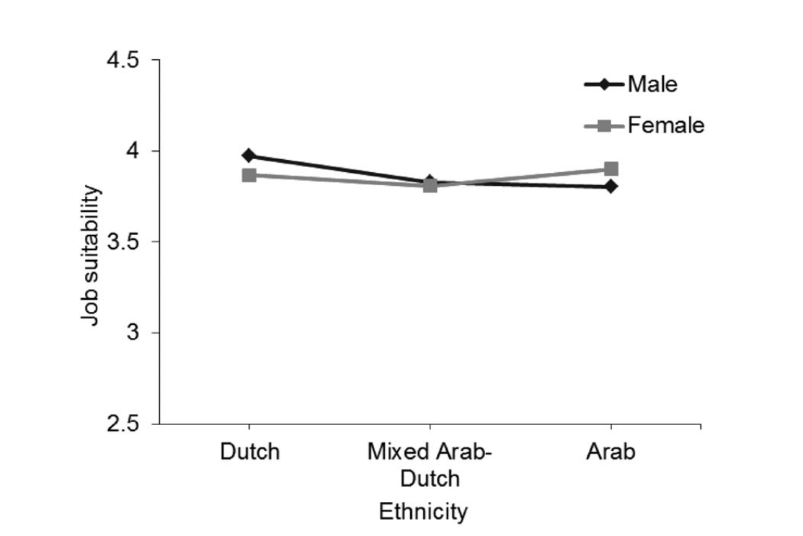
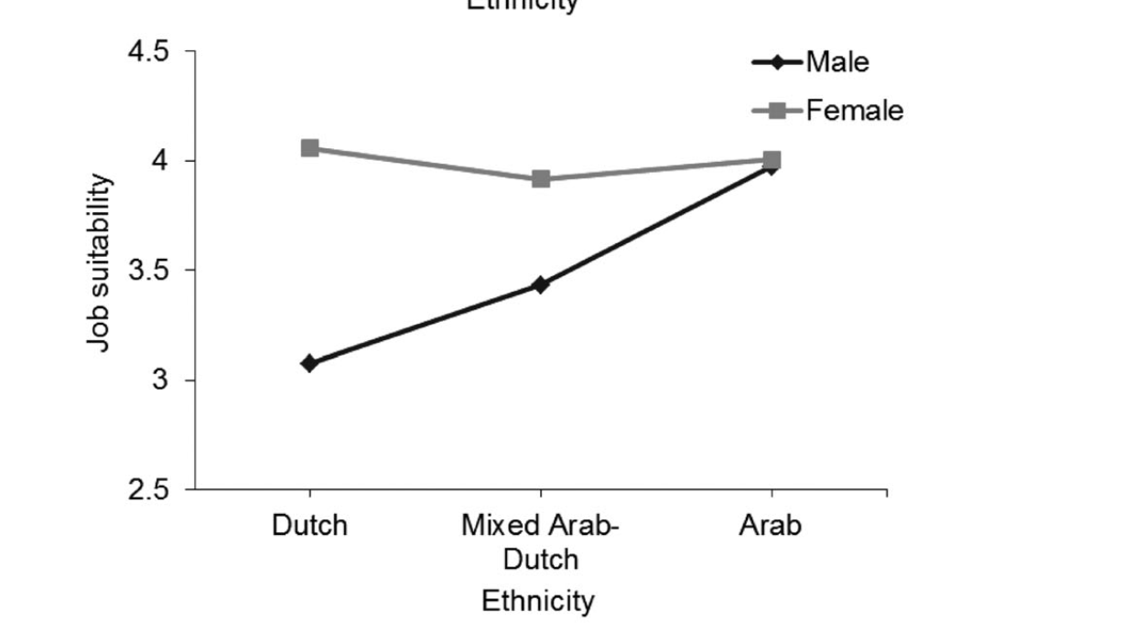
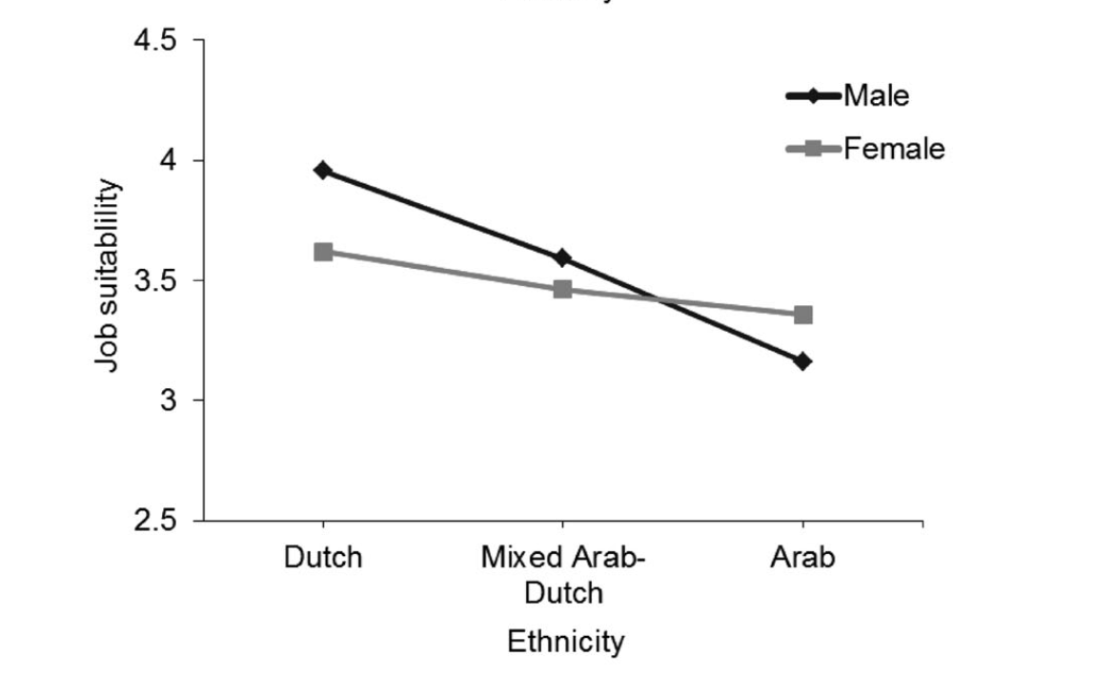
Interaction of Ethnicity and Sex by Client Contact
Client Contact -Low
Client Contact -Moderate
Client Contact -High
Notes:
Arab applicants received lower ratings when external client contact was high than when client contact was low or moderate.
when client contact was low (equal ratings for men/women)
when client contact was moderate, women were rated significantly higher
when client contact was or high (only Arab women were given high preference)
in the high client contact condition, the difference in ratings between female and male Arabs was higher than in the low client contact conditions

Slide 10
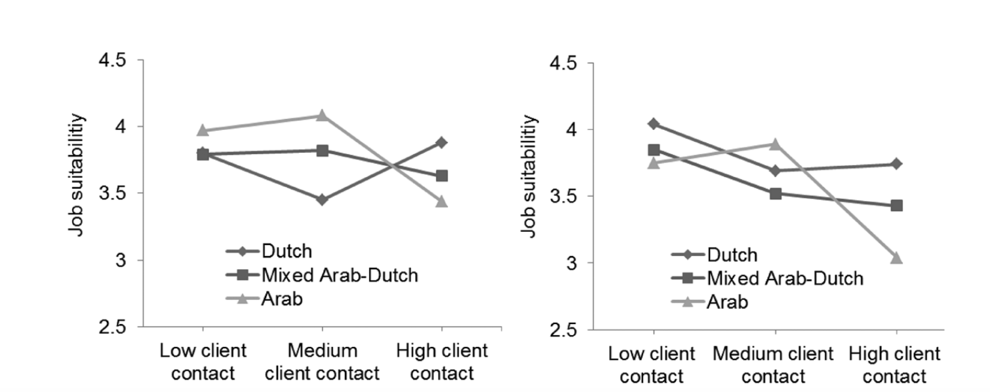
Suitability Ratings of Dutch, Mixed, & Arab with Low/Medium/High Client Contact
Ethnic Prejudice: Low
Ethnic Prejudice: High
Inference: Arab men faced hiring discrimination even for high demanding jobs
Notes:
Interaction wrt to ethnic prejudice
When ethnic prejudice was low for recruiter, Arabs were given high suitability rating than mixed Arab–Dutch and Dutch profiles in the medium client contact condition.
When ethnic prejudice was high for recruiters, Arabs were given low suitability ratings than mixed Arab–Dutch and Dutch profiles in both high and low client contact condition.
This again, confirms that Arabs men faced hiring discrimination even for high demanding job.

Slide 11
Practical Implications
For Recruiters :
Educate regarding structured screening procedure
Create awareness with a training program on job stereotypes , their biases, broader diversity
Use competency-based resume ́ screening
For Organizations :
Make recruiters more accountable for resume screening
Use of technology like Application Tracking System can reduce recruiter's attention to biases
Use of Panel Screening-multiple recruiters screening piles of resume
Notes:
To increase the validity of the hiring process, the take home messages for recruiters would be
Develop stringent policies and better practices like the following :

Slide 12
Can Honest and Deceptive Impression Management Be Detected?
Jose Vasquez
Based on the article
“Honest and Deceptive Impression Management In the Employment Interview: Can It Be Detected and How Does It Impact Evaluations”
Personnel Psychology (2015) 68: 395-444

Slide 13
What is Impression Management?
Impression Management
Honest
Self-promotion
Deceptive
Lying, image creation
“A company hiring half of applicants could hire up to 31% of people who falsified responses during the selection process.” (Griffith, Chmielowski, and Yoshita (2007)

Slide 14
Study Overview
5 studies
Sample Size
516 Interviewers
246 Professionals
270 Novice
Goal
Can Interviewers detect honest and deceptive IM
Can they detect higher than chance level
What questions make it easier to detect IM

Slide 15
Study 1
Participants
154 Professional Interviewers
Gender
48.7% Female
51.3% Male
Education
61.7% had a university degree or equivalent
Interview Experience
Mean: 9.6 years
Position
HR Assistant
Method
Interviewers asked standard interview questions
Situation-task-action-results (STAR)

Slide 16
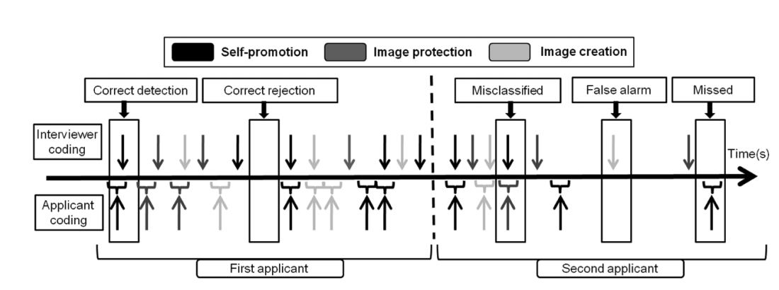
Study 1

Slide 17
Study 2
Participants
92 Professional Interviewers
Gender
52.2% Female
47.8% Male
Education
82.6 % had a university degree or equivalent
Interview Experience
Mean: 10.4 years
Position
Project Manager
Method
Past-behavior and situational questions
“If working on a team project that is due at the end of the day, how would you manage the team”

Slide 18
Study 3
Participants
136 Students
Gender
58.1% Female
41.9% Male
Education
57% Business, 43% Law
Interview Experience
Average of 3 interviews
Method
Past behavior or situational questions

Slide 19
Study 4
Participants
48 Students
Gender
42% Female
58% Male
Education
27% Business/Econ, 49% Humanities, 19% Social Sciences, 14% Other
Interview Experience
Average of 3.9 interviews
Method
5-minute video, measured performance and then coded IM while rewatching

Slide 20
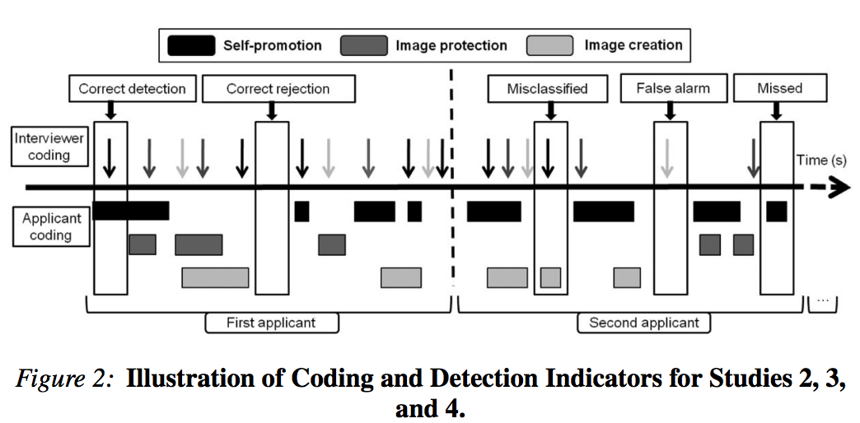

Slide 21
Study 5
Participants
86 Students
Gender
51% Female
49% Male
Education
35% Business/Econ, 34% Law, 19% Engineering, 13% Social Sciences,
Interview Experience
Average of 3 interviews
Method
Watched 5 minute video, rated performance and IM perception
Detections
None of the IM tactics reached standard levels of significance

Slide 22
Results
 | Study 1 | Study 2 | Study 3 | Study 4 | Study 5
Above Chance Level | 67% | 60% | 80% | 54% | N/A
Below Chance Level | 24% | 37% | 15% | 42% | N/A

Slide 23
Conclusion
For Research:
Larger sample sizes (Studies 4 and 5 were small)
Gender can be a difference (Study 2)
Age and interview experience did not have an effect
For Recruiters :
Detecting IM is difficult for Recruiters
Ask behavioral, situational and more detailed questions
Longer interviews

Slide 24
HRM and Organisational Effectiveness
Priyanka Neelakrishnan

Slide 25
Effect of Internal and External Networking on Voluntary Turnover
Arvin Emadi
Based on
INTERNAL AND EXTERNAL NETWORKING DIFFERENTIALLY PREDICT TURNOVER THROUGH JOB EMBEDDEDNESS AND JOB OFFERS
Personnel Psychology (2016) 69, 635–672

Slide 26
TERMINOLOGY
Voluntary Turnover: Employee(s) willingly choose to leave their position
Internal Networking: Networking with coworkers within one’s organization
External Networking: Networking with colleagues across different organizations
Job embeddedness: The extent to which people feel attached, regardless of why
Notes:
Job embeddedness: Fit, links, and sacrifice respect to community and organization

Slide 27
VOLUNTARY TURNOVER CONSEQUENCE
Substantial potential costs
Loss of human capital
Loss of knowledge
Indirect
90% - 200% of leaver’s annual salary
Direct
Recruitment
Selection
Training
Allen, Bryant, Vardaman 2010; Cascio 2006; Woo, Maertz 2012

Slide 28
DOES EMPLOYEES’ NETWORKING RELATE TO VOLUNTARY TURNOVER?
WHEN?
Internal Networking
External Networking
WHY?
Desire to remain
Opportunities to exit
Job satisfaction
Job embeddedness
Perceived alternatives
Job offers

Slide 29
WHAT ARE NETWORKING BEHAVIORS
Definition: Building, Maintaining, and Using informal relationships in work-related activities by
Granting access to resources
Maximizing common advantages
Behavior | Example of
Using company events to make contancts | Internal Building
Catching up with people in other groups on what they do | Internal Maintaining
Receing confidential business advice from people on projects | Internal Using
Developing informal contacts outside the company | External Building
Keeping contacts with ex-colleagues | External Maintaining
Exchanging tips with people on other companies | External Using
Notes:
Type of resources: information, socioemotional support (friendship), services, influence

Slide 30
INTERNAL NETWORKING OUTCOMES
Increased perception of support
Exchange of resources:
Instrumental (how to handle a situation)
Expressive (emotional support)
Positive loop with job satisfaction
Fostering job embeddedness:
Links: Connections forces
Fit: Comfort with the job and people
Sacrifice: Psychological cost of leaving
Notes:
Embeddedness: psychological attachment
Links: Pressure from friends
Comments on when employees are already embedded

Slide 31
EXTERNAL NETWORKING OUTCOMES
Increased alternative employment opportunities
Perception of one’s abilities
Attainment of job offers (referrals etc.)
Notes:
Embeddedness: psychological attachment
Links: Pressure from friends
Comments on when employees are already embedded

Slide 32
THEORY AND HYPOTHESES
Internal networking reduces the likelihood of turnover
External networking increases the likelihood of turnover
Job satisfaction mediates internal networking and turnover
Job embeddedness mediates internal networking and turnover
Perceived employment opportunity mediates external networking and turnover
Job offers mediate external networking and turnover
Notes:
Internal networking increases desire to remain in the company by increasing job satisfaction and embedding them
Positive relation of external networking and turnover is explained by its relation with perceived and actual employment opportunities

Slide 33
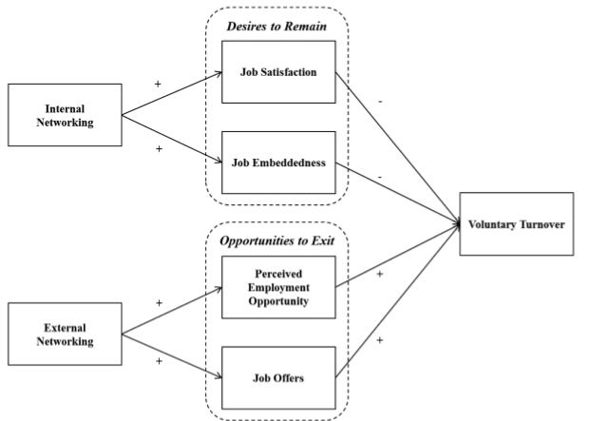
CONCEPTUAL MODEL

Slide 34
METHODOLOGY
2 years later
Phase 1
Phase 2
Contacted 2,936 professionals
540 responded (18.4%)
Selected 371 eligible (+2 years on job)
Surveyed measures of demographic, perceived opportunities, job search, job offers, networking behaviors, job satisfaction, job embeddedness
Contacted the previous respondents
266 responded (72%)
Assessed if they had voluntarily left

Slide 35
MEASURES
Criterion Variable | Scale
Voluntary Turnover | Y/N
Predictors | Scale | Based on
Networking behavior | 1=never to 4=always | 18 selected items from 44-items of Wolff et al (2011)
Job satisfaction | good vs. undesirable | 8 items job in general of Russell et al. (2006)
Employement opportunity | 1=strong disagree to 7=strong agree | Employment opportunity Index
Job embeddedness | Y/N | 7-item global embeddedness of Crossley et. al (2007)
Job offers | Y/N | Any job offer in the past 12-months
Control Variables | Scale | Why
Age and Tenure |  | Shown to relate to turnover (Griffeth et. al 2000)
Firm size | 1 (1-5), 2 (51-100), …, 7 (3000+) | Relates to networking behavior
Education | 0=master's, 1=professional or PhD | Relates to networking behavior
Job search effort | Y/N | Networking as a job search strategy.
Note: Networking behavior on two structural dimensions (internal vs. external) and three functional dimensions (building, maintaining, using)

Slide 36
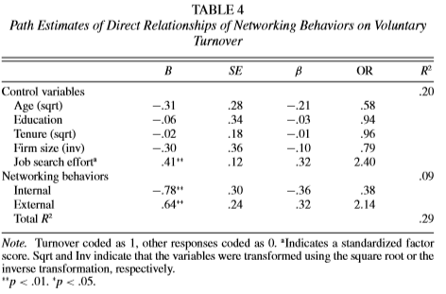
RESULTS: PATH ANALYSIS
Internal networking reduces the likelihood of turnover
Reduction in turnover likelihood
1 std reduction 🡪 140% more turnover
External networking increases the likelihood of turnover
Rise in turnover likelihood
1 std increase 🡪 114% more turnover

Slide 37
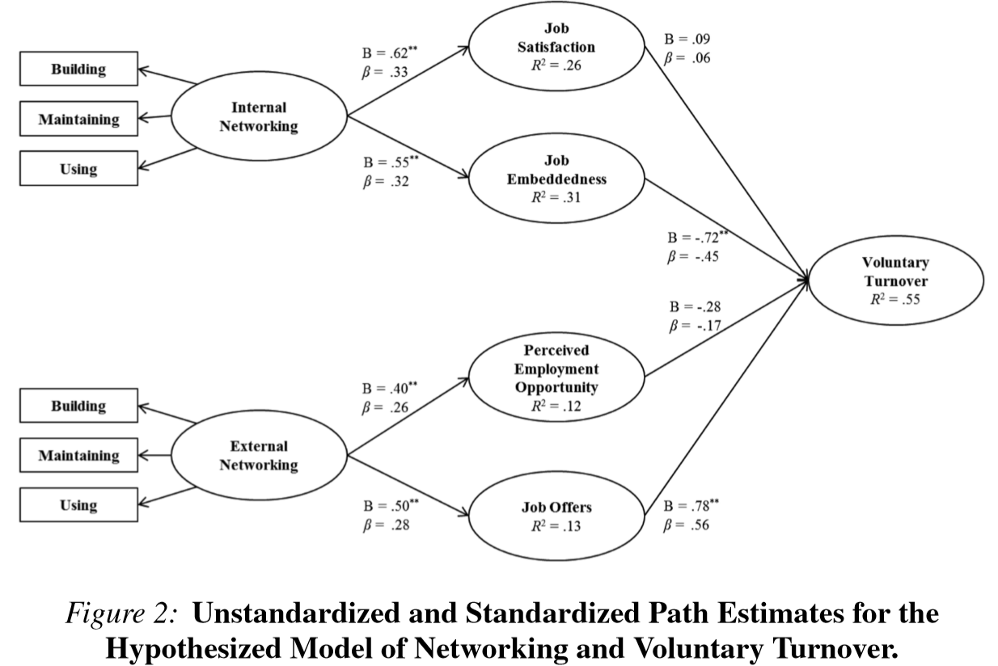
RESULTS: PATH ANALYSIS
? Job satisfaction mediates internal networking and turnover
Positive effect from internal networking
Not significant effect on turnover
Job embeddedness mediates internal networking and turnover
Positive effect from internal networking
Positive effect on turnover

Slide 38
RESULTS: PATH ANALYSIS
? Perceived employment opportunity mediates external networking and turnover
Positive effect from external networking
Not significant effect on turnover
Job offers mediate external networking and turnover
Positive effect from external networking
Positive effect on turnover

Slide 39
DISCUSSION ON RESULTS
How different networking behaviors relate to turnover
Internal vs. external promotes access to different interpersonal resource and outcomes are different.
Internal networking increases desire to stay (feeling embedded)
External networking increases opportunities
Offered theoretical explanation and empirical evidence on the reason.

Slide 40
TAKE-HOME MESSAGE: HOW ORGANIZATIONS MAY PROMOTE OR MANAGE EMPLOYEES’ NETWORKING?
Creating and investing in internal networking
Increasing embeddedness:
HRM practice such as generous benefits
Promoting from within (fit)
Social events (links)
On-site services (sacrifice)
Counter job offers:
Competitive salaries, stocks, 401k etc
Identifying, monitoring, and engaging these type of employees can translate to substantial saving:
Above average external networking can indicate desire to leave.
Below average internal networking can indicate job withdrawal.
Notes:
Creating and investing in internal networking: online community, mentoring programs, company events, job rotations

Slide 41
Thank You

Slide 42
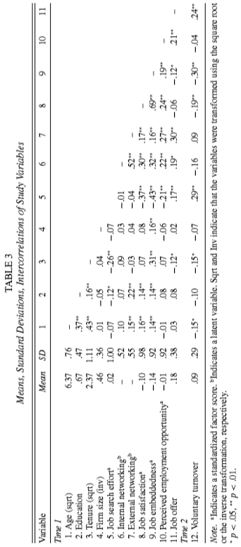
RESULTS: INTERCORRELATIONS
Note: Structural Equation Modeling (SEM) with weighted least mean square in Mplus v.7.1
Allowed 1- internal networking to correlate with perceive employment opportunities, 2- perceived employment opportunities to correlate with job offers, and 3- job satisfaction to correlate with job embeddedness

