Slide 1
Is Being a Good Leaner Enough? An Examination of the Interplay Between Learning Goal Orientation and Impression Management Tactics on Creativity
Desiree Wion
Professor Malos
BUS 251
February 27, 2020

Slide 2
Why is this important?
“Researchers have suggested that employee creativity, the development of novel and useful ideas about products, practices, services or procedures, is a crucial contributor to organizational effectiveness and sustainability”
Positive social perspective of creativity

Slide 3
Keywords
Learning Goal Orientation
Impression Management
Protégés
Mentoring Provision
Formal Mentoring Program: Reciprocity, developmental benefits, consistent interaction

Slide 4
Previous Research
Srull and Wyer (1989): Encode social information
VandeWalle & Cummings (1997): LGO & feedback
Noe, Greenberger, & Wang (2002): Beneficial mentoring outcomes
Liao, Liu & Loi (2010): Supervisor facilitating or hindering creativity

Slide 5
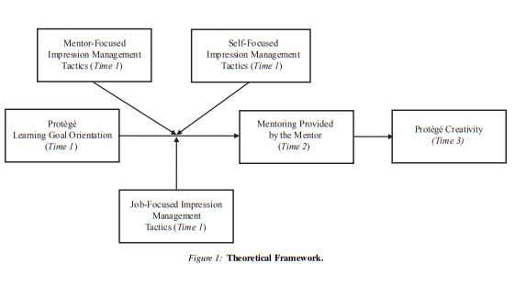
Question?
Do different impression tactics have a greater influence on an employee’s learning goal orientation when paired with mentoring to influence creativity?

Slide 6
Method
Newly hired technicians and mentors
8 month formal mentoring program in Northeast China
One protégé per mentor (not supervisor)
2 hours per week minimum
Data
3 points in time from 3 different sources (Protégé, mentor, HR department)
Questionnaires
80% response rate Time 1 (2 months)
83% response rate Time 2 (5 months)
Hypothesis 1-3: The use of mentor/self/job focused IM tactics will moderate the positive relationship between protégé LGO and extent if mentoring is provided frequently.
Hypothesis 4: Mentoring provision mediates the relationship between protégé LGO and creativity

Slide 7
Questionnaire examples
Mentor Focused IM Tactics: “Praise my mentor on his/her accomplishments”
Self Focused IM Tactics: “Work hard when I know results will be seen by my mentor”
Job Focused IM Tactics: “Play up the value of a positive event that I have taken credit for”
Extent of Mentoring: “I place my protégé in important assignments”
Creativity: Independent judges with bonuses

Slide 8
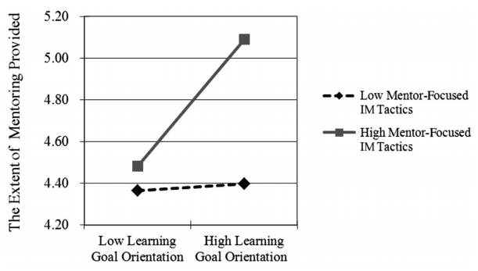
Results: Mentor-Focused IM tactics
Protégé mentor focused IM tactics strengthen the relationship between LGO and the extent of mentoring provided.
Cronbach’s alpha = .71

Slide 9
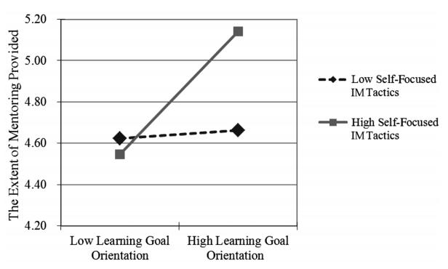
Results: self-Focused IM tactics
Protégé self focused IM tactics strengthen the relationship between LGO and the extent of mentoring provided.
Cronbach’s alpha = .71

Slide 10
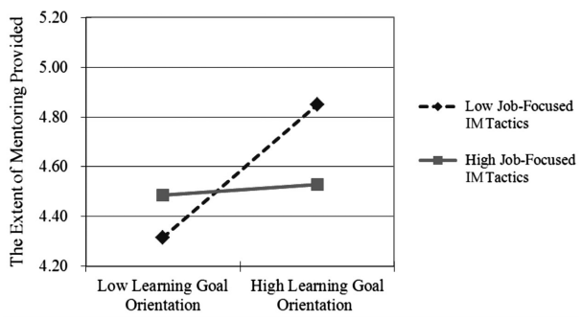
Results: job-Focused IM tactics
Protégé job focused IM tactics weakened the relationship between LGO and the extent of mentoring provided.
Cronbach’s alpha = .86

Slide 11
Take Home Message
Positive outcomes for employees with high LGO
-Learning culture
-Creative time
Positive reinforcement for mentors
-Open door policies
-Behavioral selection for protégés
Broad impact of mentoring on protégé outcomes
- Mentor rewards
- Protégé spotlight for creative ideas

Slide 12
Thank you!

