Slide 1
High Performance/
High Involvement Systems & Worker Attitudes
Presentors:
Vincent Arteaga
Ashwini Jayaram
Jing Fan
Peng Si
BUS-251

Slide 2
The Impact of High-Performance Work Systems on Frm Performance: The moderating effects of the human resource function’s in ﬂuence
by DAE YONG JEONG AND MYUNGWEON CHOI
Vincent Arteaga BUS 251 Dr. Malos Spring 2020

Slide 3
This study is organized into four sections.
Theoretical and empirical studies on the relationship between HPWSs and ﬁrm performance.
Clariﬁcation of their position on the universalistic and contingency perspective debate.
Empirical test of the hypotheses using data collected from ﬁrms in South Korea.
What conclusions the researchers came to.

Slide 4
Defining HPWS
No universally agreed-upon deﬁnition of the term HPWS owing to differences regarding the theoretical, empirical, and practical approaches adopted by different researchers.
Inﬂuence is a more appropriate construct than power for the HR function.
“Power” in the meaning of control over the employee.

Slide 5
Defining HPWS
Without having a strong and universal standard for the definition of HPWS, this may pose a challenge to how the study can be conducted.
Nonetheless, an HPWS can be broadly described as a group of separate but interconnected HR practices designed to enhance employees’ skills and effort.

Slide 6
Positives of HPWS
HPWS systems are designed to improve an employee’s overall performance in the workplace.
Many firms practice the methods of HPWS and many studies have argued that high-performance work systems (HPWS) improve ﬁrm performance signiﬁcantly.
This is done by offering training for the employee and then periodically giving performance evaluations.

Slide 7
Reinforcing findings
That other studies have called for further investigation to enrich their theoretical explanations.
Several other studies found either no relationship or a negative relationship between HPWSs and ﬁrm performance.
This study conceptualizes the inﬂuence of the HR function as a critical moderator in the HPWS–performance link.

Slide 8
Four items of HPWS measure in this study
Emphasis on loyalty and commitment.
Internal promotions with long-term employment relationships,
Use of teams
Use of training focused on employee development

Slide 9
Workplace Panel Survey (WPS) from the Korea Labor Institute
Taken once every 2 years since 2005 to gather information about the HR and labor relations practices of businesses in Korea.
Also covers hard data such as employee count, top line sales, and the firm’s current assets.
Survey was administered to companies with more than 30 employees.
Most recent data set used, 2011 which included 632 manufacturing ﬁrms.

Slide 10
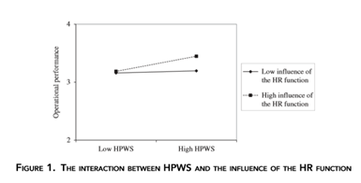
High HPWS and High Influence of HR Function

Slide 11
High HPWS and High Influence of HR Function
The results show that HPWS had a signiﬁcant main effect on ﬁrm performance (both operational and ﬁnancial).
This provides support for Hypothesis 1. Which was that there is a positive relationship between HPWS and ﬁrm performance.

Slide 12
Take Home Message
Managers should understand that high HR influence will help an organization to receive the most benefit from HPWS.
Whereas if the HR influence is low, the efforts will be the same whether or not the organization has implemented HPWS.
To start, an organization will need to set what the definition of HPWS is for them and then dive deeper and see if they have the capacity to engage with their employees from a position of influence.

Slide 13
Take Home Message
Organizations should not waste money and resources on implementing a HPWS if there is no intention of having a high HR influence.
In order to have great employee relations and a complex plan for your employee, it is important to look at:
The hiring and recruiting process.
Employee daily routines and activities.
Employee development.
Employee promotions.

Slide 14
Optimizing The Benefits Of A HPWS Through The Dual Alignment Of Vertical And Horizontal Fit -Ashwini Jayaram BUS - 251
Based on the Journal: THE GOLDILOCKS EFFECT OF STRATEGIC HUMAN RESOURCE MANAGEMENT? OPTIMIZING THE BENEFITS OF A HIGH PERFORMANCE WORK SYSTEM THROUGH THE DUAL ALIGNMENT OF VERTICAL AND HORIZONTAL FIT.
By : JOO HUN HAN, SAEHEE KANG, IN-SUE OH, REBECCA R. KEHOE and DAVID P. LEPAK
Notes:
Hello Everyone, Today I'm presenting a paper on HPWS.

Slide 15
Agenda Key Terms New Product Hypothesis Research Design Results Take Home Message
Notes:
Agenda for the presentation

Slide 16
Key Terms
High-Performance Work System?
Internal Consistency?
Notes:
HPWS - Is the right combination of people, technology and organizational structure that makes full use of the organization’s resources and opportunities in achieving its goals.
Internal Consistency - The idea central to internal consistency is the positive outcomes generated by consistent combinations of multiple HRM practices, where the effect of the whole is greater than the sum of its parts.
HPWS through their HR functions by giving more importance to the training provided to their employees, retaining those trained and skilled employees within the organization and achieving success throughout their business.

Slide 17
New Product Development
3 MAJOR ENTRY TIMING MODES:
FIRST MOVER
FAST FOLLOWER
FENCE SITTER
Notes:
Pursuit of new product development, organizations choose from among three major entry timing modes in introducing their products to market: first mover, fast follower, fence sitter.

Slide 18
New Product Development
First movers seek to produce new-to-market products, and thus endeavor to generate novel technical and market knowledge, which entail high technical uncertainties.
Notes:
Compared with imitative products developed by followers, first-mover products carry higher risks of adopting technology that may turn out to be impractical, costly, or deficient.
Even when first movers successfully produce pioneering products, they still face high market risks due to uncertainties in customer needs and reactions.

Slide 19
New Product Development
In contrast to first movers, fast followers wait to take advantage of available information about first movers new products and customers.
Fast followers face lower levels of technical and market uncertainties.
Notes:
They learn by analyzing first movers successes and failures.
Taking a more incremental approach to knowledge development, fast followers reverse engineer first movers new products.
Survey their new customers, and assimilate their technical and market knowledge to develop superior imitative products.

Slide 20
New Product Development
Fence sitters, primarily focused on operating within a narrow competitive scope, maintaining their current markets, and removing market disturbances.
Notes:
They do not require the same level of knowledge search, exchange, and combination among employees as do first movers or fast followers.
Along these lines, its significant for an organization to have an effective HPWS to ensure the modes of market entry timing won't cut down the product sales or organizations performance.

Slide 21
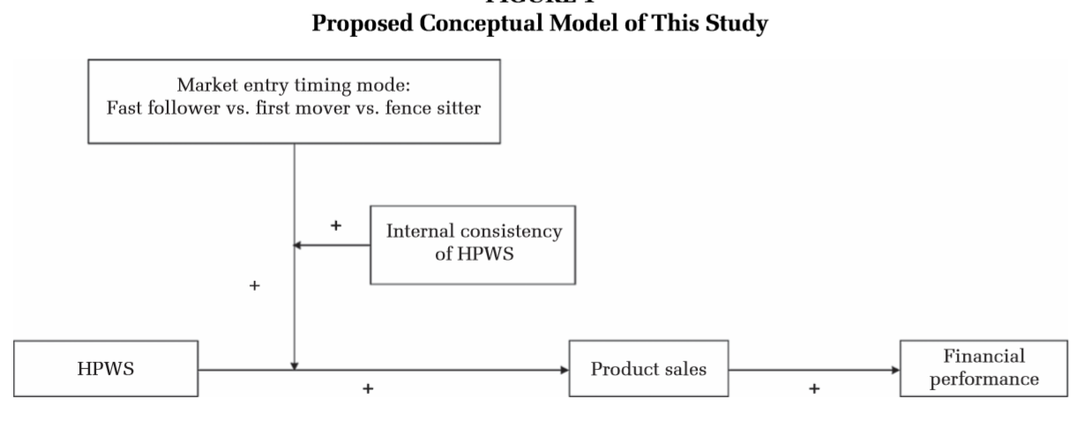
Conceptual Model
Notes:
Market entry timing mode with Internal consistency of HPWS has positive effect on Product sales.
Which influences in better or greater financial performance of a organization.

Slide 22
Hypothesis:
Hypothesis 1 - Market entry timing modes will moderate the relationship between the use of an HPWS and subsequent product sales, such that the relationship will be most positive among organizations pursuing a fast-follower entry timing, followed by a first-mover entry timing, and subsequently a fence sitter entry timing.
Notes:
Which Means - Market entry timing modes will direct the connection between the utilization of a HPWS and subsequent product sales, to such an extent that the relationship will be best among organizations seeking after a fast-follower entry timing, followed by a first-mover entry timing, and subsequently a fence sitter entry timing.

Slide 23
Hypothesis:
Hypothesis 2 - HPWS internal consistency will moderate the interactive effect between the use of an HPWS and market entry timing modes on product sales, such that the successive effects of HPWS utilization on product sales across the three market entry timing modes will be more pronounced when HPWS internal consistency is high.
Notes:
Which Means - HPWS inward consistency will direct the intuitive impact between the utilization of a HPWS and market entry timing modes on product sales, with the end goal that the progressive impacts of HPWS usage on product sales over the three market passage timing modes will be increasingly articulated when HPWS interior consistency is high.

Slide 24
Hypothesis:
Hypothesis 3 - Product sales will mediate the three-way interactive effects among an HPWS, market entry timing modes, and HPWS internal consistency on subsequent organizational financial performance.
Notes:
Which Means - Product sales will intervene the three-way intuitive impacts among a HPWS, showcase market entry timing modes, and HPWS internal consistency on subsequent organizational financial performance.

Slide 25
Research Design
Sample
3,456 business establishments
30 or more employees
17 different industry sectors
Measures
16 HR practices that could be mapped onto the AMO model of HRM.
Notes:
Data is from the Workplace Panel Survey (WPS), a government-funded research institution. Sample frame to select 3,456 business establishments with 30 or more employees in 17 different industry sectors.
Measure is based on 16 HR practices that could be mapped onto the AMO model of HRM by referring to representative HPWS studies included those specifically, ability enhancing HR practices, selective staffing, motivation enhancing HR practices and opportunity enhancing HR practices.

Slide 26
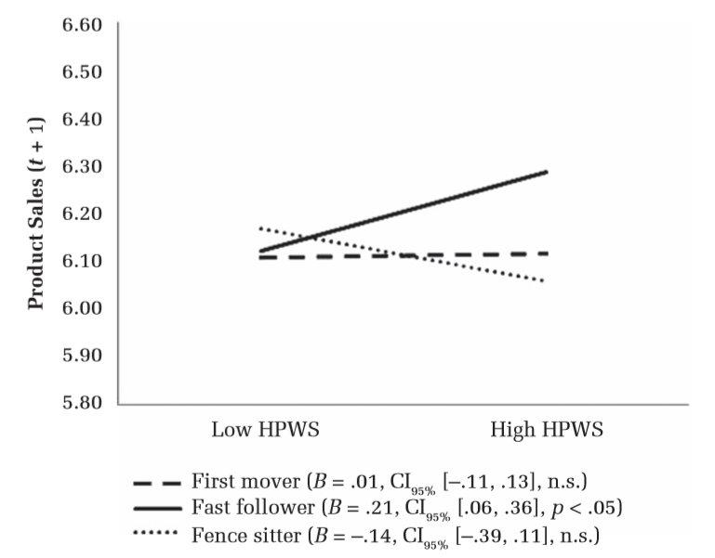
Results Effects of an HPWS on Subsequent Product Sales Across Market Entry Timing Modes
Notes:
Result - Hypothesis 1 proposed that the relationship between an HPWS and subsequent product sales would be most positive among fast followers, followed by first movers, and then fence sitters.
Fast follower sales moving from 6.10 to 6.30 with High HPWS is clearly seen. Where as in first mover sales we can see slight change and fence sitter sales drastically reduce.

Slide 27
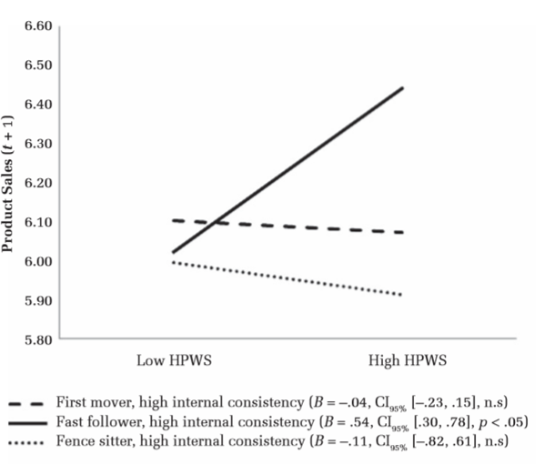
Results Effects of an HPWS on Subsequent Product Sales Across Market Entry Timing Modes Under High versus Low Degrees of HPWS Internal Consistency
Notes:
Result - Hypothesis 2 proposed that internal consistency of an HPWS would magnify the positive interactive effect of an HPWS with a fast-follower.
Fast follower sales moving from 6.00 to 6.50 with High HPWS and High internal consistency is clearly seen. Where as in first mover we can see slight change and fence sitter sales drastically reduce.

Slide 28
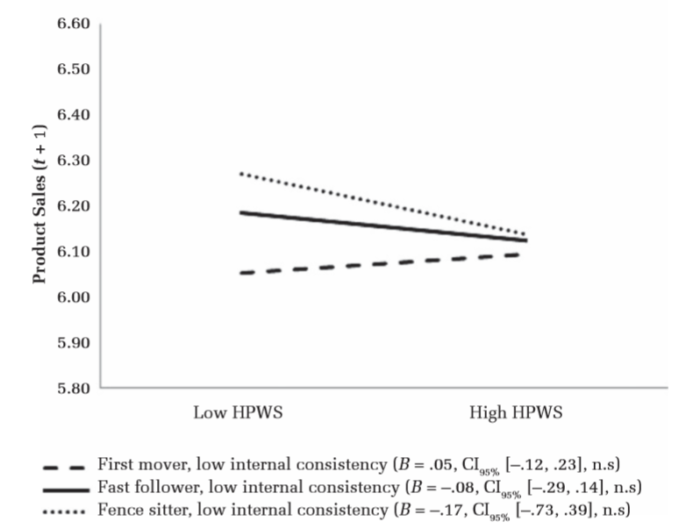
Results Effects of an HPWS on Subsequent Product Sales Across Market Entry Timing Modes Under High versus Low Degrees of HPWS Internal Consistency
Notes:
Result – with low internal consistency fast follower sales moves from 6.20 to 6.10 is clearly seen. Where as in first mover sales we can see slight increase and fence sitter sales drastically reduce.
Conclusion is that with High internal consistency and High HPWS the product sales increases for fast follower.

Slide 29
Take Home Message
HPWS should be implemented only after managers determine whether the key technical and market knowledge for successful strategy enactment is within reach of employees for assimilation and leveraging.
HR managers in organizations would be well advised to attend to all three AMO domains and to balance budget and resource allocations accordingly.
Notes:
Thus, Performance can be maximized when organization uses an HPWS with high internal consistency across HR practice that develop A(ability), M(motivation) and O(opportunity) employees to engage in desired knowledge behaviors.

Slide 30
Thank you
Notes:
Any Questions?

Slide 31
How reward satisfaction affects employees’
turnover intentions and performance: an individual differences approach
By Sara De Gieter and Joeri Hofmans, Department of Work and Organizational Psychology, Vrije Universiteit Brussel
Jing Fan
BUS-251 Group 4

Slide 32
Which kind of reward do you prefer? Money, Training opportunity, or Compliments?

Slide 33
Previous Research
Satisfaction with financial rewards relate positively to employees’ task performance, and negatively to employees’ turnover intention.
Employees with a high performance on agreeableness are more attracted by quality of work, relationships, and indirect pay.
Employees’ employment levels and personal characteristics have an influence on their preference of reward.
The previous research always focus on financial rewards and neglect the potential individual differences.
Notes:
This research paper is the response to the assumption that satisfaction with rewards has the same effect on the behavior and attitudes of every employee. It intends to figure out the relationship between the effect of different type of rewards and the employees’ turnover intention and task performance. Although the previous scholars traditionally focus on financial rewards and always neglect the potential individual differences, there has been a series of previous researches supporting this research. Williams’ research (2006) shows that satisfaction with financial rewards relate positively to employees’ task performance, and negatively to employees’ turnover intention. Vandenberghe’s research (2008) shows employees with a high performance on agreeableness are more attracted by quality of work, relationships, and indirect pay. Kovach(1995) and Dubinsky(2000) shows employees’ employment levels and personal characteristics have an influence on their preference of reward.

Slide 34
Issues
Whether the type of rewards has an influence on employees’ task performance and turnover intention?

Slide 35
Keyword
- Pay satisfactions
- Task performance
- Turnover intentions
- Reward types (financial rewards, material rewards, and psychological rewards)
- Individual differences
Notes:
- Pay satisfactions: the degree to which an employee is satisfied with his or her reward.
- Task performance: the supervisors’ ratings of employees’ task performance.
- Turnover intentions: the employee’s intentions to leave office.
- Reward types: the research divides rewards into 3 types: financial rewards, material rewards, and psychological rewards. Financial rewards mean cash and cash equivalent like stock right. Material rewards mean the tangible or intangible benefit for one person, like insurance or the opportunity to travel. Psychological rewards mean the psychological gains at work like compliment or good relationship with colleagues.

Slide 36
Hypothesis
Hypothesis 1: The effect of satisfaction with financial, material and psychological rewards on turnover intentions will differ significantly between employees.
Hypothesis 2: The effect of satisfaction with financial, material and psychological rewards on task performance will differ significantly between employees.

Slide 37
Hypothesis
Hypothesis 3: The effect of satisfaction with financial rewards on turnover intentions and task performance is significantly stronger for employees who score high on financial security.
Hypothesis 4: The effect of satisfaction with psychological rewards on turnover intention and task performance is significantly stronger for employees who score high on recognition.
Hypothesis 5: The effect of satisfaction with psychological rewards on turnover intention and task performance is significantly stronger for employees who score high on interpersonal contact.

Slide 38
Data
179 employees in the back office of a Belgian financial institution.
68% women and 32% men.
39.9 years old on average, ranging between 21 and 65 years.
13.1 years work experience on average.
64% had completed higher education.
48.6% performed ‘good’, 40.2% performed ‘very good’ and 11.2% performed ‘poor’.
Notes:
The date was from a study for 179 employees in the back office of a Belgian financial institution in 2011. The researchers sent Pay Satisfaction Questionnaires to 250 employees and received the responses of 179 (response rate of 71.6%). Among 179 participants, 68% are female and 32% are male. The average age of all participants is 39.9 years, ranging between 21 and 65 years. The average tenure is 13.1 years, and 64% of the participant had completed higher education. According to the 2010 annual task performance evaluation score of each participant, 48.6% performed ‘good’, 40.2% performed ‘very good’ and 11.2% performed ‘poor’.

Slide 39
Method
Sending Pay Satisfaction Questionnaires to 250 employees (response rate of 71.6%).
Getting the previous year’s annual task performance evaluation score of each participant.
fitting a series of models with an increasing number of employee subgroups. (BIC)
The model including 3 employee subgroups is the best.
Cluster-wise regression analysis
Notes:
The researchers sent Pay Satisfaction Questionnaires to 250 employees and received 179 responses. They also obtain the previous year’s annual task performance evaluation score of each participant from managers. The researchers decided to divide all the participants into three subgroups through the Bayesian Information Criterion. Then the researchers used Cluster-wise regression analysis to analyze the date.

Slide 40
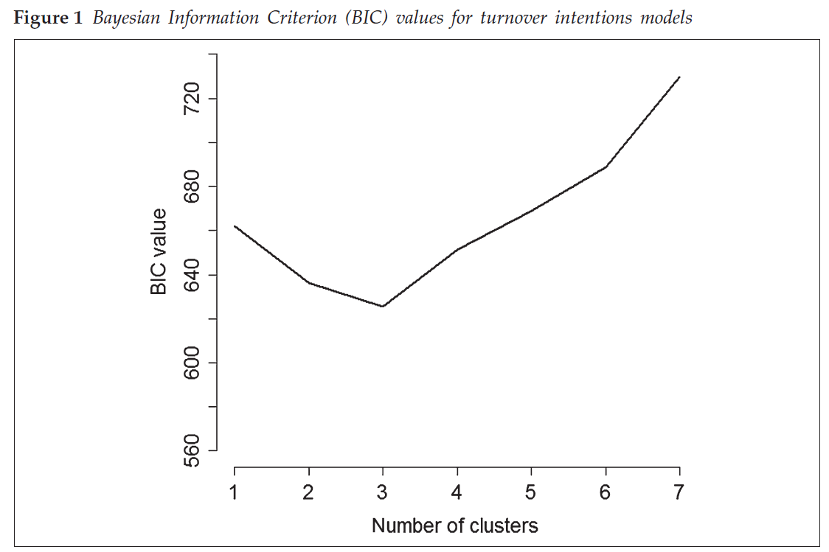
Result
Bayesian Information Criterion (BIC)
The lower BIC value is, the better the model is.
The model with 3 cluster is the best.
Hypothesis 1 supported.
Notes:
Bayesian Information Criterion (BIC) is a model selection criterion to improve the likelihood by simply adding parameters to a model. It’s a little bit difficult to explain how Bayesian Information Criterion works. We just need to know that a model with a lower BIC value is preferred over a model with a higher BIC value.
Figure-1 shows that the turnover intention model with 3 clusters has the lowest BIC value. This result can also support the hypothesis that the effect of satisfaction with financial, material and psychological rewards on turnover intentions will differ significantly between employees.

Slide 41
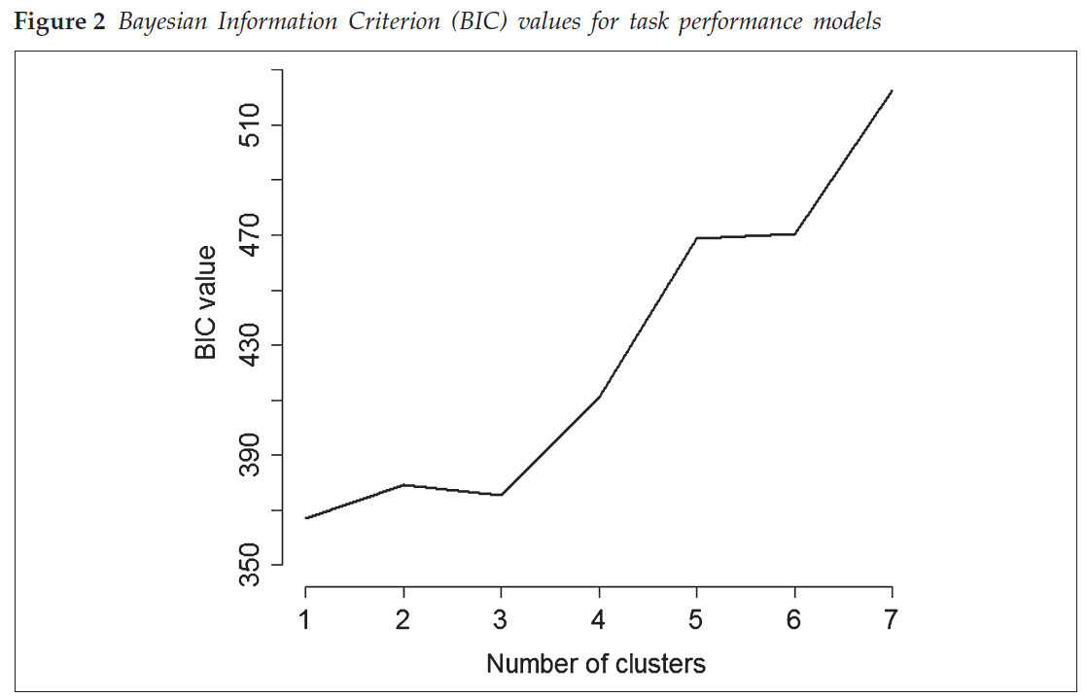
Result
The task performance model with 1 cluster is the best.
Hypothesis 2 rejected.
Notes:
Figure-2 shows that the task performance model with merely 1 cluster has the lowest BIC value. This result rejects the hypothesis that the effect of satisfaction with financial, material and psychological rewards on task performance will differ significantly between employees.

Slide 42
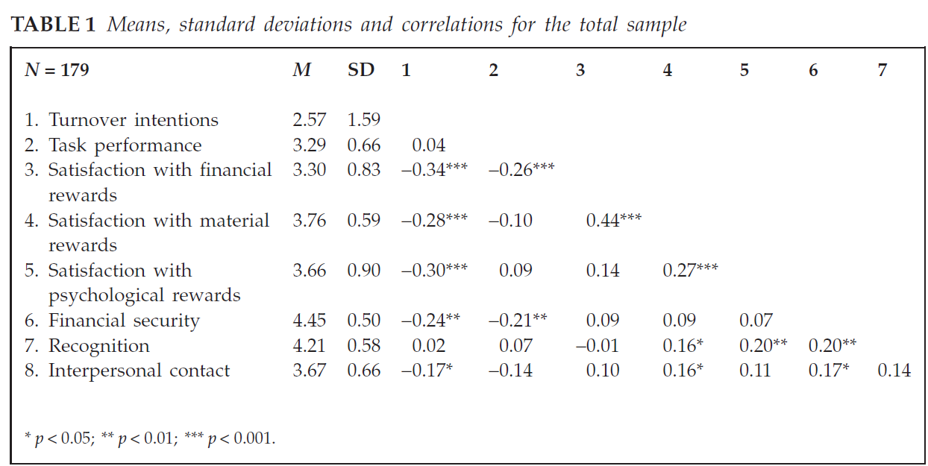
Result
Turnover intentions related positively to satisfaction with all three types of rewards
Task performance related negatively to satisfaction with financial rewards.
Satisfaction with material related positively to satisfaction with psychological rewards.
- Individuals who were more satisfied with their psychological rewards scored higher on recognition.
Notes:
Table 1 shows the date of all participants. From this table we can draw the following conclusions. Firstly, turnover intentions related positively to satisfaction with all three types of rewards. Secondly, task performance related negatively to satisfaction with financial rewards. Thirdly, satisfaction with material related positively to satisfaction with psychological rewards. Finally, individuals who were more satisfied with their psychological rewards scored higher on recognition.

Slide 43
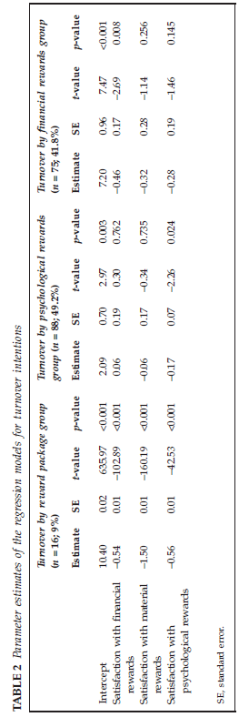
Result
Notes:
Table 2 shows the subgroup-specific regression function for all subgroups. The researchers used put the participants into different subgroups based on their personal characteristics. In the turnover by reward package group, satisfaction with financial rewards, material rewards and psychological rewards negatively and significantly related to turnover intention. In the turnover by psychological rewards group, only psychological rewards negatively and significantly related to turnover intention. In the turnover by financial rewards group, only financial rewards negatively and significantly related to turnover intention

Slide 44
Result
The turnover intention of people with a secondary school degree negatively related to all 3 reward types.
People with a bachelor’s degree were spread out across the three subgroups.
The turnover intention of people with a master degree only negatively related to financial rewards.
Notes:
Table 3 shows the distribution of different educational levels across 3 subgroups. From this table we can know: 1. the turnover intention of people with a secondary school degree negatively related to all 3 reward types; 2. The turnover intention of people with a master degree only negatively related to financial rewards; 3. People with a bachelor’s degree were spread out across the three subgroups.

Slide 45
Take-home Message
- utilize the different types of rewards flexibly
- focus on between-employee difference
- quantify employees’ personal characteristics and satisfaction with different reward types
- set up a scientific and efficient rewarding system based on the quantized date of employees’ personal characteristics
Notes:
With the above result we can draw a conclusion that employees’ satisfaction with different type of rewards has an influence on employees’ turnover intention and task performance. The employers and HRs should remain flexible in utilizing the different types of rewards. Meanwhile, employee’s personal characteristics like age and education level relate to their satisfaction with different reward types. Therefore, the employers and HRs should focus on the between-employee differences and quantify the employees’ personal characteristics and their satisfaction with different reward types through questionnaires. A scientific rewarding system based on employees’ quantized date can help HRs manage and encourage their employees in a more efficient way.

Slide 46
THANK YOU

Slide 47
HR attributions High-performance work systems Employee outcomes
Peng Si
Bus 251- group 4
Based on the article:“ The role of employee HR attributions in the relationship between high-performance work systems and employee outcomes
By Karina Van De Voorde and Susanne Beijer

Slide 48
Key Words
HPWS: high-performance work systems
HR attributions: HR well-being & HR performance attributions
Notes:
HR well-being attributions were associated with higher levels of commitment and lower levels of job strain.
HR performance attributions were associated with higher levels of job strain.

Slide 49
Introduction
The relationship between HPWS and employee outcomes
The two core signals of HPWS
Notes:
The central idea here is that HPWS signal the organisations’ intentions and goals to employees including, in particular, (a) the extent to which employees are seen as valuable resources and (b) the level of performance that is expected of them at work.
Particularly important in this respect are employees’ attributions about management’s purpose in implementing given practices, which in turn shape individuals’ outcomes.

Slide 50
Issues
How employee attribute meanings to HPWS
How these meanings shape employees’ outcomes

Slide 51
Hypothesis 1
Well-being focused HR attributions are associated with higher levels of commitment.

Slide 52
Hypothesis 2
Well-being focused HR attributions are associated with lower levels of job strain.

Slide 53
Hypothesis 3
Performance-focused HR attributions are associated with lower levels of commitment.

Slide 54
Hypothesis 4
Performance-focused HR attributions are associated with higher levels of job strain.

Slide 55
Methods
Procedure and sample
1065 employee
150 units
73 organizations
Average response rage in a unit is 47%
Overall response rate is 24%
Notes:
Almost 60 per cent of the managers was male, and their average age was 43 years.
The majority of the manager sample holds at least a bachelor’s degree (more than 80 per cent).
The median number of years within the organisation is 10.
In the employee sample, almost 60 per cent of the respondents was female, and the average age of the respondents was 37 years.
Nearly 50 per cent of the respondents hold at least a bachelor’s degree, and the median number of years within the organisation was 5.
About 54 per cent of the units were in the profit sector and about 46 percent of the units in the non-profit sector.

Slide 56
Methods
Control Variables
Gender
Age
Education
Tenure
Work unit level
Work unit size
Notes:
We controlled for four demographic individual-level variables: gender (1 = male 2 = female), age (in years), tenure (0–2 years, 3–5 years, 6–10 years and more than 11 years) and education (low = lower vocational, secondary; medium = middle vocational; high = higher vocational, college/university). At the unit level, we controlled for work unit size (less than 12 employees; between 12 and 25 employees; more than 25 employees) and sector (profit = 1, non-profit = 2).

Slide 57
Results
Notes:
HR well-being attributions are found to be positively associated with commitment (β=0.57; M3;) and negatively with job strain (β= - 0.13;M3).
HR performance attributions are found to be positively associated with job strain ( β=0.05, M3).
However, no significant relationship was found between HR performance attributions and organisational commitment (β = −0.07; M3)

Slide 58
Model linking HPWS to commitment and job strain
Notes:
The higher levels of HR well-being attributions are associated with more commitment and less strain.
The higher levels of HR performance attributions are associated with higher levels of experienced strain.

Slide 59
Take-home message
The employee commitment can be enhanced based on HR well-being attributions.
The line managers can stimulate employee commitment by increasing the coverage of employees by HPWS.
The line managers can enhance employee commitment and reduce feelings of job strain by communicating that the intended goal of the HPWS practices reflects care and support for employees.
Organizations could invest in line manager’s abilities to perform these HPWS implementation tasks.
The line managers need to take account of these negative employee health effects of HPWS practices the result from HR performance attribution.

Slide 60
Thank you !

