Slide 1
Worker Attitudes
Kayla Huynh & Lakhvir Singh

Slide 2
Are workplace friendships a mixed blessing? Exploring tradeoffs of multiplex relationships and their associations with job performance
Jessica R. Methot, Jeffrey A. Lepine,
Nathan P. Podsakoff, & Jessica Siegel Christian

Slide 3
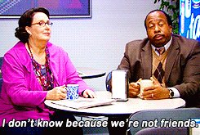
Do you have a work best friend?

Slide 4
Issue
Workplace friendships have positive and negative impacts to job productivity and job satisfaction.
We need to understand which behaviors can mitigate the negative effects.

Slide 5
Multiplex Workplace Friendships
Co-workers + friends¹
Work together and socialize outside of work
¹ Ingram & Zou, 2008

Slide 6
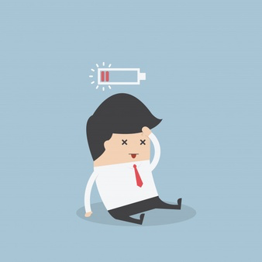
Conservation of Resources Theory (COR)
People strive to retain, protect, and build resources¹
Energy²
Physical
Emotional
Cognitive
Time
Investments provide future access to resources
¹ Hobfoll, 1989
² Kohn, 1990

Slide 7
High Quality Connections Theory (HQC)
Short-term, positive, and reciprocal interactions between 2 people
Connections at work are vital for employees' health and well-being¹
Multiplex workplace friendships are stronger than one-dimensional interactions¹
¹ Dutton & Heaphy, 2003

Slide 8
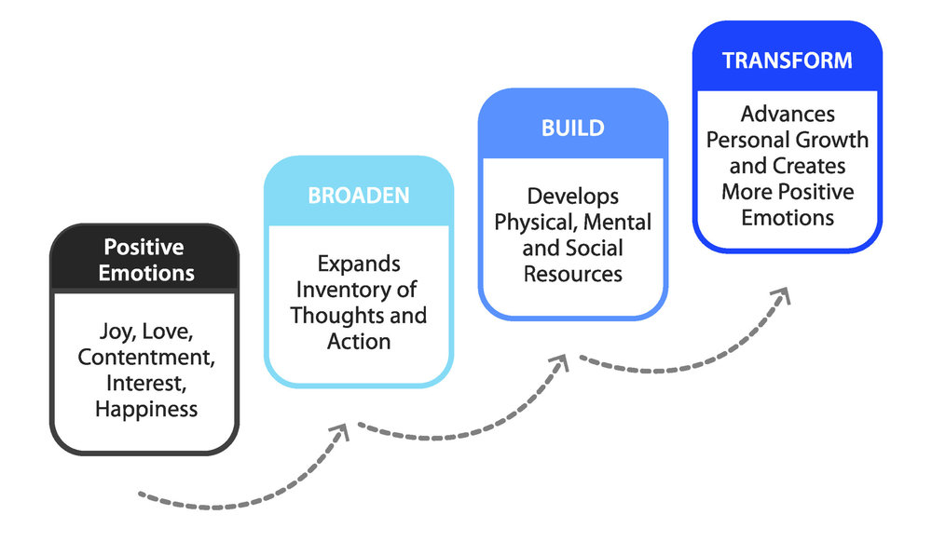
Broaden and Build Theory

Slide 9
Previous Research
Larger networks = greater access to resources
Lead to emotional exhaustion
Can be offset by positive affect
Less energy → job performance decreases
Increase in job productivity, satisfaction, retention

Slide 10
Study 1
Multiplex Network Size
Exhaustion
Positive Affect
Task Performance
Notes:
Study 1 measured the impact of multiplex workplace friendships on task performance through exhaustion and positive affect within an insurance company. They collected surveys that asked participants to rate different statements about exhaustion, positive affect, and task performance. These statements were based on previous researchers’ studies. For multiplex network size, participants were asked to list 10 people who they approach for work-related reasons and list 10 people who they approach to socialize. If these people were on both lists, then it made up the participants’ network. Exhaustion refers to feelings of lacking energy while positive affect refers to positive feelings towards another person. About 4-6 weeks after the survey, the employees’ surveys were asked to give a rating for job performance.

Slide 11
Exhaustion
0.39
-0.29
Multiplex Network Size
Task Performance
- 0.53
0.23
0.33
Positive Affect
Figure 1: Results of Hypothesized Multilevel Structural Equation Model of Multiplex Network Size on Task Performance (Study 1).
Notes:
From this figure, you can see that multiplex network size has positive impact on task performance, meaning the bigger the network, the better the task performance. Multiplex network size has a positive impact on both exhaustion and positive affect, which means multiplex network size increases exhaustion and positive affect. However, positive affect has a negative impact on exhaustion, so positive affect can reduce exhaustion. Nevertheless, exhaustion still has a negative impact on task performance. Therefore, exhaustion decrease task performance. Overall, the findings from this study is consistent with previous research.
“larger MWF networks result in greater access to resources, diverse sources of information, and control over task accomplishment. Thus, these factors would lead to increased job performance. Furthermore, large MWF networks lead to increased exhaustion due to the required investments of energy and time to maintain the relationships. In turn, if an employee has reduced levels of energy and time, they would not be able to apply that energy or time toward core job performance activities. Finally, positive affect, or feelings, can be used as a source of replenishment for energy. These positive emotions can increase employees' motivation by re-energizing, thus reducing feelings of exhaustion.”

Slide 12
Study 2
Multiplex Network Size
Emotional Support
Trust
Maintenance Difficulty
Felt Obligation
Task Performance
Notes:
Study 2 dives in deeper than Study 1 by looking at multiplex workplace friendships impacting task performance through specific behaviors of emotional support, trust, maintenance difficulty, and felt obligation. Emotional support refers to employees seeking to share feelings with their peers. Trust refers to when an employee can rely on their peer and know that they have their best interests at heart. Maintenance difficulty refers to the challenge of getting along with people as both co-workers and friends. Felt obligation refers to when an employee feels they need to put others’ need before their own. For study 2, researchers collected surveys from 3 retail stores and 6 restaurants. Because the stores and restaurants had less employees compared to the insurance company in study 1, the researchers asked employees to identify each peer as a co-worker, friend, or both. From there, the researchers were able to create the employee’s multiplex network. The researchers also used similar methods for the surveys as they did in study 1 with ratings for each statement concerning emotional support, trust, maintenance difficulty, and felt obligation. These statements were based on previous researchers’ studies. After 4-6 weeks, the employees’ supervisors gave a rating for job performance.

Slide 13
Emotional Support
0.54
- 0.01
Trust
0.51
0.35
Multiplex Network Size
Task Performance
0.24
0.20
- 0.12
Maintenance Difficulty
0.30
- 0.03
Figure 2: Results of Hypothesized Multilevel Structural Equation Model of Multiplex Network Size on Task Performance (Study 2).
Felt Obligation
Notes:
As you can see, multiplex network size does lead to increased emotional support, trust, maintenance difficulty, and felt obligation as well as task performance (which is consistent with study 1 results). It shows that having more trust can lead to better task performance. On the other hand, maintenance difficulty does decrease task performance because employees can be distracted from conflicts with co-workers. However, emotional support and felt obligation has no significant impact on task performance.
“It is assumed that people with large MWF networks will have greater access to emotional support from their peers; thus, these people would need less attention to emotional distractions and have more job productivity, which leads to positive job performance. Also, trusting relationships result in larger MWFs as people are willing to share resources, not exert energy to protect resources, and dedicating that energy to job tasks. Furthermore, job performance can decrease if employees have difficulty with maintaining their workplace friendships due to the energy and time spent on resolving issues and misunderstandings arising from the conflicting roles of “co-worker” and “friend.” Lastly, job performance can decrease if feelings of obligation to help peers is more significant than attending to job tasks.”

Slide 14
Take-Home Message
Create a welcoming environment and encourage workplace friendships:
Employee-led special interest groups
Open cubicles
Hire the right people for culture fit

Slide 15
What it takes to get proactive: An Integrative Multilevel Model of the Antecedents of Personal Initiative
Ying Hong, Hui Lia
Steffen Raub & Joo Hun Hun

Slide 16
What qualities would you use to describe someone who is proactive in the workplace?

Slide 17
Proactive Motivational States
“Can do” - Role-breadth Self Efficacy
“Reason to” - Intrinsic Motivation
“Energized to” - Activated Positive Affect
Notes:
“Proactive action is a motivated, conscious and goal oriented process driven by three active motivational states.

Slide 18
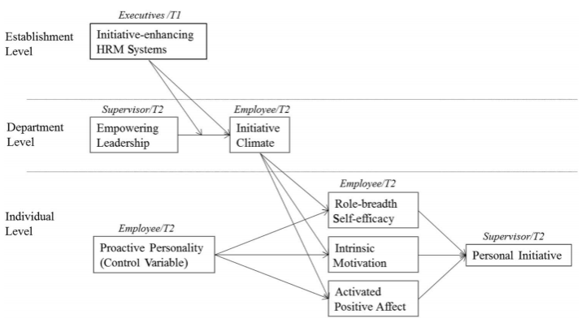
Notes:
Moderated effect of the strength of Initiative Enhancing HRM Systems and Empowering Leadership will have a direct impact on the Initiative Climate.
The improvement of the Initiative Climate will lead to Individual level affect on “Role breadth self efficacy”, “Intrinsic Motivation” and “Activated Positive Affect” which drives Personal Initiative.
Role breadth Self efficacy influences innovation
Intrinsic motivation influences more likely to generate proactive goals which extends their enjoyment
Activated positive affect influence personal initiative through shaping individuals expectancy, utility and process judgement.

Slide 19
Social Information Processing Theory
Employees seek information from coworkers, adapt to the way coworkers derive importance of Initiative taking.
Sensemaking
Work unit will collectively reflect on/develop shared view of how initiative taking is enouraged and rewarded.

Slide 20
The Study
22 high end, international hotels
Questionnaire Survey
124 Executives (General Managers and Department Heads)
2023 Lowest Hierarchal Employees
328 Direct Supervisors
Notes:
Survey results
124 executive committee members - 92% response rate -contained measures for Initiative enhancing hrm systems.
2023 employees - contained demographic, measure of employee level proactive personality, measure of proactive motivational states, measure of department level initiative climate.
328 supervisors- included measure of department level empowering leadership and measure of each subordinates personal initiative.

Slide 21
Survey Questions: Scale of 1-5, Agree or Disagree
Employees “How confidently would you feel about…”
Analyzing a long term problem to find a solution?
Representing your work area in meetings with management?
Supervisor “This particular employee…”
Takes initiative immediately when others don’t.
“Employees are encouraged to tackle service related problems without being explicitly told by their supervisor.”

Slide 22
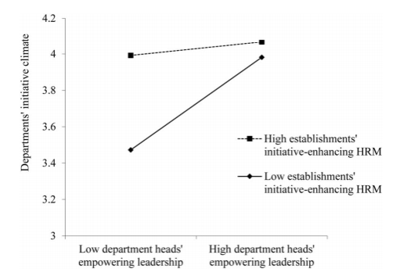
Notes:
There is a minimal increase of high establishment initiative-enhancing HRM systems when their is a high departmental initiative climate to begin with.
There is a significant increase of high establishment initiative-enhancing HRM systems when the departmental initiative climate is initially low = Signifying that management’s attempt in empowering their subordinates has a monumental affect when the initiative climate is low.

Slide 23
Take Home Message(s)
To promote employees in taking the personal initiative, upper and lower level management must sustain an initiative climate through formal HRM practices of selecting, training, evaluating and rewarding employees who take personal initiative.
If costly HRM Systems can’t be implemented, push department heads to display empowering leadership behaviors.

Slide 24
Collaborative Take Home Message
By encouraging workplace friendships, employees are more likely to reach out to their co-workers for help with job tasks; thus, employees will take on more personal initiative. Finally, the positive affect from workplace friendships can help to re-energize personal motivation.

Slide 25
Thank you!

