Slide 1
SPOTLIGHT ON AGE-DIVERSITY CLIMATE: THE IMPACT OF AGE-INCLUSIVE HR PRACTICES
Roger Lau

Slide 2
So what is age-diversity climate?
Notes:
Age diversity CLimate is to nurture a positive age diversity climate (and not a positive climate only for older employees),the need to develop and validate a new scale that reflects this claim of age inclusion

Slide 3
The benefits of age-inclusive HR system
Notes:
A improvement in all age group work performance and lower collective turnover.

Slide 4
Scholars should strive for a best possible match between the climate they study and the effects they predict in order to gain a high predictive validity of their model.
(Ehrhart, and Macey)
Notes:
more revealing to develop and test a nomological net of age-diversity climate than of general diversity climate.

Slide 5
Notes:
if one is interested in the role of age in the workplace, it might be more revealing to develop and test a science of law of age-diversity climate than of general diversity climate. Therefore, this study aims to establish such a new climate measure while equally investigating potential antecedents and consequences at the organizational level.
****Almost all existing studies focused on HR practices designed only for older workers such as “targeting older employees to update current job skills
We are interested in HR practices that might nurture a positive age diversity climate (and not a positive climate only for older employees), we felt the need to develop and validate a new scale that reflects this claim of age inclusion

Slide 6
General Diversity Work Climate
Pro Diversity Climate
Kopelman (1990) theories of signaling and collective sensemaking
Interactional model of cultural diversity (IMCD)
Previous Research
Notes:
●
● Kopelman (1990) applying arguments from theories of signaling and collective sensemaking we assume that human resource are positively related to age-diversity climate
Role of climates as intermediating variables between HR practices and company outcomes, Takeuchi, 2007

Slide 8
Take example of work done by general diversity climate and older employees to develop a sound and empirical validation at organizational level of analysis on age diversity climate.
Methodology
Notes:
Established a model that assumes an indirect relationship of age-inclusive HR practices via age-diversity climate on company outcomes, purpose is to contribute to the HRM literature.

Slide 9
2. Validate a measure of age-inclusive human resource practices as a potential precursor of an organizational age-diversity climate.
Methodology
Notes:
we assume that human resource (HR) practices, which are adjusted to an age-diverse workforce are positively related to age-diversity climate.

Slide 10
3. Age-diversity climate as a performance forerunner on the organizational level of analysis.
Methodology
Notes:
Although different types of climate have been reported to be relevant for individual-, group-, or unit-level outcomes,no study has investigated the organizational-level consequences of diversity climate

Slide 11
4. Create a model that assumes an indirect relationship of age-inclusive HR practices via age-diversity climate on company outcomes.
Methodology
Notes:
Shows an opening the “black box” between certain bundles of HR measures and firm performance, s shed light on the role of climates as intermediating variables between HR practices and company outcomes
Our study builds upon this work and extends it by (a) introducing and validating age-inclusive HR practices as a novel HR system for achieving a distinct strategic goal (i.e., fostering a positive age-diversity climate) and (b) by exploring how age-diversity climate as a new mediator translates its potential effects on firm-level outcomes such as productivity or collective turnover intentions.

Slide 12
Introducing and validating age-inclusive HR practices as a novel HR system for achieving a distinct strategic goal (i.e., fostering a positive age-diversity climate)
By exploring how age-diversity climate as a new mediator translates its potential effects on firm-level outcomes such as productivity or collective turnover intentions.
Aims to integrate research on both diversity climate and the HRM–performance through testing two three-path mediation relationships in a sample of 93 companies with 14,260 employees.
Purpose/Goals
Notes:
Shows an opening the “black box” between certain bundles of HR measures and firm performance, s shed light on the role of climates as intermediating variables between HR practices and company outcomes
Our study builds upon this work and extends it by (a) introducing and validating age-inclusive HR practices as a novel HR system for achieving a distinct strategic goal (i.e., fostering a positive age-diversity climate) and (b) by exploring how age-diversity climate as a new mediator translates its potential effects on firm-level outcomes such as productivity or collective turnover intentions.

Slide 13
Age Inclusive HR will positively relate respondent’s perception of age-diversity climate
Age-diversity climate will be positively related to collective perceptions of social exchange.
Collective perceptions of social exchange will be positively related to company performance.
6 Hypothesis
Notes:
Hypothesis 1 predicts a positive influence of age-inclusive HR prac-tices on age-diversity climate. Hypothesis 2 predicts a positive relation-ship between age-diversity climate and collective perceptions of socialexchange. Hypotheses 3 and 4 predict a positive relationship betweencollective perceptions of social exchange and company performance, anda negative one with collective turnover intentions, respectively.

Slide 14
4.Collective perceptions of social exchange will be negatively related to collective turnover intentions.
5-6.The relationship between age-inclusive HR practices and firm performance/collective turnover is mediated through a firm’s age-diversity climate and collective perceptions of social exchange.
6 Hypothesis
Notes:
Hypotheses 3 and 4 predict a positive relationship betweencollective perceptions of social exchange and company performance, anda negative one with collective turnover intentions, respectively.

Slide 15
Second Independent Data set
Unidimensional Measure
93 German small and medium sized companies, with 14260 employees participating. Mean=292
Industry (61%), production (10%), and insurance (5%)
Data Sample
Notes:
Second Indep. Data set includes

Slide 16
First, the organization's’ HR executives completed a survey asking for general information about the company.
3 Steps Rule Out Source Bias
Notes:
1. (e.g., industry affiliation, companysize as controls) and specific HR procedures, including the age-inclusiveHR practices relevant for this study as well as the firm’s innovation ca-pacities (as a control variable).

Slide 17
2. Employees were asked to obtain information on the perceived age-diversity climate, collective perceptions of social exchange, collective turnover intentions, and the positive affective climate (as a control variable).
3 Steps Rule Out Source Bias
Notes:
2.

Slide 18
3. Members of the companies’ executive boards were surveyed with an additional questionnaire mainly addressing company performance issues.
3 Steps Rule Out Source Bias
Notes:
This proceeding was chosen based on the assumption that executive board members should be the best source 679 regarding company performance information. In all companies, between one and nine executive board members participated. The top management team members were mostly male (85%), worked on average 12 years for their company (SD = 8.2), and were on average 45 years old.

Slide 19
Created 5 items with 5 points Likert Scale from low to high intensity
Used to gauge variety of organizational HR practices related to age inclusive workforce.
Age Inclusive HR Practice Measures
Notes:
Design new item from scratch because no validated scale for age inclusive HR pratice existed in literature to their knowledge

Slide 20
Age neutral recruiting effort
Equal access to training/education for all age group
Equal chance to further career steps regardless of age
Management Training to deal with age diverse workforce and respond to different needs of all age
Promotion of an age friendly organizational culture
Items used to scale
Notes:
(sample item: With how much intensity does your company offerequal opportunities to be promoted, transferred, and to make further careersteps irrespective of one’s age?).

Slide 21
Second Independent Data set
Unidimensional Measure
108 German small and medium sized companies, average size of 401 employees.
Further Measures
Notes:
Second Indep. Data set includes

Slide 22
Seven-point Likert scale, 4 items
The structural relationships were significant for both age-diversity climate (β = .63, t = 3.54, p < .001) and the general diversity climate (β = .55, t = 3.08, p < .01),
Age-diversity Climate Measures
Notes:
showing that age-diversity climate explains 15% of variance in company performance beyond the effect of the general diversity climate helped established sufficient discriminatory and predictive validity for our new age-diversity climate construct. Internal consistency estimates were α = .91.

Slide 23
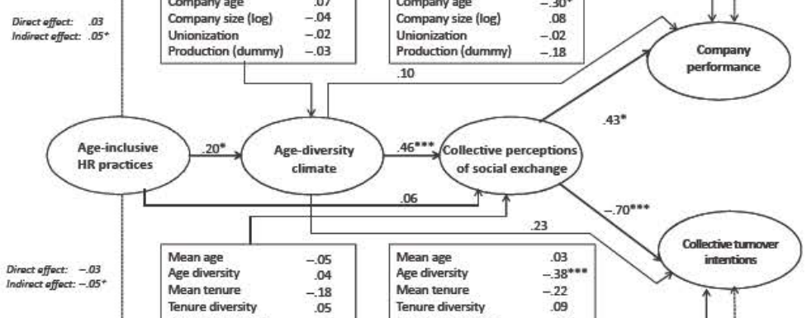
Structural Model Results

Slide 24
The results of the three-path mediation model suggested a good fit of the model to the data (χ2 = 370, df = 220; CFI = .92, IFI = .92, SRMR = .07, AIC = 740).
Structural Model Results

Slide 25
Hypothesis 1 indicated that the HR activity of age is positively associated with the age-diversity climate. The structural model supports the claim because there has been a positive and important correlation between age-inclusive HR activities and age-diversity climate
(β = .20, t = 2.19, p < .05).
Structural Model Breakdown

Slide 26
Hypothesis 2 was also confirmed by the research because the age diversity environment was, as predicted, positive for collective social exchange perceptions
(/3 = .46, t = 4.59, p < .001)^(4,5)
Structural Model Breakdown

Slide 27
Both hypotheses 3 and 4 were validated by the study and predicted social exchange expectations linked positively and substantially to organizational results.
(β = .43, t = 2.31, p < .05) compared to collective turnover intentions was negative (β = –.70, t = –4.39, p < .001).
Structural Model Breakdown

Slide 28
Positive association with social interaction between all age-inclusive employees in the company.
Collective Perceptions of Social Exchange Measures
Notes:
showing that age-diversity climate explains 15% of variance in company performance beyond the effect of the general diversity climate helped established sufficient discriminatory and predictive validity for our new age-diversity climate construct. Internal consistency estimates were α = .91.

Slide 29
Show relation between social exchange perception and company performance in age inclusive HR practice.
Age-diversity Climate Measures
Notes:
showing that age-diversity climate explains 15% of variance in company performance beyond the effect of the general diversity climate helped established sufficient discriminatory and predictive validity for our new age-diversity climate construct. Internal consistency estimates were α = .91.

Slide 30
Age inclusive HR bundles (age-neutral policies, equal access for all age group, age neutral career, and promotion systems) in managing an aging workforce.
A positive age-diversity climate HR practice brings better work performance and employee retention
High levels of pro-age diversity climate will help company effectively and efficiently manage employees of age group
Incorporating “Corporate DNA” bring sustainability and positive change only by proactively using age-inclusive HR practice through speaking, awareness, and actions
Real World Application

Slide 31
As median age of America workforce is becoming more old, it is possible for management to efficiently and cost-effectively make use of age inclusive HR bundles with positive link in social connection.
Because age inclusive HR practices are so perceptive, management must consider investing in the company culture to implement this age inclusive system.
Introduction of age inclusive HR systems is a pro for all organization and not just focused on high average age or high age diversity of the workforce.
Take Away Home Message

Slide 32
Retaining an ageing workforce: The effects of high-performance work systems and flexible work programmes
Gavin Chueh

Slide 33
Key Words
High-Performance Work System (HPWS)
Flexible Work Programs (FWPs)
Job demand-resources (JD-R)
Notes:
High-Performance Work System = sets of HR practices that place greater value on employees as a source of competitive advantage, being typically associated with employers providing higher levels of skill-enhancing practices; motivation-enhancing practices; and participation-enhancing practices.
Flexible Work Programs = sets of HR practices that increased flexibility on where and when to work to improve employees’ overall workplace experience, as individuals will have more control over their lives and can work in ways that better suit their idiosyncratic preferences.
Job demand-resources = addresses the impact perceived work characteristics have on employees’ work-place experience and attitudes

Slide 34
Background
Retention rate
HPWS
FWPs
Notes:
The research paper is focusing on the retention rate of an aging workforce and the effects of two HR initiatives, high-performance work systems (HPWS) and flexible work programs (FWPs) when applying both separately and combined to see if it will increase the retention rate in an aging workforce. The author used the job demands-resources (JD-R) model to analyze and understand HPWS and FWPs, which simply addresses the impact perceived work characteristics have on employees’ workplace experience and attitudes. A number of studies have been looking at how to best deal with an older workforce, where the retention rate of older talent becoming a critical issue for companies. Therefore, the emphasis has been put on the need to which the practices and initiatives put forward for retaining employees and the effect when applied to an older workforce. Especially that most of the initiatives in today’s labor market are not being the best in reining in the loss of invaluable expertise and knowledge or of resolving the forecasted labor shortage due to declining birth rates.

Slide 35
Previous Research
Explore the pertinence of accepted employee retention modes across different workforce characteristics
The first to examine HPWS and FWPs using the JD-R perspective
Provide practitioners with insights relevant to their HR decision making
Notes:
This research is the response to previous calls to explore the pertinence of accepted employee retention models across different workforce characteristics. It examines a potential moderator of the relationships HPWS and FWPs have with retention, going beyond the traditional “one-size-fits-all” approach to the investigation of their payoff. On the other hand, the research is the first to examine HPWS and FWPs from the angel of JD-R perspective, helping us to understand the meaning employees attach to HPWS and FWPs with age and the outcomes expectable from such initiatives as the workforce as the composition varies. Furthermore, using the logic of the JD-R perspective to help understand organizational performance outcomes. With the right HR practice, the company can increase the retention rate of the talent and expertise needed. With most of the “one-size-fits-all” approach in companies today, it’s really hard to satisfy both younger and aging workforce at the same time. With an increase of cost spending on HR practice, companies can’t make the most outcome out of current HR practice.

Slide 36
Hypothesis 1
There will be an interaction between workforce aging and HPWS, whereby HPWS will deliver lower retention outcomes with increased workforce aging

Slide 37
Hypothesis 2
There will be an interaction between workforce aging and FWPs, whereby FWPs will deliver higher retention outcomes with increased workforce aging

Slide 38
Hypothesis 3
There will be an interaction between workforce aging, HPWS and FWPs, whereby HPWS will deliver improved retention outcomes in more aging workplaces when provided together with FWPs

Slide 39
Data
Workplace Employment Relations Study 2011
46.3% response rate
Sample size of 736 workplaces
Voluntary employee turnover
Notes:
The research was conducted based on data from the Workplace Employment Relations Study in 2011, which is a government-funded survey designed to provide representative data on a wide range of employment practices use across the UK economy. The survey was conducted with a questionnaire and face-to-face interviews with HR managers with a 46.3% response rate and has omitted workplace with fewer than 100 employees as they might have lacked a formal HR practice, the same therefore comprises 736 workplaces. It used an ordinary least squares regressions with 17 industry dummies and 7 models to find the intercorrelation when applying different situation with HPWS and FWPs practices in an aging workforce and further use the result to test the validity of all three hypotheses which are hypothesis 1: there will be an interaction between workforce aging and HPWS, whereby HPWS will deliver lower retention outcome with increased workforce aging; hypothesis 2: there will be an interaction between workforce aging and FWPs, whereby FWPs will deliver higher retention outcomes with increased workforce aging; hypothesis 3: there will be an interaction between workforce aging, HPWS, and FWPs, whereby HPWS will deliver improved retention outcomes in more aging workplaces when provided together with FWPs.

Slide 40
Result
Negative and significant relationship between HPWS and workforce aging
Negative but non significant association between FWPs and workforce aging
Retention rate decrease when HPWS bundle with FWPs
Notes:
The result of the data shows that when introducing model 5, the interaction between HPWS and workforce aging has a negative and significant relationship between the two-way interaction and employee retention; therefore, support hypothesis 1 whereby the retention payoff of HPWS diminished as the workforces ages. Next, the research use model 6 that introduced the FWPs-workforce aging interaction to test out hypothesis 2, despite having a negative on the data it has a nonsignificant association between the two-way interaction term and retention, therefore does not support the hypothesis. Lastly, the research introduced model 7 which is the three-way interaction term among HPWS, workforce aging, and FWPs, the result turns out to be negative and significantly associated with retention rate; however, the finding is different from the hypothesis 3. The model 7 result appears to decrease the retention rate in more aging workplaces rather than increase it when applying HPWS together with a high level of FWPs, so hypothesis 3 is rejected.

Slide 41
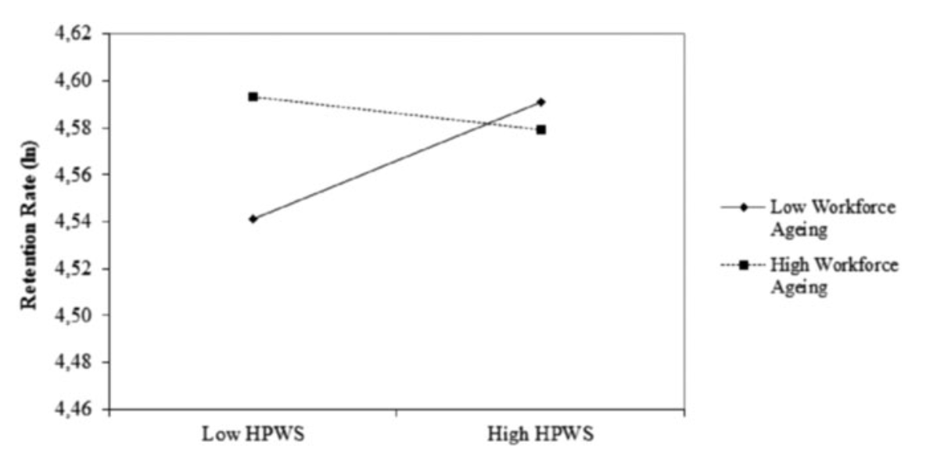
Effects of the interaction of workforce ageing and high‐performance work systems (HPWS) on retention rate
Notes:
This graph shows the effects of the interaction of workforce aging and high-performance work system on retention rates. As you can see when low HPWS is applied to low workforce aging, the retention rate is lower when compared to high HPWS applied in low workforce aging. On the other hand, when low HPWS is applied in a high workforce aging there is a higher retention rate when compared with high HPWS in high workforce aging but with only slightly dip. This means that younger employees do prefer higher HPWS practices and it helps improve the retention rate. However, when looking at the high workforce aging, there isn’t that much improvement when a higher level of HPWS was implementing and it even went lower. This proves that HPWS is not effective in an aging workforce when apply it will decrease the retention rate.

Slide 42
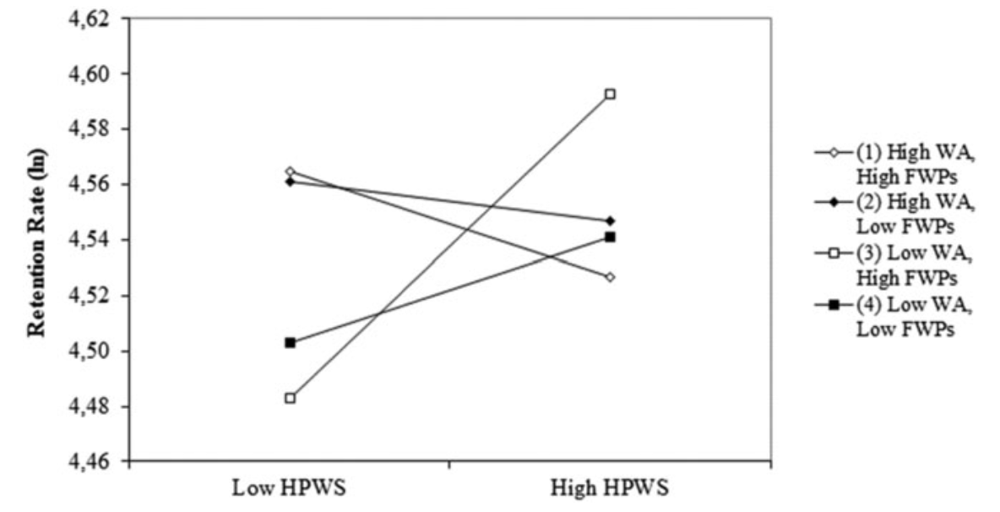
Effects of the interaction of workforce ageing (WA), high‐performance work systems (HPWS) and flexible work programmes (FWPs) on retention rate
Notes:
This graph shows the effects of the interaction of workforce aging, high-performance work systems and flexible work programs on retention rate. As you can see, the biggest jump in retention rate occurs when low workforce aging using high FWPs and High HPWS combined. This means that, for younger employees, a mix of high FWP and high HPWS will substantially improve the retention rate.

Slide 43
Take-Home Message
Cautious when deploying HPWS
HPWS remains significant part for performance outcome
Evaluate the convenience of FWPs for older employees
Cautious over-optimistic views about FWPs
Notes:
With the above result from the data, it comes to the conclusion that employers should be advised and be cautious when deploying HPWS as the workplace become to age, where the reduced payoff may hinder the recovery of the high implementation and administration costs will be incurred. However, in today’s HR practice, HPWS remains a significant part of the organizational performance but might become a less attractive approach as workforce steadily age. Employers may need to evaluate the convenience of FWPs for older employees based on the latter’s current psychological and physical health, as well as on their need for autonomy, structure, and engagement. Despite being more flexible, employers should be cautious over-optimistic views about the role of FWPs may play in increasing workplace appeal for older employees.

