Slide 1
Gender and Leadership Emergence
Anita Chen
BUS 251 - Group 2
Based on the article: “Gender and leadership emergence:
A meta-analysis and explanatory model”.
By Katie L. Badura, Emily Grijalva, Daniel A. Newman, Thomas Taiyi Yan, Gahyun Jeon

Slide 2
Why aren’t there more women business leaders?
Women are:
46.9% of the workforce (Catalyst, 2019)
4.8% of Fortune 500 CEO’s (Pew Research, 2018)
Why?
Leadership Emergence: “Whether” and “to what degree” an individual is considered a leader by others.

Slide 3
Previous Research
Perception of being leaderlike, leads to higher job performance and promotability.
Participation in group discussion is one of the dominant predictors of leadership emergence.
Men associated with “breadwinner”, women associated with “homemaker”.
Men more likely to be chosen for managerial roles.
Stereotype changing: more women occupying managerial roles.

Slide 4
Research Question
Why do men emerge into leadership roles more frequently than do women?
Traits of agency
Dominance and assertiveness
Traits of communion
Warmth and nurturance
Participatory behavior in discussions
Providing suggestions and offering opinions

Slide 5
Research Methodology
Gathered 59 studies, measured them on three areas:
Agentic traits
Communal traits
Participation in discussion
Controlled for the following factors:
Date of publication
Length of interaction
Social complexity of task (interpersonal skills)

Slide 6
Research Results
All hypothesized paths were statistically significant in the expected directions:
However, negative path from communal traits to participation (𝛽 = −.05, p < .05).
Of note, communal traits were detrimental to leader emergence (𝛽 = −.15, p < .05).’
Hypothesis: Communal personalities take on a listening-facilitating role, rather than a speaking-commanding role, typically associated with leaders.

Slide 7
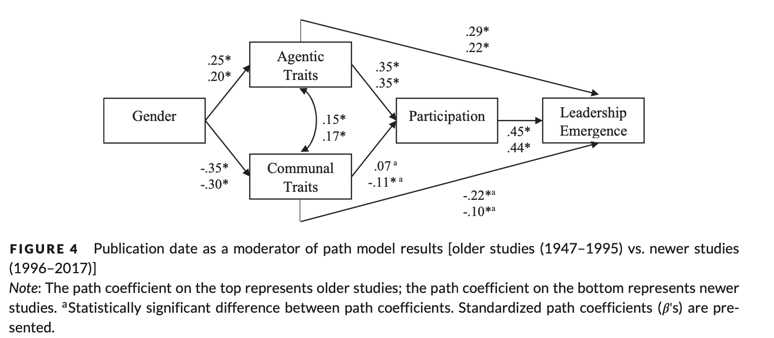
Research Results
When controlled for publication date:
Association between agentic traits and leadership remained strong
Detrimental effect of communal traits and leadership weakened
Meaning: Over time, communal traits are seen less negatively.

Slide 8
Research Results
When controlled for interaction time:
Positive agency-leader link AND Negative communion-leader link weakened
Meaning: first impressions are not always accurate!

Slide 9
Research Results
When controlled for social complexity:
No statistically significant influence on gender gap
Meaning: both men and women can have excellent (or terrible) interpersonal skills

Slide 10
Take Home Message
Perceptive education vs. behavior modification:
We must learn to respect communal traits in both men and women
Education on the agency bias in selecting leaders:
Extended interaction so stereotypes can fade
Conducting multiple interviews increases accuracy
Can lead to choosing better candidates
Training to create collaborative discussion:
Draw out ideas through questions => better ideas
“Amplify” opinions or suggestions
Respectful dialogue

Slide 11
If we want a world with greater equality, we need to acknowledge that women are less likely to keep their hands up. We need institutions and individuals to notice and correct for this behavior...and women have to learn to keep their hands up.”
- Sheryl Sandberg, COO of Facebook

