Slide 1
Do Labor Regulatory Factors Impact Offshore Location Attractiveness? Stan Malos Professor of Management/HRM San Jose State University
Based on the article,
“Regulatory Effects and Strategic Global Staffing Profiles:
Beyond Cost Concerns in Evaluating Offshore Attractiveness”
Employee Responsibilities and Rights Journal (2010) 22: 113-131

Slide 2
Labor Regulatory Effects on Offshore Location Attractiveness
“Offshoring”: A business decision to replace domestic labor by outsourcing it overseas or beyond geopolitical borders
Question: What factors would influence your decision whether and where to relocate some or all of your business operations “offshore”?
[Your thoughts here ☺]

Slide 3
Labor Regulatory Effects on Offshore Location Attractiveness
Typical considerations by decision makers [per A.T. Kearney survey of its consulting clients]:
Labor costs and overall financial structure
Labor availability at requisite skill levels
Labor cultural factors, infrastructure, and overall business environment
*Question: Should labor regulatory factors be more explicitly considered in the decision process?

Slide 4
Labor Regulatory Effects on Offshore Location Attractiveness
Issue examined via aggregate archival data:
(1) A. T. Kearney Global Services Location Index
Financial Structure [labor compensation costs, taxes, overhead, regulatory costs and fees]
People Skills & Availability [labor availability, education and language ability, business process skills, attrition]
Business Environment [economic/political stability, cultural adaptability, infrastructure, I.P. security]
(2) World Bank “Ease of Doing Business” ratings
Infrastructure/overall development [as measured by GNI]
Factors re: employing workers, starting/closing a business, enforcing contracts, trading across borders, etc. (Appendix)

Slide 5
Labor Regulatory Effects on Offshore Location Attractiveness
Part I: Regression Analyses
Each A.T. Kearney measure regressed in turn on all World Bank Ease of Doing Business measures
Where overall results significant, sub-dimensions of World Bank measures substituted and analysis repeated to ID particular significant effects
[A selected example follows]

Slide 6
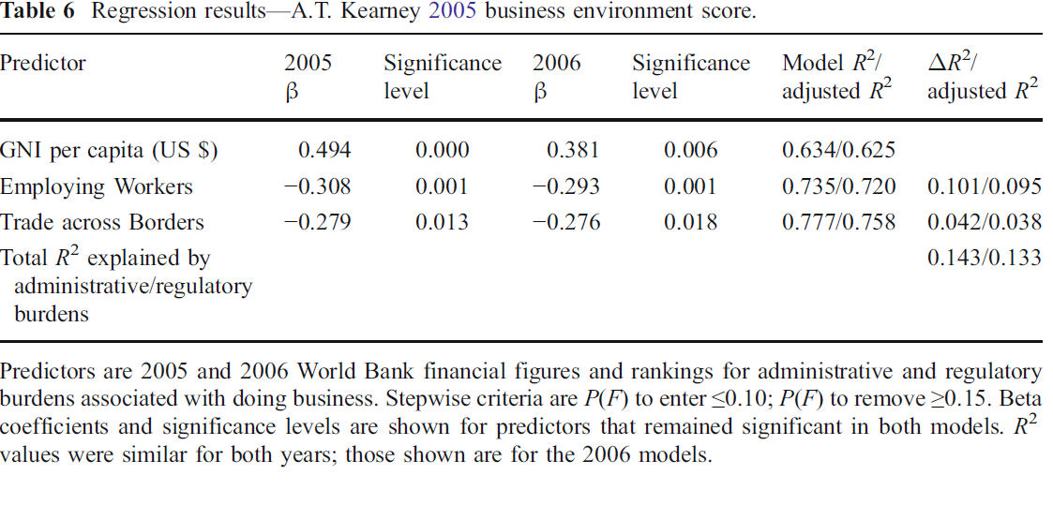
Labor Regulatory Effects on Offshore Location Attractiveness

Slide 7
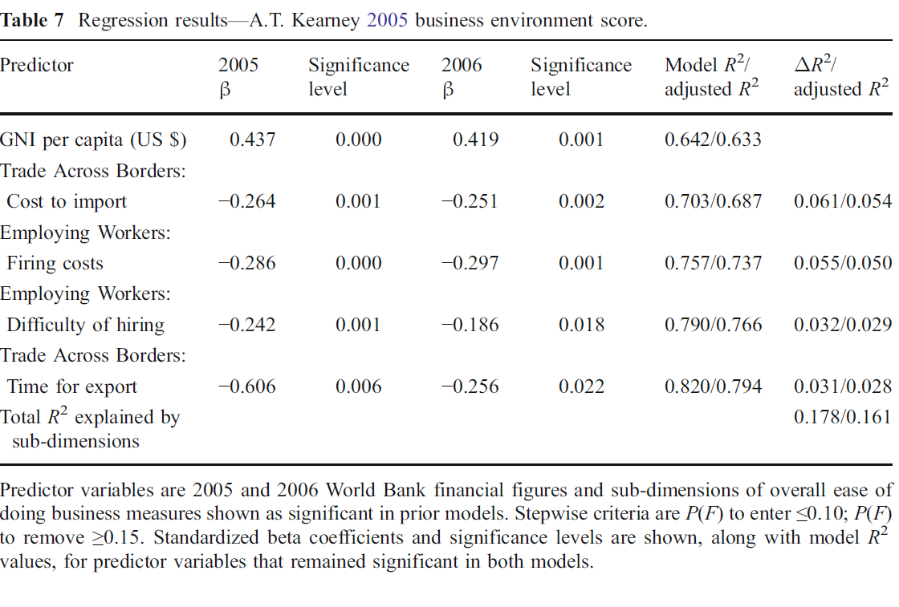
Labor Regulatory Effects on Offshore Location Attractiveness

Slide 8
Labor Regulatory Effects on Offshore Location Attractiveness
Part II: Cluster Analyses
A.T. Kearney measures used to cluster the top 40 offshore locations [per Kearney] into 3 groups:
Developed offshore user countries [low financial structure rating (i.e., high costs), high skills availability, high business environment rating]
Established offshore provider countries [high financial structure rating (i.e., low costs), moderate to low skills availability, moderate to low business environment rating]
Emerging offshore provider countries [high financial structure rating (i.e., low costs), moderate to low skills availability, moderate to low business environment rating (similar but less favorable overall relative to established offshore providers]

Slide 9
Labor Regulatory Effects on Offshore Location Attractiveness

Slide 10
Labor Regulatory Effects on Offshore Location Attractiveness

Slide 11
Labor Regulatory Effects on Offshore Location Attractiveness

Slide 12
Labor Regulatory Effects on Offshore Location Attractiveness

Slide 13
Labor Regulatory Effects on Offshore Location Attractiveness

Slide 14
Labor Regulatory Effects on Offshore Location Attractiveness

Slide 15
Labor Regulatory Effects on Offshore Location Attractiveness
Some conclusions and discussion points:
Restrictive regulatory factors may undermine the apparent cost advantages of some offshore providers
Where profiles are similar, offshore users may prefer shorter supply chains, cultural similarities (e.g. NZ vs. Malaysia, Chile, Costa Rica, Czech Rep.; similar but $$!)
Cluster results may provide helpful diagnostics for users and providers alike but are general starting points only
Rankings have already changed substantially since this study and may do so dramatically given global political (e.g., Tunisia, Egypt) and financial (e.g., Ireland) volatility

Slide 16
Labor Regulatory Effects on Offshore Location Attractiveness
Final takeaways:
Repeat analyses frequently to capture changing realities but embed actions within overall HR strategy
Impact of regulatory factors may depend on type of business [e.g., IT or telecommunications vs. manufacturing] & infrastructure investments needed
Consider hedging political and financial risks via portfolios of strategic offshoring options where feasible given type of business & reasons to offshore

Slide 17
Labor Regulatory Effects on Offshore Location Attractiveness
Questions/comments?
Thank you! ☺

