Slide 1
Performance Evaluation
Gurkiran Dhaliwal, Marko Pavisic & Astrik Yepremyan

Slide 2
Tell us about a performance evaluation experience.

Slide 3
WHEN ACCOMPLISHMENTS COME BACK TO HAUNT YOU: THE NEGATIVE EFFECT OF COMPETENCE SIGNALS ON WOMEN’S PERFORMANCE EVALUATIONS
M. Ena Inesi
Daniel M. Cable

Slide 4
Issue
Women who are hired with stronger competence signals may receive worse performance evaluations than women with weaker competence signals.
Notes:
Even if the work being evaluated is identical.

Slide 5
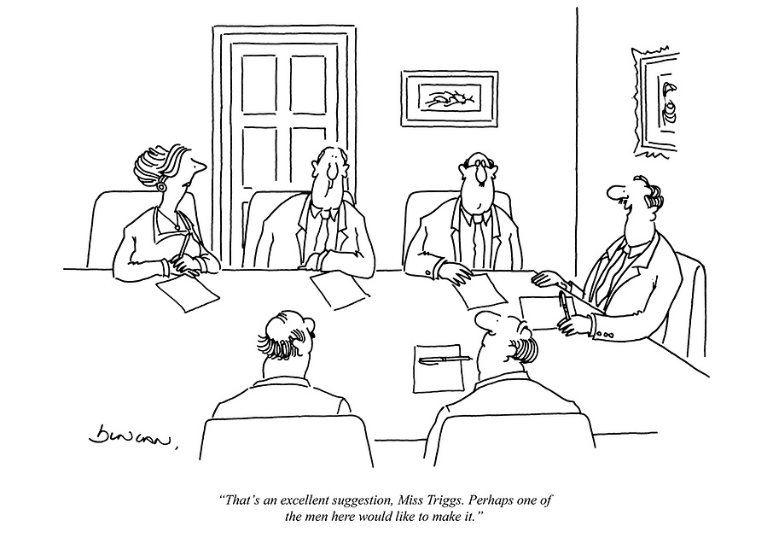

Slide 6
Previous Research
The 3 Hurdles:
Women are perceived as less competent
Male-stereotyped behaviors are prohibited
Stronger competence signals are a threat to the gender hierarchy

Slide 7
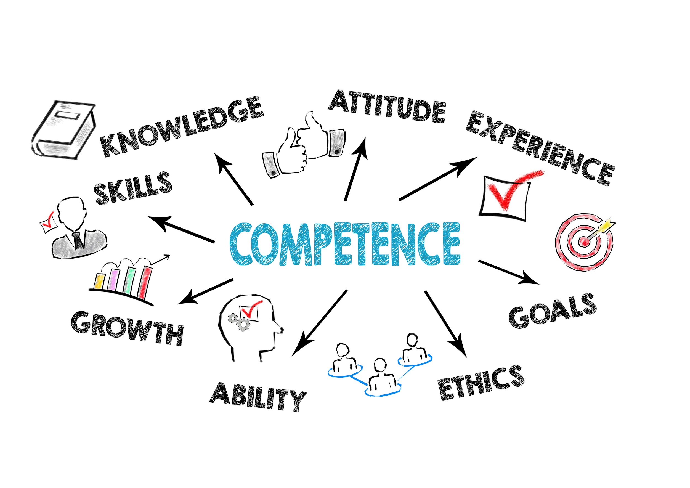
Competence Signals
Signals that help make inferences about applicant ability
Education
Job level
Past job accomplishments

Slide 8
Social Dominance Orientation (SDO)
Individual support for group-based hierarchies
Domination of “inferior groups”
SDO Scale:
Measures preference for hierarchy, group-based domination, and discrimination

Slide 9
Method
Participants acted as managers
Answered questions to be rated on SDO scale
Worked with subordinate to solve problem
Evaluated the subordinate

Slide 10
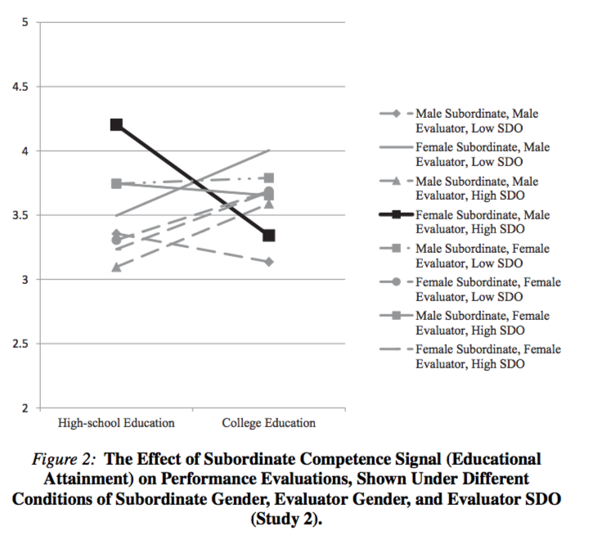

Slide 12
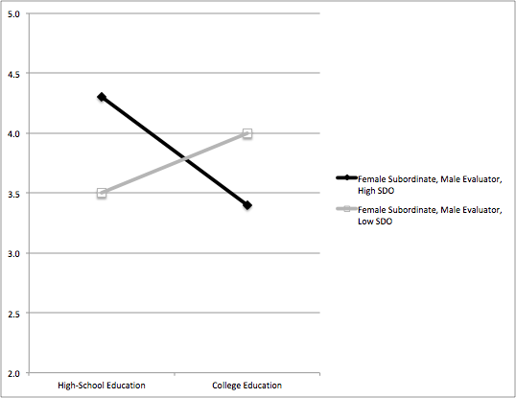

Slide 13
Take-Home Message
Training
New Employee Orientation
Yearly Training
Change the type of evaluation
Subjective vs. Objective Performance Evaluations

Slide 14
The Implications of Unconfounding Multisource Performance Ratings
Jackson, D. J. R., Michaelides, G., Dewberry, C., Schwencke, B., & Toms, S. (2020). The implications of unconfounding multisource performance ratings. Journal of Applied Psychology, 105(3), 312–329.

Slide 15
Agenda
Multisource Performance Ratings
Existing Research
Methodology
Results
Key Takeaways

Slide 16
Multisource Performance Ratings
Popular in late 1990s/early 2000s
Feedback stratified
Manager, peer, subordinate, customer/stakeholder, etc.
More granular information
Recent decline due to concerns with:
Reliability
Effectiveness
Legal Implications

Slide 17
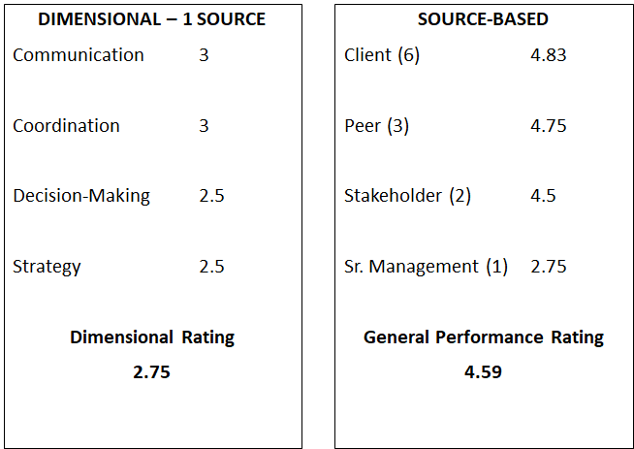
Mutlisource Performance Ratings

Slide 18
Multisource Ratings - Existing Research
Support employee development 1
Supervisory ratings of performance unreliable 2
Multi-faceted impacts on effects of multisource ratings studied individually, but not together 3
Common Factors
General Performance Factor
Rater Factor
Source Factor
High variability in degree of variance explained by different factors

Slide 19
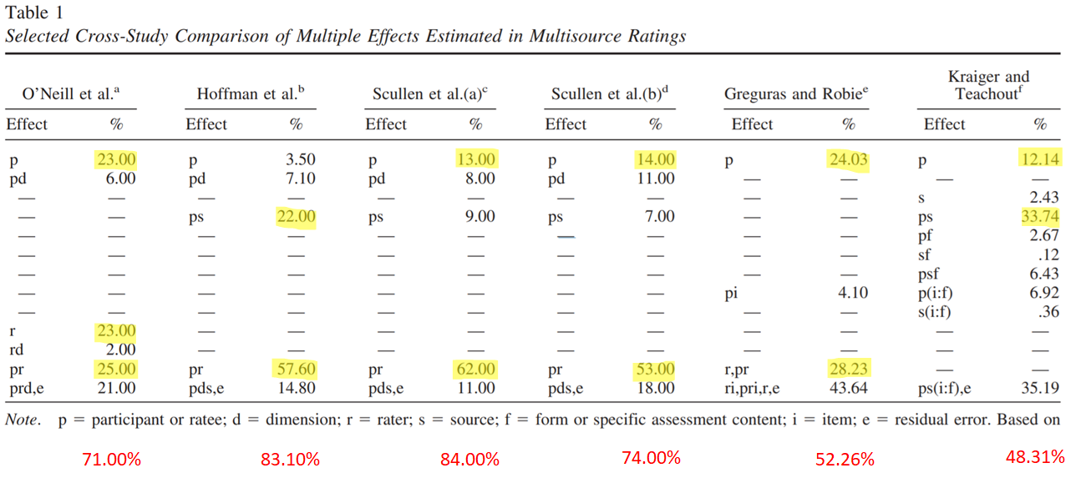

Slide 20
Jackson et. al. Methodology
Two Samples of Managerial Ratees
Sample 1: single organization seeking employee development
392 managerial ratees; 1,495 unique raters
Sample 2: multiple organizations, mixed intent (evaluation and development)
342 managerial assessees; 2,636 unique raters
Included five broad dimension categories
Raters nested in sources: senior manager, peer, subordinate, self, and client/stakeholder

Slide 21
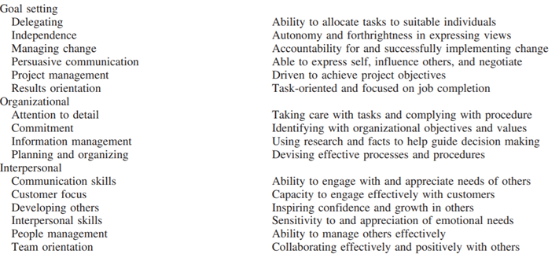
Dimensional Factors

Slide 22
Jackson et. al. Methodology
Bayesian Inference: calculating probabilities that have changed from prior knowledge of potentially confounding conditions
Used to determine sources of variance simultaneously: “ratees, raters, sources, items, dimensions, and their interactions” (317)
Aggregation: rating Items aggregated to dimension scores; dimension scores aggregated across raters within sources
To review effects on variance outcomes after certain types of aggregations related to dimension scores

Slide 23
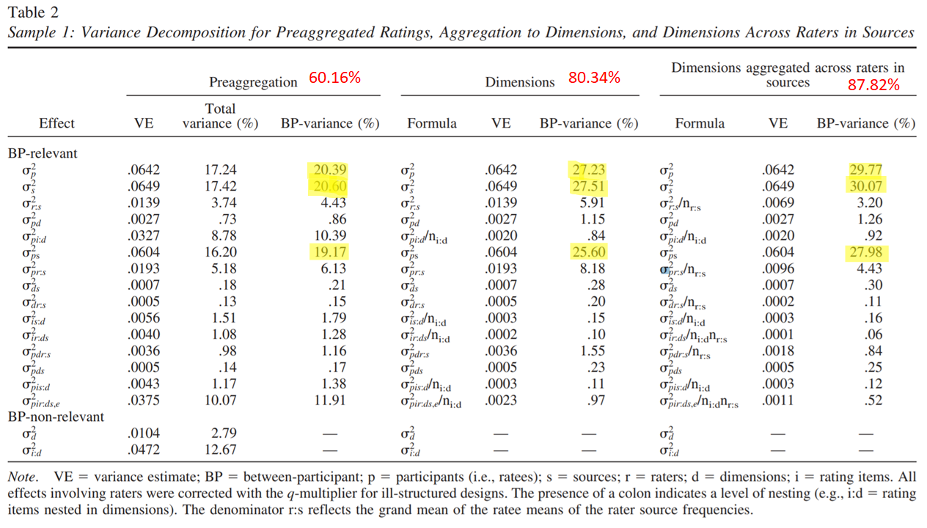

Slide 24
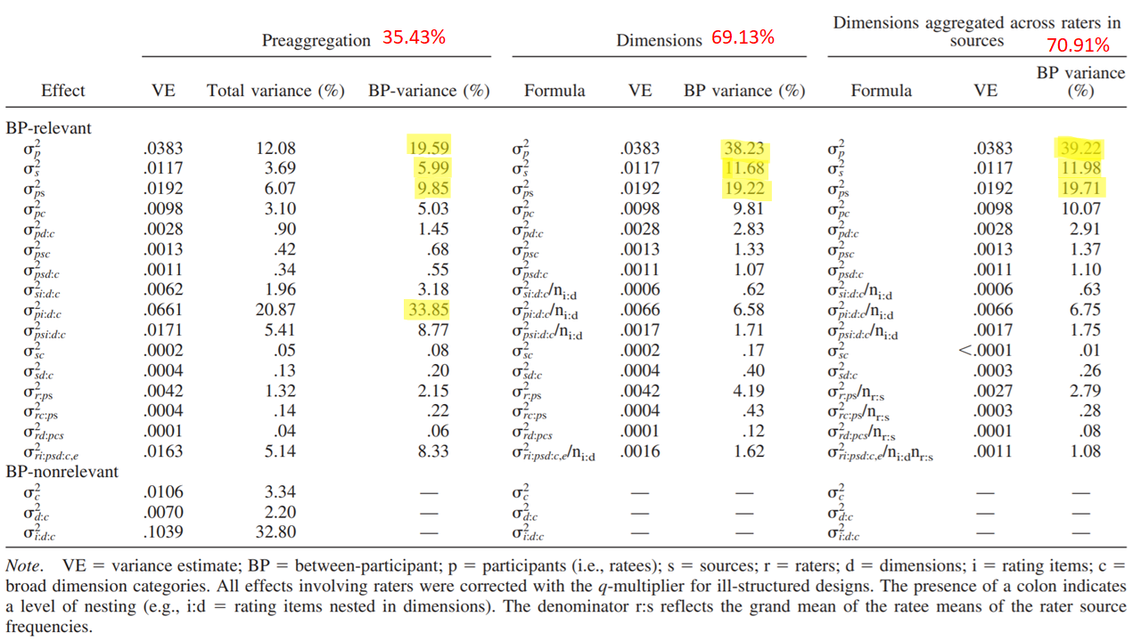

Slide 25
Key Takeaways
“…it is possible, as was identified almost a century ago, that raters continue to be ‘unable to treat an individual as a compound of separate qualities’ (Thorndike, 1920, p. 28)”
Structuring Multisource Feedback
Dimensions irrelevant
General performance crucial
Aggregate feedback by source

Slide 26
Mutlisource Performance Ratings

Slide 27
Quantifying with words: An investigation of the validity of narrative-derived performance scores
Andrew B. Speer

Slide 28
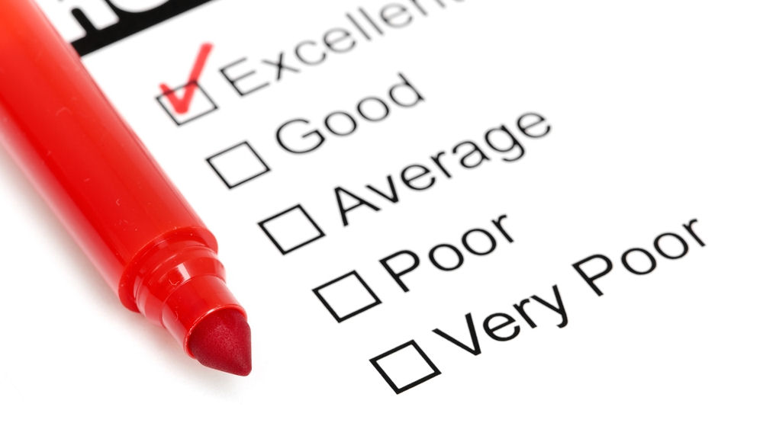
Issue Dealt With
Traditional performance evaluations:
Context effects
Low user acceptability
Narrative-derived performance scores
Reliable
Provide unique insights
Are narrative-derived performance scores an efficient evaluation method?
Notes:
Context effects→ aspect of cognitive psychology where environment affects perception

Slide 29
What are words you would use to describe a good performer?
What are words you would use to describe a poor performer?

Slide 30
Previous Research
Used since 20th century & heavily researched
Numerical/graphical scales with preidentified legend
Comment boxes
Little research done with narrative ratings
College admission analysis
Notes:
Early 20th century. Manual ratings were tedious

Slide 31
Why is this important?
Notes:
Go to next slide to answer this question

Slide 32
Gauge management effectiveness
Satisfies legal requirements for performance appraisals
Performance based bonuses
Notes:
Making sure your performance ratings are accurate helps to effectively allocate company resources. Narratives are more insightful. Lawsuits are expensive!! Justifies employee promotion/demotion

Slide 33
The Study: Comparing traditional and narrative ratings based on similar data
Notes:
Study was on US Financial services firm

Slide 34
Narrative sentiment scores produced with auto text mining algorithms
2011-2013 Performance data formed calibration sample
2014-2015 evaluations scored based on model

Slide 35
2011-2013 → calibration sample
2011-2013 model used to score 2014-2015 evaluations
Numerical ratings→ job-specific competencies, goal expectations & overall performance ratings
Comment box
150 < word count < 2500
Terms that only comprised 1% were removed
Text reduced to terms that strongly correlated with job performance
Notes:
Between 5000-6000 participants tested each year

Slide 36
Text Mining Code
Text mining analysis
Break sentence into smaller components, or “clean text”
Track words like “always”/ “struggles”
Words that go together: “White House”
Dictionaries
Words = numerical score
Machine learning algorithms
Notes:
Managers had to write in the comment box

Slide 37
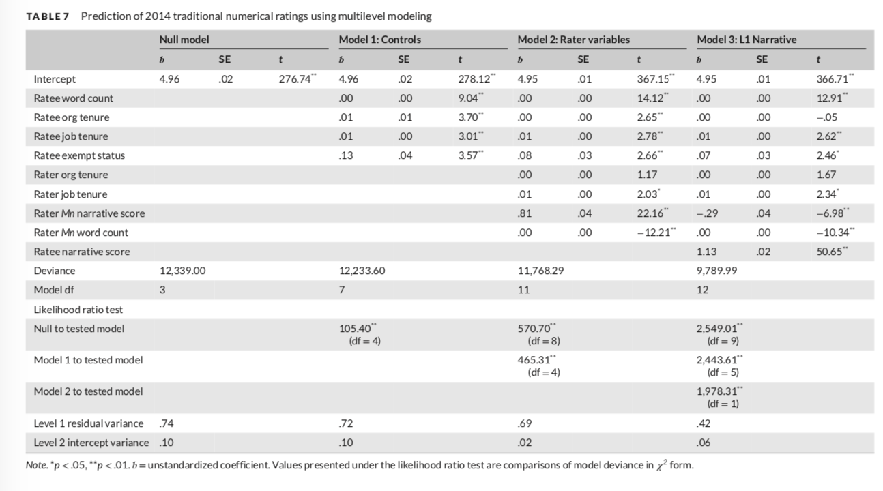
Notes:
Traditional compared to narrative ratings ranged from a negligible 0.00 to 0.04 standard error. Numerical ratings and narrative scores for the same year correlated by 0.64 on average. THE NARRATIVE SCORE DID NOT REQUIRE ANY ADDITIONAL WORK FROM CODERS.

Slide 38
Potential sources of error
Systematic writing differences
Writing tenure/experience
Authoring styles
Notes:
That said, traditional numerical ratings can also contain bias

Slide 39
Humans can make decision errors.
Notes:
Narratives increase reliability and can thus better predict future performance

Slide 40
Narrative scores can be insightful for employees that are rated average or below average.
Notes:
Managers need to think back on specific examples; talk about machine zone

Slide 41
As technology is becoming more advanced, it is possible for management to efficiently and cost-effectively make use of narrative performance ratings with auto text mining
Because narrative based performance ratings are so insightful, management must consider investing in the infrastructure to implement this rating system.
Given the ongoing advancements in technology, management must consistently explore and experiment with different rating techniques and technologies
Take Home Message
Notes:
Take Home Message

Slide 42
Management must constantly re-evaluate performance management techniques to ensure they are consistently reliable, unbiased, accurate and insightful.
Collective Take Home Message
Notes:
Collective Take Home Message

