Slide 1
What’s Up? Finance
5/9/2016

Slide 2
Agenda
AVP Finance Update – Josee Larochelle
Fiscal Year End – Meg Deiss
Fund Balance Management – Bradley Olin & Kim Napoli
Travel Tips & Tricks – Amy Chan

Slide 3
Avp finance updates
Josee larochelle

Slide 4
Fiscal Year End 15/16
Meg Deiss

Slide 5
Plan Ahead
Accounts Payable and Contracts & Purchasing Services make every effort to ensure timely processing of procurement requests.
Accounts Payable |  |  | Purchasing
Process Time | Subject |  | Process Time | Subject
Two Weeks | Direct Payment Requests |  | One Week | RapidReqs
Two Weeks | Employee/Student Reimbursements |  | Two Weeks | Change Order Requests
Two Weeks | Travel Reimbursements |  | Two Weeks | Requisitions < $10K
Two Weeks | Registration Payment Requests |  | Four Weeks | Requisitions between $10K to $50K
Two Weeks or according to terms | e-Invoice (PO invoice Submit) |  | Six to Eight Weeks | Requisitions > $50K
Departments ensure invoices related to fiscal year 15/16 processed as soon as possible as these invoices need to be reported in the fiscal year.
Notes:
The stated processing times are an average. Both AP and Contracts and Purchasing Services strive to process all departments requests as quickly as possible.

Slide 6
Reminders and Tasks
In a Fiscal Year, Expenses for GoCard, ProCard, and recharges cover June to May
Subject | Description
Reconcile Accounts | Departments should review their Data Warehouse reports throughout the fiscal year to reconcile financial activity posted to their accounts as well as manage Purchase Order encumbrances. As we near year-end, more attention should be given to these transactions. Identified errors can be corrected through an Expense or Budget Transfer in FTS. Purchase Order encumbrances can be modified through a Change Order Request submitted to the Purchasing Office.
GoCard, Office Max, ProCard | GoCard, ProCard, and Office Max purchases made for the June 2016 billing cycle will be expensed in FY 16/17.
Recharges | May 2016 recharges for UPD, Facilities, Travel Agent prepaid charges, copier meter readings, postage, and telephone expenses will be charged to FY 15/16 and are due to Accounting Services by Tuesday, June 7. Recharges for the month of June will be expensed in FY 16/17.
Notes:
This slide provides reminders and year round tasks of which you should be aware. Bottomline - manage your finances and know the impact to your budget and when actual expenses will be posted.

Slide 7
Important Dates
Due Date | Subject | Description | Department
Tuesday, June 28 | Petty Cash | Expenses submitted for reimbursement before or on this date will be charged to 15/16 fiscal year. Expenses submitted after this date will be charged to FY 16/17. | Bursar’s Office Window 1
Wednesday, June 29 | Deposits | Deadline is 3 PM on this last day to make cash deposits at the Bursar’s Office. Deposits received after this deadline will be posted to the 16/17 year. | Bursar’s Office Window 1
Friday, June 24 | Budget & Expense Journals | Last day to complete and approve FTS budget and expense journals and HR expense journals. | Budget Office/ Accounting Services
Friday, June 24 | Journal Upload Request | Last day to submit journal upload request to Accounting Services. | Accounting Services

Slide 8
Year End Information
  Finance management is a daily function not a year-end task!
2015/16 Year End Guide

Slide 9
Fund Balance Management
Bradley Olin & Kim Napoli

Slide 10
Fund balance roll process objectives
“Decision Support”
Fund Owners make decisions on available equity based on operational need
System financial info easily interpreted
Fund balance universally rolled to fund level
Ease of implementation (weighed against workload considerations)
Process should not generate “bad data”
Transactions to take place only in revenue and expense accounts
Transacting in equity accounts is like running a red light

Slide 11
Reminder
Fund Balance (Equity) no longer posts to DeptID*
    Equity now reported at Fund level.
Equity is result of revenue/expense/prior year equity
    No actual or budget transactions against 30xxxx accounts
    Current practice involves provisional approval from “fund owner” to exceed expenditure budget
New business process required…we’re working on solutions.

Slide 12
Proposals under advisement
  Discussions under way about “all funds budgeting” approach
  Fund owners = decision makers
  We want to implement functional “value-added” processes
  Granularity & attention to detail on every potential idea…
  Put your thinking caps on!

Slide 13
Proposals under advisement
For all Funds…
  One-sided expenditure budgets to utilize all/part of prior year Equity balance
    Facilitated by Budget & Risk Management Office (BRM)
    Only expenditures in 60xxxx accounts
    Budget posts to fund owner, who may choose to distribute in FTS
For Cost Recovery/Enterprise Funds…
  Incorporate prior year Equity balance into Business Planning Procedure
  Incorporate planned equity uses into 1-sided budget upload template
  BRM will verify YE balances/encumbrances & upload template for accuracy

Slide 14
Further considerations
*Current “Exceptions” need to be addressed:

Slide 15
Feedback? IDEAS?
When providing your thoughts…
  Keep in mind the Fund Balance Rollforward Objectives
  OBJECTIVES - these should be optimized
Email or Call:
Bradley.Olin@sjsu.edu / 4-1663
Kim.Napoli@sjsu.edu / 4-1671

Slide 16
Fts travel – tips & tricks
Amy chan

Slide 17
Before the Traveler leaves…
All business trips require a Travel Authorization
FTS is open to all SJSU employees
Purpose is to inform department and Approving Officials of
  a business trip
  upcoming expenses
Authorization required regardless of who pays the expense (SJSU or non-SJSU)
Notes:
Purpose of Travel Authorization is to notify your Approving Officials of pending business trip and upcoming expenses.
Required regardless if paid for by SJSU or non-SJSU party such as Research Foundation or outside sponsor.
Employees are to complete authorization in FTS.
If student or candidate, have them complete the paper authorization form.

Slide 18
Travel Authorization (TA) - Header
Basic information regarding request displayed
Requester vs Traveler
  There is a benefit of having Requester (other than Traveler) complete TA
Traveler Home DeptID
  Drives the approval process
Employee address displays only if Requester is the Traveler
Notes:
Basic info found in Header section such as
Status: New, Open, Pending Approval, Distributed, AP Processing, and Cancelled
Requester vs Traveler
An authorization can be completed by a Requester (usually an admin) on behalf of the Traveler
Traveler will still need to submit the request for approval
Benefit of having a Requester complete for Traveler?
Requester can complete the Traveler’s reimbursement after trip.
Traveler Home DeptID
Department Traveler reports to. Not the department who is paying for the trip.
Authorization will be approved by Home DeptID.

Slide 19
TA– Trip Information
Destination drives the level of approvals needed to
review and approve trip
Travel Type
  Paid by SJSU
    Creates Travel Reimbursement
  Not Paid by SJSU
    Does not create Travel Reimbursement
Additional Trip Details
  Use it to provide extra information about the trip
Notes:
Section tells us the length of trip, name of event or purpose, who is paying for it
Identifies type of trip and who is responsible for paying for it.
Business Related, Team Travel, Field Supervision are paid by SJSU results in Travel Reimbursement being created
Travel Paid By Non-University Funds are not paid for by SJSU and as a result no Travel Reimbursement will be created.
Destination
This will drive the level of approvals needed to review and approve the trip.
Example:
International trips required to be approved by Dept. Reviewer plus Dept. Chair, AVP/Dean, VP/Provost, and the President’s Office
In-State travel needs Dept. Reveiwer, Dept. Chair and AVP/Dean

Slide 20
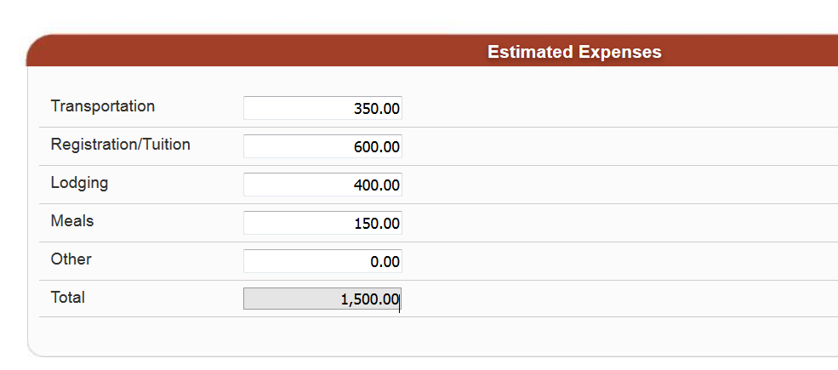
TA- Estimated Expenses
Estimated Expenses are just that- an estimate

Slide 21
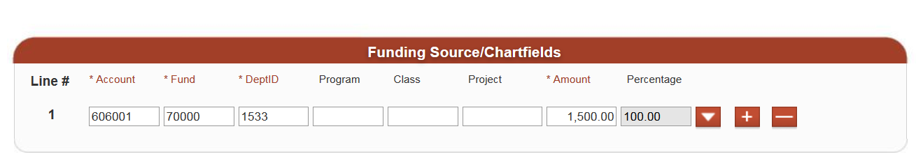
TA- Funding Source/Chartfields
Enter chartfield string of department who will pay for trip
No approval routing
Notes:
Enter chartfield string of department responsible for the expense.
This does not drive the approval. Home DeptID does.
You can add more than one chartfield string by clicking the + button.
You can change the chartfield string in Travel Reimbursement.

Slide 22

TA- Buttons
Upload Attachments
  Documentation can include
    to support your request to go on the trip
    show how estimated expenses were obtained
    provide additional trip information
Submit
  Only the Traveler can submit the authorization to start the approval process
Notes:
Additional Trip Informatio- conference agenda

Slide 23
TA- Routing and Approval Status
Allows Requester/Traveler to monitor the request
Approval Routing
  Displays the level of approvals needed and names
  Time stamp when an Approver or Reviewer takes action
Activity History
  Time stamps the action made by Traveler, Reviewer(s), Approvers, and Accounts Payable
  Displays comments made by Reviewer(s), Approvers and Accounts Payable
Once approval process is completed, FTS creates a Travel Reimbursement and assigns same Trip Number as Travel Authorization
Notes:
Activity History
Collapse the section to view

Slide 24
When the Traveler returns...
A Travel Reimbursement awaits for Traveler to complete after trip in FTS, if there is an associated Travel Authorization
  Travel Reimbursement will have same trip number as authorization
  Reimbursement populates with data from the authorization
Purpose in completing a Travel Reimbursement
  Traveler can claim a reimbursement for out of pocket expenses
  If nothing to claim, then Traveler completes one to close out the trip
Notes:
If you do not close out trip, then you’ll start a collection of Open status travel
Reimbursement data populates from authorization
Creating less work for Requester/Traveler to fill out.
Closing out of trip tells department your trip is completed.

Slide 25
Travel Reimbursement (TR)- Header
View Travel Authorization button
If Travel Reimbursement was created from a TA, then click button to view the authorization details
Notes:
View Travel Authorization button
View what was approved on the Authorization
Trip Number on TR will be the same as Authorization

Slide 26
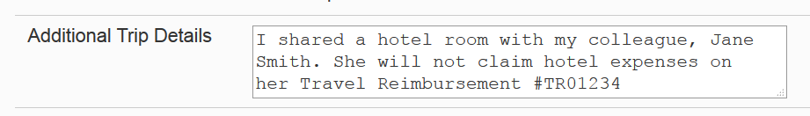
TR- Header
Use Additional Trip Details to provide explanation for any unique situations or arrangements

Slide 27
TR- One Time Charges
Base travel expenses paid in advance by SJSU or the Traveler
Charges include
  Lodging, air, and car
  Registration/conference fees
  Fell Travel
Do not enter daily charges such as meals, taxi, and incidentals
Notes:
Travel Reimbursement should be submitted 30 days of completion of trip.

Slide 28
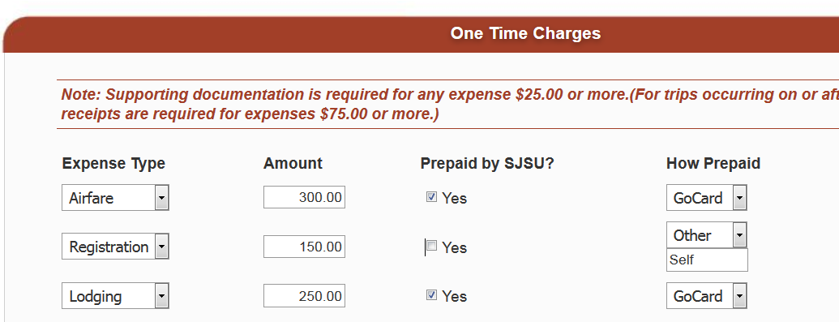
TR – One Time Charges
Notes:
Do not break out the expenses (multiple lines for one date)
Record Meal as $55 and not create multiple lines for a single day for each type of meal (B, L, and D).

Slide 29
TR- Daily Charges
Expenses include
    Meals
    Incidentals
    Shuttle, Taxi and Parking
    Other Business Expenses
Each line in Daily Charges represents one travel date
Notes:
One Time Expenses are not Daily Expenses

Slide 30
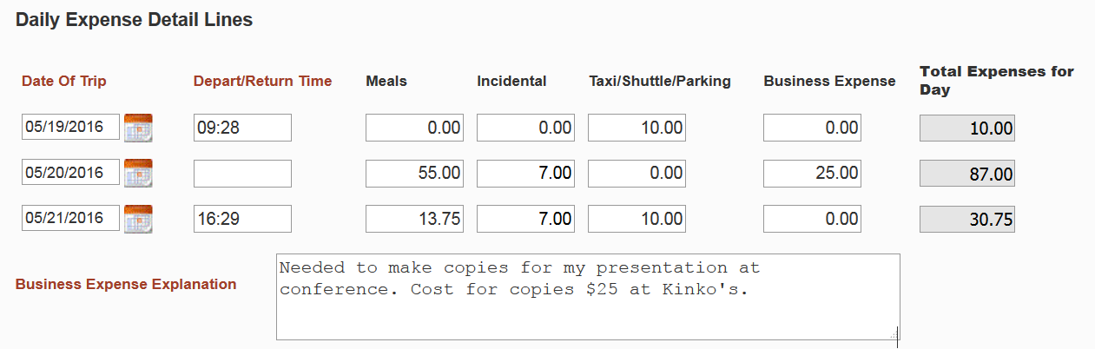
TR- Daily Charges
One line per travel date
Notes:
Do not create multiple lines for one date.
Expenses outside of limit for Meals and Incidentals or extra expenses are considered Business Expense and provide explanation.

Slide 31
TR- Total Calculations
FTS calculates your entries and deducts prepaid by SJSU (One Time Charges)
Amount Due is what is owed to Traveler as a reimbursement
Amount Approved is what department agrees to reimburse
  Can be modified by Reviewer or Approver

Slide 32
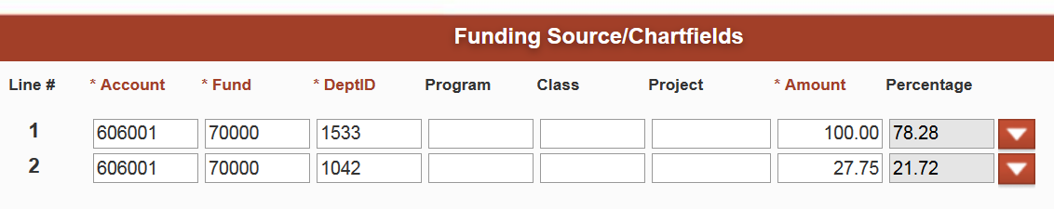
TR – Funding Source/Chartfields
Approval routing driven by DeptID
Split distribution allowed; however approval routing will go to DeptID listed in line #1

Slide 33
TR- Buttons
Upload Attachment(s)
  Backup documentation requirement
    Itemized receipts
    Exchange rates
    Mapquest or Google Maps for mileage
Submit
  Only the Traveler can submit the authorization to start the approval process
Notes:
Additional Trip Informatio- conference agenda

Slide 34
Questions?
Refer to Travel Guide
Contact Finance Support
  4-1558
  financeconnect@sjsu.edu

Slide 35
Thank You!

