Slide 1
SJSU Career Fair – April 16, 2021
Working at SJC
Adam Quartarolo ACE – Airport Operations Supervisor
Notes:
Thank group for invitation to speak and provide an update on how SJC is transforming how Silicon Valley travels.
Briefly introduce yourself – anything beyond what was shared in your introduction from the bio that was sent to them.
Go to next slide and introduce the video, then play it

Slide 2
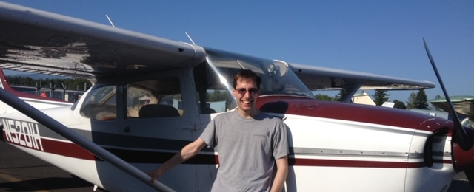
About Adam
BBA – Airport Management – Univ. of North Dakota
PPL
Airport Operations – FAT (2014-2016)
Airport Operations – SJC (2016 – Present)
  Senior Airport Ops. Specialist
  Airport Operations Supervisor (Noise & GA)

Slide 3
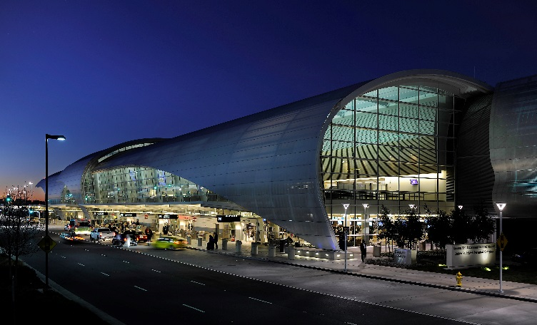
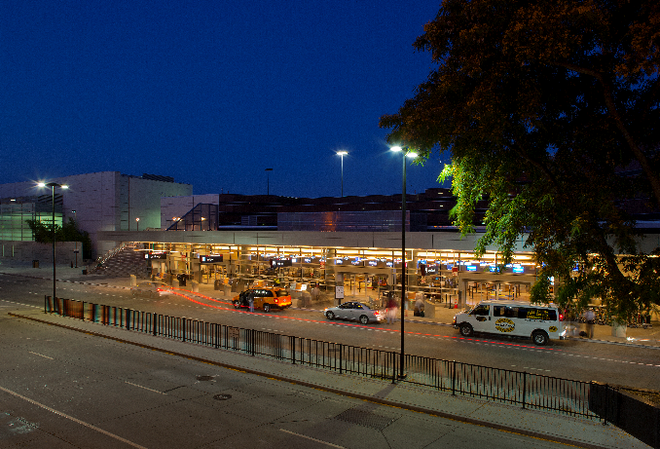
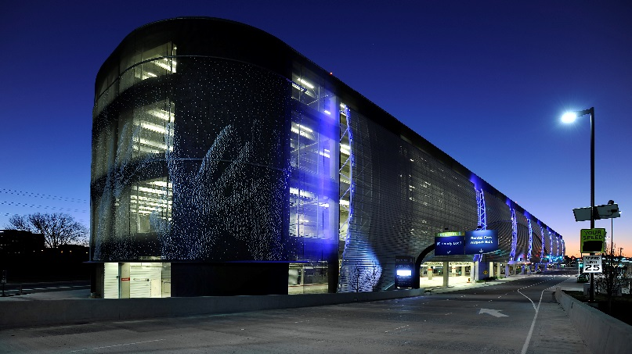
Mineta San Jose International Airport (SJC)
Mission: To Connect, Serve and Inspire
Vision: To Transform how Silicon Valley Travels
Owned/operated by the City of San José
1,000-acre site; two 11,000’ ft. parallel runways
Serve commercial and general aviation
Notes:
Norman Y. Mineta is our namesake (we are Silicon Valley’s Airport)
Located in the heat of Silicon Valley with more than 100 hi-tech companies within an 18-mile radius of the airport.
Mission: To Connect, Serve and Inspire
Vision: To transform how Silicon Valley Travels
Relatively small footprint but innovative Enterprise Fund (self-supporting through sale of goods & svcs. and various fees)

Slide 4
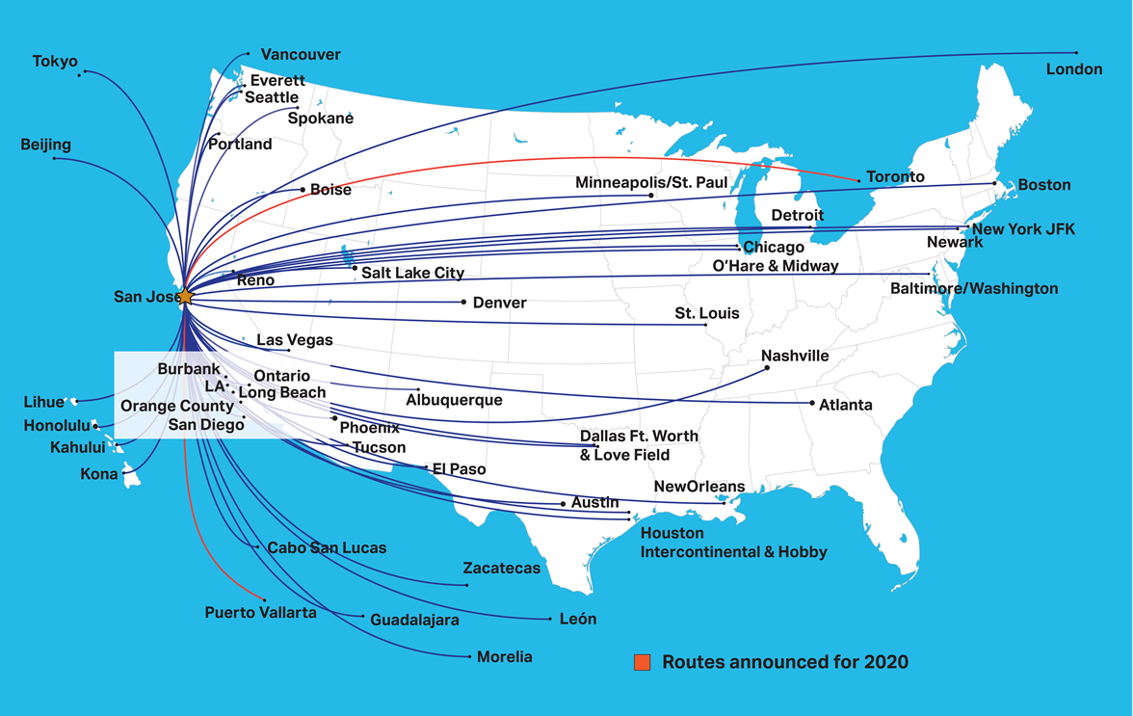
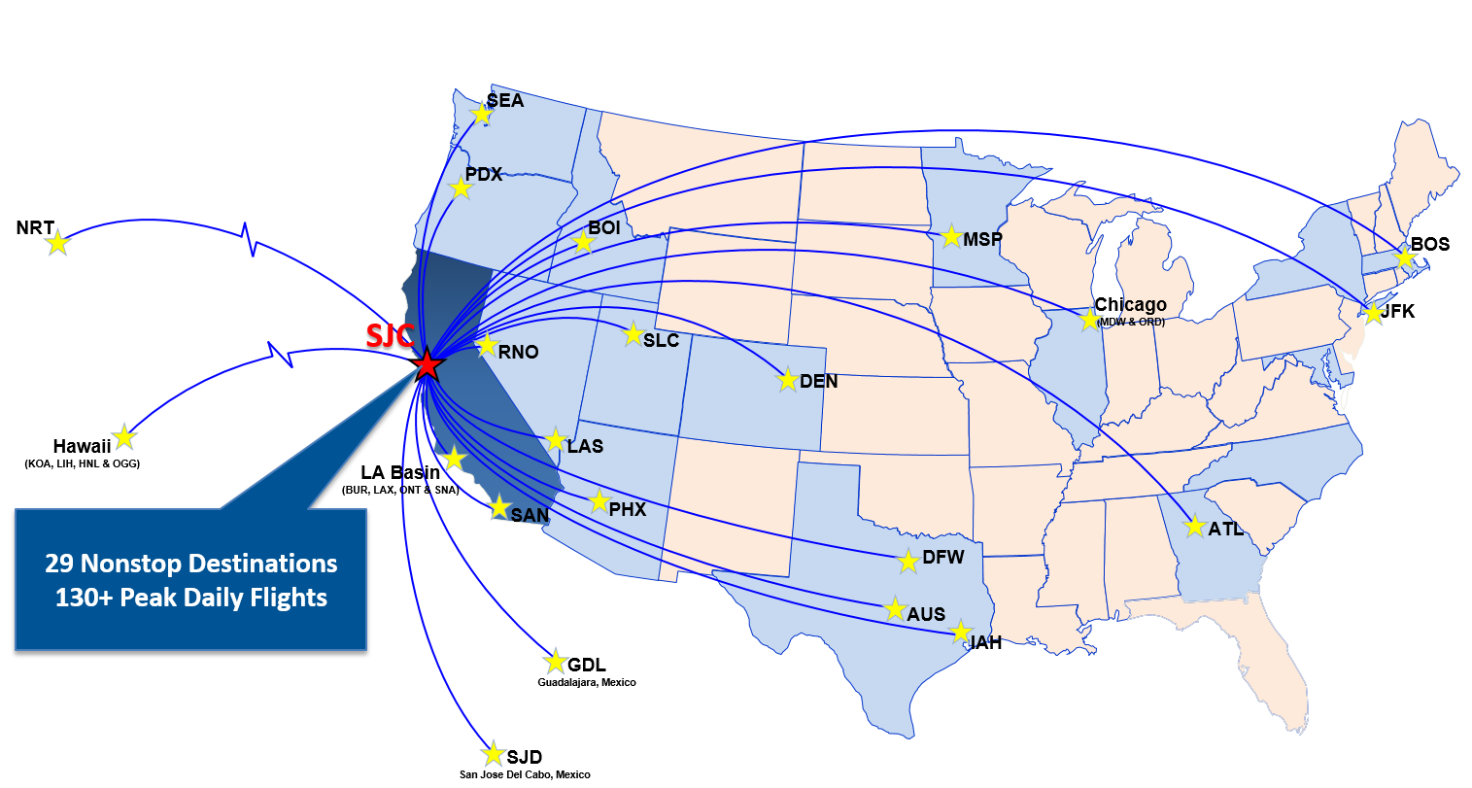
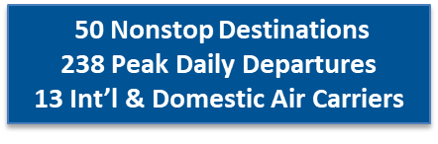
Pre-COVID Story – Rapid Growth Since 2013
Notes:
50 domestic & international nonstop routes – includes Asia, Canada, Europe and Mexico
476 peak daily departures and arrivals / one of the fastest growing airports over the past few years / double digit growth
8 domestic / 5 international airlines
We have handouts of this page

Slide 5
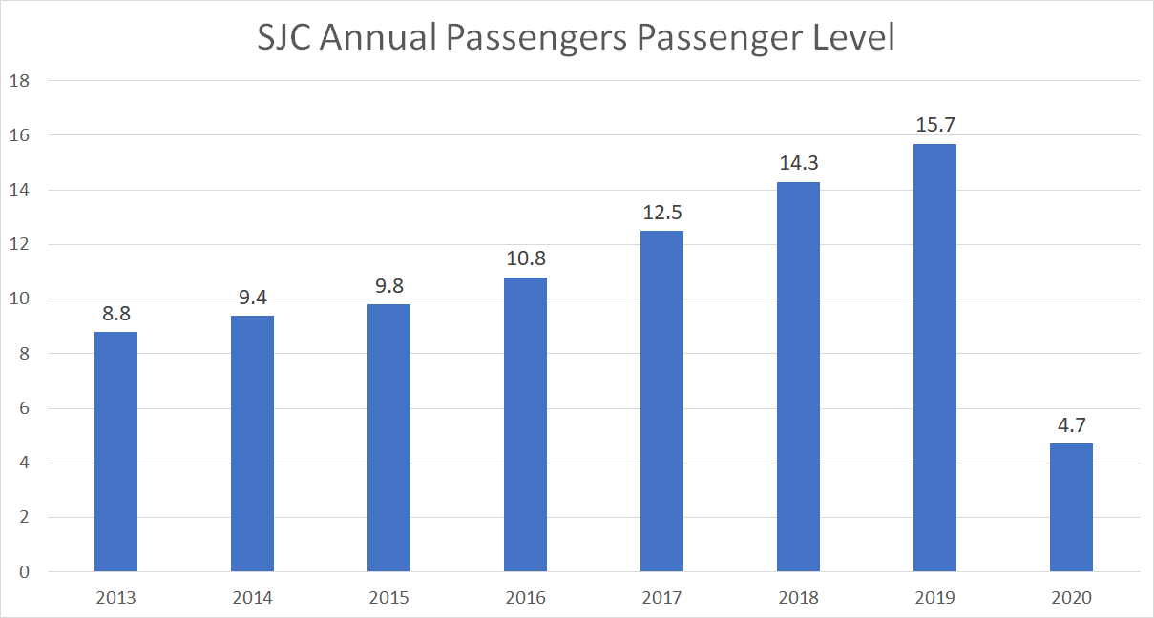
SJC Strong Trend of Passenger Growth 2013-2019
15.7 Mil
14.3 Mil
12.5 Mil
10.8 Mil
9.4 Mil
9.8 Mil
8.8 Mil
Notes:
Think about showing the impact of COVID

Slide 6
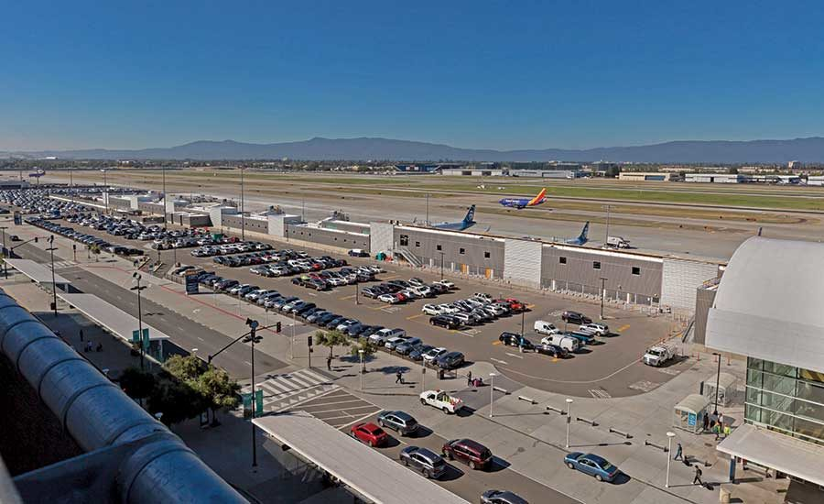
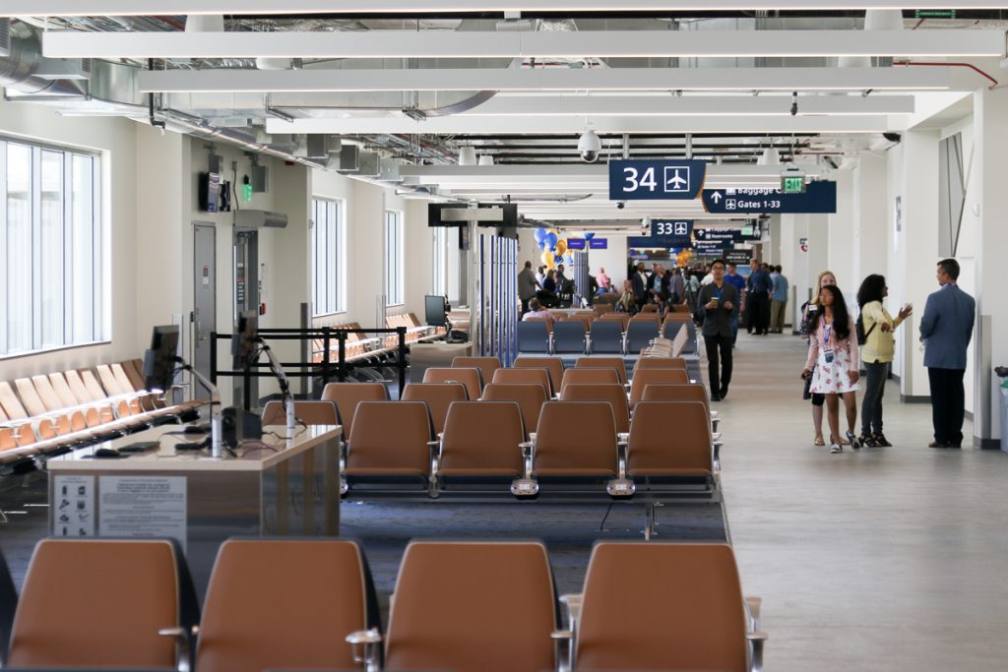
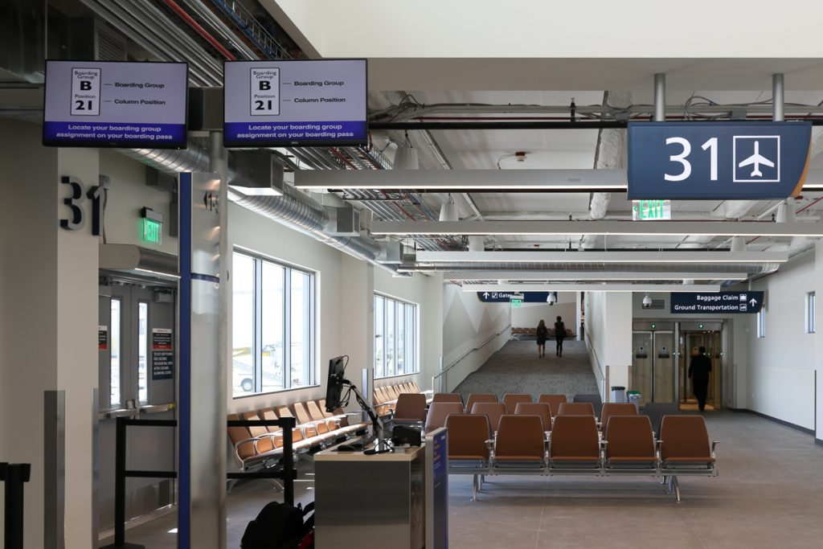
Interim Facility Gates (2019)

Slide 7
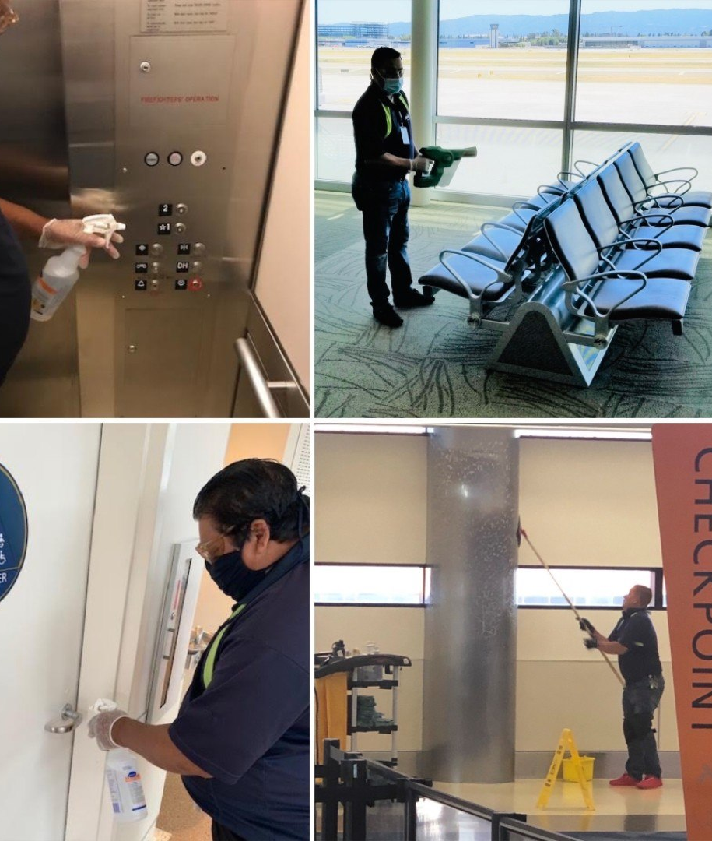
COVID Impacts
~80% loss of passenger traffic
Revenue strain, but not fatal blow
Capital projects on hold
Increased cleaning/social distancing protocols
GBAC STAR accreditation
New technologies
  Touchless check-in process
  UV/electrostatic cleaning

Slide 8
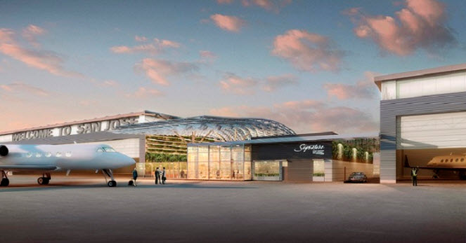
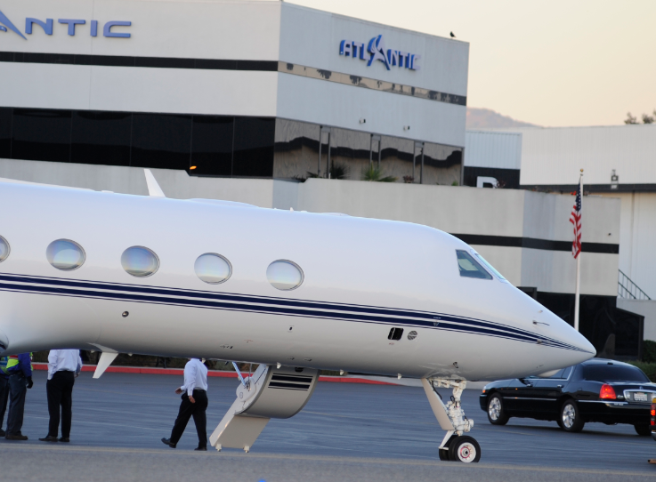
Meeting Corporate Aviation Demand
8

Slide 9
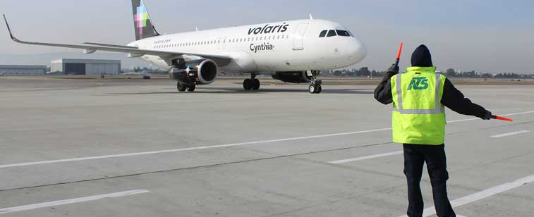
Not All Bad News!
Volaris to Mexico City
Alaska Airlines to Jackson Hole (seasonal), Spokane, Missoula
Capital Projects
  ARFF Station
  Economy Lot Parking Garage
  Airfield improvements

Slide 10
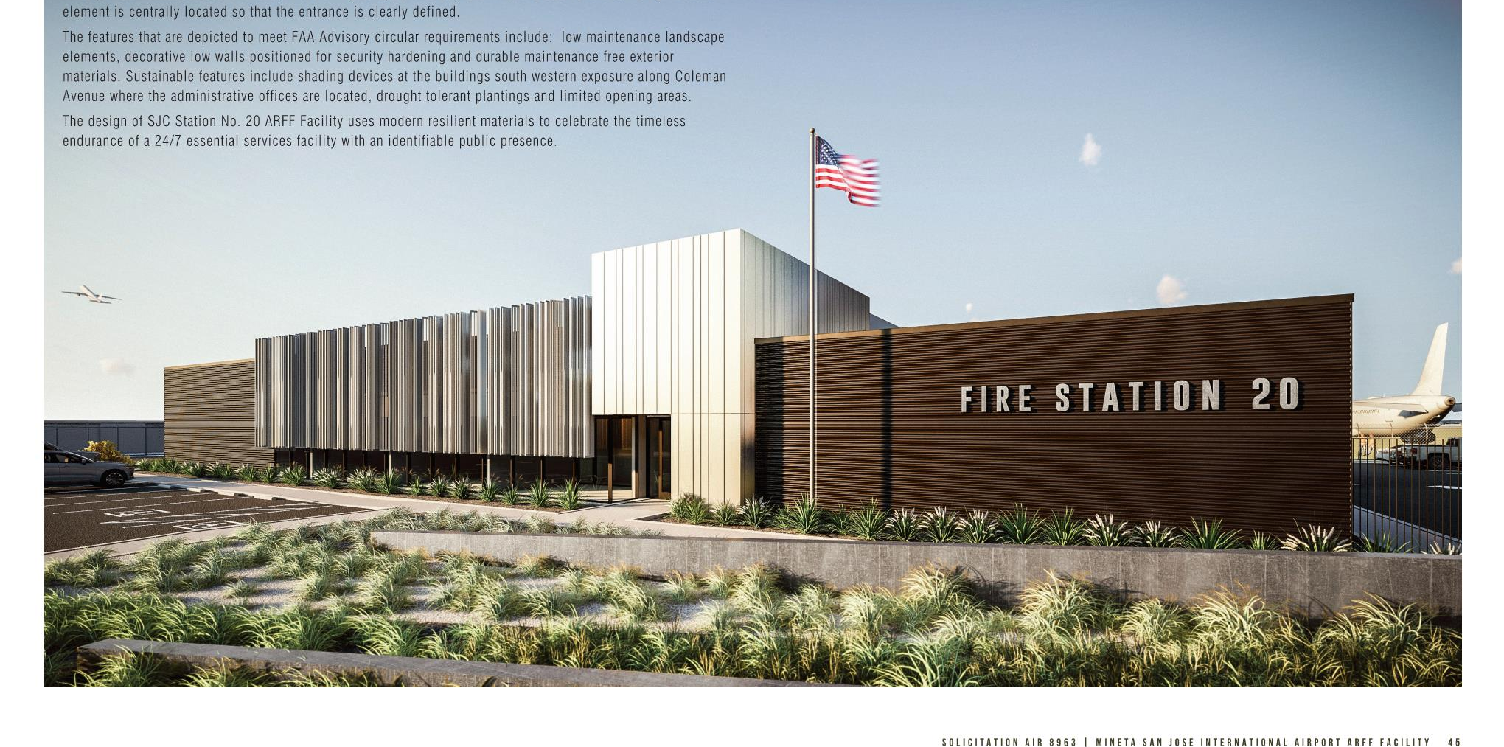
Aircraft Rescue and Fire Fighting (ARFF) Facility
14,000 Square Feet
(4) ARFF Vehicle Bays
(6) Firefighter Dormitories
LEED Silver Certification
Notes:
To be located on southwest side of airfield
– opposite Avaya Stadium and adjacent marketplace
Replaces 50+ year-old facility currently located south of terminals.
Important facility and service upgrade = enhance safety of our travelers and Airport users.

Slide 11
Airport Divisions
Director’s Office (HR/Air Service Dev./IT)
Finance (Properties)
Marketing & Communications
Planning & Development (Environmental)
Operations
Facilities & Maintenance

Slide 12
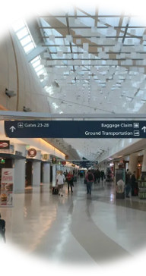
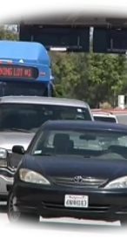
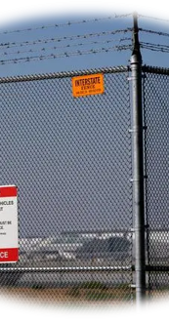
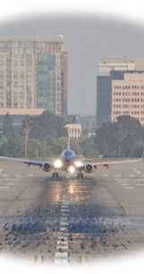
Operations Sections
Customer Service/Terminal Management
Landside
Security Compliance
Airside

Slide 13
Operations
Management Structure
Deputy Director
Managers
Superintendents
Supervisors
Senior Airport Operations Specialists
Badging Specialists
Analysts
Office Specialists
Security Guards
Third-Party Vendors
Terminal Volunteers

Slide 14
Summer Internships
Most recently in 2019
Likely resuming in 2022 (check City website)
  Student Intern - $11.82 - $16.87/hr (unbenefitted)
  Graduate Student - $15.29 - $22.58/hr (unbenefitted)
Marketing & Communications (MarCom)
Operations
Airport Technology Services (IT)

Slide 15


Interns Hiring
Operations: Aviation, Aviation Management
Finance: Finance, Accounting, and Business Administration/Management
IT: Computer Engineering, Computer Science, Computer Information Systems, Management Information Systems, and Information Technology
MarCom: Marketing, Communications, Public Relations, Business Administration, and Hospitality Management
E-mail application
Selection process
  Interviews
  Practical/Writing exercise

Slide 16
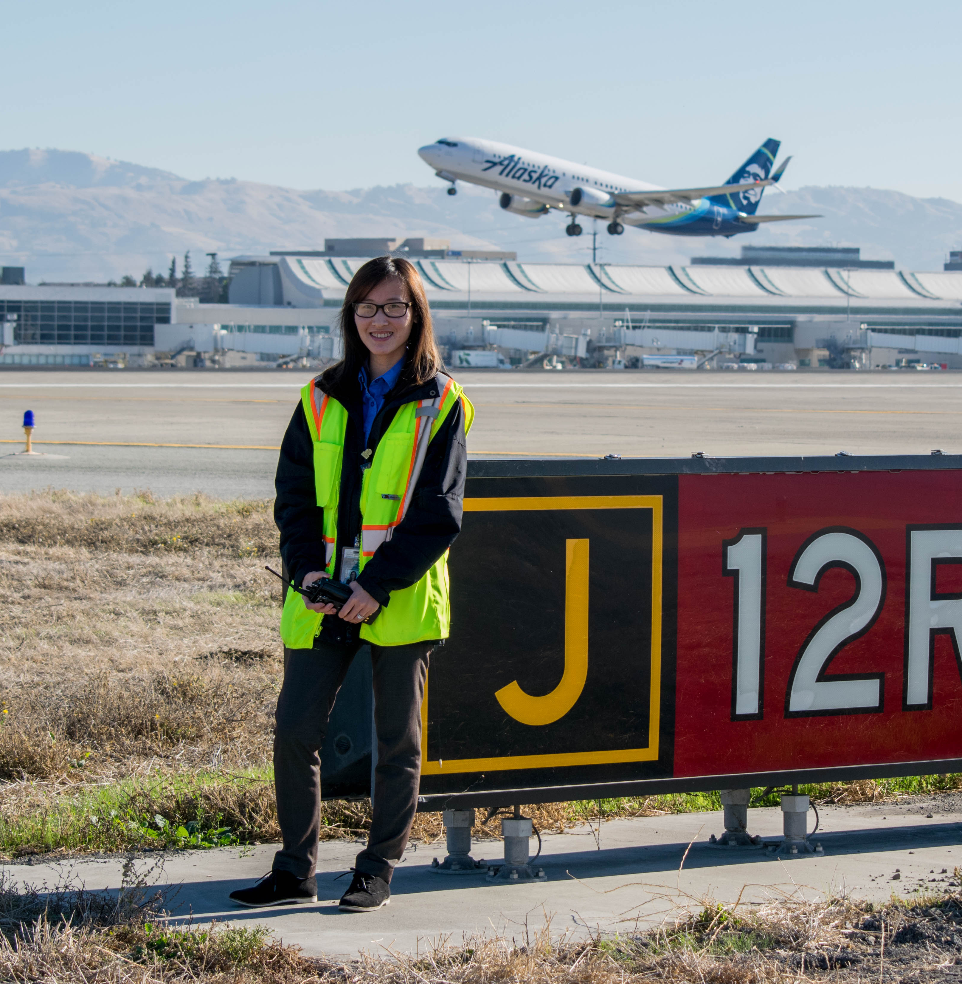
Senior Airport Ops. Specialists
~25 Employees
Rotate between sections
Well-rounded position
  Dispatching
  Routine/Daily work
  Project work
  Emergency response
  Directed by MOD/Supervisors

Slide 17
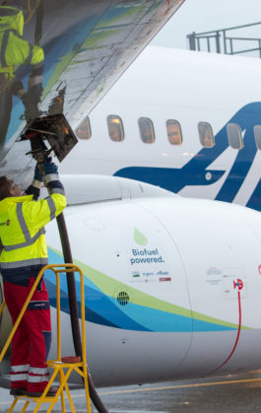
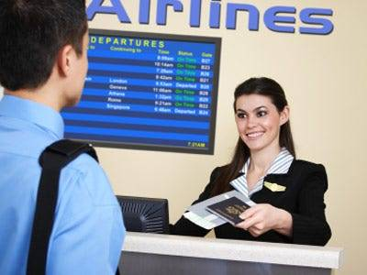
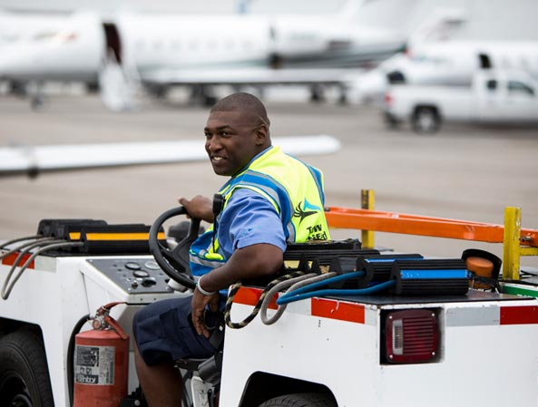
Operations –
Entry Level Applicants
Ideal candidates are…
  Bachelor’s+ in Aviation-field
  Experience at airline/FBO/airport
  Customer-service oriented
  Enjoy fast-paced, unpredictable work
  Able to work flexible shifts
  Team players and self-driven

Slide 18
CSJ - Entry Level Hiring
Interview Process
Job Posting (CSJ Website)
Application/Resume submissions
Panel Interview 1
Panel Interview 2
Offer

Slide 19
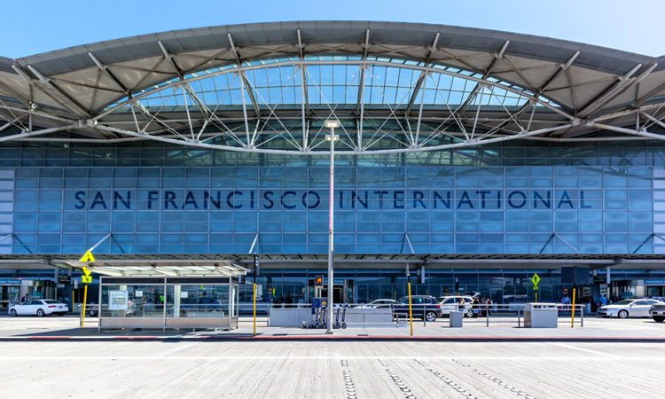
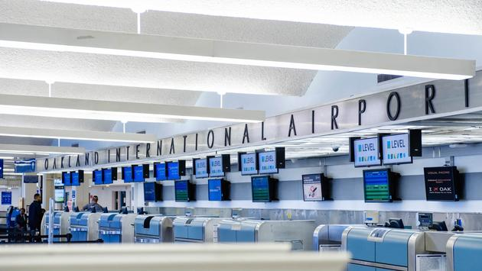
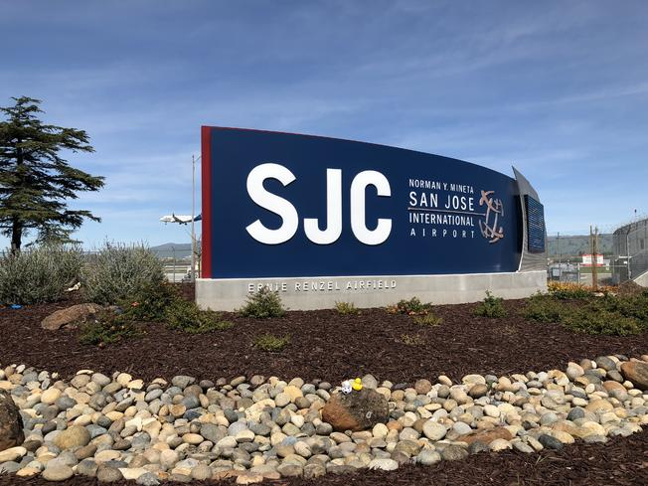
Comparing Airports
Airport | Part 139 | Ownership | Category | Operations (2019) | Airlines | Staff
SJC | YES | City | Medium Hub | 205886 | ~12 | ~200
SFO | YES | City/County | Large Hub | 458502 | ~50 | ~1700
OAK | YES | Port Authority | Medium Hub | 242757 | ~10 | ~250
RHV/PAO/HWD/etc. | NO | Varies (City/County) | General Aviation | Varies | None | 5~20

Slide 21




Thank You / Questions
FlySanJose.com/employment
FlySanJose.com/follow

