Slide 1

Department of African American Studies
An Introduction

Slide 2
What is African American Studies?
  … a transdisciplinary study pertaining to intellectual traditions and practices of African and African-descended peoples
  ---Berkerie, 2007

Slide 3
Africana scholars are required as practitioners to have a knowledge base that comes from the life experiences of people of African descent
Kershaw, 1992

Slide 4
Our Roots…
Africana Scholars

Slide 5
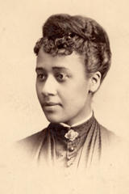
Dr. Anna Julia Cooper
Dr. Anna Julia Cooper established and co-founded several organizations to promote black civil rights causes. She helped found the Colored Women’s League in 1892, and she joined the executive committee of the first Pan-African Conference in 1900. Since the Young Women’s Christian Association (YWCA) and the Young Men’s Christian Association (YMCA) did not accept African American members, she created “colored” branches to provide support for young black migrants moving from the South into Washington, D.C.
Quote:
The cause of freedom is not the cause of a race or a sect, a party or a class-it is the cause of human kind, the very birthright of humanity.
-Anna Julia Cooper

Slide 6
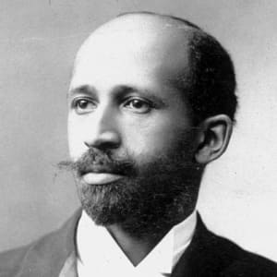
Dr. William Edward Burghardt DuBois
W.E.B. DuBois, or William Edward Burghardt DuBois, was an African American writer, teacher, sociologist and activist whose work transformed the way that the lives of black citizens were seen in American society. Considered ahead of his time, DuBois was an early champion of using data to solve social issues for the black community, and his writing – including his groundbreaking The Souls of Black Folk – became required reading in African-American studies.
Quote:
The worker must work for the glory of his handiwork, not simply for pay; the thinker must think for truth, not for fame.”
-W.E.B. DuBois

Slide 7
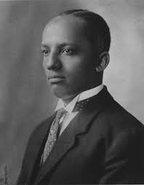
Dr. Carter G. Woodson
In 1915, he and friends established the Association for the Study of Negro Life and History. A year later, the Journal of Negro History, began quarterly publication. In 1926, Woodson proposed and launched the annual February observance of "Negro History Week," which became "Black History Month" in 1976. It is said that he chose February for the observance because February 12th was Abraham Lincoln’s birthday and February 14th was the accepted birthday of Frederick Douglass.
Dr. Woodson was the founder of Associated Publishers, the founder and editor of the Negro History Bulletin, and the author of more than 30 books. His best known publication is The Mis-Education of the Negro, originally published in 1933 and still pertinent today.
Quote:
The large majority of the Negroes who have put on the finishing touches of our best colleges are all but worthless in the development of their people.
-Carter G. Woodson

Slide 8
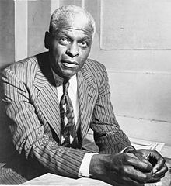
Dr. Benjamin E. Mays
Born August 1, 1894 near Epworth, South Carolina, Dr. Mays was a member of Phi Beta Kappa. He graduated at Bates College in Maine. He served as pastor of Shiloh Baptist Church from 1921-1923 in Atlanta, Georgia. Recruited by Morehouse President John Hope, Mays later on joined the faculty as a mathematics teacher and debate coach. He obtained a master's degree in 1925 and in 1935 a Ph.D. degree from the University of Chicago. In 1934, he was appointed dean of the School of Religion at Howard University and served until 1940.
Quote:
It must be borne in mind that the tragedy of life does not lie in not reaching your goal. The tragedy of life lies in having no goal to reach.
-Benjamin E. Mays

Slide 9
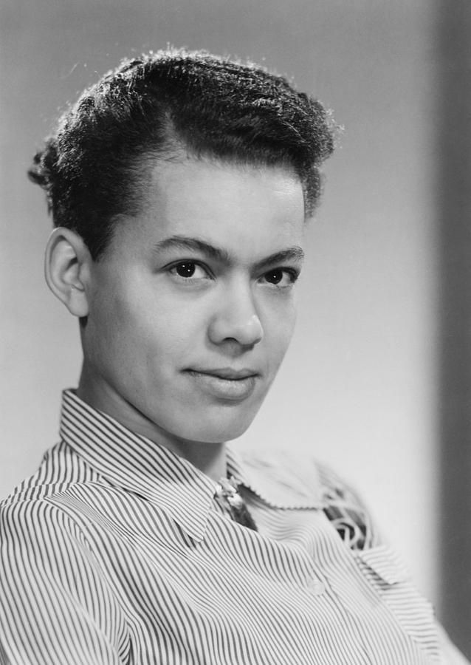
Dr. Anna Pauline Murray
In 1956, Murray published Proud Shoes: The Story of an American Family, biography of her grandparents, and their struggle with racial prejudice and a poignant portrayal of her hometown of Durham. In 1960 Murray travelled to Ghana to explore her African cultural roots. When she returned President John F. Kennedy appointed her to his Committee on Civil and Political Rights. In the early 1960s Murray worked closely with Philip Randolph, Bayard Rustin and Martin Luther King but was critical of the way that men dominated the leadership of these civil rights organizations
Quote:
“True Community is based upon equality, Mutuality, and Reciprocity. It affirms the richness of individual diversity as well as the common human ties that bind us together”.
-Pauli Murray

Slide 10
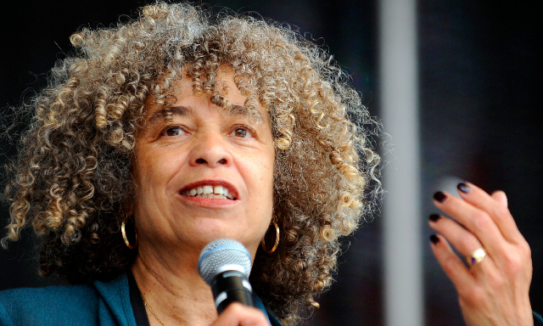
Dr. Angela Y. Davis
Dr. Angela Y. Davis was born January 26, 1944, she is a American political activist, academic, and author. She emerged as a prominent countercultural activist in the 1960s working with the Communist Party USA of which she was a member until 1991, and was briefly involved in the Black Panther Party during the Civil Rights Movement
Davis is a professor emerita at the University of California, Santa Cruz, in its History of Consciousness Department. She is also a former director of the university's Feminist Studies department.
Quote:
“I am no longer accepting the things I cannot change. I am changing the things I cannot accept.”
-Angela Y. Davis

Slide 11
African American Studies Homeplaces
The Struggle to Exist Where Knowledge is Centered…

Slide 12

Merritt College
First Afro-American Studies program established in Fall 1968

Slide 13
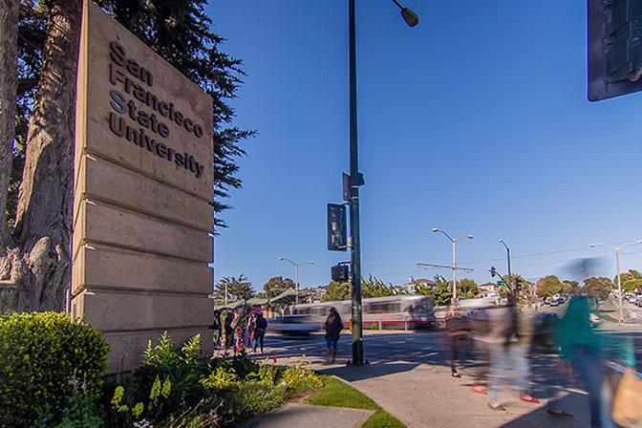
San Francisco State University
First Department of Black Studies established Spring 1969

Slide 14
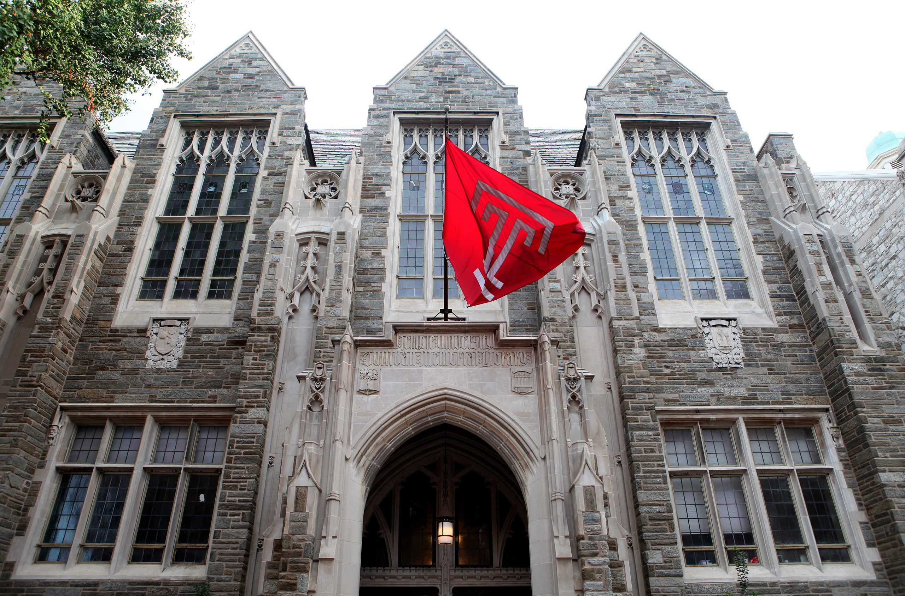
Temple University
First Ph.D. program in Africana Studies, 1988

Slide 15
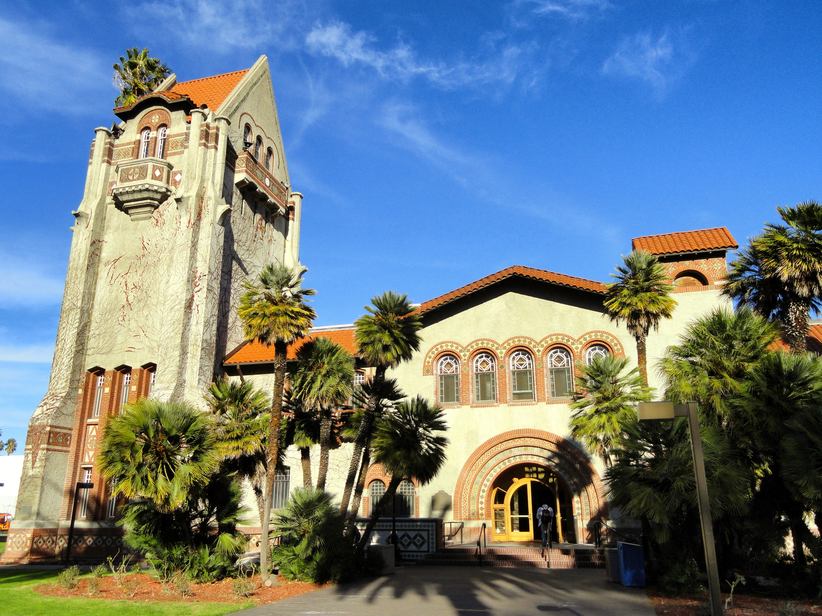
African American studies @SJSU

Slide 16
Timeline
December 1968-February 1969
Official Date of SJS Black Studies Department announced for Fall 1969

Slide 17
1969-1974
Fall 1969
First semester for Black Studies
First Chair: Leonard Jeffries
First Class Schedule: 17 courses instructed by 10 faculty

Slide 18
1973
Name changed from Black Studies to Afro-American Studies
December 1973
1500 students enrolled
20 Full time professor
35 courses

Slide 19
1975-1980
1976
Spring: 881 students
Fall: 1,016 students
1979
Passage of Prop 13 causes cutbacks in ethnic studies departments

Slide 20
1980-1990
Fall 1982
New course, “Black Community Health” offered
Black students collect petition signatures on campus and in San José to save the major from termination
Spring 1983
Protest – Students march to save program

Slide 21
1990-2019
Spring 1991
New course, “Black Women Writers: Race, Culture, and Life Cycle in Cross Cultural Perspective”
Spring 1992
Transfer– African American Studies moves from School of Social Sciences to College of Social Work

Slide 22
Spring 2002
Change – department implements new program, “San José State University’s Model for Black Studies”. SJSU was the first of five universities in the nation to adopt the program.

Slide 23
Spring 2004
Offended – Students protest outside Washington Square Hall because African American Studies classes canceled because of budget cuts.

Slide 24
Summer 2013
Hardship – conversations indicate department may be set to close Spring 2014
Fall 2013
Students demonstrate to represent the lack of ethnic studies courses

Slide 25
Spring 2014
Chancellor forms CSU Task Force on the Advancement of Ethnic Studies
Spring 2016
Report on the CSU Task Force on the Advancement of Ethnic Studies Released
Spring 2017
Status Report on the CSU Task Force on the Advancement of Ethnic Studies Released

Slide 26
Fall 2018
New Department Chair, Dr. Theodorea Berry, started
New Assistant Professor, Dr. Wendy Thompson Taiwo, started

Slide 27
Spring 2019
Legacies and Legends program initiated
New minor, Black Women’s Studies, approved
Dr. Steven M. Millner appointed Professor Emeritus

Slide 28
The Legacy Remains, The Story Continues…
African American Studies at San José State University

Slide 29

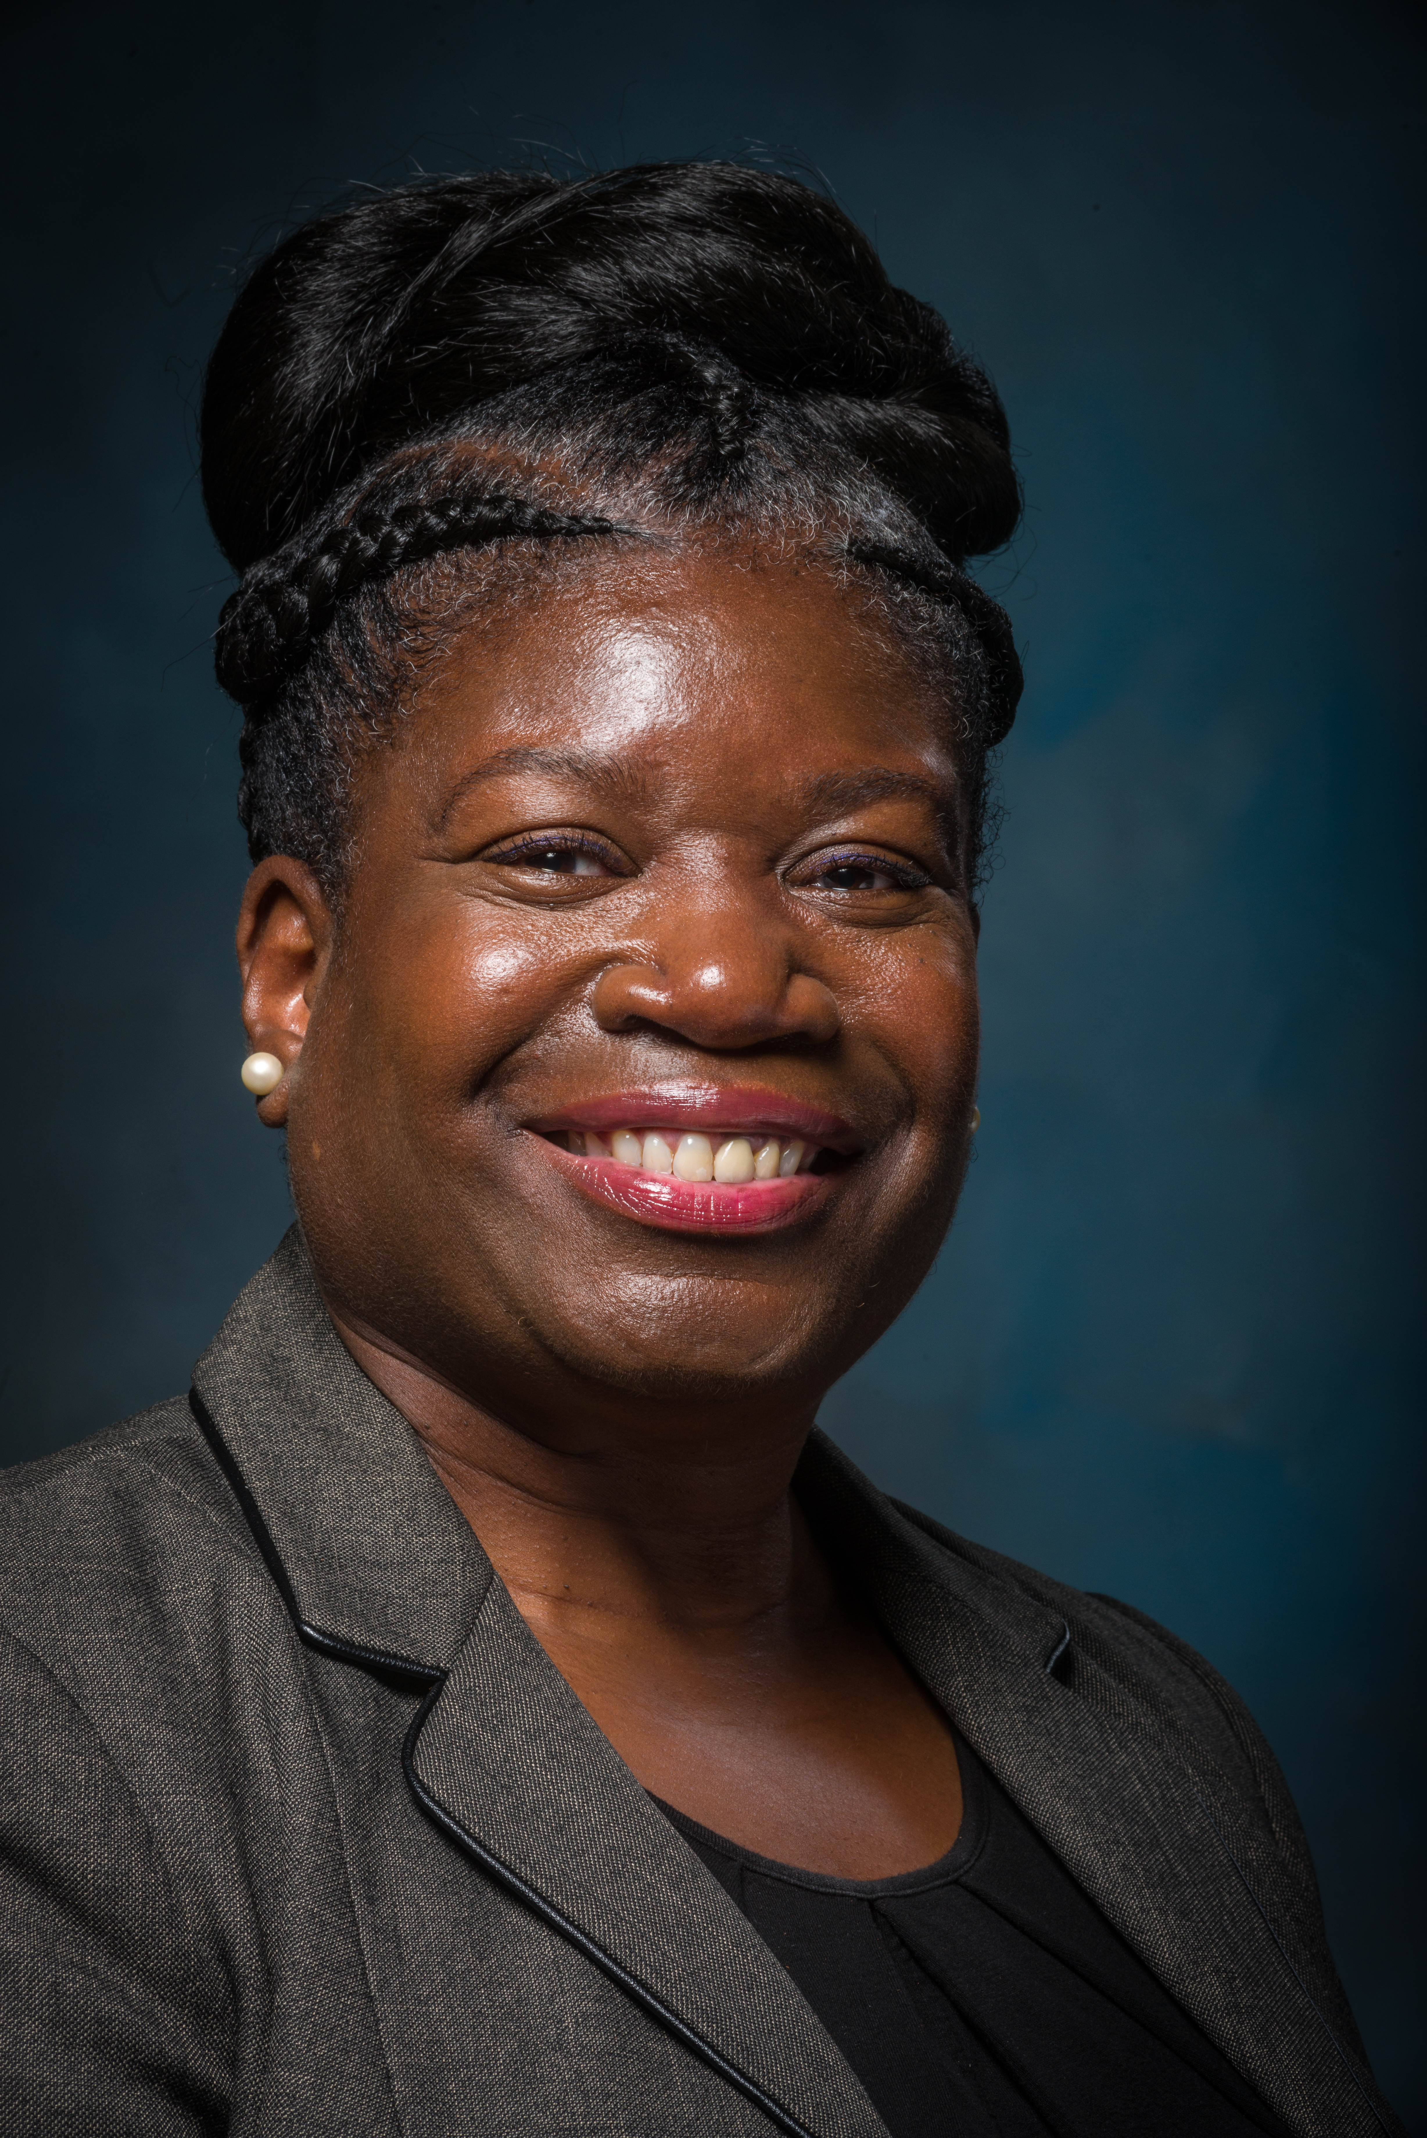
Dr. Theodorea Regina Berry
Professor and Chair
Theodorea Regina Berry, Ed.D. joined us as Professor and Chair of the Department of African American Studies in Fall 2018. Most recently, Dr. Berry served as Associate Dean of Academic Affairs and Director, Graduate Recruitment and Engagement in the Graduate School at the University of Texas at San Antonio. Prior to her appointment to the Graduate School, Dr. Berry served as Director of the African American Studies Program (2014-2016) and the Graduate Advisor of Record for the PhD in Interdisciplinary Learning and Teaching program (2014-2016).

Slide 30
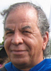
Dr. Steven Millner
Professor Emeritus
Professor Steven Millner is a native of Columbus, Ohio who spent his formative youth in Los Angeles County. He earned his M.A. and Ph.D. from the University of California, Berkeley before returning to San José State University where he had earned his undergraduate degree. His research and primary publications have focused on race relations in the U.S.A.’s deep South.

Slide 31
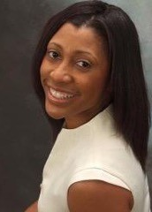
Dr. Akilah R. Carter-Francique
Executive Director of ISSSSC
Associate Professor
Akilah R. Carter-Francique (Ph.D., University of Georgia) is an Associate Professor at San José State University (SJSU) in the Department of African American Studies. She also serves as the Executive Director for the Institute for the Study of Sport, Society, and Social Change (ISSSSC) at SJSU. Her scholarly endeavors and field of focus encompasses the intersection of sport, society, and social justice that is inclusive of issues of diversity, social movements, and the dynamics of social change and development.

Slide 32
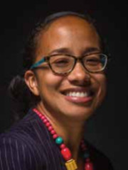
Dr. Wendy Thompson Taiwo
Assistant Professor
Dr. Wendy Thompson Taiwo is an Assistant Professor of African American Studies whose research and teaching interests focus on Black southern migration to California, Black and Black mixed race mothering, race and the built environment, and Black articulations of social status and class. Her scholarly and creative writing has appeared in MN Artists, Meridians: feminism, race, transnationalism, Nokoko, carte blanche, and several anthologies including War Baby/Love Child: Mixed Race Asian American Art.

Slide 33
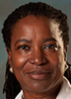
Dr. Ruth P. Wilson
Professor
Dr. Ruth Wilson, a native of Beaumont, Texas, at the University of California at Santa Cruz (UCSC), where she completed a double major in Biology and Community Studies. After graduating from UCSC, Professor Wilson continued her interests in the intersection of culture and medicine as a graduate student at Stanford University, where she began her early research projects focused on the impact of acute respiratory infections (pneumonia) among infants internationally. More recently, Dr. Wilson’s research and publications focus on the survival strategies of East African immigrants in the Silicon Valley.

Slide 34
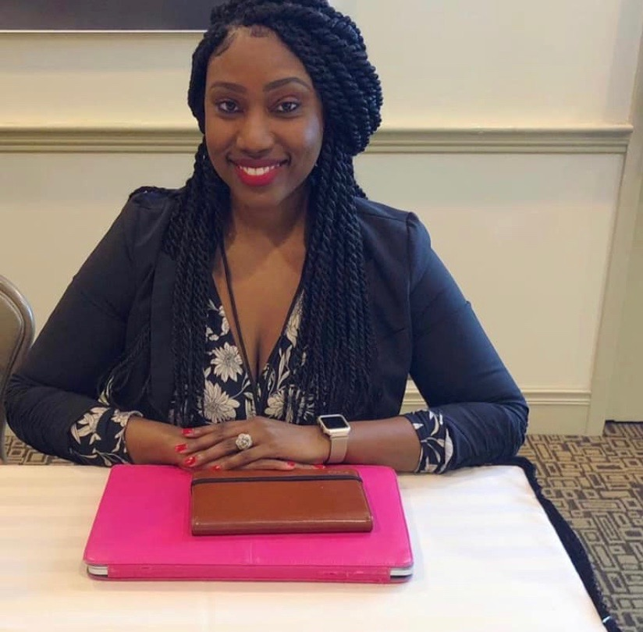
Dr. Leah T. Gaines
Outreach Coordinator
Dr. Gaines serves as a Lecturer and Outreach Coordinator for the Department of African American Studies at San José State University. She graduated from Michigan State University with a PhD in African American and African Studies, with a concentration in Urban Education. Her most recent work, "Being in the Center of the Projects,: Urban Education, Structural Inequities, and Provisional Resistance," examines the systemic inequalities experienced by one Baltimore City school, and how their educational community resists such oppressions. Dr. Gaines' research interests include structural inequities, African American education, community resistance, and all things revolving around the experiences, histories, and cultures of Black peoples.

Slide 35
African American Studies Lecturers
Briana Barner
Dr. Walter Easter
Mark Lott
Dr. Frank Ortega
Tabia Shawel
Bernell Smithen
Leslye Tinson
Michelle Tran
Emmanuel J. Watkins

Slide 36
African American Studies Programs
Knowledge in Black

Slide 37
Major: African American Studies
Required Courses
  AFAM 2A, 2B, 22, 120, 159, 198 and 40 or 111
Required Electives (Minimum 5 courses required)
  Select five (or more) courses from the following: AFAM 102, 105, 106, 110, 112, 115, 119, 125, 130, 134, 137, 142, 151, 152, 155, 156, 157, 160, 161, 164, 166, 190

Slide 38
Minor: African American Studies
Required Courses
  AFAM 2A and AFAM 2B
Required Electives
  12 units (4 courses @ 3 credit hours each) of upper division courses

Slide 39
Minor: African Studies
Required Courses
  AFAM 40 and AFAM 111
Required Electives
  Select 9 units (3 courses) from the following: AFAM 112, 119, 150, ENGL 123B, and POLS 142

Slide 40
Minor: Black Women’s Studies
Required Courses
  AFAM 2A , AFAM 2B, and AFAM 152
Required Electives
  Select 6 units (2 courses) from the following: AFAM 156, 166, COMM 176, WOMS 020, and WOMS 160

Slide 41
Steps To Take….
For African American Studies Majors…
For Undeclared Majors/Other Majors…
  Consider African American Studies as a major or minor.
  Consider a minor in African Studies or Black Women’s Studies.
  Make an appointment to see Dr. Berry, Chair, African American Studies for additional information.
  Sign up to volunteer in the department.
  Consider Alternative Spring Break and Study Aboard opportunities within and outside the department.
  Make an appointment to see Dr. Berry, Chair, African American Studies
  Sign up to volunteer in the department.
  Consider Alternative Spring Break and Study Abroad opportunities within and outside of the department

