Slide 1
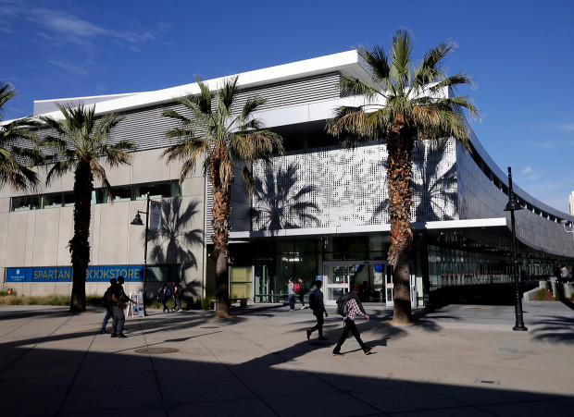
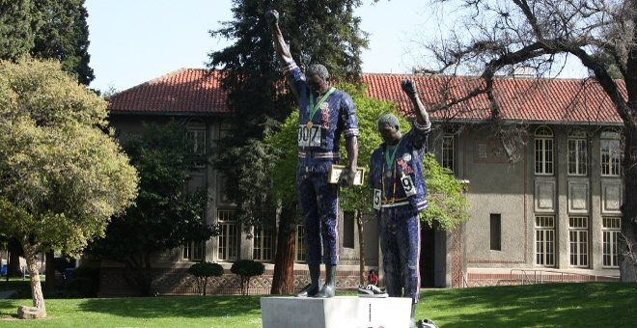
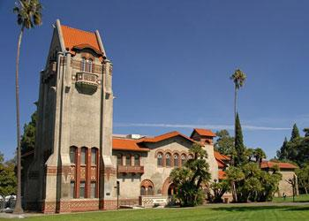
Department of African American Studies
San José State University

Slide 2

Department of African American Studies
Major:
African American Studies
Minors:
African American Studies
Black Women’s Studies
African Studies
Full-Time Faculty:
Dr. Travis Boyce, Professor and Chair
Dr. Akilah Carter-Francique, Associate Professor
Dr. Jalylah Burrell, Assistant Professor
Dr. Michael Fisher, Assistant Professor (on leave AY 20/21)
Dr. Wendy Thompson Taiwo, Assistant Professor
Dr. Steven Milner, Professor Emeritus
Dr. Ruth Wilson, Professor Emeritus

Slide 3
Graduation Requirements
Earn 120 Units
Up to 70 units may be transferred from a community college
40 units must be from upper division classes (numbered 100 or higher)
Complete all University requirements
GE core classes
SJSU Studies (Areas R, S, V, and Z) classes
American Institution Classes
PE Classes
Complete all Major requirements (39 units)*
Complete all Minor requirements (if applicable)

Slide 4
Major Requirements*
Core (24 units*)
Area Z*
AfAm 100W: Writing Workshop
Historical
AfAm 002A: African-Americans and the Development of America’s History and Government
AfAm 002B: African-Americans and the Development of America’s History and Government
AfAm 040: African Origins OR AfAm 11: African Nations: History, Politics, and Culture
Social-Behavioral
AfAm 120: Sociology of African-American Communities
AfAm 159: Economic Issues in the Black Community
Cultural
AfAm 022: The Humanities in African-American Culture
Senior Seminar
AfAm 198: Senior Seminar in African American Studies
Major Electives (15 units)

Slide 5
Academic Advising
Major Advising: See African American Studies advisor
Minor Advising: See advisor from intended department
GE Advising: See the Academic Counseling Center for Excellence in the Social Sciences (ACCESS Center) located in Clark Hall 240
General Education advising
Help with decisions about changing majors
Academic policy related questions
Peer advising
Academic advice and tips about how to navigate your way around SJSU
Probation and Disqualification
Socsci-access@sjsu.edu (408) 924-5363

Slide 6
What Classes Do I Register For?
What African American Studies classes have you previously taken?
How many classes do you want to take?
Have you taken the Writing Skills Test (WST) Directed Self Placement and placed into AfAm 100W?
Take required/core courses as soon as possible.
If you see a major elective course you like, take it!
Minor Classes?
University Electives?
If you have questions, reach out to an advisor. This summer feel free to contact the AFAM Studies Department office.

Slide 7


Mode of Instruction: Fall 2020
Synchronous
Asynchronous

Slide 8
How To:
Search of classes
Manage waiting lists
Apply for graduation

Slide 9
Questions?
Next steps?

Slide 10
Department of African American Studies
San José State University

