Slide 1
HELLO.

Slide 2
Today
(aka, the “Good News”)

Slide 3



The Good News
Job Growth, 2014
San Jose MSA: 4.0%
Bay Area: 3.2%
U.S.: 2.1%

Slide 4
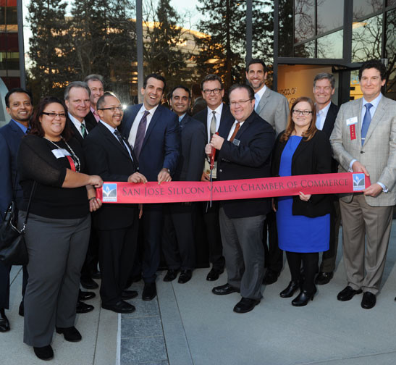
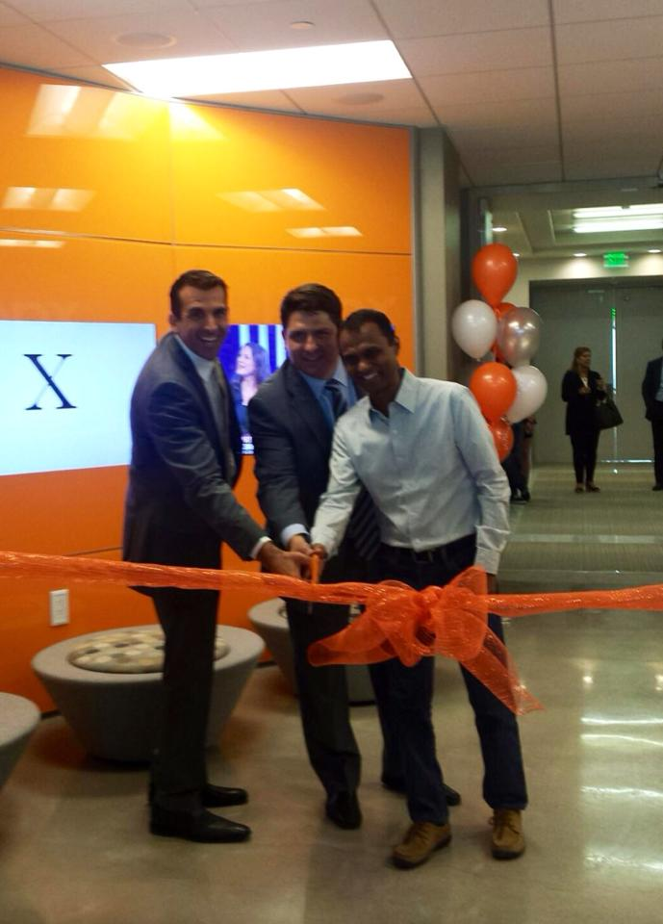
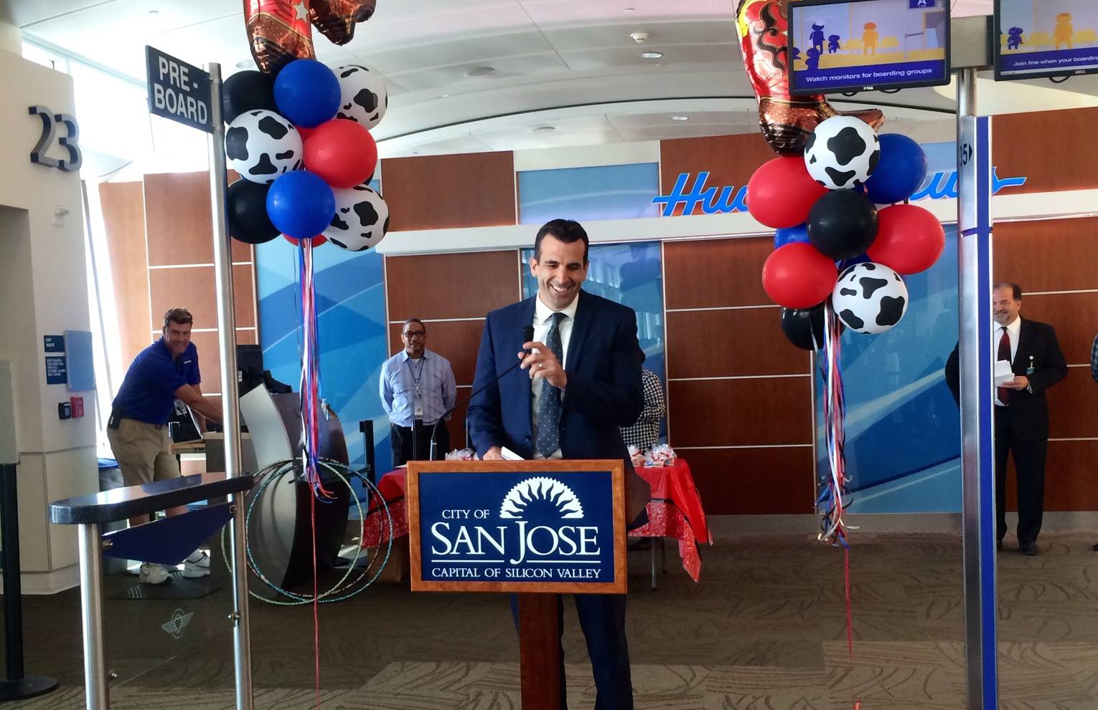
Ribbon Cuttings

Slide 5
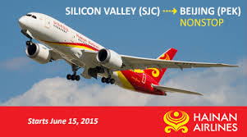
Airport: Taking Off

Slide 6
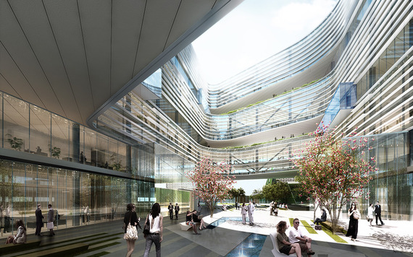
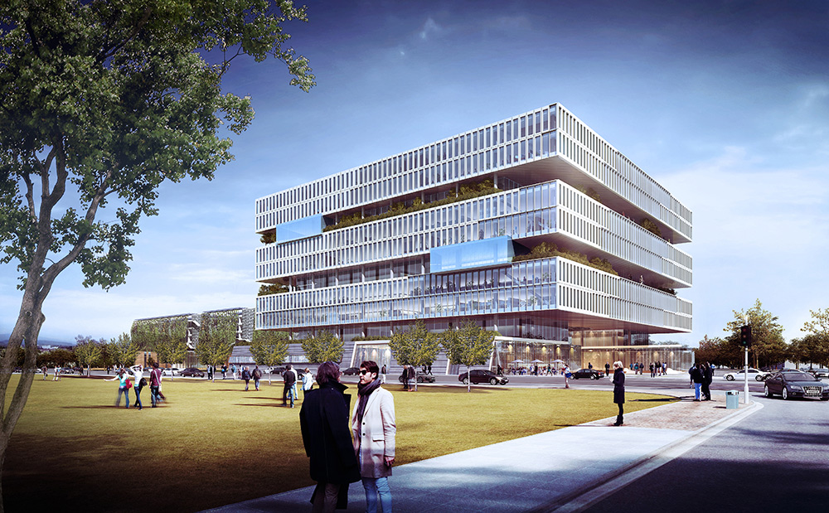
North San Jose Burgeoning
Pipeline: >10 million SF
Expansions:
Avago, F5,
Samsung,
BD BioSciences,
Nimble Storage,
etc.
Announcements TBD

Slide 7


South San Jose Emerging

Slide 8


Manufacturing on the Move

Slide 9
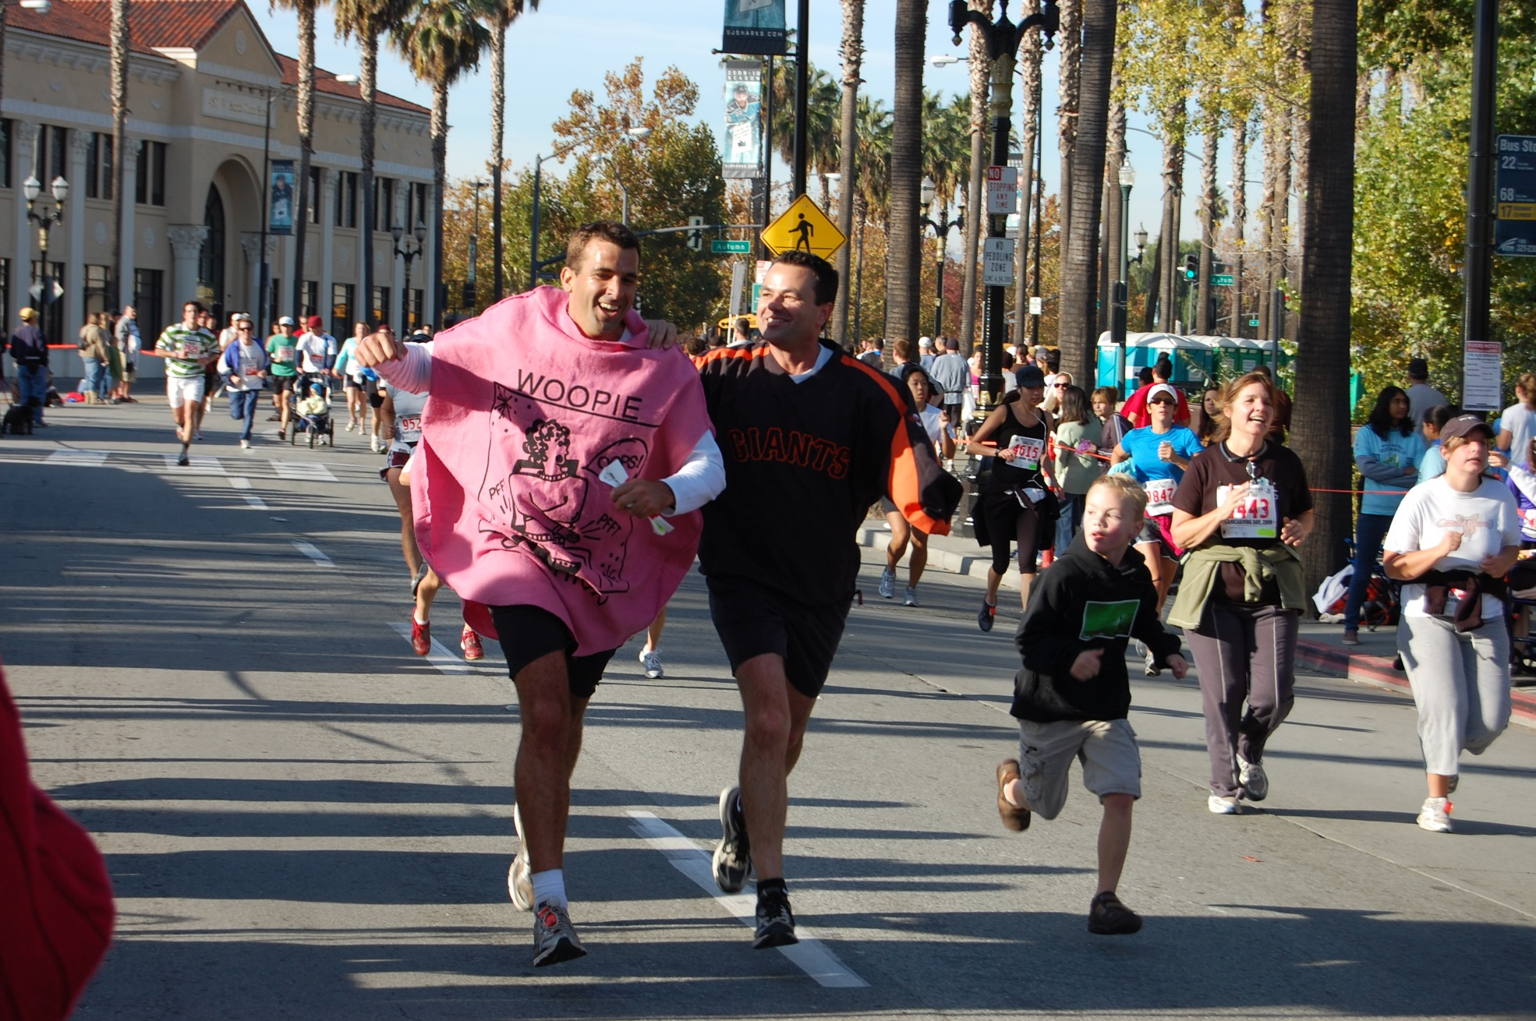

Slide 10
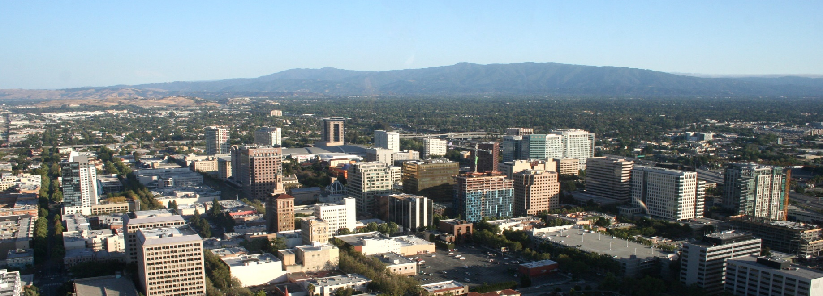
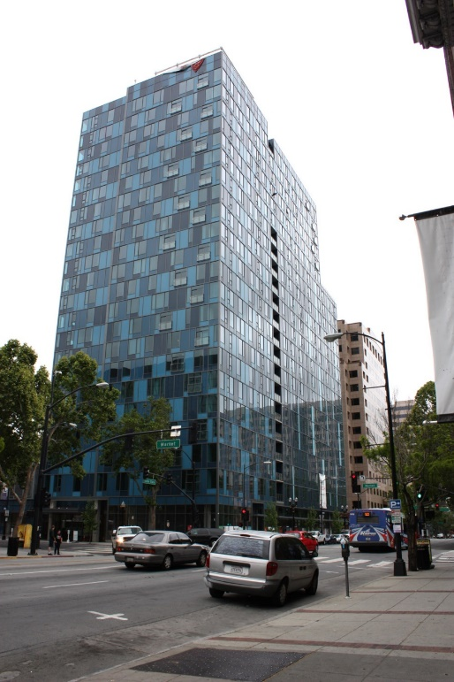
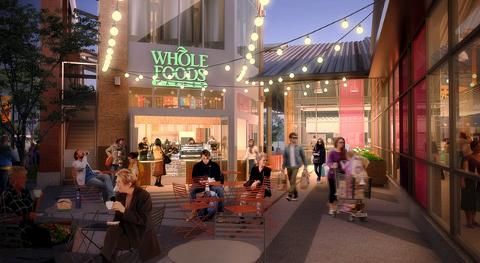
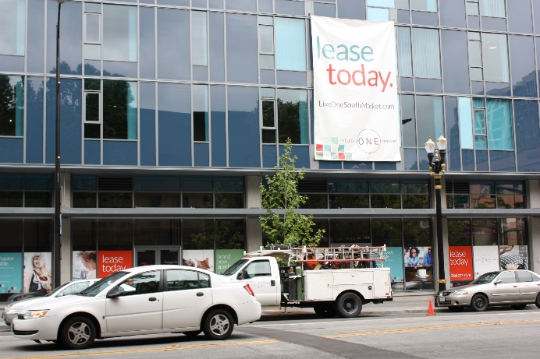
Downtown Rising

Slide 11
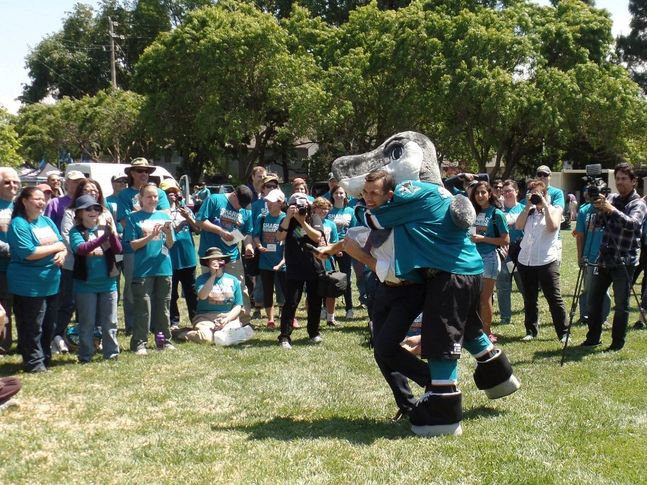
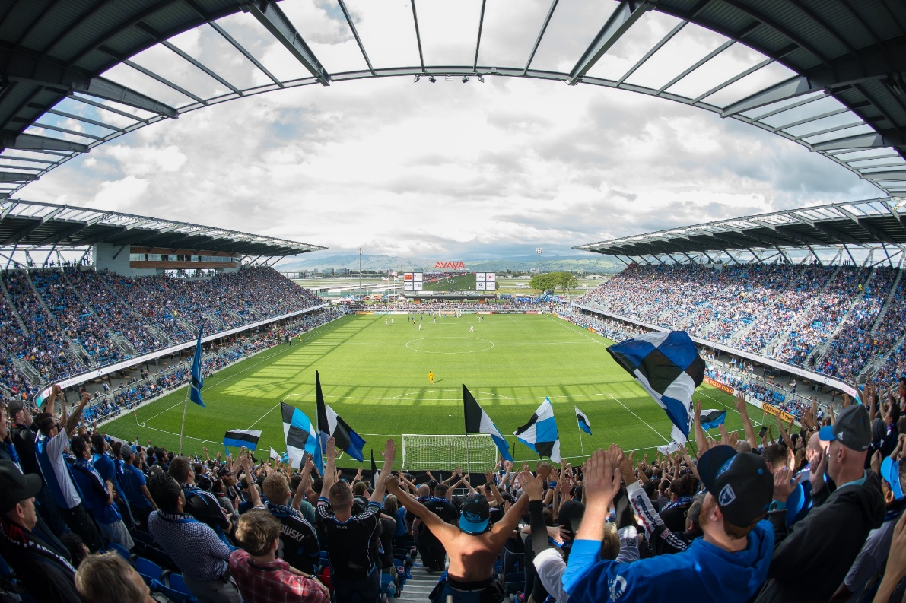
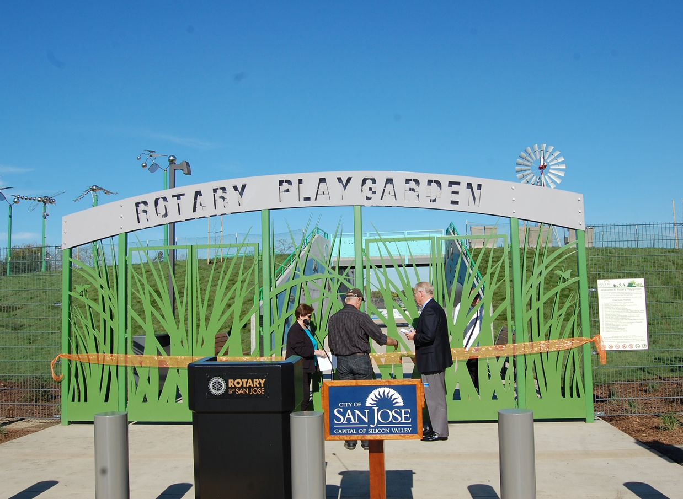
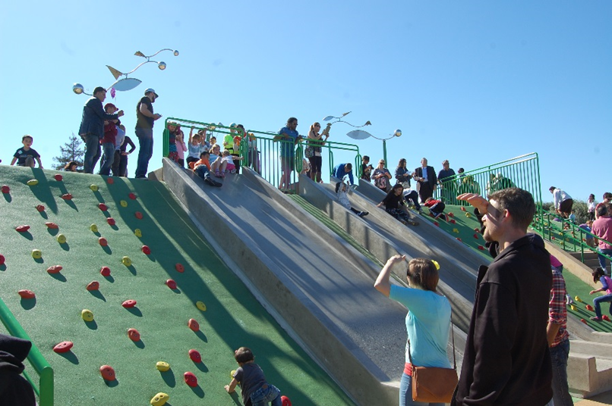
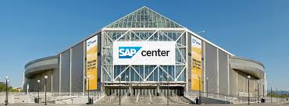
Emerging Wealth of Amenities

Slide 12
Near-Term Opportunities & Strategies
Getting Out of the Way (permitting & planning)
Immigrant-led businesses
Manufacturing
Strategic Partnerships, e.g.,
  San Jose State University
  Chamber “REDI” Initiative

Slide 13
The Long View :
Threats to Our Economic Vitality

Slide 14
Threat Assessement
      OUR WATER
      OUR LAND
      OUR TRAFFIC & INFRASTRUCTURE
      HOUSING COSTS
      WAR FOR TALENT

Slide 15
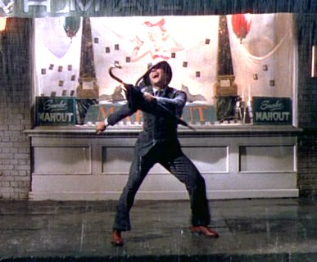
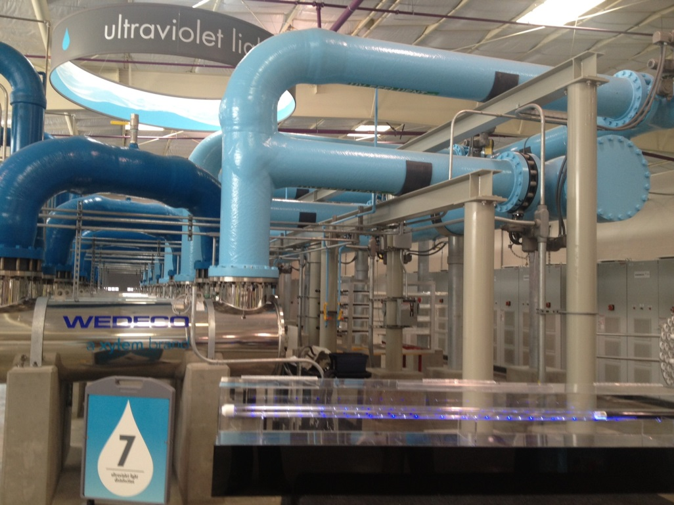
1. Our Water

Slide 16
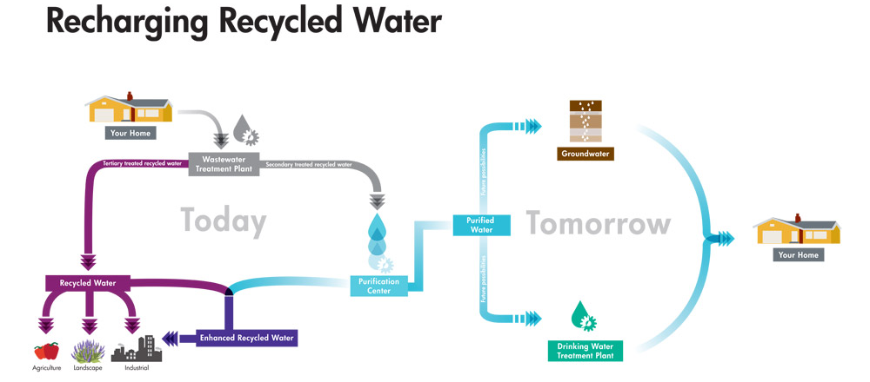

Slide 17
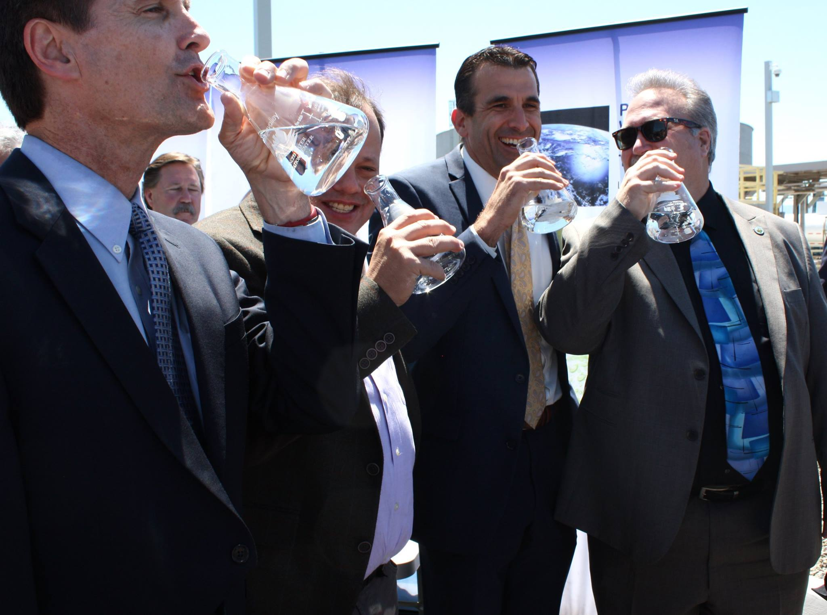

Slide 18
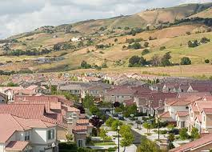
2. Our Land

Slide 19
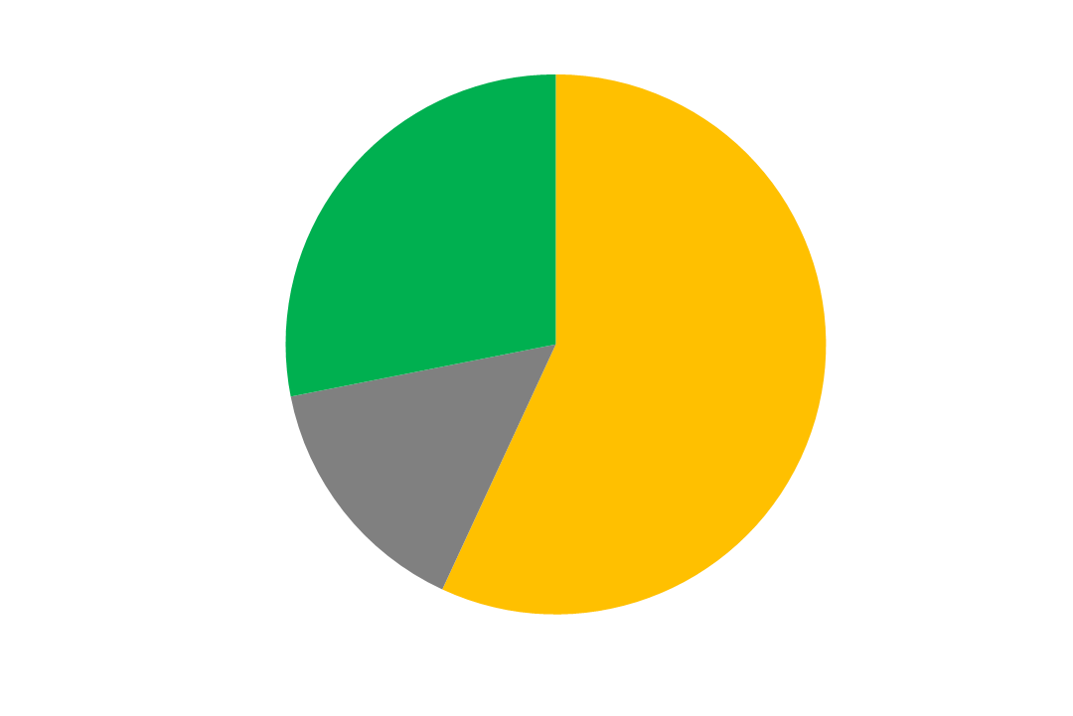
Of Existing San José Lands,
Only 15% is for Employment Uses
San Jose
Public/Other
Lands
28%
Residential
Lands
57%
Employment
Lands
15%

Slide 20

Employment Lands Provide Tax Base
For Funding Resident Services
San Jose
Residential
Lands
57%
Employment
Lands
15%
Employment Lands
Tax Revenue
- Service Costs
NET BUDGET IMPACT
+ $124,000,000 est.
Residential Lands
Tax Revenue
- Service Costs
NET BUDGET IMPACT
- $110,000,000 est.
Approximate Annual Dollar Impact Source: Applied Development Services, May 2015

Slide 21
Tax Base Lost
From Land Conversions Since 1980
San Jose
2,300 acres lost
1980 to 2007
Public/Other
Lands
28%
Residential
Lands
57%
Employment
Lands
15%
15,912 to 13,614 acres =
16% reduction of employment lands
Source: Applied Development Economics, April 2015

Slide 22
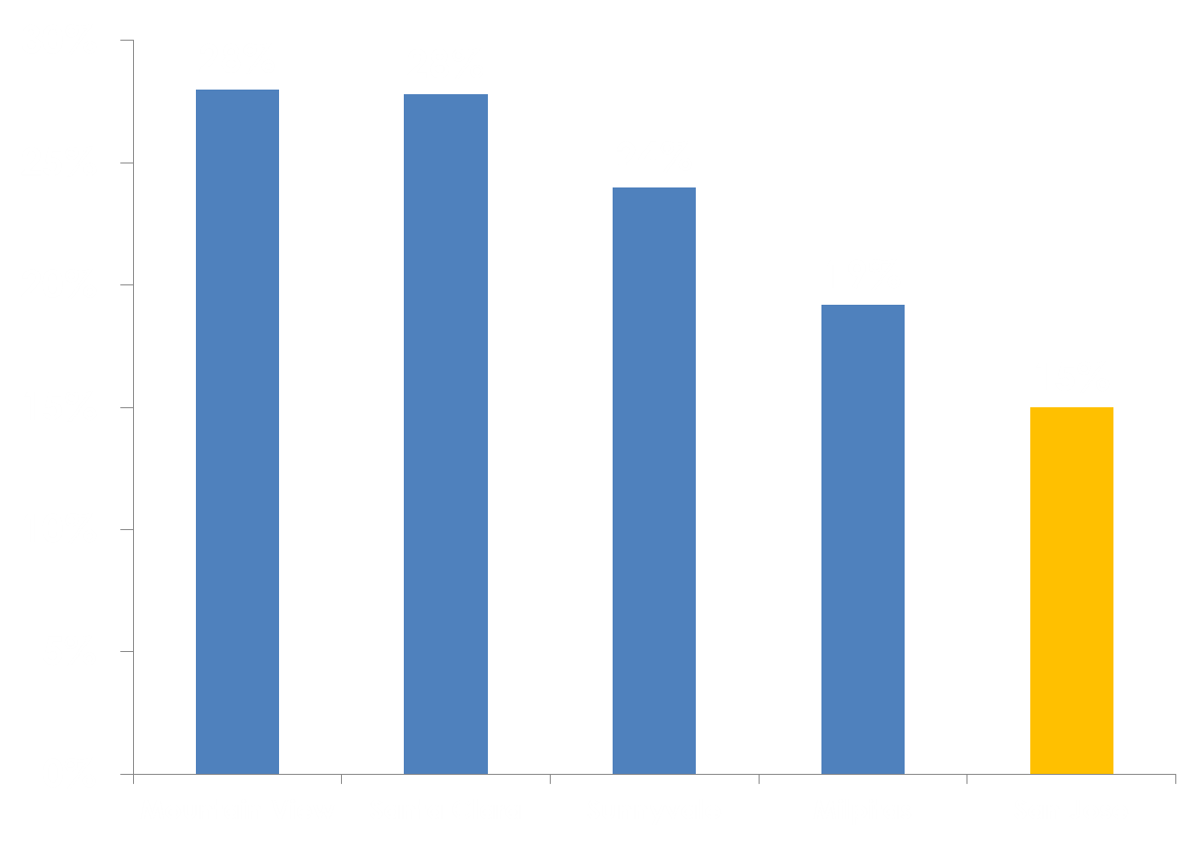
Other Cities Use 20-30% of
Lands for Employment

Slide 23
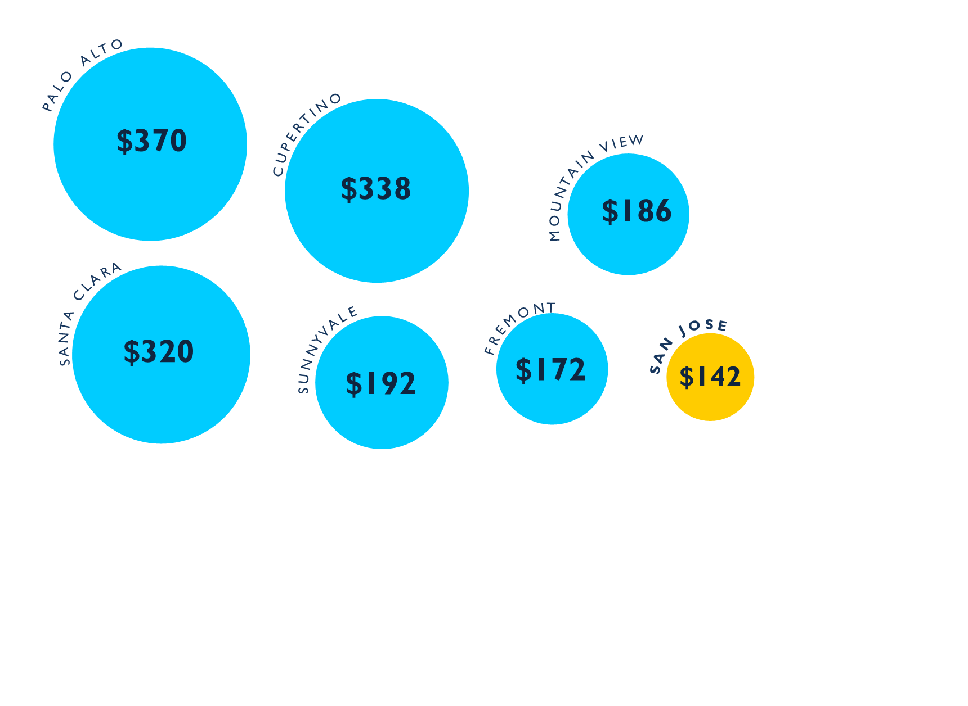
Low Sales Tax Per Capita
Notes:
=========Add notes about what will it take – 20 Santa Rows etc

Slide 24
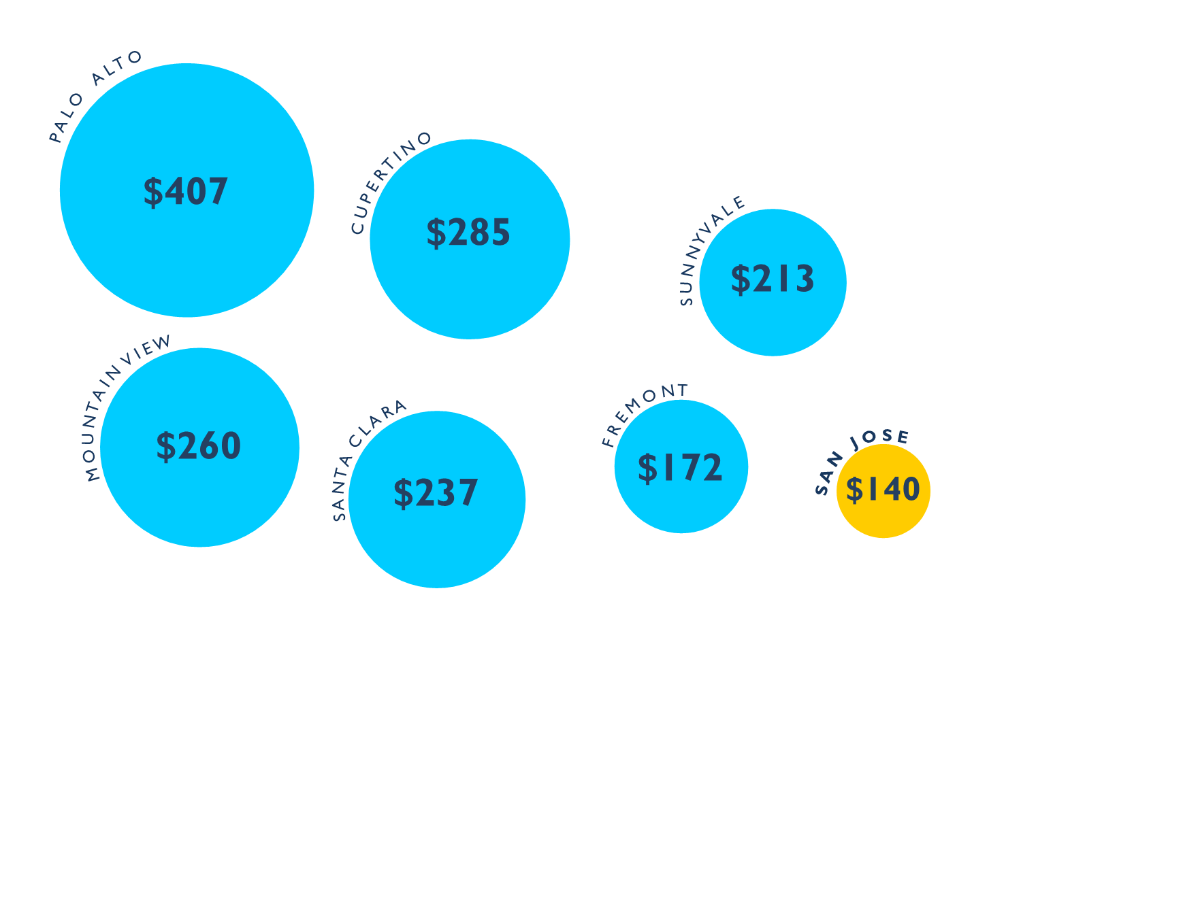
Low Property Tax Per Capita

Slide 25
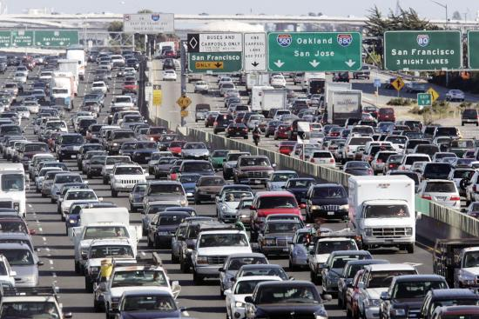
3. Our Transportation

Slide 26
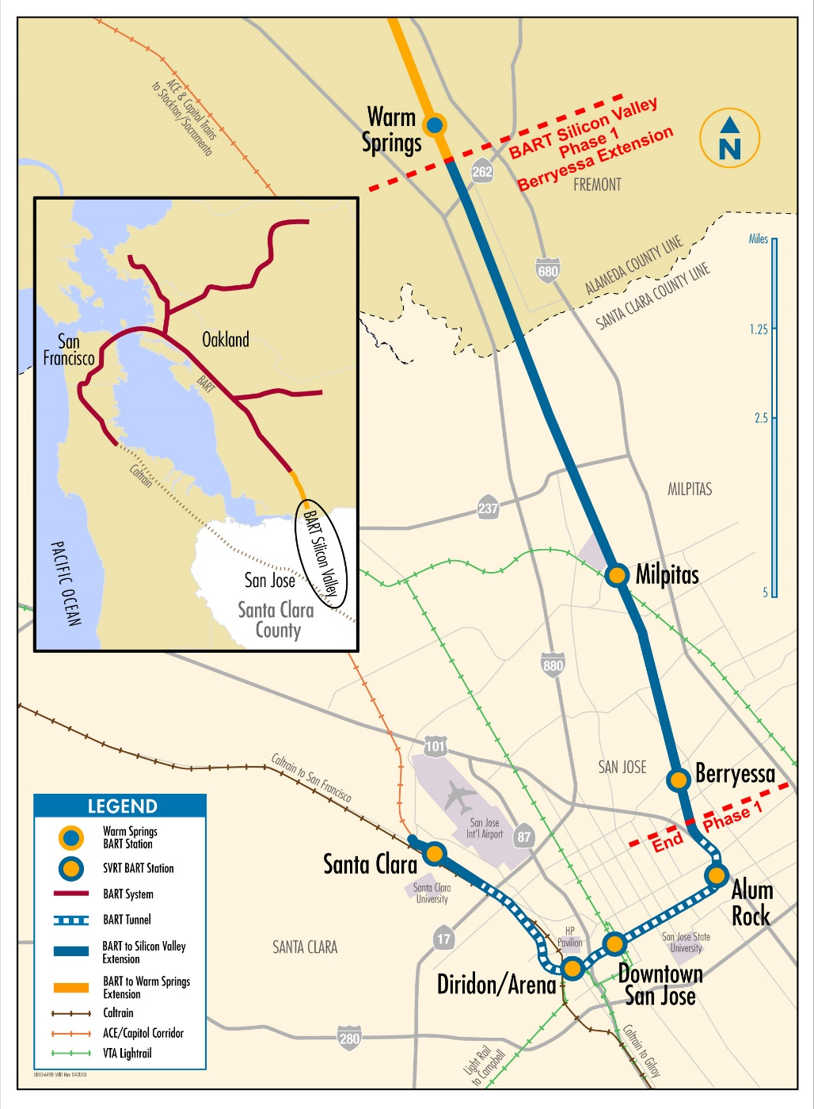
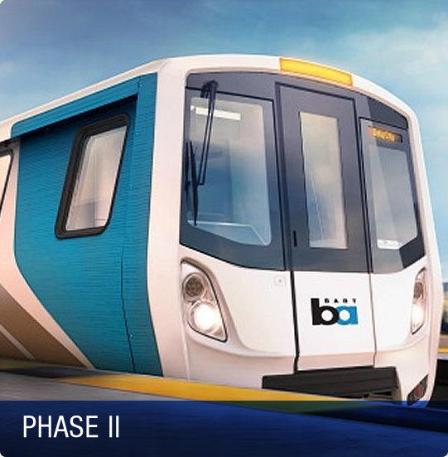
BART to San Jose

Slide 27
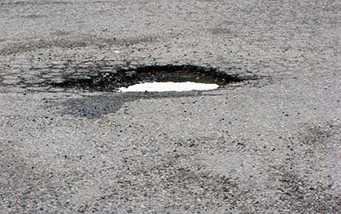
Pothole

Slide 28
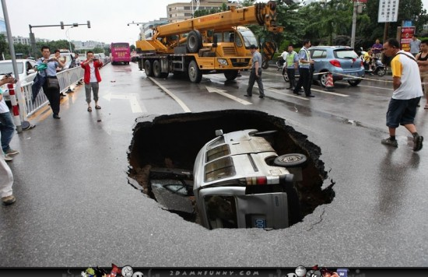
Large Pothole

Slide 29
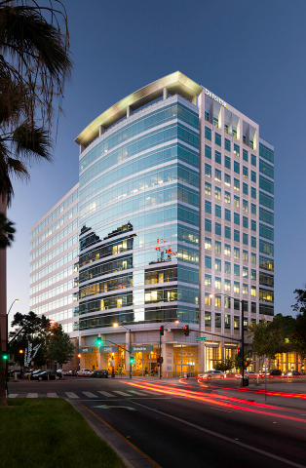
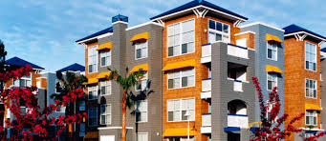
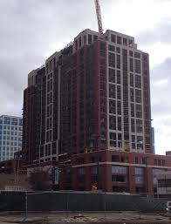
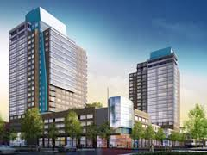
4. Housing: “Smaller and Taller”

Slide 30

5. The War for Talent

Slide 31
Talent: Growing Our Own
SJSU: Growing the Pipeline
San Jose Learns
“1000 Hearts for 1000 Minds”
East Side Internet Access Initiative
San Jose Works
Libraries: Access and Career Training

Slide 32
www.WeAreSanJose.org
San Jose Works: Hire a Teen this Summer
1000 Hearts for 1000 Minds: Tutor a child
Many other ways to engage: wearesanjose.org

