Slide 1

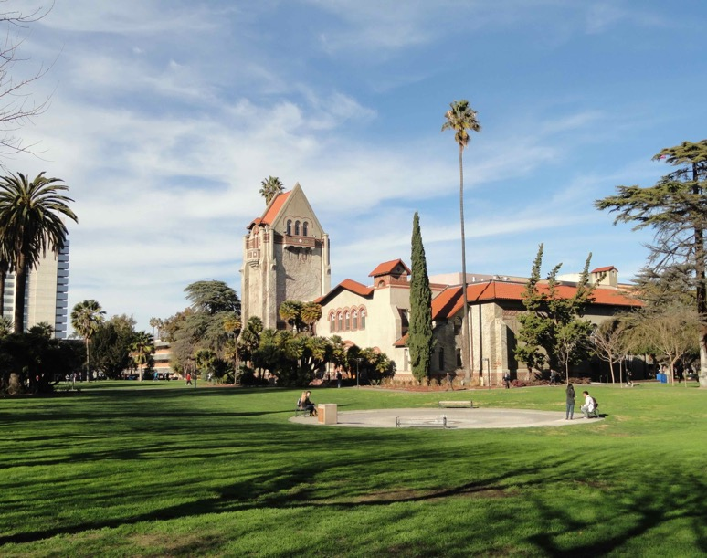
Dept. of Computer Science
Admitted Spartan Day
Melody Moh, Interim Chair
Ben Reed, Assist. Professor
Rula Khayrallah, UG Coordinator
Teng Moh, Assoc. Chair

Slide 2

Agenda
Introduction of Panelists
Brief Introduction of the Dept. of Computer Science
FAQ
Open Q&A
Conclusion

Slide 3

Panelists
Prof. Ben Reed came to our department to fulfill his dream of being a professor after a couple of decades in industry.
He got his PhD from UC, Santa Cruz. He is a "sophomore" faculty member, so he understands what a new experience SJSU is.
Prof. Reed’s son is considering SJSU as one of his college options, so he is also attending as a parent of an admitted spartan.
He has a bunch of office hours on his faculty website that you can zoom in to to ask any questions you weren't able to get answered here.
He's also always looking for students for the programming team!

Slide 4

Panelists
Prof. Rula Khayrallah is our UG Coordinator.
She is probably the most important, most helpful person for you throughout your UG grad. study.
She is also one of the most popular instructors in the Dept. She teaches courses in AI, Python Programming, Prog. Languages.
Providing live
Prof. Teng Moh has been the Assoc. Chair for over 7 years, so he is very familiar with the SJSU and Dept policies. Teach mainly grad courses.

Slide 5

Student Panelists
Alora Clem is a graduating senior here at SJSU, receiving her degree in Computer Science.
During her time here she has fallen in love with Computer Science, specifically user interface work and information security.
Through the support of the Society of Women Engineers chapter here at SJSU, Alora has had many leadership and networking opportunities, including working as an intern at Apple last summer on the Apple Pay and Wallet team.
She has happily accepted a return offer from the Apple Pay and Wallet team for after her graduation.

Slide 6

Student Panelists
Brett Dispoto is a community college transfer student (Foothill College)
He is a senior with one semester left
He will be working a (remote) software engineering internship this Summer at HP
He has been heavily involved in CS Department UG research.

Slide 7

Student Panelists
Lovejit Kharod has been a student at SJSU for three years now, and started as a freshman in Fall 2017.
Lovejit spent last summer at an internship with Western Digital, and currently work for a local startup until he will start as a full time developer at Amazon in July.
For future career, Lovejit plans to focus on backend and full stack development for now, and hopefully continue to find some exposure to machine learning topics as they become more relevant and accessible.
Being a commuter student, Lovejit hasn't had the opportunity to take part in many campus events, although he said “it did give me a different perspective on planning out my classes that in a way forced me to work around some interesting schedules.”

Slide 8
Agenda
Introduction of Panelists
Brief Introduction of the Dept. of Computer Science
FAQ
Open Q&A
Conclusion

Slide 9
Brief Intro to CS Dept
Let’s go to the Dept website!
  UG Program
  Advising
  Roadmap to complete the program in 4 years
  FAQ

Slide 10
Agenda
Introduction of Panelists
Brief Introduction of the Dept. of Computer Science
FAQ
Open Q&A
Conclusion

Slide 11
FAQ
Is it possible to graduate in 4 years? (Alora)
Getting into the classes I need? (Lovejit)
Class size (Ben)
UG research (Brett)
Internship (Alora and Lovejit)
Open FAQ

