Slide 1
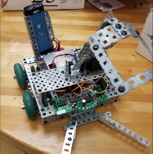
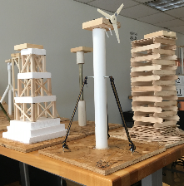
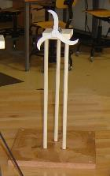
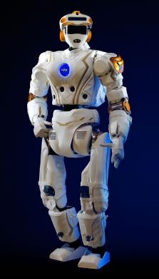
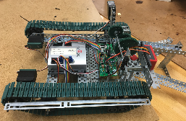
Welcome to ENGR10
Meet our faculty & TAs
Visit our web site
engineering.sjsu.edu/e10

Slide 2
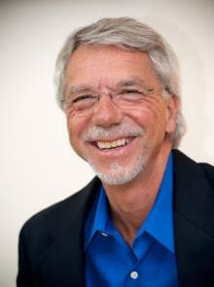
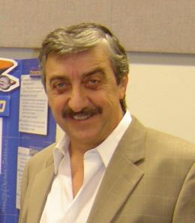
Lecture Faculty
Jack Warecki
Professor of Record
Section 1 lecture at 8:00 am
Ken Youssefi
Professor of Record
Section 2 lecture at 1:30 pm

Slide 3
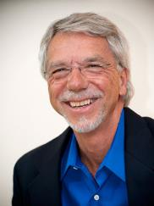
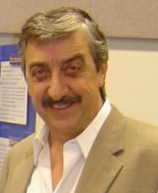

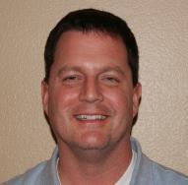
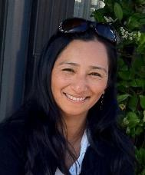
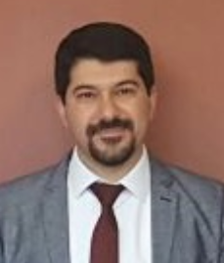
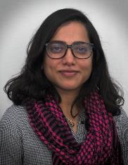
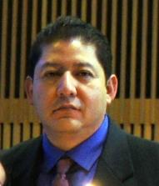
Lab Faculty
Jack Warecki
(Lecture/Lab)
Ken Youssefi
(Lecture/Lab)
Ahmed Banafa (Lab)
Steven Sepka (Lab)
Smita Duorah
(Lab)
Spoorthy Ananthaiah
(Lab)
Farshid Marbouti
(Lab)
Javier Valencia (Lab)

Slide 4
Graders and Lab Assistants
HW Graders
Lab Assistants
Gurpreetsingh Baweja
Denise Gip
Hanna Vu
Leon Gallardo
Ryan Nguyen
Mohibkhan Pathan
Pal Nicola
Reshma Nawaz
Aditya Bhole

Slide 5
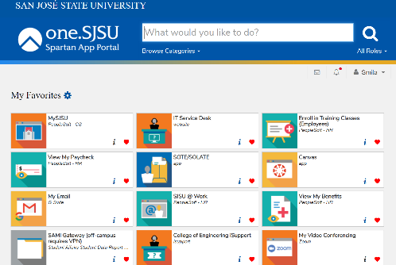
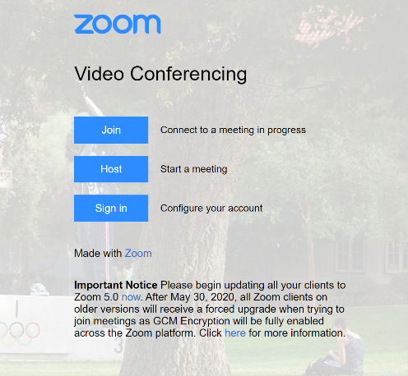
Log into Zoom via your SJSU account
Step 1. Go to one.sjsu.edu
Step 2. Click on “My Video Conferencing Zoom” tab
Step 3. Click on Sign in and login using your SJSU credentials if prompted
Step 4. Click on “Join a Meeting”
and use meeting ID and passcode from Canvas
Notes:
Welcome to orientation. We are so happy to have you all join us in your next steps. Before we start, I just wanted to make sure that you are all logged into Zoom via your sjsu ID. If you are not sure how you can do that, just follow the steps

Slide 6
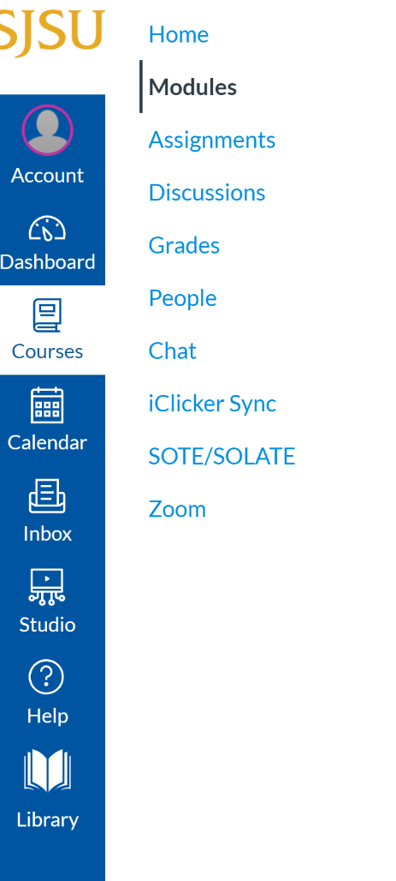
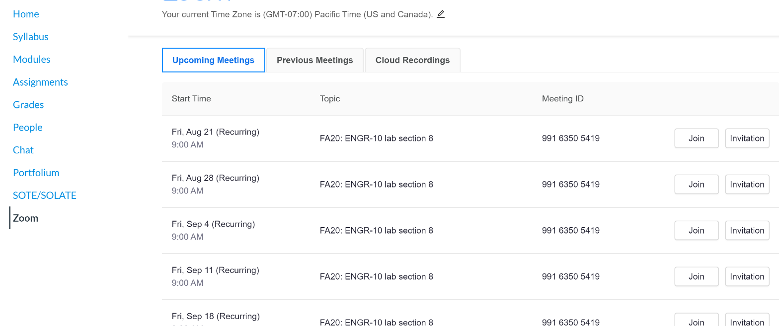
Accessing Zoom through Canvas
For E10 labs
You can access Zoom through Canvas
No need to know the Zoom ID, just Join after logging to Canvas

Slide 7
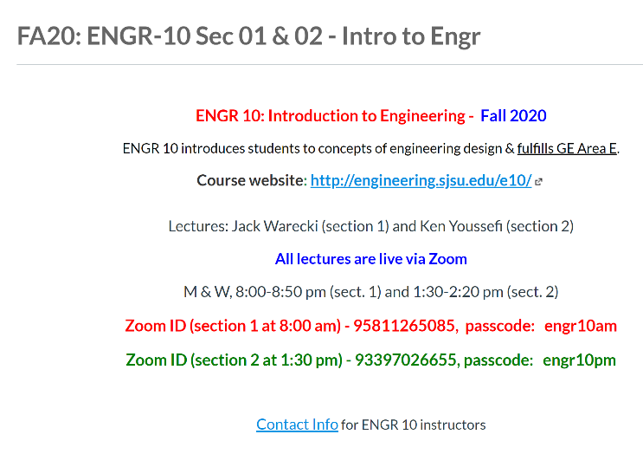
Lectures and Labs
What is the format?
Lecture:
All lectures will be online live via Zoom
Access Zoom via one.SJSU.edu – not through Canvas
Lecture meetings will be recorded and posted on Canvas
The Zoom meeting IDs and passcodes will be posted on Canvas for both lecture sections; it is the same ID for the entire semester. You must join the Zoom lecture meeting assigned to the section you are enrolled in.

Slide 8
Zoom meeting Protocol
Enter the Zoom meeting on time
Mute your microphone
Make sure your name or your picture (live or stationary) appears in the Zoom window when you join the meetings.
Chat room will be open for the duration of the lecture
The last 10-12 min. of each lecture will be devoted to answer some of the questions submitted through Chat on Zoom as time permits. Contact your lecture faculty if you have any questions.

Slide 9
Lectures and Labs
What is the format?
Lab:
All labs are in hybrid mode
There are 14 weeks of lab: 6 weeks will be 100% live online and 8 weeks will require one member of each group to attend the lab in-person.
Students will be divided into 4 groups of 5-6 members in each lab section.
One member of each group volunteers to attend the lab in person and perform the lab activity, the other group members watch and participate via live Zoom.
This week (first week of semester), there will be an ice breaker lab Zoom meeting to meet your lab instructor and other students in your lab section.

Slide 10
Safety Measures for Labs
Every person attending in-person lab must wear a mask.
Social distancing of 10 ft. will be observed within the lab at all times.
All will be asked screening questions and have their temperature taken before entering the lab.
All surfaces, equipment and furnishings are sanitized after each lab session.
Hand sanitizer will be available in the labs.

Slide 11
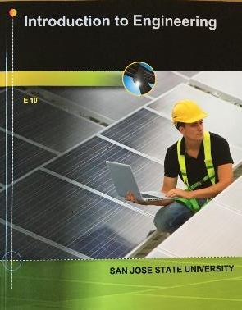
E10- Textbook (hard copy or eBook)
eBook
http://create.mheducation.com/shop
Custom textbook, soft cover
ISBN# 978-1-307-00917-0

Slide 12
San Jose State University
College of Engineering Departments
Mechanical Engineering (ME)
Electrical Engineering (EE)
Computer Engineering (CMPE)
Civil & Environmental Engineering (CEE)
Aviation and Technology (AVTech)
Chemical & Material Engineering (CME)
Biomedical Engineering (BME)
Industrial & Systems Engineering (ISE)
General Engineering
Aerospace Engineering (AE)
Software Engineering (SE)

Slide 13
Course Goals - Engineering
At the end of this course students will be able to:
Understand the steps of the engineering design process
Apply basic physics concepts to the design and analysis of built systems
Apply teamwork skills and resolve team conflict
Write a simple engineering report and present the report orally
Use tools such as spreadsheets, C++ programming, and CAD software to support engineering design and analysis
Use ethical reasoning to address and evaluate ethical dilemmas
Explain principles of sustainability and how they affect engineering design
Recognize the value of participation in professional activities

Slide 14
Course Goals – GE Area E
At the end of this course students will be able to identify the:
Physiological
Social/Cultural and
Psychological
factors and their interrelation on human development and recognize how:
Those factors and their interrelation influence a student’s well-being
A student’s well-being is affected by the university’s academic and social systems
To use appropriate social skills to enhance learning and develop positive interpersonal relationships

Slide 15
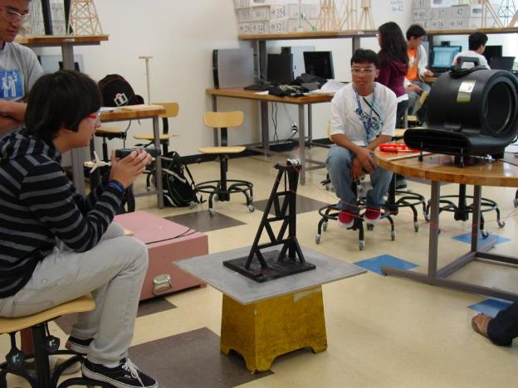
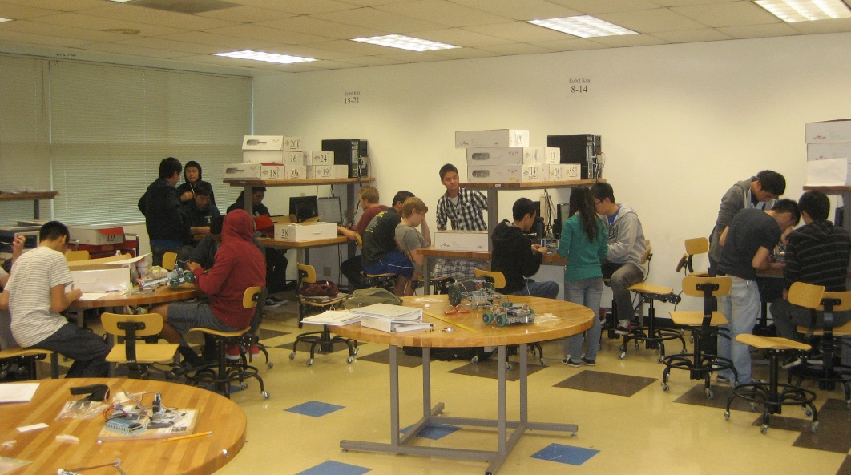
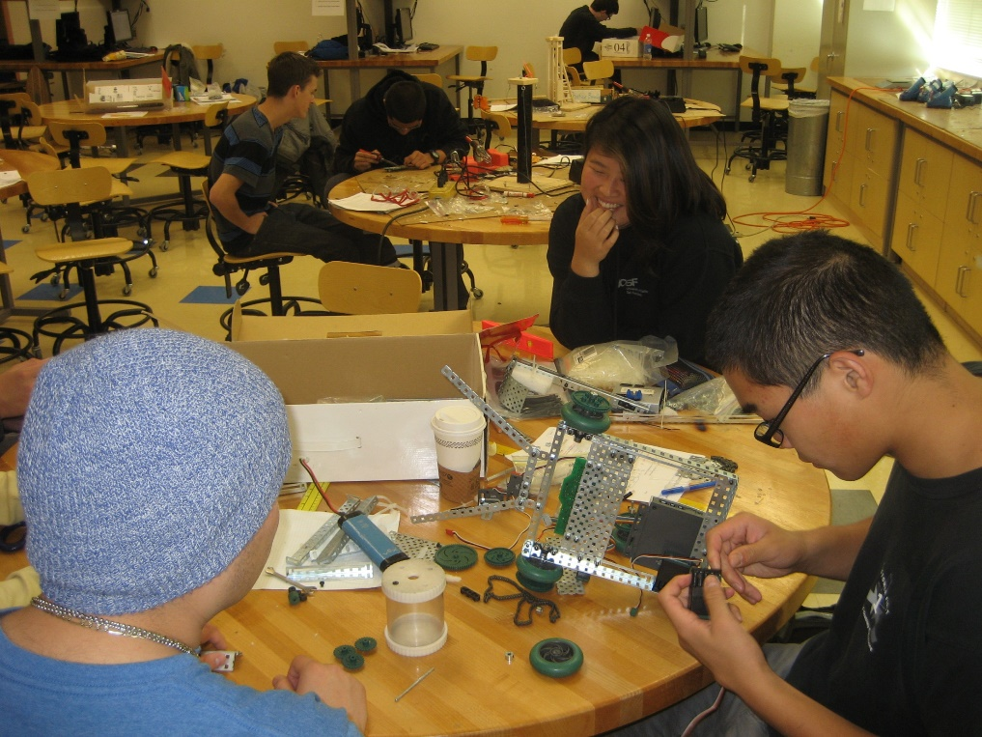
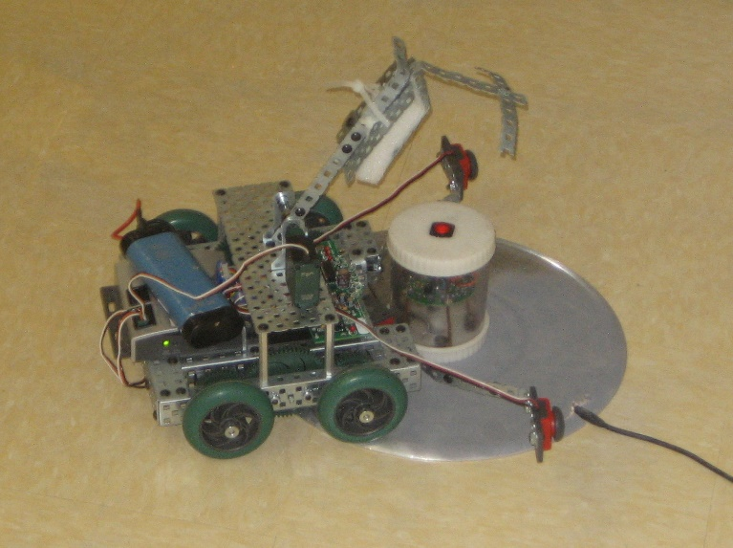
Project-Based Learning

Slide 16
Lab Projects
Excel lab: two weeks
Solar Energy Experiment: One week
CAD lab: one week
Wind Turbine Project: five weeks
Robot Project: six weeks

Slide 17

Let’s Explore the Class Web Site & Canvas

Slide 18
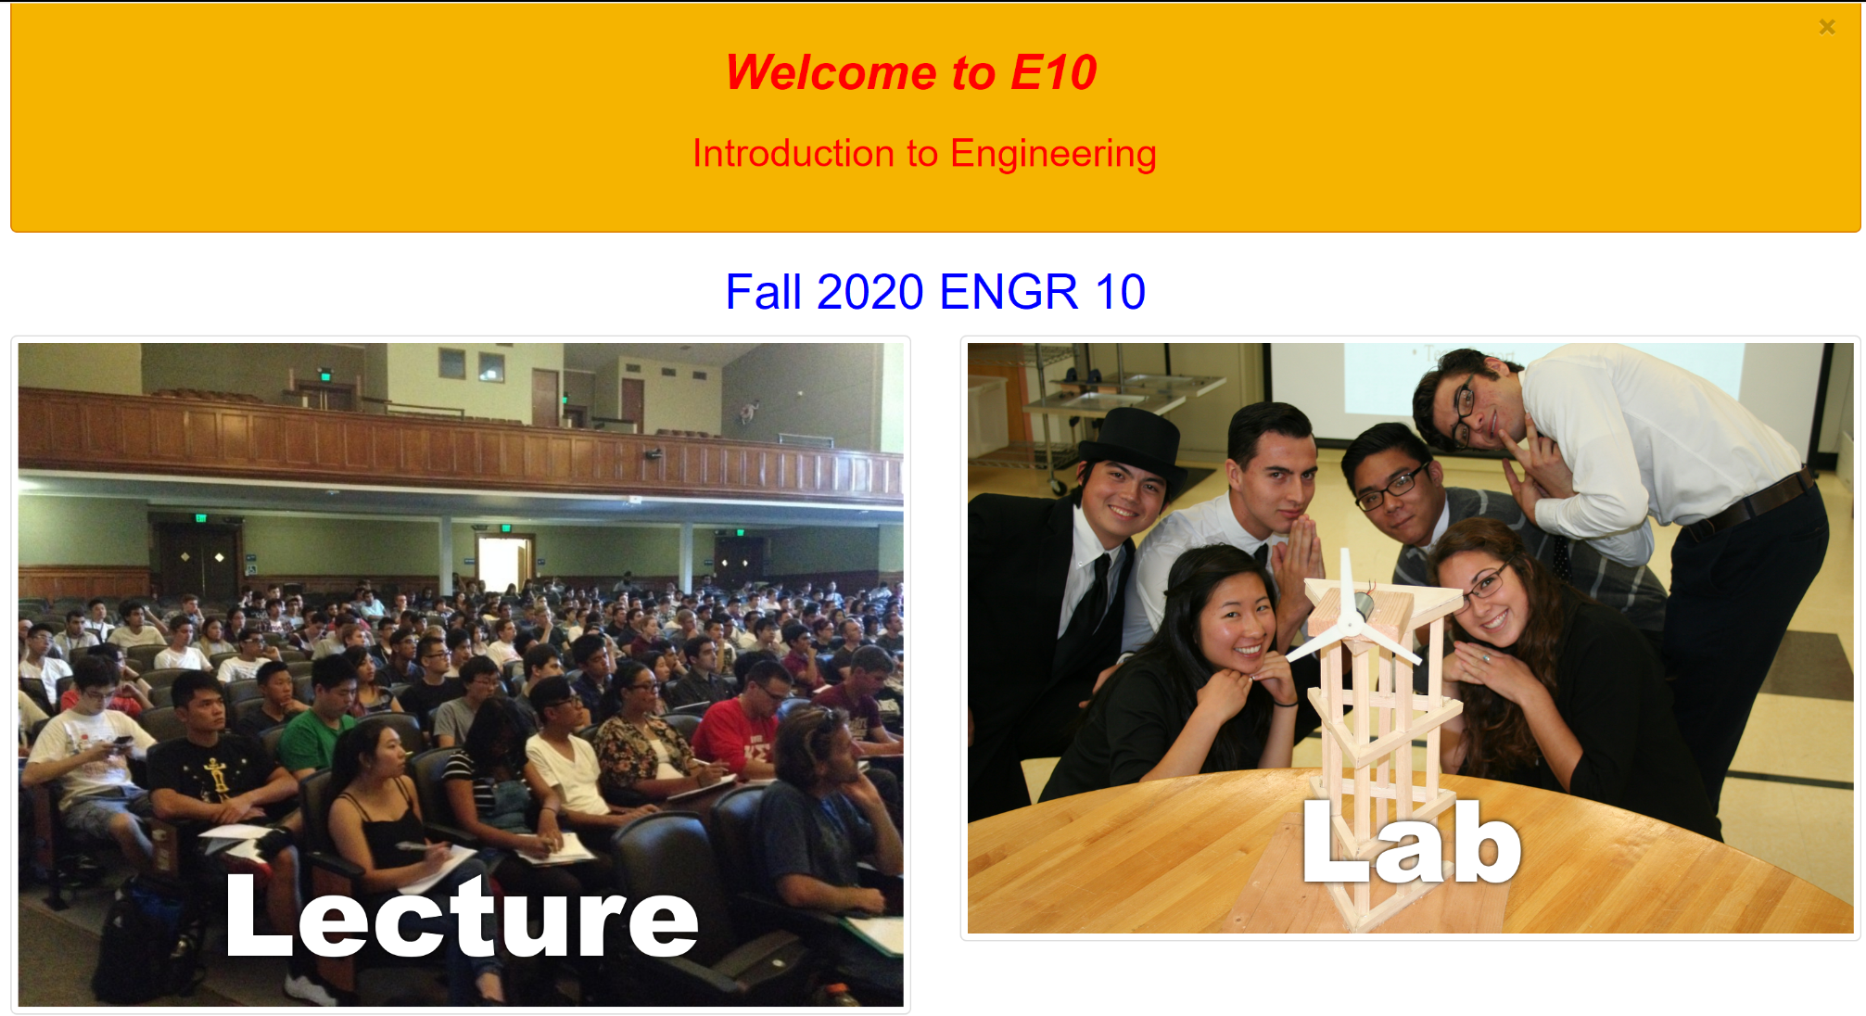
Visit the E10 web page & Canvas frequently engineering.sjsu.edu/E10

Slide 19
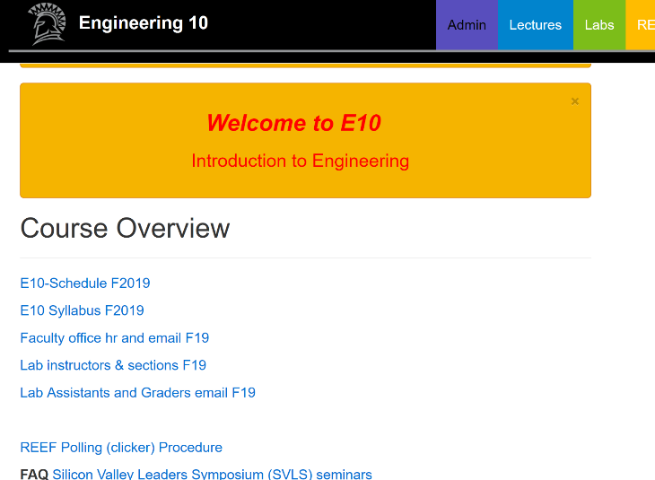
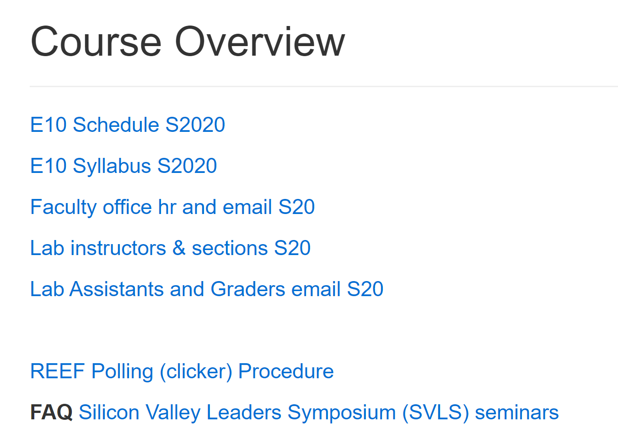
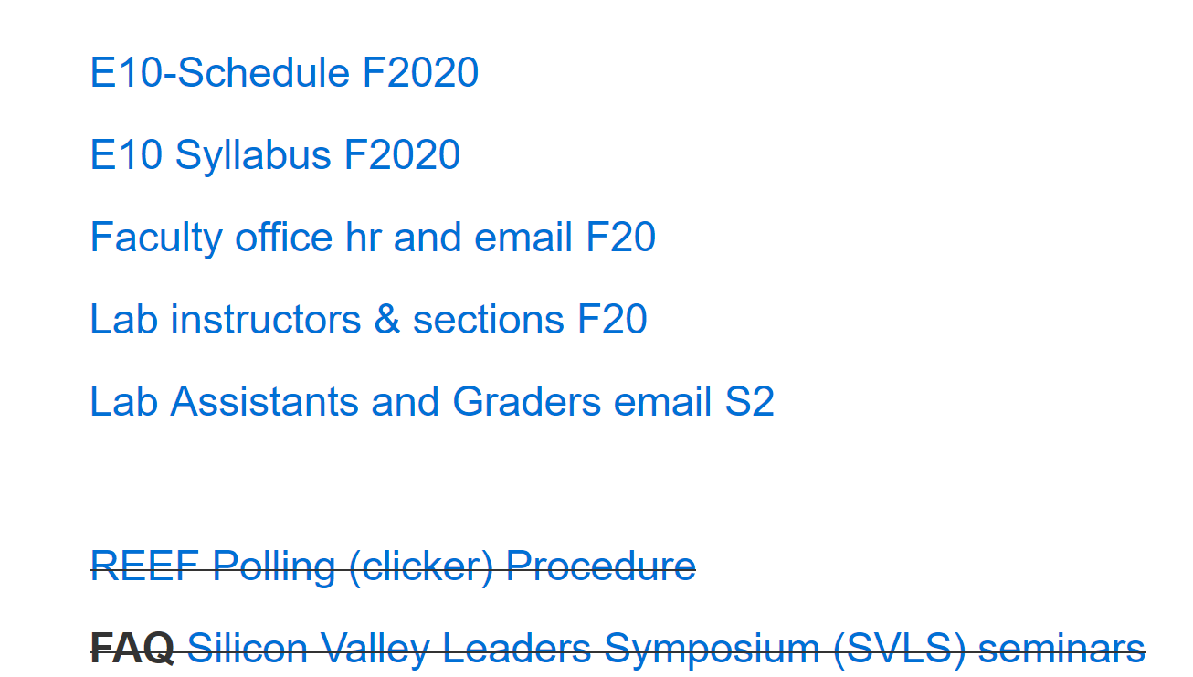
Visit the E10 web page & Canvas frequently engineering.sjsu.edu/E10
Click on Admin

Slide 20
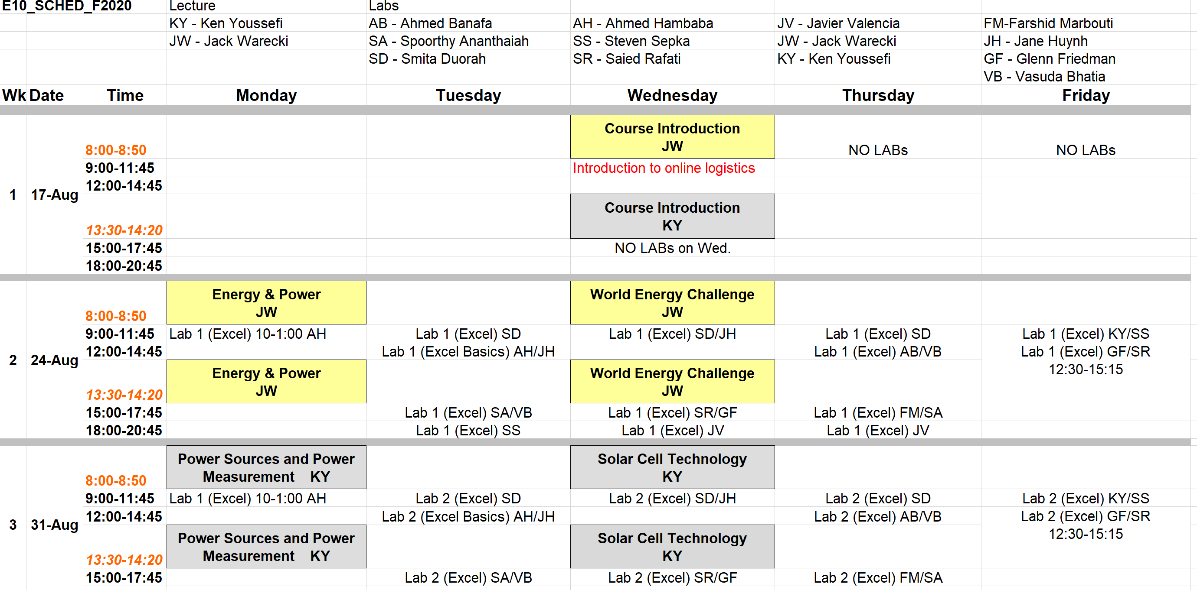
Class Schedule
Lectures
Labs
Note different lecturers (JW – Jack Warecki, KY = Ken Youssefi)

Slide 21
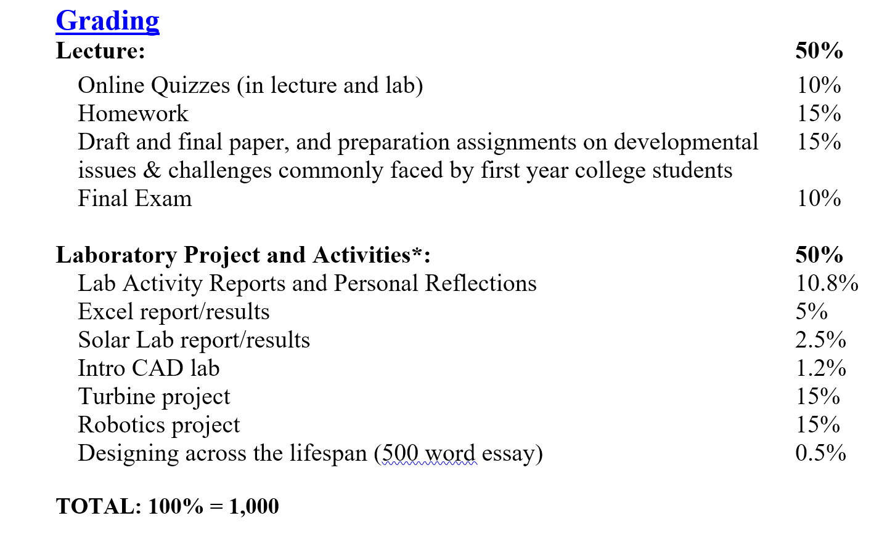
Syllabus
Lecture: 500 pts
Lab: 500 pts

Slide 22
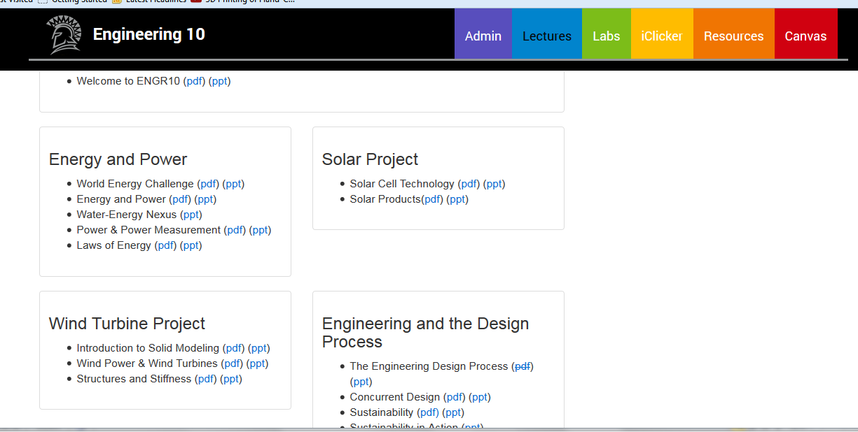
Visit the E10 web page & Canvas frequently engineering.sjsu.edu/E10

Slide 23
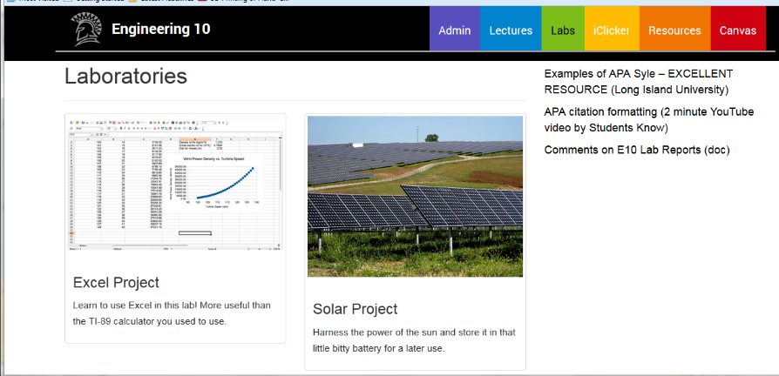
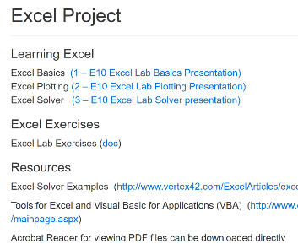
Visit the E10 web page & Canvas frequently engineering.sjsu.edu/E10

Slide 24
For questions or issues Canvas and Zoom
Email eCampus, eCampus@sjsu.edu or visit the office at IRC building (Instructional Resources Center) room 206

Slide 25
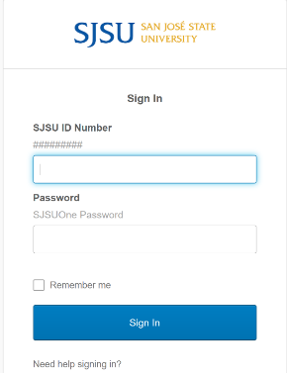
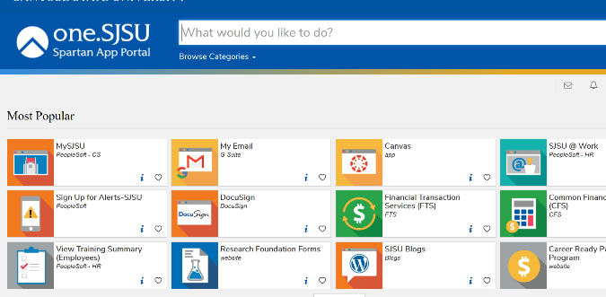
Canvas
Click on Canvas Canvas and sign in
One.sjsu.edu

Slide 26
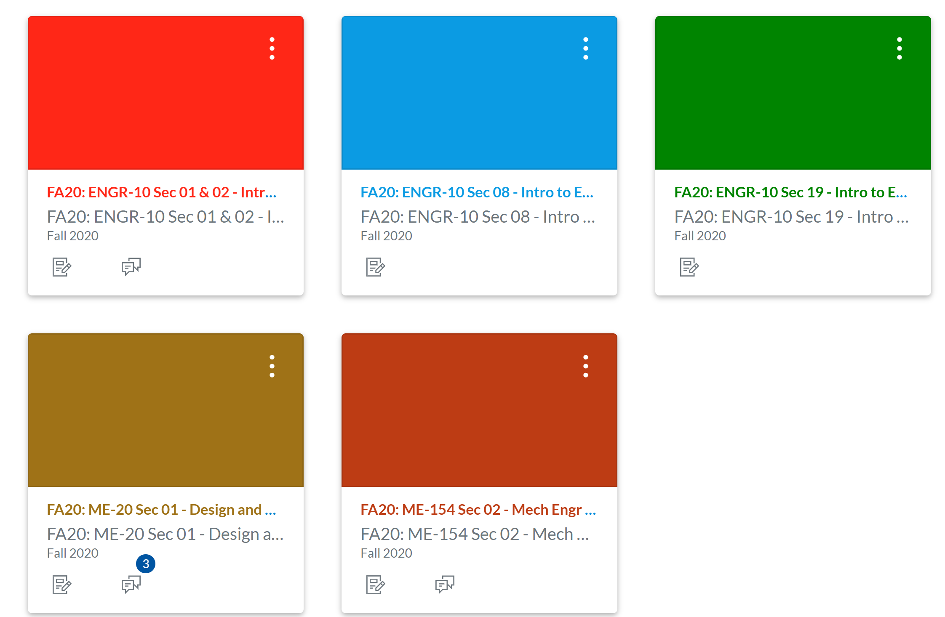
E10 Canvas site
Both lecture sections are in one Canvas shell
Lecture section
Lab section

Slide 27
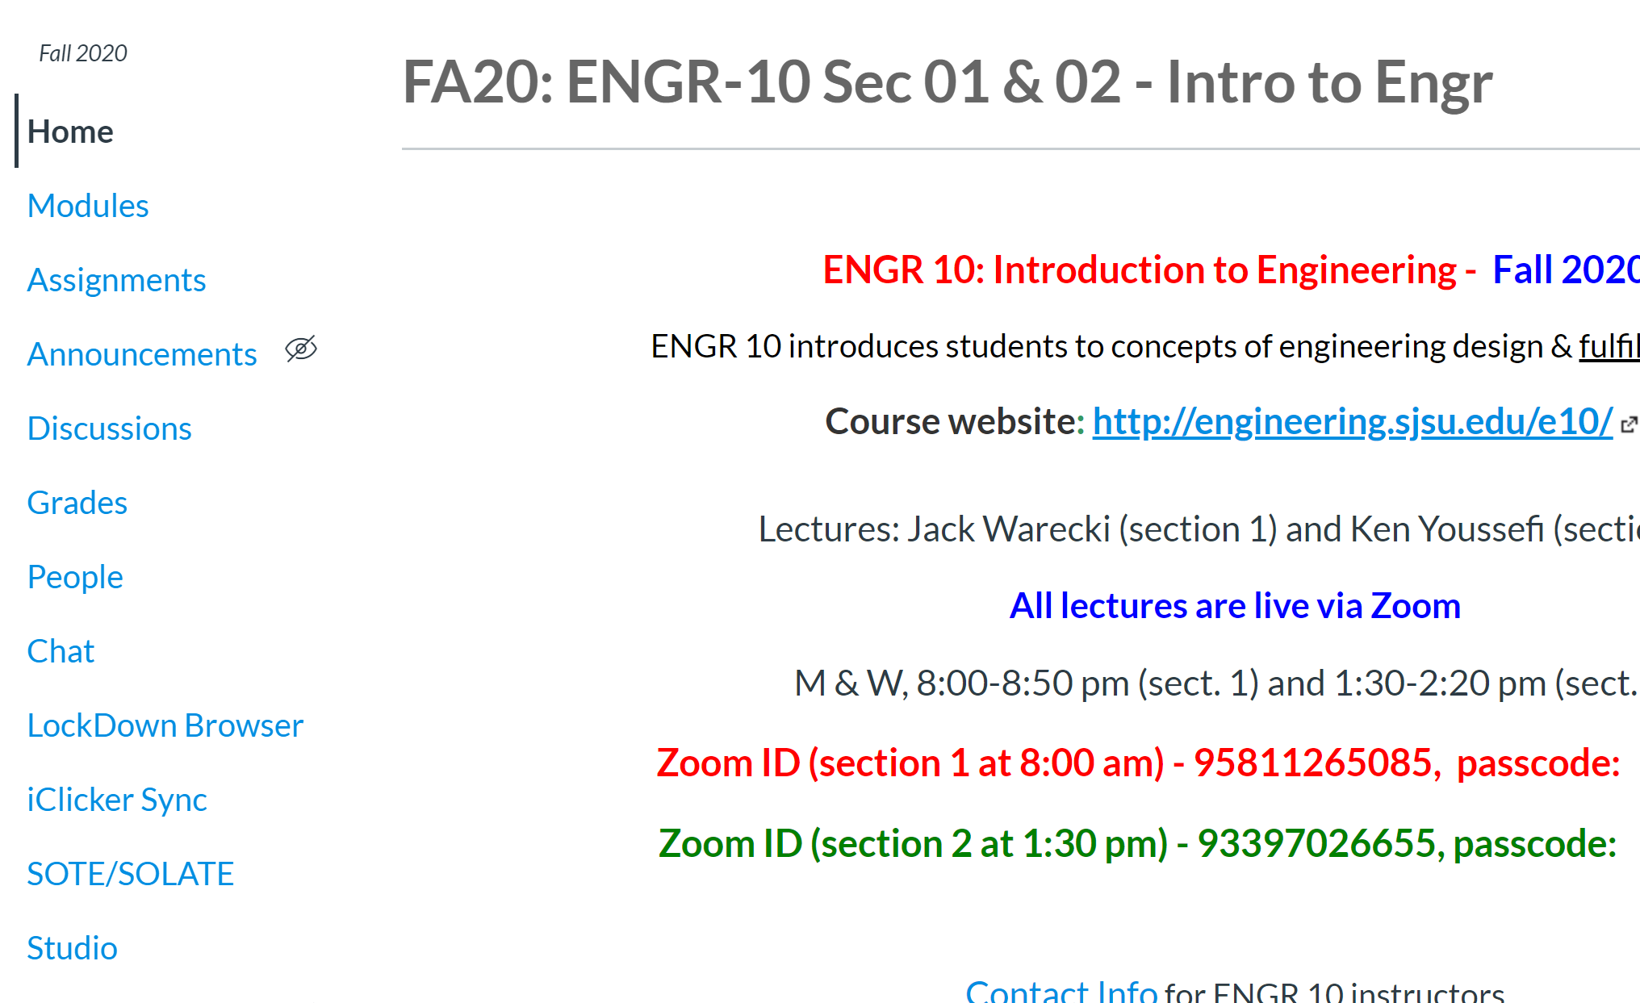
E10 Canvas site

Slide 28
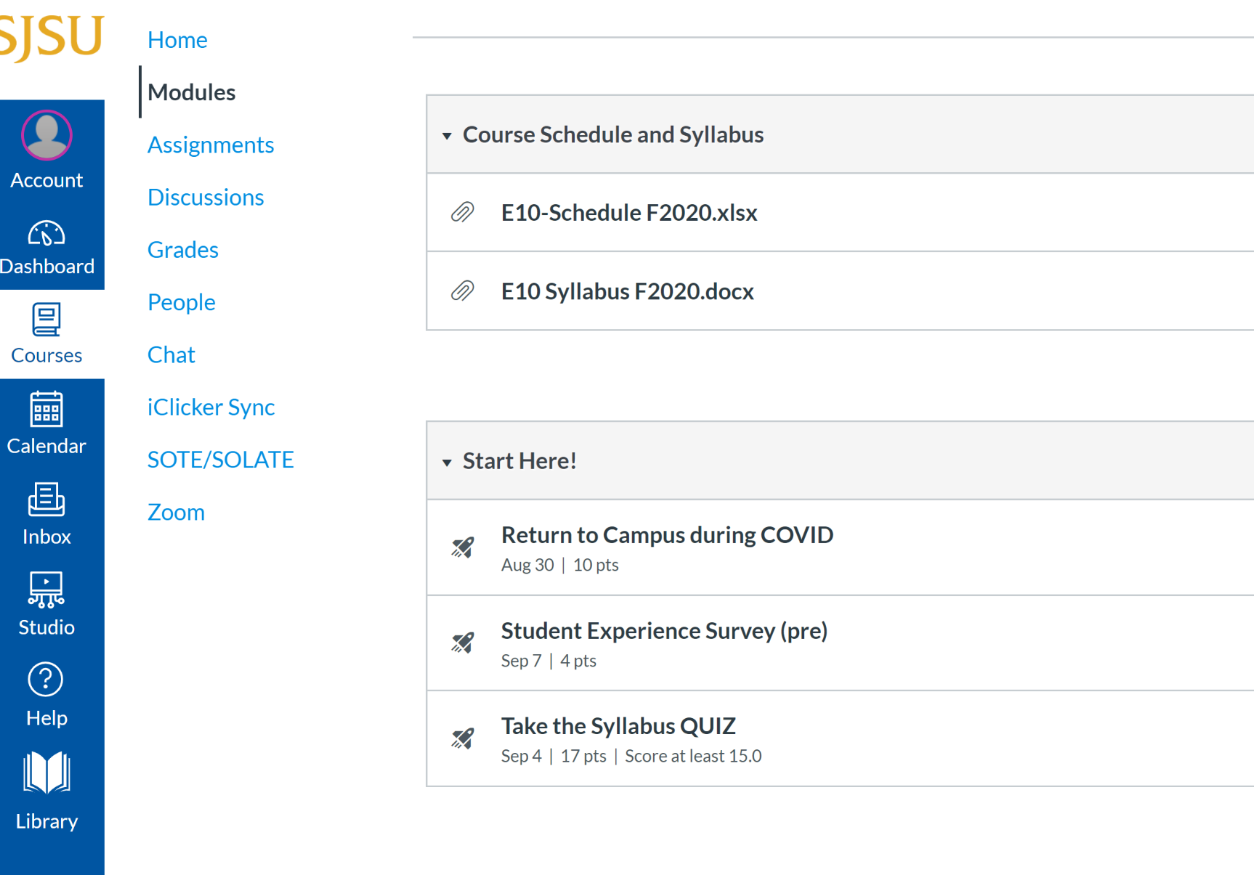
Modules section

Slide 29
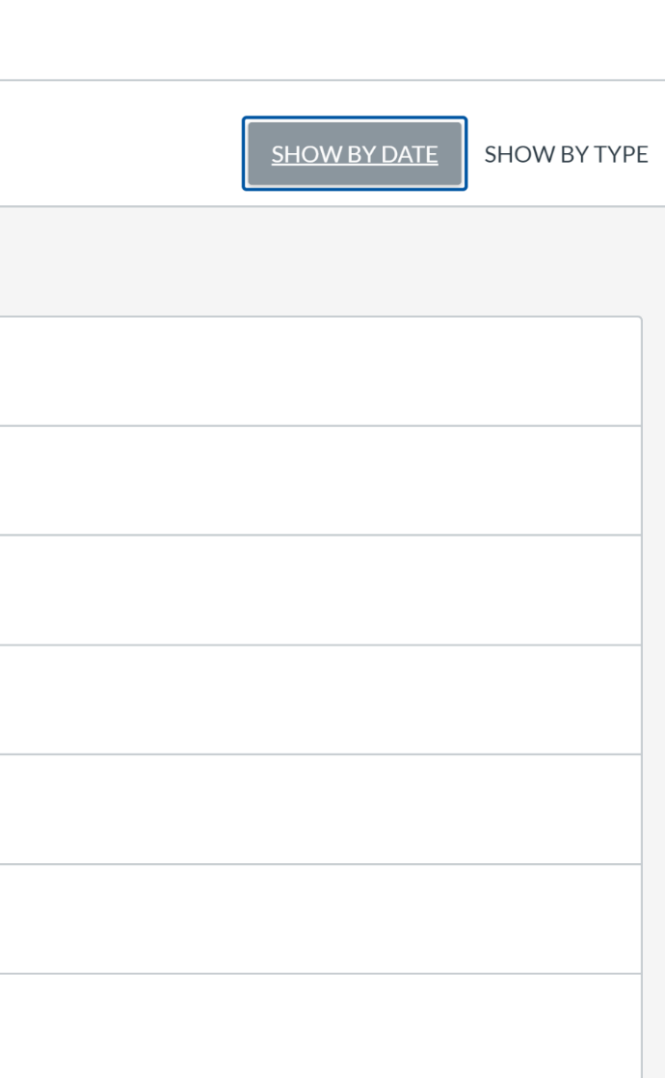
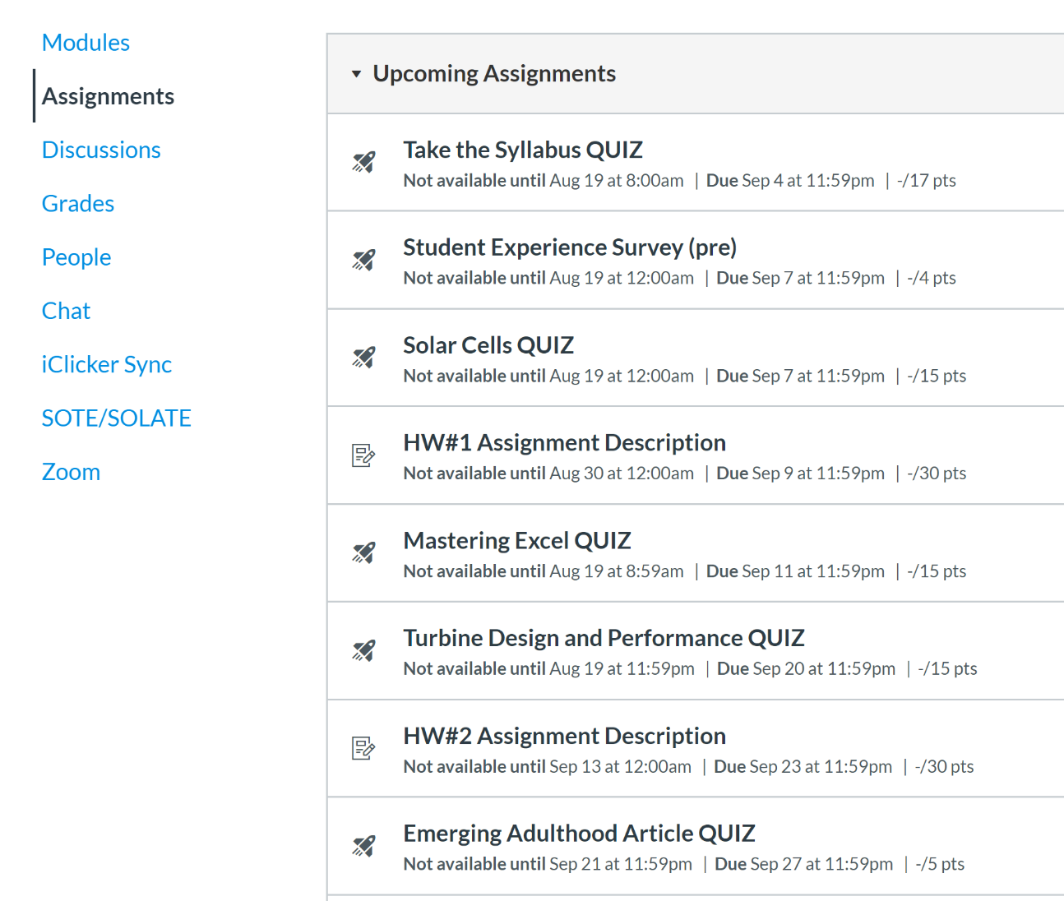
Assignments section
Select Show by Date to see the list of the assignments by due date

Slide 30
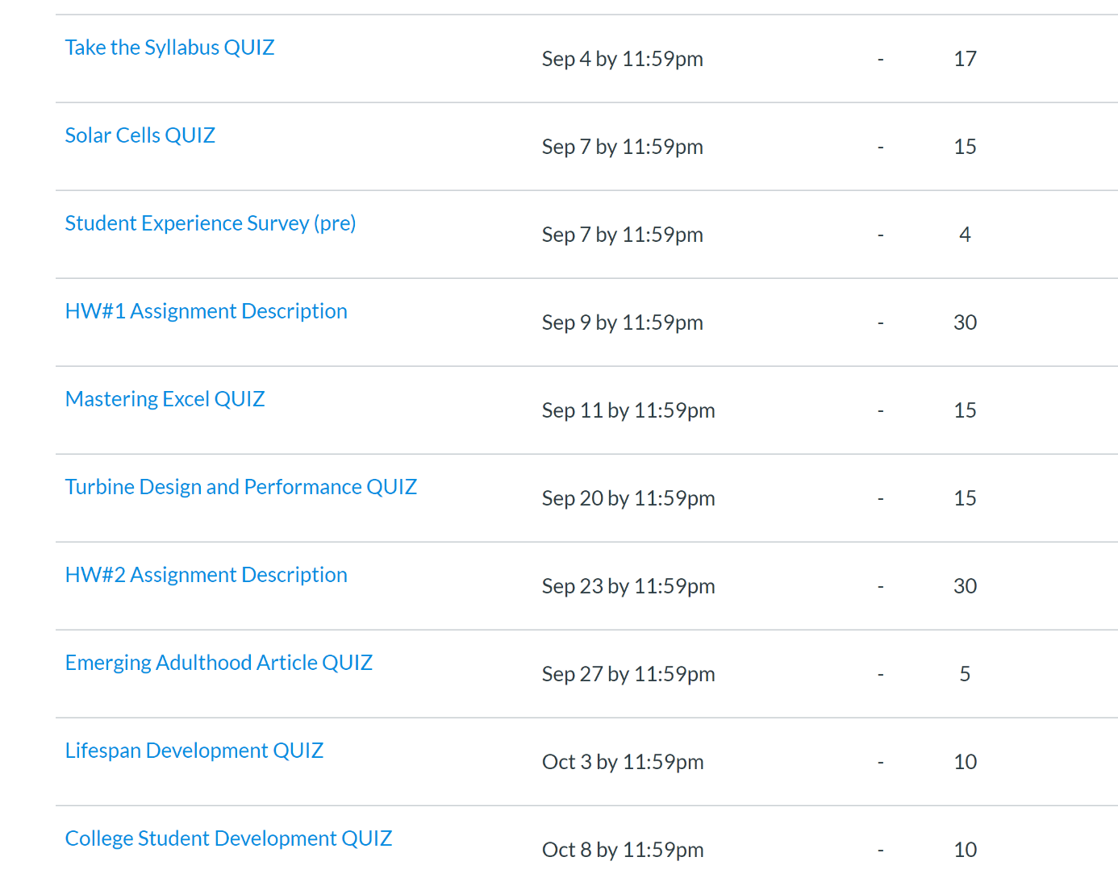
Check your score for assignments, click on the Grades tap and arrange by due date, dash line ( – ) means it has not been graded yet.

Slide 31




