Slide 1

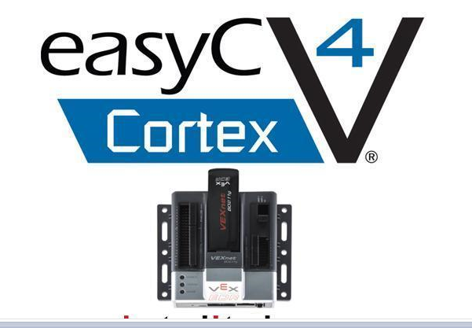
Programing Concept
(Part A)
ENGR 10
Introduction to Engineering

Slide 2
What is Computer Programming ?
Programming is breaking a task into small steps
As a computer programmer, your job is to instruct a computer to perform tasks
One thing that you will realize quickly is that a computer is very dumb, but obedient. It does exactly what you tell it to do, which is not always what you wanted.

Slide 3
A Math Example
y = [ 3 × ( a × a + 7) ] / b + 4
a²
a² + 7
3 × (a² + 7) = 3a² + 21
(3a² + 21) / b
(3a² + 21) / b + 4

Slide 4
Consider the sequential execution of the above expressions to find the value of y:
y = [ 3 × ( a × a + 7) ] / b + 4
p = a x a;
q = p + 7;
r = 3 x q;
s = r / b;
y = s + 4;

Slide 5
What is a Programming Language?
Computers only understand the binary language. Programming languages were developed to make it easier for us to communicate with computers.
There are many different languages. The main choices, used by professional programmers, are: C, C++ and Java.
C
Probably the most widely-used, it is the oldest of the three languages. It's been in use since the 70s, and is a very compact , powerful and well-understood language.

Slide 6
What is a Programming Language?
Object Oriented Programming (OOP) is a modern (more user friendly) programming concept where the programmer creates "objects" like real-life objects, with both properties and abilities. C++, Java are examples of widely used OOPs; MATLAB, Perl, EasyC are examples of special purpose OOPs; there are many more.
C++
This language includes pretty much all of C with more features added. Its main advantage over C is that it’s object oriented.

Slide 7
What is a Programming Language?
A compiler is a computer program (or set of instructions) that transforms source code written in a programming language (the source language) into another computer language (the target language, often having a binary form known as object code)
Java
Java runs on more than one platform without needing to be recompiled. Java runs inside web browsers, letting programmers create little applications which can run on websites. But Java historically is slower than compiled languages.
EasyC (VEX Robot)
Over time, special purpose languages have been
developed for specific applications - to make the
programmers job easier. EasyC is a C++ based language
specifically for telling the VEX robot what to do.

Slide 8
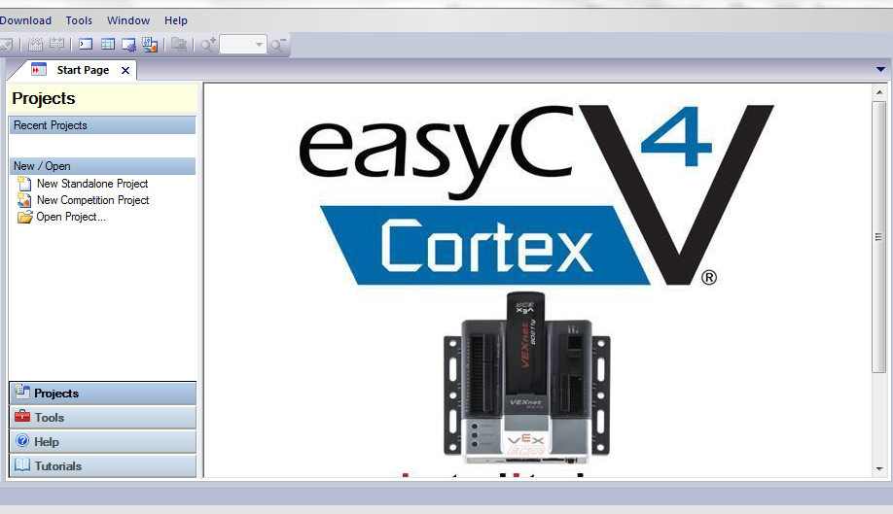
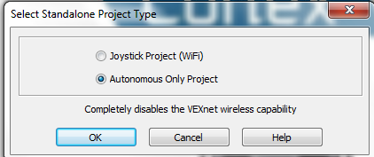
EasyCcortex – new version
Open a New Standslone Project and select Autonomous Only Project

Slide 9
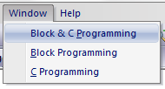
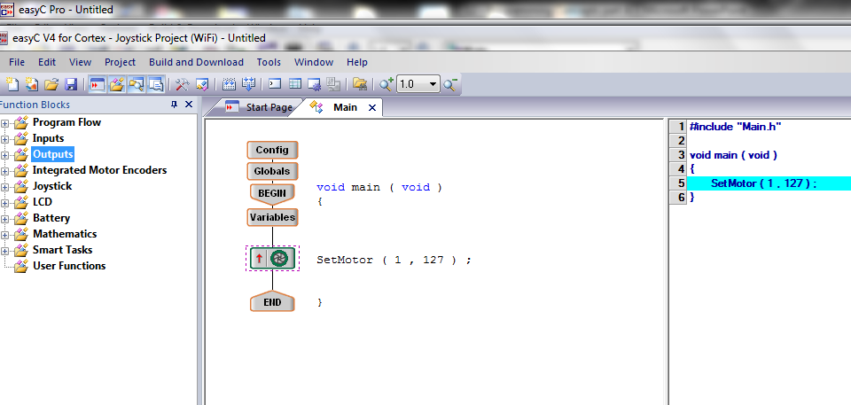
EasyCcortex - new version
Use the Window option to configure the appearance of the screen
Your program is inserted here
Program code
Function blocks
Flow chart

Slide 10
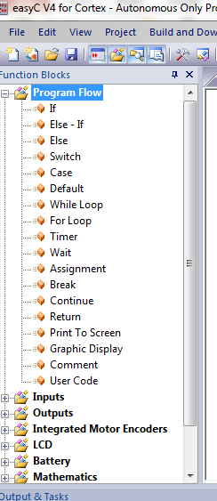
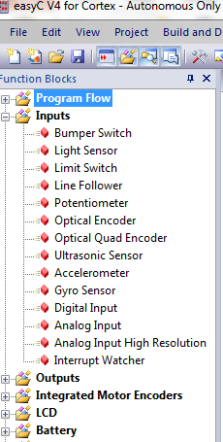
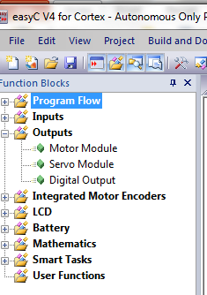
Program blocks
Sensor blocks
Outputs options

Slide 11
Variables
A “variable” is a place where we store a value.
A = 10 ; // The value 10 is stored in A.
Value of 10 is placed in the storage location called “A”. So “A” is a variable
A semicolon is required at the end of each instruction.
Any statement after the sign “//” is NOT part of the program. It is a comment made by the programmer.

Slide 12
Variables
Every variable in the program needs to be declared in the beginning of the program.
Declaration of the variable tells the program its name and its type
int speed ;
The word “int” indicates that the variable ‘speed’ is an integer variable.

Slide 13
Commonly Used Variable Types
Variable Type | Description | Range
Int | Stores integer values EX: 5, -3200 | -32,768 to +32,767
Long | Stores integer values with extended range EX: 56, 6000, -4,234,128 | -2,147,483,648 to +2,147,483,647
float | Stores values with decimal point EX: 1.245, -4.2341 | [-10^+38, -10^-38] 0 [10^-38, 10^+38]
char | Stores characters* EX: A, B, @, # | _
2¹⁵
2³¹

Slide 14
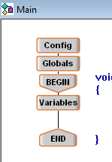
Variables
Global Variable
This variable is accessible from anywhere within your program.
Local Variable
This variable is only accessible from a “local area” within your program (“functions” will be discussed later).

Slide 15
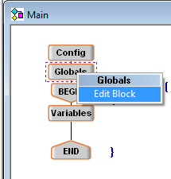
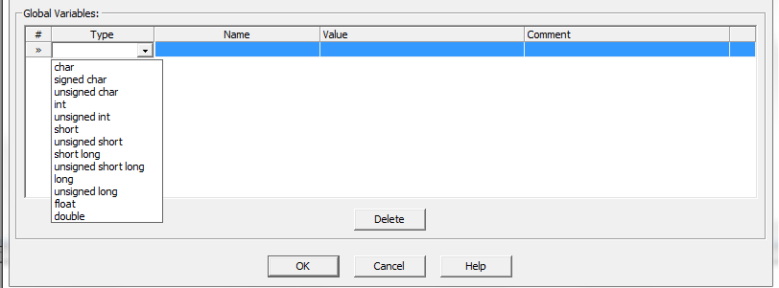
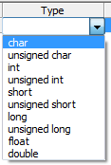
Global Variable Declaration
To declare a global variable, right click on the tab “Global” in the Main program and select Edit Block (or double click the block)
Starting value of the variable
Variable name
Select variable type

Slide 16
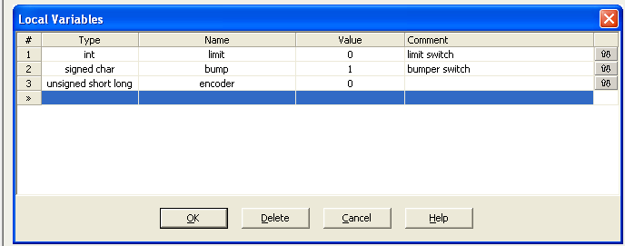
Example of Assigning Variables

Slide 17
Assignment Operator
In C language “ = ” is an assignment operator, NOT an “ is equal to ” statement.
This == symbol is used for checking ‘equal’ condition, not for value assignment.
A = 10; // means assign 10 to A.
A = B; // means assign the value of B to A
A = A+1; //means assign the value A+1
// back to A, i.e., increase A by 1.

Slide 18
Assignment Operator: Examples:
int A; // a variable named A of type integer
int B; // a variable named B of type integer
A = 10; // value 10 is assigned to variable A
B = (24+16)/2; // 20 is assigned to variable B
A = A + 15; // value of (A+15) is first evaluated
and then assigned to A.
So now A=(10+15)=25
B = A + B ;
// Now A = 25, B = (25+20)=45
A = B – 40; // Now A=(45-40)=5, B=45
A = A * B; // Now A=(5*45)=225, B=45
B = A / 9; // Now A=225, B=25

Slide 19
Decision Making
The ability to make decision is the most basic form of intelligence.
A linear (sequential) execution of instructions can only perform a simple task that does not involve decision making.
Most common conditional statements are:
  IF statement
  IF - Else statement
  While statement

Slide 20
IF Statement (logic statement)
Example
Only if this condition is true, this instruction is executed.
if (Number == 0)
{
PrintToScreen (“The Number is Zero”);
}
if (Number < 0)
{
PrintToScreen (“The Number is negative”);
}

Slide 21
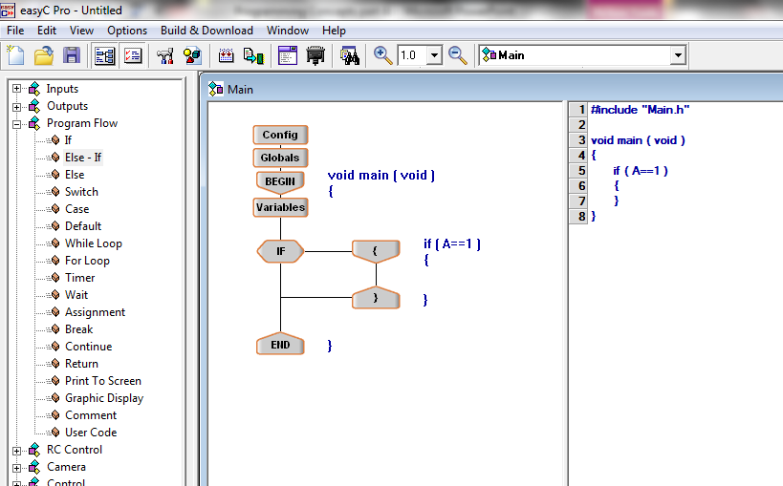
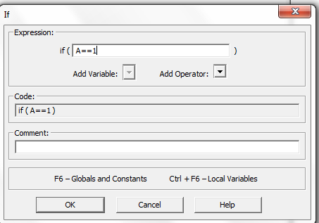
IF Statement
Select, drag and drop the IF statement into the flow chart

Slide 22
IF-ELSE Statement
IF-ELSE statement should be used where there are only two possible cases.
If (score <60)
{ PrintToScreen(“You failed the test”);}
else
{ PrintToScreen(“You passed the test”);}

Slide 23
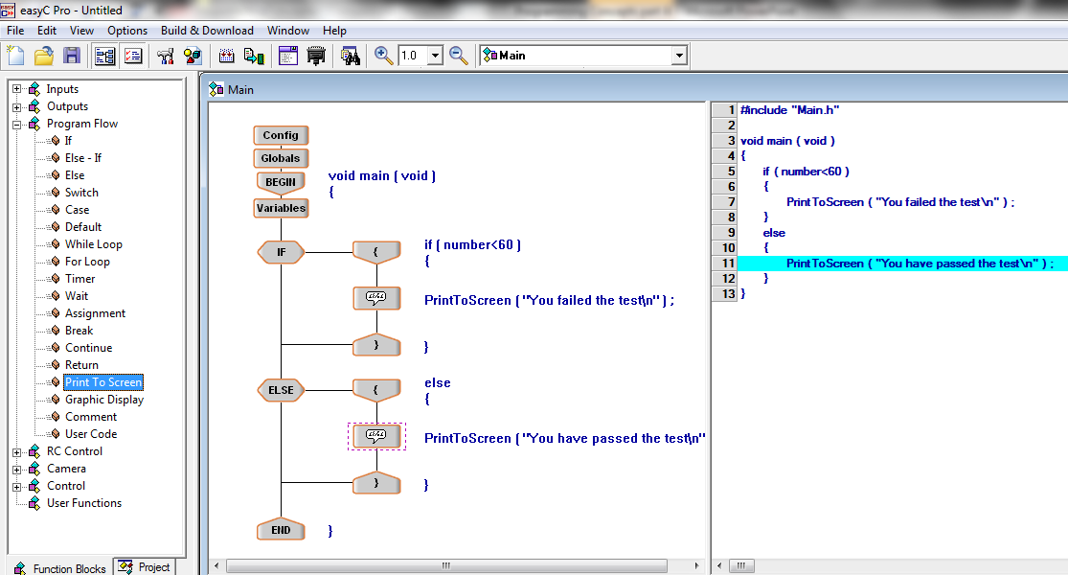
EasyCPro - Example
Drag and drop the IF module, the Print To Screen, and Else module into the flow chart

Slide 24
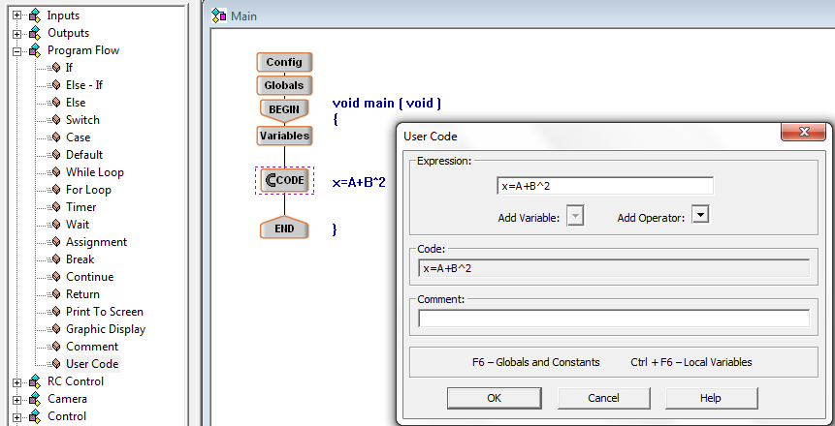
How to Add a User Code
Enter the expression to be executed
Drag and drop User Code

Slide 25
WHILE Statement
The WHILE statement is useful for repeating a set of instructions
Suppose we have to add the first 50 positive integers
1+2+3+4+……………………+48+49+50
You could use a single statement:
int SUM ; // integer variable for the result
SUM = 1+2+3+………………..+48+49+50;

Slide 26
Much better approach is
To use “While” statement
Initialize the variables SUM and COUNTER
This condition is checked first. If it is true, the block of instructions enclosed by the curly brackets { } is executed.
This block of instructions is executed repeatedly until the condition is not true.
Finite loop

Slide 27
Solution to Clicker question 3
Initially i = 0, x = 0.
First iteration: condition 0<3 is true
x = 0+0=0, i = 1
Second iteration : condition 1<3 is true
x = 0+1=1, i = 2
Third iteration : condition 2<3 is true
So x = 1+2=3, i = 3
Fourth iteration : condition 3<3 is false
So the WHILE loop stops.
Final Value of x is 3.
int x;
int i;
x = 0;
i = 0;
while (i < 3)
{
x = x + i;
i = i + 1;
}

Slide 28
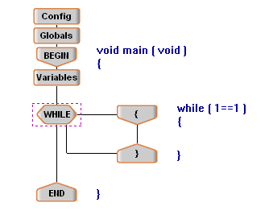
Finite and Infinite Loop
In the previous examples we have employed condition checking in order to control the flow of execution.
  We have made the loop to repeat only a finite number of times.
We can also make the loop to repeat infinitely
The infinite loop is necessary to continuously check the signal coming from the sensor. This loop is included in the Go-To-Beacon program.
Infinite loop
Notes:
10/24/18 (wed.)

Slide 29
In Summary
Most commonly used logic statements:
IF statement
IF – ELSE statement (for two cases only)
ELSE – IF statement (for more than two cases)
WHILE loop (finite or infinite) statement
Write a short program so that the robot moves forward as long as it has not encounter any obstacles (bumper sensor is not pressed), and it stops when bumper is activated (hit an obstruction).

Slide 30
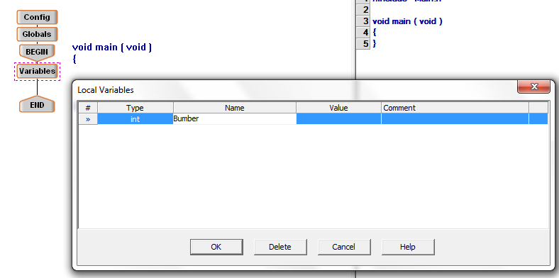
Setting up the program for the Sensors
Declare the variable Bumper
Double click the Variable block to create a new “int” variable named “bumper”

Slide 31
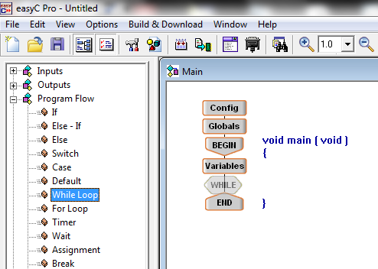
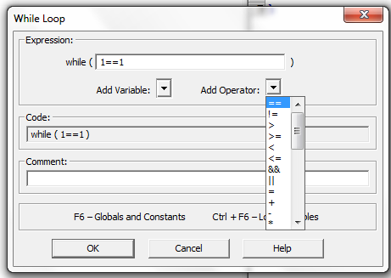
Setting up the program for the Sensors
Select, drag and drop the While Loop icon between the BEGIN and End
In the config. window set the condition of the while loop to be 1==1, this will force the while loop to loop for an infinite amount of time

Slide 32
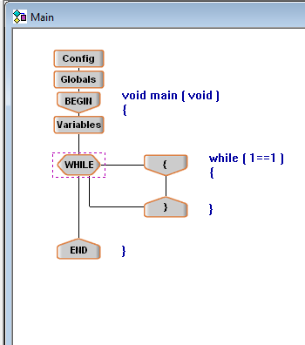
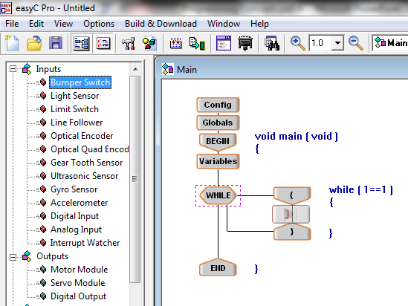
Setting up the program for the Sensors
Select, drag and drop the “Bumper Switch” icon into the program in the WHILE loop

Slide 33
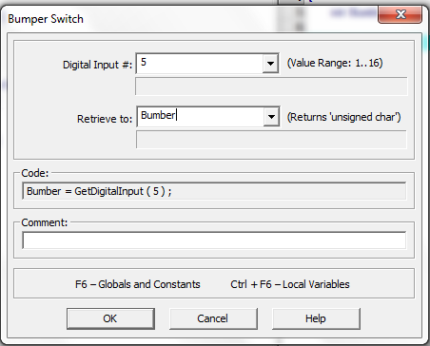
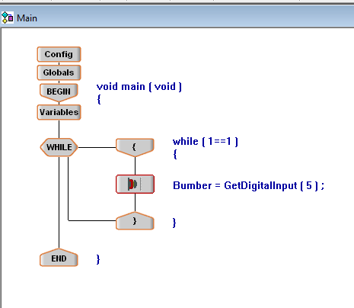
Setting up the program for the Sensors
Set the Digital Input # to the port that the sensor is plugged in
This is an infinite loop to check the signal from the bumper. If the bumper is pushed its value will change to 0
Select Bumper from the list of variables

Slide 34
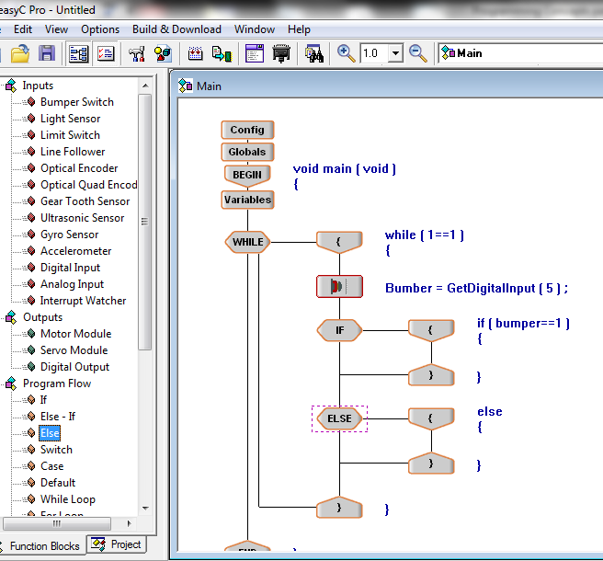
Integrating Motors with Sensors
Drag and drop an IF and ELSE icons from the Program Flow into the program below the sensor
Set the condition for the IF statement, bumper == 1, no obstacle (not pressed)

Slide 35
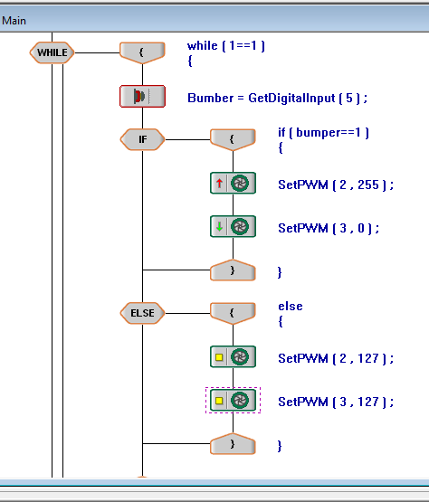
Integrating Motors with Sensors
Your robot will be using two motors. Drag and drop two motors in the IF loop and two motors in the ELSE loop. Set the motor ports and speeds.
Go forward
[ 2 , 127] ;
[ 3 , -127] ;
With this program, the robot moves forward as long as the bumper is not pressed (value=1). Robot will stop if it hits an obstacle (value=0)
Stop
[ 2 , 0] ;
[ 3 , 0] ;

Slide 36
Bumper is not pressed
[ 2 , 127] ;
[ 3 , -127] ;
Bumper is pressed
[ 2 , 0] ;
[ 3 , 0] ;

