Slide 1
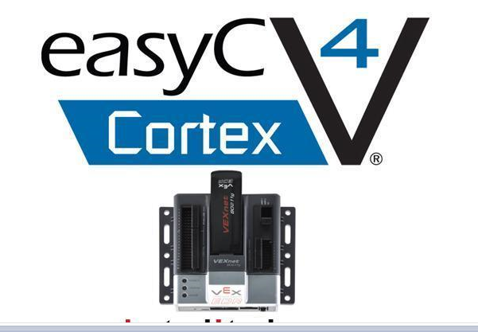
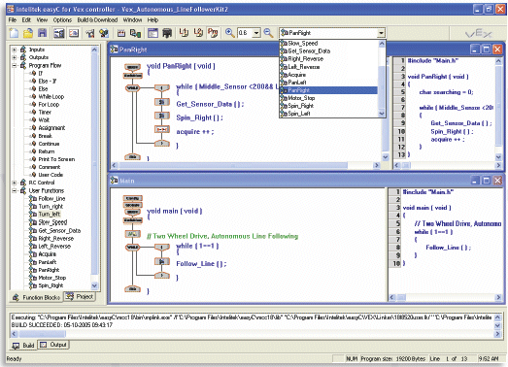
Programming Concepts
(Part B)
ENGR 10
Introduction to Engineering

Slide 2
Summary
Most commonly used logic statements:
IF statement (for one case only)
IF – ELSE statement (for two cases only)
ELSE – IF statement (for more than two cases)
WHILE loop (finite or infinite) statement

Slide 3
Functions
What is a function?
Function is just a group of code given a name. By grouping and naming it we can reuse it any where in the application without having to rewrite the whole block of code again.
Why use a function?
It saves time and reduces the overall code size of your program. But more importantly, if there is a problem you only have to fix it in one place.
The following example shows how to write a function and how to call that function
  MAX_Three → find the maximum of 3 numbers

Slide 4
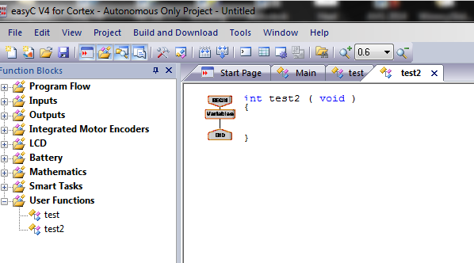
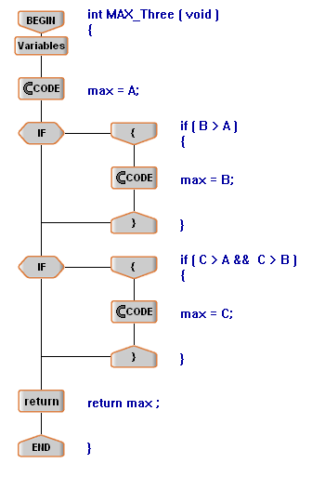
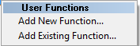
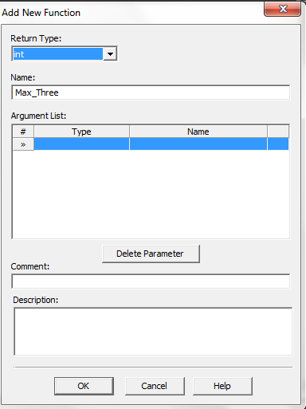
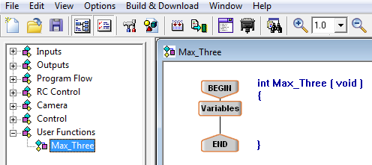
How to Define a Function in easyC V4
Right click on User Functions and select Add New Function
Name the function (Max_Three and select Return Type (Int)

Slide 5
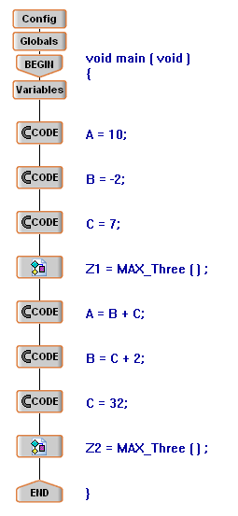
Sequential execution of main program which calls the defined function
A, B, C, Z1, and Z2 are defined as global variables
Main Program
Function

Slide 6
Introduction to Local Variable
The MAX_Three function finds the greatest of the three numbers A, B and C.
These variables were defined as global variables.
Before this function is called, your program must have copied the values into these three variables.
This operation can be done more efficiently by using local variables.

Slide 7
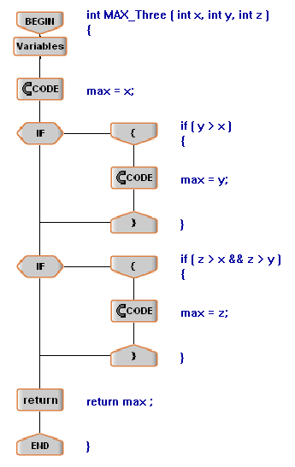
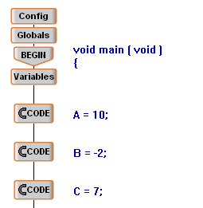
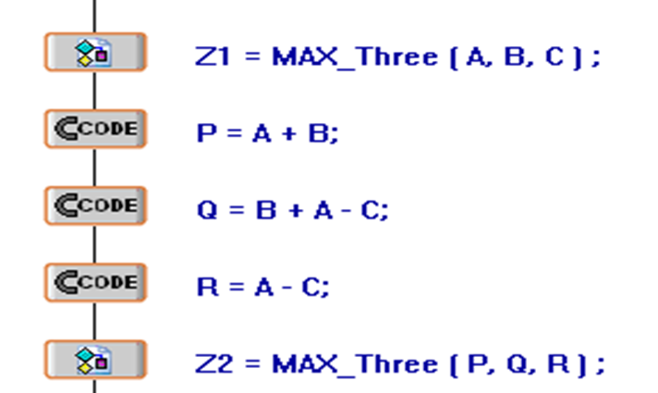

Program using Function with passing variables
x, y, and z are defined as Local variables
A, B, and C are NOT defined as global variables

Slide 8
What is a Local variable ?
The value of a local variable is accessible only to the function within which it is defined.
The main function (main program) passes the values into the function and these values are copied into the local variables of the function.
The function doesn’t care what are the names of the variables defined in the main function.
The function does what it should do and then returns the result to the main function.
The values of these local variables are lost after the execution of the function is completed.

Slide 9
Global Variable Concept
A, B, C, and Z are defined as global variables
Main Function
Defined Function
A
Task of the function
B
Z
C

Slide 10
Local Variable Concept
Main Function
Defined Function
x, y, and z are defined as Local variables
A
x
Task of the function
B
y
max
Z
C
z

Slide 11
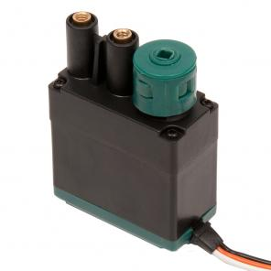
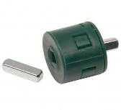
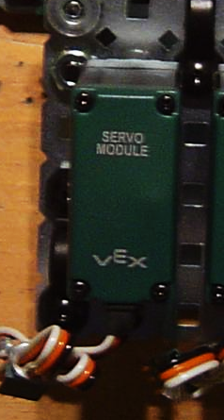
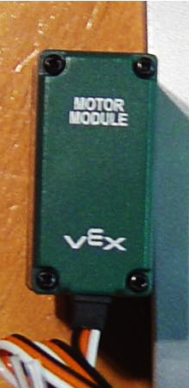
Mechanical Components – Motors
Clutch
Motor, continuous rotation of the shaft (3 wire)
Motor
(Continuous)
Servo, shaft rotates through a specified angle (3 wire)
Make sure the clutch module is always used. It prevents damage to the motor in case of large torque (resistance to motion).
Servo

Slide 12
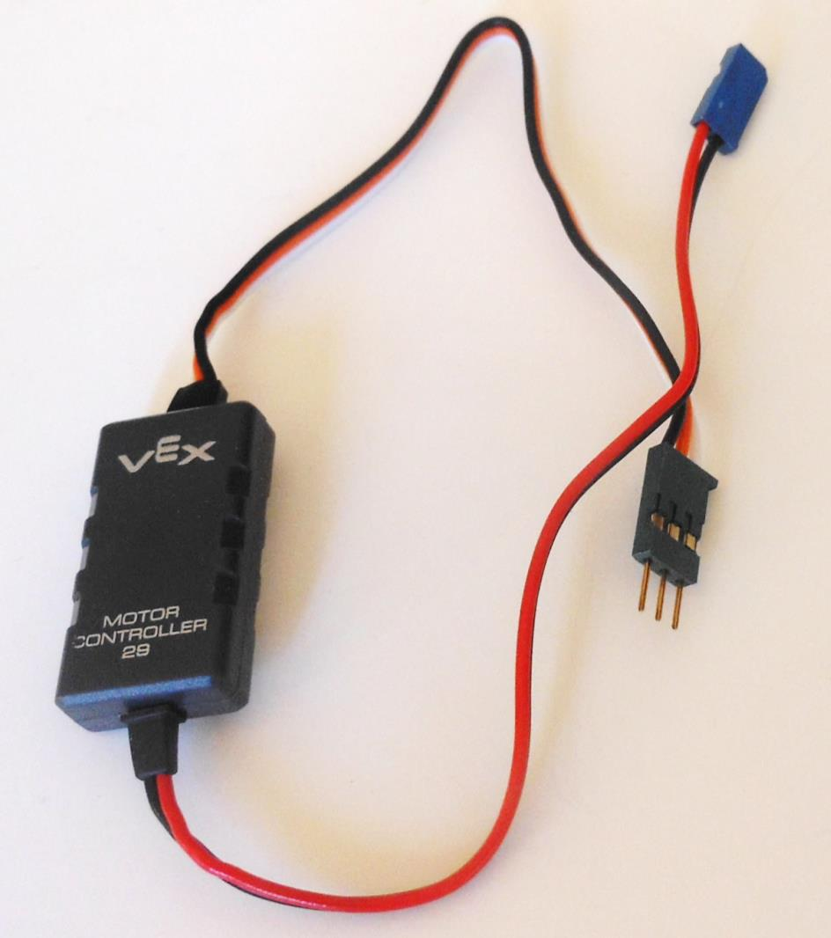
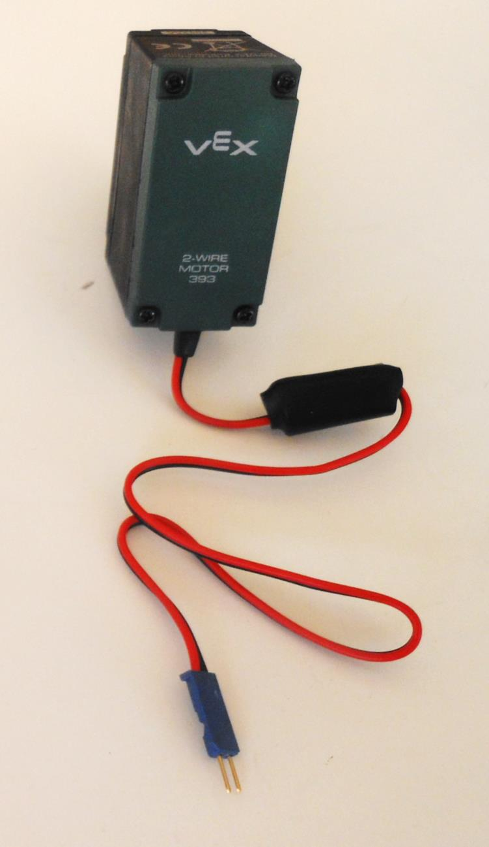
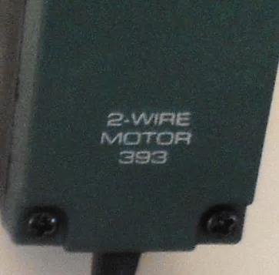
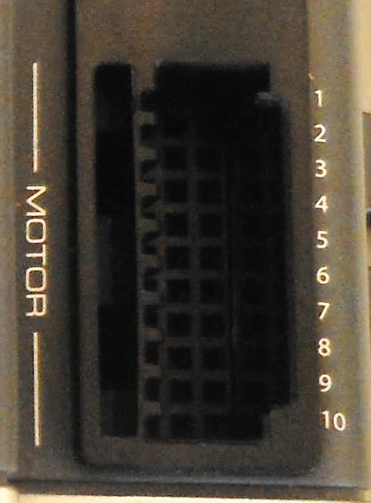
Mechanical Components – Motor (New)
The new motor has two wires (2-wire motors). It can be converted to a 3-wire motor using the controller 29. Ports 1 and 10 on the controller are designated for 2-wire motors only.
3 pins
2 pins

Slide 13
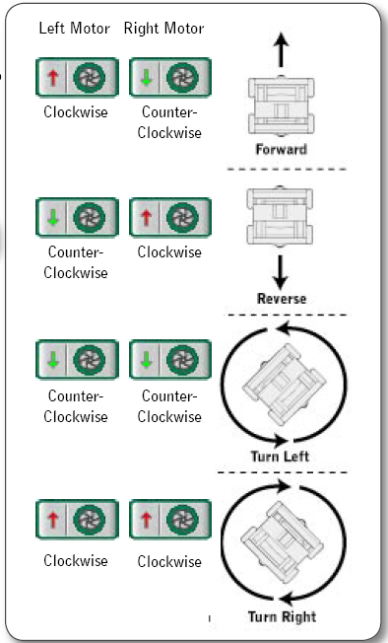
This chart describes the combination of the motor movement required to perform each maneuver

Slide 14
How to connect the motor to the Controller?
On the VEX controller you have several ports available so that you can connect not only motors but also other devices and sensors to it.
PORT:
A port is a specific place on the board where we can connect other external devices, so that the two devices in connection can exchange information or data.

Slide 15
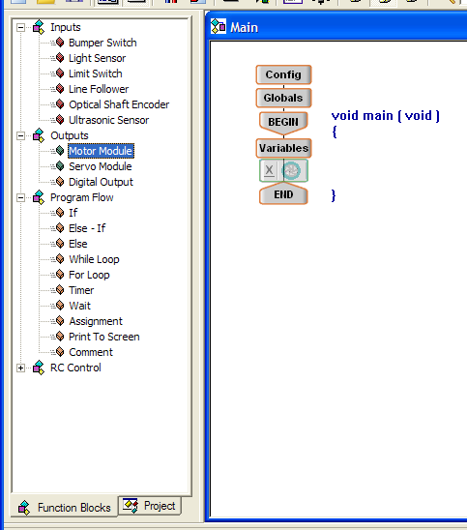
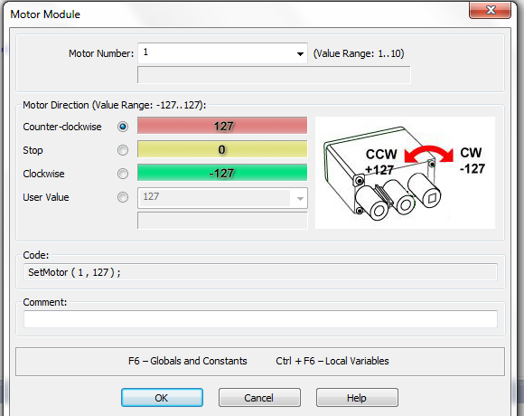
Continuous Motor
Choose motor number, as connected to the Controller
Max. speed counter clockwise
Select Motor, drag and drop on the line between Begin and End
Custom speed
Max. speed clockwise

Slide 16
How to move a motor?
Use the following statement to move a motor
SetMotor ( 2 , 60 );
This number indicates that the motor is connected to motor port 2 of the total available 10 ports
This number sets the direction and speed of the motor

Slide 17
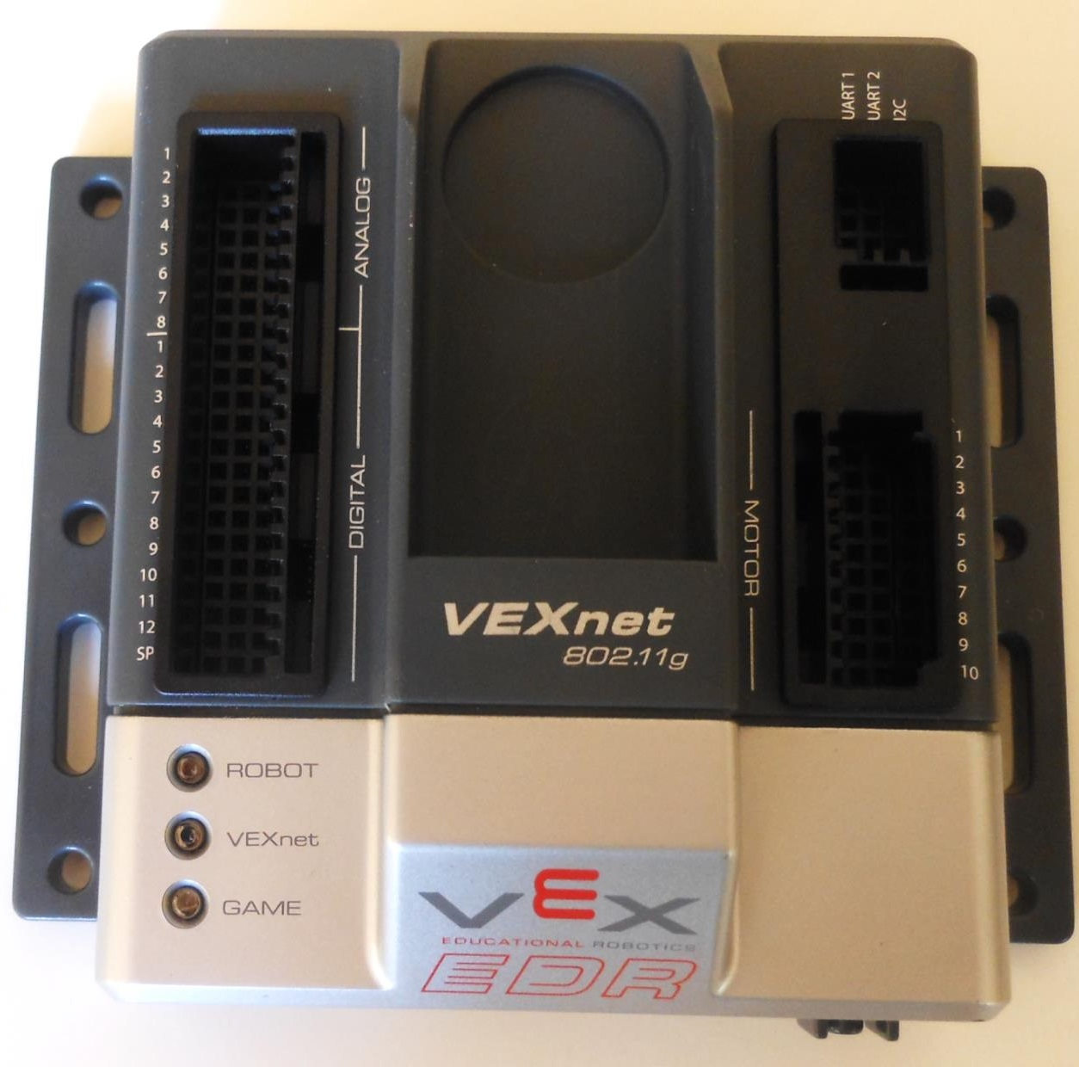
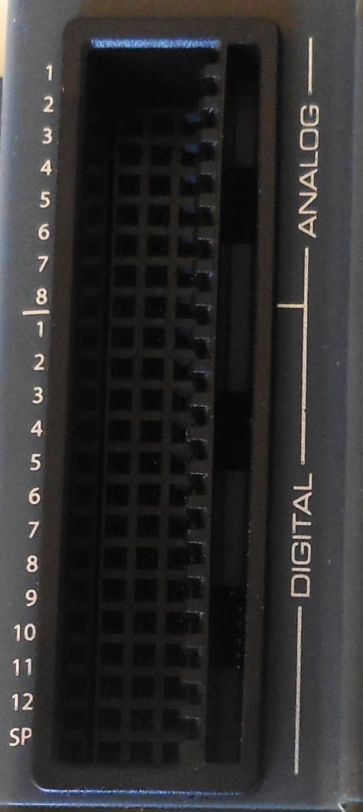
Motor and Servo ports
Controller (Cortex)
8 analog and 12 digital ports. Digital ports are used for Limit, Bumper and Ultrasonic sensors
X
connected to the IRB mounted on the robot

Slide 18
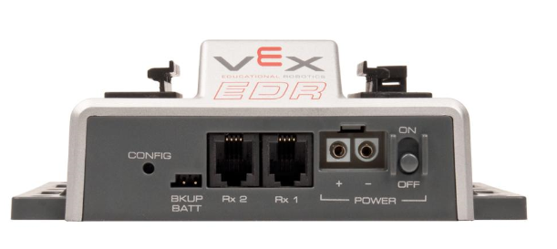
Side view of the VEX Controller
Battery Ports (Square and round connectors)

Slide 19
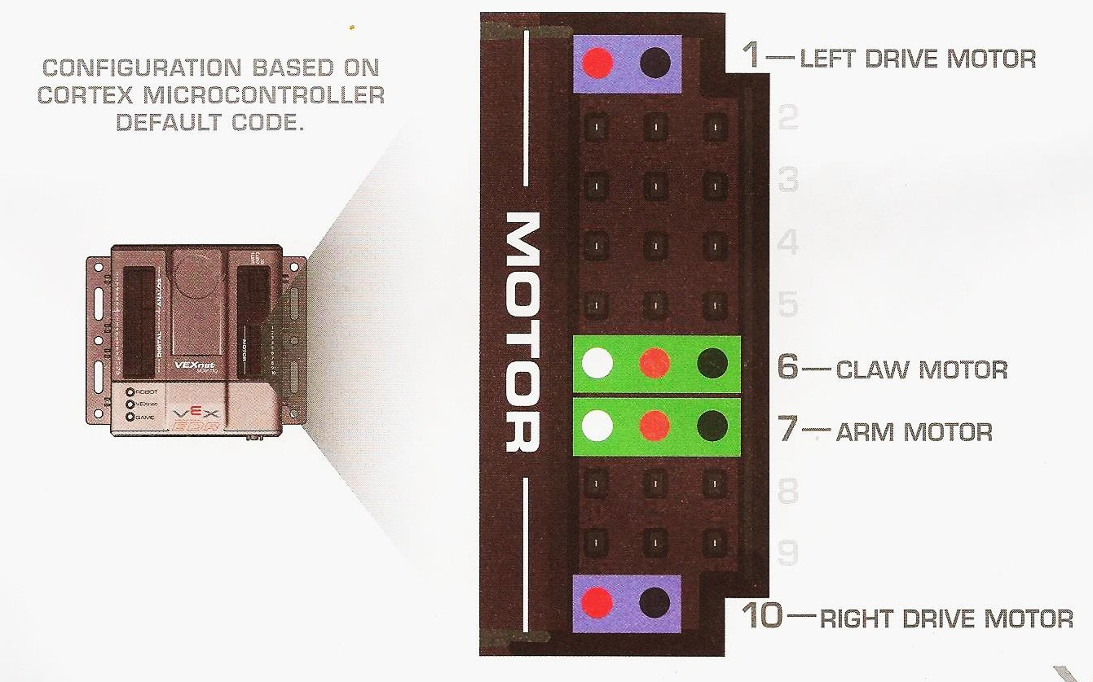
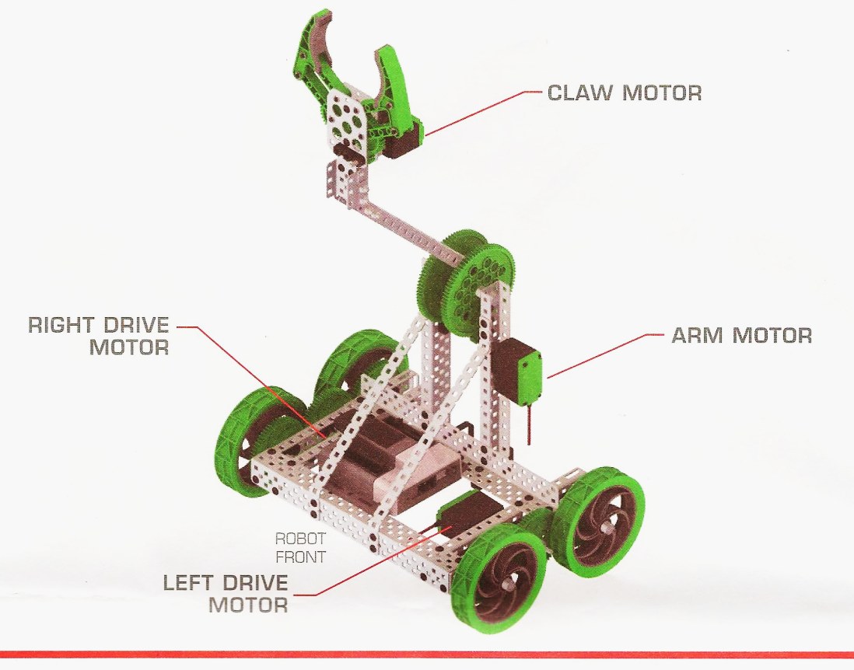
Cortex
Two continuous motors to drive the robot (2-pin)
Two 3-Wire motors to operate the claw and the arm (3-pin)

Slide 20
Program to move the robot forward
Now let us write a program to make the robot move forward for 2 seconds and then stop.
Assume:
Left Motor – connected to motor port 3
Right Motor – connected to motor port 2

Slide 21
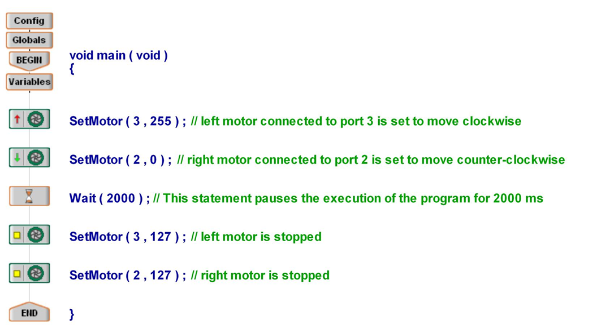



Program to make the motor move forward for 2 seconds and then stop
;

Slide 22
Clicker Question 3
What value of x will cause the motor for Cortex controller to be stopped: SetMotor(2, x)?
A. 64
B. 127
C. 0
D. 255
E. -127

Slide 23
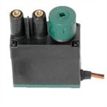
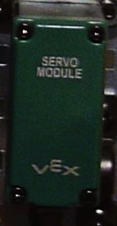
Servos
Servo units are similar to motors except that they control position rather than speed.
Servo units have limited range of motion (about 120º)
A value between (-127) and (127) sets
the direction of the servo.
(127) – Extreme counter clockwise direction
(0) – No movement
(-127) – Extreme clockwise direction

Slide 24
Graphical representation of the direction of rotation of the Servo
0º
← Counter-clockwise
Clockwise
0
←
60º
-60º
127
-127

Slide 25
Servo
Indicates the motor port number to which the servo is connected.
This value sets the
direction and the rotation of the servo
Similar to the motor the following statement is used to set the servo to turn to a direction.
SetServo ( 5 , 64 );

Slide 26
SetServo (5 , 64) - EasyC
Motor shaft rotates 30º clockwise and then stops
0º
← Counter-clockwise
clockwise →
30º
0
64
60⁰
-60º
127
-127

Slide 27
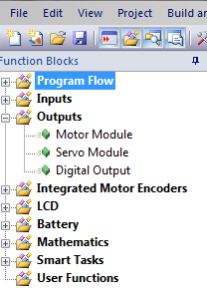
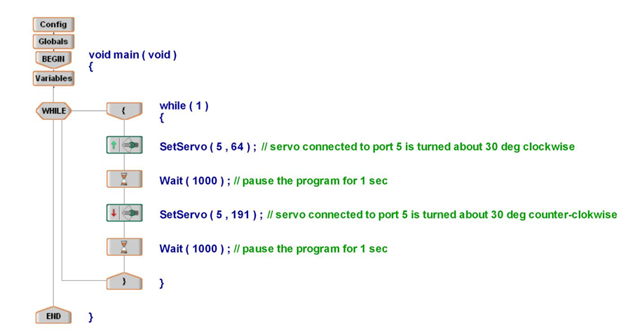
Program showing how to move the servo continuously

Slide 28
Output of the above program
← Counter-clockwise
0º
clockwise →
-30º
30º
0
-64
64
60º
- 60º
127
-127

Slide 29
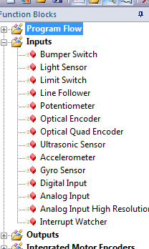
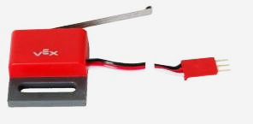
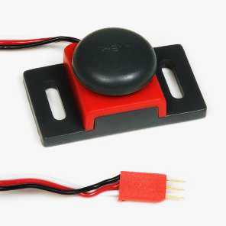
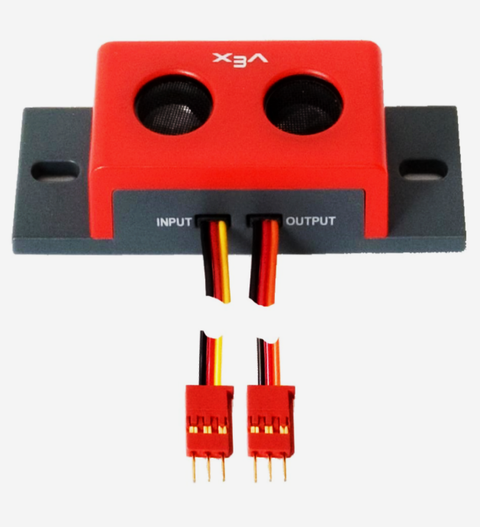
Mechanical Components - Sensors
Sensor blocks
Limit Switch Sensor (Digital)
Ultrasonic Sensor (Digital)
Bumper Switch Sensor (Digital)

Slide 30
Introduction to Logic Signals
A logic signal can take on either 0 volt or 5 volt
0v represents “Low state” or “Logic 0”
5v represents “High state” or “Logic 1”
A logic signal can also be called a “digital signal”

Slide 31
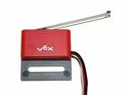
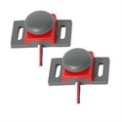
Bumper/Limit Switch
A Bumper/Limit Switch is a digital sensor.
It can distinguish between two states: pressed or not pressed (On or Off)
When the switch is not pressed, the robot interprets this value as a 1 (high state).
When the switch is pressed the robot interprets the value as a 0 (low state).

Slide 32
Bumper & Limit Switches
Use of the following statement in the program to read the bumper/limit switch.
Bumper = GetDigitalInput ( 2 );
A variable into which the status of the bumper/limit switch will be stored.
This indicates the port number to which the bumper/limit switch is connected

Slide 33
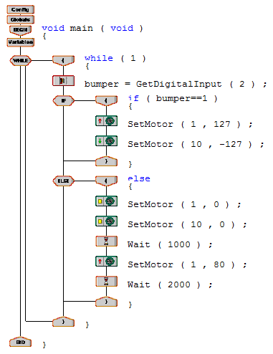
Program to make the robot stop and turn for 2 seconds when it hits an obstacle
stores the state of the bumper switch into the variable “bumper”.
checks if there is a contact with an obstacle (switch will be pressed if there is a contact)
motor moves forward as long as there is no obstacle (bumper ==1)
if the switch is pressed (bumper==0), these statements make the robot halt for 1 second
Then the robot turns left for 2 seconds (green arrow is ccw)

Slide 34
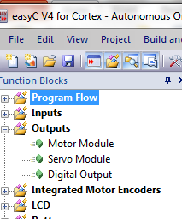
Digital Output
The “Digital output” function can be used to control the state of a digital output.
By using this function you can send digital signals (either 0 or 1) to the devices which can accept digital signals.
For example, by using this function you can turn off or on an LED.
1 => 5v => light is on
0 => 0v => light is off

Slide 35
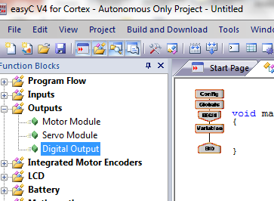
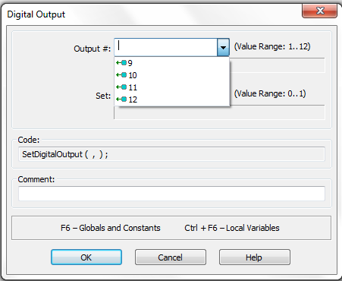
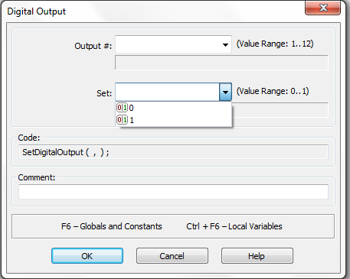
Drag and drop the Digital Output
Port #
List of the output port #
Set the output signal (range), 0 or 1

Slide 36
Digital Output
Indicates the port number (here port 11) to which the device to be controlled is connected
The digital value to be sent (either 0 or 1)
This statement is used in the program to control the devices i.e., send digital signals.
SetDigitalOutput ( 11 , 1 );

Slide 37
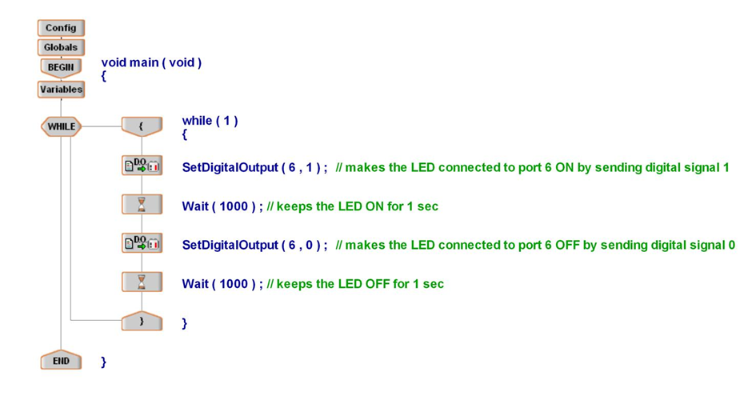

Program to make an LED blink continuously

Slide 38
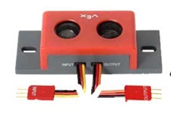
Ultrasonic Sensor
The Ultrasonic Sensor is a digital sensor.
The Ultrasonic Sensor uses high-frequency sound waves to detect objects.
It emits a sound wave, measures how long it takes the sound wave to bounce back, and then calculates how far away the object is.
The measurement is translated into a numeric value from 2 - 100.
Lower signal value corresponds to a closer detected object and vice versa.

Slide 39
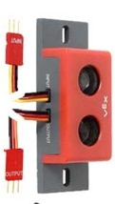
Ultrasonic Sensor Connections
Digital Output port
Input
Digital Input port
Output
(Interrupt port)
VEX Controller
Ultrasonic Sensor

Slide 40
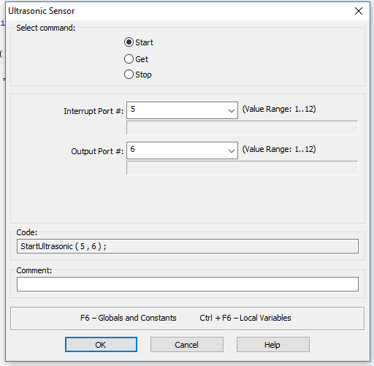
Ultrasonic Sensor
The following statement starts an ultrasonic sensor i.e., the sensor starts sending and recording the sound signals.
Sensor connected to output port 6 through which it receives digital control signals from the controller.
StartUltrasonic ( 5, 6 ) ;
Sensor connected to input port 5
Select start

Slide 41
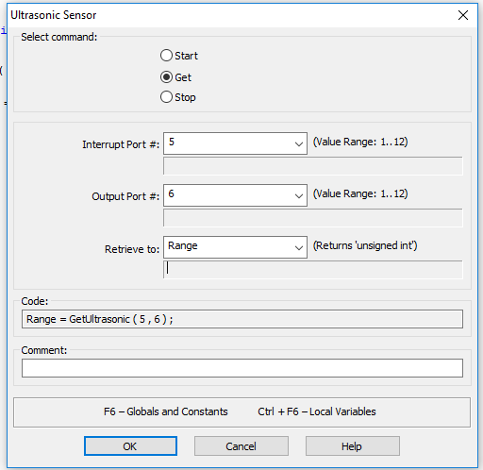
Ultrasonic Sensor
The following statement is used to read a value from the sensor
Range = GetUltrasonic ( 5 , 6 );
Variable into which the translated value is stored
The sensor is connected to output port # 6 on the controller
Input to Ultrasonic port #5
Select Get option
Define variable Range, (2-100)

Slide 42
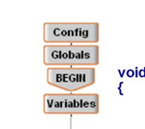
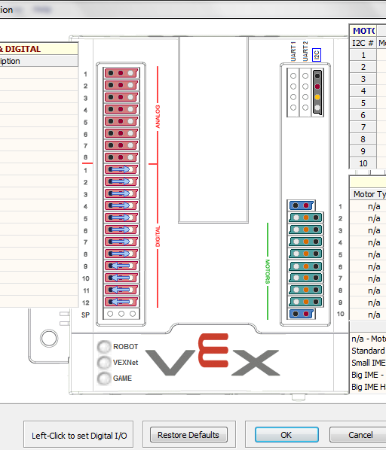

Changing Input port to Output port
Edit Config
Change port 6 from input to output by clicking on the circle
Digital ports taken by the IRB

Slide 43


Input to Ultrasonic sensor connected to output port 6 on controller
Output from Ultrasonic sensor connected to input port 5 on controller
Checking if the obstacle is near or far

Slide 44
Analog Signals
For the VEX controller, an analog signal can take any value between 0v and 5v.
0v is represented by a value 0
5v is represented by a value 1023 (2¹⁰)
All other voltage levels between
0v and 5v are represented by the
numbers between 0 and 1023.
5v
1023
2.5v
511
0v
0

Slide 45
Light Sensor
A light sensor is an example of an analog sensor.
A light sensor reads the intensity of light of an area, translates the reading into a single numeric value, and sends that value to the robot.
The range of values used by this sensor is
0-1023
The higher the value, the darker will be the area and vice versa.

Slide 46
Light sensor
A variable named “light” into which the reading (0-1023) from the light sensor is stored
Indicates the port number (here port 1) to which the light sensor is connected
The following statement is used to read the analog signal from a light sensor.
light = GetAnalogInput ( 1 ) ;

Slide 47


Program to make the robot move towards the moving light source
ELSE IF is used for more than 2 cases
If light intensity is more on the left side, the robot turns toward the left side
If light intensity is more on right side, the robot turns toward the right side
If light intensity is the same on both sides, the robot moves forward

Slide 48

Optical Shaft Encoder
The optical shaft encoder is a digital sensor. It is used to measure rotational movement.
As the disc rotates, an infrared light sensor is used to count the number of slots passed.
A count of 90 makes one revolution.
Disc with 90 equally spaced slots

Slide 49

Optical Shaft Encoder
The following statement is used to start the encoder counting.
StartEncoder ( 2 ) ;
This number indicates that the encoder is connected to interrupt port # 2 on the VEX controller

Slide 50
Optical Shaft Encoder
The following statement is used to get the present count value from the encoder.
Count = GetEncoder ( 2 ) ;
A variable named “count” into which the present count value will be stored
Interrupt port # 2 to which the Encoder is connected

Slide 51
PresetEncoder ( 2, 20) ;
This statement is used to make the encoder start counting from a given number (here 20) instead of from zero.
Example
Write a program to make the robot move for 1 meter and then stop.
Assume 5 turns of the wheel = 1 meter

Slide 52

Program to make the robot move forward for 1 meter
Presetting the encoder to 20. Count value starts from 20.
if count reaches 470 the robot stops.
470 = 450 (count for 5 turns x 90) + 20 (initial value)
0
0

