Slide 1

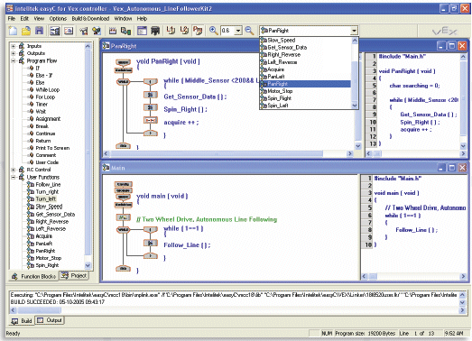
Programming Concepts
Part C
GOTO_Beacon
ENGR 10
Introduction to Engineering

Slide 2
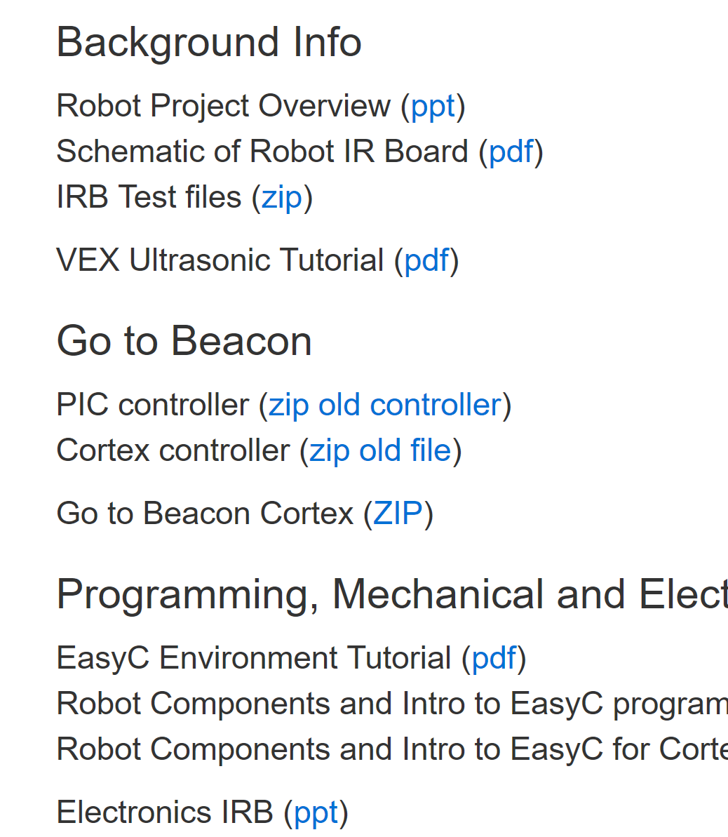
Download the GOTO BEACON program from the E10 website, Robot lab section,
New controller (Cortex)

Slide 3
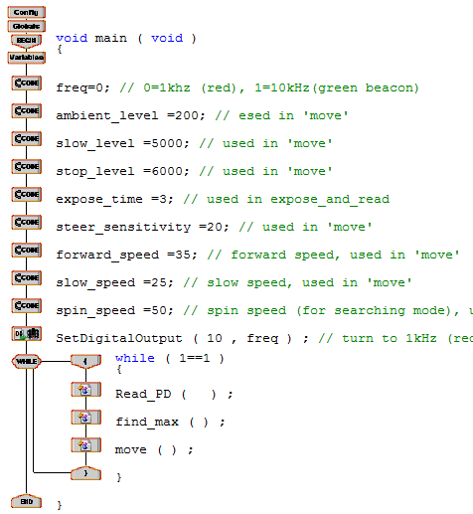
Main() for GOTO_Beacon Program
Note: you need to change freq for the beacon you want to find!
Global
Variables
Infinite loop
Call three functions

Slide 5
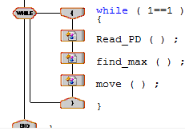
The main body of the GOTO_Beacon program
is an infinite loop with three functions in the loop
While Loop (1==1)
{
Read_PD(); //read 8 Photo-detector outputs
find_max(); //find the max detector output
move(); // move to the direction of max PD
}
PD4
PD7
Left side
Right side
PD0

Slide 6
Read_PD()
This function reads the intensity of all 8 Infrared Photo-Detectors and stores the intensity (0 to 1023) into PD0~PD7 variables. It also produces the sum of all 8 readings (PD_sum). The sensing sensitivity is set by expose_time.
This function reads the intensity of either 1kHz or 10kHz infrared signal depending on the setting of digital output port 10 on Cortex, (0=1kHz , 1=10kHz). You should set the digital output port #10 to the intended frequency before this function is called.
find_max()
This function determines which variable (among PD0~PD7) has the greatest value. The PD number is saved in the variable max_no.

Slide 7
move()
If PD_sum < Ambient (noise level, 200), the robot spins at the speed spin_speed (50). If PD_sum > Ambient (beacon is in view), go forward at speed of forward_speed (35).
Turns the left wheel faster if max_no (PD #) <4
Turns the right wheel faster if max_no > 4,
same speed if max_no = 4
Slows the forward motion to slow_speed if PD_sum > slow_level (5000)
Stop if PD_sum > stop_level (6000)
Red beacon
PD4
PD0
PD7

Slide 8
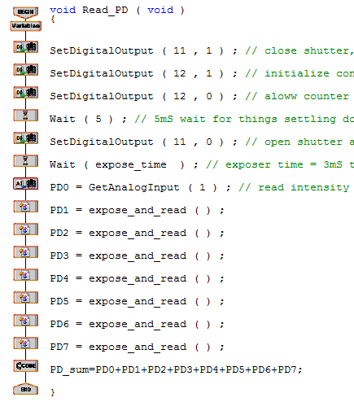
Read_PD() Function

Slide 9
Find maximum intensity

Slide 10
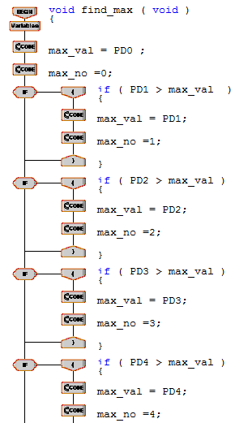
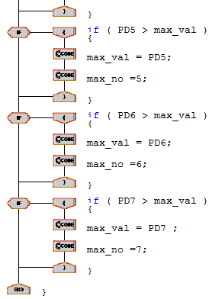
find_max() Function

Slide 11
Move the robot

Slide 12
Move() Program
PD_sum<200, no beacon in sight, robot spins
PD_sum >5000, robot slows down, beacon is close
PD_sum >6000, very close to beacon, robot stops
Robot moves toward beacon

Slide 13
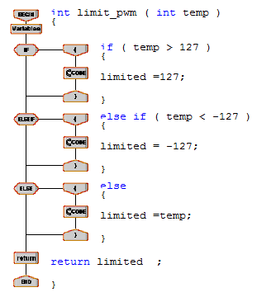
limit_pwm() Program

Slide 14
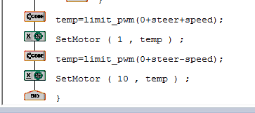
Cortex Controller
PD2 reads max intensity → max_no = 2 → error = 4-2=2 → steer=error*steer_sensitivity=2*20=40
Motor1 speed = 0+40+35=75,
Motor10 speed=0+40-35=5,
if motor 1 is on the left side the robot turns right

Slide 15
How to add to the GOTO_beacon program to perform the required task?
Use state variable !
Somewhere here, when red beacon is found, state=2.
No infinite loop in all blocks!
Initialization
While state==1
Read PD();
Find Max();
Move ();
Find red beacon
While state==2
Try to turn off red beacon. when confirmed, state=3
While state==3
Go to green
When found, state=4
Find green beacon

Slide 16
While state==4
Capture green (turn off) ,
When confirmed.
state =5
While state==7
GO home,
When confirmed.
state =6
STOP

Slide 17
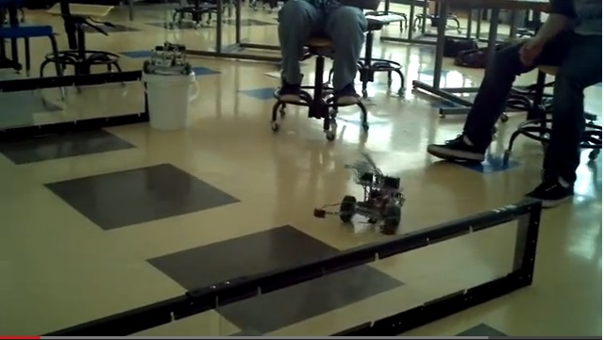
E10 robot, bumper switches, it wonders

Slide 18
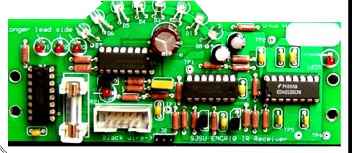
IR Receiver Board

Slide 19
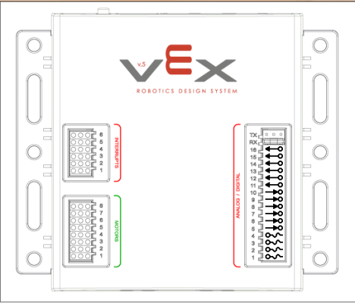
Beacon Frequency Selection
(filter)
Tuning circuit
amplifier
To next stage
From previous stage
AD14
Freq select (0=1kHz, 1=10kHz)

Slide 20
IR Detector Selection
Infrared Detectors
LEDs
Selector
counter
To next stage
1
0
1
AD16 Counter reset
AD15 pulse
1
Increment count (0 to 1 transition)
1
Count output set to zero
0
Get ready to count

Slide 21
Beacon Frequency Selection
(filter)
Tuning circuit
amplifier
To next stage
From previous stage
AD14
Freq select (0=1kHz, 1=10kHz)

Slide 22
Exposure Control Circuit
From previous stage
Amplifier
AD15
To AD1
(VEX Analog input)
1
Clear ‘film’ (discharge C14)
0
Open ‘shutter’ (allow C14 to charge)

