Slide 1
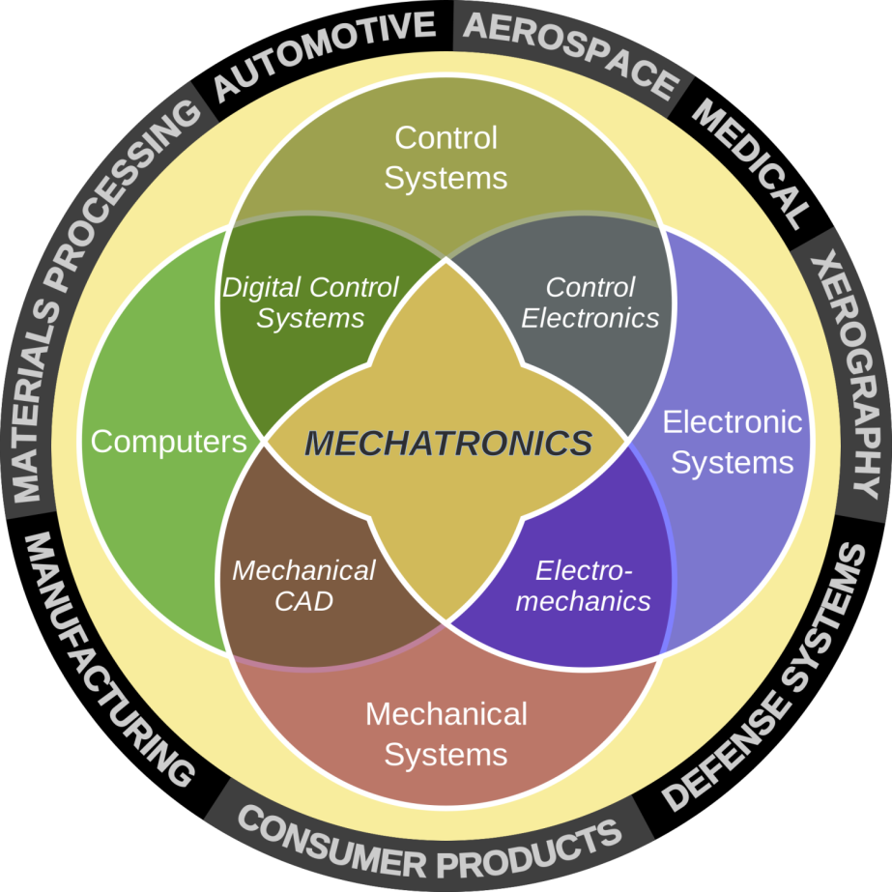
Sensors, Actuators, Signals, and Computers
Part D
Ping Hsu, Winncy Du, Ken Youssefi

Slide 2

Mechatronics – a design process that includes
Mechanical engineering
Electrical engineering
Control engineering
Computer engineering

Slide 3
Mechatronics System
Control code
Sensing signal
Command signal
Microprocessors and Microcontrollers
Sensors
Actuators
Actuation
Variables
Product
(Robot, Autonomous Guided vehicle, Numerical Controlled Machine,
Vehicle engines, Consumer products, Conveyor systems, Assembly systems, Cranes, Defense equipment, Air craft engines, etc)

Slide 4
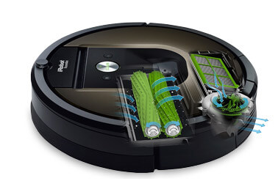
iRobot Roomba (automatic vacuum cleaner)
Roomba

Slide 5
Sensors measure changes in physical quantities, (Input). The changes occur in response to some excitation, for example heat or force and covert that into an electrical signal.
Devices which perform an “Output” function are generally called Actuators and are used to control some external device, for example movement or sound.

Slide 6
Types of Signals
Analog:
An analog signal is a continuous signal and is often represented by a V(t).
A dimmer light switch continuously increases/decreases the current.
Digital :
A digital signal is a discrete time signal, binary signal.
An On/Off light switch applies a fixed, predetermined voltage.

Slide 7
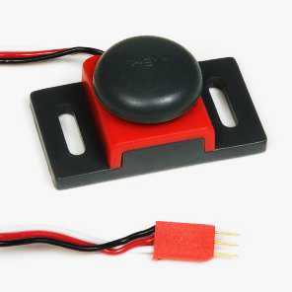
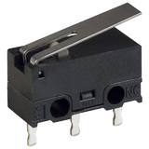
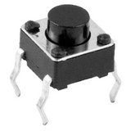
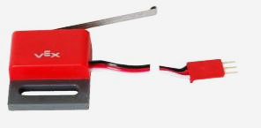
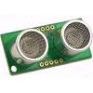
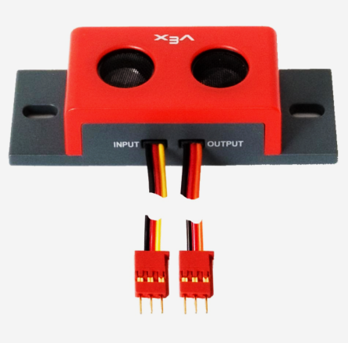

Digital Sensors
Button
Lever
Bumper Switch Sensor
Limit Switch Sensor
Ultrasonic sensor
Motion

Slide 8
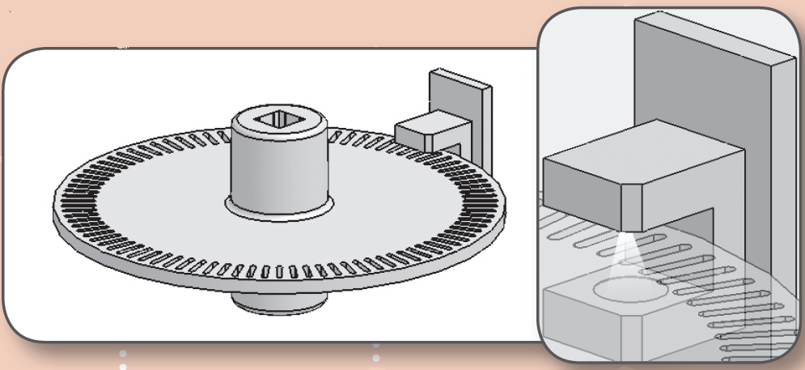
Optical Shaft Encoder
The optical shaft encoder is a digital sensor. It is used to measure rotational movement.
As the disc rotates, an infrared light sensor is used to count the number of slots passed.
A count of 90, 180, 360 makes one revolution.
Disc with 90 equally spaced slots

Slide 9

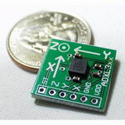
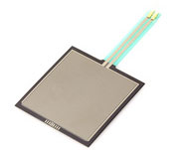
Analog Sensors
Proximity sensors
Proximity sensors measure the distance from the sensor to an obstructing object in front of the sensor. There are two types, Infrared and Sonar
Accelerometers
Accelerometers sense motion and are used to detect changes in position, tilt, and orientation
Pressure sensors
Measure the amount of pressure, for example of a finger press, or the weight of someone standing on a surface

Slide 10
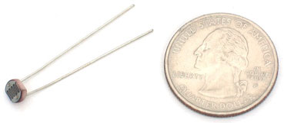
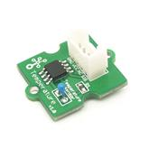

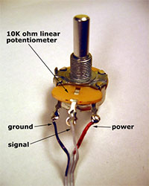
Analog Sensors
Light sensors
Detect the amount of light striking the sensor, which is called a photocell, photoresistor,
Temperature sensors
Measure the air temperature in Fahrenheit or Celsius.
Ribbon sensors
Measure the position of a finger touch across a surface
Potentiometers
Measure rotation or linear travel, and are used in car stereos, dimmers, equalizers, etc

Slide 11
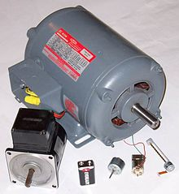
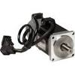
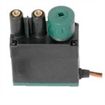
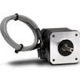
Actuators
Actuators are devices that is responsible for moving and controlling a mechanism or system: Rotary or linear -Electric, hydraulic or Pneumatic
Electric motor (AC or DC)
Servo motor
Stepper motor
Controls the rotation of the shaft, needs sensor and closed feedback system
Divides a full rotation into a number of equal steps. No need for sensors or feedback system

Slide 12
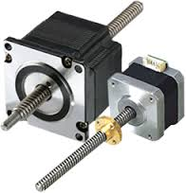
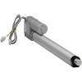
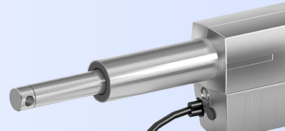
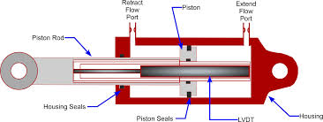
Linear Actuators – Hydraulic, Pneumatic, mechanical
Hydraulic and Pneumatic actuators

Slide 13
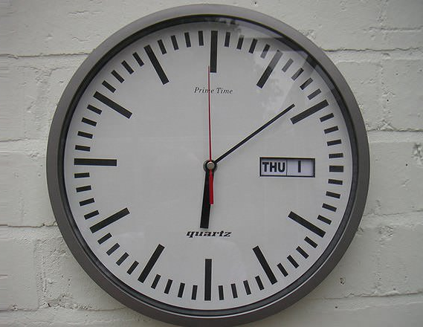
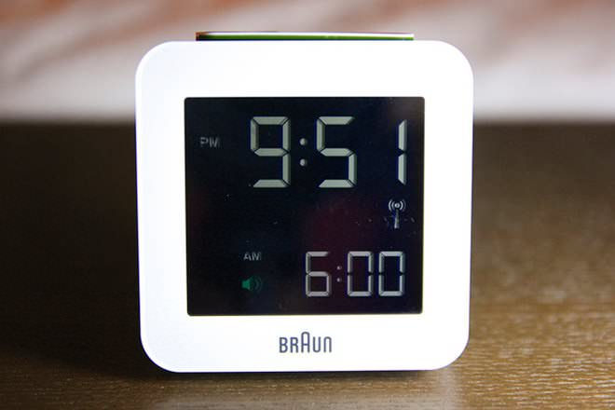
Analog and Digital Signals

Slide 14
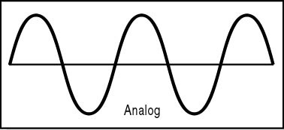
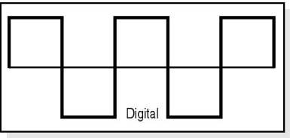
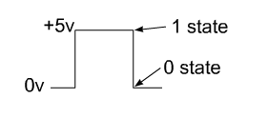
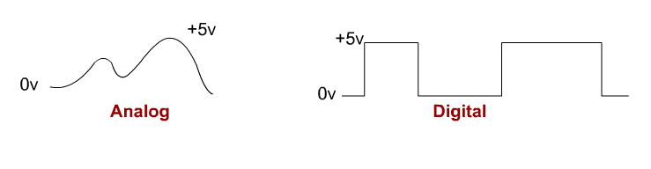
Analog and Digital Signals
Light intensity
Temperature
Pressure
Flow rate
Force
Notes:
Mon 4/13

Slide 15
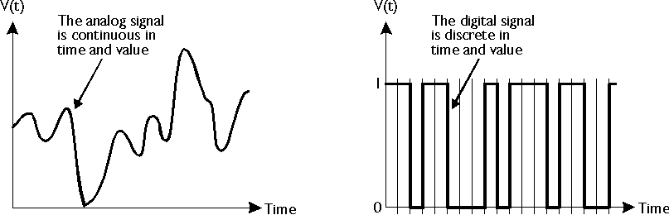
Analog Signal
Digital Signal
0011 0010 0100
0001 1010 0111
0101 0011 0110
Buffer
Amplifier
Sample & hold
A/D
Converter
Computer
Memory
Sensor
Low-pass filter

Slide 16
Voltage Level vs. Logic State
Digital Signal has a high noise immunity level –
the level of noise that can be added to the signal without affecting its state.

Slide 17
Analog Signal vs. Digital Signal
Analog signals
Pros: high resolution, efficient transmission, smaller bandwidth (1 wire, 1 signal), no delay, ‘real world’ signals, cost less
Cons: Difficult to process (perform operations, storage), the signal is affected by noise
Digital Signals
Pros: high immunity to noise, easy to process
Cons: needs a lot of ‘bits’ and circuits, data processing delay
LP record vs CD audio analog TV vs digital TV

Slide 18
Analog – Digital Conversion
Bit 0
Digital input
DAC
Analog output
Bit 9
Bit 0
Analog input
ADC
Digital output
Bit 9

Slide 19
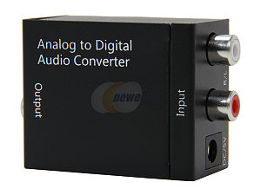
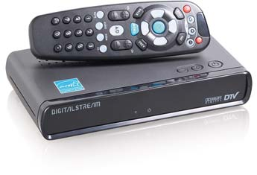
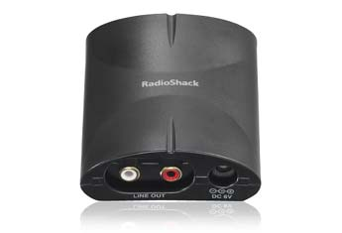
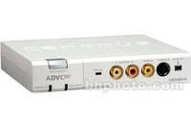
Digital to Analog video converter
Digital Audio to Analog Converter
Analog to Digital video converter

Slide 20
Binary Numbers - Bits, Bytes and Words
Consider a number 7582, it has four digits
The 2 is filling the “1s place”, the 8 is filling the “10s place”, the 5 is filling the “100s place while the 7 is filling the “1000s place.
(7 * 1000) + (5 * 100) + (8 * 10) + (2 * 1) = 7000 + 500 + 80 + 2 = 7582
A different way of expressing the same number is to use powers of 10 – this is a base 10 system.
(7 * 10³) + (5 * 10²) + (8 * 10¹) + (2 * 10⁰) = 7000 + 500 + 80 + 2 = 7582
We can select any number as the base, for example 8, 5, ….
Computers operate using the base 2 number system, also known as the binary number system.
Notes:
Start Wed. 11/13

Slide 21
Bits, Bytes and Words
The word bit is an acronym for
"Binary digIT."
Decimal digits have 10 possible values ranging from 0 to 9, bits have only two possible values: 0 and 1. Therefore, a binary number is composed of only 0s and 1s, like 1011.
We can use the same method as base-10 to determine the value of 1011, but instead of 10 use 2:
(7 * 10³) + (5 * 10²) + (8 * 10¹) + (2 * 10⁰) = 7000 + 500 + 80 + 2 = 7582
(1 * 2³) + (0 * 2²) + (1 * 2¹) + (1 * 2⁰) = 8 + 0 + 2 + 1 = 11

Slide 22
Counting in decimal and binary from 0 to 20
Decimal
Binary
0 and 1 are the same in both systems
0 = 0
1 = 1
2 = 10
3 = 11
4 = 100
5 = 101
6 = 110
7 = 111
8 = 1000
9 = 1001
10 = 1010
11 = 1011
12 = 1100
13 = 1101
14 = 1110
15 = 1111
16 = 10000
17 = 10001
18 = 10010
19 = 10011
20 = 10100
Carrying over starts at the second number.
Binary Arithmetic
There are four basic rules
1) 0 + 0 = 0 and carry 0
2) 0 + 1 = 1 and carry 0
3) 1 + 0 = 1 and carry 0
4) 1 + 1 = 0 and carry 1
11 + 1 = 100
101 + 1 = 110

Slide 23
Bits, Bytes and Words
Bits: (2⁰)
One ‘bit’ can only represent a binary state:
0 or 1,
on or off,
stop or go.
Bytes. (2³)
One byte consists of 8 bits.
Mega (M)
2^20 = 1,048,576
Giga (G)
2^30 = 1,073,741,824
Words: (2⁴ or 2⁵ or 2⁶)
One word consists of 16 bits or 32 bits or 64 bits, depending on the computer.

Slide 24
Number of bits | Number of different values that can be represented
4-bit (1 nibble) | 2⁴ =16
8-bit (1 byte) | 2⁸ = 256
10-bit | 2¹⁰ = 1024
16-bit (1 word) | 2¹⁶=65536
32-bit | 2³²=4294967296
64-bit | 2⁶⁴=8589934592

Slide 25
A 4-bit binary number
2³ (b₃) | 2² (b₂) | 2¹ (b₁) | 2⁰ (b₀)
8 | 4 | 2 | 1
MSB
LSB
Most Significant Bit
Least Significant Bit
Binary number: 0110 = (0x8)+(1x4)+(1x2)+(0x1)=6
Binary number: 1101 = 8+4+1=13

Slide 26
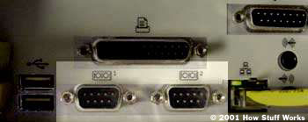
Digital Communication
Serial connection
A serial port is a general-purpose interface that can be used for almost any type of device, including modem, mouse, …, ( 9 or 25 pin)
Bits are sent sequentially, it takes a long time
9-pin serial ports

Slide 27
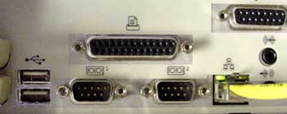
Digital Communication
Parallel connection
Uses a dedicated wire for each bit, faster than serial port. Printer is connected to the parallel port.
parallel port sends 8 bits of data (1 byte) at a time. These 8 bits are transmitted parallel to each other
25 pin female at the PC

Slide 28
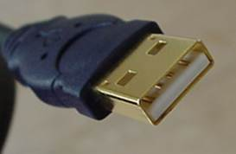
Universal Serial Bus - USB
With the advances made in technological, both the serial and parallel port have largely been replaced by the use of USB ports, and fewer new devices are designed to include either a serial or parallel port.
USB ports support much faster (often 100x or greater) data transfers than serial or parallel.
The USB industry standard exists in multiple versions including 1.1, 2.0, 3.0 and 3.1. However, USB ports feature identical physical layouts no matter the version of USB supported.

Slide 29
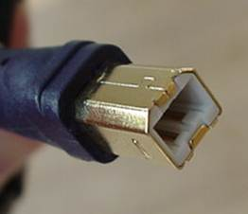
USB version/Year
Data transfer rate (Mbps)
1.1 (1998)
1.5 & 12 (keyboard and mouse)
2.0 (2001)
480 (high speed))
3.0 (2008)
4800 (Super Speed)
3.1 (2014)
9600
"A" connectors head "upstream" toward the computer
"B" connectors head "downstream" and connect to individual devices

Slide 30
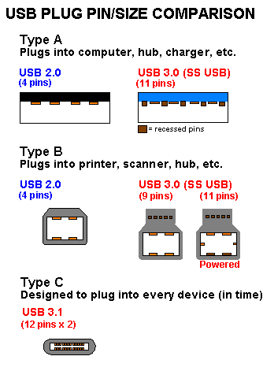
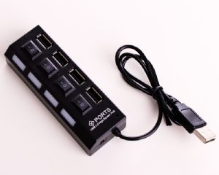
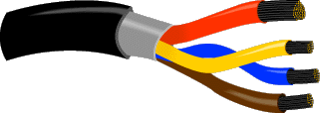
Universal Serial Bus - USB
The USB gives you a single, standardized, easy-to-use way to connect up to 127 devices to a computer.
4-Port Hub
Inside a USB B type cable
Power
Data

Slide 31
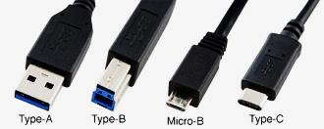
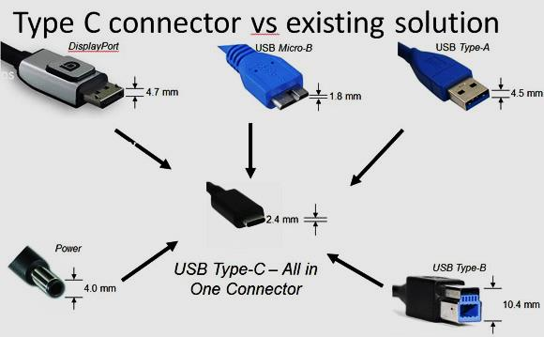

Slide 32
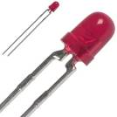
LEDs- Light Emitting Diodes:
A special kind of diode: They allow current to
flow in one direction.
The 5 LEDs on the IRB are for status indication only. They don’t serve any purpose for the operation of the board.
LED 1-3, show which IR detector is the active detector, blinking.
LED 4 indicates the tuning frequency, when on, robot is looking for the red beacon
When LED 5 is on, the circuit is at the low sensitivity setting.

Slide 33
IRB - Chips
Selector
Amplifier
Counter
Tuning

