Slide 1
Solver
Feature
Excel’s
KY

Slide 2
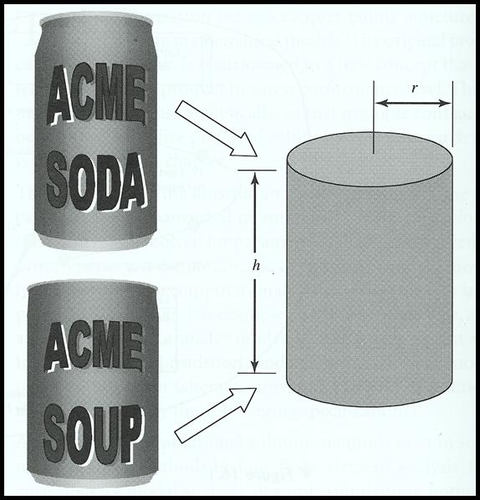
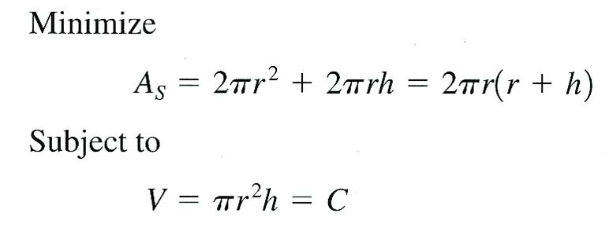
Solver
The Solver is intended primarily for solving constrained optimization problems.
For example, the goal could be to minimize the amount of material used to make the can while keeping the volume constant.
Volume of soda can = 12 oz = 355 mL
h and r have to be positive numbers h > 0 and r > 0
The Solver would return the values for height, h, and radius, r.

Slide 3
Solver
Solver can also solve a single algebraic equation.
2x⁵ – 3x² – 5 = 0
Find a positive real root of this equation, the added restriction is that x ≥ 0.
Simultaneous algebraic equations arise in many engineering applications. Solver is capable of finding the solution.
3x₁ + 2x₂ – x₃ – 4 = 0
2x₁ – x₂ + x₃ – 3 = 0
x₁ + x₂ – 2x₃ + 3 = 0
Find the values of x₁, x₂, and x₃ that will cause all three equations to equal zero.

Slide 4
Optimization – Problem Formulation
Design variables – a set of parameters that describes the system (dimensions, material, load, …)
Can example: height, h, and radius, r
Objective function – a criterion is needed to judge whether or not a given design is better than another (cost, profit, weight, deflection, stress, ….)
Design constraints – all systems are designed to perform within a given set of constraints. The constraints must be influenced by the design variables (max. or min. values of design variables).
h and r have to be positive numbers h > 0 and r > 0

Slide 5
Optimization Problem - Example
The US Environmental Protection Agency (EPA) regulates the maximum amounts of some pollutants that can be released in the air annually.
The problem
A steel mill releases two major types of pollutants: sulfur oxides and hydrocarbons. Their amounts exceed the limits imposed by the EPA. Minimum reduction is required for each of the two pollutant types.
The solution
Two possible approaches could be used to reduce the amount of pollution: better filters and better fuels. Each of the two methods can be implemented either in full or in any fraction.

Slide 6
Optimization Problem - Example
The results of the manufacturer experiments are shown in the tables below.
The Data

Slide 7
Optimization Problem – Example Formulation
Design (Decision) Variables
x₁ = fraction of better filter approach
x₂ = fraction of better fuel approach
Objective Function
The objective is to select abatement methods (better filter and fuel), for full or fractional implementation, so that all the pollutant reduction requirements are satisfied at the minimum cost.
Cost = 300(x₁) + 250(x₂)

Slide 8
Optimization Problem – Example Formulation
Constraints
EPA required pollution level reduction
10
x
+
5
x
≥
12
1
2
7
x
+
12
x
≥
14
1
2
x₁ (better filter) and x₂ (better fuel) variables are fractions between 0 and 1.
x
≤
1
1
x
≤
1
2
x
≥
0
1
x
≥
0
2

Slide 9
Optimization Problem – Example Formulation
Minimize
Cost = 300(x₁) + 250(x₂)
Subject to;
10
x
+
5
x
≥
12
1
2
7
x
+
12
x
≥
14
1
2
x
≤
1
Six constraints
1
x
≤
1
2
x
≥
0
1
x
≥
0
2

Slide 10
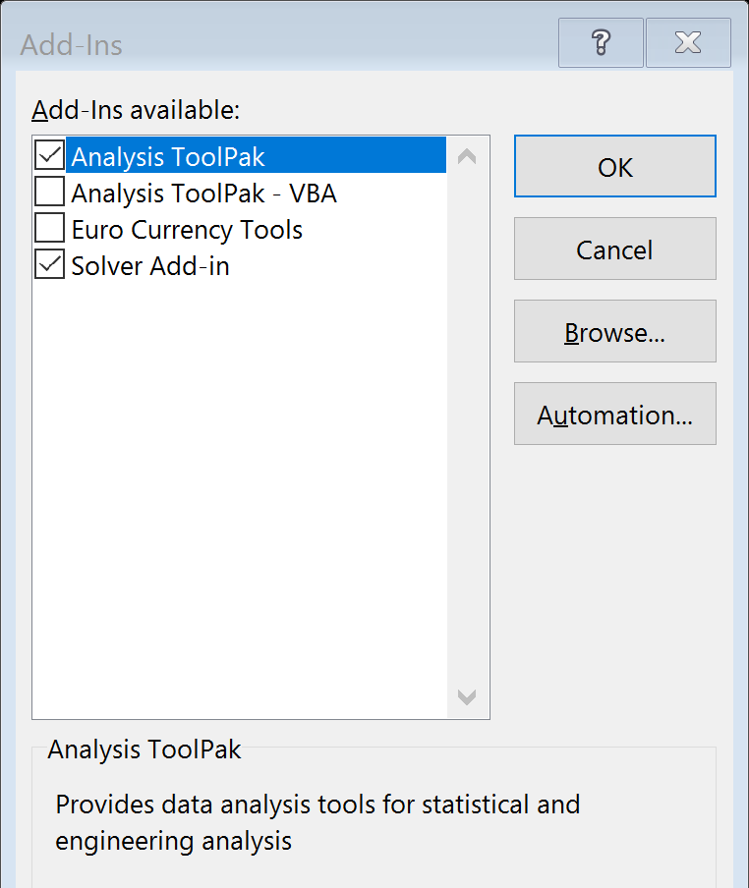
Activate ToolPak and Solver
Select Add Ins, click on Go
Select File and choose Options
Check Analysis ToolPak and Solver

Slide 11
Excel’s Solver
Select Data, If the Solver icon does not appear, use Add-Ins command to install the program
Formulate the optimization problem and enter the data into the spreadsheet
Design variables
Objective function
Design constraints

Slide 12
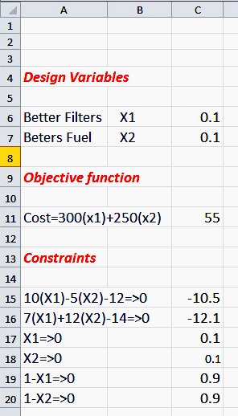
Excel’s Solver
Excel sheet entries
Columns A & B, text only
Column C, formula in Excel syntax
Initial guess for the variables
=300*C6+250*C7
Enter formula (syntax form) for the objective function
Enter formula for all constraints

Slide 13
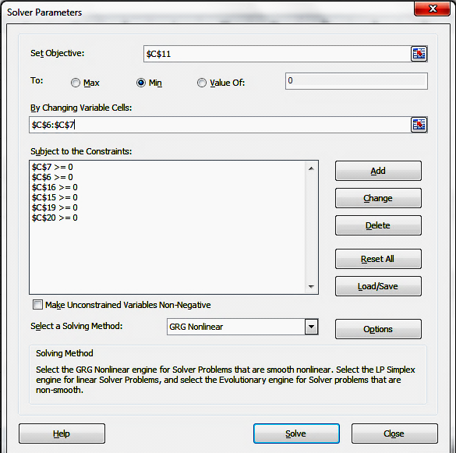
Excel’s Solver
Minimize the objective function

Slide 14
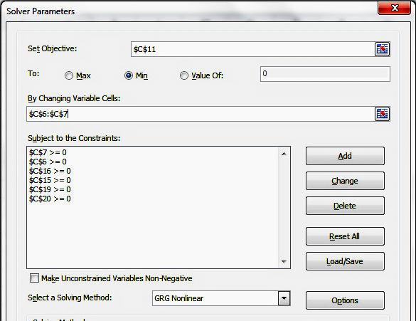
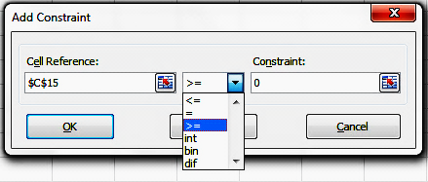
Excel’s Solver
Adding Constraints
Select Add and input the constraints one at a time

Slide 15
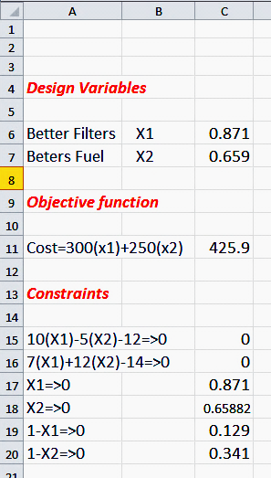
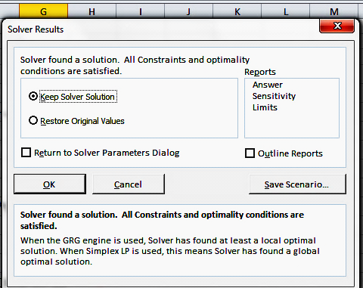
Excel’s Solver
The results
The minimized cost

Slide 16
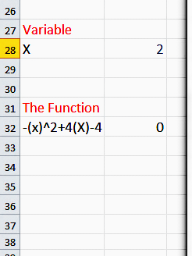
Excel’s Solver – Unconstraint Optimization
Maximize the function f(x) = - x² + 4x – 4
No constraint
The maximum value of the function is zero for x = 2
=-B28^2+4*B28-4

Slide 17
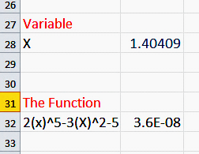
Solving Equations using Solver
Solving a one variable equation, 2x⁵ – 3x² – 5 = 0
With an added restriction that x has to be positive. For engineering problems a positive value is the only acceptable answer.
The answer

Slide 18
Solving a System of Equations
Find the values of x₁, x₂, and x₃ that will cause all three equations to equal zero.
f = 3x₁ + 2x₂ - x₃ - 4 = 0
g = 2x₁ - x₂ + x₃ - 3 = 0
h = x₁ + x₂ - 2x₃ + 3 = 0
Form the sum, y = f ² + g ² + h ²
If f = 0, g = 0, and h = 0, then y will also equal zero. For any other values of f, g, and h (whether positive or negative), however, y will be greater than zero.
Hence, we can solve the given system of equations by finding the values of x₁, x₂, and x₃ that cause y to equal zero. Use Solver to determine the values of x₁, x₂, and x₃ that drive the target function, y, to zero.

Slide 19
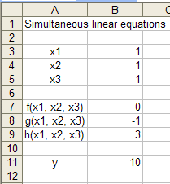
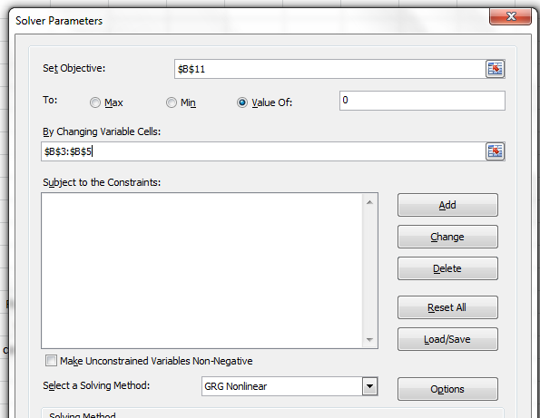
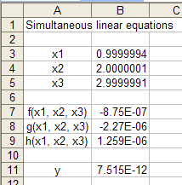
Solving a System of Equations
f = 3x₁ + 2x₂ - x₃ - 4 = 0
Answers
g = 2x₁ - x₂ + x₃ - 3 = 0
h = x₁ + x₂ - 2x₃ + 3 = 0
y = f ² + g ² + h ²
Target cell

