Slide 1

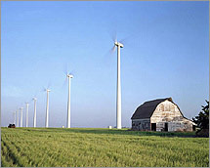

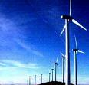

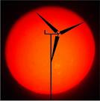
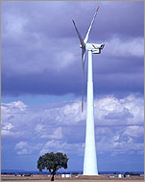
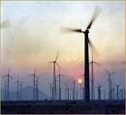


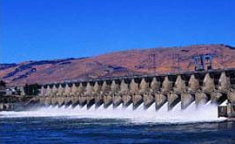


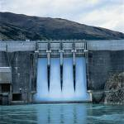
Alternative Sources of Energy
Wind Power
Solar Power
Hydro Power

Slide 2
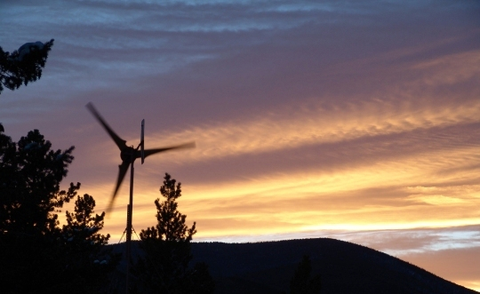
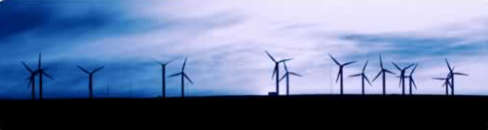
Wind Power
Wind Turbine Energy

Slide 3
The nation’s first wind farm going online was in southern California in 1975, producing enough electricity to power 4,149 homes.
By 1995, there were 54 wind farms across the country, mostly in California, powering 349,000 homes.
By 1999, wind farms were coming online throughout West, Texas, Minnesota, Wisconsin, Iowa, Colorado and Wyoming.

Slide 4
By the end of 2012, there were more than 45,000 wind turbines in 39 states, providing enough electricity to power about 15 million homes
As of 2014, there were more than 46,000 wind turbines in 44 states, providing 66,000 MW of power, enough electricity to power about 18 million homes
Nationwide, wind energy provided 2.3% of U.S. electricity generation during 2010.
For 2015, wind energy made up about 4.67% of total U.S. electric power generation (100% increase in 5 years)

Slide 5
Wind Turbine
Wind energy is created when the atmosphere is heated unevenly by the Sun, some patches of air become warmer than others. These warm patches of air rise, other air rushes in to replace them – thus, wind blows.
A wind turbine extracts energy from moving air by slowing the wind down, and transferring this energy into a spinning shaft, which usually turns a generator to produce electricity. The power in the wind that’s available for harvest depends on both the wind speed and the area that’s swept by the turbine blades.

Slide 6
Wind Turbine Design
Two types of turbine design are possible – Horizontal axis and Vertical axis. In horizontal axis turbine, it is possible to catch more wind and so the power output can be higher than that of vertical axis. But in horizontal axis design, the tower is higher and more blade design parameters have to be defined. In vertical axis turbine, no yaw system is required and there is no cyclic load on the blade, thus it is easier to design. Maintenance is easier in vertical axis turbine whereas horizontal axis turbine offers better performance.
Vertical axis Turbine (VAT)
Horizontal axis Turbine (HAT)

Slide 7
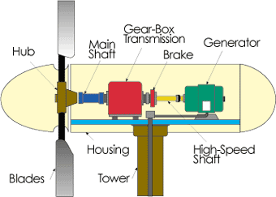
Main components of a Horizontal Axis Wind Turbine
Rotor: Converts the wind power to a rotational mechanical power.
Generator: Converts the rotational mechanical power to electrical power.
Gear box: Wind turbines rotate typically between 20 rpm and 400 rpm. Generators typically rotates at 1,200 to 1,800 rpm. Most wind turbines require a step-up gear-box for efficient generator operation (electricity production).

Slide 8
The Rotor
Rotor
Rotor
The portion of the wind turbine that collects energy from the wind is called the rotor. The rotor usually consists of two or more wooden, fiberglass (new design) or metal blades which rotate about an axis (horizontal or vertical) at a rate determined by the wind speed and the shape of the blades. The blades are attached to the hub, which in turn is attached to the main shaft.

Slide 9
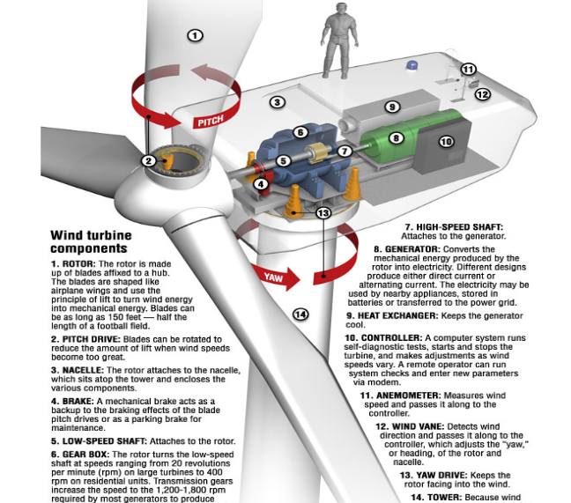

Slide 10
Rotor Blade Variables
Blade Length
Blade Number
Blade Pitch
Blade Shape (profile)
Blade Materials (weight)
For our class, we have control over three parameters
What should be the blade profile?
What should be the angle of attack?
How many blades to use?
Conduct an internet search to obtain enough information to help you decide on the number, the profile and the angle of attack of the blade.

Slide 11
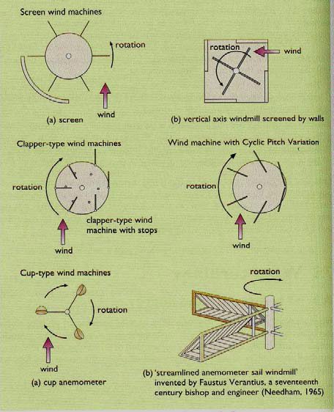
Wind Turbine
Blade designs operate on either the principle of drag or lift.
Drag Design
For the drag design, the wind literally pushes the blades out of the way. Drag powered wind turbines are characterized by slower rotational speeds and high torque capabilities. They are useful for the pumping, sawing or grinding work that Dutch, farm and similar "work-horse" windmills perform. A farm-type windmill must develop high torque at start-up in order to pump, or lift, water from a deep well.

Slide 12
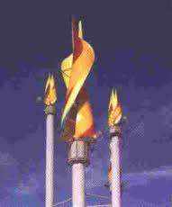
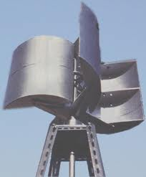
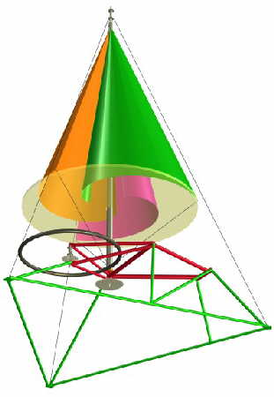
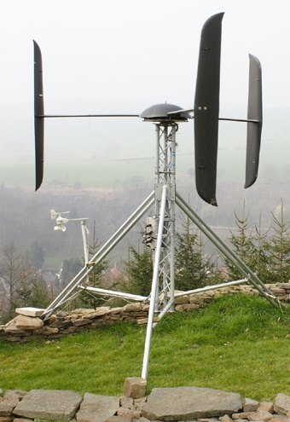
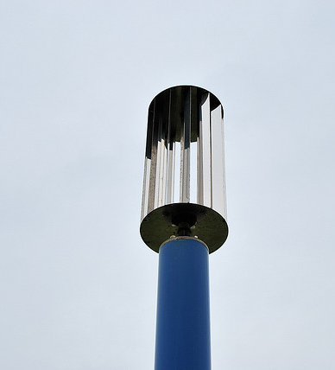
Wind Turbine Design using Drag Principle

Slide 13
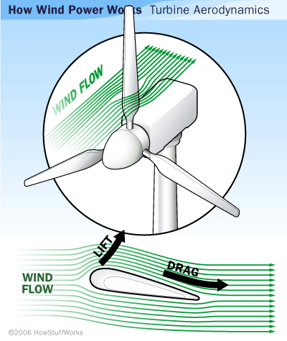
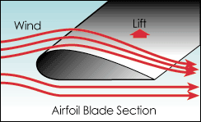
Lift Design
The lift blade design employs the same principle that enables airplanes, kites and birds to fly. The blade is essentially an airfoil, or wing. When air flows past the blade, a wind speed and pressure differential is created between the upper and lower blade surfaces. When blades are attached to a central axis, like a wind turbine rotor, the lift is translated into rotational motion. Lift-powered wind turbines have much higher rotational speeds than drag types and therefore are well suited for electricity generation.
Relative pressure difference causing lift
Same amount of air travels further creating lower pressure
Air
Same amount of air travels shorter distance creating lower pressure

Slide 14
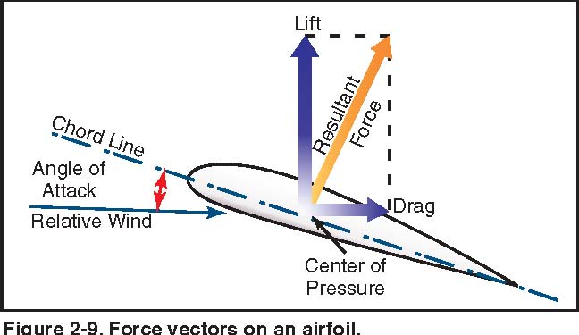

Slide 15
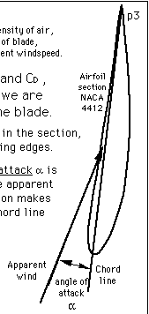
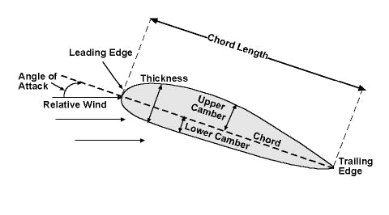
Wind Turbine – Blade Design
Angle of attack (blade angle)
The angle between the chord line of the airfoil and the flight direction is called the angle of attack. Angle of attack has a large effect on the lift generated by an airfoil. This is the propeller efficiency. Typically, numbers here can range from 1.0 to 15.0 degrees.

Slide 16
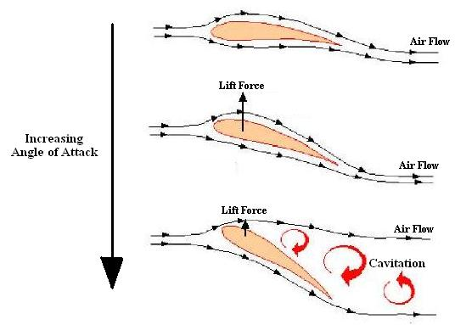
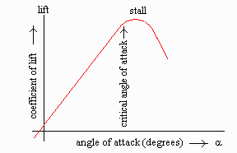
Angle of attack

Slide 17
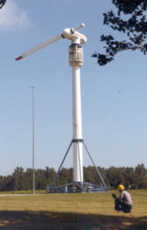
Wind Turbine – Blade Design
Blade Number
The determination of the number of blades involves design considerations of aerodynamic efficiency, component costs, system reliability, and aesthetics..
Aerodynamic efficiency increases with the number of blades but with diminishing return.
Increasing the number of blades from one to two yields a 6% increase in efficiency, whereas increasing the blade count from two to three yields only an additional 3% in efficiency. Further increasing the blade count yields minimal improvements in aerodynamic efficiency and sacrifices too much in blade stiffness as the blades become thinner.
Generally, the fewer the number of blades, the lower the material and manufacturing costs will be. Higher rotational speed reduces the torques in the drive train, resulting in lower gearbox and generator costs.
One blade rotor

Slide 18
Wind Turbine – Blade Design
Even or Odd Number of Blades
A rotor with an even number of blades will cause stability problems for a wind turbine. The reason is that at the very moment when the uppermost blade bends backwards, because it gets the maximum power from the wind, the lower most blade passes into the wind shade in front of the tower. This produces uneven forces on the rotor shaft and rotor blade.

Slide 19
Blade Linear Speed
V (linear speed) = R (dist. from the hub center) x ω
V_{tip}
Blade
R
V = ¼ V_{tip}
ω (constant)
Hub

Slide 20
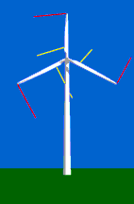
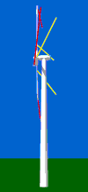
Wind Turbine – Blade Design (Shape)
To study how the wind moves relative to the rotor blades of a wind turbine, attach red ribbons to the tip of the rotor blades and yellow ribbons about 1/4 of the way out from the hub.
Since most wind turbines have constant rotational speed, the speed with which the tip of the rotor blade moves through the air (the tip speed) is typically some 64 m/s, while at the center of the hub it is zero. 1/4 out from the hub, the speed will then be some 16 m/s.
The yellow ribbons close to the hub of the rotor will be blown more towards the back of the turbine than the red ribbons at the tips of the blades. This is because, at the tip of the blades, the speed is some 8 times higher than the speed of the wind hitting the front of the turbine.

Slide 21
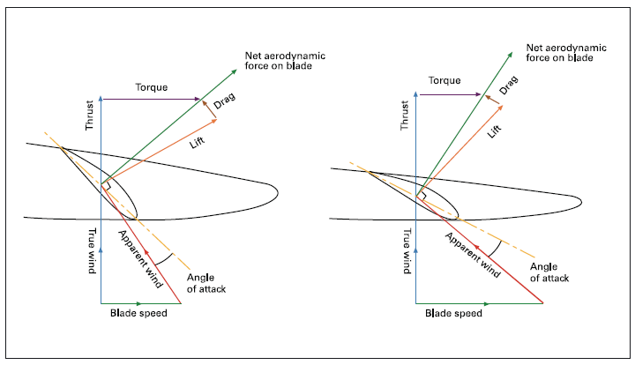
Blade Twist

Slide 22
Wind Turbine – Blade Design (Twist)
Rotor blades for wind turbines are always twisted. Seen from the rotor blade, the wind will be coming from a much steeper angle (more from the general wind direction in the landscape), as you move towards the root of the blade, and the center of the rotor. A rotor blade will stop giving lift (stall), if the blade is hit at an angle of attack which is too steep.
Therefore, the rotor blade has to be twisted, so as to achieve an optimal angle of attack throughout the length of the blade.

Slide 23
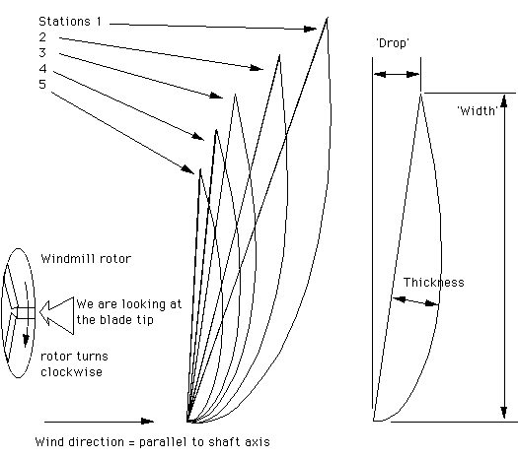
Wind Turbine – Blade Design
Blade size and shape
Last profile next to the hub
5-station design as seen from the tip
First profile at the tip

Slide 24
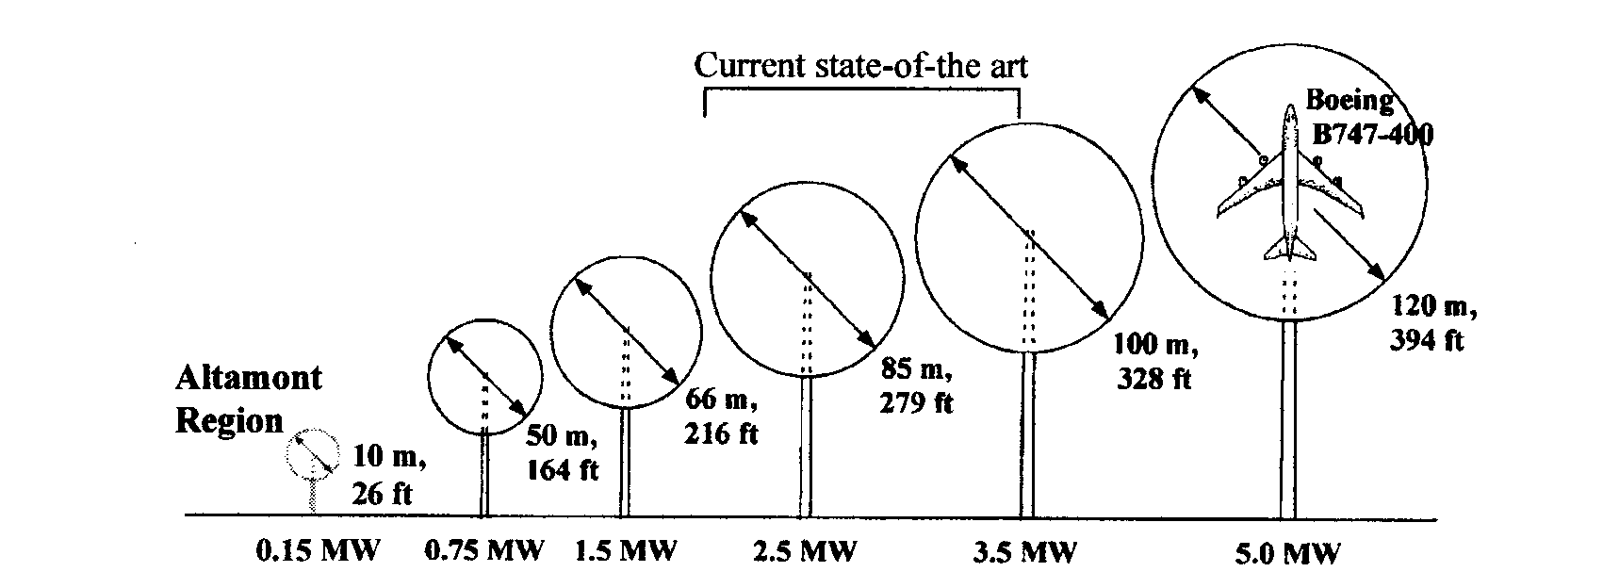
Power Generated by Wind Turbine
Swept area
Diameter
Elevation
There are about 4,900 wind turbines in California at Altamont Pass (between Tracy and Livermore). The capacity is 580 MW, enough to serve 180,000 homes. In the past, Altamont generated 822x10⁶ kW hours, enough to provide power for 126,000 homes (6500 Kwh per house)
Notes:
wed

Slide 25
Typical Wind Turbine Operation
0 ~ 10 mph --- Wind speed is too low for generating power. Turbine is not operational. Rotor is locked.
10 ~ 25 mph --- 10 mph is the minimum operational speed. It is called “Cut-in speed”. In 10 ~ 25 mph wind, generated power increases with the wind speed.
25 ~ 50 mph --- Typical wind turbines reach the rated power (maximum operating power) at wind speed of 25mph (called Rated wind speed). Further increase in wind speed will not result in substantially higher generated power by design. This is accomplished by, for example, pitching the blade angle to reduce the turbine efficiency.
> 50 mph --- Turbine is shut down when wind speed is higher than 50mph (called “Cut-out” speed) to prevent structure failure.

Slide 26
Theoretical Power Generated by Wind Turbine
Power = ½ (ρ)(A)(V)³
ρ = Density of air = 1.2 kg/m³ (.0745 lb/ft³), at sea level, 20 ºC and dry air
A = swept area = π(radius)², m²
V = Wind Velocity, m/sec.
A
ρ = 1.16 kg/m³, at 1000 feet elevation
ρ = 1.00 kg/m³, at 5000 feet elevation
ρ = 1.203 kg/m³ at San Jose, at 85 feet elevation. The average wind velocity is 5 mph at 50m tower height
ρ = 1.16 kg/m³ at Altamont pass, at 1010 feet elevation and average wind velocity of 7m/s (15.6 mph) at 50m tower height (turbines need a minimum of 14 mph, 6.25 m/s, wind velocity to generate power).

Slide 27
Wind Turbine Efficiency, η
Betz Limit (1919)
It is the flow of air over the blades and through the rotor area that makes a wind turbine function. The wind turbine extracts energy by slowing the wind down. The theoretical maximum amount of energy in the wind that can be collected by a wind turbine's rotor is approximately 59.3%. This value is known as the Betz limit. If the blades were 100% efficient, a wind turbine would not work because the air, having given up all its energy, would entirely stop. In practice, the collection efficiency of a rotor is not as high as 59%. A more typical efficiency is 35% to 45%. A complete wind energy system, including rotor, transmission, generator, storage and other devices, which all have less than perfect efficiencies, will deliver between 10% and 30% of the original energy available in the wind.

Slide 28
Power Generated by HWind Turbine
How much power a wind turbine with 50 meters long blade can generate with a wind speed of 12 m/s? The site of the installation is about 1000 feet above sea level. Assume 40% efficiency (η).
Air density is lower at higher elevation. For 1000 feet above sea level, ρ is about 1.16 kg/m³
Power = ½ (ρ)(A)(V)³ (η)
= 0.5(1.16)(π50²)(12)³(0.4)
= 3.15 x 10⁶ Watt
= 3.15 MW
where we assumed the turbine efficiency is 40%.

Slide 29
Wind Turbine
Doubling the tower height increases the expected wind speeds by 10% and the expected power by 34%. Doubling the tower height generally requires doubling the diameter as well, increasing the amount of material by a factor of eight.
At night time, or when the atmosphere becomes stable, wind speed close to the ground usually subsides whereas at turbine altitude, it does not decrease that much or may even increase. As a result, the wind speed is higher and a turbine will produce more power than expected - doubling the altitude may increase wind speed by 20% to 60%.
Tower heights approximately two to three times the blade length have been found to balance material costs of the tower against better utilization of the more expensive active components.

Slide 30
Wind Turbine
Tip Speed Ratio
The tip-speed ratio is the ratio of the rotational speed of the blade to the wind speed. The larger this ratio, the faster the rotation of the wind turbine rotor at a given wind speed. Electricity generation requires high rotational speeds. Lift-type wind turbines have maximum tip-speed ratios of around 10, while drag-type ratios are approximately 1. Given the high rotational speed requirements of electrical generators, it is clear that the lift-type wind turbine is the most practical for this application.
The number of blades and the total area they cover affect wind turbine performance. For a lift-type rotor to function effectively, the wind must flow smoothly over the blades. To avoid turbulence, spacing between blades should be great enough so that one blade will not encounter the disturbed, weaker air flow caused by the blade which passed before it.

Slide 31
Wind Turbine
The Generator
The generator converts the mechanical energy of the turbine to electrical energy (electricity).
Inside this component, coils of wire are rotated in a magnetic field to produce electricity. Different generator designs produce either alternating current (AC) or direct current (DC), available in a large range of output power ratings.
Most home and office appliances operate on 120 volt (or 240 volt), 60 cycle AC. Some appliances can operate on either AC or DC, such as light bulbs and resistance heaters, and many others can be adapted to run on DC. Storage systems using batteries store DC and usually are configured at voltages of between 12 volts and 120 volts.
Generators that produce AC are generally equipped with features to produce the correct voltage (120 or 240 V) and constant frequency (60 cycles) of electricity, even when the wind speed is fluctuating.

Slide 32
Wind Turbine
Transmission
Most wind turbines require a gear-box transmission to increase the rotation of the generator to the speeds necessary for efficient electricity production.
The number of revolutions per minute (rpm) of a wind turbine rotor can range between 40 rpm and 400 rpm, depending on the model and the wind speed. Generators typically require rpm's of 1,200 to 1,800. As a result, Some DC-type wind turbines do not use transmissions. Instead, they have a direct link between the rotor and generator. These are known as direct drive systems. Without a transmission, wind turbine complexity and maintenance requirements are reduced, but a much larger generator is required to deliver the same power output as the AC-type wind turbines.

Slide 33
Wind Turbine
Cut-in Speed
Cut-in speed is the minimum wind speed at which the wind turbine will generate usable power. This wind speed is typically between 7 and 15 mph.
Rated Speed
The rated speed is the minimum wind speed at which the wind turbine will generate its designated rated power. For example, a "10 kilowatt" wind turbine may not generate 10 kilowatts until wind speeds reach 25 mph. Rated speed for most machines is in the range of 25 to 35 mph. At wind speeds between cut-in and rated, the power output from a wind turbine increases as the wind increases. The output of most machines levels off above the rated speed. Most manufacturers provide graphs, called "power curves," showing how their wind turbine output varies with wind speed.

Slide 34
Wind Turbine
Cut-out Speed
At very high wind speeds, typically between 45 and 80 mph, most wind turbines cease power generation and shut down. The wind speed at which shut down occurs is called the cut-out speed. Having a cut-out speed is a safety feature which protects the wind turbine from damage. Shut down may occur in one of several ways. In some machines an automatic brake is activated by a wind speed sensor. Some machines twist or "pitch" the blades to spill the wind. Still others use "spoilers," drag flaps mounted on the blades or the hub which are automatically activated by high rotor rpm's, or mechanically activated by a spring loaded device which turns the machine sideways to the wind stream. Normal wind turbine operation usually resumes when the wind drops back to a safe level.

Slide 35
Power Generated by Wind Turbine
Wind turbines with rotors (turbine blades and hub) that are about 8 feet in diameter (50 square feet of swept area) may peak at about 1,000 watts (1 kilowatt; kW), and generate about 75 kilowatt-hours (kWh) per month with a 10 mph average wind speed. Turbines smaller than this may be appropriate for sailboats, cabins, or other applications that require only a small amount of electricity. [Small Wind]
For wind turbine farms, it’s reasonable to use turbines with rotors up to 56 feet in diameter (2,500 square feet of swept area). These turbines may peak at about 90,000 watts (90 kW), and generate 3,000 to 5,000 kWh per month at a 10 mph average wind speed, enough to supply 200 homes with electricity.
Homes typically use 500-1,500 kilowatt-hours of electricity per month. Depending upon the average wind speed in the area this will require a wind turbine rated in the range 5-15 kilowatts, which translates into a rotor diameter of 14 to 26 feet.

Slide 36
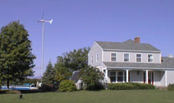
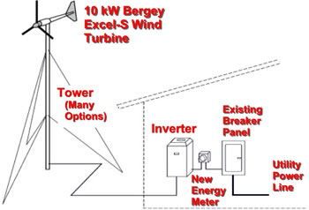
Example of Residential Wind Turbine
Bergey wind turbines operate at variable speed to optimize performance and reduce structural loads. Power is generated in a direct drive, low speed, permanent magnet alternator. The output is a 3-phase power that varies in both voltage and frequency with wind speed. This variable power (wild AC) is not compatible with the utility grid. To make it compatible, the wind power is converted into grid-quality 240 VAC, single phase, 60 hertz power in an IGBT-type synchronous inverter, the GridTek Power Processor. The output from the GridTek can be directly connected to the home or business circuit breaker panel. Operation of the system is fully automatic. It has a rotor diameter of 23 feet and is typically installed on 80 or 100 foot towers.
10kW Turbine | $27,900
100 ft.Tower Kit | $9,200
Tower Wiring Kit | $1,000
Total Cost: | $38,100

Slide 37
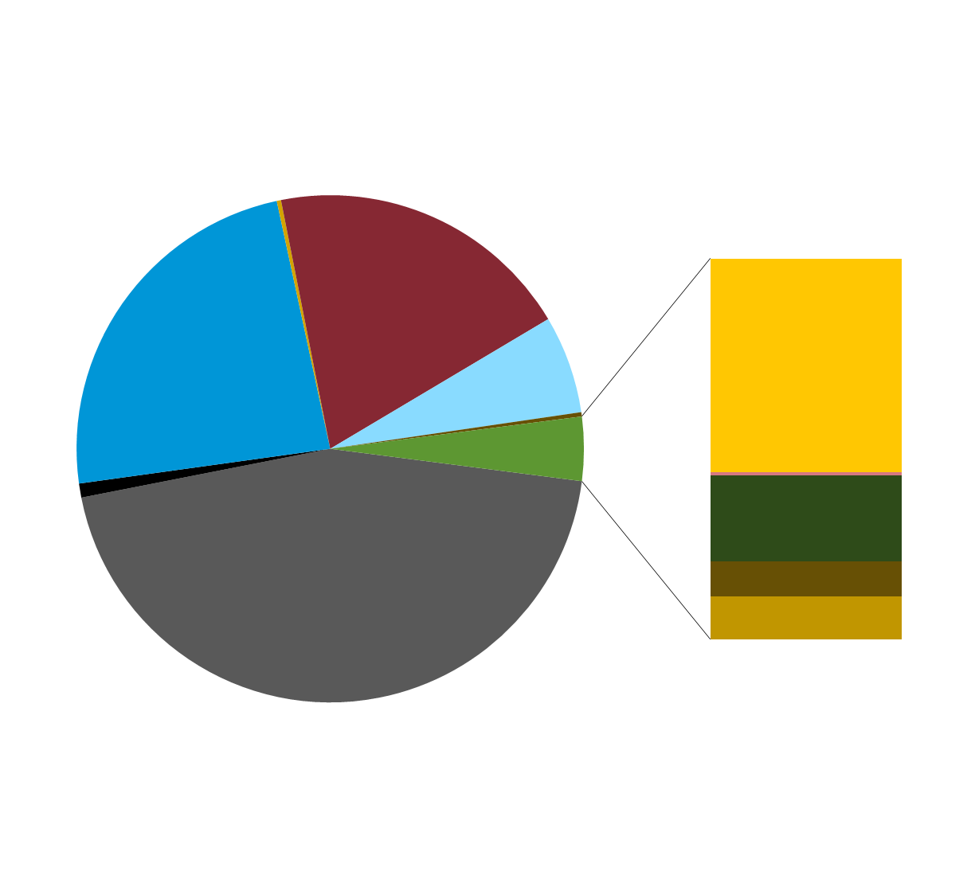
In 2010, U.S. electricity generation was 70% fossil fuels, 20% nuclear, and 10% renewable
2010 Total net generation:
4,120 billion kWh
2010 Non-hydro renewable
net generation:
168 billion kWh
Other gases
0.3%
Conventional
hydroelectric
6.2%
Nuclear
19.6%
Natural gas
23.8%
Other
0.3%
Wind: 2.3%
Other
renewable
4.1%
Solar thermal and PV: <0.1%
Wood and wood-derived fuels: 0.9%
Geothermal: 0.4%
Coal
44.9%
Petroleum
0.9%
Other biomass: 0.5%
Source: EIA, Annual Energy Review, October 2011
37

Slide 38
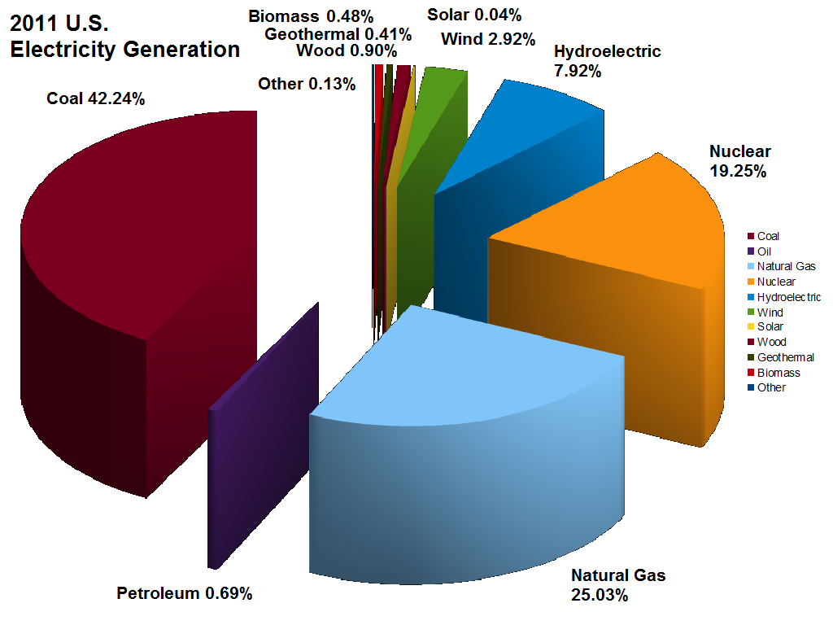

Slide 39
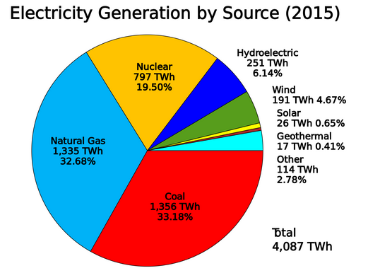

Slide 40
Total Electrical Energy Produced Nationwide
2010
2011
2012
2013
Coal
44.9%
42.2%
37.0%
39.0%
Natural Gas
23.8%
25.03%
30.0%
27.0%
Nuclear
19.6%
19.25%
19.0%
19.0%
Hydroelectric
6.2%
7.92%
7.00%
7.00%
Wind
2.3%
2.92%
3.50%
4.13%
Solar
No data
.04%
.11%
.23%
Biomass
.50%
.48%
1.50%
1.48%
Geothermal
.41%
.41%
.39%
.41%

Slide 41
2013
2014
2015
2016
Coal
39.0%
39.0%
33.2%
Natural Gas
27.0%
27.0%
32.7%
Nuclear
19.0%
19.0%
19.0%
Hydroelectric
7.0%
6.0%
6.2%
Wind
4.13%
4.40%
4.67%
Solar
0.23%
0.40%
0.65%
Biomass
1.48%
1.70%
1.75%
Geothermal
0.41%
0.41%
0.41%

Slide 42
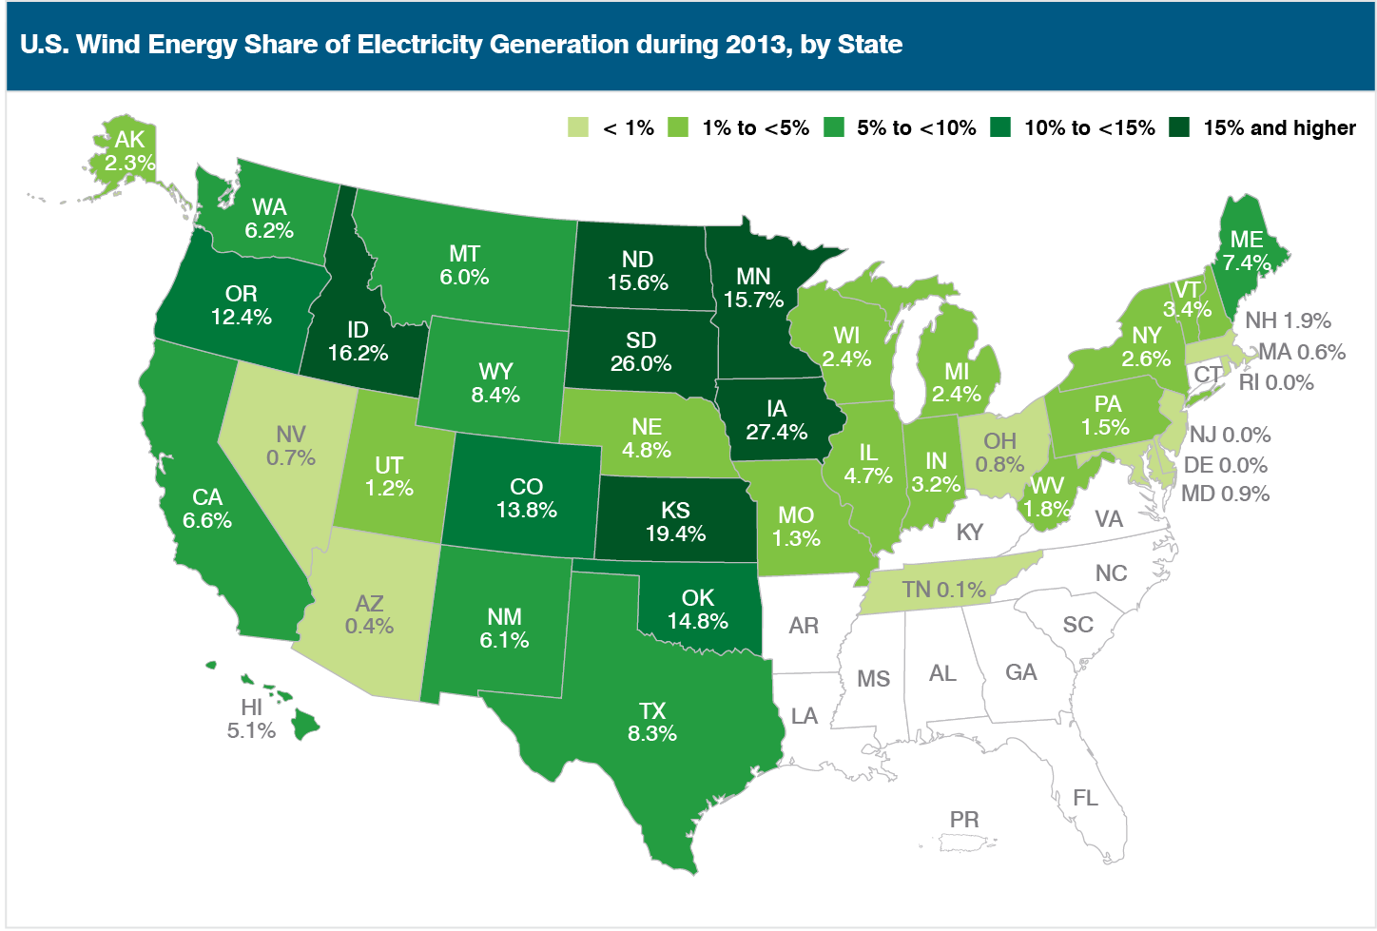

Slide 43
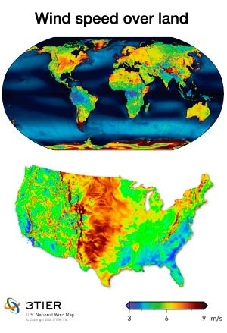
Wind Speed
Building wind facilities in the corridor that stretches from the Texas panhandle to North Dakota could produce 20% of the electricity for the United States at a cost of $1 trillion. It would take another $200 billion to build the capacity to transmit that energy to cities and towns.

Slide 44
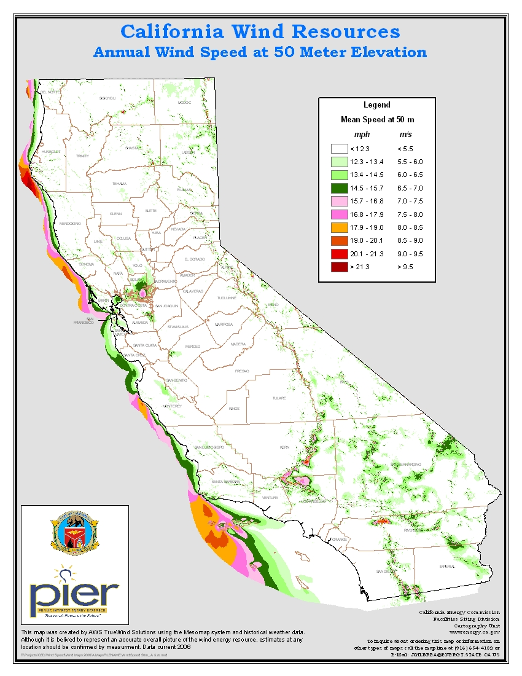
Altamont Pass,
Livermore
Tehachapi,
Mojave
Palm Spring

Slide 45
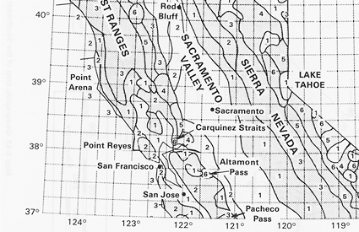
Northern California annual average wind power
Wind Power Class* | 10 m (33 ft) |  | 50 m (164 ft)
 |  | Speed^{(b)} m/s (mph) |  | Speed^{(b)} m/s (mph)
1 |  | 4.4 (9.8) |  | 5.6 (12.5)
2 |  | 5.1 (11.5) |  | 6.4 (14.3)
3 |  | 5.6 (12.5) |  | 7.0 (15.7)
4 |  | 6.0 (13.4) |  | 7.5 (16.8)
5 |  | 6.4 (14.3) |  | 8.0 (17.9)
6 |  | 7.0 (15.7) |  | 8.8 (19.7)
7 |  | 9.4 (21.1) |  | 11.9 (26.6)
Bay Area

