Slide 1
Design Process Concurrent Engineering

Slide 2
Design
Personal Expression
(Artistic)
Product/Process
(Technical)
Concrete
(realism)
Abstract
Aesthetic
(Industrial Design)
Functional
(Engineering Design)
Engineering
Design Cycle
Product
Process

Slide 3
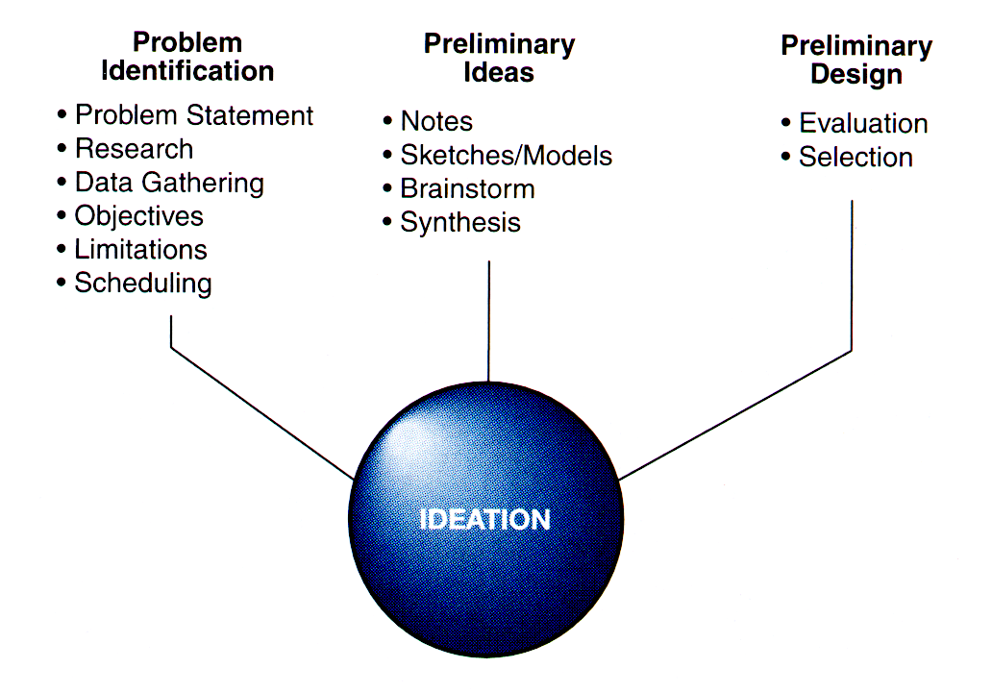
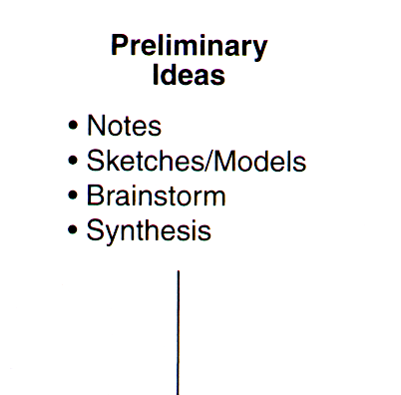
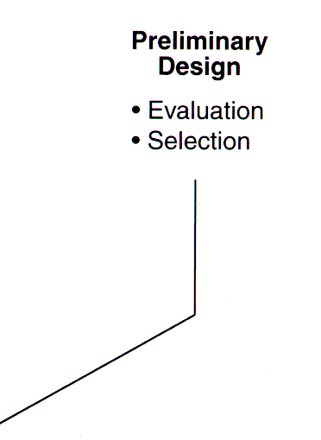
Ideation Process

Slide 4
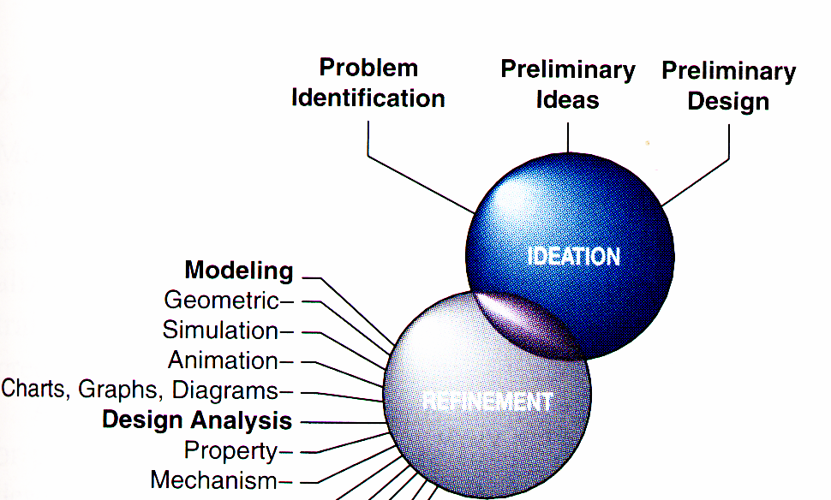
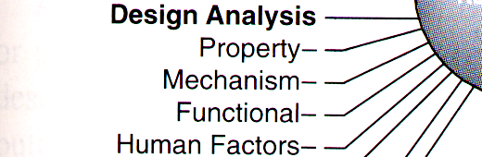
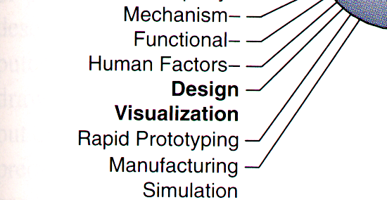
Refinement Process
Refinement Process

Slide 5
Implementation
Finance
Analyzes the feasibility of producing a product, relative to capital requirements and return on investment (management of cash flow).
Production
Production is a process used to transform raw materials into finish products, using labor, equipment, capital, and facilities. It requires engineering drawings, technical specifications, bill of materials, ……..
Marketing
Anticipates customer needs and directs the flow of goods from the producer to the consumer – much more than just selling and advertising. Satisfy the customer at a profit.

Slide 6
Implementation
Service
An activity that supports the installation, training, maintenance, and repair of a product or structure for the consumer.
Documentation
Documentation is a process used to formally record and communicate the final design solution. 3D models are used as inputs to the documentation stage to create engineering drawings, technical illustration, animation, and patent drawings. Documentation thus becomes a concurrent activity throughout the design process, instead of something that occurs only at the end.

Slide 7
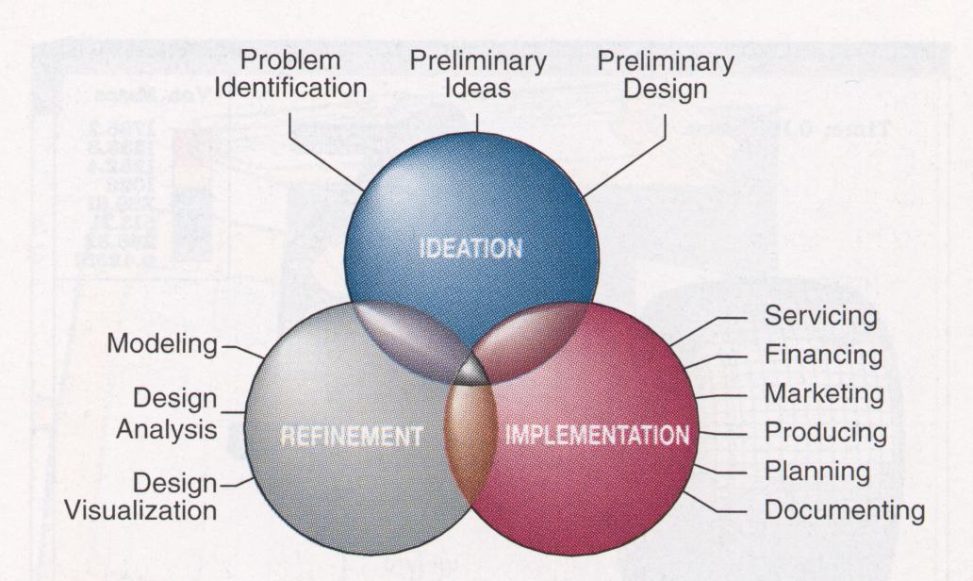
Concurrent Design Process
Involves coordination of the technical and non-technical functions of design and manufacturing within a business.

Slide 8
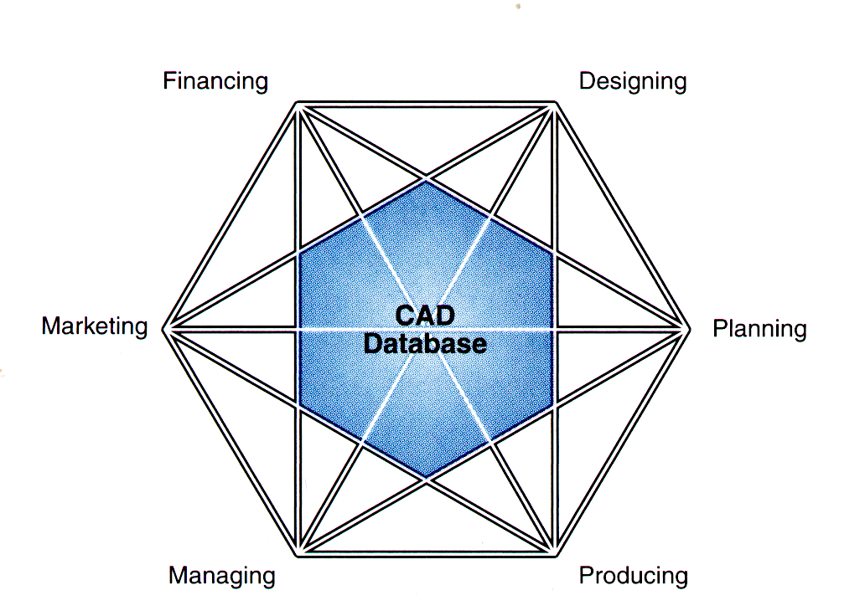
Sharing the CAD Database

Slide 9
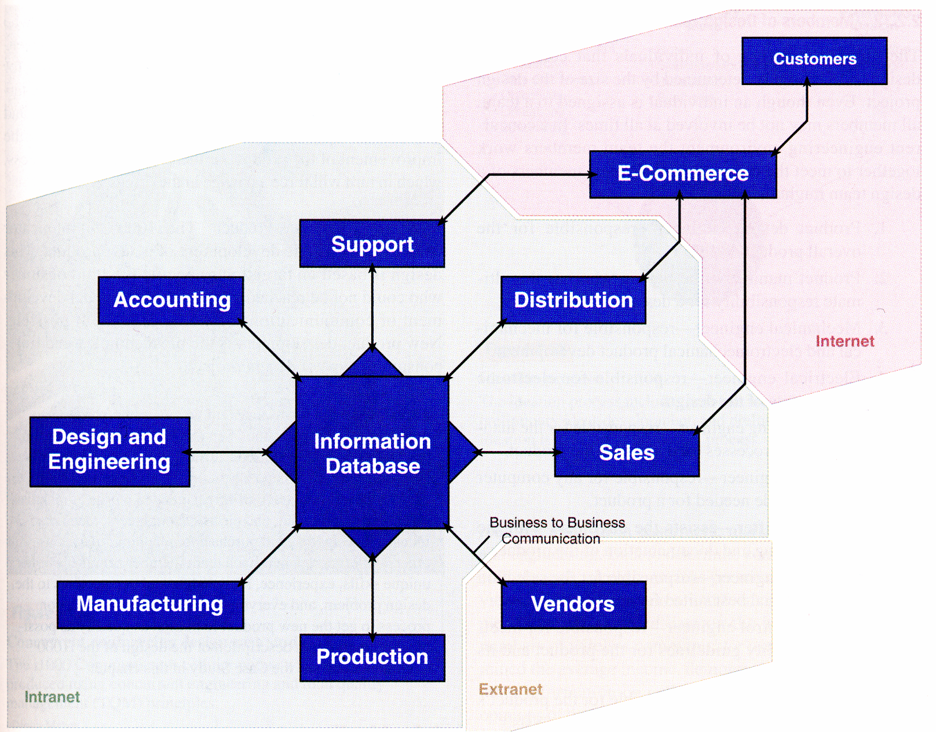
The Digital Enterprise

Slide 10
3 - Clicker Question
What is concurrent design process ?
A. The process includes only engineers
B. The process includes only the business part of the design
C. The process includes all disciplines involved in designing a product
D. The process includes business and science fields

Slide 11
Product life cycle
Design phase
Manufacturing phase
Product usage phase
Disposal phase
The design phase is the most critical
Determines the product success or failure in the market place.
Has a direct impact on product cost, quality, manufacturing,
maintenance cost, and disposal cost.
Approximately 80% of the product cost is fixed at the design stage;
it is easier and less costly to change the design in early phases.
Reduction in cost and lead time and improvements in product quality must be sought from all areas of a product-life cycle.

Slide 12
Computer Integrated Design and Manufacturing
Companies must deliver products to customers at the minimum possible cost, the best possible quality, and the minimum lead time starting from the product conception stage to final delivery, service and disposal.
The core of computer technology includes:
Computer-Aided Design (CAD)
geometric modeling
Computer-Aided Manufacturing (CAM)
Computer Numeric Control (CNC)
Computer-Aided Engineering (CAE) Analysis
Finite Element Analysis (FEA)

