Slide 1

Tips for Great Oral Presentations
ENGR 10
Charles W. Davidson
College of Engineering
San José State University

Slide 2
Purpose
Provide ENGR 10 students with presentation guidelines to help improve their oral communication skills
  Build a foundation of basic oral communication skills for the future
  Provide specific tips for successful E10 presentations

Slide 3
A presentation is . . .
Oral/visual form of communication
Preferred method of the industrial and business environment

Slide 4
Why present?
To sell, explain, justify,
your design, solution, ideas,
to colleagues, management, customers.
Remember:
  You are presenting yourself in addition to your project.
  The audience is listening and watching you.

Slide 5
An Oral Presentation is Different from a Written Report
Time sensitive
Fleeting
Spoken
Visual
gestures, body language, eye contact, graphics
intonation, pronunciation, style, speed
confused listeners cannot flip the page and review what was said
specific time allotment

Slide 6
Commonalities with a Written Report
Oral presentation prep starts with:
What is my purpose?
Who is my audience?

Slide 7


Oral Presentations in E 10
Wind Turbine Design and Performance
Robot Design and Performance
Some samples of previous presentations

Slide 8
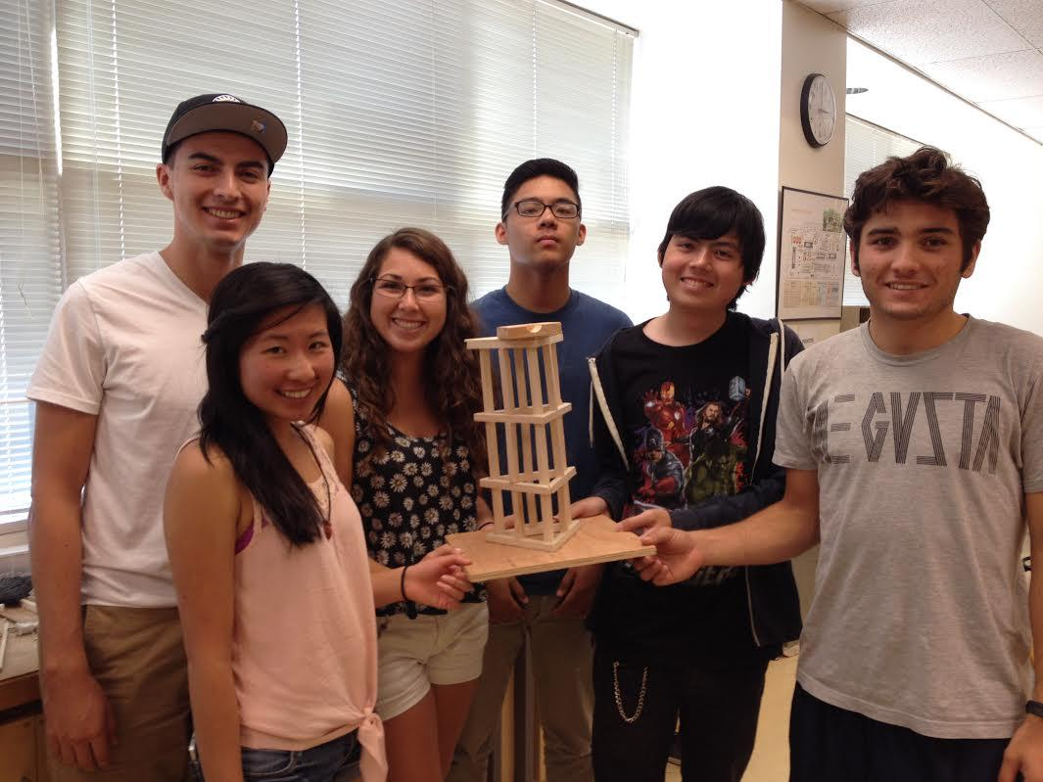
Wind Turbine Lab
Section 26,
Professor Warecki
Group 2
John Marcos, Chris Weber,
Isaac Rubio, Drew Lyell,
Michelle To, Jordan Helledy

Slide 9
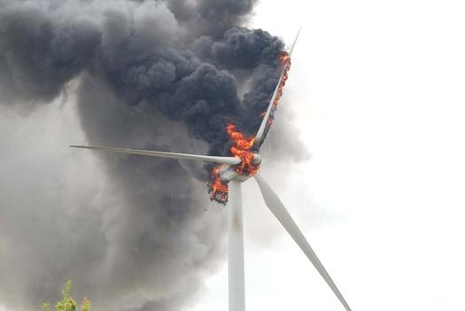
Performance Conclusion
We did not meet 2.0W design goal
Satisfied with our stiffness test
Satisfied with our light-weight design
The blade seemed to be the issue

Slide 10
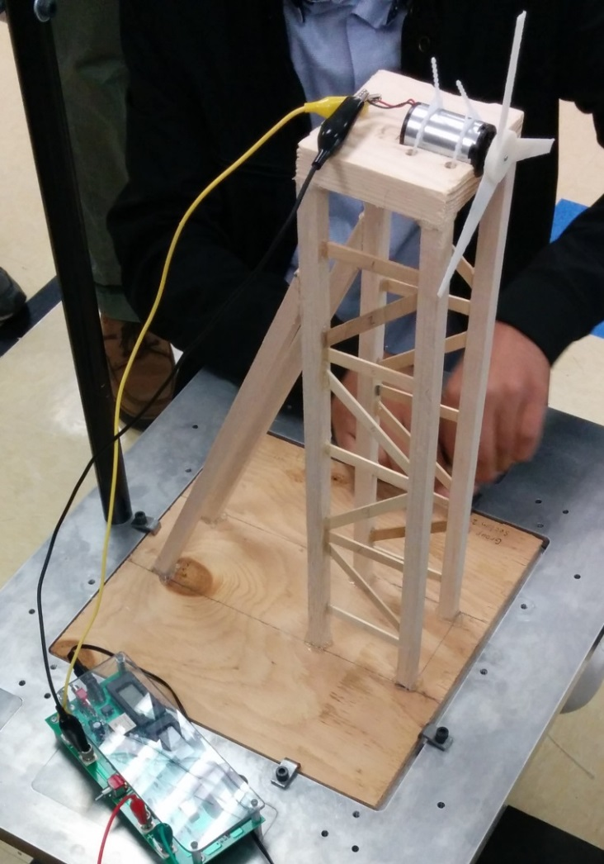
Structure Design
No support beams in the front and back, kept empty for air flow. Supports were placed just on sides.
Popsicle sticks for support beams
  Oriented at 45 degree angles
  Inserted instead of glued for more strength
Two rear wood support structures, for extra stability.

Slide 11
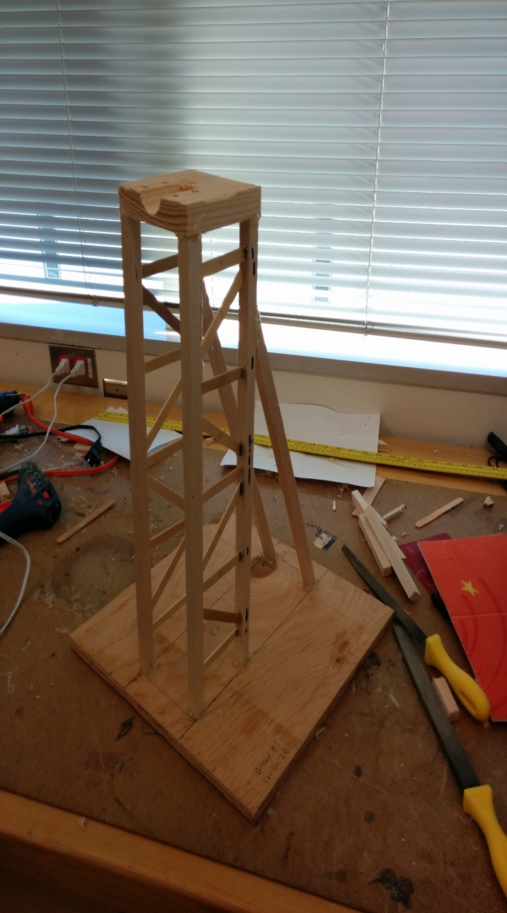
What worked well?
The creative support structure with the trusses built into the wood
The high stiffness value of k = 25N/mm showed little deflection

Slide 12
Tips for Slide Presentations
or
Major Pitfalls to Avoid
See Following Examples
www.elmhurst.edu/~jacobh/WorstPresentationEverStandAlone.ppt

Slide 13
Chilean Exports
Fresh fruit leads Chile's export mix - Chile emerges as major supplier of fresh fruit to world market due to ample natural resources, consumer demand for fresh fruit during winter season in U.S. and Europe, and incentives in agricultural policies of Chilean government, encouraging trend toward diversification of exports and development of nontraditional crops - U.S. Dept. of Agriculture, Economic Research Service Report
Chile is among the developing economies taking advantage of these trends, pursuing a free market economy. This has allowed for diversification through the expansion of fruit production for export, especially to the U.S. and Western Europe. Chile has successfully diversified its agricultural sector to the extent that it is now a major fruit exporting nation. Many countries view Chile's diversification of agriculture as a model to be followed.
Meanwhile, the U.S. remains the largest single market for Chile's fruit exports. However, increasing demand from the EC and Central and East European countries combined may eventually surpass exports to the U.S., spurring further growth in Chile's exports.
If you’ve read this far, your eyes probably hurt and you’ve been reading this tedious long-winded text instead of listening to me. I’m insulted- can’t you see I’m doing a presentation up here? Look at me! Congratulations, however, on having such good eyesight.

Slide 14
Too Much Text, and Font too small
Don’t put large blocks of text in your presentation.
Emphasize the main points.
Use pictures- PowerPoint is multimedia!
Use a large font…at least 22-point or more.

Slide 15
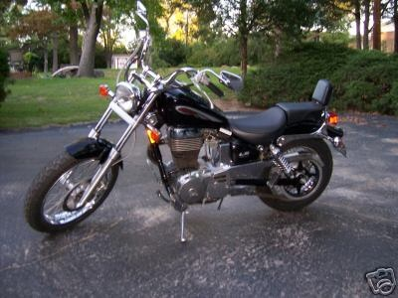
Beginner Motorcycles
My personal favorite: the Suzuki Savage
Light weight (~380lbs)
Adequate power (650cc engine)
Low seat height fits most riders

Slide 16
Bad Color Choices
Avoid loud, garish colors…dark text on light background is best.
Avoid text colors that fade into background, i.e. blue and black
Avoid color-blind combinations:
  Red and green
  Blue and yellow

Slide 17






Buying a New Suit

Slide 18
Overwhelming Pictures
Use pictures, but don’t let them use you.
Keep slides SIMPLE! Too much diverts audience away from content.
Too many pictures also make saving a presentation difficult.
1 or 2 pictures per slide is probably enough.

Slide 19
Racquetball Fundamentals
2, 3, or 4 players.
1 player serves, other “returns.”
Only serving player can score.
Served ball must land past serving line and cannot hit back wall.
Ball can only bounce once before striking front wall…but ball does not have to bounce.

Slide 20
Using too much Slide Animation
Again, keep slides simple!
Apply one Slide Transition style and one Animation Scheme to ALL slides.
Don’t change between styles- a single style makes a presentation look unified.
“Busy” presentations divert audience attention from content.

Slide 21
FILE NOT FOUND
Microsoft PowerPoint is unable to open the requested file. This could be because your file is corrupted and/or this is an unsupported file type. Do you wish to retry or cancel?
Disk is unformatted. Click “yes” to format your disk now.
Boot startup failure, shutdown in 10 seconds.
Having a backup plan could avoid a disaster

Slide 22
General Format of a Presentation
Front Slide
The beginning
Introduction
The middle
Body of the Presentation
Conclusions
The end
Recommendations

Slide 23
Slides for Beginning of Presentation
Title Slide:
  Sets the stage; The 1st impression.
  Title, Date, Location.
  Names of all team members and possible titles of responsibility. (Names of presenter on individual slides can also be practical and shows organization.)
Introduction slide: (The beginning)
  Must always have one. Connects with the audience.
  What is the presentation all about? It may include an outline to indicate where the presentation is going.
  Its purpose/goal.

Slide 24
The Middle Section
  Design: Your final design concept
  Construction: Sequential sets of activities. Use lists, table formats, flow charts.
  Test: Summary of test set up/procedures, summary of measurements, plots.
  Performance evaluation:
    Compare test/performance results to project criteria.
    Good performance meets/exceeds given criteria.

Slide 25

The End Section
  Conclusions:
    On information already presented (not on anything new).
    Review of presentation’s key points/ accomplishments.
  Recommendations (If any)
  …This concludes our presentation - are there any questions?...
  This will wake up those who are asleep and give you an extra:

Slide 26
Preparing Your E10 Presentation
Model
Wind
Turbine
Report
E10
Group 3
First complete (or almost) the “project technical report.”
Your Presentation → the high points of report

Slide 27
Good Practices
    -Use the L² rule:
      Large ( font: 20-22 minimum; this is 28) and Loud (voice)
    -Use simple font:
    Arial, Helvetica if available, or similar.
    Sometimes the computer doesn’t support them.

Slide 28
More Good Practices
    -Use bullets: Short phrases or sentences
    No more than 2.5 lines per sentence
    -Use past tense: Project has been completed
    -Use third person: State what the team did.
    -Organize in terms of goals, processes, & outcomes
      Not as a chronological journal
      Don’t present “dear diary”

Slide 29

Stay on Time

Slide 30
Slide Design
Color and background selection:
  What may look good on a PC screen 18 in. away may not be visible at 25-40 ft.
Timing: Estimate ½ - 2 minutes per slide.
  Give the audience time to absorb the information.
PPT animation effects: Keep it simple.
  Not every line needs animation and not every slide needs an image.
Typically have a heading and/or subheading

Slide 31
Formatting Graphics
Charts – Preferred over tables.
  Must have labels: title (other than x vs. y), parameter names and units.
Tables (when appropriate):
  Titles, section headings, highlight specific data, (do not read the entire table, use charts instead.)
Math (when appropriate): show the formula and final answer only.
  Skip the calculations
Drawings, sketches, pictures etc.
  Do not clutter the slide.

Slide 32
Perfecting Your
Presentation
Practice
Rehearse: (individually and as a team.)
  Figure out
    Who is doing what part
    How to hand off sections.
  Some team members may need more rehearsal time than others.
  Have a dry run the day before, and in the same environment as the final presentation, if at all possible.
Practice
PRACTICE

Slide 33
Delivery
  Presenter: Maintain eye contact with the audience. Stand ~ 90˚ and near the edge of the viewing screen.
  Rest of the team positioning: Stay out of the viewing screen path. Do not become a distraction.
  Room environment: Presenting team is in control of lights, noise, chairs, and any other obstacle. Adjust as needed.
  Team organization: Sequence of events and of presenters.
  Dress code: Appropriate for the audience. (no hat, gum, etc.)

Slide 34
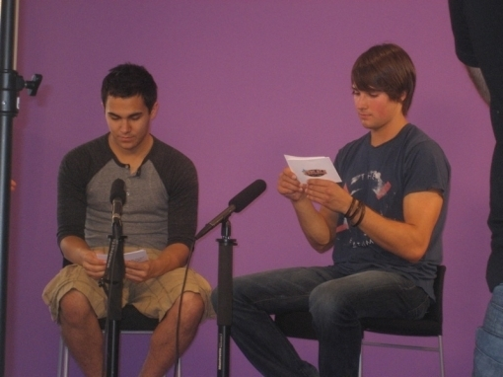

Delivery
Reading from notes: No. Don’t.
You participated in the design, assembly, and test of the project, you can present it without “Cue-Cards”.
They make you look like you don’t know what you are doing.
Enthusiasm: An absolute must.
(best thing since sliced bread).

Slide 35
Summary Points
Connect with your audience
Slide Appearance: Font size and type, color, etc
“ Just enough” text; include visuals
Be conscious of appearance, body language

Slide 36

Recommendations for A+ Presentations
Review project and presentation guidelines
Generate a rough draft of your presentation
Coordinate and review with the team.
REHEARSE

