Slide 1
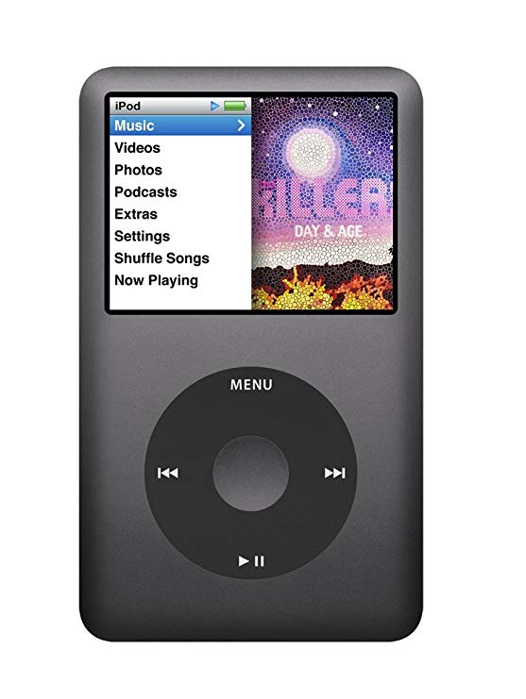
Apple Ipod Classic MP3 Player
Wasn’t the first MP3 Player
Less storage capacity
Fewer features and
Cost more!
And was extremely successful
Why???

Slide 2
Poor Design and User Error
FDA receives on average 100,000 medical device incident reports per year
    More than 1/3 involve user error
In an FDA recall study, almost half of medical device recalls are due to design problems, and user error often correlates with poor product design

Slide 3
Human Factors in Design
Societal Needs
Engineering
Science Knowledge
“Powers of Nature”

Slide 4
What is Human Factors Engineering?
"Human Factors is concerned with the application of what we know about people, their abilities, characteristics, and limitations to the design of equipment they use, environments in which they function, and jobs they perform.“
–Human Factors and Ergonomic Society

Slide 5
Human Factors is the application of knowledge about human characteristics to design
Physical
  Strength, size, reaction time, endurance, frailty, eyesight, fine motor skills
Social/Emotional/Cultural
  User preferences (simplicity, reliability, aesthetics, safety, cost, etc.), culturally-based behaviors (reading, speaking), acceptance
Cognitive
  Understanding cause and effect, user interface, interpreting emotions and intentions
Notes:
Usability Engineering or Ergonomics Engineering or Human Factor Engineering: All equivalent
From Wikipedia (http://en.wikipedia.org/wiki/Human_factors_and_ergonomics):
the practice of designing products, systems or processes to take proper account of the interaction between them and the people that use them.

Slide 6
Man – Machine Interface
Human
Machine
Sensory
Cognitive
Action
Output/
Image, Sound, Motion
Machine Processing
Control
Interface/Interaction

Slide 7

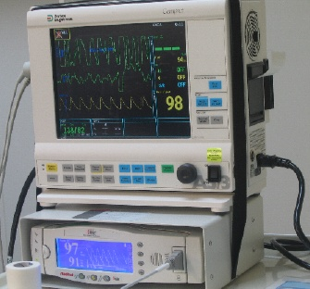
Human-System Interface
Senses
- Vision - Hearing
INTERFACE
Output
- Display - Sound
Psychomotor
- Hands
Input Devices
- Buttons
US Department of Veteran Affairs
Notes:
Human factors is in part the study of the human machine interaction.
But actually this slide represents how we interact with everything - using our eyes, ears, fingers, hands …
Our senses take in inputs, then we rely on our memory and knowledge to process the information and then make decisions and formulate a response
HFE recognizes that we can make errors at each step of this process …

Slide 8
Human Factors also acknowledge that humans are fallible.., people make mistakes!
So why consider Human Factors?
Increase desirability
Increase human performance (i.e., productivity)
Minimize costs (economic, legal, social)
Ensure safety*
*Especially critical to space/air, nuclear and healthcare industries

Slide 9
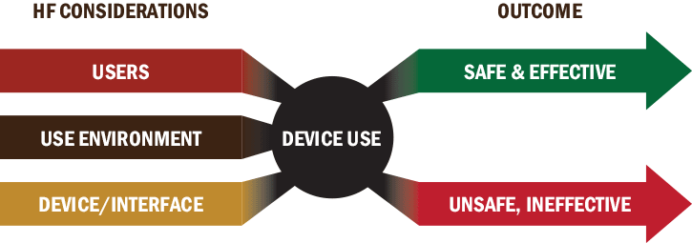
Human Factors design considerations affect product effectiveness, safety, and ultimately, desirability.

Slide 10
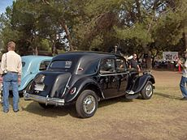
1954 Citroën Traction Avant 15CVH - high position

Slide 11
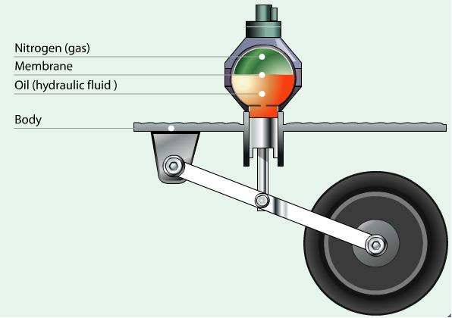
http://automotiveengineeringfundamental.blogspot.com/2012_04_01_archive.html

Slide 12
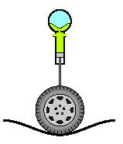
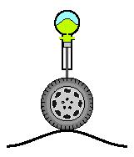

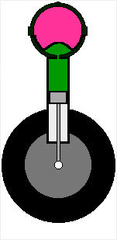
http://www.citroenet.org.uk/miscellaneous/hydraulics/hydraulics-16.html
Notes:
Pressurized Spheres
A fundamental component of the Citroën hydraulic system is the pressurized sphere. There are six such units in the average DS19. They are used for a variety of purposes, but each one functions in exactly the same way.
Each unit separates into halves. They screw together to form a solid unit that has a perfectly spherical cavity inside. A hemispherical rubber bladder conforms to one half of the cavity, secured in the seam between the two halves. The cavity is then completely charged with compressed nitrogen creating a very stable pressurized environment. (Note: more modern sphere units to not unscrew into halves, but were maufactured as integrated units).
Hydraulic fluid can enter the unit through an orifice below the bladder. As a quantity of fluid is pressed into the cavity, the rubber bladder is forced upward further compressing the nitrogen gas. When pressure outside the unit decreases, the quantity of fluid will be forced back out of the cavity as the compressed nitrogen again attains equilibrium.

Slide 13


Slide 14

PIONEERING SPIRIT

Slide 15


Slide 16
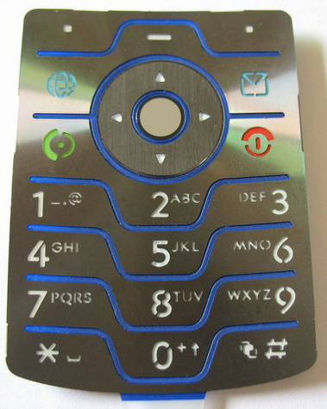
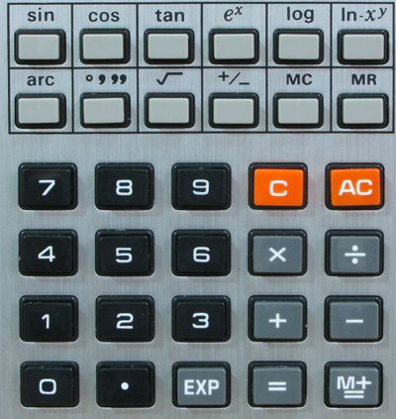
Enter Numbers – Different Interfaces?
Cell phone keypad
Calculator keypad

Slide 17
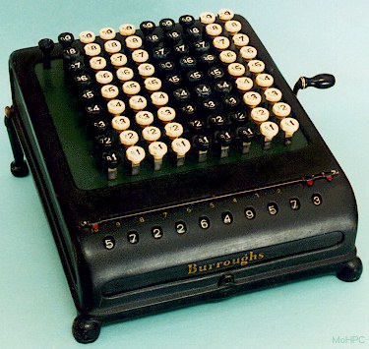
Early Calculator
Industry standard in the 1950’s
Basically, a mechanical adding machine
Earlier models looked like cash registers
http://www.xnumber.com/xnumber/pic_burroughs5.htm

Slide 18
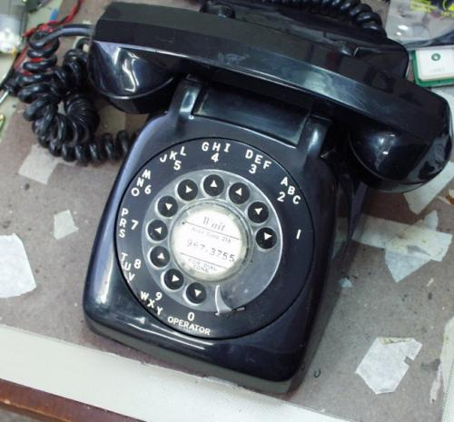
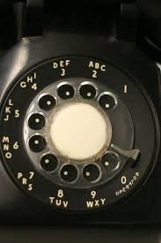
Rotary Phone
Rotary Dial

Slide 19
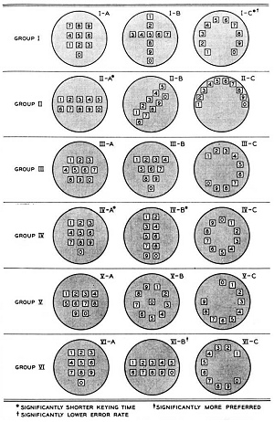
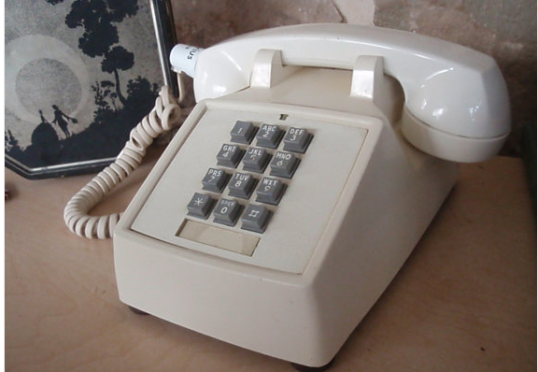
Bell Labs Study
Research showed*:
Easiest to master
Natural way to match letters with numbers
* “Human Factor Engineering Studies of the Design and Use of Pushbutton Telephone Sets.” Published July 1960, Bell System Technical Journal
http://www.vcalc.net/Keyboard.htm

Slide 20
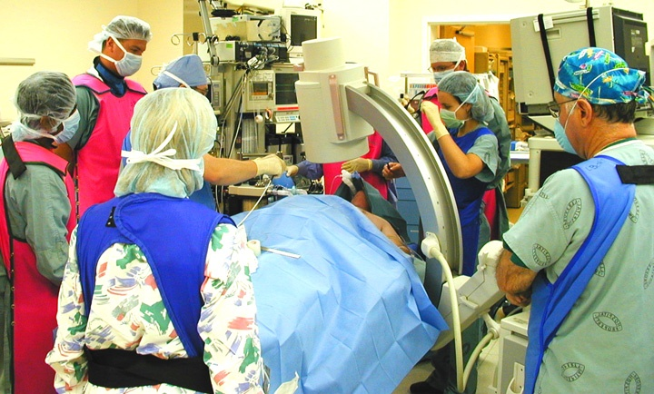
Example: Healthcare-related technology is rapidly growing
You hope Human Factors were considered in the design of this equipment

Slide 21
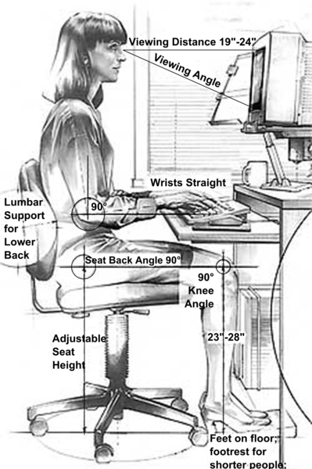
Human Factors (ergonomics) integrates knowledge from multiple fields
Engineering
Psychology
Physiology/Kinesiology
Biology
Anthropology
SJSU has a Human Factors program in the Industrial and Systems Engineering Department
Source: Integrated Safety Management, Berkeley Lab
wikipedia

Slide 22
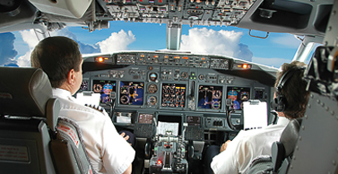
Majority of air crashes involve human error
http://www.apa.org/action/science/human-factors/index.aspx/

Slide 23
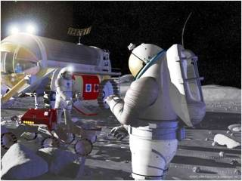
Astronaut interacting with a space system that was designed with human factors.
(This image is in the public domain. Source: NASA)

Slide 24
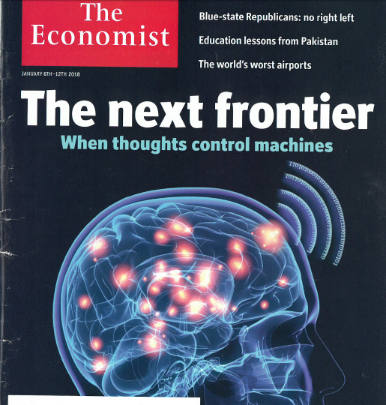

Slide 25
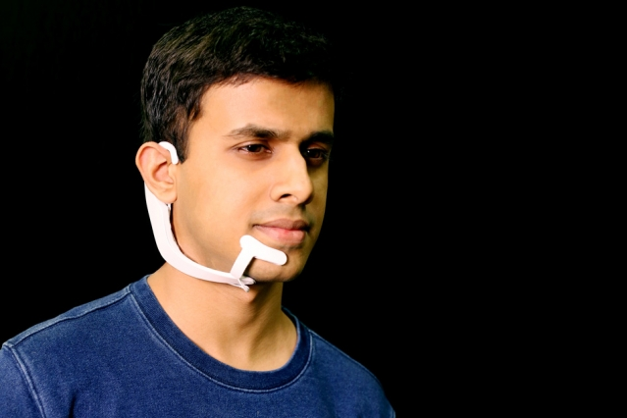
AlterEgo
Speech thought recognized by computer
Arnav Kapur, MIT Media Labs
Electrodes on the face and jaw pick up signals triggered by when you think about saying something.
Larry Hardesty | MIT News Office , April 4, 2018

Slide 26
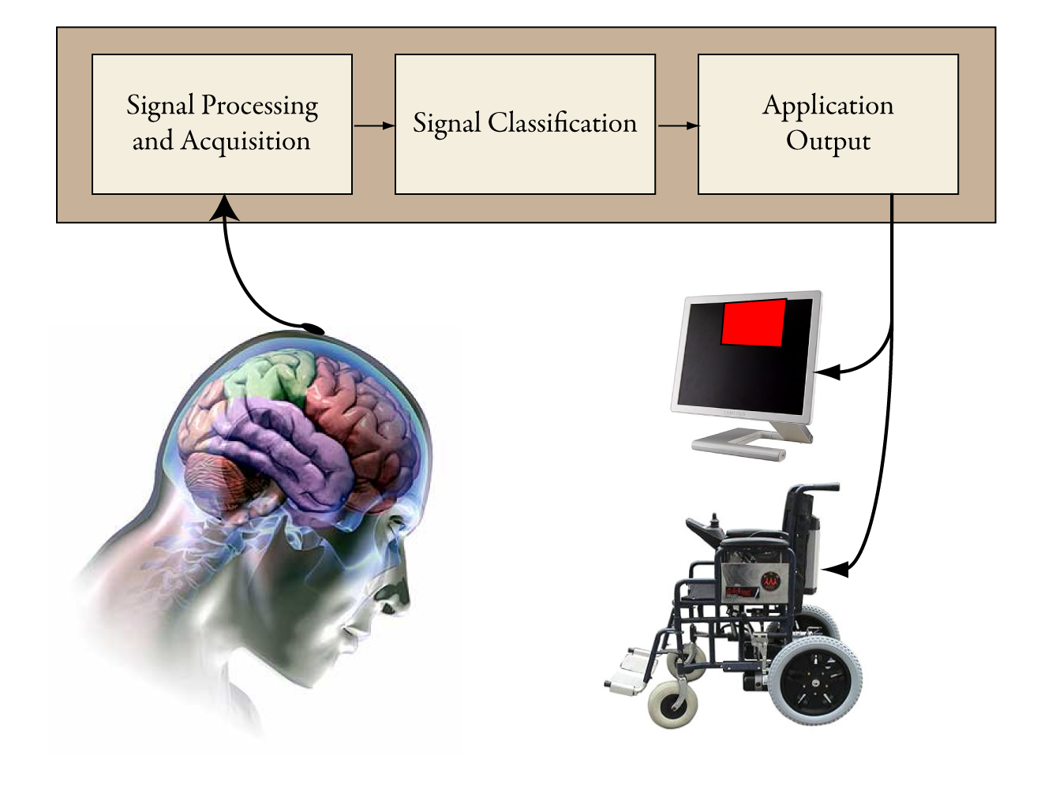
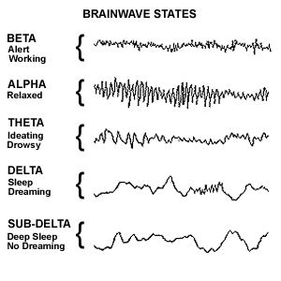
Human neural prosthetics include human factors engineering, creating new interface methods.
http://nitrolab.engr.wisc.edu/research.php
Notes:
The field of Brain-Computer Interfaces (BCI) is a driving force for utilizing electroencephalography technology (EEG), which is the process of recording brain activity from the scalp using electrodes (See chapter 3). In the past, the main focus have been about developing applications in a medical context, helping paralyzed or disabled patients to interact with the external world (Plass-Oude Bos et al., 2010), by mapping brain signals to human cognitive and/or sensorymotor functions.
A simple example scenario is as follows: A user is wearing the NeuroSky mindset that forwards brain wave signals to the software application. In order to get general information about the users brain wave pattern, a series of mental task scenarios must be executed by the user. This information will then be used to train a classification system so it can learn to recognize and thus map different brain patterns to actions. The user can then start a game, and the classification system will continuously analyze the incoming brain waves and map them to the appropriate actions and thus control some feature(s) of the running game.

Slide 27
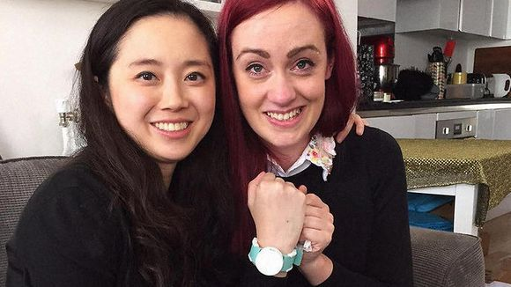
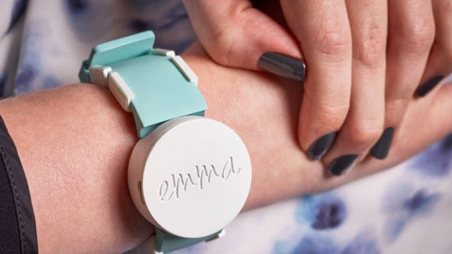
Microsoft watch that quiets Parkinson's tremors
Marco della Cava , USA TODAYPublished May 10, 2017
Notes:
Microsoft research engineer Haiyan Zhang, left, and design engineer Emma Lawton

Slide 28
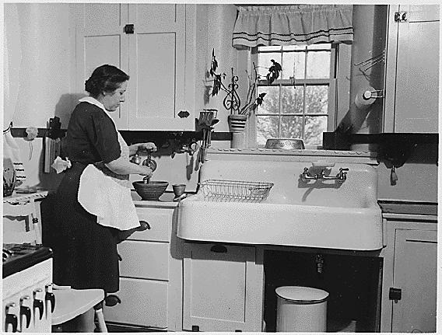
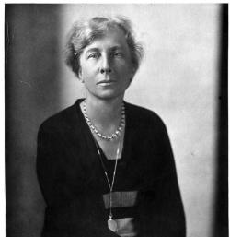
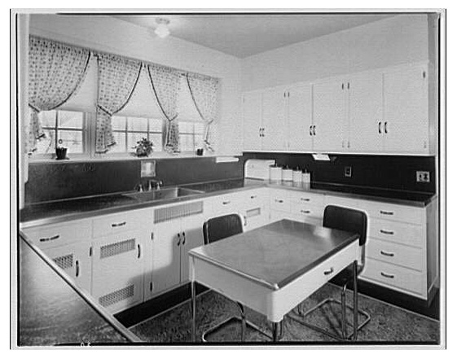
The Kitchen
Kitchen layout 1920-1954
Lillian Gilbreth
Department of Agriculture/National Archives.
Gilbreth’s “Kitchen Practical” Design
Harris & Ewing/ Smithsonian Institution Archives/Wikimedia Commons
Photograph by Theodor Horydczak/Library of Congress

Slide 29
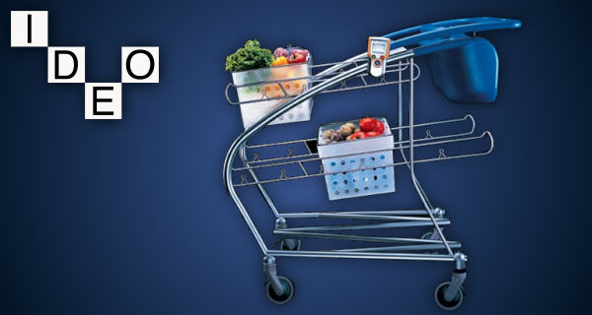
Consider how human factors were included in the IDEO shopping cart design.
http://www.ideo.com/work/shopping-cart-concept
Notes:
their concept was all about: safety for kids, modularity while shopping, easy handling and facilitated check-out Child safety, human shopping behavior (shopping practices, theft by homeless people, reduced time in line), maneuverability
The nestable steel frame lacks sides and a bottom to deter theft, and holds removable plastic baskets to increase shopper flexibility, help protect goods and provide a method to promote brand awareness. A dual child seat uses a swing-up tray for a play surface, and a hole provides a secure spot for a cup of coffee or a bunch of carnations.
One of the unique—and potentially patentable—features of the cart is the design of its steerable back wheels. Normally fixed straight for stability and familiarity, an easy sideways effort allows the wheels to turn left or right. Pushing the cart forward puts the wheels straight again.

Slide 30
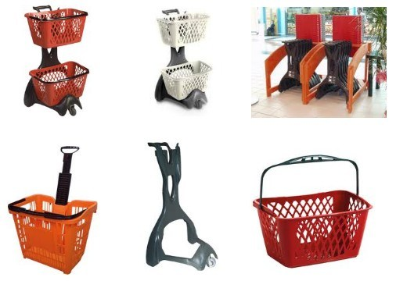
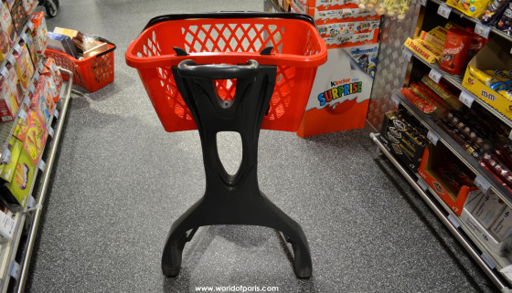
IDEO cart didn’t take off but there were others.
In Europe easy to navigate in small markets
https://worldofparis.wordpress.com/tag/carrefour/
Notes:
Paris: One basket too small to carry a heavy load of wine, cheese, water and, of course, chocolate. Whole Foods expressed interest given some refinement.

Slide 31
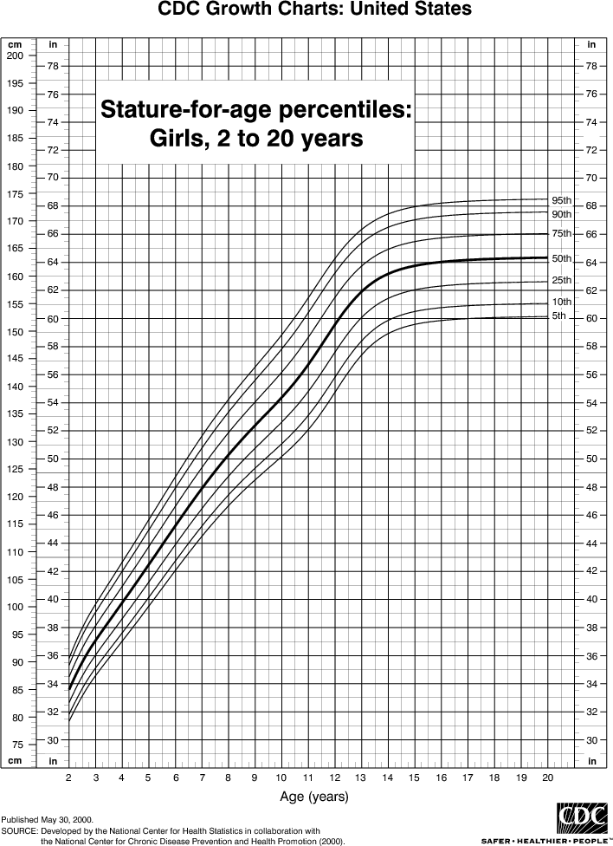
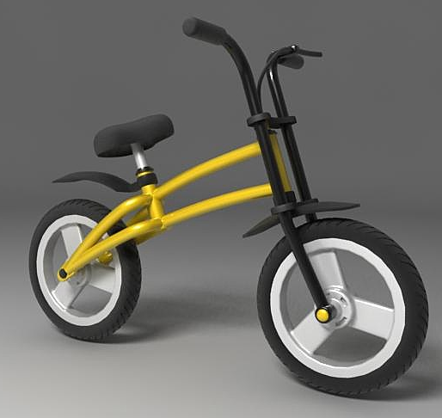
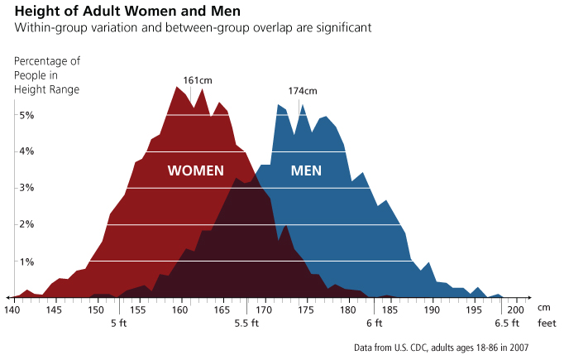
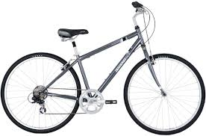
Physical Domain –
Consider human scale

Slide 32
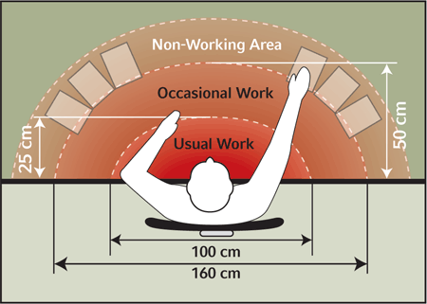
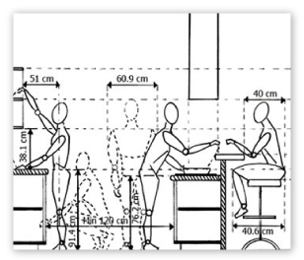
Physical Domain –
Consider Anthropometric Data –
For example, reach
Source: http://openacademyofknowledge.wikispaces.com/
Source: http://www.mccauslandco.com/

Slide 33
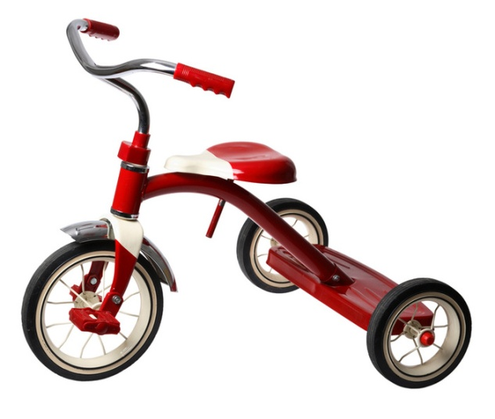
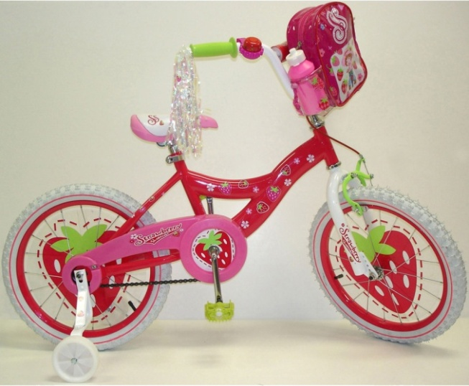
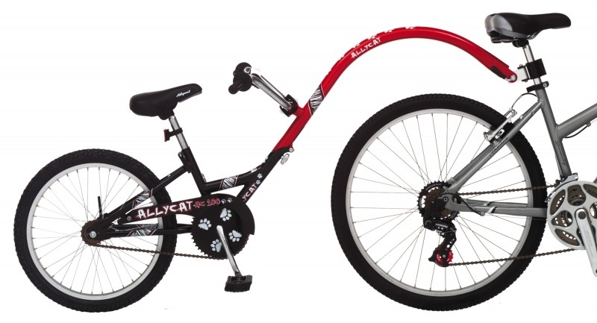
Physical Domain – Consider Developmental Capabilities

Slide 34
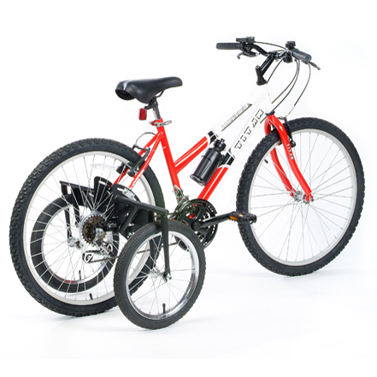
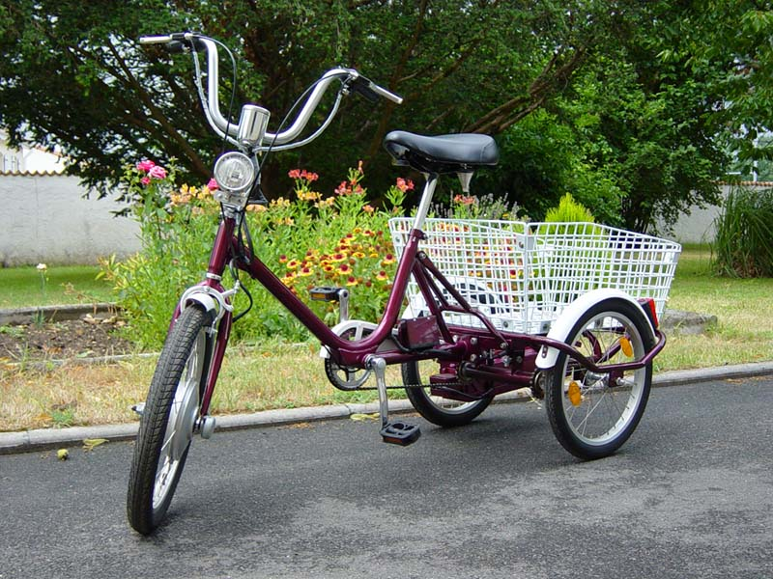
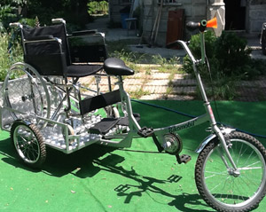
Physical Domain –
Assistive Technology

Slide 35
Physical Domain: Consider Effects of Stress
The relationship between stress and performance
Performance level
Area of “optimum” stress
Low stress Boredom
High stress Anxiety, panic
Stress level
Yerkes, R. M., & Dodson, J. D. (1908) The relation of strength of stimulus to rapidity of habit-formation.
Journal of Comparative Neurology and Psychology, 18, 459-482
Notes:
The optimum level of performance is reached when the level of arousal is neither too high or too low.
Boredom is a problem if we are doing a highly automated and repetitive task, e.g. transcribing medication charts:
may be easy to commit a transcribing error

Slide 36
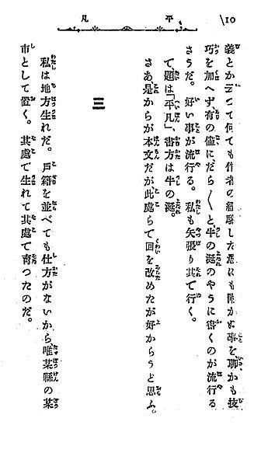

Social Domain – Cultural Norms

Slide 37
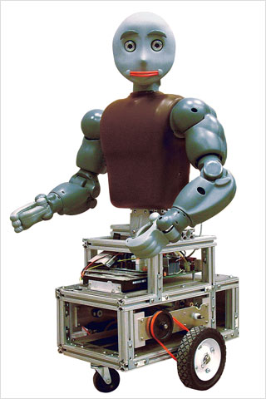
Social/Emotional
Follows Social Conventions
  Getting on elevator – wait your turn
Can respond to human signals
  Change of voice (e.g. express sympathy when you are tired)
  Response to violent behavior
Bandit-II used in hospitals

Slide 38
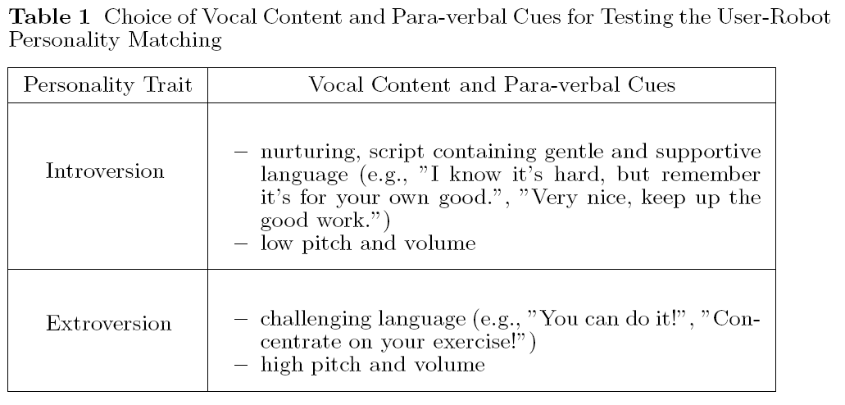
Social/Emotional
Match robot personality to that of user
Source: Tapus (2008)

Slide 39
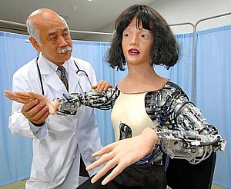
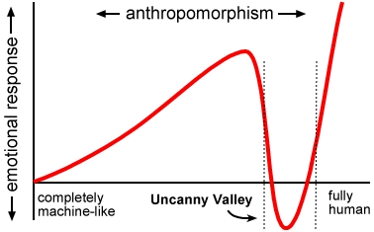
Social/Emotional
Human but not too human – “uncanny valley”
Source: pinktentacle.com

Slide 40
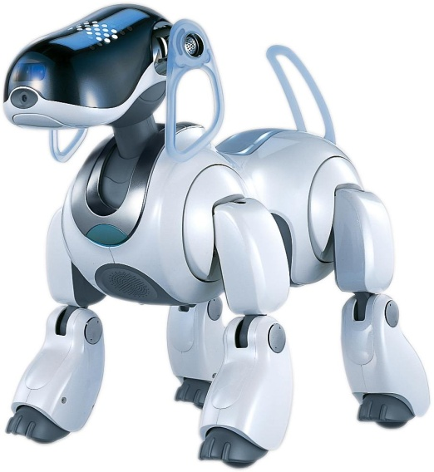
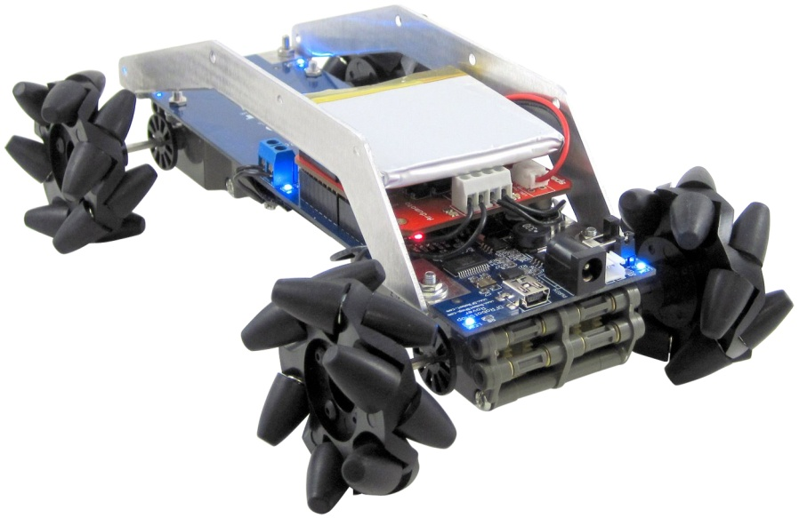



Cognitive Domain –
What do users perceive?
See Woods paper
Friendly?
Unfriendly?

Slide 41



Cognitive Domain –
Consider creativity

Slide 42





Cognitive Domain - Compatibility
Notes:
All these are representations of human-machine interfaces. Does it work the way you expect it to work

Slide 43

Cognitive Domain –
Sometimes we don’t say what we see ….
Say the color of the words that appear
Optillusions.com
Notes:
Misperceiving situations is one of the main reasons that our decisions and actions can be incorrect

Slide 44


Ooops! There goes my coffee!!!
http://www.baddesigns.com/starbucks.html

Slide 45

Remedy(?): An instruction card was placed next to machine
http://www.baddesigns.com/starbucks.html

Slide 46


Can Opener
Conventional can opener
Cuts below the rim of the can
What’s wrong with the design on the right?
http://www.baddesigns.com/canopen.html

Slide 47


Driverless Cars
Google photo

Slide 48

Driverless cars: levels of automation and the barrier of ‘human factors’
http://www.caradvice.com.au/394415/driverless-cars-levels-of-automation-and-the-barrier-of-human-factors/

Slide 49

Driverless, but not entirely autonomous

Slide 50
Designing Across the Lifespan
1 page (400-500 words) for each member of the team (not a team paper)
Discuss how to modify the design of a companion robot to serve a child or a 65+ adult
Base your design decisions on information from reliable literature (see example in Canvas: Robot Module: Background Reading….)
You will be submitting this in your Lab

Slide 51

Discuss some ways you might modify an assistive robot for the two audiences
Source: http://www.robaid.com/

Slide 52


