Slide 1
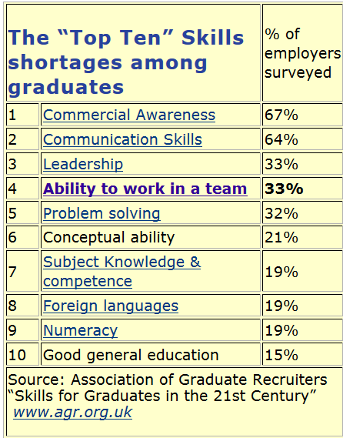

Slide 2
Scenario:
Anthony worked in an engineering firm before he started at SJSU and knows a bit about design and construction. In his efforts to ensure a good project he appoints himself as team leader and tells all the others what to do. What do you think will happen?
The team will build the best turbine structure in the lab
Team members will appreciate Anthony taking charge
Team members will resent his controlling attitude
Anthony will end up doing all of the work himself
C&D

Slide 3
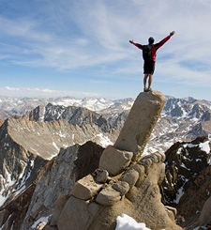
Engineering Success & Teamwork
ENGR 10
Introduction to Engineering

Slide 4

What makes a Successful Engineer?
Amongst yourselves, answer these two questions:
  What are the attributes of a successful engineer?
  If you asked a company CEO the same question, what would he or she say?

Slide 5
How do I become a successful engineer?
Master technical knowledge
Develop soft skills --- communication, teamwork, leadership, social skills, interpersonal skills, professionalism, sense of responsibility, dependability, maturity, confidence, positive attitude…..

Slide 6
Technical Knowledge vs Soft Skills
Which one is more important if you want to be viewed as “successful”?
Especially, if you want to grow (have more impact, more responsibility).
Soft Skills!!!
Notes:
If you want to have more impact, more responsibility. Examples, Engineering Manager, Professor, CEO, Marketing, Venture Capitalist,….

Slide 7
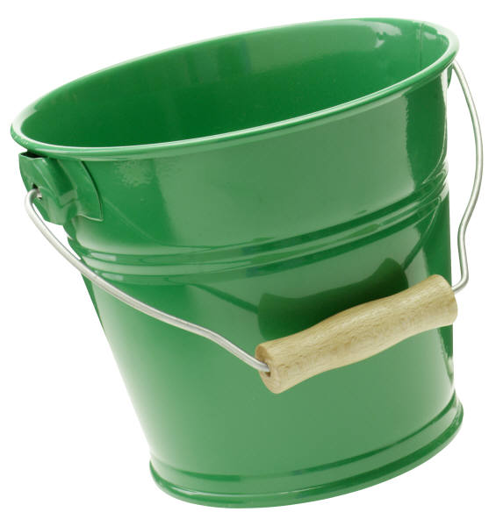
Teamwork
Organization
Responsibility
Persistence
Communication
Creativity
Listening
Pride in Work
Technical
Always Learning
Leadership
Ethics
Cooperation
Engineering
Success
JKA_ 2009
7

Slide 8
What People Say About Teamwork
“Coming together is a beginning.
Keeping together is progress
Working together is success.”
Henry Ford
“Teamwork is the ability to work together toward a common vision. The ability to direct individual accomplishments toward organizational objectives. It is the fuel that allows common people to attain uncommon results.”
Andrew Carnegie
“Getting” good players is easy.
Gettin' 'em” to play together is the hard part.”
Casey Stengel
(former NY Yankees manager)
Notes:
“Everyone has to work together; if we can’t get everybody working toward common goals, nothing is going to happen
Harold K. Sperlich
(Former President, Chrysler Corporation)

Slide 9
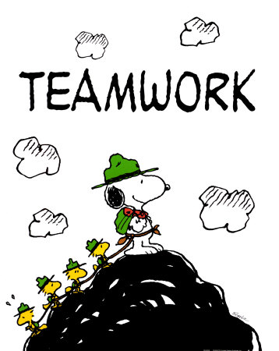
What is teamwork….
Is a group that has:
A common purpose and clear goals
Complimentary skills
A common approach to work
The willingness to share information
Member-supporting environment
The ability to work through conflicts
The willingness to take responsibility for team actions.
maketeamworkhappen.com

Slide 10
Why Teamwork?
Accomplish more in:
        Quantity
        Complexity
Generate more solutions/brainstorming ideas.
Gain exposure to various points of view.
Develop/use “critical thinking” & “evaluation” skills.
Improve conflict resolution skills
Improve communication skills

Slide 11
Benefits
Accomplish projects an individual cannot do
Most engineering projects are too large or too complex for one individual to complete alone.
Brainstorm More Solution Options
Different people looking at the same problem will find different solutions.
Detect Flaws in Solutions
A team looking at different proposed solutions may find pitfalls that an individual might miss.
Build Community
Imagine trying to build the Golden Gate Bridge all by yourself!
Members of effective teams can form personal bonds which are good for individual and workplace morale. In the university setting, students on teams often form bonds that extend beyond the classroom.

Slide 12
Benefits (cont)
Exposure to different points of view
Critical Thinking & Evaluation Skills
You learn different ways of approaching a problem when you are exposed to methods and ideas that other people have.
You must use these skills to evaluate the complex issues of team project goals and to formulate appropriate solutions and plans.

Slide 13
Benefits (cont)
Conflict Resolution Skills
Increased academic work
Yes, teams have conflicts, but you can develop the skills to facilitate solutions to conflicts so that the team remains functional.
Some students may accomplish more in order to keep up with the rest of the team.

Slide 14
Benefits (cont)
Communication Skills
Effective teams . . .
Actively and effectively listen to their team members to understand their ideas and concerns.
Effectively articulate their ideas or their concerns to others.
Provide genuinely constructive feedback to team members

Slide 15
Teamwork Also Enhances Learning
Teamwork provides the opportunity for collaborative learning.
Teamwork keeps members motivated.
People (students, engineering colleagues) are the best motivators of other people.
Teaching others is the deepest form of learning.
Teamwork helps speed up the solution process.
IT IS how engineering professionals work and learn.

Slide 16
Organizing a Successful Team
Define a common goal for the project.
List tasks to be completed.
Assign responsibility for all tasks.
Develop a timeline.
Develop and post a checklist.
Maintain a central archive for all communications.
(Drawings, Photos, Report, Presentation)
Send reminders when deadlines approach.
Send confirmation when tasks are completed.
Communicate all team meetings.
See YouTube Video
Notes:
I.e., building strategy for effective team

Slide 17
Running Effective
Meetings
See YouTube Video
Plan the meeting – objectives & agenda
Inform the team – when, where, information they need, what they need to prepare
Conduct effectively – follow agenda, one item at a time, manage discussion, maintain focus and pace
Summarize meeting – summarize decisions and action items, send notes out to team

Slide 18
Has teamwork worked for you?
Talk about:
one thing your lab team has done that has been particularly effective.
Turn to your neighbors and discuss this

Slide 19
Team Skills for Members
Listen
Question
Persuade
Respect
Help
Share
Participate
Listen to other's ideas. When people are allowed to freely express their ideas, these initial ideas produce other ideas.
Ask questions, interact, and discuss the objectives of the team.
Individuals are encouraged to exchange, defend, and then to ultimately rethink their ideas.
Treat others with respect and support their ideas.
Help one's coworkers, which is the general theme of teamwork.
Share with the team to create an environment of teamwork.
All members of the team are encouraged to participate in the team.

Slide 20
Team Dynamics - Communication
See YouTube Video
Listen
Listen actively
Share Ideas
Ask questions
Don't express opinion as fact
Feedback
Compliment each other's ideas
Evaluate - Do not criticize
Critique the idea, not the person
Respond, don't react
Don't interrupt
Explain your reasons
Be aware of tone & body language
Restate an idea to be sure it is understood
Be patient and courteous
Use appropriate humor
PARTICIPATE!

Slide 21
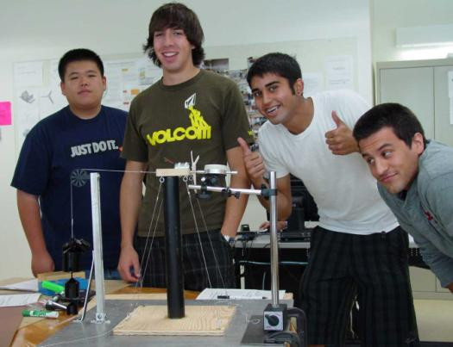
Team Dynamics
Full Participation
  All team members contribute their time and energy to the project. More importantly, all team members participate in the decision making process.
  Having a dominant leader may work for the very short term, but will eventually lead to morale problems.

Slide 22
Team Dynamics
Trust
  Members trust that each member will add value to the project
  Members work to ensure that everybody does contribute and that appreciation is expressed for different contributions.

Slide 23
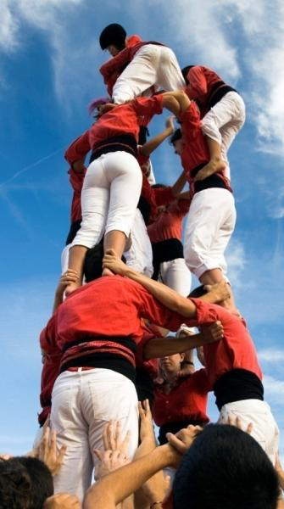
What do I expect to get out of
E10 teamwork experience?
Complete a project and earn a top grade
Develop/practice/improve teamwork skills
Satisfaction of achievement
Networking and friendships
Peer performance evaluation

Slide 24
Teamwork Evaluation on Projects
Teamwork Skill | Performance Level (1 to 5)
1) open and honest communication among members
2) each individual carried his/her own weight
3) collaboration in decision making
4) team set goals and milestones
5) people listened to each other
6) leadership was shared among the members
5 = we did this all of the time
1 = we did not do this at all

Slide 25
What are the E10 Teamwork Basics?
Team Formation
  Team members: 4 to 6 per team
  Team Name
  Team Roster: Name, phone, e-mail
    Copy to all members
Member introduction
(“getting to know you” )
Set Ground Rules-Operational

Slide 26
E10 Teamwork Basics - Ground rules
Assign a Group Leader
  (Project manager, Project Leader, Facilitator, etc.)
  (why)? Do we need a boss???????
Distribute the work among members
  Equivalency-Fairness-Balance
  Ability-Training-Experience
  Time and Effort
Establish communication methods
Ensure accountability
  Who is going to do what and when
Determine conflict resolution process
Notes:
How will you:
Conduct meetings
Share information and communicate with each other
Make decisions
Hoid members accountable
Foster an environment to support each other
Encourage creativity and innovation
Resolve conflicts

Slide 27
Conflicts are Natural
Four Stages of Team Development
Forming
  Getting to know each other, establish goals, tasks
Storming
  Competition for roles, personal agendas, goals constantly debated
Norming
  Roles and common interests established (goals)
Performing

Slide 28
Reasons for Conflict
Conflicting personal goals or expectations
Lack of contact or communication
Poor planning processes
Unfair distribution of work
Poor use of team members’ skills for tasks
Missed minor deadlines
Lack of coordinated finishing process, resulting in disjointed product
External factors such as work or personal commitments
Dominance of the group by one or more members
‘Freeloading,’ where a group member deliberately avoids contributing

Slide 29
Resolving Conflict
Avoid them to begin with – be proactive
Acknowledge the conflict – don’t ignore it
Actively listen
Stick to the facts – don’t get personal
Analyze the situation – encourage different points of view
Focus on a solution – don’t get stuck on things you can’t change
Once you decide on a solution – move forward

Slide 30
More on Team Dynamics
While equal contribution from each member is ideal, a true equal division of work may not be always possible.
Doing more than your ‘fair’ share of the work is an opportunity to demonstrate your ability and commitment.
A team’s success is measured by the achievement of the team as a whole. -- Nothing can justify an intentional act that negatively impact the achievement of the team. Examples:
  I don’t want to share that information because I spent a lot of time to find it.
  I don’t want to do that because that is his job.

Slide 31
Finally - Keep in mind that:
Working in a group does NOT mean that you are working as a team.
Teamwork does NOT just happen.
Team skills need practice and development.
A team’s success is measured by the achievement of the team as a whole.
Industry values teamwork more than an individual’s ability to contribute.

Slide 32
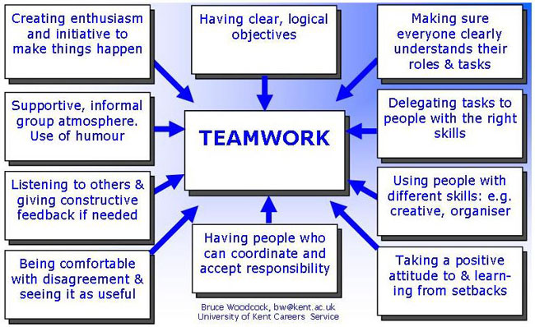

Slide 33
Acknowledgement
This presentation is adopted in part from the following web pages:
Student success:
http://www.discovery-press.com/catalog/studyengr/instructorsguide.doc
Team Dynamics:
http://tlt.its.psu.edu/suggestions/teams/

