Slide 1
Final Review of
Emerging Adulthood Paper

Slide 2
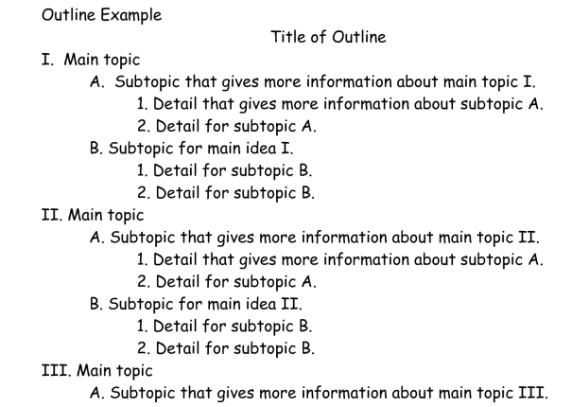
Review of Outline
Introduction
Domains
  Psychological, Social and Physiological
Conclusion
Reference List

Slide 3
Outline
Introduction
  What is the topic? Why do you think relevant to 18 – 25 yr olds?
  How will it be addressed in paper? “This paper will show….”
For Each Domain
  What is the impact, influence, affect, … of the topic on each domain?
    Pyschological (e.g., Cognitive, Emotional)
    Social (e.g., Relationships)
    Physiological (e.g., Physically)
Conclusion
  Summary of key points. What did you learn? Insights gained?
Reference List
  In APA format
- Based on research.
- Reference citations
Notes:
N

Slide 4
Factors That Affect Development in
Emerging Adults
Topic
Domain
Depression
  Psychological
What does the research say?
Depression
  Social
What does the research say?
Depression
  Physiological
What does the research say?

Slide 5
Factors That Affect Development in
Emerging Adults
Topic
Domain
Drugs
  Psychological
What does the research say?
Drugs
  Social
What does the research say?
Drugs
  Physiological
What does the research say?

Slide 6
Factors That Affect Development in
Emerging Adults
Topic
Domain
Hooking Up
  Psychological
What does the research say?
Hooking Up
  Social
What does the research say?
Hooking Up
  Physiological
What does the research say?

Slide 7
Factors That Affect Development in
Emerging Adults
Topic
Domain
Anxiety
  Psychological
What does the research say?
Anxiety
  Social
What does the research say?
Anxiety
  Physiological
What does the research say?

Slide 8
Emerging Adulthood Paper:
Is a requirement to meet Area E
Explores influences on 18 to 25 year olds development
Requires “peer-reviewed” references
All the Above
A and B

Slide 9
Review – Introduction
Does it:
  Clearly identify the topic?
    Topic and emerging adulthood relate?
  Does it describe how the topic will be addressed in the paper?

Slide 10
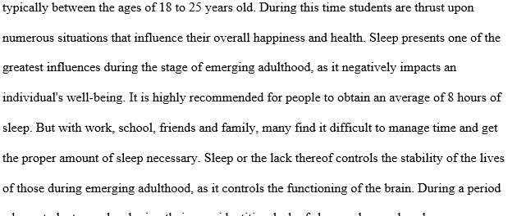
What is the Topic?
No Topic? Too Many Topics?

Slide 11
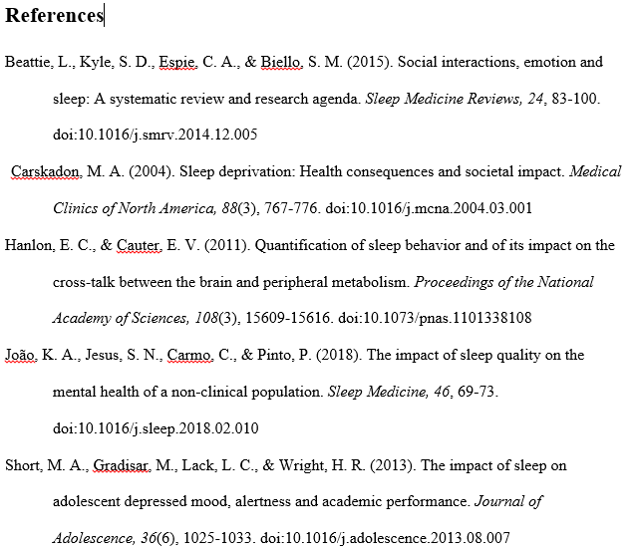

Slide 12
Introduction
College students are in an interesting position in their life. They are in this transition period between adolescence and adulthood where they are learning to become fully independent while also balancing their career and personal life. This time period is called emerging adulthood (Arnett, 2007), which is the stage of life that many college students are going through. Arnett developed this term and theorized that this phase should be in between adolescence and adulthood.
One common thing that a lot of college students who are going through emerging adulthood have is anxiety. Anxiety is a very prevalent issue and is one of the most diagnosed mental conditions out there among emerging adults, making it a huge stress or and negative influence. Anxiety that is not dealt with properly can lead to worse things down the line. The effects of anxiety among college students must be understood as it negatively affects the different major development domains of life, which include the psychological, social and physiological domains.

Slide 13
Each Domain should include:
A reference cited in APA format
The results of the study
Narrative on how study integrates with the topic for that domain
All the above

Slide 14
Review – Domains
Are there 3 domains? Are they labeled and in order? Does each domain:
  Have research cited that fits the domain and the topic, correctly? E.g., (Warecki, 2012)
  Describe the most important, relevant results of the study?
  Effectively integrate the references for each domain discussed

Slide 15
Psychological Domain
Alcohol is known to impact the psychological domain of emerging adults. A study conducted on 1100 college students found that the use of alcohol was linked to depression and sensation-seeking (Author, 2013). The study reported a very high relation specifically between emerging adults with depression who used alcohol and sensation seeking. This means that these students used alcohol as a means to escape their depression and feel good.
These students turn to alcohol and can escape, for some time, they feel numb and forget their problems. Alcohol for these students ……..

Slide 16
Review – Conclusion
Does it briefly:
  Summarize? State key points?
  Provide original insights as it relates to the topic?
  Discuss how the domains may interrelate?

Slide 17
Conclusion
As a college student with ADHD, I have long been conscious that the way I interact with the world has seemed different than my peers. Prior to this paper, however, I didn’t recognize the broader-reaching connections between my behavior and the domains, and the effect this has had and will continue to have on my development. In hindsight, the connection is clear. At the peak of my anxiety I found myself so afraid of checking grades that I failed a class due to a mismarked score that I never corrected.
Becoming aware of my impairments and addressing them has become a critical step in improving my grades, networking, and avoiding unhealthy coping methods, all of which will determine the opportunities available to me as I transition into adulthood. There are many other college students who face similar difficulties who haven’t yet experienced such extreme consequences, and this is where understanding the impacts of conditions such as ADHD becomes so critical. By being able to identify the possibility of pitfalls before they occur, emerging adulthood becomes a time during which setbacks are minimized and growth is abundant.

Slide 18
The Reference List
Has peer-reviewed articles cited in each domain
Is in APA format
Alphabetized by author
All the above
Only A and C

Slide 19
Review Reference List
  Are there a minimum of 3 peer-reviewed articles? One per domain.
  Do article titles appear to relate to topic?
  In alphabetical order?
  Is each entry in proper APA format?
Last Name, First Initial, Middle Initial (Year Published). Title of article. Title of Online Journal, Volume Number(issue number if available), pp. Pages, doi:# or Retrieved from URL

Slide 20
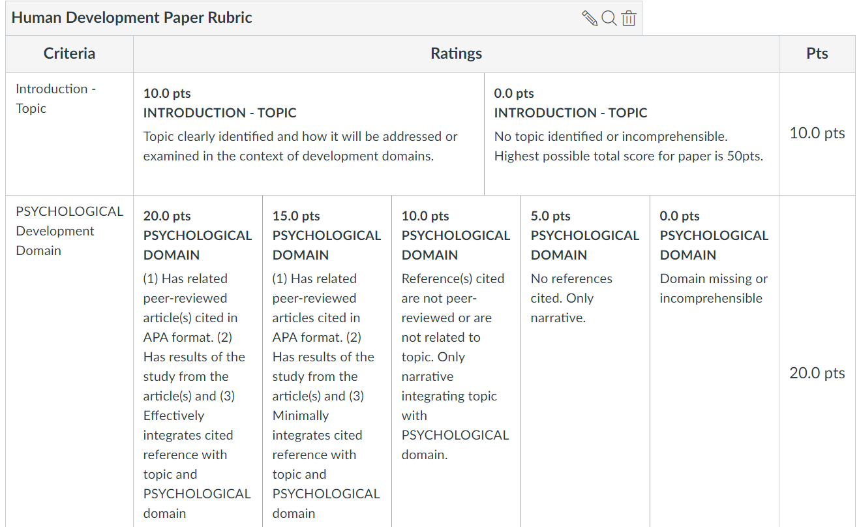
Rubric

Slide 21
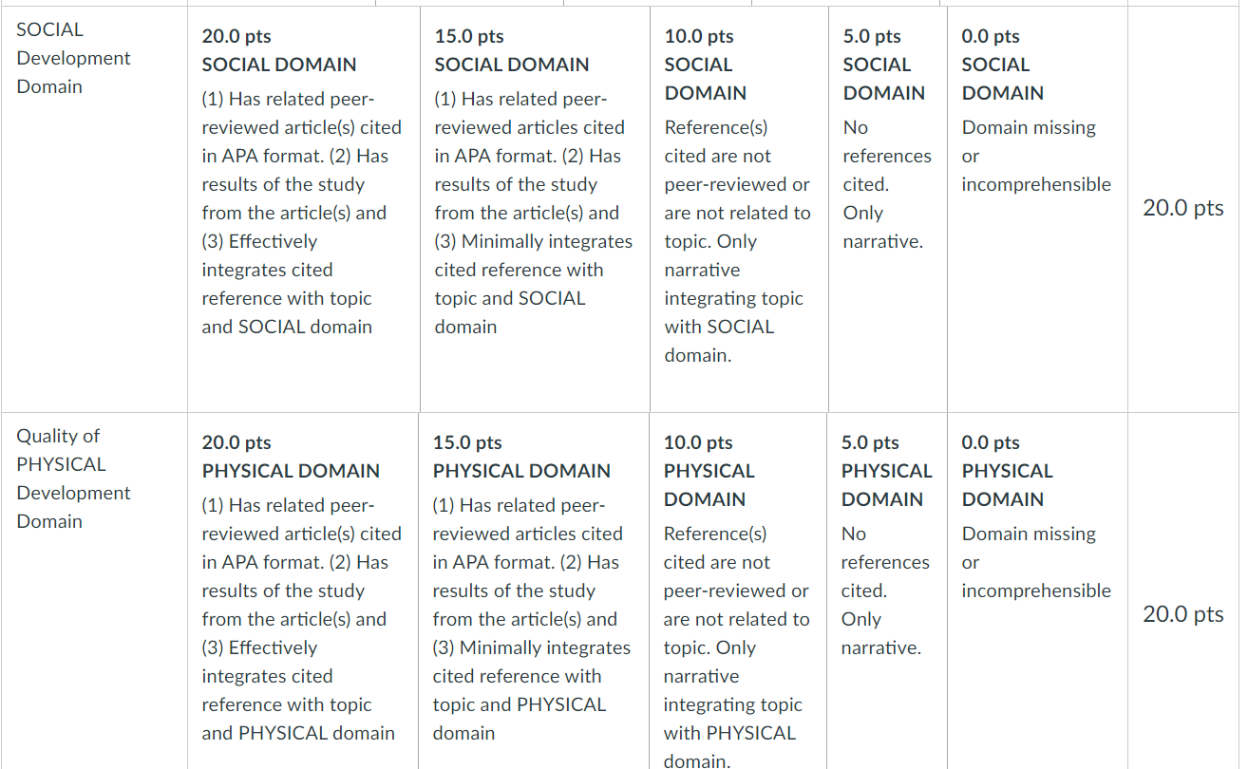
Rubric (cont)

Slide 22
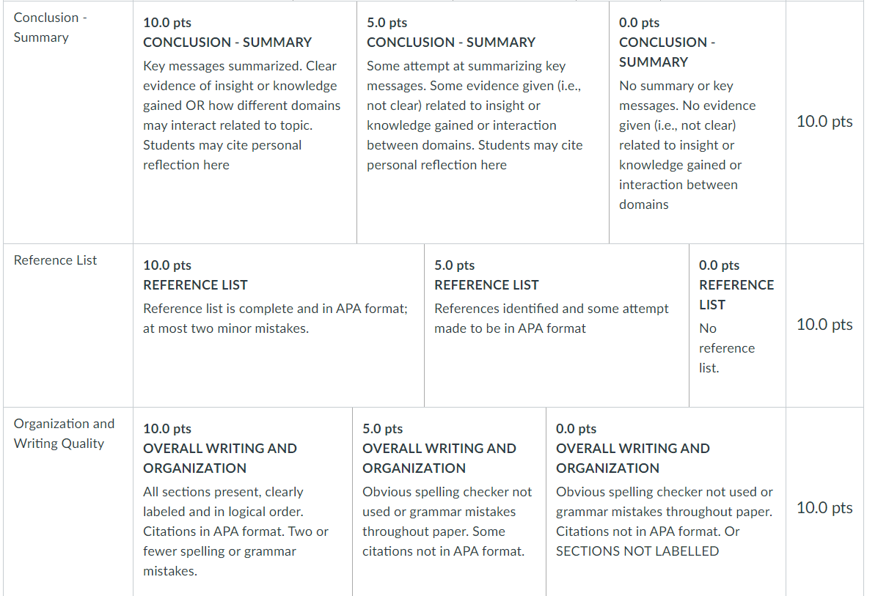
Rubric (cont)

Slide 23
Tips for a Good Score
Clearly Defined Topic
Quality References Related to the Topic and Domain
References Cited in Paper and Listed on Last Page (APA style)
Each Section Labeled
Review the Guidelines and Rubric
Not a Self-Reflection but a Research Report
No Late Papers Accepted
Do Not Quote and Do NOT Plagiarize!
Notes:
Any turnitin score > 15% will be reviewed for plagiarism

Slide 24
Examples of Unacceptable Reasons for Submitting a Late Paper
“I forgot”
“My internet stopped working”
“I had to make some final edits”
“I thought I submitted it”
“I tried to submit it but it wouldn’t let me”
“I didn’t know how to submit the paper”
If you are PC/MS Word user, upload as .doc or .docx
If you are a Mac/Pages user, upload as .pdf

