Slide 1
Announcements
  New Website
    sjsu.edu/e10
  Syllabus Quiz Closes Sept 4
  Solar Lab Quiz
    Take before Solar lab week (Sept 7)
  Mastering Excel Quiz
    Take after your Excel Labs
    Due Sept 11

Slide 2



ESSC Guided Pathway Advisors
Smita Duorah
Guided Pathways Advisor
ENGR 10 Instructor
smita.duorah@sjsu.edu
Lower division pathways for BME/ChE/MatE
Ahmed Banafa
Guided Pathways Advisor
ENGR 10 Instructor
ahmed.banafa@sjsu.edu
Lower division pathways for EE/CMPE/SE/GE
Jack Warecki
Guided Pathways Advisor
PLTW Affiliate Director
ENGR 10 Instructor
jack.warecki@sjsu.edu
Lower division pathways for ME/CEE/AE/GE

Slide 3

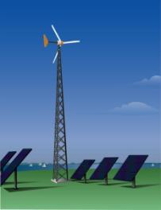
Energy and Power
ENGR 10 – Intro to Engineering
College of Engineering
San Jose State University

Slide 4
Which of the following heaters can heat up a gallon of water to 90º C?
(A) 5 W heater
(B) 90 W heater
(C) 100 W heater
(D) All of the above

Slide 5
Today’s Main Concepts
Energy
  Potential Energy
  Kinetic Energy
Work
Power
Efficiency
Conservation of Energy

Slide 6
What is Energy?
Merriam-Webster → Energy is “a fundamental entity of nature that is transferred between parts of a system in the production of physical change within the system and usually regarded as the capacity for doing work”
Simplified:
In other words, energy measures the capacity of an object or system to do work on another system or object.
Energy is what is needed to change the state of an “object” or system.
Notes:
Energy is just the ability of a body to do work. Conversely, work done on a body changes the energy of the body. How much energy is needed is how much work gets done. Work and Energy are essentially, equivalent. Work is energy transferred by a force.

Slide 7
How much work is needed to change the state of the object or system is how much energy is needed.

Slide 8
Examples of “Change of state”
Note: Some objects or systems “gain” energy.
Some objects or systems “release” energy.

Slide 9
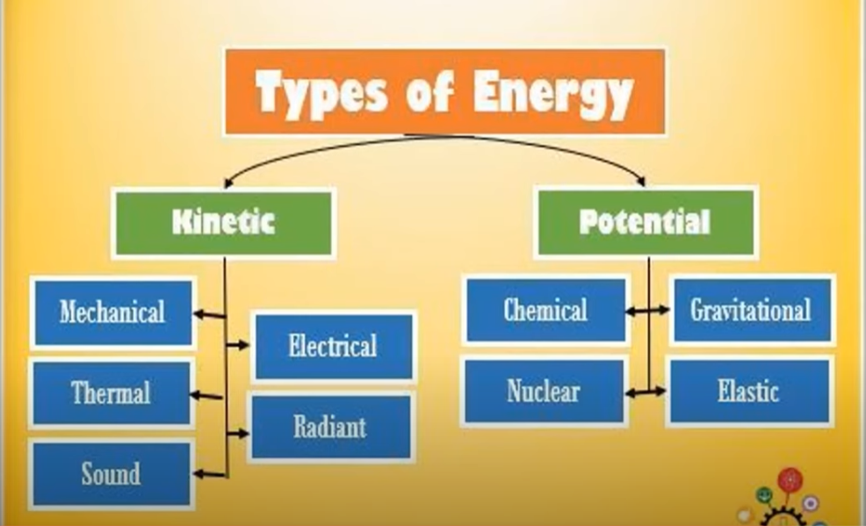
Different Forms of Energy

Slide 10
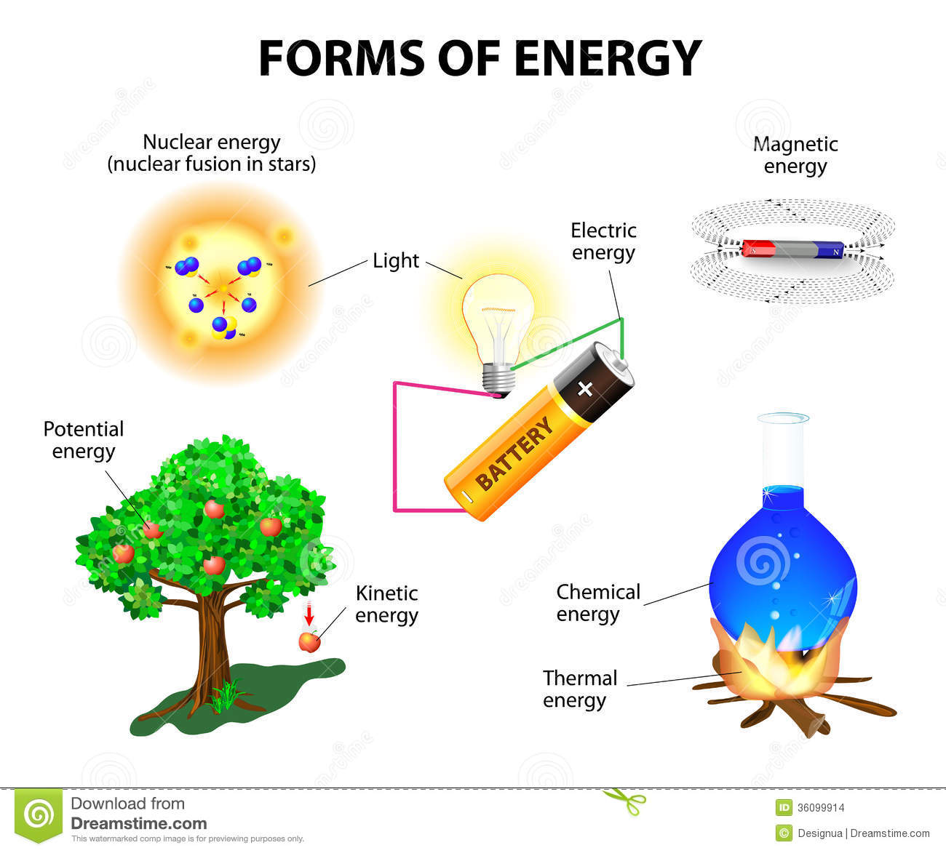

Slide 11
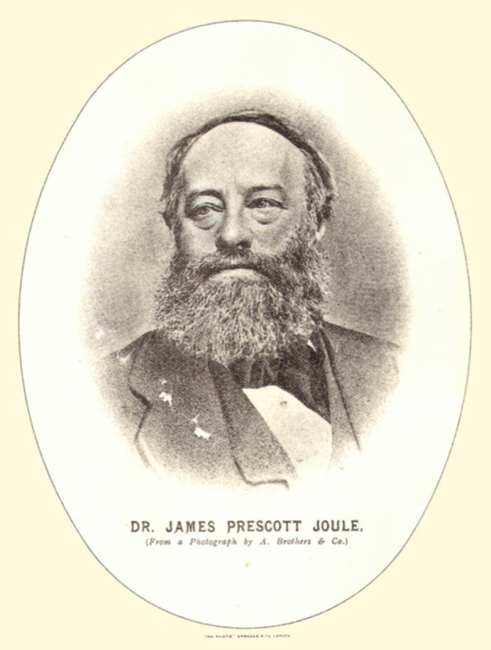
Units of Energy
Metric system (SI)
Joule (J)
1 Joule = 1 Newton-meter
J = N-m
www.mlfhs.org.uk/worthies/joule.jpg
US units - English system (IPS)
ft-lb or in-lb
1 foot-pound force = 1.3558 J (Let’s say 1.36 J)
Notes:
Joule is the unit for Energy and Work

Slide 12

But How Much is a Joule?
To lift an average apple* one meter.
1m
*An apple weighs approximately 1 Newton

Slide 13


State Change (Work) | Required Energy (J)
Creation of the Universe | 10⁶⁸
Starting Earth moving in orbit | 10³³
Atomic Bomb Explosion | 10¹⁴ (energy release)
Accelerating a 2006 Honda Accord from 0 to 60 mph | 5x10⁵
Hard-hit baseball | 10³
Lifting an apple by 1 meter | 1
Hopping flea (per hop) | 10⁻⁷

Slide 14
Other Energy Units
Energy Unit | In Joules
1 BTU (British Thermal Unit ) | 1055 joules
1 calorie* | 4.184 joules
1 food Calorie (kilocalorie) | 4184 joules
1 kwH (kilowatt-hour) | 3.6x10⁶ joules
*1 calorie = Amount of energy required to change temperature of one gram of liquid water by one degree Celsius.
1 gram = 0.001 kg For water: 1 gram=1 cm³

Slide 15
Energy Conversion
Energy is what it takes to do work, but energy is NOT “consumed” by doing the work. It is transformed from one form to another form.
In a gas water heater, the energy is transformed from energy contained in the gas to the heat energy in the water (and other forms in the byproducts such as heat in the exhaust air).

Slide 16
The work of lifting a mass of m kg for h meters requires the following amount of energy:
Energy = m (mass) x g(acceleration of gravity) x h (height)
PE = m g h
This amount of energy is transformed to the energy, called Potential Energy, that is contained in the mass situating at a higher elevation. Note: Energy is transformed, not ‘used up’.

Slide 17
Which one of the following values is closest to the amount of energy that is required to take you (about 65kg) from the 1st to the 2nd floor in the Engr building (a change of 7m)? (Hint: mgh)
40 J
400 J
4000 J
40000 J
400000 J
This energy is transformed from the energy in the food that you ate to the potential energy of your body mass on the 2nd floor.
PE = mgh = 70 (kg) x 9.8 m/s² x 7 (m) = 4900 J
Notes:
Lowest estimate 50kg * 4 meter * 9.8 = 2000
Highest estimate 100kg * 6 meter * 9.8 = 6000
Pound: mass is the amount of material, and weight as the force of attraction of the Earth

Slide 18

The work of accelerating a mass of m kg from 0 speed to the speed of v (meter/second) requires the following amount of energy:
This amount of energy is transformed from burning fuel to the energy that is contained in the moving mass is called Kinetic Energy. Note: Energy is transformed, not ‘used up’.

Slide 19

How much energy is in a Honda Accord (1300 kg) when it is traveling at 30 mph?
(note: 1 mph = 0.447 m/s)
Kinetic Energy = 0.5*1300kg*(13.4 m/s)² = 1.17x10⁵ J
How much energy is needed to accelerate it from 30 to 60 mph?
At 60 mph: Kinetic Energy = 0.5*1300*(26.8)² = 4.67x10⁵ J
Required energy = KE₆₀-KE₃₀
= 4.67x10⁵ J - 1.17x10⁵ J = 3.5x10⁵J

Slide 20
When a brake is applied, the kinetic energy of a moving car is converted into heat energy in the brake pads and later, ambient air. In this case, the energy is transformed, not created.
50 mph
0 mph
(1/2)mv²
(Kinetic Energy)
0
(Kinetic Energy)
Heat energy in brake pad

Slide 21
Fuel (energy) is required to keep a car moving at a constant speed on a level ground. In this case, the energy from the fuel is transformed mostly into which one of the following forms?
Potential energy of the car
Kinetic energy of the car
Heat energy of the air
Heat energy of the car engine
Kinetic energy of the air
Notes:
14% to 20% goes into moving the wheels
70% to 72% goes into engine losses such as heat, friction, pumping
10% drive train and other losses

Slide 22
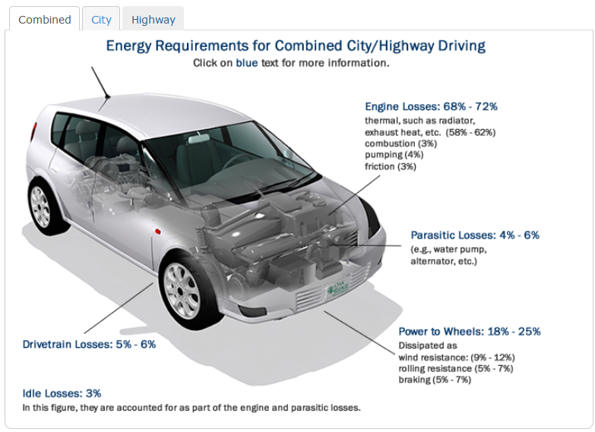
https://www.fueleconomy.gov/feg/atv.shtml

Slide 23
Energy Content
Energy is ‘stored’ in various forms around us.
 | Energy Content (J)
Gallon of gasoline | 1.3 x 10⁸
Pound of coal | 1.6 x 10⁷
Candy bar | 2 x 10⁵
A passenger car at 60 mph | 5 x 10⁵
AA battery | 10³
30 mph wind through an area of 100 m² for 1 hour. | 5.3 x 10⁸
A pound of TNT is about 2.42 mega (10⁶) joules.

Slide 24
Energy Transformation Machines
Some energy transformation is done naturally such as releasing energy contained in a log by burning for heat.
To better suit our needs, we build machines to facilitate, manage, and control the energy transformation.

Slide 25
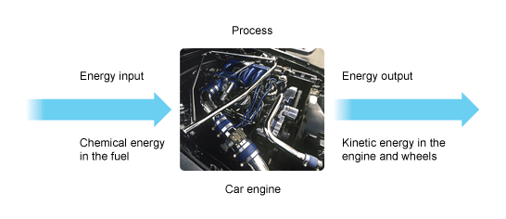
Energy Transformation Machines
http://www.bbc.co.uk/schools/gcsebitesize/science/aqa_pre_2011/energy/heatrev5.shtml

Slide 26


Example: A car’s engine
  Spark plugs initiate the combustion of fuel vapor in the engine cylinder, which releases energy from the gasoline.
  Cylinders and pistons transform the expansion force of the combusted fuel/air to mechanical force, which in turn accelerates the car and increases the car’s kinetic energy.
  Cooling systems take the heat energy (a byproduct) away from the engine.

Slide 27
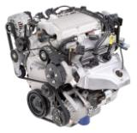
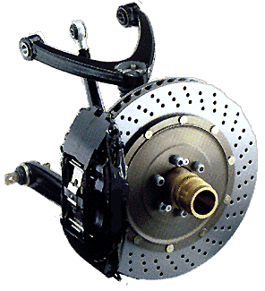
Energy is transformed into
several forms
Mechanical energy is transformed to heat
50 mph
Kinetic Energy
Heat
25ºC Brake
200ºC Brake

Slide 28
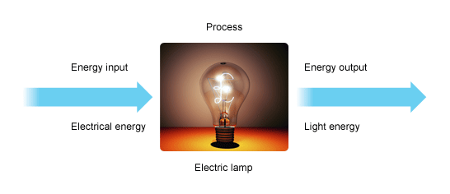
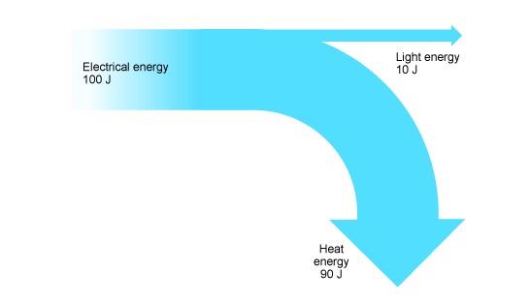
Undesired forms, too!
http://www.bbc.co.uk/schools/gcsebitesize/science/aqa_pre_2011/energy/heatrev5.shtml

Slide 29
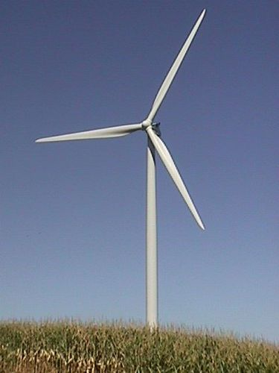
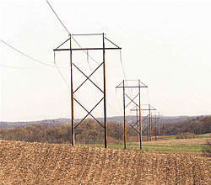
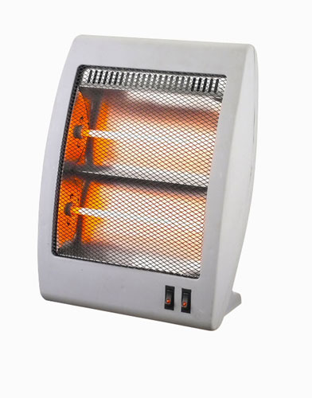
Energy is converted into several forms using transformation machines
electrical

Slide 30
Can energy be destroyed? No!
Conservation of Energy
Energy never vanishes. Energy only changes into different forms.
Efficiency
₌ Desired Energy Out
Energy In
In this case:

Slide 31
Undesired forms, too!
Efficiency
Desired Energy Out ₌ 10 joules _{= 10%}
Energy In 100 joules

Slide 32
How difficult is it to convert energy from one form to another (a more useful) form?
Very Easy:
Burning wood, coal, fossil fuel, potential energy stored in the water in a reservoir, nuclear reaction, energy stored in a battery, etc.
Not difficult but higher cost:
Solar, wind (kinetic energy of the air mass), ocean current (kinetic energy of water).
Impossible to transform efficiently to a ‘useful’ form:
Energy in the exhaust gas from a car engine.
Energy in the warm ocean water in a tropical region.

Slide 33

Key Concept
We see work being done (for example, a car is accelerated by the engine), but we don’t always realize this is a process of energy transformation (from energy in the fuel to the car’s kinetic energy).
vroom . . .

Slide 34
Key Concepts
Energy is added or released to change the physical state of an “object”.
Energy cannot be ‘created’ or ‘destroyed’.
Efficiency is the ratio of the part of output energy that is beneficial to us and the total input energy
We build machines to ‘manage’ energy conversion.

Slide 35
Energy Transformation
Phet Interactive Simulations, University of Colorado

Slide 36
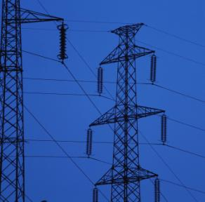
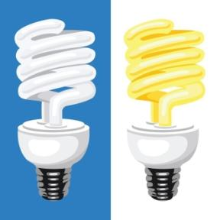
What is POWER?

Slide 37
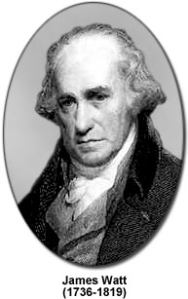
It takes time to transform energy from one form to another (i.e., to do work)!
Power is a measure of how fast energy is converted.
Power = energy transformed/time taken
= work done/time taken
A unit of power in metric system is the WATT.
1 watt = 1 joule/second
www.magnet.fsu.edu/education/tutorials/pioneers/watt.html

Slide 38
Power
Mechanical Power
Power produced by motion
Hydraulic Power
Pneumatic Power
Thermal Power
Electrical Power
Electric power is the rate at which electrical energy is transferred by an electric circuit. It’s a product of voltage and current (P=V x I)

Slide 39
Back to Earlier Question
Which of the following heaters can heat up a gallon of water to 90º C?
(A) 5 W heater
(B) 90 W heater
(C) 100 W heater
(D) All of the above

Slide 40

Mechanical Power - Example
A cyclist is travelling at a constant speed of about 5 m/s (18 km/hr). The retarding forces (resisting motion) acting on the cyclist are about 5 N.
5 N
How much energy does the cyclist have to provide to travel 15 m?
v =5 m/s
Work = force x distance moved
= 5 N x 15 m = 75 N-m = 75 J
Calculate the power of the cyclist.
It takes the cyclist 3 seconds to travel 15 m
Power = energy transferred/ time taken = 75 J/ 3 s= 25 watt
Power = force x distance/time → P = force x velocity
= 5 N x 5 m/s = 25 watt

Slide 41
Define the term ‘gps’ for water flow rate:
1 gps = 1 gallons per second
A 50-gallon barrel is filled to capacity in 10 seconds, what is the flow rate of the in-flow water (in gps)?
If you can do this problem, you understand the relationship between Energy and Power.

Slide 42
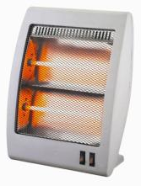
Example:
1500 J of energy per second carried by electricity
1500 J heat energy per second produced
This heater converts 1500 J of energy carried by electricity into heat energy per second.
This electric heater’s power rating is 1500 J/s or 1500 watts.

Slide 43
Equipment power consumption/generation
(strictly speaking, energy transformation rate)
Equipment | Watts
iPod | 0.3
Flash light | 1
Compact fluorescent light bulb | 10
Incandescent light bulb | 100
Hair dryer | 1000
Electric Range (with oven) | 10000
Engine in a compact car | 100000
A wind turbine with 30-meter blades in 12 m/s wind (power generation) | 1000000

Slide 44
Power output of a 60 kg (132 lbs) person
Speed (mph) | Output (watts)
0 | 70
2 | 179
3 | 233
4 | 286
5 | 610
10 | 1150
15 | 1690
at rest (0 mph)
walking (1~4 mph)
running (5~15 mph)
Where does the energy go?
Kinetic energy in the speed of the body. (a small fraction)
Overcoming air resistance. (a small fraction)
Operating body’s biological function e.g., breathing, heart pumping blood, maintaining body temperature, etc. (lots)

Slide 45
Other Units of Power
HorsePower (HP) 1HP = 746 watts
(Used mostly for mechanical systems)
kiloWatt (kW) 1kW = 1000 watts
BTU per Hour (BTUH) 1BTU/h = 0.3 watts
(Used mostly for thermal systems)

Slide 46
Back to Energy - Example
kilowatt-hour (kWh) is a unit of energy.
Since 1 W=1 joule/second
1 kWh=1000 (J/s) * 3600 (s) = 3.6*10⁶ joules
Your monthly energy consumption is measured in kWh. You pay about 40 - 45 cents for 1 kWh of energy these days.

Slide 47
More on Energy vs. Power
Information about a certain amount of energy (J) does not involve a sense of time.
(Analogy: 100 gallon of water)
Power (J/s=W), on the other hand, tells how fast the energy being converted or how fast the work can be done.
(Analogy: 2 gallon/sec)

Slide 48
More on Energy vs. Power
Energy conversion machines (car engine, hair dryer, microwave oven, light bulb etc.) are rated by how fast they can transform energy (i.e., how fast they do work).
Therefore, they are rated by Watt (J/S).

Slide 49
Which of the following heaters can heat up a gallon of water from 10ºC to 90ºC faster?
(A) 5 W heater
(B) 90 W heater
(C) 100 W heater
(D) All heaters above will take the same amount of time.

Slide 50
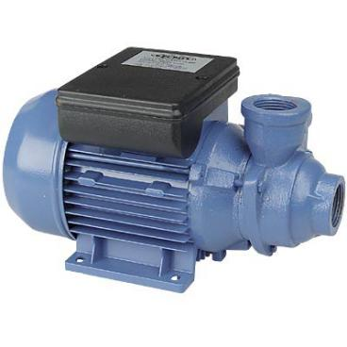
Analogy
1500 gallons per minute
This pump is rated 1500 gpm
1500 gallons per minute
Analogy:
Gallon is like ???
Gallons per minute is like ????

Slide 51
Both your and your neighbor's basement are flooded. You have a 5 HP gasoline power pump and your neighbor a 10 HP pump. You each have only 1 gallon of gasoline.
If both pumps have the same efficiency, which one can pump more water out of the basement with the 1 gallon of gasoline?
(A) You
(B) Your neighbor
(C) Same
(D) Insufficient information.

Slide 52
Another Analogy
It makes sense to say:
  The tank contains 500 gallons of water.
  The pump is pumping 10 gallons per minute.
It does not make sense to say:
  The tank contains 10 gallon per minute of water.
  The pump is pumping 500 gallons.

Slide 53
Polling Question
Which equipment’s energy bill is the highest per month?
(A) a 5 W nightlight
(B) a 50 W soldering iron
(C) a 100 W light bulb
(D) a 1000 W heater
(E) Insufficient information

Slide 54
Summary
Energy is what it takes to change the physical state of an “object”.
Power is a measure of how fast energy is converted.

