Slide 1

The Engineering Profession
E10 - Introduction to Engineering
Charles W. Davidson
College of Engineering

Slide 2
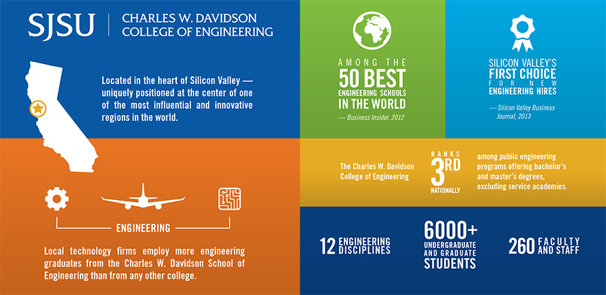

Slide 3
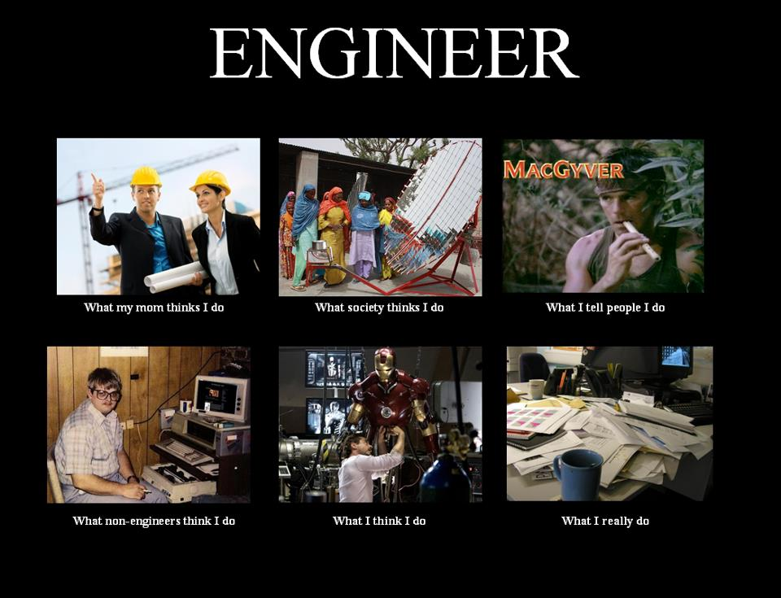


http://whatmyfriendsthinkido.net/what-my-friends-think-i-do-engineer/

Slide 4
What Is Engineering
“... the application of scientific knowledge about matter and energy for practical human uses such as construction, machinery, products, or systems.”
Academic Press dictionary of science and technology. San Diego,
Harcourt Brace Jovanovich, c1992. p.749. Q123.A33 1992
“ ... the science by which the properties of matter and the sources of power in nature are made useful to humans in structures, machines, and products.”
McGraw-Hill dictionary of scientific and technical terms.
6th ed. New York, McGraw-Hill, c2003. p. 722. Q123.M15 2002
Notes:
Directing the “great sources of power in nature for the use and convenience of man” British Institute of Engineers, circa early 20th century

Slide 5
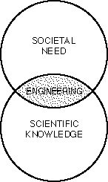
What Do Engineers Do?
Apply the Principles of Science and Mathematics to:
Innovate, Design, Build and Analyze Technical Systems and Products for the Benefit of Mankind

Slide 6
.
The Engineering Process
Develop
Communicate
Assemble
Design
Test/Evaluate
Analyze
management
Manufacture

Slide 7
Engineering Work in E10
Skills/Fundamentals: Excel, 3D CAD - SolidWorks, Teamwork,
Aerodynamics, Strength of Materials,
Communication, Programming - EasyC
Design: Turbine Blades and Structure (CE, ME, AE)
Robot SW and HW (EE, CompE, ME, SE)
Analysis: Solar Power (EE, ME)
Build Parts (Mfg): Turbine Blade (3D Printer)
Turbine Structure (CE, ME, MatE)
Assembly: IRB (EE, CompE)
Robot (EE, ME, CompE)
Test: Blade Performance (AE, ME, EE)
Structure Stiffness (CE, ME, ChemE, MatE )
Robot Performance (SE, CmpE, ME, EE)

Slide 8
Typical Product Cycle
Idea
Concept
Design/
Modeling
Product
Documentation
Specifications
Development/
Prototyping
A
Feasibility study
$$$
Testing
To MFG
Testing
Packaging
Facilities
Training
Shipping
A
Tooling/
Automation
To Customer/
Consumer
Production

Slide 9

Where do you see your self
5 to 10 years from now?
‘

Slide 10


Engineering Education Timeline
grad school
work
Fr.
So
Jr
Sr
What Next?
???
Time (years)
Notes:
Grad school?

Slide 11
Maybe you would like to work for an Engineering Company
OR
Maybe you would like to be a “Professional” Engineer

Slide 12
From Student to Engineer
Step 1
BS/MS
Majors
ME, EE, CE
ISE, SWR.E,
Comp.E …
Specialization

Slide 13
Timeline
Courses
Degree
Specialization
E10
EE98
ME20
Math30
MATE25
MATE115
CHE115
EE97
EE98
EE110
CMPE30
CMPE110
CMPE125
CE99
CE112
CE160
……..
BSME
BSEE
BSCMPE
BSCHE
BSCE
Solid Mechanics
Fluid Mechanics
Thermodynamics
Control Syst.
Digital Syst.
Commun. Syst.
;;
;; ‘’
Structural Engr
Geotechnical
Transportation
From Student
© 2004 J. Athanasiou
Notes:
A given job title can be held by engineers of various disciplines.
A given Co. Level can be held by engineer of various Functional jobs

Slide 14
From Student to Engineer
Step 3
BS/MS
Functional
(Job)
Classification
Company
Levels
Majors
Specialization
Notes:
A given job title can be held by engineers of various disciplines.
A given Co. Level can be held by engineer of various Functional jobs

Slide 15
Timeline
Entry Level
Sr. Level
Analytical E.
Research E.
Design E.
Experimental E.
Development E.
Test Engr.
Product Eng.
Mfg E
Quality E
Sales/Marketing
CEO
CTO
CFO
“”
“”
VP of..
Director Of..
Prgrm Mngr
Proj. Mngr
Sr Engr
Advisory
Staff E.
Engr.
Company
Levels
Notes:
A given job title can be held by engineers of various disciplines.
A given Co. Level can be held by engineer of various Functional jobs

Slide 16

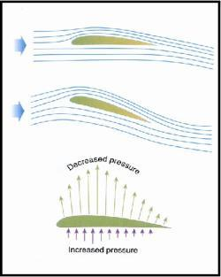
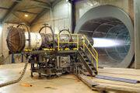
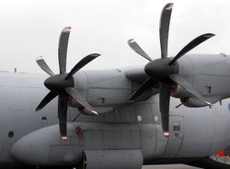
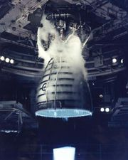
Engineering for aviation
and space exploration
Structural design
Guidance Systems
Navigation and Control
Instrumentation
Aero
Aerodynamics
Propulsion
Flight
Dynamics
Structure &
Materials

Slide 17
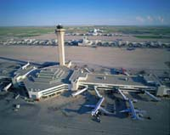

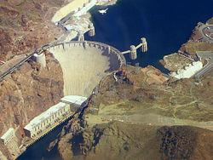
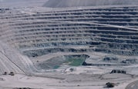
.
Highways
Bridges
Tunnels
Airports
Resevoirs
Civil E
Construction
Structural
Transportation
Geotechnical
Water Resources/
Environmental
Plan, design and supervise
construction

Slide 18

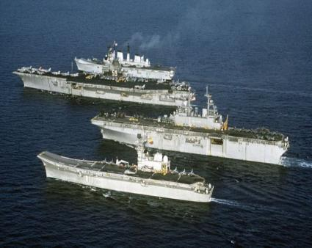
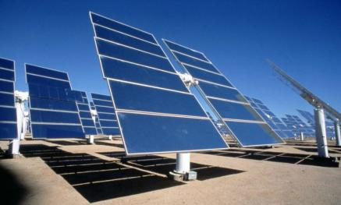
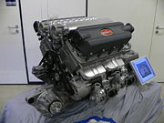
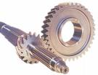
.
Research, design and production
of any machinery with moving parts
Power producing machines
(generators, turbines, hybrid)
Power using machines
(HVAC, power tools, industrial
equipment)
ME
Fluid
Dynamics
Thermo-
dynamics
Mechanical
Design
Mechatronics

Slide 19
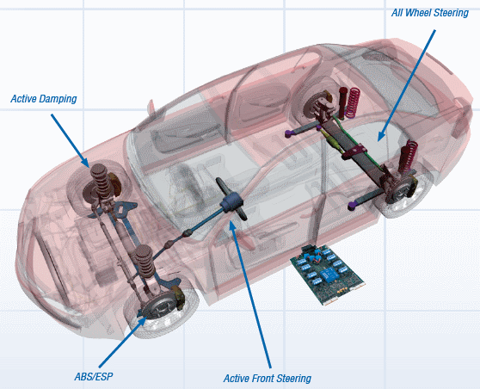
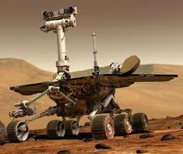
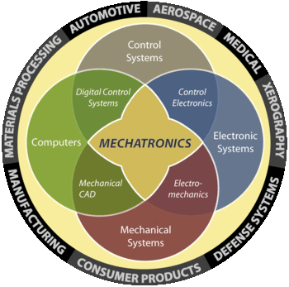
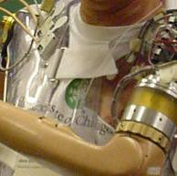
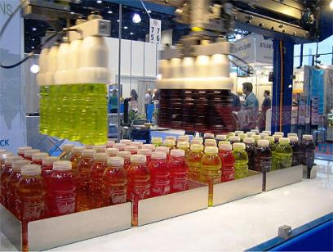
Mechatronics
Mechanical, Electronic, Control & Computing systems

Slide 20
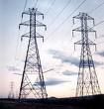
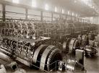
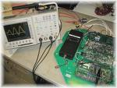
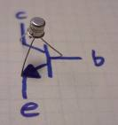




.
Computers
Communications
(Satellites, phone, antennas…)
Robotics
Microelectronics
Research and design large
scale power grids to power drills
to integrated circuits
EE
Power
Generation
Communication
Systems
LSI
Electronics

Slide 21

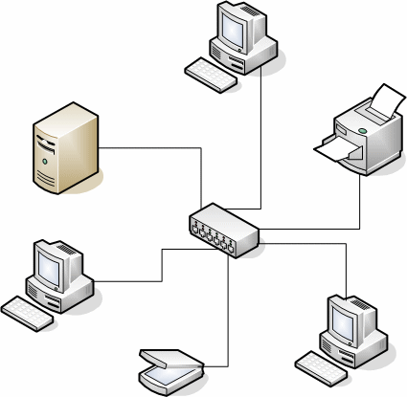

.
ICs
Boards
SoC
Operating Systems
Networks
Apps
Research and design related to
computer HW and SW applications
Computer OR
Software E
Hardware
Design
Software
Design
Networks
Databases

Slide 22
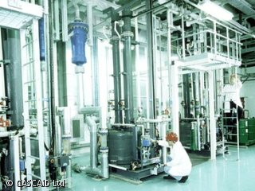




.
Solve problems for production or
use of chemicals
For producing
Energy
Food
Clothing
Healthcare
Biotechnology
Batteries
Chem. E
Biochemical
Polymers
Plastics
Food
Processing

Slide 23


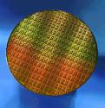
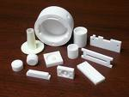


.
Create new material
Metals
Ceramics
Plastics
Semiconductors
Composites
Mat. E
Semiconductors
Microelectronics
Ceramics

Slide 24
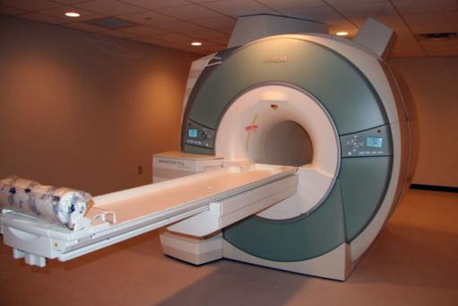

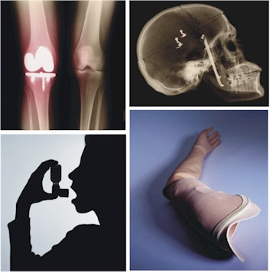
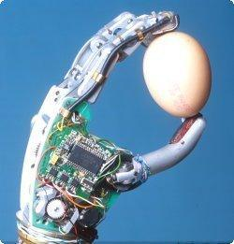
.
Develop devices and processes
to solve medical and health
related problems.
Combining biology/medicine with
Engineering
MRI
Artificial organs
Prosthetics
Biomedical Engineering
Biomechanics
Pharmaceuticals
Medical Devices

Slide 25





.
General Engineering
Engineering Electives
Technical Electives
Minor
Broadly Focused
Engineering Management
Engineering-related Career

Slide 26
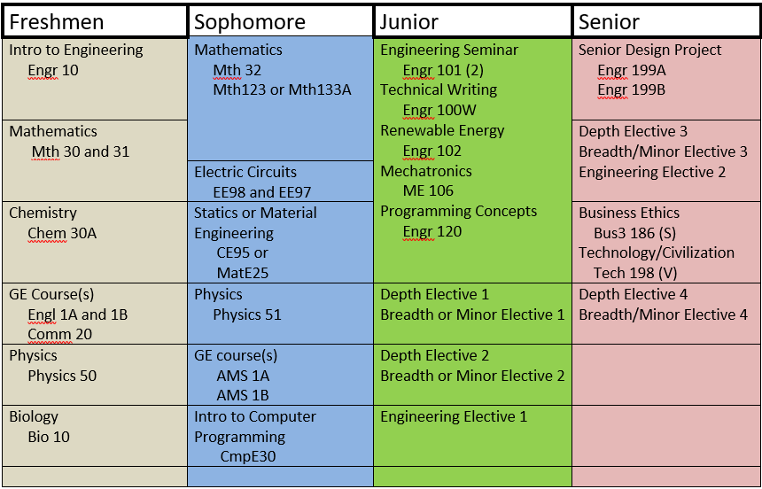
General Engineering Curriculum – Fall 2020

Slide 27
Maybe you would like to be a “Professional” Engineer

Slide 28
What do we mean by a Profession?
Requires specialized & highly skilled knowledge
Requires academic training
Regulated by professional bodies
Requires examination of competence
Function of professional work is vital to society
Perform under a standard of professional behavior that requires adherence to the highest principles of legal and ethical conduct
Requires continuing education to keep current with rapidly changing technology

Slide 29

The Engineering Profession
Training, Qualifications, Advancements, Licensure
BS required for all entry level engineering jobs
To become a Professional Engineer (PE) requires a license
All 50 states require licensure for engineers who offer their services directly to the public²

Slide 30
Training, Qualifications, Advancements, Licensure
BS Degree
Pass the Fundamentals of Engineering (FE) Exam
Work Four Years Under a PE
Pass Principles and Practice of Engineering Exam
Notes:
Exam by NCEES (National Council of Examiners for Engineering and Surveying)
Principles and Practice of Engineering

Slide 31
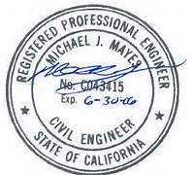
Being a licensed engineer
The PE license allows you to call yourself a professional engineer
Can have legal authority for engineering work (e.g. sign/stamp drawings,
bid for government contracts,
own company, serve as expert
witness, etc.)
Some states require at least one licensed engineer in a company.

Slide 32
What are employers looking for in new graduates?
Number One: Matching Their Needs

Slide 33
What are employers looking for in new graduates?
Technical Competency
  Good grades are important
  What does a Viterbi Decoder do?
  Work experience
  Internships
Co-ops
Good communication skills:
Written
Verbal
Ability to “think on your feet”

Slide 34
What are employers looking for in new graduates?
Understanding of commercialization
Knowledge of the industry
Knowledge of the company
Customer or client comportment
Ability to think critically and creatively as well as independently and cooperatively
A multidisciplinary systems perspective
Value the importance of teamwork
Subscribe to ethical standards

Slide 35
What are employers looking for in new graduates?
Flexibility – the ability and the self- confidence to adapt.
Change projects, teams
Relocate
Adopt another culture or language
Curiosity and a LifeLong desire to Learn. (LLL)
"I have no particular talent. I am only inquisitive." -- Albert Einstein
Well-rounded, T-Shaped

Slide 36
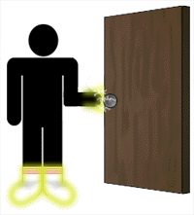
Bachelor of Science in Engineering:
The Key to Many Doors

Slide 37
The Engineering Profession

Slide 38
Back Up

Slide 39
Directions After BS “Engineering”
Advanced Degrees-Academic Institutions
(Teaching, researching, publishing, community involvement)
Engineering Management (MSE/MBA)
Medicine (Bioengineering, prosthetics, ”Bionic Man/Woman”)
Government, Defense, CalTrans
Engineering Consultant (PE)
Your Own Business
Notes:
CAN YOU THINK of any other directions?
HOW ABOUT The CIA????????

Slide 40
Functional Classification - All majors
1. Research
2. Experimental
3. Analytical
4. Design
5. Development
6. Testing
7. Production
8. Operations
9. Sales/Marketing
10. Customer (large systems)
11. Management
12. Consulting
Construction
Safety
Notes:
These are generic, Companies may have additional “Jobs”
So, frame your degree. Or frame it and give it to the one who paid as a thank you.
It did its job.
Now you have a new title.

Slide 41
Engineering Functional Jobs
Title | Function | SKILLS/Knowledge
Research E. | -Solve new problems -Obtain new data -Devise new methods of calculation -Gain new knowledge | Perceptiveness Patience Self-Confidence
Analytical E. | Model physical problems using math to predict performance Perform failure analysis | Math, physics, engineering, science, applications software
Development E. | -Develop products, processes, or systems -Use well-known principles and employ existing processes or machines to perform a new function -Concerned mostly with a prototype or model | Ingenuity Creativity Astute Judgment

Slide 42
Engineering Functional Jobs
Title | Function | SKILLS/Knowledge
Design E. | -Convert concepts & information into detailed plans & specs from which the finished product can be be manufactured -Restricted by the state of the art | Creativity Innovation Fundamental knowledge of many disciplines Understanding of economics and people
Production E. | - Devise a schedule to efficiently coordinate materials and personnel - Order raw materials at optimum times - Set up the assembly line - Handle and ship finished product | -Knowledge of design, economics & psychology -Ability to visualize the overall operation of a project -Knowledge of each step of the production effort

Slide 43
Engineering Functional Jobs
Title | Function | SKILLS/Knowledge
Test E. | -Develop & conduct tests to verify that a new product meets design specs -Test products for structural integrity, performance, & reliability -Testing is performed under all expected environmental conditions | -Knowledge of statistics, product & process specifications -Measurement techniques -Fundamental engineering aspects of the design
Operations or Plant E. | -Select sites for facilities -Specify layout for all facets of the operation -Select fixed equipment for climate control, lighting, and communication -Responsible for maintenance and modifications | Industrial engineering, economics and law

Slide 44
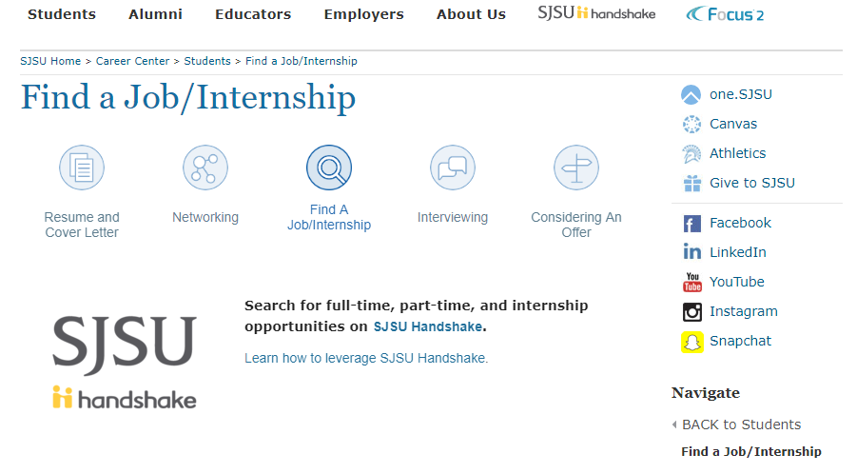
Handshake has about 45 Job Function categories that you can use as filters in your job/internship search.

Slide 45
Salary Calculators
Interviewing Guide:
www.sjsu.edu/careercenter > Launch Your Career> Interviewing Guide> Negotiating an Offer
www.jobsearchintelligence.com/etc/jobseekers/salary-calculator.php
www.payscale.com
www.glassdoor.com

Slide 46





What Employers Seek?
Written Communication
Problem Solving
Ability to work in a team
Initiative
Analytical/Quantitative skills
National Association of Colleges and Employers, 2019
Notes:
-Before displaying the answers ask the audience what they think are the top skills employers seek on a resume?
-Some of the other skills employers seek on a resume are…
Strong work ethic
Communication skills (verbal)
Leadership
Detail-oriented
Technical skills
Flexibility/adaptability

