Slide 1
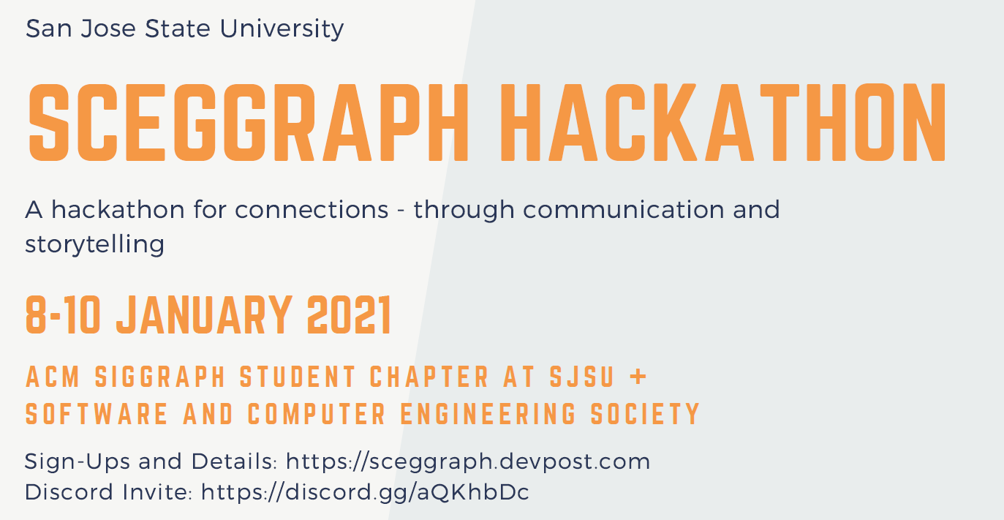

Slide 2

The Engineering Profession
E10 - Introduction to Engineering
Charles W. Davidson
College of Engineering

Slide 3
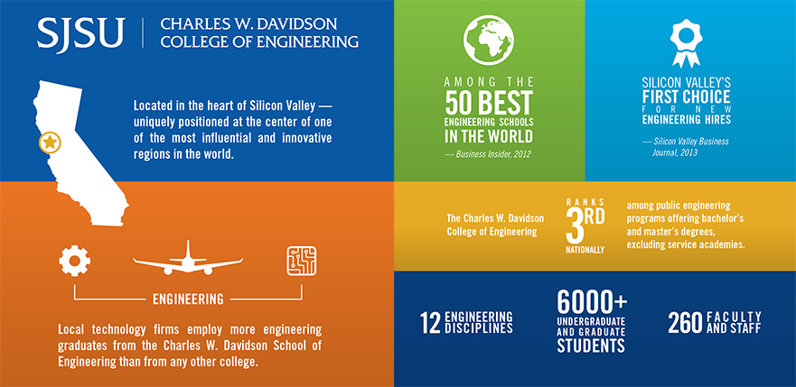

Slide 4
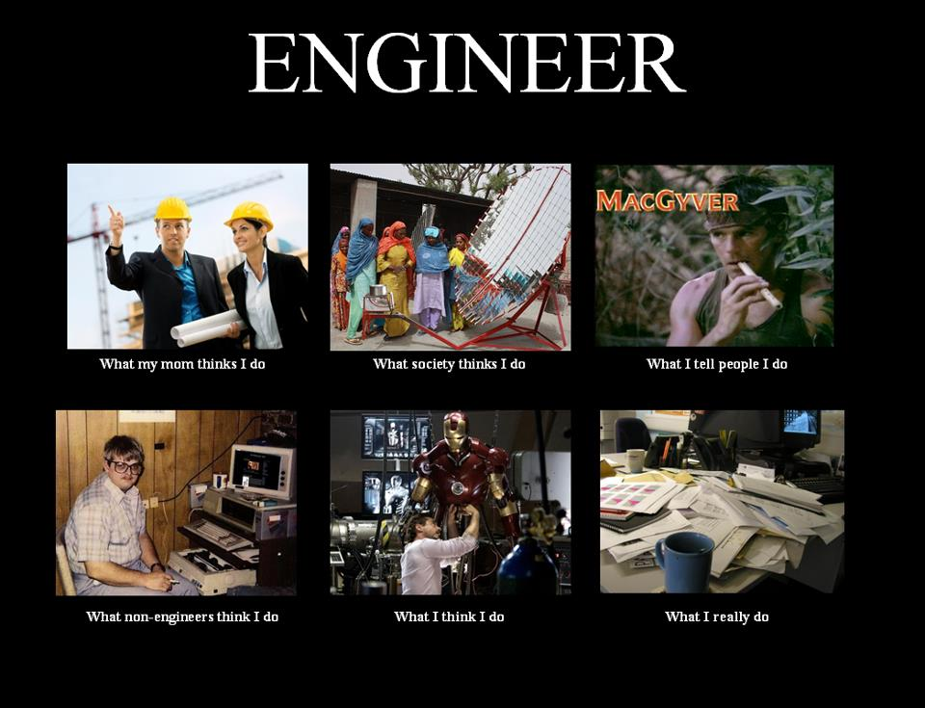


http://whatmyfriendsthinkido.net/what-my-friends-think-i-do-engineer/

Slide 5
What Is Engineering
“... the application of scientific knowledge about matter and energy for practical human uses such as construction, machinery, products, or systems.”
Academic Press dictionary of science and technology. San Diego,
Harcourt Brace Jovanovich, c1992. p.749. Q123.A33 1992
“ ... the science by which the properties of matter and the sources of power in nature are made useful to humans in structures, machines, and products.”
McGraw-Hill dictionary of scientific and technical terms.
6th ed. New York, McGraw-Hill, c2003. p. 722. Q123.M15 2002
Notes:
Directing the “great sources of power in nature for the use and convenience of man” British Institute of Engineers, circa early 20th century

Slide 6
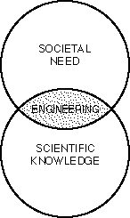
What Do Engineers Do?
Apply the Principles of Science and Mathematics to:
Innovate, Design, Build and Analyze Technical Systems and Products for the Benefit of Mankind

Slide 7
.
The Engineering Process
Develop
Communicate
Assemble
Design
Test/Evaluate
Analyze
management
Manufacture

Slide 8
Engineering Work in E10
Skills/Fundamentals: Excel, 3D CAD - SolidWorks, Teamwork,
Aerodynamics, Strength of Materials,
Communication, Programming - EasyC
Design: Turbine Blades and Structure (CE, ME, AE)
Robot SW and HW (EE, CompE, ME, SE)
Analysis: Solar Power (EE, ME)
Build Parts (Mfg): Turbine Blade (3D Printer)
Turbine Structure (CE, ME, MatE)
Assembly: IRB (EE, CompE)
Robot (EE, ME, CompE)
Test: Blade Performance (AE, ME, EE)
Structure Stiffness (CE, ME, ChemE, MatE )
Robot Performance (SE, CmpE, ME, EE)

Slide 9
Typical Product Cycle
Idea
Concept
Design/
Modeling
Product
Documentation
Specifications
Development/
Prototyping
A
Feasibility study
$$$
Testing
To MFG
Testing
Packaging
Facilities
Training
Shipping
A
Tooling/
Automation
To Customer/
Consumer
Production

Slide 10

Where do you see your self
5 to 10 years from now?
‘

Slide 11


Engineering Education Timeline
grad school
work
Fr.
So
Jr
Sr
What Next?
???
Time (years)
Notes:
Grad school?

Slide 12
Maybe you would like to work for an Engineering Company
OR
Maybe you would like to be a “Professional” Engineer

Slide 13
From Student to Engineer
Step 1
BS/MS
Majors
ME, EE, CE
ISE, SWR.E,
Comp.E …
Specialization

Slide 14
Timeline
Courses
Degree
Specialization
E10
EE98
ME20
Math30
MATE25
MATE115
CHE115
EE97
EE98
EE110
CMPE30
CMPE110
CMPE125
CE99
CE112
CE160
……..
BSME
BSEE
BSCMPE
BSCHE
BSCE
Solid Mechanics
Fluid Mechanics
Thermodynamics
Control Syst.
Digital Syst.
Commun. Syst.
;;
;; ‘’
Structural Engr
Geotechnical
Transportation
From Student
© 2004 J. Athanasiou
Notes:
A given job title can be held by engineers of various disciplines.
A given Co. Level can be held by engineer of various Functional jobs

Slide 15
From Student to Engineer
Step 3
BS/MS
Functional
(Job)
Classification
Company
Levels
Majors
Specialization
Notes:
A given job title can be held by engineers of various disciplines.
A given Co. Level can be held by engineer of various Functional jobs

Slide 16
Timeline
Entry Level
Sr. Level
Analytical E.
Research E.
Design E.
Experimental E.
Development E.
Test Engr.
Product Eng.
Mfg E
Quality E
Sales/Marketing
CEO
CTO
CFO
“”
“”
VP of..
Director Of..
Prgrm Mngr
Proj. Mngr
Sr Engr
Advisory
Staff E.
Engr.
Company
Levels
Notes:
A given job title can be held by engineers of various disciplines.
A given Co. Level can be held by engineer of various Functional jobs

Slide 17
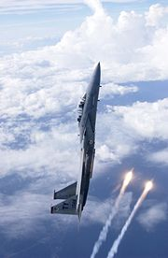
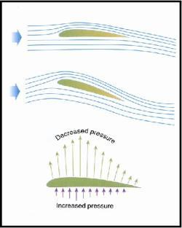
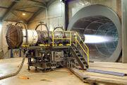
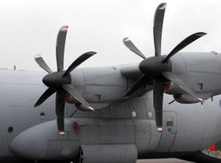
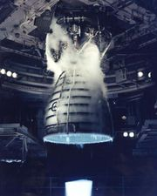
Engineering for aviation
and space exploration
Structural design
Guidance Systems
Navigation and Control
Instrumentation
Aero
Aerodynamics
Propulsion
Flight
Dynamics
Structure &
Materials

Slide 18
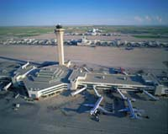
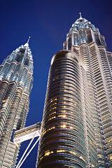
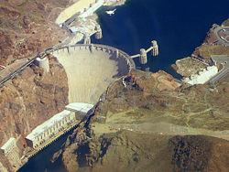
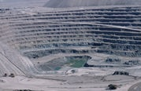
.
Highways
Bridges
Tunnels
Airports
Resevoirs
Civil E
Construction
Structural
Transportation
Geotechnical
Water Resources/
Environmental
Plan, design and supervise
construction

Slide 19
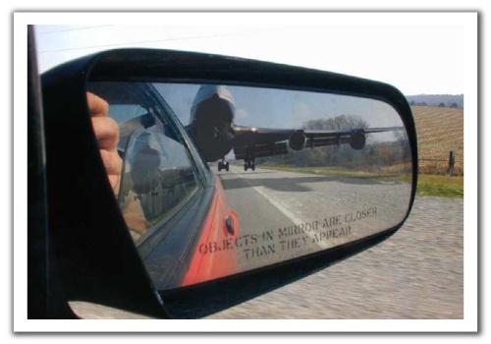
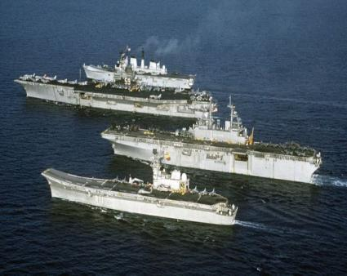
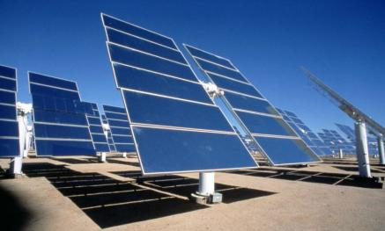
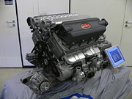

.
Research, design and production
of any machinery with moving parts
Power producing machines
(generators, turbines, hybrid)
Power using machines
(HVAC, power tools, industrial
equipment)
ME
Fluid
Dynamics
Thermo-
dynamics
Mechanical
Design
Mechatronics

Slide 20
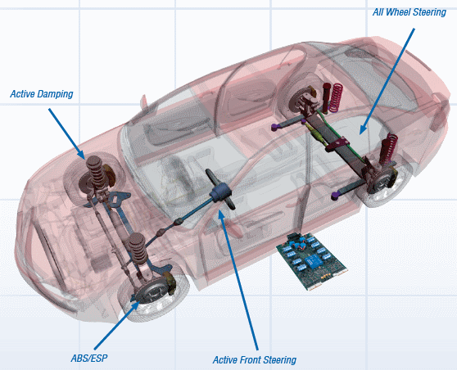
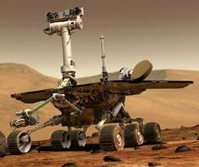
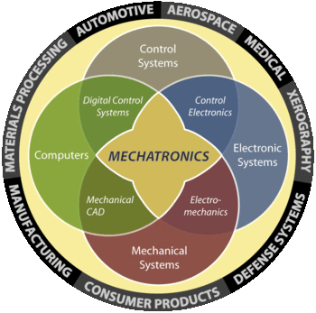
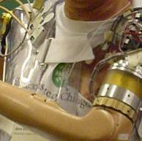
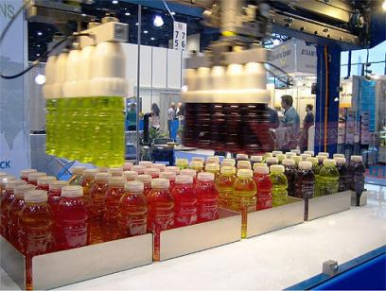
Mechatronics
Mechanical, Electronic, Control & Computing systems

Slide 21
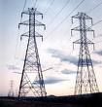

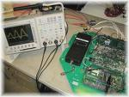
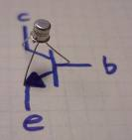




.
Computers
Communications
(Satellites, phone, antennas…)
Robotics
Microelectronics
Research and design large
scale power grids to power drills
to integrated circuits
EE
Power
Generation
Communication
Systems
LSI
Electronics

Slide 22

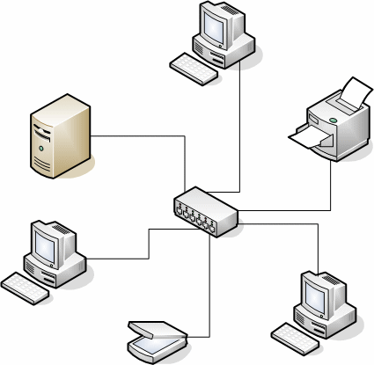

.
ICs
Boards
SoC
Operating Systems
Networks
Apps
Research and design related to
computer HW and SW applications
Computer OR
Software E
Hardware
Design
Software
Design
Networks
Databases

Slide 23
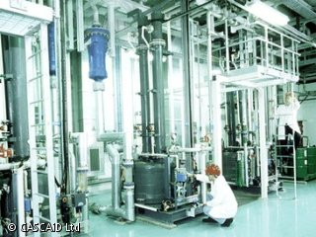




.
Solve problems for production or
use of chemicals
For producing
Energy
Food
Clothing
Healthcare
Biotechnology
Batteries
Chem. E
Biochemical
Polymers
Plastics
Food
Processing

Slide 24


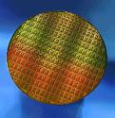
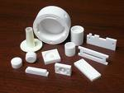


.
Create new material
Metals
Ceramics
Plastics
Semiconductors
Composites
Mat. E
Semiconductors
Microelectronics
Ceramics

Slide 25
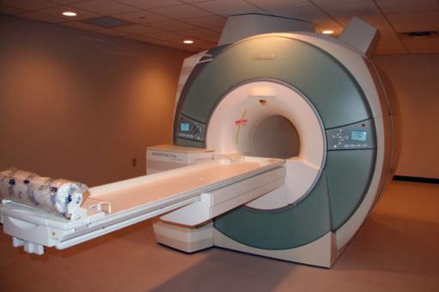
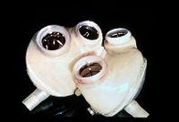
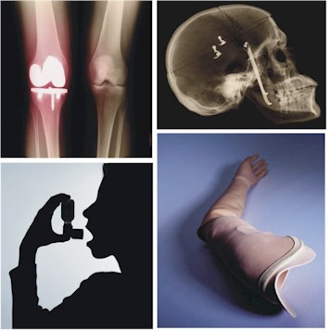
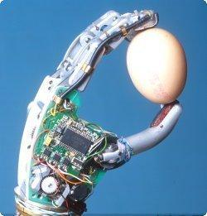
.
Develop devices and processes
to solve medical and health
related problems.
Combining biology/medicine with
Engineering
MRI
Artificial organs
Prosthetics
Biomedical Engineering
Biomechanics
Pharmaceuticals
Medical Devices

Slide 26




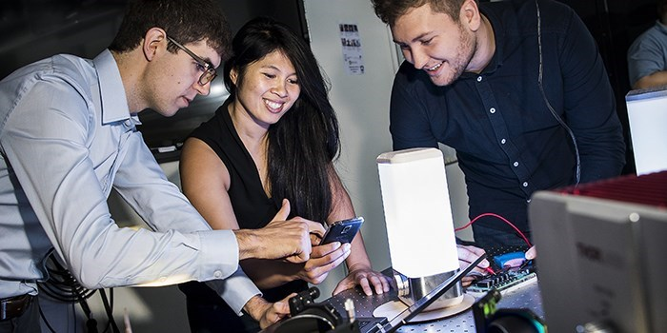
.
General Engineering
Broadly Focused
Engineering Management
Engineering-related Career
Minor Within 120 Units
Career-Related Engineering Electives
Customized Technical Electives
Minor in Non-Engineering Program
26
Notes:
The program provides a platform so students can develop their own customized course pathway through a broad set of upper division electives that are not available in other specific engineering majors.
They may even take courses outside of the College of Engineering in support of their education and career goals.
Students in General Engineering gain the same knowledge and skills as students matriculating in these other specific engineering majors.
Next slide.

Slide 27








Engineering Employment Opportunities for Non-Traditional Majors
  Interdisciplinary Engineering, Multidisciplinary Engineering or Integrated Engineering
Related Job Titles
  Project or Engineering Management
  Quality Engineer
  Test Engineer
  Patent Attorney
  Astronaut
  More, . . .

Slide 28
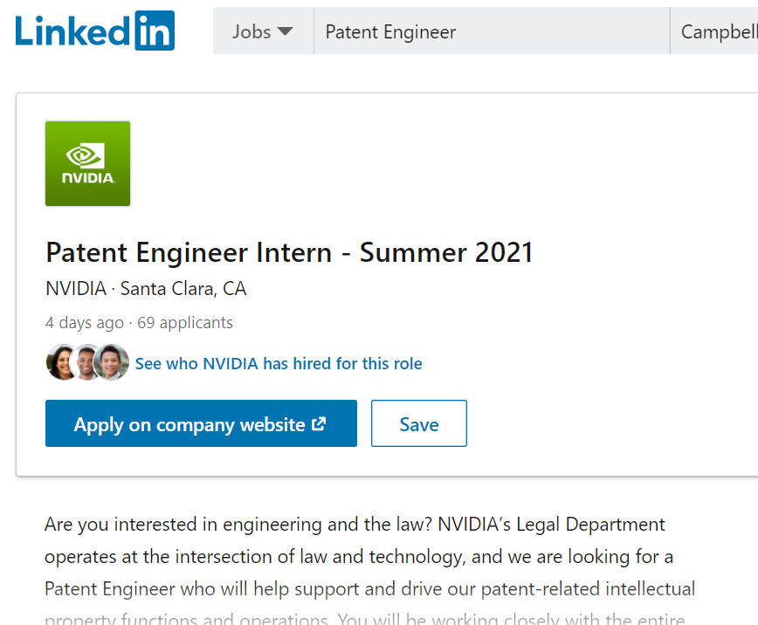

Slide 29
Bachelor of Science Degree in General Engineering
Intended for Students:
  With strong skills in Math and the Sciences
  Interested in applying engineering practices across different fields of study or emerging technologies
Similar Curriculum First Two Years as Other Majors
Minor Degree Encouraged in a Non-Engineering Discipline

Slide 30
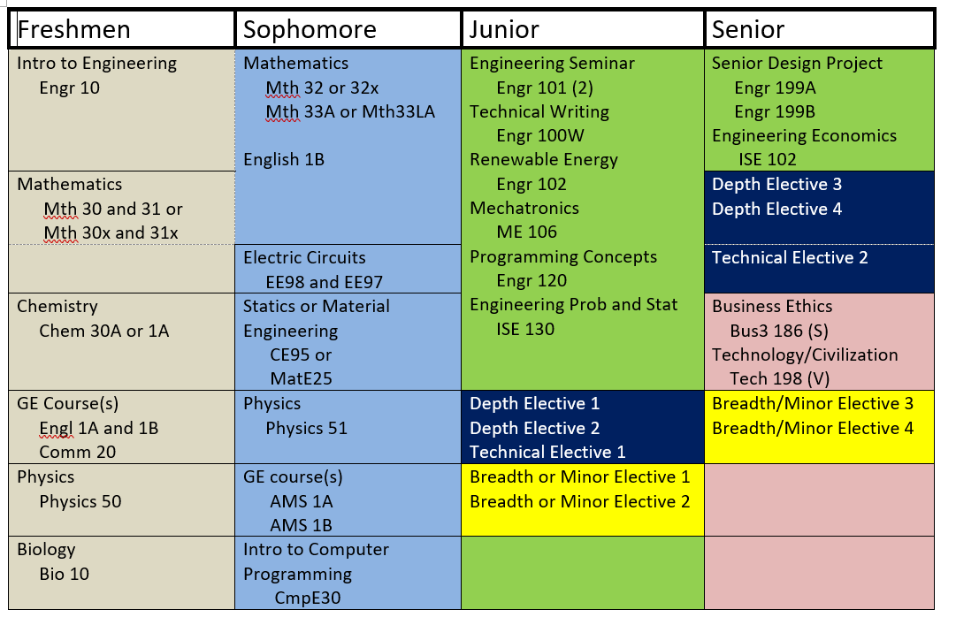

Slide 31
Electives
General Engineering - Upper Division Curriculum
Depth Area Electives (12 Units)
    Four-course set in an Engineering area
    Pre-approved by Major Depts
Technical Electives (6 Units)
    Two courses in engineering, science or business
Breadth Electives or Minor (12 Units)
Not limited to engineering or science
Recommended for Minor Program
Notes:
Students are strongly encouraged to use the “Breadth Electives” to complete a minor degree not limited to engineering or science (for example, Business).
Next slide.

Slide 32
Depth Area Electives - Examples
General Engineering - Upper Division Curriculum
Electrical Engineering - Digital Area
  EE112 - Intro to Signal Processing
  EE118 - Digital Logic Circuit Design
  EE120 - Microprocessor Based System Design
  EE138 - Embedded Control System Design
  Civil Engineering - Construction and Traffic
  CE122 - Traffic Engineering
  CE130 - Civil Engineering Economic Analysis
  CE131 - Introduction to Construction Engineering
  CE134 - Project Management for Construction

Slide 33
Depth Area Electives – Examples (cont)
General Engineering - Upper Division Curriculum
Aerospace Area
AE100 - Fundamentals of AE
AE165 - Aerospace Flight Mechanics
AE110 - Space Systems Engineering
AE166 – Rocketry
Systems Engineering Area
ISE120 - Work methods design and measurement
ISE131 - Statistical process control and improvement
ISE140 - Operations planning and control
ISE151 - Introduction to Engineering Management

Slide 34
Depth Area Electives – Examples (cont)
General Engineering - Upper Division Curriculum
Mechanical Engineering Area
ME20 - Design and Graphics (2)
  ME41- Machine shop safety (1)
  ME 101 - Dynamics (3)
  ME180 - Workshop for ME101 (1)
  ME120 - Experimental method (2)
  ME111 - Fluid Mechanics (3)
Notes:
Next slide.

Slide 35
Depth Area Electives – Examples (cont)
General Engineering - Upper Division Curriculum
Computer Engineering Area
CMPE 050 - Object-Oriented Concepts and Methodology
CMPE 120 - Computer Organization and Architecture.
CMPE 126 - Algorithms and Data Structure Design
CMPE 138 - Database Systems I
Notes:
Next slide.

Slide 36
General Engineering - Upper Division Curriculum
Minor Degree Program Examples
Computer Science
  Business
  Bio-Informatics
  Applied Computing for Behavioral and Social Scientists
Notes:
Electives can also be used to pursue a minor degree in: Computer Science, Business, Bio-informatics, or Applied Computing for Behavioral and Social Scientists

Slide 37
  Name Change Fall 2021: Interdisciplinary Engineering
Notes:
The General Engineering program is also the home for courses required for all specific engineering majors. Examples include technical writing (Engr 100W) and Introduction to Engineering (Engr 10) of which I am a lecturer.
If you get an opportunity, check out the videos from one of the lab projects in Introduction to Engineering where teams of students design and build an autonomous robot. Students took the initiative to produce these videos using their own creativity.
Just for future reference: We are in the process of changing the name from General Engineering to Interdisciplinary Engineering to reflect a more accurate description of the major.
Thank you for your attention, stay healthy and look forward to seeing you in the Fall.

Slide 38
Maybe you would like to be a “Professional” Engineer

Slide 39
What do we mean by a Profession?
Requires specialized & highly skilled knowledge
Requires academic training
Regulated by professional bodies
Requires examination of competence
Function of professional work is vital to society
Perform under a standard of professional behavior that requires adherence to the highest principles of legal and ethical conduct
Requires continuing education to keep current with rapidly changing technology

Slide 40

The Engineering Profession
Training, Qualifications, Advancements, Licensure
BS required for all entry level engineering jobs
To become a Professional Engineer (PE) requires a license
All 50 states require licensure for engineers who offer their services directly to the public²

Slide 41
Training, Qualifications, Advancements, Licensure
BS Degree
Pass the Fundamentals of Engineering (FE) Exam
Work Four Years Under a PE
Pass Principles and Practice of Engineering Exam
Notes:
Exam by NCEES (National Council of Examiners for Engineering and Surveying)
Principles and Practice of Engineering

Slide 42
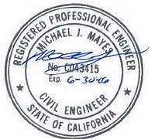
Being a licensed engineer
The PE license allows you to call yourself a professional engineer
Can have legal authority for engineering work (e.g. sign/stamp drawings,
bid for government contracts,
own company, serve as expert
witness, etc.)
Some states require at least one licensed engineer in a company.

Slide 43
What are employers looking for in new graduates?
Number One: Matching Their Needs

Slide 44
What are employers looking for in new graduates?
Technical Competency
  Good grades are important
  What does a Viterbi Decoder do?
  Work experience
  Internships
Co-ops
Good communication skills:
Written
Verbal
Ability to “think on your feet”

Slide 45
What are employers looking for in new graduates?
Understanding of commercialization
Knowledge of the industry
Knowledge of the company
Customer or client comportment
Ability to think critically and creatively as well as independently and cooperatively
A multidisciplinary systems perspective
Value the importance of teamwork
Subscribe to ethical standards

Slide 46
What are employers looking for in new graduates?
Flexibility – the ability and the self- confidence to adapt.
Change projects, teams
Relocate
Adopt another culture or language
Curiosity and a LifeLong desire to Learn. (LLL)
"I have no particular talent. I am only inquisitive." -- Albert Einstein
Well-rounded, T-Shaped

Slide 47
Overview of Career Center Services by Kelly Masegian

Slide 48







SJSU Career Center and You
We help students:
With career development during their time on-campus and beyond
Market your strengths to employers
Find opportunities to get real-world experience
Notes:
→ Market your traits to employers
resume building
interview preparation
job fair preparedness
Networking
→ Find opportunities to get real world experience
Job/Internship prep
Volunteer opportunities

Slide 49
How We Can Help You
Virtual
Appointments
One-on-One sessions
Virtual
Workshops
Group sessions
Virtual Fairs & Information Sessions
Connect with Employers
Schedule online https://sjsu.campus.eab.com/
Career > ESSC
Job Fair Success, Resume, Networking & Informational Interview, Job/Internship Search and more
See the schedule on sjsu.joinhandshake.com under Events

Slide 50

Connect With Us
Our Website: http://www.sjsu.edu/careercenter
Features Resources for:
Major/Career Exploration
Resume/Cover Letter
Build Career Experience
Networking
Interview Preparation
and More

Slide 51

For more details visit sjsu.edu/careercenter > resources
Notes:
*

Slide 52

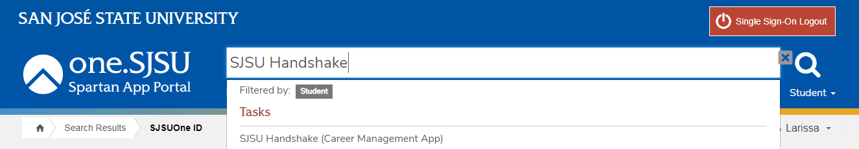
What is Handshake?
Online database for career opportunities exclusive to SJSU students
Full-time, part-time, internships, volunteer work
Sort by major, job type, location, keywords and more!
Follow employer events

Slide 53
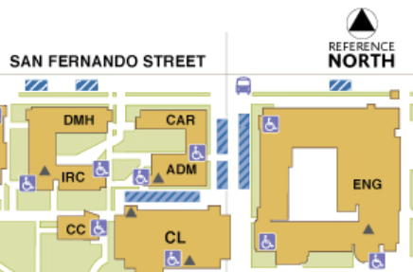
Career Advising
https://sjsu.campus.eab.com/
www.sjsu.edu/careercenter
www.sjsu.joinhandshake.com
Questions? Feel free to email me:
kelly.masegian@sjsu.edu
Career Center
ADM Bldg, Room 255
Phone: 408-924-6031

Slide 54
Thank you!

Slide 55

Bachelor of Science in Engineering:
The Key to Many Doors

Slide 56
The Engineering Profession

Slide 57
Back Up

Slide 58
Directions After BS “Engineering”
Advanced Degrees-Academic Institutions
(Teaching, researching, publishing, community involvement)
Engineering Management (MSE/MBA)
Medicine (Bioengineering, prosthetics, ”Bionic Man/Woman”)
Government, Defense, CalTrans
Engineering Consultant (PE)
Your Own Business

Slide 59
Functional Classification - All majors
1. Research
2. Experimental
3. Analytical
4. Design
5. Development
6. Testing
7. Production
8. Operations
9. Sales/Marketing
10. Customer (large systems)
11. Management
12. Consulting
Construction
Safety
Notes:
These are generic, Companies may have additional “Jobs”

Slide 60
Engineering Functional Jobs
Title | Function | SKILLS/Knowledge
Research E. | -Solve new problems -Obtain new data -Devise new methods of calculation -Gain new knowledge | Perceptiveness Patience Self-Confidence
Analytical E. | Model physical problems using math to predict performance Perform failure analysis | Math, physics, engineering, science, applications software
Development E. | -Develop products, processes, or systems -Use well-known principles and employ existing processes or machines to perform a new function -Concerned mostly with a prototype or model | Ingenuity Creativity Astute Judgment

Slide 61
Engineering Functional Jobs
Title | Function | SKILLS/Knowledge
Design E. | -Convert concepts & information into detailed plans & specs from which the finished product can be be manufactured -Restricted by the state of the art | Creativity Innovation Fundamental knowledge of many disciplines Understanding of economics and people
Production E. | - Devise a schedule to efficiently coordinate materials and personnel - Order raw materials at optimum times - Set up the assembly line - Handle and ship finished product | -Knowledge of design, economics & psychology -Ability to visualize the overall operation of a project -Knowledge of each step of the production effort

Slide 62
Engineering Functional Jobs
Title | Function | SKILLS/Knowledge
Test E. | -Develop & conduct tests to verify that a new product meets design specs -Test products for structural integrity, performance, & reliability -Testing is performed under all expected environmental conditions | -Knowledge of statistics, product & process specifications -Measurement techniques -Fundamental engineering aspects of the design
Operations or Plant E. | -Select sites for facilities -Specify layout for all facets of the operation -Select fixed equipment for climate control, lighting, and communication -Responsible for maintenance and modifications | Industrial engineering, economics and law

Slide 63





What Employers Seek?
Written Communication
Problem Solving
Ability to work in a team
Initiative
Analytical/Quantitative skills
National Association of Colleges and Employers, 2019

