Slide 1
Ethics in Engineering
Lecture 2/3
ENGR 10

Slide 2
Outline:
Brief Review
Pentium Case
Framework for Ethical Decision-Making
Moral Reasoning
Case Studies

Slide 3
Ethics (Review)
System of moral principles
  Principles of right and wrong, justice and injustice, good and evil, vice and virtue, rights and responsibilities
Principles governing conduct or behavior of an individual or a group

Slide 4
What Ethics is Not:
Feelings
Religion
Following the law
Following cultural norms
http://www.scu.edu/ethics/practicing/decision/framework.html

Slide 5
Role | Responsibilities
Friend | Look out for the interests of your friend.
Athlete | Play your sport in a professional manner.
Employee | Perform the duties of your job.
Parent | Look after your children and their interests
Citizen | Follow the laws of the country in which you live.
Depending on the role, we have responsibilities

Slide 6
Social Responsibility
One main connection between ethics and engineering comes from the impact that engineered products and processes have on society.
Engineers have to think about designing, building, and marketing products that benefit society.
Social Responsibility requires taking into consideration the needs of society.

Slide 7
Professional Responsibility
Social responsibility requires professional responsibility.
National Society of Professional Engineers (NSPE) Fundamental Canons of Ethics

Slide 8
NSPE Fundamental Canons of Ethics
Engineers in the fulfillment of their professional duties shall:
Hold paramount the safety, health, and welfare of the public.
Perform services only in areas of their competence.
Issue public statements only in an objective and truthful manner.
Act for each employer or client as faithful agents or trustees.
Avoid deceptive acts.
Conduct themselves honorably, responsibly, ethically, and lawfully, so as to enhance the honor, reputation, and usefulness of the profession.

Slide 9
Going Beyond The Code
The code of ethics for engineers gives us a good set of guides to follow, puts duties and obligations on us individually.
But knowing what the codes say and what exactly to do in a given situation is not always obvious.
The primary reason for this is that really hard ethical situations require moral reasoning and conflict resolution.

Slide 10
Ethical Issues (Conflicts) that Engineers Encounter
Safety
Acceptable risk
Compliance
Confidentiality
Environmental health
Data integrity
Conflict of interest
Honesty/Dishonesty
Societal impact
Fairness
Accounting for uncertainty, etc.

Slide 11
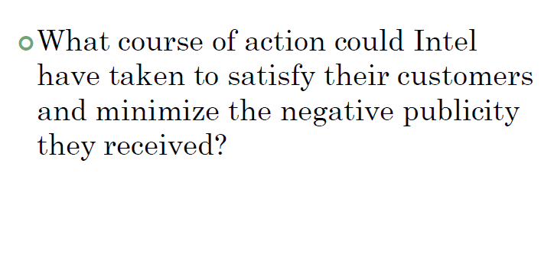
Pentium Case

Slide 12
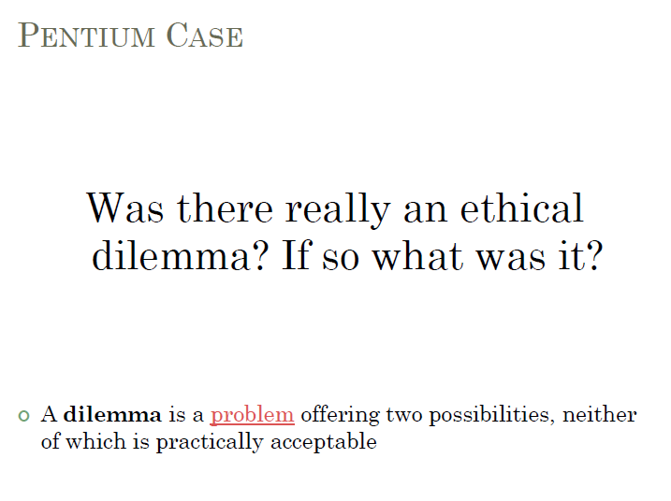

Slide 13

Framework for Solving Ethical Dilemmas:
What is the Ethical Dilemma?
Get the Facts
Evaluate Viewpoints
Make a Decision
Position of Action
Humphreys, K. K. (1999). What every engineer should know about ethics, New York, CRC Press

Slide 14
Approaches for Solving Ethical Dilemmas
 | Consequentialist | Duty | Virtue
Deliberative process | What kind of outcomes should I produce (or try to produce)? | What are my obligations in this situation, and what are the things I should never do? | What kind of person should I be (or try to be), and what will my actions show about my character?
Focus | Directs attention to the future effects of an action, for all people who will be directly or indirectly affected by the action. | Directs attention to the duties that exist prior to the situation and determines obligations. | Attempts to discern character traits (virtues and vices) that are, or could be, motivating the people involved in the situation.
Definition of Ethical Conduct | Ethical conduct is the action that will achieve the best consequences. | Ethical conduct involves always doing the right thing: never failing to do one's duty. | Ethical conduct is whatever a fully virtuous person would do in the circumstances.
Motivation | Aim is to produce the most good. | Aim is to perform the right action. | Aim is to develop one’s character.
https://www.brown.edu/academics/science-and-technology-studies/framework-making-ethical-decisions

Slide 15
What is the Ethical Dilemma?
Clearly define the nature of ethical problem or dilemma
You want to provide an answer that is relevant to to all those that have a stake
Ask these questions:
  Could this decision or situation be damaging to someone or to some group?
  Does this decision involve a choice between a good and bad alternative, or perhaps between two "goods" or between two "bads"?
  Is this issue about more than what is legal?

Slide 16
Get the Facts
You want to make an informed decision
Make clear any interpretations of the facts or the values that support conflicting moral viewpoints
Ask these questions:
  What are the relevant facts?
  Do I know enough to make a decision?
  What are the groups that have a stake?
  Are some concerns more important?

Slide 17
Evaluating Viewpoints
Use moral considerations to assess the pros and cons of competing moral viewpoints
Be able to identify the most compelling reason for the course of action
You must be able to justify the course of action
Ask the following questions:
  What outcomes are desirable for a given situation, and what will achieve the best consequences? (Consequentialist-Based View)
  What obligations do you have and what things should you not do? (Duty-Based View)
  What would a virtuous person do? (Virtue-Based View)

Slide 18
Moral Considerations
Having a defensible and thought out position-of-action does not mean that:
  There are no other defensible alternative positions of action.
  You don’t have to listen to and reason with others who are relevant parties.
  You should not seek advice also.

Slide 19
Make a Decision and Act
Decide which of the viewpoints is the most compelling
Write out your position-of-action as an argument that uses the factors you have chosen as reasons for your position of action.
Attempt to defend your position of action against responses a person may have to your position.
If I chose an option, what would an objective group say?
  Will judgment be confirmed to be morally correct
Notes:
If you had the will, would you make it universal law?

Slide 20
Position of Action
How can the decision be implemented given the concerns of all those involved?
What have you learned from this action?

Slide 21
Moral Considerations

Slide 22
What Are moral Considerations?
Moral considerations come from moral theories. It is a type of practical reasoning that concerns certain societal or life-form goals, such as justice, equality, freedom, health and safety.
They are considerations important in evaluating whether an action or a way of being is morally right or good.
There are many different moral theories. Some of them overlap in various ways. Others are completely distinct.

Slide 23
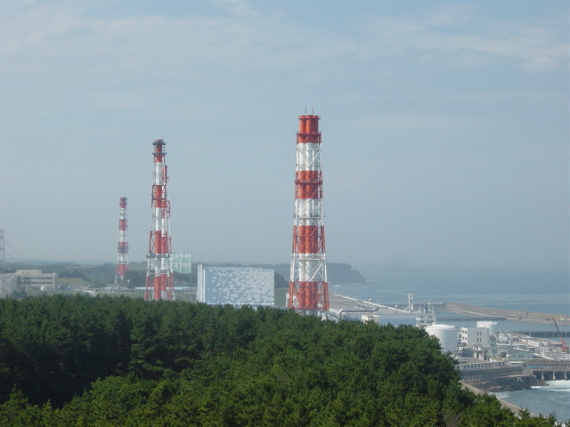
The Fukushima I Nuclear Power Plant

Slide 24
Notice the issues that come up in these discussions:
ISSUE #1: HEALTH AND SAFETY
RISKS: Danger to current and future
generations from leakage of radio-
isotopes used in nuclear power.
Plutonium-239 (half-life = 24,110 yrs) is a particularly toxic radio-isotope.
Normally, 10 half lives are required before a Pu-239 contaminated area is considered safe again, in the case of plutonium, roughly 250,000 years.
So if Pu leaked, -- say, due to an
earthquake -- it would cause a
health risk for roughly 8000
generations!!

Slide 25
Issues (cont.):
ISSUE #1: HEALTH AND SAFETY RISKS, FURTHER CONSIDERATIONS:
a) The possibility of medical science discovering a cure for cancer sometime in the current or next centuries adds uncertainty to the long-term health risks of leakages of radio-active isotopes.

Slide 26
Issues (cont.):
ISSUE #1: HEALTH AND SAFETY RISKS, FURTHER CONSIDERATIONS:
b) The use of nuclear power may increase our knowledge of radioisotopes used for medical purposes (possible benefit?).

Slide 27

Issues that come up in these discussions:
CONSEQUENCES OF
ALTERNATIVES TO NUCLEAR
POWER.
ISSUE #2: DEPLETION OF RESOURCES:
Fossil fuels, oil, natural gas and coal, are non-renewable. These resources also affect the goal of health because of their impact on pollution and climate changes.

Slide 28
Issues that come up in these discussions:
CONSEQUENCES OF
ALTERNATIVES TO NUCLEAR
POWER.
ISSUE #3: COMPARATIVE ECONOMIC COSTS OF RENEWABLE SOURCES.
Renewable sources such as hydro-electric-power, wind power, solar power, geo-thermal heat, agricultural biomass and tides do not cause the environmental hazards that fossil-fuels do.
But renewable sources must be balanced with the amount of energy needed to produce and maintain them and consequent environmental hazards. Currently, for example, the energy required to manufacture and install solar energy systems comes from fossil fuels.

Slide 29
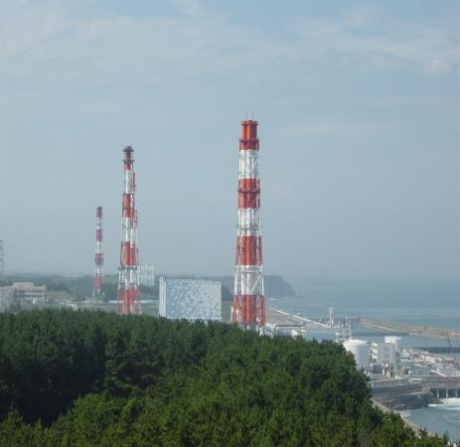
Reasoning
The kind of reasoning that goes on in such discussions involves certain goals
such as, in this case, health, safety and biodiversity.
The reasoning then focuses on finding the best – or at least the reasonably better --
means
for obtaining those goals.

Slide 30




N
Compass
Moral Action
Rules of the Jungle
Moral Considerations

Slide 31
Recall Sample Moral Theories
Utilitarian
  Provides the most good and the least harm
Justice
  Maintains all equals should be treated equally
  This option treats people as you wanted to be treated
Rights
  Best protects and respects rights of others
  This option best respects the rights of all who have stake
Harm/Care
  Ensures kindness and gentleness to those in need
  This option is best for those in need
Virtue
  It’s virtuous if consistent with an ideal virtue
  This option leads me to act as a responsible person
Notes:
Philosophers and ethicists suggest that these theories help determine the appropriate ethical action

Slide 32
Other Moral Theories – Prima Facie Duties
Prima Facie Duties are guidelines, used for moral consideration, that give moral reason for action
Fidelity
Reparation
Gratitude
Non-Maleficence
Beneficence
Justice
Non-parasitism
Ethical Theory Based on
W. D. Ross
http://people.wku.edu/jan.garrett/ethics/rossethc.htm
Notes:
moral guidelines to be considered before taking action (what we ought to do). Guidelines to do something (the actual duty). they are binding at first sight, without taking into consideration conflicting circumstances; but when the time comes to follow the rules, we need to be aware of the ways our obligations may be mitigated or overruled.
1. Duties to behave according to our agreements or in reaction to our previous wrongdoing. These rules state obligations that we create by our past actions: we are morally required to keep promises and make proper reparations.
2. When others help us, we are sometimes morally required to do something for them in return, to reciprocate in order to show proper gratitude.
3. We must be just. For example, people should be rewarded according to their merits.
4. We are also duty bound to help others in need. This is the moral requirement to act with beneficence.
5. We are all under the moral obligation to perfect ourselves, intellectually and morally.
6. Finally, we should not harm another person.

Slide 33
Prima Facie Duties
Fidelity involves keeping one’s promises, contracts and duties, and not lying.
Reparation is the duty to make up for the injuries one has done to others.
Gratitude is the duty to be grateful for benefits that have been given to you.
http://people.wku.edu/jan.garrett/ethics/rossethc.htm

Slide 34
Prima Facie Duties
Non-maleficence is the duty not to harm others physically or psychologically.
Beneficence is the duty to do good to others. To foster their good will, wisdom, health and security.
Justice is the duty to distribute benefits and burdens fairly. Or, to prevent unfair distribution of benefits and burdens.
http://people.wku.edu/jan.garrett/ethics/rossethc.htm

Slide 35
Prima Facie Duties
Non-parasitism is the duty to not free-ride on society either professionally or personally. It involves taking only the appropriate benefits from the burdens one has undergone.
http://people.wku.edu/jan.garrett/ethics/rossethc.htm

Slide 36
Applying Prima Facie Duties
When moral reasoning with prima facie duties, there are two kinds of cases:
Cases where duties do not conflict.
Cases where duties do conflict.
In cases where duties do conflict, we use rules about priority in order to settle the conflict.
Notes:
For conflict: seek ways to fulfill as many obligations as possible, or, seek to avoid conflict among duties.

Slide 37
Rules of priority
Non-injury normally overrides all other prima facie duties.
  You can’t harm a person to save another.
Fidelity overrides beneficence.
  You cannot forgo a contract in order to be kind to someone else.
Beneficence and non-maleficence in relation to lasting positive qualities override prima facie duties that give one short term pleasure or pain

Slide 38
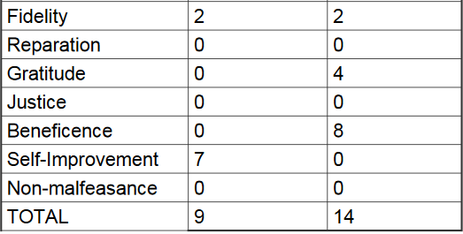
Applying Prima Facie Duties Example
Prima Facie Duty | Action 1 | Action 2

Slide 39
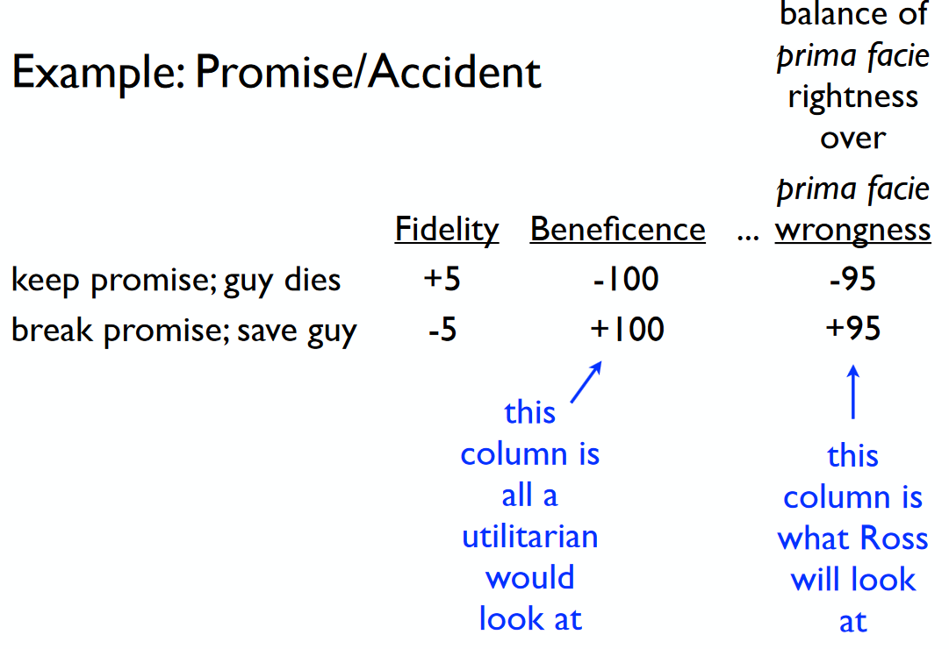
Applying Prima Facie Duties Example
http://spot.colorado.edu/~heathwoo/phil1100FA14/1100%20FA14%20-%20Topic%207%20%20Ross'%20Theory%20of%20Prima%20Facie%20Duties.pdf

Slide 40
From Codes to Cases

Slide 41
Where we will begin
To start our exploration into case analysis, we will simply begin by looking at some cases.
Our goal will be to engage in a form of proto-moral reasoning about the cases, which involves the following:
  Taking note of which codes of engineering ethics apply (moral considerations).
  Identifying conflicts.
  Making a choice of what to do.
All of this will lead us to a discussion of moral considerations and reasoning.

Slide 42
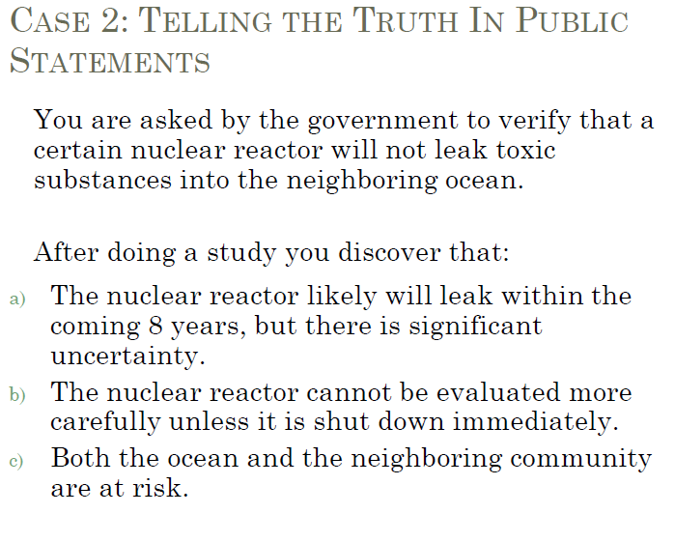
1:

Slide 43
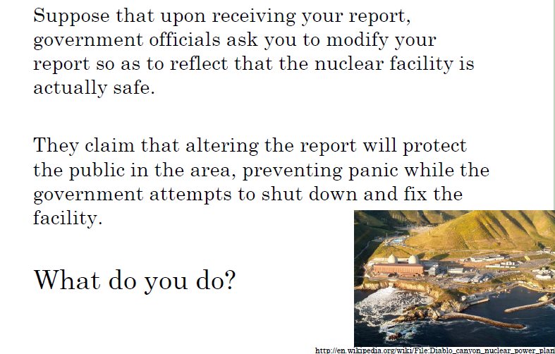

Slide 44
What is the Conflict?
The code of ethics requires that you
  Safeguard the public’s welfare.
  But it also requires that you
  Tell the truth when making public statements concerning your area of engineering.
To solve this conflict, you must
  Correctly understand what each code is telling you
  And choose to act on the obligation that is of priority.

Slide 45
What is the Conflict?
What does protecting the public mean?
  Making sure that they are safe
What does issue public statements in an objective and truthful manner mean.
  Telling the public the nuclear reactor is not safe but outlining the uncertainties
But the government is asking you to alter your report in order to protect the public.

Slide 46
What is the conflict?
Your obligation is to safeguard public safety and to tell the truth in your role as an engineer. This means that you cannot alter data as an engineer, and that you must tell the truth about the nuclear reactor.
The government is calling on you as a citizen to alter documents as a way to protect your fellow citizens.
The conflict is between your obligations as an engineer and your obligations as a citizen.

Slide 47
What is more important?
Role conflicts are hard!!!
No easy answer!!!
This is where thinking about other moral considerations matter.
  What about the public’s right to know?
  What about the government’s obligation to tell the truth?
In this case your duty as an engineer to tell the truth when making public statement supercedes your civic duty to be loyal to your government.

Slide 48
Case 2: Protecting the safety of society
Suppose you are asked by your employer to design a bridge that will cost only $1 billion. After doing a study you determine the following:
An ideal bridge can be built for $1.5 billion.
Given the design constraints, a bridge built for $1 billion will collapse in a moderate earthquake.
A bridge built for $1.25 billion, will survive a moderate earthquake, but in an infrequent extreme earthquake it will collapse.

Slide 49
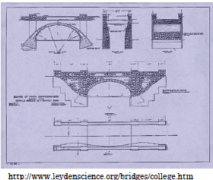
Case 2: Protecting the Safety of Society
Suppose your employer says, “if we don’t build the bridge for $1 billion, then we are going to have to lay off half of the staff, including you.”
He further asks you to go ahead with the next stage of the project.
What do you do?

Slide 50
What is the conflict?
The code of ethics for engineers requires:
  You to take the safety of society as being of paramount importance.
However, you also feel a personal sense of loyalty to your company and fellow co-workers. You don’t want anyone to lose their job.
The conflict is between your duty to society and your loyalty to your own career and the welfare of your other fellow employees.

Slide 51
What is more important?
In a case like this the welfare of society comes first.
We have to take into account the fact that your duty to protect the public is greater than your duty to your own career, and that of your fellow employees.

Slide 52
Case 3: Acknowledging Mistakes
You approach your boss and tell him that you are sure that your team is responsible for the failure in the device.
Your boss says, “Well we will just replace it with a fixed design. We don’t need to tell them anything. It could undermine our relationship with the company, they might not come back for business.”
Should you go ahead and tell the client?

Slide 53
Understanding Your Obligation
The code of ethics for engineers requires:
  You to avoid deceptive acts.
Your boss is asking you to not reveal something to the client because by not revealing it you can maintain their confidence while at the same time replacing the device.
Are you violating the code of ethics?

Slide 54
Deception by Commission vs. Omission
There are two kinds of deceptive practices.
Deception by commission occurs when a person tells a lie, such as when one reports data that one knows to be false.
Deception by omission occurs when one omits something that another party has a right and interest in knowing.

Slide 55
What is the conflict?
Your boss wants you to omit something because doing so will help the company.
Your client however has an interest in knowing about the functionality of the product that you sell them, since they use it.
So, although your boss is not asking you to lie to them and tell them that the product is fine. He is asking you to omit the truth, which is in clear violation of avoiding deceptive acts.

Slide 56
What is more important?
It is true that a company that makes too many products that are faulty will go under.
It is also important to recognize that a company that is known to be unreliable in terms of owning up to its mistakes is subject to being ostracized.
Telling your boss that your team made a mistake is a good thing. It shows integrity. Letting the client know that the mistake shows courage. It also brings goodwill into the relationship between company and client.

Slide 57
NSPE Case Study Case No. 98-2
Engineer A is a legally recognized engineer and resident in his home country
He is an NSPE International Member
He provides consulting, engineering, and construction contracting services to foreign national and local governments
Under the laws of Engineer A's home country, it is not illegal for individuals and companies to provide cash payments or in-kind property to public officials in foreign countries in order to obtain and retain business from those public officials
http://www.onlineethics.org/Resources/Cases/ec98-2/ForeignBER.aspx

Slide 58
Ethical Dilemma?
Would it be ethical for Engineer A to provide cash payments or in-kind property to public officials in foreign countries in order to get their business?

Slide 59
NSPE Code of Ethics References
“Section II.1.d. - Code of Ethics: Engineers shall not permit the use of their name or associate in business ventures with any person or firm which they believe is engaged in fraudulent or dishonest enterprise.
Section II.5.b. - Code of Ethics: Engineers shall not offer, give, solicit or receive, either directly or indirectly, any contribution to influence the award of a contract by public authority, or which may be reasonably construed by the public as having the effect or intent of influencing the awarding of a contract. They shall not offer any gift, or other valuable consideration in order to secure work. They shall not pay a commission, percentage or brokerage fee in order to secure work, except to a bona fide employee or bona fide established commercial or marketing agencies retained by them.
Section III.8.a. - Code of Ethics: Engineers shall conform with state licensure laws in the practice of engineering.”
http://www.onlineethics.org/Resources/Cases/ec98-2/ForeignBER.aspx

Slide 60
Summing up at this stage
Being an ethical engineer requires:
Knowing your obligations and duties as specified by the code of ethics.
Recognizing what your obligations require of you.
Being able to reason to a conclusion about what to do by employing moral considerations.

Slide 61
A Recurring Ethical Dilemma
Engineering commitment to safety
vs.
All of the factors management must consider
“It’s time to take off your engineering hat and put on your management hat.”
Morton Thiokol Senior Vice President Jerry Mason
VS

Slide 62
Acknowledgement
“This framework for thinking ethically is the product of dialogue and debate in the seminar Making Choices: Ethical Decisions at the Frontier of Global Science held at Brown University in the spring semester 2011. It relies on the Ethical Framework developed at the Markkula Center for Applied Ethics at Santa Clara University and the Ethical Framework developed by the Center for Ethical Deliberation at the University of Northern Colorado as well as the Ethical Frameworks for Academic Decision-Making on the Faculty Focus website which in turn relies upon Understanding Ethical Frameworks for E-Learning Decision-Making, December 1, 2008, Distance Education Report (find url)
Primary contributors include Sheila Bonde and Paul Firenze, with critical input from James Green, Margot Grinberg, Josephine Korijn, Emily Levoy, Alysha Naik, Laura Ucik and Liza Weisberg. It was last revised in May, 2013”
http://www.brown.edu/academics/science-and-technology-studies/framework-making-ethical-decisions

Slide 63
Back Up

Slide 64
What does it mean when something is SAFE?
Does it mean - - 100% chance nothing bad will happen?
Does it mean 1 in a million change something bad will happen? 1 in 100,000? 1 in a billion?

Slide 65
Acceptable Risk
“A thing is safe if, were its risks fully known, those risks would be judged acceptable by reasonable persons in light of their settled value principles.”
William W. Lowrance, 1976
If I told you that the probability of a poisonous release occurring from the Student union construction in one year is 1 in 20,000 – would you consider that acceptable risk?

Slide 66
Acceptable Risk
If I told you that the annual probability of you dying from a transport accident is 1 in 6,000, how would you feel about the 1 in 20,000 odds of the poisonous release?
Finally – If I told you that the annual odds of you dying from a fall is also 1 in 20,000, does that change the way you feel about the student union?

