Slide 1
Ethics in Engineering
Lecture 3/3

Slide 2
An important and major case….
The Challenger Disaster (January 28, 1986)

Slide 3
Challenger Launch

Slide 4
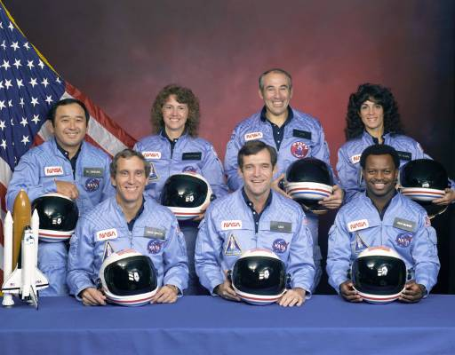
http://images.jsc.nasa.gov/luceneweb/caption_direct.jsp?photoId=S85-44253
Challenger Crew
(front row) Michael J. Smith, Dick Scobee, Ronald McNair
(back row) Ellison Onizuka, Christa McAuliffe, Gregory Jarvis, Judith Resnik

Slide 5
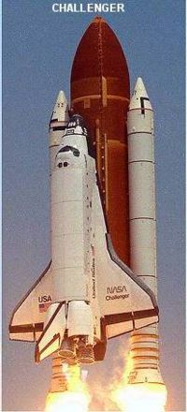
Technical Details
The primary component of the vehicle assembly was the Orbiter, the reusable, winged craft containing the crew that actually traveled into space and returned to land on a runway.
Orbiter containing flight deck and crew
Challenger disaster photos copied and text adapted from Aerospaceweb.org (2004) Space Shuttle Challenger Disaster, Retrieved November 3, 2008 Aerospaceweb.org, Web site: http://www.aerospaceweb.org/question/investigations/q0122.shtml

Slide 6
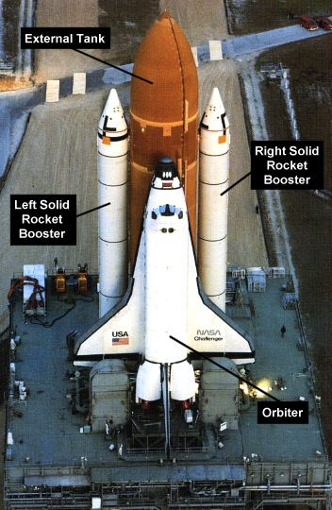
The Orbiter alone did not generate enough thrust or carry enough fuel to get into orbit.
Additional thrust was provided by two large Solid Rocket Boosters (SRB)
  Attached to the side of the External Tank by means of two struts

Slide 7
Once the two solid rocket boosters lift the Shuttle to an altitude of about 45,760 m (roughly 28.4 miles), they are jettisoned
External Tank
Right Solid Rocket Booster
Left Solid Rocket Booster
Three main engines of the orbiter

Slide 8
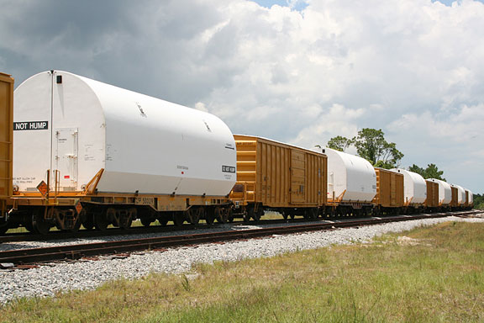
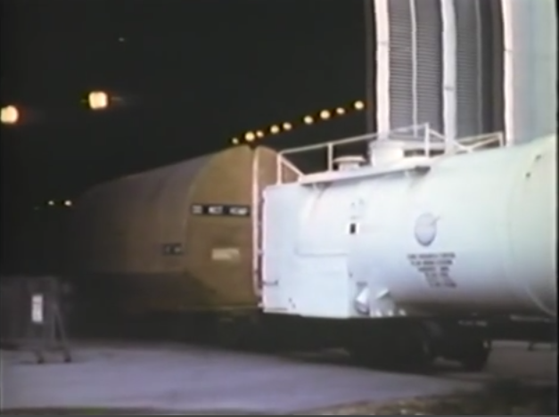
http://www.spaceref.com/news/viewnews.html?id=1399
https://www.youtube.com/watch?v=4-jbIYjHOmc
SRB built in Utah and shipped by train to launch pad

Slide 9
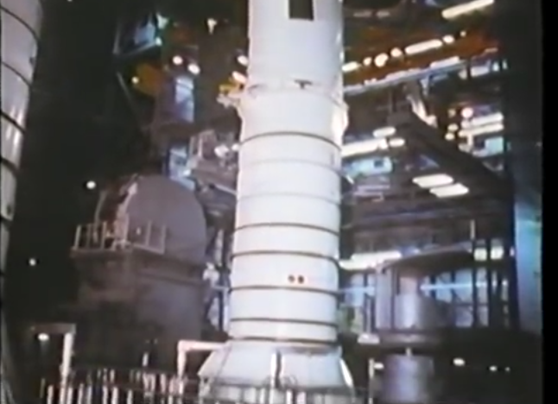
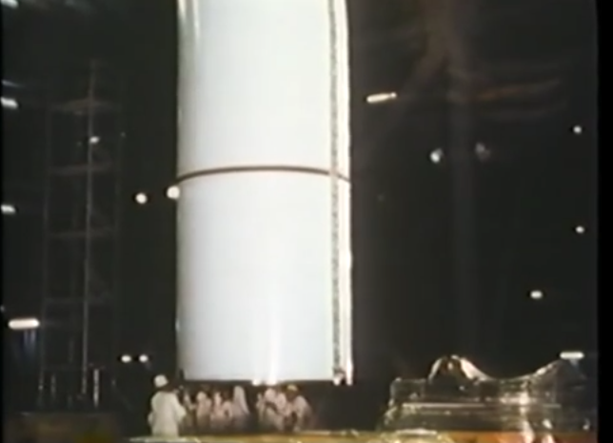
https://www.youtube.com/watch?v=4-jbIYjHOmc

Slide 10
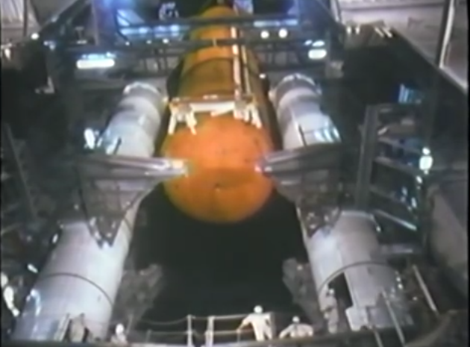
https://www.youtube.com/watch?v=4-jbIYjHOmc

Slide 11
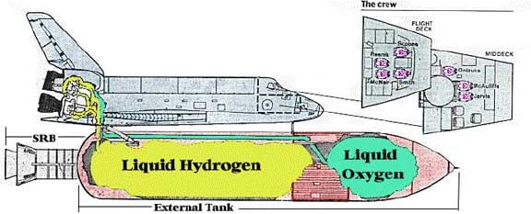
Two-thirds of the External Tank was filled with liquid hydrogen;
the top third with liquid oxygen
This fuel supplied the three main engines of the Orbiter until about 8 1/2 minutes after liftoff
Then the External Tank would be jettisoned at about 111,355m
(roughly 69.2 miles) .
Challenger disaster diagrams copied and text adapted from Aerospaceweb.org (2004) Space Shuttle Challenger Disaster, Retrieved November 3, 2008 Aerospaceweb.org, Web site: http://www.aerospaceweb.org/question/investigations/q0122.shtml

Slide 12
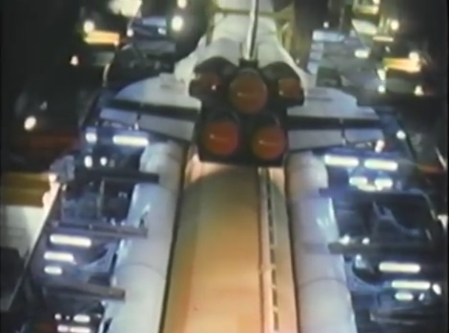
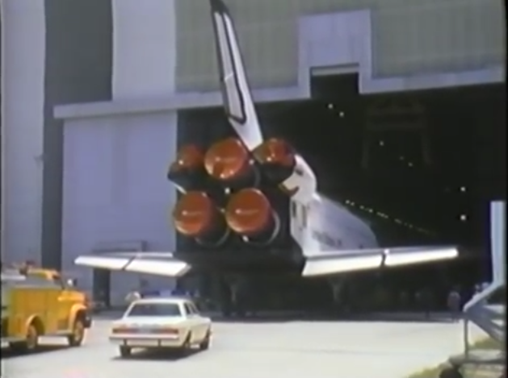

Slide 13
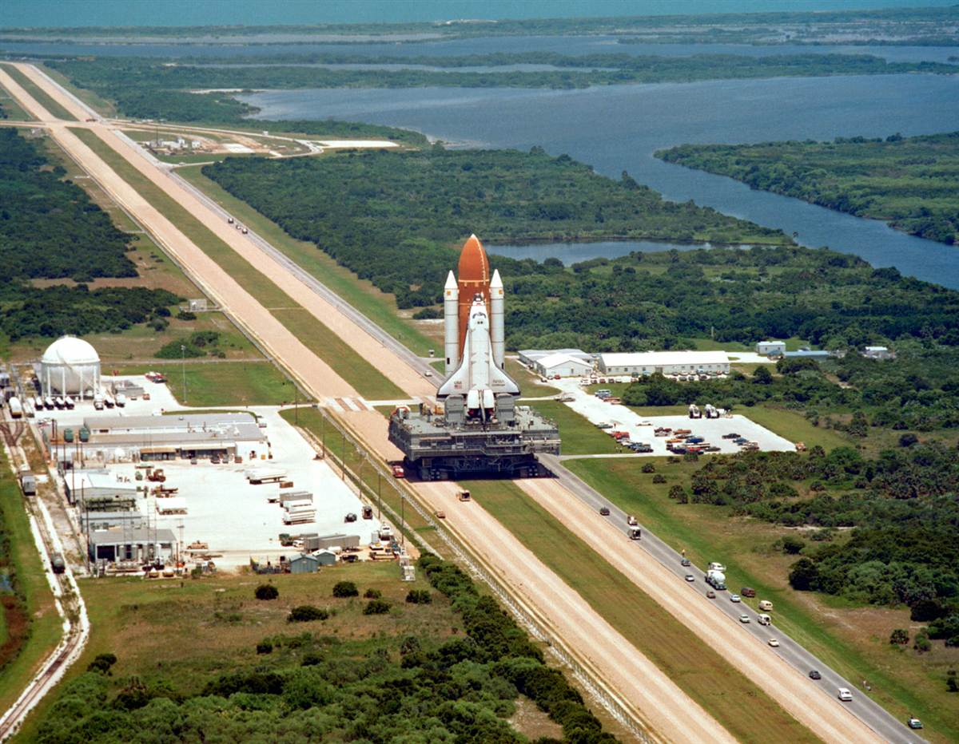
NASA Images

Slide 14
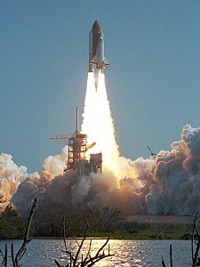
Challenger lifts off at 11:37 AM

Slide 15
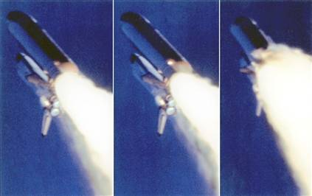
Just less than 73 seconds after lift-off, smoke was seen billowing out from the right solid rocket booster followed by several explosions

Slide 16
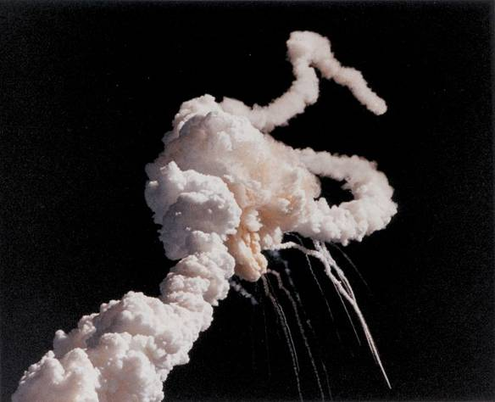
Challenger disintegrated
73 Seconds into flight
Smoke plume of the Space Shuttle, Challenger at 73 seconds after launching

Slide 17
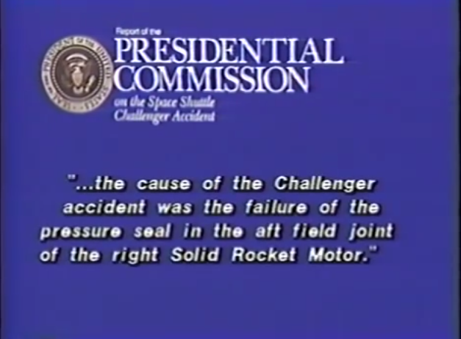

Slide 18
The Failure that Caused the Disaster
O-ring seal in the right SRB failed to remain sealed.
O-ring failure allowed a flare of pressurized hot gas from the SRB
Resulting flames burned the adjacent SRB attachment hardware -- the strut -- and ignited the liquid hydrogen and oxygen in the external fuel tank.
Various subsequent structural failures caused orbiter to break apart

Slide 19
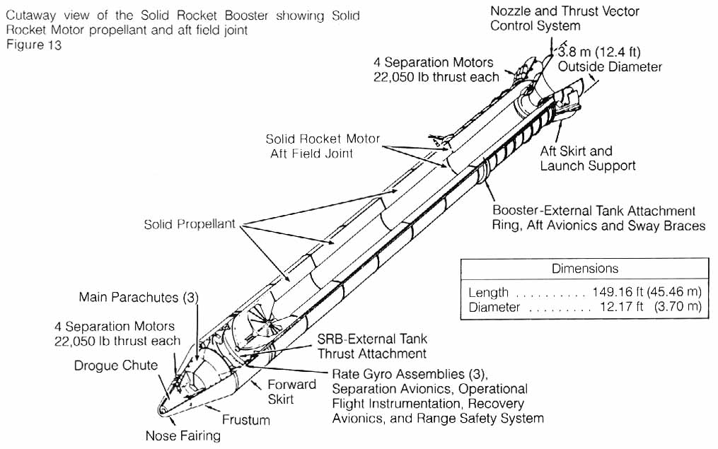
SRB
Solid Rocket Booster (SRB)
http://history.nasa.gov/rogersrep/v1p56.htm

Slide 20
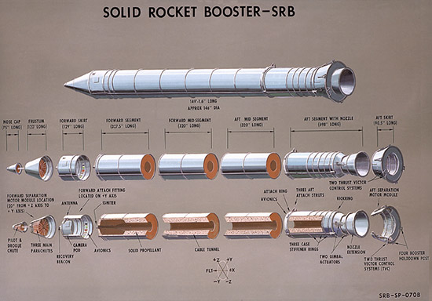
http://galaxywire.net/2009/07/06/solid-rocket-booster-cutaway-view/

Slide 21
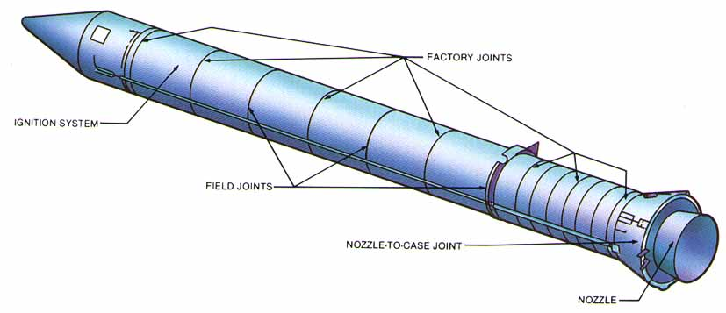
SRB
http://engineeringfailures.org/?p=85

Slide 22
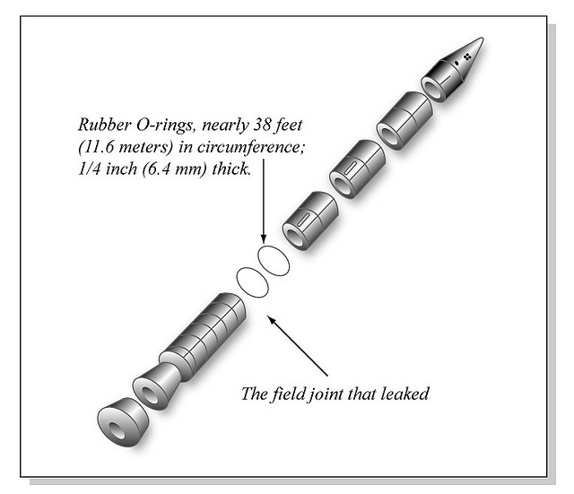
SRB
http://www.carpinner.com/solid-rocket-booster-diagram/

Slide 23
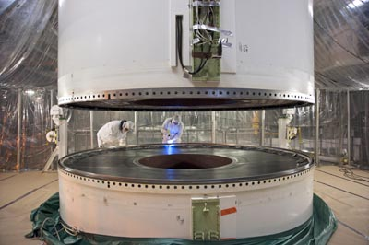
http://www.spaceflightnow.com/shuttle/sts135/110410flow/

Slide 24
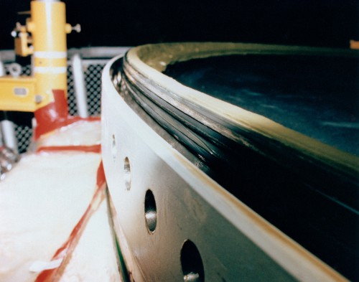
Close-up view of the rubberized O-ring seals within the Solid Rocket Booster casing. These seals were intended to prevent a leakage of hot gases, but on Mission 51L they failed spectacularly. Photo Credit: NASA

Slide 25
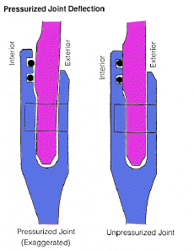
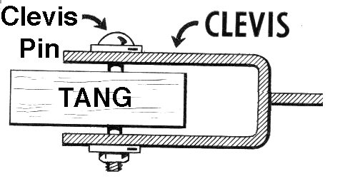
Design of the Solid Rocket Booster
The four segments of each booster were joined by what is known as tang and clevis joints.
Tang
Clevis

Slide 26
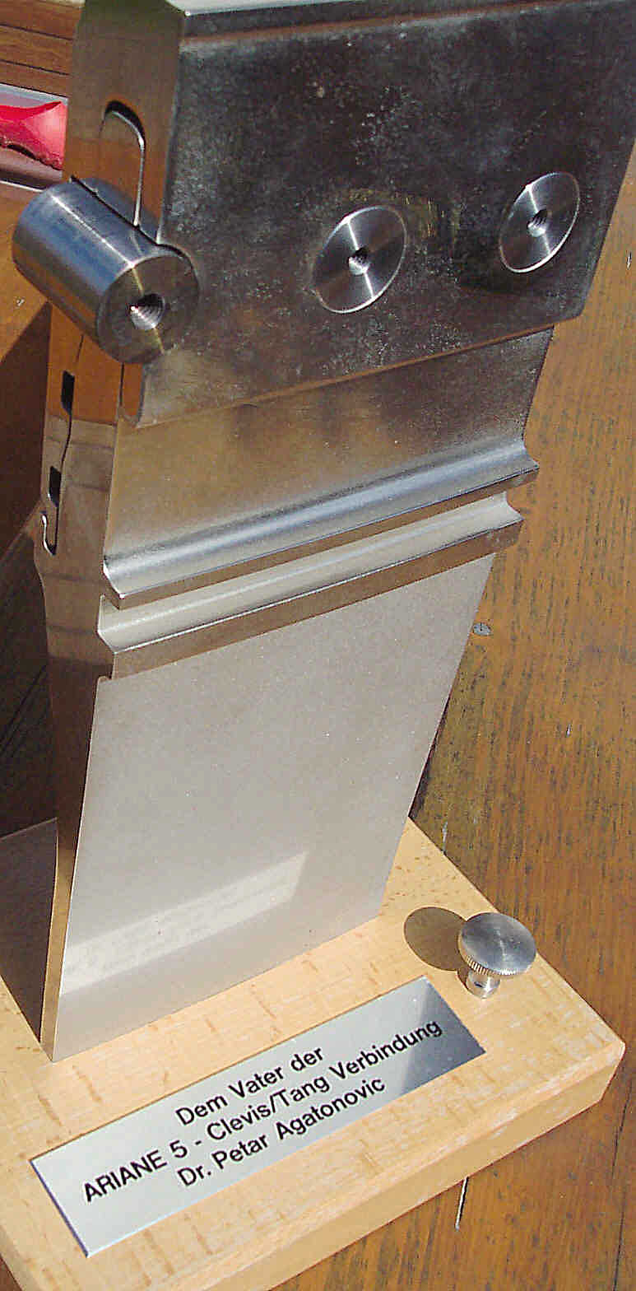
O-Ring
Slots

Slide 27
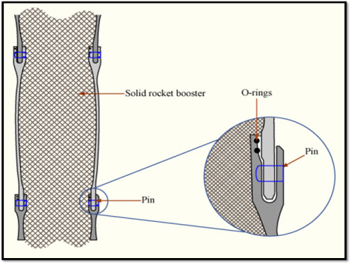
https://religiousreason.wordpress.com/2014/10/10/boldly-going-where-no-one-has-gone-before/

Slide 28
Gas Pressure
O-rings
As pressure increases inside the SRB, it pushes the tang away, but also flattens out the O-ring to seal the gap.

Slide 29
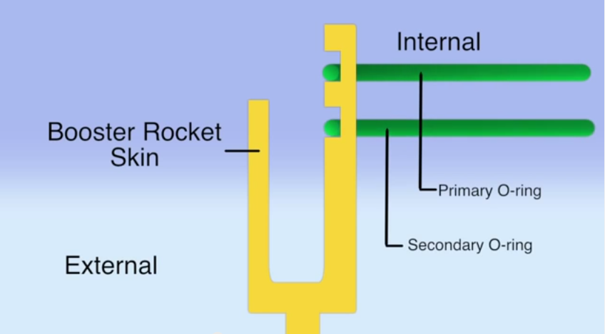
https://www.youtube.com/watch?v=nspP1YFftAY – Boston Science Communications

Slide 30
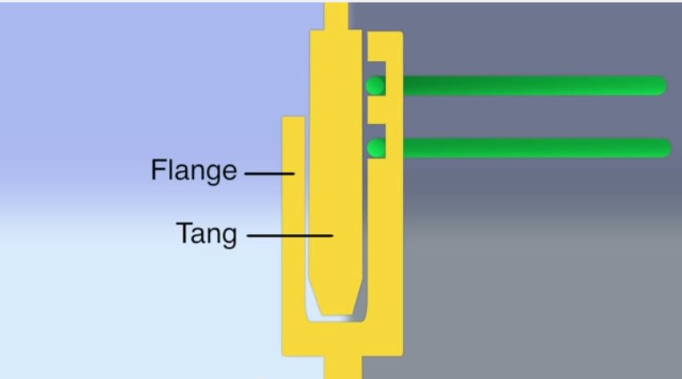

Clevis
https://www.youtube.com/watch?v=nspP1YFftAY – Boston Science Communications

Slide 31
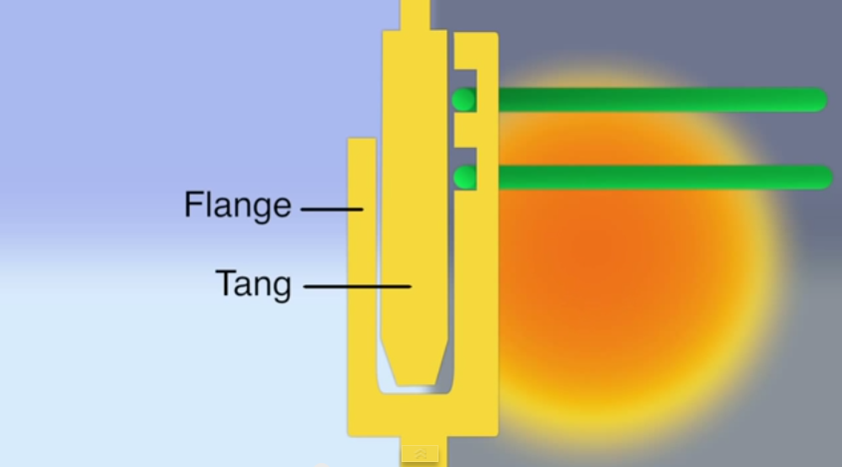
Clevis
https://www.youtube.com/watch?v=nspP1YFftAY – Boston Science Communications

Slide 32
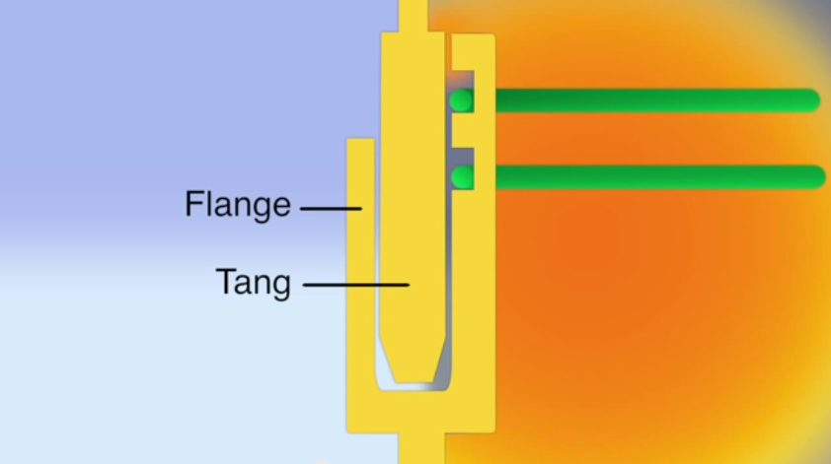
Clevis
https://www.youtube.com/watch?v=nspP1YFftAY – Boston Science Communications

Slide 33
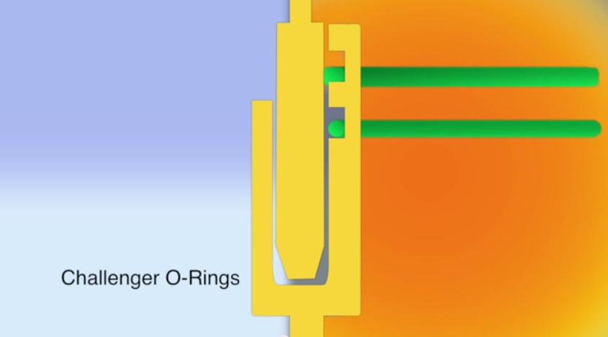
https://www.youtube.com/watch?v=nspP1YFftAY – Boston Science Communications

Slide 34

O-Ring Seal Flattens
https://www.youtube.com/watch?v=nspP1YFftAY – Boston Science Communications

Slide 35
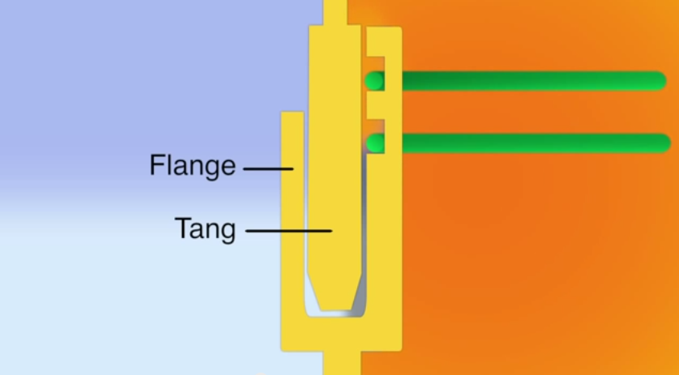
O-Ring Seals
Don’t Flatten
Clevis
https://www.youtube.com/watch?v=nspP1YFftAY – Boston Science Communications

Slide 36
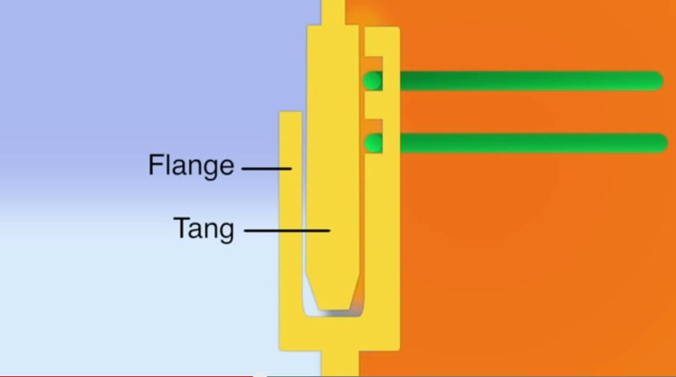
“Blow by” Begins
Clevis
https://www.youtube.com/watch?v=nspP1YFftAY – Boston Science Communications

Slide 37

“Blow by”
https://www.youtube.com/watch?v=nspP1YFftAY – Boston Science Communications

Slide 38
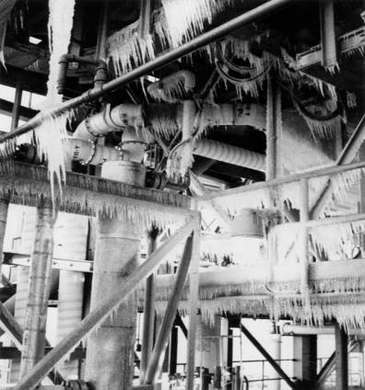
This picture was taken on the morning of the Challenger launch January 28, 1986.
With temps in 20ºs overnight and 36º at launch, it was the coldest day in history that a shuttle had been launched.

Slide 39
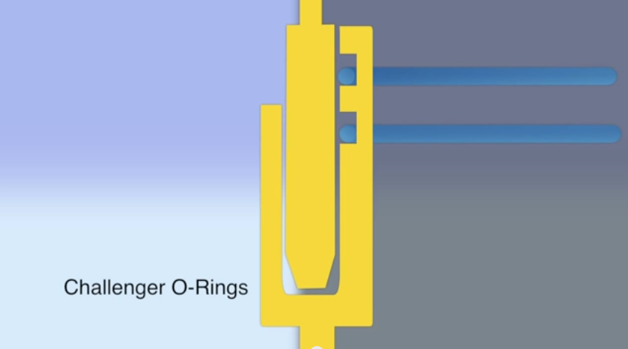
https://www.youtube.com/watch?v=nspP1YFftAY – Boston Science Communications

Slide 40
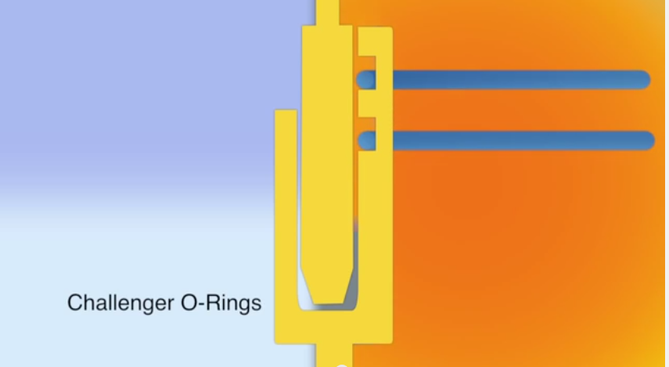
https://www.youtube.com/watch?v=nspP1YFftAY – Boston Science Communications

Slide 41
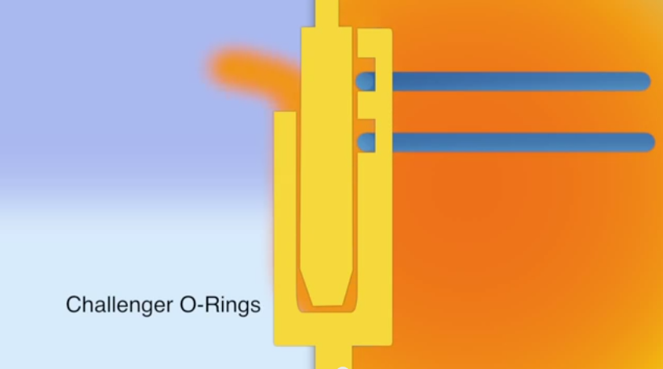
https://www.youtube.com/watch?v=nspP1YFftAY – Boston Science Communications

Slide 42
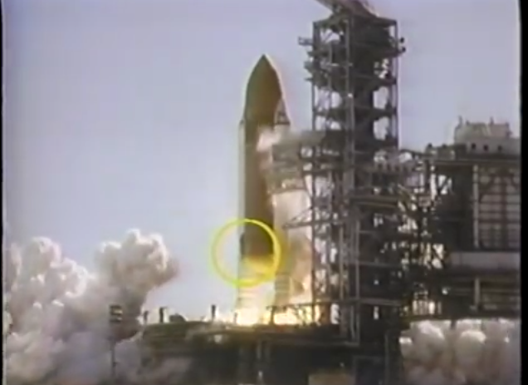
https://www.youtube.com/watch?v=4-jbIYjHOmc

Slide 43
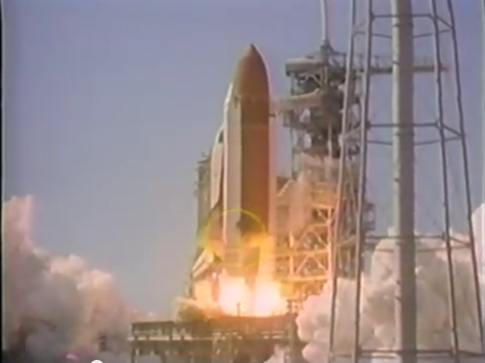
https://www.youtube.com/watch?v=nspP1YFftAY – Boston Science Communications

Slide 44
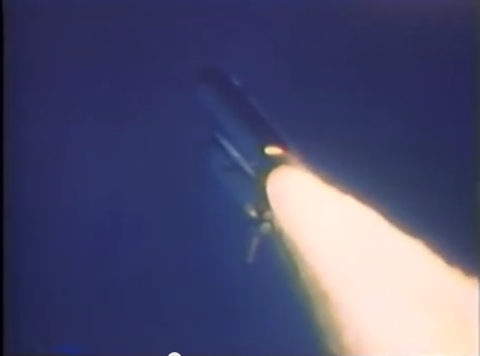

Slide 45
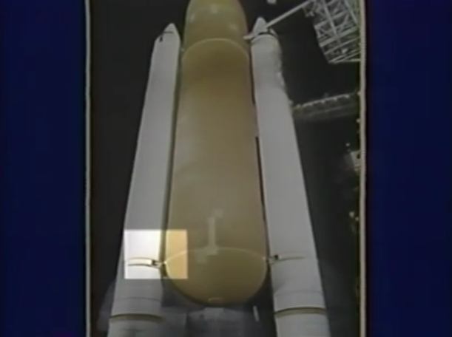

Slide 46
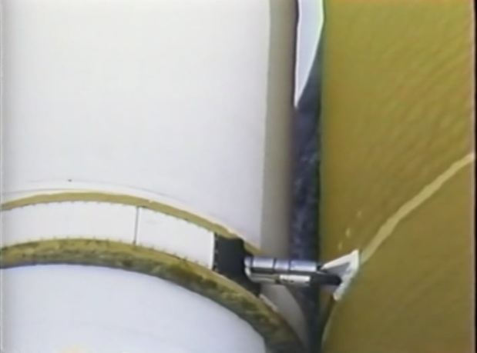

Slide 47

One reason the Challenger disaster occurred was due to a faulty factory joint.
True
False

Slide 48
Actually the Case is Much more complex
Rather than only looking at the facts after the disaster – let’s look at what was happening in real time

Slide 49
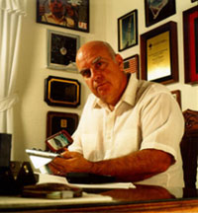
Roger Boisjoly, chief O-ring engineer at Morton Thiokol, had warned his colleagues that O-rings lose their resiliency at relatively low temperatures
August 19, 1985 - NASA Level I management briefed on booster problem
April 25, 1938 – January 6, 2012

Slide 50
Night before the Launch
Engineers, including Roger Boisjoly, could not supply conclusive data regarding at what temperatures it would be unsafe to launch the Challenger.
According to a Marshall Space Flight Center manager no one had performed a statistical analysis correlating past O-ring performance with either temperature or leak check pressure

Slide 51
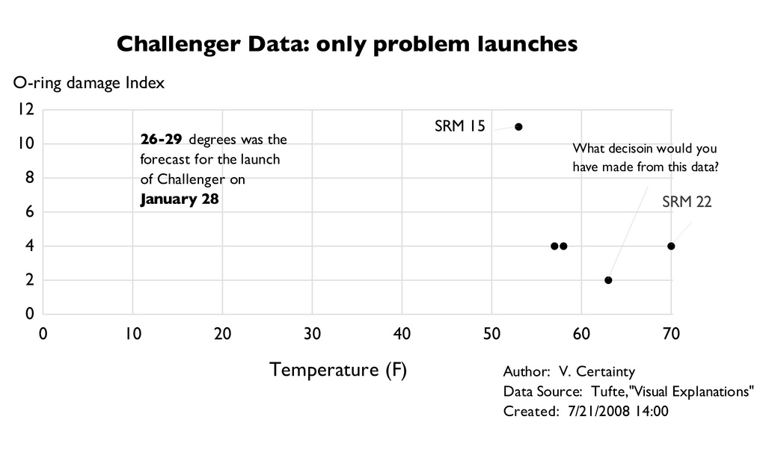
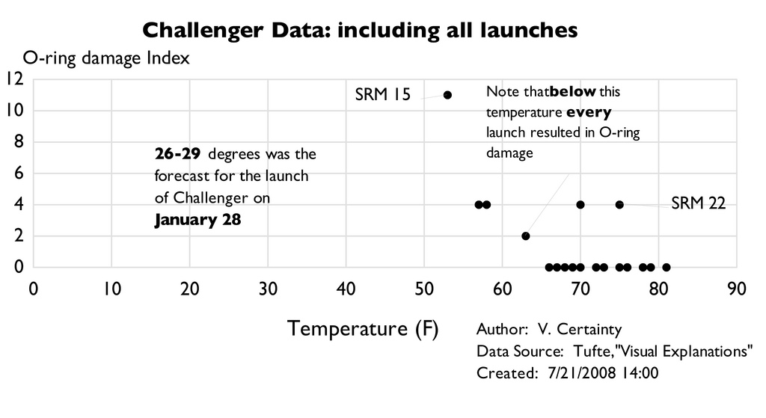
Each of the four launches below 61º showed thermal distress to at least 1 O-ring

Slide 52
NASA Manager Anxious to Launch
Economic considerations
  Delays are costly
  Limited windows for space probes or satellites
Political pressures
  Competition with European Space Agency & Russians
  Need to justify budget requests
  Possible pressure to launch before presidential speech
Scheduling backlogs
  Many delays in previous shuttle mission
  Several days of bad weather, electronic switch malfunction
Notes:
NASA proposed year-round launches, up to 24 launches per year!!!

Slide 53
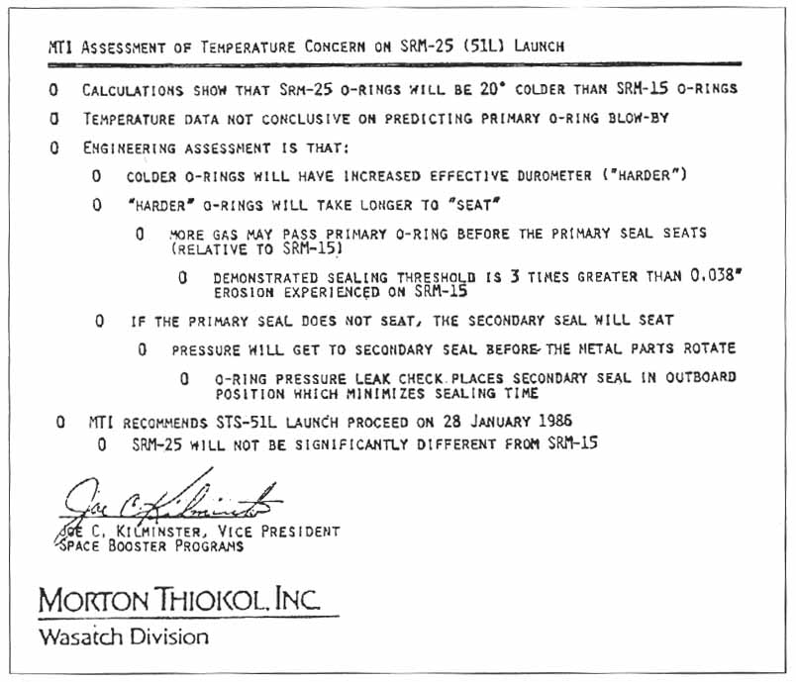
http://aam.govst.edu/projects/csexton/student_page5.htm

Slide 54
Final Decision
After much back and forth discussion with NASA, Jerald Mason told Morton Thiokol supervising engineer, Robert Lund: “take off your engineering hat and put on your management hat.”
Without firm figures to determine that the launch was unsafe, the earlier recommendation to delay the launch was reversed.
Rogers Commission, Report to the President by the Presidential Commission on the Space Shuttle Challenger Accident (Washington, D. C.: June 6, 1986), pp. 772-773.

Slide 55
Do you think NASA should have launched?
Is there a clear moral issue here?
Did NASA take unnecessary risks because of external pressure?
Did M-T engineers violate their duty to put public safety first?

Slide 56
Was there a conflict between…..
Engineering Code of Ethics and
Upholding high standards of professional competence and expertise
Holding paramount the health, safety & welfare of the public
Prima Facie Duties for Management?:
A. Maximizing the well-being of the organization
B. Upholding organizational employee morale and welfare

Slide 57
Quotes from Investigation
Larry Sayer – Engineer at Morton Thiokol
[W]e had a very weak engineering position when we went into the telecom
Ben Powers – Marshall Space Flight Center
I don‘t believe they did a real convincing job of presenting their data … The Thiokol guys even had a chart in there that says temperature of the O-ring is not the only parameter controlling blow-by. In other words, they‘re not coming in with a real firm statement. They‘re saying there‘s other factors. They did have a lot of conflicting data in there.

Slide 58
More about Internal Discussions
Unusual situation
  First time in the life of project that a contractor had made a recommendation not to launch. Usually NASA called for a delay
NASA engineers did not know that the final M-T “Launch” decision was not unanimous
While concerns about O-rings had been raised, the concerns had not been specifically about launching a low temperatures – NASA taken somewhat by surprise

Slide 59
Benefit – Cost in Decision Making
Wouldn’t the NASA manager think the potential costs were too great?
  Human lives
  His reputation
  Criminal charges
  100% of the blame on him
  Suspension of the shuttle program
Wouldn’t the M-T managers come to the same conclusion?

Slide 60
Rogers Commission Findings
“…failures in communication… resulted in a decision to launch 51-L based on incomplete and sometimes misleading information, a conflict between engineering data and management judgments, and a NASA management structure that permitted internal flight safety problems to bypass key Shuttle managers.”
Rogers Commission report (1986). "Report of the Presidential Commission on the Space Shuttle Challenger Accident"

Slide 61
If you want to Dive into This Case More Deeply
Elements of whistle blowing
Many more uncertainties associated with technical issues – conflicting data
Issues of poor communication
Poor decision making based on “group think”

Slide 62
In the cases we’ve considered before, we’ve frequently seen that ethical dilemmas often appear as a hard choice. You have to choose between the lesser of two evils.
In the Challenger disaster, obviously the lesser of two evils choice should have been to delay the launch.

Slide 63
A final Question
Can you suggest a creative middle way solution between the disastrous decision to launch the Challenger on January 28, 1986 and to postpone it?
The creative middle way solution should address both the goal of eliminating the risk of the malfunctioning O-rings and at the same time allow NASA to keep its commitments for on-schedule launches.

Slide 64
Final Summary
1. Engineering professional goals, such as protecting public safety and client and employee honesty, lead to the trust and progress of the engineering profession
2. Ethical problem solving, whether personal or
professional, strives to find creative ways to
reconcile conflicting goals.

