Slide 1

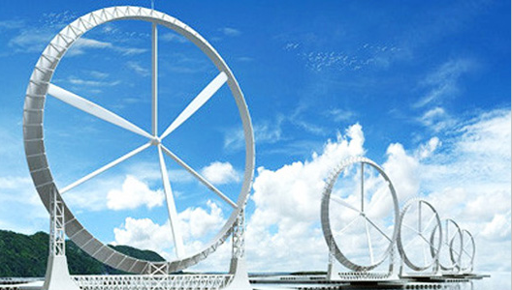
ENGR 10 Course Wrap-up
Fall 2020

Slide 2
Engr10 Final Exam
Final Exam Online in Canvas (both Lecture Sections)
Wednesday, Dec. 16, 10:00am to 11:30am
You can have an 8 ½ by 11 inch review sheet. Only one side, hand written or typed, font size 10
Basic calculator
Final Exam Review Quiz (Due Dec. 15, 11:59pm)

Slide 3
Areas of study
(should include but not limited to):
Units
Excel
  Basic operations (*, -, /, +)
  Functions logical (if, countif, etc.) statistical (mean, variance)
  Cells: programming and copying
  Plotting: what makes a complete correct graph
  Selecting the correct type of graph
Technical writing
  The basic sections of a report
  Proper formatting for figures and tables
  Issues of audience and purpose
  APA formatting for references
SolidWorks
  Basic commands: Extrusion, Revolve, Sweep and Loft.

Slide 4
Areas of study
(should include but not limited to):
Ethics
Solar Cells
  Basic concepts, how they work, basic composition of atoms
  Conductors, insulators, semiconductors
  N, P type
  PN junction, electrons, holes
  Cells in a circuit: series, parallel
  Ohm’s Law to calculate V, R and I
Structural Behavior
  Definition of stiffness
  Moment of Inertia
  Relative stiffness of different structural elements
  Relative stiffness of different materials

Slide 5
Areas of study
(should include but not limited to):
C Programming
  IF Statements
  IF-ELSE Statements
  WHILE Statements
  Basics of robot programming
    Getting the wheels to turn forwards and backwards
    Making the bumper switches and limit switches work
Energy and Power
  Calculations of power and energy for mechanical systems
    PE = mgh KE = mv²/2
    Work = Force X Distance
  Calculations of power and energy for electrical systems
  Efficiency

Slide 6
Areas of study
(should include but not limited to):
Sustainability
  Sustainability concepts
  Recycling and resource use
  Greenhouse gases and effects
Engineering as a profession
  Licensure requirements, training, testing
  Engineering majors, specialization
  Lifelong learning
Engineering design
  Function, form, materials
  Process - Basic elements of engineering design process
  Human factors

Slide 7
What is the final value of A?
Int A;
Int i;
A = 0;
i = 0;
while (i < 3)
{
A = A + i;
i = i + 1;
}
Ans. (A) 2, (B) 3, (C)4, (D) 6, (E)10

Slide 8
What is the Stiffness of this Beam?
Deflection of a Cantilever Beam
Support
F = force
L = length
Δ = deflection = FL³
3EI
Fixed end
F
3EI
K
=
=
Δ
L³

Slide 9
If you increase the length of this beam what will happen to its stiffness?
Deflection of a Cantilever Beam
Support
L = length
F = force
Δ = deflection = FL³
3EI
Fixed end
Stiffness
F
3EI
K
=
=
Increase
Δ
L³
b) Decrease

Slide 10
Double the length of this beam. What will happen to its stiffness?
Deflection of a Cantilever Beam
Support
L = length
F = force
Δ = deflection = FL³
3EI
Fixed end
1/8 x stiffness
b) 1/2 x stiffness
c) 2 x stiffness
d) 8 x stiffness

Slide 11
Consider a wind turbine design.
If you double the length of the blades, what happens to the power it produces?
P (power) = ½ ρ A V³ η
1/2 x power
b) 2 x power
c) 4 x power
d) 8 x power
e) 16 x power

Slide 12
Consider a wind turbine design.
If the efficiency is increased by a factor of 2, what happens to the power it produces?
P (power) = ½ ρ A V³ η
1/2 x power
b) same power
c) 2 x power
d) 4 x power
e) 8 x power

Slide 13
Power Calculation
The following expression can be used to calculate power: Power = Force × Speed
  True/False
  Answer:
  Power = work/time
  = force X distance/time
  = force X speed
True

Slide 14
Engineers shall undertake assignments only when qualified by education or experience in the specific technical fields involved
True
True/False

Slide 15
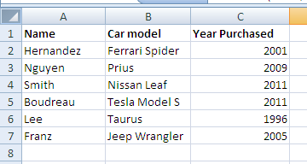
You type the following command in cell A8
=COUNTIF(C2:C7,>2005), What will appear in cell A8?
  D) error , it should be =COUNTIF(C2:C7,”>2005”)
  A) 2 B) 3 C) 4 D) error

Slide 16
I have collected some data from a wind turbine test.
What kind of trend line should I select?
Linear
Quadratic
Cubic
Exponential
Any function that minimizes R²
Why?
P (power) = ½ ρ A V³ η

Slide 17
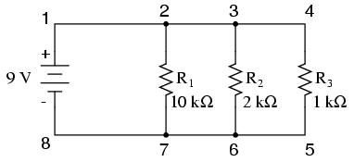
What is the current flowing between point 2 and point 7?
V= IR
9 V = I₁(10 kΩ)
I₁ = 9/10,000 = 0.9 mA

Slide 18
What is the typical efficiency of a wind turbine?
90%-100%
75% - 80%
35% - 45%
20% - 30%
10% - 15%

Slide 19
From the values given in the diagram below, what is the resistance (R) of an IPod?
0.3 Ω
3.1 Ω
0.03 Ω
30 KΩ
(e) 30 Ω

Slide 20
If you use the Sweep command in SolidWorks to create a feature, which statement is true?
A solid with round edges is created
A solid with variable cross section is created
A solid with a uniform cross section is created
A solid with hollow section is created
None of the above

Slide 21
What value of x will cause the motor to be stopped for a Cortex controller: SetMotor(2, x)?
127
125
0
255
265

Slide 22
What is the meaning of the value 2 in this statement: SetMotor(2, x)?
The motor is plugged into slot (Port) #2 on the controller.

Slide 23

Goodbye
Adios
Auf Wiedersehn
Sayonara
Alavida
Au Revoir
Shalom
Arrivederci, Ciao
Aloha
Khodahafez
Proshchay
Lā ќxn
Zàijiàn
Paalam filipino
अलविदा
خداحافظ
Tạm biệt
Прощай
ลาก่อน
再见

