Slide 1
Peer Review of
Emerging Adulthood Paper

Slide 2
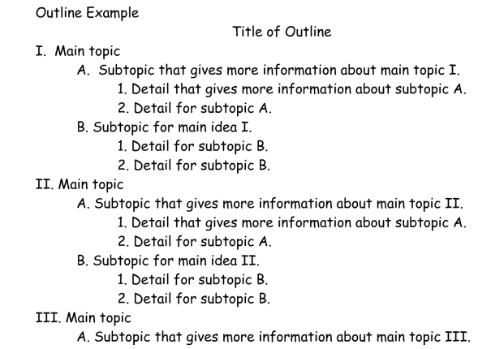
Review of Outline
Introduction
Domains
  Psychological, Social and Physiological
Conclusion
Reference List

Slide 3
If you can,….
Have someone read your outline
Have them ask questions
Do the references make sense?
Ask them to point out the strengths and weaknesses of the outline

Slide 4
Outline
Introduction
  What is the topic? Why do you think relevant to 18 – 25 yr olds?
  How will it be addressed in paper? “This paper will show….”
For Each Domain
  What is the impact, influence, affect, … of the topic on each domain?
    Pyschological (e.g., Cognitive, Emotional)
    Social (e.g., Relationships)
    Physiological (e.g., Physically)
Conclusion
  Summary of key points. What did you learn? Insights gained?
Reference List
  In APA format
- Based on research.
- Reference citations
Notes:
Not included (only in ..,,_W slides

Slide 5
Factors That Affect Development in
Emerging Adults
Topic
Domain
Depression
  Psychological
What does the research say?
Depression
  Social
What does the research say?
Depression
  Physiological
What does the research say?

Slide 6
Factors That Affect Development in
Emerging Adults
Topic
Domain
Drugs
  Psychological
What does the research say?
Drugs
  Social
What does the research say?
Drugs
  Physiological
What does the research say?

Slide 7
Factors That Affect Development in
Emerging Adults
Topic
Domain
Hooking Up
  Psychological
What does the research say?
Hooking Up
  Social
What does the research say?
Hooking Up
  Physiological
What does the research say?

Slide 8
Factors That Affect Development in
Emerging Adults
Topic
Domain
Anxiety
  Psychological
What does the research say?
Anxiety
  Social
What does the research say?
Anxiety
  Physiological
What does the research say?

Slide 9
Review – Introduction (5 min)
Does it:
  Clearly identify the topic?
    Topic and emerging adulthood relate?
  Does it describe how the topic will be addressed in the paper?

Slide 10
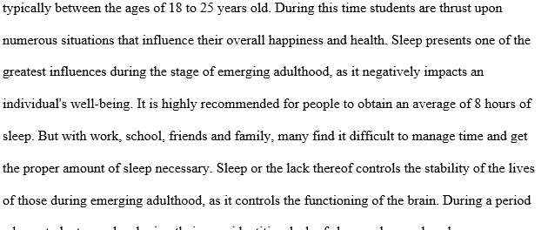
What is the Topic?
Can you say it one or two words? Is it too general?

Slide 11
Review – Domains (10 min)
Are there 3 domains? Are they labeled and in order? Does each domain:
  Have research cited that fits the domain and the topic, correctly? E.g., (Warecki, 2012)
  Have at least one study cited per domain?
  Describe the most important, relevant results of the study?
  Effectively integrate the references for each domain discussed

Slide 12
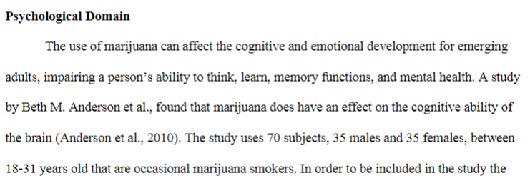
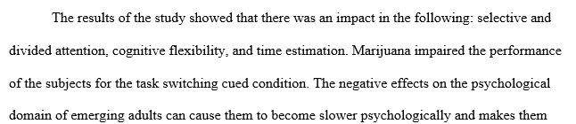
Are References Cited and Results Provided?
Topic: Marijuana

Slide 13
Review – Conclusion (5 min)
Does it briefly:
  Summarize? State key points?
  Provide any original insights as it relates to the topic?
  Discuss how the domains may interrelate?

Slide 14
Review Reference List (5 min)
  Are there a minimum of 3 peer-reviewed articles? One for each domain?
  Do article titles appear to relate to topic?
  In alphabetical order?
  Is each entry in proper APA format?
Last Name, First Initial, Middle Initial (Year Published). Title of article. Title of Online Journal, Volume Number(issue number if available), pp. Pages, doi:# or Retrieved from URL

Slide 15
Tips for a Good Score
Clearly Defined Topic
Quality References Related to the Topic and Domain
References Cited in Paper and Listed on Last Page (APA style)
Visit SJSU Writing Center (Clark Hall or MLK)
Each Section Labeled
Review the Guidelines and Rubric
Not a Self-Reflection but a Research Report
No Late Papers Accepted
Do Not Quote and Do NOT Plagiarize!
Notes:
Any turnitin score > 15% will be reviewed for plagiarism

Slide 16
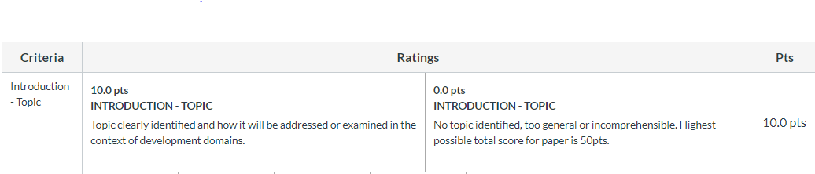
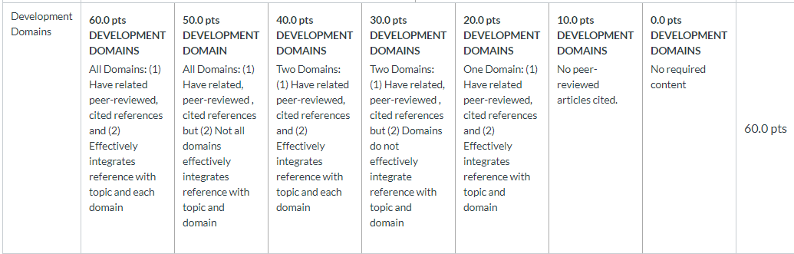
Rubric

Slide 17
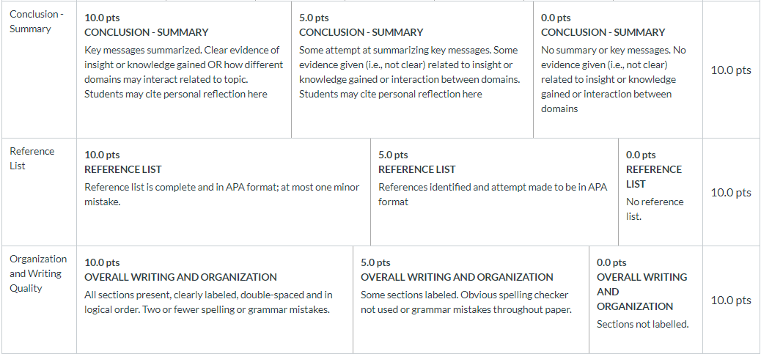
Rubric (cont)

Slide 18
Upload Paper in Canvas
Paper Due Sunday, Mar 22, 11:59pm
If you are PC/MS Word user upload as .doc or .docx
If you are a Mac/Pages user upload as .pdf

Slide 19
Examples of Unacceptable Reasons for Submitting a Late Paper
“I forgot”
“My internet stopped working”
“I had to make some final edits”
“I submitted it at 11:58pm”
“I tried to submit it but it wouldn’t let me”
“I didn’t know how to submit the paper”

